Slide 1
Government of Canada
Enterprise Architecture Review Board (GC EARB)
Presenter Template
Department – Initiative Name
(Date)
Presentation for:
EARB Appearance:
Contact Information:
 Endorsement
Information
 Initial
Follow-up
Final Architecture
Presenter(s):
Name /Email / Phone #
Name /Email / Phone #
Beta Release for Pilot
Last Updated August 18, 2020
GC Docs #XXXXXXX0

Slide 2
Purpose of GC EARB Session
The purpose of this presentation is to seek GC EARB endorsement of …
OR
The purpose of this presentation is to provide GC EARB information related to …

Slide 3
Request - Background
Describe which departmental policies, programs and business services the presentation is addressing.

Slide 4
Business Capabilities Addressed
List the business capabilities addressed with this architecture.
Business Capability Model 2.0 reference material, https://gcconnex.gc.ca/file/download/50303103
Business Capabilities | List the Business capabilities addressed, 2 examples below
1. Legislation, Regulation and Policy Management
2. Enterprise Planning
3. Outcomes Management | 3.2 Performance Management
4. Relationship Management | 4.3 Stakeholder Interaction Management
5. Compliance Management
6. Program and Service Delivery
7. Information Management
8. Government Resources Management
9. Corporate Management

Slide 5
Current State Architecture– Problem Summary
Describe the problems with the current architecture.
Summary of the business problem as described in the Concept Case
Describe the problem in each of the layers of EA Framework: Business, Information, Application, Technology and Security

Slide 6
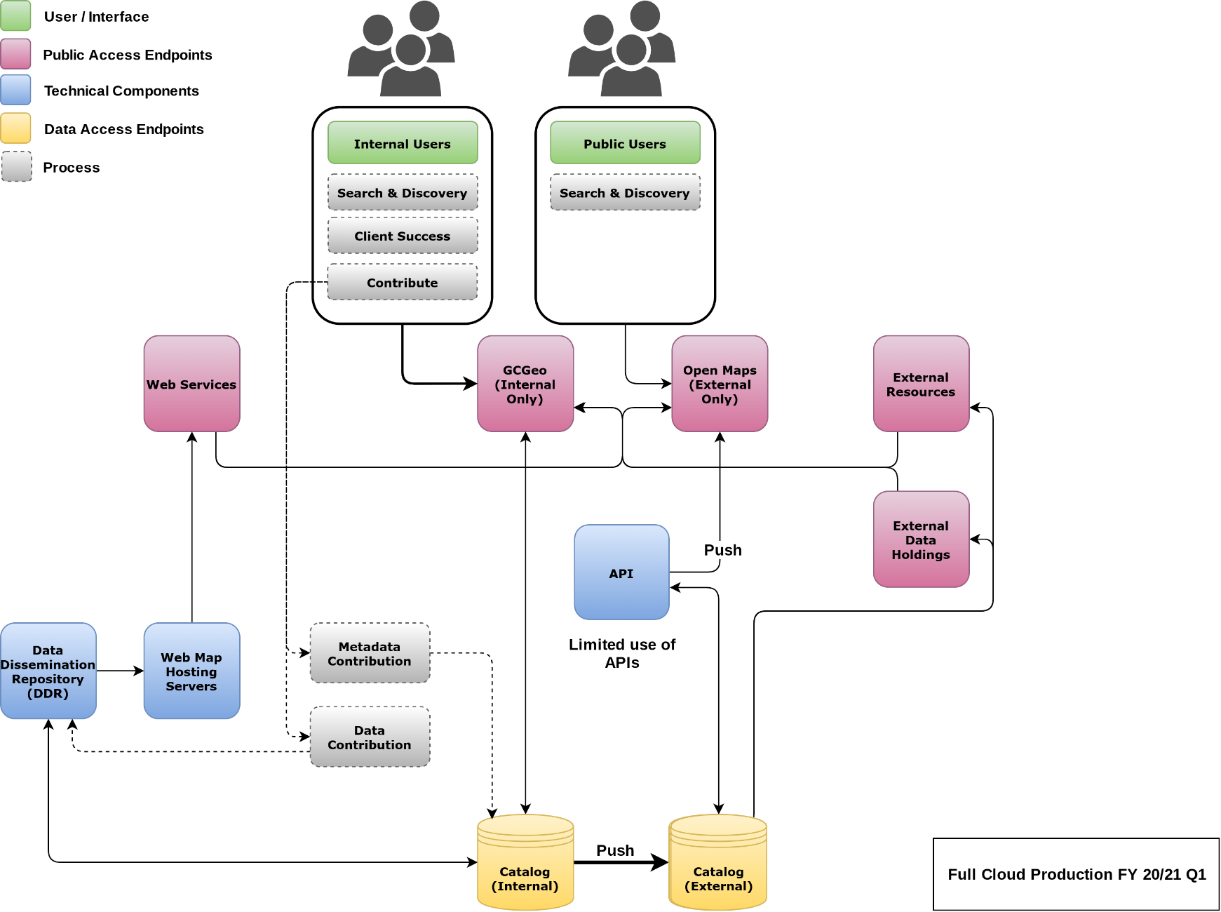
Current State Architecture Diagram
EXAMPLE

Slide 7
Target State Architecture – Solution Summary
Describe the Target State Architecture.
Describe how the target state architecture addresses the business problem stated in the Concept Case…
Describe the solution in each layer of the EA Framework: Business, Information, Application, Technology and Security

Slide 8
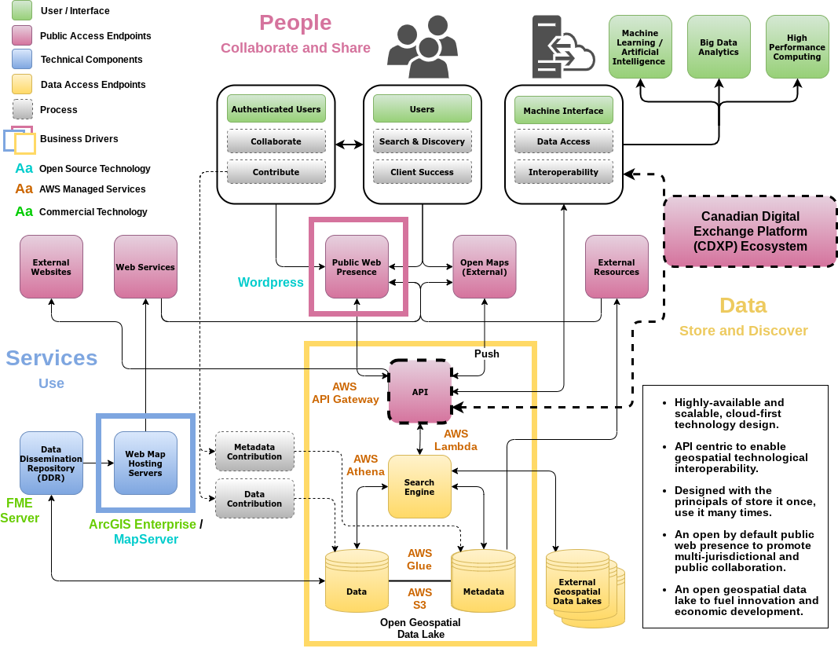

Target State Architecture Diagram
EXAMPLE
NEW
Identify the old component(s) in GREY and the new component(s) in BRIGHT COLOURS, show zoning and legend.

Slide 9
Summary of Cloud Access Scenarios and Usage Profiles
Use Case | Details
B4 | GC users connecting over internet to System X sitting in Y cloud service provider departmental Protected B tenant. This will also connect back to on-premises application Z in EDC
C1 | Non-CG users will connect to System Z, but there is now connection back to legacy data centre.
Details of the Cloud Connection Patterns can be found in the presentation https://gcconnex.gc.ca/file/view/58109995/gc-earb-2019-12-19-02-gc-cloud-enablement-cloud-connection-patterns-pptx?language=en

Slide 10
Environmental Scan and Analysis
Which crown institutions have you been discussing your problem with to identify potential reusable solution / component?
What other solution(s) available in the GC have you taken into consideration?
Summary of options analysis – (fill out full analysis on Appendix 3)
Summary of assessment against the Enterprise Solution(s) – (fill out full analysis on Appendix 4)

Slide 11
GC EA Assessment
 Endorsement  Information | PCRA: OPMCA: | One time: $ On going: $ | Overall:
Type of Cloud |  SaaS |  PaaS |  IaaS |  Not Applicable | Data Classification |  Unclassified |  Protected A |  Protected B |  Other
Summary of Proposal
To be completed by GC EA Team
Enterprise Architecture Assessment
 | Business
 | Information
 | Application
 | Technology
 | Security & Privacy
GC EA Recommendation | Conditions
Architectural Alignment:
Fully
Partially
Not

Slide 12
ANNEX, reference material, not for presentation
APPENDIX 1
GC EA Framework
Required for GC EA Assessment
NOT to be part of Presentation
APPENDIX 2
Service & Digital Target
Enterprise Architecture
Reference Material
NOT to be part of Presentation
APPENDIX 3
Additional Project Details
Required for GC EA Assessment
NOT to be part of Presentation
APPENDIX 4
Option Analysis
Required for GC EA Assessment
NOT to be part of Presentation
APPENDIX 5
Enterprise Solution Assessment
Required for GC EA Assessment
NOT to be part of Presentation
APPENDIX 6
SSC Involvement
Complete as required
NOT to be part of Presentation
APPENDIX 7
List of Acronyms
Complete as required
NOT to be part of Presentation

Slide 13
APPENDIX 1: GC EA Framework
Business Architecture
(Please check  all that apply)
1 – Fulfill the Government of Canada users and other stakeholder’s needs | HOW will this be achieved?
Clearly identify internal and external users and other stakeholders and their needs for each policy, program and business service
Include policy requirement applying to specific users and other stakeholder groups, such as accessibilities, gender based+ analysis, and official languages in the creation of the service
Model end-to-end business service delivery to provide quality, maximize effectiveness and optimize efficiencies across all channels (e.g lean process)
2 – Architect to be outcome driven and strategically aligned to the Department and to the Government of Canada | HOW will this be achieved?
Identify which departmental/GC business services, outcomes and strategies will be addressed
Establish metrics for identified business outcomes throughout the lifecycle of an investment
Translate business outcomes and strategy into business capability implications in the GC Business Capability Model to establish a common vocabulary between business, development, and operation

Slide 14
APPENDIX 1: GC EA Framework
Business Architecture
(Please check  all that apply)
3 – Promote horizontal enablement of the Enterprise | HOW will this be achieved?
Identify opportunities to enable business services horizontally across the GC enterprise and to provide cohesive experience to users and other stakeholders
Reuse common business capabilities, processes and enterprise solutions from across government and private sector
Publish in the open reusable common business capabilities and processes (in the Open Government portal) for others to develop cohesive horizontal enterprise services

Slide 15
APPENDIX 1: GC EA Framework
Information Architecture
(Please check  all that apply)
4 – Collect data to address the needs of the users and other stakeholders | HOW will this be achieved?
Assess data requirements based on users and other stakeholder needs
Collect only the minimum set of data needed to support a policy, program, or service
Reuse existing data assets and only acquire new data if required
Ensure data collected, including from third party sources, are of high quality
5 – Managed data strategically and responsibly | HOW will this be achieved?
Define and establish clear roles and responsibilities and accountabilities for data management
Identify and document the lineage of your data assets
Define retention and disposition schedules in accordance with business value as well as applicable privacy and security policy and legislation
Ensure data are managed to enable interoperability, reuse and sharing to the greatest extent possible within and across departments in government to avoid duplication and maximize utility, while respecting security and privacy requirements
Contribute to and align with enterprise and international data taxonomy and classification structures to manage, store, search and retrieve data

Slide 16
APPENDIX 1: GC EA Framework
Information Architecture
(Please check  all that apply)
6 – Use and share data openly in an ethical and secure manner | HOW will this be achieved?
Share data openly by default as per the Directive on Open Government and Digital Standards, while adhering to existing enterprise and international standards, including on data quality and ethics
Ensure data formatting aligns to existing enterprise and international standards on interoperability. Where none exist, develop data standards in the open with key subject matter experts, in consultation with the Enterprise Data Community of Practice
Ensure that combined data does not risk identification or re-identification of sensitive or personal information

Slide 17
APPENDIX 1: GC EA Framework
Application Architecture
(Please check  all that apply)
7- Use open source solutions hosted in Public Cloud | HOW will this be achieved?
Select Existing solutions that can be reused over custom built
Contribute all improvement back to the communities
Register open source software to the Open Resource Exchange
8- Use Software as a Services (SaaS) hosted in Public Cloud | HOW will this be achieved?
Choose SaaS that best fit for purpose based on alignment with SaaS capabilities
Choose SaaS solution that is extendable
Configure SaaS and if customization is necessary, extend as Open Source modules
9- Design for Interoperability | HOW will this be achieved?
Design systems as highly modular and loosely coupled services
Expose services, including existing ones, through APIs
Make the APIs discoverable to the appropriate stakeholders

Slide 18
APPENDIX 1: GC EA Framework
Technology Architecture
(Please check  all that apply)
10 - Use Cloud first | HOW will this be achieved?
Adopt the use of GC Accelerators to ensure proper Security and Access Controls
Enforce this order of preference: Software as a Service (SaaS) first, then Platform as a Service (PaaS), and lastly Infrastructure as a Service (IaaS)
Fulfill Cloud Services through SSC Cloud Brokering Services
Enforce this order of preference: Public cloud first, then Hybrid cloud, then Private cloud, and lastly non-cloud (on-premises) solutions
Design for cloud mobility and develop an exit strategy to avoid vendor lock-in
11 - Design for Performance, Availability, and Scalability | HOW will this be achieved?
Ensure response times meet user needs and critical services are highly available
Support zero-downtime deployments for planned and unplanned maintenance
Use distributed architectures, assume failure will happen, handle errors gracefully, and monitor performance and behaviour actively
Establish architectures that supports new technology insertion with minimal disruption to existing programs and services
Control Technical Diversity – design systems based on modern technologies and platforms already in use

Slide 19
APPENDIX 1: GC EA Framework
Technology Architecture
(Please check  all that apply)
12- Follow DevSecOps Principles | HOW will this be achieved?
Use continuous integration and continuous deployments (CI/CD)
Ensure automated testing occurs for security and functionality
Include your stakeholders as part of DevSecOps process

Slide 20
APPENDIX 1: GC EA Framework
Security and Privacy Architecture
(Please check  all that apply)
13 – Build Security into the System Life Cycle, Across All Architectural Layers | HOW will this be achieved?
Identify and categorize information based on the degree of injury that could be expected to result from a compromise of its confidentiality, integrity and availability.
Implement a continuous security approach, in alignment with CCCS’s IT Security Risk Management Framework. Perform threat modelling to minimize the attack surface by limiting services exposed and information exchanged to the minimum necessary.
Apply proportionate security measures that address business and user needs while adequately protecting data at rest and data in transit.
Design systems to be resilient and available in order to support service continuity.
14 – Ensure Secure Access to Systems and Services | HOW will this be achieved?
Identify and authenticate individuals, processes and/or devices to an appropriate level of assurance, based on clearly defined roles, before granting access to information and services. Leverage enterprise services such as Government of Canada trusted digital identity solutions that are supported by the Pan-Canadian Trust Framework.
Constrain service interfaces to authorized entities (users and devices), with clearly defined roles. Segment and separate information based on sensitivity of information, in alignment with ITSG-22 and ITSG-38. Management interfaces may require increased levels of protection.
Implement HTTPS for secure web connections and DMARC for enhanced email security.
Establish secure interconnections between systems through secure APIs or leveraging centrally managed Hybrid IT connectivity services.

Slide 21
APPENDIX 1: GC EA Framework
Security and Privacy Architecture
(Please check  all that apply)
15 – Maintain Secure Operations | HOW will this be achieved?
Establish processes to maintain visibility of assets and ensure the prompt application of security-related patches and updates in order to reduce exposure to vulnerabilities, in accordance with GC Patch Management Guidance.
Enable event logging, in accordance with GC Event Logging Guidance, and perform monitoring of systems and services in order to detect, prevent, and respond to attacks.
Establish an incident management plan in alignment with the GC Cyber Security Event Management Plan (GC CSEMP) and report incidents to the Canadian Centre for Cyber Security (CCCS).
16 – Privacy by Design | HOW will this be achieved?
Perform Privacy Impact Assessment (PIA) to support risk mitigation activities when personal information is involved
Perform Algorithmic Impact Assessment (AIA) to support risk mitigation activities when deploying an automated decision system as per Directive on Automated Decision Making. For more info, please go to this link
Implement security measures to assure the protection of personal information and data
Take into consideration the 7 Foundational Privacy Design Principles (English only) when designing services

Slide 22
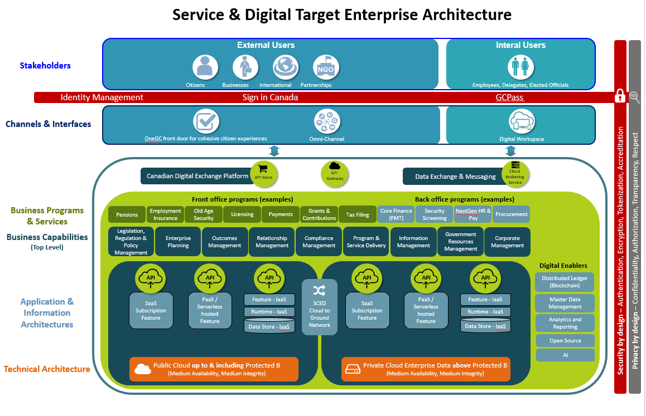
APPENDIX 2:
Service & Digital Target Enterprise Architecture
The Service & Digital Target Enterprise Architecture defines a model for the digital enablement of Government of Canada services that addresses many of the key challenges with the current GC enterprise ecosystem.
1
It seeks to reduce the silos within the current GC ecosystem by having departments adopt a perspective centred on users and service delivery when considering new IT solutions or modernizing older solutions.
It advocates a whole-of-government approach where IT is aligned to business services and solutions are based on re-useable components implementing business capabilities optimized to reduce unnecessary redundancy. This re-use is enabled through the use of published APIs shared across government.
It will be realized through new digital investments that are assessed against the criteria of the revised GC Enterprise Architecture Framework (BIATSP) reflecting the detailed elements of the target architecture. This approach allows GC to focus on improving its service delivery to Canadians while addressing the challenges with legacy systems.
2
3
The Service & Digital Target Enterprise Architecture and Whitepaper were presented at GC EARB on July 16, 2020 for pre-endorsement.

Slide 23
APPENDIX 3:
Additional Project Details
Request Summary Information
TBS Project/Activity ID (from IT PLAN)
Concept Case (ENDORSED ?) | YES  DATE: ___________ | NO    REASON:
Timeline | Planned Start Date: MM – YYYY | Planned End Date: MM - YYYY
Cost Summary | One Time project cost: $ | On-going (annual) costs: $
Funding Source | A-Base  B-Base  | Other: Please specify
Current Gate*
On schedule? | YES  NO    | IF not… why not?
(TB Sub)
Departmental Architecture
Do you have a Departmental Architecture Review Board (ARB)? |  | YES  | NO 
Who is the Chief Architect? |  | Name Email / Phone #
When did the Departmental EA and Architecture Review Board sanctioned the preferred Solution Architecture option? |  | Date:
Name of Business owner: | Name of Technical owner:
* TBS Gates:
https://www.canada.ca/en/treasury-board-secretariat/services/information-technology-project-management/project-management/guide-project-gating-it-enabled-projects.html

Slide 24
APPENDIX 4:
Options Analysis
Summary of architecture options reviewed, analysis criteria and rating
Analysis Criteria | Option 1 | Option 2 | Option n
1.
2.
3.
4.
n

Slide 25
Is the endorsed enterprise solution sufficient?
APPENDIX 5:
Assessment against the Enterprise Solution(s)
Select the applicable impact level for each of the assessment criteria below, and describe your rationale for choosing that impact level.
Assessment Criteria |  | Impact (choose applicable items & provide rationale)
 | Zero Impact | Low Impact | Medium Impact | High Impact
1. Timing Urgency >>How well does the estimated implementation schedule using the endorsed enterprise solution align to required deadlines? | No impact to benefit realization timelines | Minor impact to benefits realization timelines (e.g. 3 to 6 month extension) | Moderate impact to benefits realization timelines. (e.g. 6 to 12 month extension) | Significant impact to benefits realization timelines (e.g. 12+ months)
2. Functional Requirements >>How well does the endorsed enterprise solution support the departmental CIOs requirements? | Requires no workaround to support business requirements | Requires minor manual workarounds to support business requirements | Requires customizations to support business requirements | Requires significant customizations “OR” functional requirements not on the product roadmap
3. Non-functional Requirement (NFR) >> How well does the endorsed enterprise solution meet non-functional requirements including compatibility, maintainability, usability, availability, performance, and/or scalability. | Requires no compromise to NFRs | Requires slight compromise on NFRs. (e.g. response time, availability, etc.) | Requires compromise on NFRs. (e.g. response time, availability, etc.) | Cannot meet critical NFRs.

Slide 26
APPENDIX 5:
Decision Making Framework for Assessment against the Enterprise Solution(s)
G
A
B
C
D
E
F
End: Endorse use of existing instance
Is there an enterprise solution*?
Is enterprise solution aligned with objectives?
Can an existing instance be used?
Yes
Start: Departmental CIO submits request to TBS EA unit.
Assess option of enterprise solution.*
Evaluate use of an existing instance
Yes
Yes
H
End: Endorse use of new instance
* = endorsed by TBS GC EARB
No
No
No
Is there a Pathfinder or reuse opportunity available?
L
I
K
End: Endorse Selection
No
Present options analysis of alternative solutions
N2
N1
Yes
J
Explore Pathfinder/ reuse opportunity

Slide 27
APPENDIX 6:
Shared Services Canada (SSC) Involvement
SSC Scope
What is the scope of work required by Shared Services Canada?
When/How has SSC been involved in this project?
What SSC Services are to be impacted or consumed? | http://service.ssc-spc.gc.ca/en/services Include due dates for SSC deliverables.
What are the dependencies and assumptions? | (ex: authentication, cloud connectivity. If legacy Data Centre, which one and has capacity has been confirmed.)
SSC Internal Governance
Presentation title: Please include Presentation title, committee and date of presentation (or rational for not going through governance) | Governance Committees: Committee DD/MM/YY Committee DD/MM/YY
SSC Contact
SSC BR number (if available) | BR Number
SSC Client Executive contact | Name/Title
SSC project contact | Name/Title
SSC architecture contact | Name/Title (if available)
For help in completing this slide feel free to contact your Client Executive
http://service.ssc-spc.gc.ca/en/contact/partclisupport/client-execs

Slide 28
APPENDIX 6:
Additional Technical Details required by Shared Services Canada (SSC)
Complete the information below by selecting values from the available options, or providing an additional value where applicable
Solution’s Security Profile (eg. PBMM, PBHM, etc) |  | Network Name(s) (eg. Science Network, GCNet, GCSI, etc)
Maximum Allowable Downtime (Unplanned) / Year (in hours) |  | Minimum bandwidth needed:
Availability Requirements: Med (95%), High (>=99 %) |  | Expected Network Traffic: (Video, Audio, Data, Interactive)
Disaster Recovery Requirements: (None, Cold Site, Warm Site, Hot Site) |  | Approximate number of users:
Authentication Method (DCAM, ICE/ECM, Sign-in Canada, Other) |  | Network Geographical Distribution: (Low, Moderate, Regional, National, Global spread)
Sensitivity to Network Latency: Very High, High, Medium, Low |  | Hosting Solution(s): (Legacy DC, EDC, Cloud – list all applicable)
Workload migrating off legacy?
For help in completing this slide refer to the guidance on: https://wiki.gccollab.ca/GC_EARB_Presenter_Template_%E2%80%93_SSC_Appendix_3_Guidelines

Slide 29
APPENDIX 7:
List of Acronyms used in this presentation
Abc... - …..
Def…. - ……
Ghi…. - ……

