Slide 1
Departmental Showcase
Ministère sous les projecteurs
Correctional Service of Canada
Service correctionnel du Canada

Slide 2
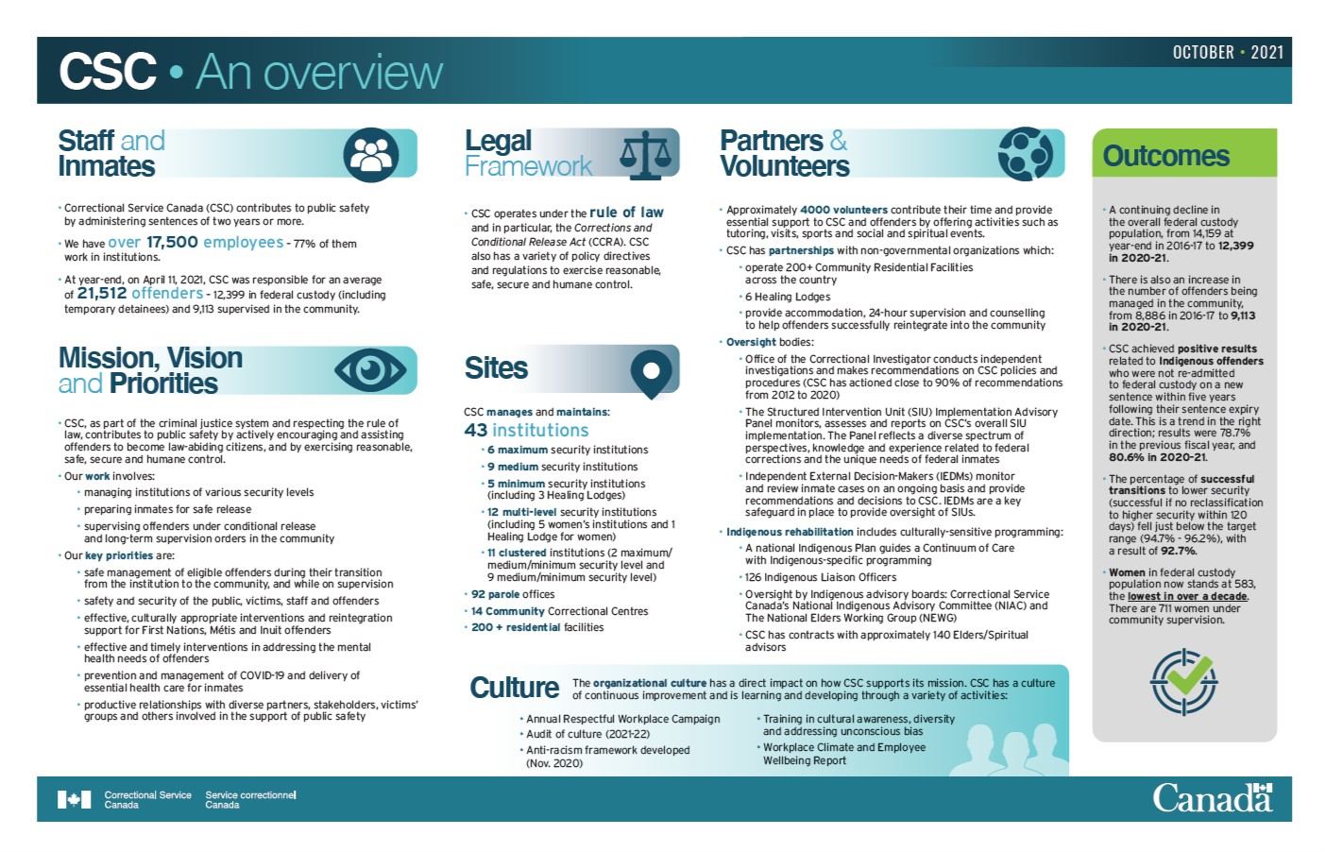

Slide 4
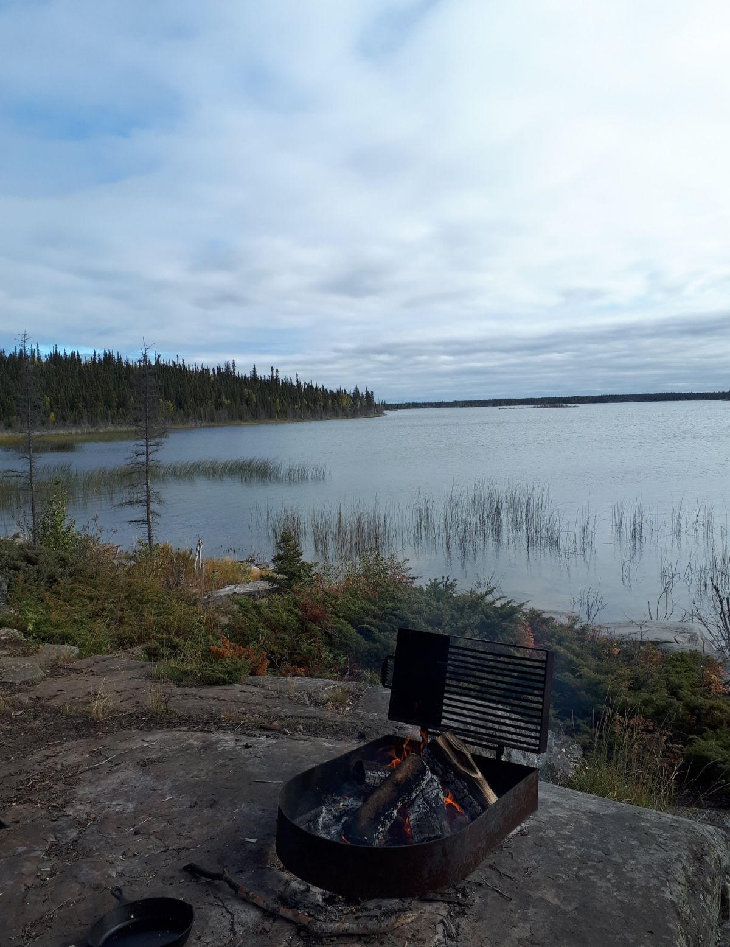
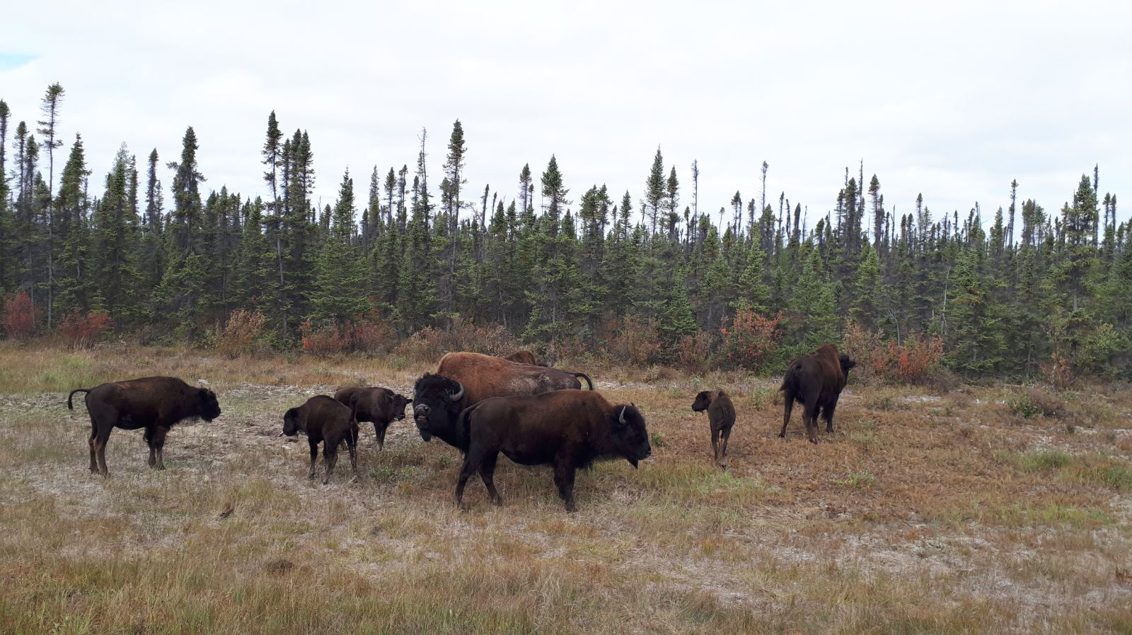
Bureau de libération
conditionnelle des TNO
Situé à Yellowknife (Sǫ̀mba K'è ), TNO:
sur le territoire Chief Drygeese, qui constitue la terre et le siège traditionnel de la Première Nation des Dénés Yellowknives et du Traité numéro 8.

Slide 5
NWT Parole
Located in Yellowknife (Sǫ̀mba K'è ), NT:
Chief Drygeese Territory, the traditional home and land of the Yellowknives Dene First Nation and Treaty 8 territory.

Slide 6
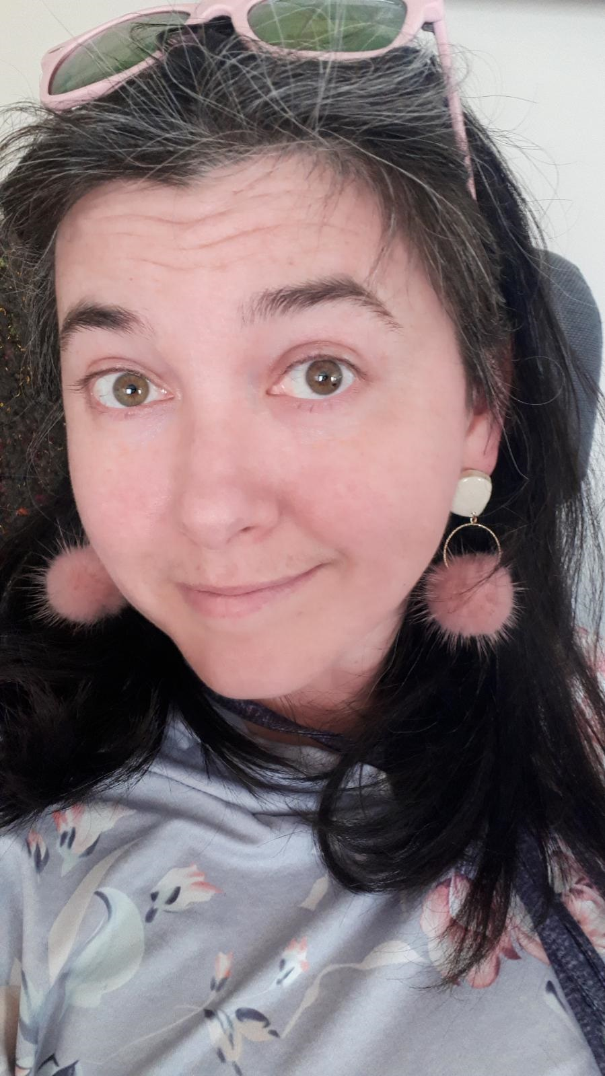
Jennifer Gould
She/ Her/ Elle
Un peu d’histoire sur moi: Ma première expérience au sein de la fonction publique fédérale a eu lieu en 2008, alors que je travaillais dans le cadre du Programme fédéral d'expérience de travail étudiant (PFETE) en tant que spécialiste en information de groupe (SIG) pour le Centre Service Canada pour jeunes. J’ai reçu une nomination en 2011 pour devenir employée pour une période indéterminée au sein du portefeuille de la sécurité publique. Je travaille comme agente de libération conditionnelle au Service correctionnel du Canada (SCC) depuis environ 5 ans. Je vis et travaille à Yellowknife, dans les Territoires du Nord-Ouest, pour le bureau de libération conditionnelle des TNO. Notre petit bureau secondaire est géré à partir de l'Alberta et je suis l'une des trois (3) employés représentant le SCC aux Territoires du Nord-Ouest. Il y a quelques années, j'ai suivi une formation sur les programmes MPCI pour les hommes (multicibles et délinquants sexuels). Depuis lors, j'ai dispensé des programmes de maintien dans la communauté (MC et DS). Depuis 2022, je coanime le Programme d'orientation pour nouveaux employés (PONE) de manière virtuelle via MS Teams. Enfin, j'ai été intervenante de première ligne à l'Établissement Nova pour femmes
de Truro, en Nouvelle-Écosse, avant de devenir agente de libération conditionnelle. Il y a tellement de possibilités de carrière au sein du
SCC ; d'un océan à l'autre !
Notes:
The NWT Parole office is located in Yellowknife (the Capital of the NWT) representing the Correctional Service Canada in the NWT we are part of the Alberta/NWT district. Our management and administrative supports are based out of Alberta. There are two Parole Officer positions for the NWT; my role is hybrid as I also offer Correctional Programs in the community. Like many smaller/ rural offices, we wear a number of hats within the office and take care of all daily operations as well as case management. We work closely with our justice partners including the RCMP and Government of the Northwest Territories/ Territorial Government (Justice Department, Courts, Probation Services, Corrections and Employment, Culture and Education Department) as well as local NGOs (Arctic Indigenous Wellness Foundation, Tree of Peace Friendship Centre, NWT John Howard Society, NT/YT Elizabeth Fry Society, Native Women’s Association, Women’s Centre, etc.). The NWT is a part of the Prairie Region and although our population is approximately 44,000 people that population is spread out over 1,171,918 square kilometres. The NWT has 11 official languages (Inuktitut, Inuvialuktun, Inuinnaqtun, Gwich’in, Tlicho, North Slavey, South Slavey, Cree, and Chipewyan in addition to English and French). Demographics of the NWT are approximately 51% Indigenous (First Nations, Inuit and Metis), 39% European and 10% Visible Minorities (Canada Census 2016). We fulfill the roles of Community Parole Officers as well as Institutional Parole Officers (from Preliminary Assessments and Intakes, Case Preparation for Conditional Release, to Community Supervision and Urinalysis for female parolees). Our institutional caseloads are housed in the Territorial Correctional Facilities under the auspices of the Exchange of Services Agreement (ESA) between CSC and the GNWT. Parolees who are in the community may be supervised indirectly by CSC via the ESA whereby Probation Officers located closer to the individuals’ community do direct meetings and cases are managed collaboratively. Being part of small community creates the opportunity to forge strong collaborative relationships to support the safe, secure, humane custody of our clients as we assist and support their reintegration as law-abiding citizens!!!

Slide 7
Jennifer Gould
She/ Her/ Elle
A little about me: My first experience with the Federal Public Service was as a Student in 2008, working with the Federal Student Work Experience Program (FSWEP) as a Group Information Specialist (GIS) for Service Canada Centre for Youth. I became an Indeterminate employee in 2011 working within the Public Safety Portfolio. I have been a Parole Officer with the Correctional Service of Canada (CSC) for approximately 5 years living and working in Yellowknife, Northwest Territories; NWT Parole. Our small sub-office is managed out of Alberta and I am one of three (3) staff who represent CSC in the Northwest Territories. A few years ago, I was trained in the male, mainstream ICPM programs (Multi-Target and Sex Offender). Since then I have delivered one-to-one Community Maintenance Programming (MT and SO). Since 2022, I have been co-facilitating the New Employee Orientation Program (NEOP) virtually via MS Teams. Finally, I was a Primary Worker at the Nova Institution for Women in Truro, Nova Scotia prior to becoming a Parole Officer. There are so many career opportunities within CSC; from Coast to Coast to Coast!
Notes:
The NWT Parole office is located in Yellowknife (the Capital of the NWT) representing the Correctional Service Canada in the NWT we are part of the Alberta/NWT district. Our management and administrative supports are based out of Alberta. There are two Parole Officer positions for the NWT; my role is hybrid as I also offer Correctional Programs in the community. Like many smaller/ rural offices, we wear a number of hats within the office and take care of all daily operations as well as case management. We work closely with our justice partners including the RCMP and Government of the Northwest Territories/ Territorial Government (Justice Department, Courts, Probation Services, Corrections and Employment, Culture and Education Department) as well as local NGOs (Arctic Indigenous Wellness Foundation, Tree of Peace Friendship Centre, NWT John Howard Society, NT/YT Elizabeth Fry Society, Native Women’s Association, Women’s Centre, etc.). The NWT is a part of the Prairie Region and although our population is approximately 44,000 people that population is spread out over 1,171,918 square kilometres. The NWT has 11 official languages (Inuktitut, Inuvialuktun, Inuinnaqtun, Gwich’in, Tlicho, North Slavey, South Slavey, Cree, and Chipewyan in addition to English and French). Demographics of the NWT are approximately 51% Indigenous (First Nations, Inuit and Metis), 39% European and 10% Visible Minorities (Canada Census 2016). We fulfill the roles of Community Parole Officers as well as Institutional Parole Officers (from Preliminary Assessments and Intakes, Case Preparation for Conditional Release, to Community Supervision and Urinalysis for female parolees). Our institutional caseloads are housed in the Territorial Correctional Facilities under the auspices of the Exchange of Services Agreement (ESA) between CSC and the GNWT. Parolees who are in the community may be supervised indirectly by CSC via the ESA whereby Probation Officers located closer to the individuals’ community do direct meetings and cases are managed collaboratively. Being part of small community creates the opportunity to forge strong collaborative relationships to support the safe, secure, humane custody of our clients as we assist and support their reintegration as law-abiding citizens!!!

Slide 8
Nina Halstead
she/her/elle
Coordonnatrice de projet pour l’équipe “Équité en matière d’emploi, diversité et inclusion” au sein de la direction des ressources humaines.
Fonctions antérieures en tant que technicienne du comportement et agente de libération conditionnelle.
Priorités actuelles:
Faire progresser l'équité en matière d'emploi et le cadre de travail antiracisme/anti-oppression au sein du SCC
Créer et consulter des politiques, des plans et des documents afin de s'assurer qu'ils soient inclusifs au niveau du langage, des actions et de l'accessibilité

Slide 9
Nina Halstead
she/her/elle
Project Coordinator for Human Resource Management’s Employment Equity, Diversity, and Inclusion team.
Previous roles as a Behavioural Technologist and Parole Officer
Current focus:
Advancing employment equity and antiracism/anti-oppression within CSC
Creating and consulting on policies, plans, and documents to ensure that they are inclusive in terms of language, actions, and accessibility

Slide 10
Mental Health Services at CSC
Les services de santé mentale au sein de SCC
Équipes multidisciplinaires (psychologues, techniciens du comportement, ergothérapeutes, travailleurs sociaux, infirmiers en santé mentale).
Divers niveaux de soins en fonction des besoins des délinquants
Centres de traitement qui fonctionnent comme des établissements psychiatriques
Collaboration avec différents départements pour promouvoir la réadaptation des délinquants (opérations, gestion des cas, éducation, programmes, aumônerie, initiatives autochtones).
Traitement individuel et de groupe
Évaluation, intervention, gestion de crise

Slide 11
Mental Health Services at CSC
Les services de santé mentale au sein de SCC
Multidisciplinary teams (Psychologists, Behavioural Technologists, Occupational Therapists, Social Workers, Mental Health Nurses)
Varied levels of care based on offender needs
Treatment centres that function as psychiatric facilities
Work with various departments to promote offender rehabilitation (Operations, Case Management, Education, Programs, Chaplaincy, Indigenous Initiatives)
Individual and group treatment
Assessment, intervention, crisis management

Slide 12
Employment Equity in CSC
L’équité en matière d’emploi au SCC
Loi sur l’équité en matière d’emploi
Quatre groupes: les femmes, les peuples autochtones, les personnes racisées
et les personnes ayant un handicap
Actuellement en cours de révision– changements, ajouts
L’équipe EEDI veille à ce que le SCC respecte la Loi sur l’équité en matière d’emploi
Revoir les politiques, les plans et les documents
Créer des réseaux pour des groupes spécifiques (par exemple, le réseau des employés fédéraux noirs)
Introduire l'équité dans tous les aspects du SCC qui sont axés sur les employés et dont certains sont axés sur les délinquants
Fait intéressant: le SCC est l’un des employeurs au sein du gouvernement fédéral qui embauche
le plus grand nombre d’autochtones

Slide 13
Employment Equity in CSC
L’équité en matière d’emploi au SCC
Employment Equity Act
Four equity groups: Women, Indigenous peoples, Racialized persons, People with disabilities
Currently under review – changes, additions
EEDI team works to ensure that CSC is following the EE Act
Review policy, plans, documents
Create networks for specific groups (e.g., Black Employees Network)
Infuse equity into all aspects of CSC that are employee-focused and some that are offender-focused
Cool fact: CSC employs one the highest numbers of Indigenous Peoples within the federal government

