Slide 1
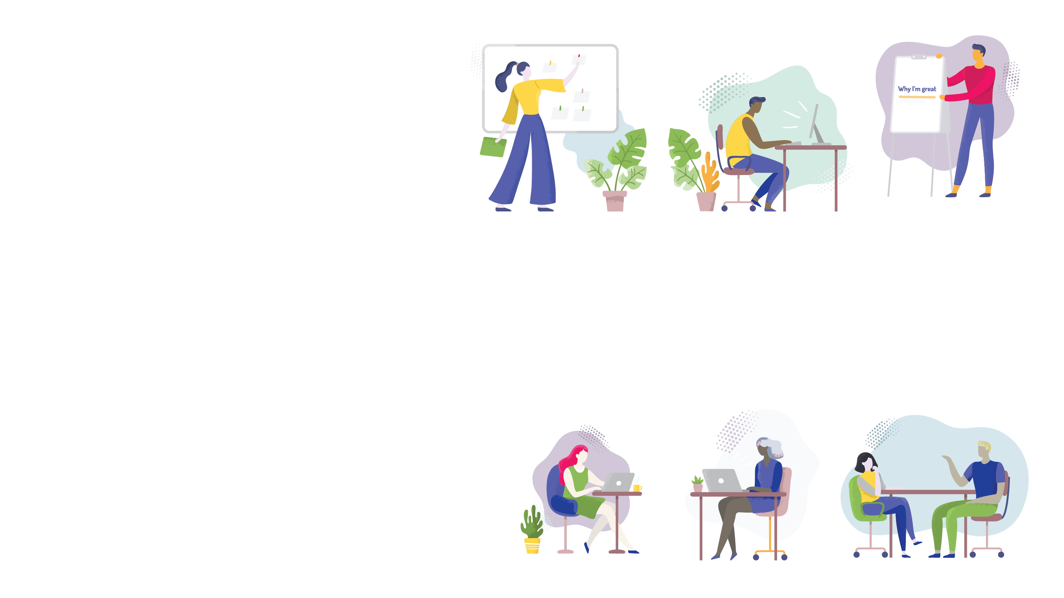
Discussion On
The elevator pitch

Slide 2
Speakers: Taran Wasson Anna Stefanovici
July 28, 2020 elevator pitch

Slide 3
PRESENTATION
CONTENTS
Introductions
Icebreaker Activity
Purpose of an Elevator Pitch
Elevator Pitch Principles
Where, When and How to Connect
Question Period
Resources
Staying in touch

Slide 4
Everyone
Hello
- Taran Wasson & Anna Stefanovici

Slide 5
Icebreaker Activity
B
E
Y
o
u
r
B
E
S
T
S
E
L
F
A
B
C
D
E
F
G
H
I
J
K
L
M
N
O
P
Q
R
S
T
U
V
W
X
Y
Z

Slide 6
Purpose of an elevator pitch
To make an introduction
To connect with another person
To leave a positive impression

Slide 7
Elements to consider
Professional
Skills? Work? Experience?
Volunteering?
Personal
Any awards?
Achievements (e.g., athletic)?
Volunteering?
Personality
A sense of humour
Confidence, good body language

Slide 8
Practice a little
Remember to be genuine, networking is not a science, and be kind to yourself.
What if you really were on an elevator with someone you admire, think on that, what would you say? ☺

Slide 9
Elevator Pitch Principles
01
02
№
№
relationship
Be genuine
The key is to begin building a relationship. All relationships are built and based on trust.
Be genuine. Networking is an art and not a science. There are many approaches and find one that reflects and suits you.

Slide 10
Elevator Pitch Principles
03
04
№
№
approachability
adaptability
Be open and positive. A relationship is a two-way concept, and give more than you get if a conversation develops.
Networking is for everyone. Introverts, extroverts and those in-between (ambiverts).

Slide 11
Where, When and How should I connect with others?

Slide 12
Virtual
Social media is designed for 2-way exchanges
Twitter, LinkedIn – find a medium and engage!
If you do not have one yet, create a LinkedIn profile
Explore the spaces on GC Tools, such as GCConnex. GCCollab lets you connect externally!
Take advantage of Zoom and MS Teams (virtual coffee get-togethers)

Slide 13
And one day… in-person
Participate in networking activities
Participate in learning events
Meet with a contact over a coffee or for lunch
Join professional networks, like YMAGIN and IPAC
Best way to connect is in-person (yes, as soon as it is safe to resume activities)

Slide 14
LinkedIn Learning
Search for Free Courses, such as Designing a Resume
YouTube tutorials
Books
Guerrilla Marketing by Conrad & Levinson
https://www.amazon.ca/Guerrilla-Marketing-Job-Hunters-3-0/dp/1118019091
Tuesdays with Morrie by Mitch Albom
https://www.amazon.ca/Tuesdays-Morrie-Greatest-Lesson-Anniversary/dp/076790592X
LEARNING RESOURCES

Slide 15
Networking/Career-related mailing lists:
Michael J. Hughes
Harvey MacKay
Articles to review:
9 Best Networking Tips for 2018 https://bushmarketing.ca/successful-networking-tips/
Networking for Introverts https://www.huffingtonpost.com/michael-s-solomon/networking-for-introverts_b_10637306.html
https://www.forbes.com/sites/jonlevy/2018/04/20/8-networking-tips-for-introverts-from-a-superconnector
NETWORKING RESOURCES

Slide 16
Taran Wasson
Twitter: @taranwasson | Search on Linkedin
Instagram:@tsw613
Email:taran.wasson@tbs-sct.gc.ca
Anna Stefanovici
Search on Linkedin
Email: a.ste@outlook.com
Thank you

