Slide 1
Value Proposition Business Architecture Working Group
For Discussion
Month 2: 2022 02 21

Slide 2
Purpose
Get the noggin jogging to help define your own Value Proposition statement

Slide 3
BA Program Roadblocks
Hard to Define
What is it?
Hard to Sell
Why should I care?
Hard to Execute
How do I do it?
Hard to Measure
What did I get?

Slide 4
Business Architecture – What is it?
"A blueprint of the enterprise that provides a common understanding of the organization and is used to align strategic objectives and tactical demands.“
Notes:
Source: Object Management Group®, OMG®

Slide 5
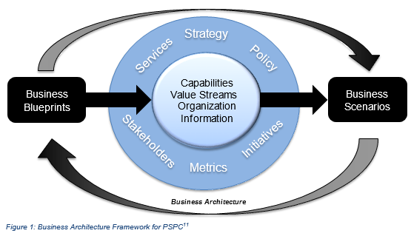
For example, at PSPC – we defined it as:
Business Architecture represents a holistic, multidimensional business view of the enterprise.
Business Scenarios
Used to identify business needs, and drive the business requirements that the architecture development, and ultimately the IT, has to address.
Architecture Blueprints (models/maps/diagrams)
Reveals how the organization is structured and how capabilities, processes, organization and information fit together.
Notes:
Source: Business Architecture Framework (Bizbok Guide)

Slide 6
Business Architecture – Who is it for? (example)
Q1 – Who are my clients/customers/consumers?
Consumer | Job (tasks trying to perform, problem trying to solve, need trying to satisfy) | Pains (risks, costs, undesired outcome) | Gains (Expected benefits/outcomes)
Business Executive | Define strategy and key related projects and manage critical implementation decision and actions Manage successful strategy execution (demands, impact on the origination structure, coordinate requirements, talents and capabilities) Ensure implementation | Miscommunication leading to ineffective issue analysis, lack of collaboration and unresolved problems Lack of transparency into cross-functional complexity making it difficult to envision and deploy solutions Widespread redundancy and inconsistency leading to missed opportunity, increase costs and failed initiatives Silo-based planning and deployment resulting in fragmented solution deployment | Take ownership and drive transformation strategies through business-centric roadmaps Align business processes across business untis Deliver stakeholder focused benefits Transparency and clarity to enable issue collaboration, issue analysis, and problem resolution

Slide 7
Business Architecture – Who is it for? (example)
Q1 – Who are my clients/customers/consumers?
Consumer | Job (tasks trying to perform, problem trying to solve, need trying to satisfy) | Pains (risks, costs, undesired outcome) | Gains (Expected benefits/outcomes)
Account Executive/Portfolio Management Representative/Business Relationship Manager | Create digital strategy for client Support business in delivering on their priorities
Project Managers

Slide 8
Problem -> Solution Fit
Gain
Gain Creator
Pain
Pain Reliver
Job
Products & Service

Slide 9
Business Architecture – Why should I care?
Value Proposition Definition: Expression of the value to a recipient evaluated in terms of the recipient's level of satisfaction.
Q1 – How can executives and strategists use Business Architecture to make business strategy come to life and bring value to the department?
- Provide an overall framework in which to visualize, plan, scope, assess, and manage business alignment and transformation initiatives

Slide 10
Business Architecture – Why should I care?
Q2 – Does investment in Business Architecture really deliver value to the business? If so, what types of value are being realized?

Slide 11
Business Architecture – Why should I care?
Q3 – What is the role of Business Architecture in leveraging transformational relationships among strategy, operations (business, process, people) and IT?

Slide 12
Business Architecture – Why should I care?
Q4 – What are the best practices for supporting a sustainable value proposition for Business Architecture and what are the greatest challenges to attaining it?

Slide 13
Month 2: Homework Assignment
Submit your Business Architecture “road show” decks and/or responses from this workshop
before March 4th

Slide 14
ANNEX – CBSA Presentation
How does the business have access to your models? – Everyone in the department has access to it
How do you keep them maintained? Wait for a change, or periodic review with the business? Creating a RACI to help maintain it. The business owner will be responsible for maintaining it. Change request will be submitted through a governance workflow.
Any benefits to business processes?
WG: What out of these models would you see as a priority for your organization?

Slide 15
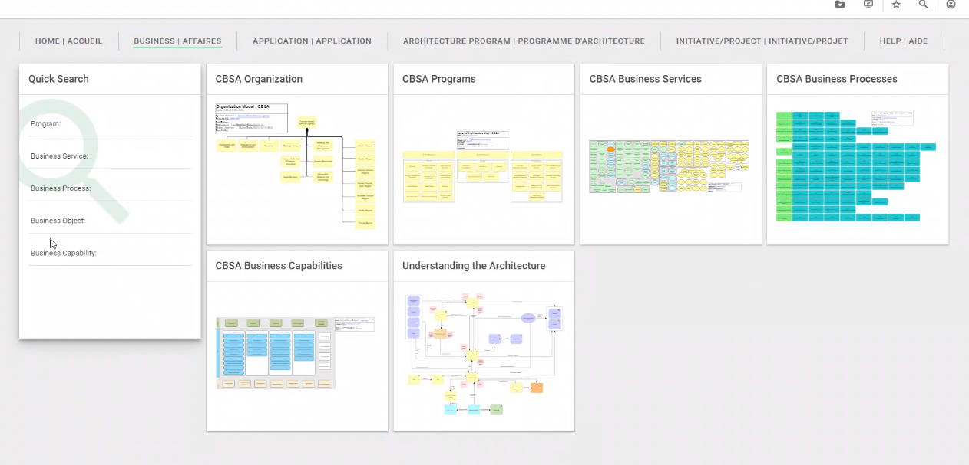

Slide 16
ANNEX – Comments/Notes
Can business architecture link to a “account executive”?

