Slide 1
Collecting and Using Disaggregated Data Panel Discussion Statistics Canada
Presenter: Tony Labillois, Director General of the Justice, Diversity and Population Statistics Branch, Social, Health and Labour Statistics Field, Statistics Canada
December 7, 2022

Slide 2
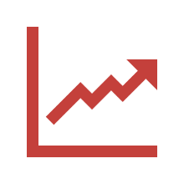
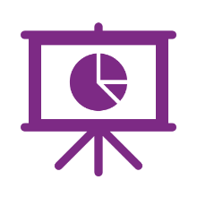
The Five Elements of the DDAP
Increased analytical insights on diverse groups of people
Promotion of national statistical standards
Enhanced engagement and communication
Expanded disaggregated data
Increased access to disaggregated data
Social license and increased trust
Indigenous communities
Other diversity groups
Governments and NGOs
Population health
Labour market
Business conditions
Social identity
Not-for-profit boards
Justice and safety
Demographic projections
New admin data
Data Analytics as a Service
Virtual Data Lab
Enhanced web portal
Research Data Centres
Expanded CODR tables
Social Insights
Social longitudinal data
Enhanced modelling
Data visualization
What works platform
Promote the use of existing standards
Review EE group standards
Develop standards for equity-seeking groups
Other stewardship roles

Slide 3
Resources
Disaggregated Data Action Plan
Why it matters to you Infographic
Disaggregated data standards for Employment Equity Group (Disability, Women, Ethnocultural Diversity, Indigenous)
https://www.statcan.gc.ca/en/concepts/dds
Other standards (Immigration, Geography, Business Ownership, Children, Official Languages, Low-income, Seniors, Sexual Orientation, Veterans)
https://www.statcan.gc.ca/en/concepts/dds
New Statistical Standards (Gender of a person & Sex at birth person)
https://www23.statcan.gc.ca/imdb/p3Var.pl?Function=DEC&Id=410445
https://www23.statcan.gc.ca/imdb/p3Var.pl?Function=DEC&Id=24101
Gender, Diversity and Inclusion Statistics Hub
http://www.statcan.gc.ca/gender-diversity-inclusion

