Slide 1
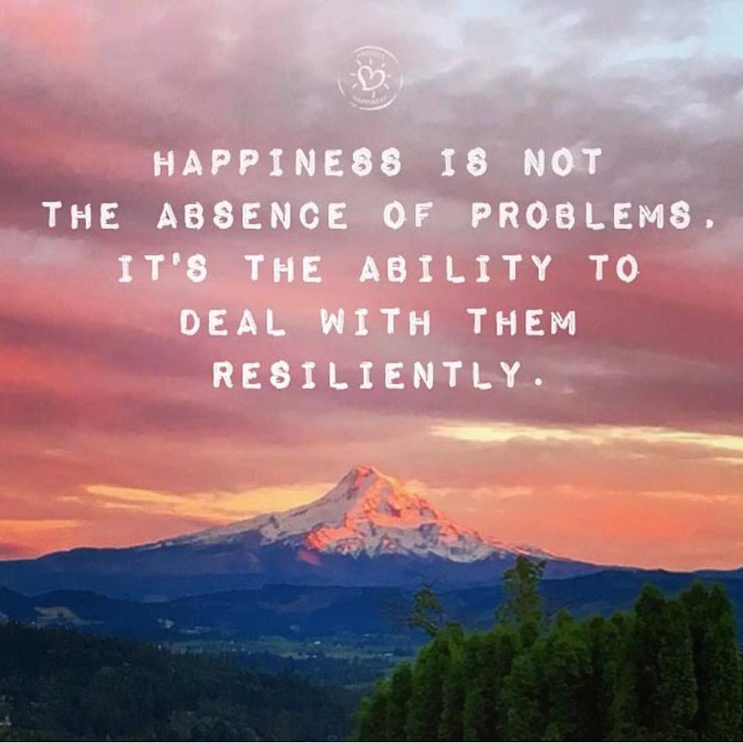
Welcome
Notes:
Dani
Facilitators:
(Prep for sharing audio & video, including French CC and 100% font size)
In case needed: https://archive.org/details/LovingKindness15Minsb
Optional: skip the body scan, starting at around 5:18, with a quick intro “take a couple of breaths, close your eyes…” and resume the recording
Video: Mindfulness & EQ connection - https://www.youtube.com/watch?v=s57sce71zNI
10 Minute Timer Options to play during Mindful Movement exercise:
10 Min timer - Cozy Vibes - Silent 10 minute timer with bell at the end - Bing video
10 Minute Timer with Alarm, without music - Bing video
🌌 10 Minute Timer with Alarm, In the Galaxy ( without music ) - Bing video
Mindfulness Bell Sound – YouTube – optional to begin and end the Loving Kindness exercise
Facilitators - Remember to disconnect from VPN
If sharing your screen – select « share computer audio » so participants can hear sound on video and audio clips

Slide 2
Mindful Change Leadership Development Program
Week 7 (of 8)
6 June 2022
Notes:
Dani
« Vous savez maintenant que vous pouvez exprimer vos commentaires ou poser vos questions dans la langue officielle de votre choix »
By now, you know you can use the language of your choice to express your comments or questions

Slide 3



Mindful Self-Love Exercise – Centering
Notes:
Dani
For today’s centering exercise, we’ll use a slight variation…. Similar to previous ones, the idea is to shift from “doing” to “being”
Let’s start by doing the following...
Sit in a comfortable attentive position
It helps if you close or semi-close your eyes
Focus on your breathing…
and repeat any of the following phrases aloud or in your mind as they may feel right to you, in this moment…
(read them allowing space in between)
I am a kind person (Je suis amiable)
I love myself (Je m’aime)
I do my best (Je fais de mon mieux)
I am enough (je suis assez moi-même)
(Repeat once a minute over three to five minutes, then ask participants to…)
take a couple of deep breaths, slowly open their eyes, and return to the group session.

Slide 4











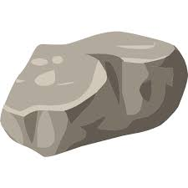
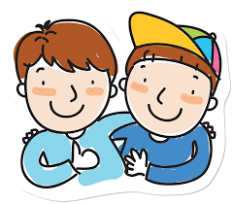

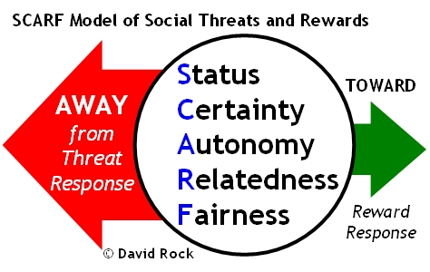





Questions/Insights from last week (6)
Notes:
Dani
Plenary: Open mic to share your comments, challenges, surprises… particularly would like to hear from those who haven’t shared yet
the gratitude journaling
Your practice
Mindful eating
Human Being is enough
Present
Mindful – Win Win Win
Raise your hand to speak, type in the chat… be mindful about the time, let’s take as many as we can in 10 mins.

Slide 5

Agenda – week 7
Centering exercise
Questions/Insights from last week (6)
Today’s intentions:
Focus, Compassion, Clarity, Creativity
Mindful Movement Exercise
Mindful Loving Kindness
Some articles regarding EQ, Leadership
Your take away assignment
Notes:
Dani

Slide 6

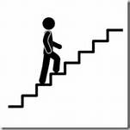
Mindful Movement Exercise
“Where can you take a mindful walk during your day?”
“If you can, go outside and into nature when you walk. Researchers in Finland found that city dwellers reported significantly more stress relief when they took a walk through a park or woodland than those who strolled through a city center.” - https://siyli.org/mindful-walking/
For us, let’s go for a mindful walk down the hallway, up and down the stairs, or outside in the garden … for 10 minutes
Pay attention to your pace, your breathing, your
steps, your motion, your effort, your balance,
your heart
Be safe
*If you are unable to walk, please adapt this exercise to suit your
own movement ability – standing or sitting
Notes:
Mindful movement is a bridge between sitting meditation and the mindful presence that we can bring with us through the more demanding environment of our day-to-day lives.
Think about where you can take a mindful walk during your day.
For example, mindful walking can serve as a mini-reset during your workday. Try bringing awareness to walking from your desk to the bathroom or to a meeting. Some people step into a stairwell and walk mindfully up the stairs when things get overwhelming, and they need a time out.
If you can go outside into nature, like through a park or woodland, that is a bonus that will boost the stress-reduction benefits and activate your parasympathetic nervous system.
You might consider scheduling a mindful walk during a break or at lunch. Regular practice can help prevent you from reaching overwhelm in the first place.
For today, let’s find somewhere safe to walk where you will not be disturbed such as a hallway, up and down stairs, or outside in the garden … for 10 minutes.
If you are unable to walk, please adapt this exercise to suit your own movement ability – standing or sitting.
When you begin this exercise today, start by standing still and become aware of how you feel. Consider your posture, the weight of your body, feet in your shoes, and your muscles as you balance. Take a few deep breaths and slowly bring your awareness into the present.
Begin moving, a little slower than normal.
Move as mindfully as you can.
Maintain awareness of:
Each footstep as it rolls from heel to toe
The muscles and tendons in your feet and legs
The movement and muscles elsewhere in your body
Pay attention to your breath
Whether you are inside or outside, notice the sights and sounds around you.
Most of all – be safe. Resist the urge to walk on a tight rope for this exercise.
Now let’s take 10 minutes to do the exercise… the goal is to be aware… of what you feel, how you feel, what you hear, what you think… as always, if your mind wanders, that’s fine; just acknowledge the side-trip and gently bring your mind back to the exercise.
10 mins timer starting now.
10 Minute Timer Options to play during exercise:
10 Min timer - Cozy Vibes - Silent 10 minute timer with bell at the end - Bing video
10 Minute Timer with Alarm, without music - Bing video
🌌 10 Minute Timer with Alarm, In the Galaxy ( without music ) - Bing video
(after 10 mins… acknowledge those who came back)
Hope everything went well. Remember there will be time to do a debrief at the end of the session if you would like to share your experience.
Resources:
Mindful Walking & Walking Meditation: A Restorative Practice (positivepsychology.com)
https://siyli.org/mindful-walking/

Slide 7
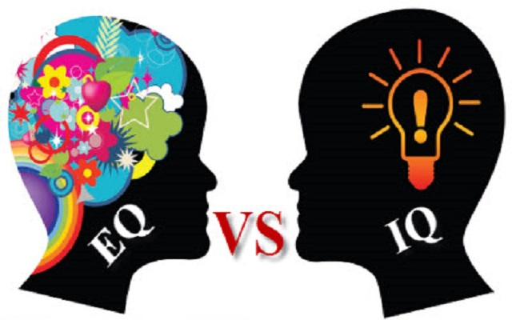
EQ: a core leadership skill
Self-awareness… allows people to tune into their feelings… involves recognizing one’s own emotions and their effects, and also having confidence in one’s self-worth and capabilities.
Self-control/self-regulation… ability to manage disruptive impulses and moods, and the propensity to suspend judgment and to think before acting… maintaining standards of honesty and integrity, taking responsibility for one’s behaviour, being adaptable in the face of change and being innovative and open to new ideas.
Internal Motivation… passion for work … not just about money and status… inner vision of what is important in life, a joy in doing something, curiosity in learning
Empathy… ability to understand others’ emotional makeup, the skill to treat people according to their emotional reactions… can read an organization’s dynamics, emotional currents and relationships, while sensing what people working for… service to clients and customers.
Social skills/Interpersonal skills… know how to negotiate and resolve conflicts, collaborate, co-operate, and create group synergy in pursuing collective goals/find common ground and build rapport… managing relationships and building networks… effective in leading change, persuasiveness, and expertise building and leading teams
Adapted from: https://bluenotes.anz.com/posts/2017/04/emotional-intelligence-a-core-leadership-skill/
Notes:
Casey-Marie
(paraphrase from the slide)

Slide 8
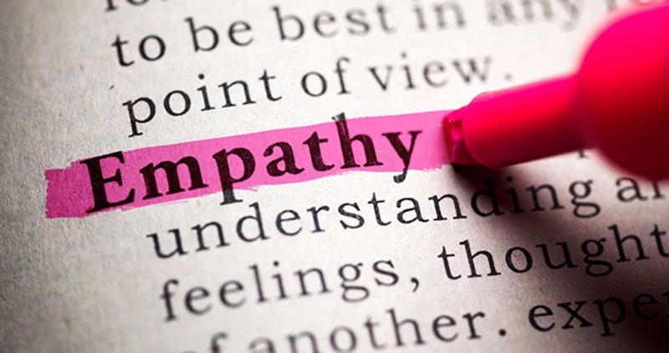
Empathy: the key to effective leadership
“… You must always remember that whoever you are, you are nothing without other people… Without empathy, you will never move past zero.
…Empathy means
understanding that the
decisions you make
every single day impact
not just you… when you
understand that you move from “me” to “we”… ”
http://www.businessinsider.com/why-empathy-is-key-to-effective-leadership-2017-4
Notes:
Casey-Marie
This is a story from recognized author and successful leader, he says: “…the leadership principle a grandfather shared with him as a child, it is the same one I now teach Fortune 500 execs: Empathy”
(read the slide)
Resources…
Compassion vs empathy: what is the difference? (tonyrobbins.com)
The leadership principle my grandfather shared with me as a child is the same one I now teach Fortune 500 execs – Article
http://www.businessinsider.com/why-empathy-is-key-to-effective-leadership-2017-4
Empathy vs. Compassion - https://ascentleader.org/difference-between-empathy-and-compassion/

Slide 9
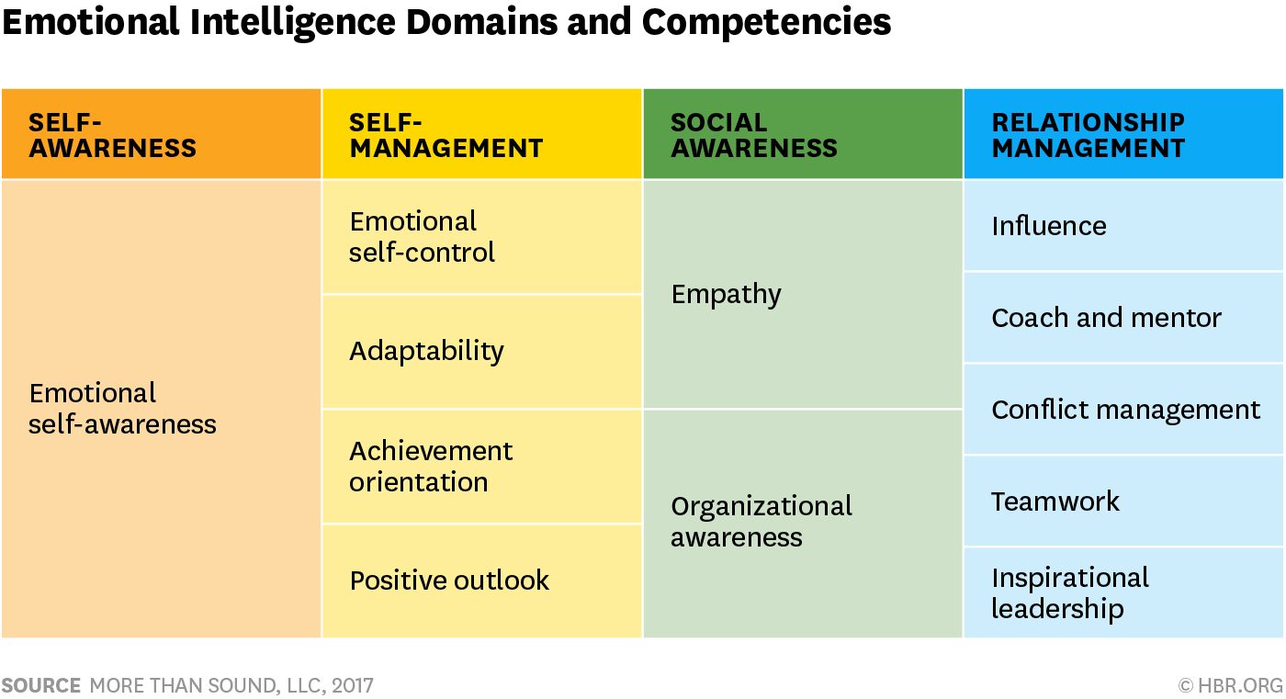

Emotional Intelligence Domains and Competencies
Article: https://hbr.org/2017/02/emotional-intelligence-has-12-elements-which-do-you-need-to-work-on
Self-assessment: https://www.tsw.co.uk/blog/leadership-and-management/daniel-goleman-emotional-intelligence/
Notes:
Casey-Marie
This table shows the 12 competencies related to EQ’s domains
Self-awareness, although the least visible emotion it is an incredible predictor of the level of emotional intelligence. Therefore, Self-aware Leaders Show Higher EQ
And those who have high self-awareness tend to have at least 10 or 12 competencies, while those who are low have one or two
Resources…
https://hbr.org/2017/02/emotional-intelligence-has-12-elements-which-do-you-need-to-work-on
Self assessment: https://www.tsw.co.uk/blog/leadership-and-management/daniel-goleman-emotional-intelligence/
Video: Mindfulness & EQ connection - https://www.youtube.com/watch?v=s57sce71zNI (2.5 mins)
Resources in French:
Self assessment: https://nomadity.be/blog_confiance/4-piliers-pour-developper-votre-intelligence-emotionnelle/
9

Slide 10

To Be An Effective Leader, Keep A
Leadership (Reflecting) Journal
Ten Questions For Your Leadership (Reflecting) Journal
What’s present for me now?
What’s going well? What’s creating that?
What's challenging? What's creating that?
What needs my attention?
What’s meaningful?
What strengths do I notice in myself?
What strengths and contributions do I notice in others?
What am I learning?
What is an action I am committing to?
“The idea here is getting people to come to terms with who they are, where they want to go… I think of expressive writing as a life course correction.”
– Dr. Pennebaker
https://www.forbes.com/sites/hennainam/2017/04/02/to-be-an-effective-leader-keep-a-leadership-journal/
http://well.blogs.nytimes.com/2015/01/19/writing-your-way-to-happiness/
Notes:
Casey-Marie
(read a few bullets, then the quote on the right)
Any questions anyone?
(if nobody has a question, perhaps read one/two with the **
if someone has a question regarding the list, read from the text)
What’s present for me now? This may feel like an esoteric question to start with but it’s a useful one to get present to what’s going on in this moment for you. Take a few deep breaths, close your eyes, and bring awareness to your body. Stretch and release any tension you’re feeling. Look inside yourself. Notice what emotions are present. Often, we rush through our day without checking in with ourselves. This is an opportunity to greet an old friend and see how they are. It will set you up for rich learning in the questions that follow.
What’s going well? What’s creating that? Acknowledging what's good helps you take a step back from what may have been a very stressful day. It helps you acknowledge yourself and others for the good that’s happening. It helps you learn what’s positive and what's helping you achieve goals.
** What's challenging? What's creating that? Acknowledging what's challenging focuses you on what needs your attention for learning and growth. Often, we start off by blaming others, ourselves, or circumstances for what is challenging. That’s fine and a perfectly human response. You can start there. And I urge you to look deeper within yourself. What are your beliefs, attitudes, or actions that contribute to what is challenging for you? This process of taking responsibility (without judgement!) is a key driver to feeling empowered as a leader rather than a victim of circumstances. It opens you up to experimenting with other ways of leading that may be more effective.
What needs my attention? This is a great question for scanning your environment, both work and personal. Your quality attention is your most precious asset. This helps you become mindful and choose where you invest it.
** What’s meaningful? Finding meaning in each day keeps you fueled. It helps you learn about what values are important to you and then lead from those values. It helps you discover purpose and lead from purpose, inspiring and engaging yourself and those around you. Another question in this same vein is what am I grateful for? This helps you focus on what’s going right overall, which helps to reduce stress and improve overall well-being. Keeping a gratitude journal has been shown to clinically improve your immune system. It also increases resilience.
What strengths do I notice in myself? This helps you become aware of your strengths and put them into action. You may also want to journal about values you exercised. It builds confidence, trust in yourself, and resilience.
What strengths and contributions do I notice in others? This helps you appreciate and see what others are contributing. You can then powerfully acknowledge and appreciate them. It helps build productive and trusting work relationships.
What am I learning? Scan your writing. Capture any learning that feels most important.
What is an action I am committing to? This helps you move the learning forward into action.
Try this exercise. Bullet-point answers are fine. I challenge you to try it as a gift to yourself for the next seven days. My hope is that it will help you to become a more inspired, authentic and agile leader.
Resources…
Writing Your Way to Happiness – Article http://well.blogs.nytimes.com/2015/01/19/writing-your-way-to-happiness/
To Be An Effective Leader, Keep A Leadership Journal – Article https://www.forbes.com/sites/hennainam/2017/04/02/to-be-an-effective-leader-keep-a-leadership-journal/

Slide 11
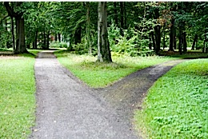
Making
Big or Small
Decisions?
Resisting the Negative
  People who meditated focused less on the past and future, which led to them experiencing less negative emotion,” Hafenbrack says. “That helped them reduce the sunk-cost bias.”
Short-term or Long-term?
  [The research doesn’t] undermine the idea that [meditating] as a long-term practice could be effective,” Barsade says. “However, one of the novel and important things [about the research] is that you can take a brief time out and get a result.”
Mindful Decision-making
  “Applying mindfulness techniques to decision-making leads to clearer thinking and to staying connected to your core values, which is crucial to your peace of mind.” – Phillip Moffitt
http://knowledge.wharton.upenn.edu/article/making-big-small-decision-meditation-can-help/
https://dharmawisdom.org/decision-time/
Notes:
Michelle
For the first two quotes on the slide - Hafenbrack and Barsade are authors of a research paper called Debiasing the Mind through Meditation: Mindfulness and the Sunk-Cost Bias.
The paper explores how short meditation sessions can reduce the likelihood that decisions will be made based on information from the past that should have no bearing on the choice at hand.
The Sunk-Cost Bias comes into play when the decision maker has invested significant time and money toward arriving at a particular outcome which is influencing their ability to clearly assess the situation and make a decision that takes the current factors into account.
Meditation has been shown to help people focus on the present and let go of both the past and future.
Even short breaks and little time-outs will get you to a place where you can think better and be in a position to make better decisions. Which can save time and money for everyone — from a consumer searching for a new car all the way to the head of a billion-dollar corporation.
The third quote is from Phillip Moffitt who is a Buddhist meditation teacher.
In the resource listed on the slide, he outlines three stages in the mindfulness process to help clarify thinking when it is muddled by the stress of deciding, and how to stay in touch with one’s deepest values when feeling anxious
The more you practice, the more skillful you become. And over time you naturally become more mindful in other moments of your life. Applying mindfulness techniques to decision making leads to clearer thinking and to staying connected to your core values, which is crucial to your peace of mind.
Resources…
Article - Making a Big (or Small) Decision? How Meditation Can Help: http://knowledge.wharton.upenn.edu/article/making-big-small-decision-meditation-can-help/
Article - Decision Time: https://dharmawisdom.org/decision-time/

Slide 12
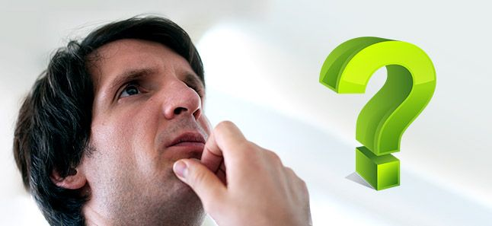
Mindfulness for Better Decision-making
A good decision is the reflection
of your thoughts and experiences,
and this can be augmented through
a mindfulness practice.
#1 – Focused mind
#2 – The right balance
#3 – Rational thinking
#4 – A strong mind
#5 – Intuition, perception and observation
#6 – Focus on the present
Calmer mind
Drop the baggage
A strong mind
Strong intuition
https://www.artofliving.org/us-en/meditation/meditation-for-you/meditation-for-better-decision-making
https://www.artofliving.org/meditation/meditation-for-you/meditation-for-better-decision-making
Notes:
Michelle
Here’s how meditation works to better your decision-making ability.
1
Calmer/Focused mind
When you are bombarded with too many thoughts, your mind is unable to arrive at a decision. Meditation helps to clear the thoughts by calming the mind down.
Just how one can see a clear reflection in still waters, similarly a calm mind gives a clear picture of all parameters and possible repercussions of a decision. You are, thus, empowered to take the right decision.
2
The right balance
Our negative emotions like fear, anxiety, guilt, regret or worry subconsciously play a part in the decision-making process. Regular mindfulness practice helps us drop our emotional baggage, be natural, and take decisions from an unbiased frame of mind.
In addition to clearing our personal emotional baggage, mindfulness helps in taking note of other people’s point of view with an unbiased mind. So, even if someone’s opinion is shrouded with anger, you are more likely to understand them instead of dismissing them.
3
Rational Thinking
Meditation helps you balance the thoughts coming from both the left and the right hemispheres of the brain, helping you be solution-driven rather than reaction- or emotionally-driven.
4
A Strong Mind
Mindfulness helps maintain your energy and enthusiasm to a great extent. This, in turn, results in boosting clarity and a holistic approach towards any issue. You can handle a greater workload, manage pressure and deadlines more easily and will be ready to take a sound decision at any given time.
5
Intuition, Perception and Observation
Intuition is the ability to understand something immediately which can be tapped into through mindfulness practices. It cuts through all the clutter to give you the best solution or brief about a situation. With intuition, you can make decisions quickly. Mindfulness practice improves this deep inner wisdom by increasing awareness. Consistent practice strengthens it.
6
Focus on the Present
Focusing on the present allows you to clearly assess the situation and make a decision that takes the current factors into account. Being present also allows you to be an active participant in your life and to make decisions with a greater sense of purpose and meaningful connection to who you are, to your surroundings and to everyone around you.
Article - Have better decision-making abilities https://www.artofliving.org/meditation/meditation-for-you/meditation-for-better-decision-making
Article - Better Decision Making Ability https://www.artofliving.org/us-en/meditation/meditation-for-you/meditation-for-better-decision-making

Slide 13

Mindful Loving Kindness exercise
Time required – 15 minutes
First, do a Mindfulness Body Scan – Relaxation exercise
Then, follow my voice
During this exercise, I’ll say a few sentences
I invite you to repeat the ones that resonate with you the most, the ones that are true to yourself
  May I be happy
  May I be healthy
  May I live with ease
  May I be free from pain and suffering
  May I be able to let go of everything
  over which I have no control
  May I find success in all areas about which
  I’m passionate
Mindfulness exercise – Loving Kindness – 15 mins (https://archive.org/details/LovingKindness15Minsb)
  Download link: https://archive.org/download/LovingKindness15Minsb/Loving%20Kindness%2015%20minsb.mp3
Notes:
Casey-Marie
Mindfulness Bell Sound - YouTube - to begin and end the exercise
Body Scan and Loving Kindness MEDITATION:
Let’s begin (BELL)
To prepare for the loving kindness mediation, sit as comfortably as possible in the chair that you are seated with both seat on the floor (pause), your hands on your laps (pause) and I invite you to close your eyes (pause) and just breath (pause).
Just for now focus on your breathing (pause).
As you breath in, notice the air going into your nostrils, expanding your chest, your abdomen, filling your lungs (pause)
As you breath out, focus the on the air coming out your nostrils, the air may be warmer (pause 10 seconds)
If at any point your mind wanders, gently bring it back and focus your attention on your breathing
Now focus on your feet and your toes and how its touching the ground (pause 5 sec)
As you inhale, focus on your lower legs (pause). Notice your muscles relaxing (pause 5 sec)
As you exhale, focus on your upper legs (pause). Notice your muscles relaxing (pause 5 sec)
Continue breathing and focus on your hips and waist (pause 5 seconds). Just notice Pause 5 seconds)
Now focus on your lower back and stomach (pause). Relax these parts of your body (pause 5 seconds)
Now focus on your middle back and solar plexus (pause 5 seconds). Just notice
Now focus on your upper back and your chest (pause 5 seconds). Notice how these parts rise and fall with your breath (pause)
As you continue breathing, focus on your shoulders and relax them as you breath out (pause 5 seconds)
Now focus on your upper arms (pause), your lower arms (pause), your hands (pause), your fingers (pause). Feel how they relax as you breath in and as we breath out (pause 5 sec)
Focus on your neck and your head (pause), your scalp (pause), Your ears (pause) and your forehead as you breath in and as you breath out (pause 5 sec)
Focus on your face, your eyes, your nose, your mouth, your lips, your jaw (pause) Feel all of those parts relaxing (pause 5 sec). Stay there for a few more moments. (5 sec)
Now we are ready to start the loving kindness meditation exercise (pause)
Just follow my voice during this exercise (pause). Start with yourself, bring loving kindness to yourself. I will say a few sentences and I invite you to repeat the ones that resonate with you the most, the ones that are true to yourself, the ones that align with your heart (pause).
May I be happy (pause)
May I be loved (pause)
May I be healthy (pause
May I live with ease (pause)
May I be free from pain and suffering (pause)
May I be able to let go of everything
for which I have no control over (pause)
May I find success in all areas for which
I’m passionate about (pause)
(Repeat the sentences) Keep repeating the ones that resonate with you. (repeat the sentences)
(pause 40 sec)
Now bring to mind someone you care a lot about, someone you admire, bring the image of their face in your mind, their eyes, their smile. (pause) Bring loving kindness to them by wishing them these well thoughts.
May they be happy (pause)
May they be loved (pause)
May they be healthy (pause
May they live with ease (pause)
May they be free from pain and suffering (pause)
May they be able to let go of everything
for which they have no control over (pause)
May they find success in all areas for which
they are passionate about (pause)
(Repeat the sentences) If your mind is struggling, just gently come back to the sensation of your breath, and keep repeating your sentences
(Repeat the sentences) (pause 40 seconds)
Next, bring to mind somebody you’re familiar with and who is going through a hard time, someone you know would benefit from these well wishes.
May they be happy (pause)
May they be loved (pause)
May they be healthy (pause
May they live with ease (pause)
May they be free from pain and suffering (pause)
May they be able to let go of everything
for which they have no control over (pause)
May they find success in all areas for which
they are passionate about (pause)
(Repeat the sentences) (Pause 40 seconds)
Now, Bring to mind someone who plays a function in your life, someone who you don’t know very well; it could be the commissionaire in your way in, perhaps the person who serves you coffee in the shop, the bus driver, or even someone in your office you don’t know that well. Get a feeling of their presence, what they look like and see how you can wish them these well thoughts. (pause)
May they be happy (pause)
May they be loved (pause)
May they be healthy (pause
May they live with ease (pause)
May they be free from pain and suffering (pause)
May they be able to let go of everything
for which they have no control over (pause)
May they find success in all areas for which
they are passionate about (pause)
(Repeat the sentences) (Pause 40 seconds)
Next, see if you can wish these well thoughts to everyone listening today, see if you can wish these well thoughts to everyone in your team, everyone in your building, everyone in your city. See if you can wish these well thoughts to every single living human being in this planet.
May they be happy (pause)
May they be loved (pause)
May they be healthy (pause
May they live with ease (pause)
May they be free from pain and suffering (pause)
May they be able to let go of everything (pause)
for which they have no control over (pause)
May they find success in all areas for which
they are passionate about (pause)
(Repeat the sentences) (pause 40 seconds)
As you continue breathing, Keep your eyes closed for a few moments (pause 5 sec)
In this moment, give yourself gratitude for taking the opportunity out of your busy day to slow down and reconnect. (pause 5 sec)
The more we practice, the more we’re able to create this gaps between our habitual thoughts and habitual patterns (pause)
When you’re ready, you can rub your hands together, creating a bit of heat; and you can put your hands over your eyes; (pause)
Slowly open your eyes (pause) And comeback. (BELL)
Thank you for trusting me and giving me this opportunity to lead you through this loving kindness exercise.
Mindfulness exercise – Loving Kindness – 15 mins (https://archive.org/details/LovingKindness15Minsb)
Optional: skip the body scan, start at around 4:22, with a quick “take a couple of breaths, close your eyes…” and resume the recording
Download link: https://archive.org/download/LovingKindness15Minsb/Loving%20Kindness%2015%20minsb.mp3

Slide 14
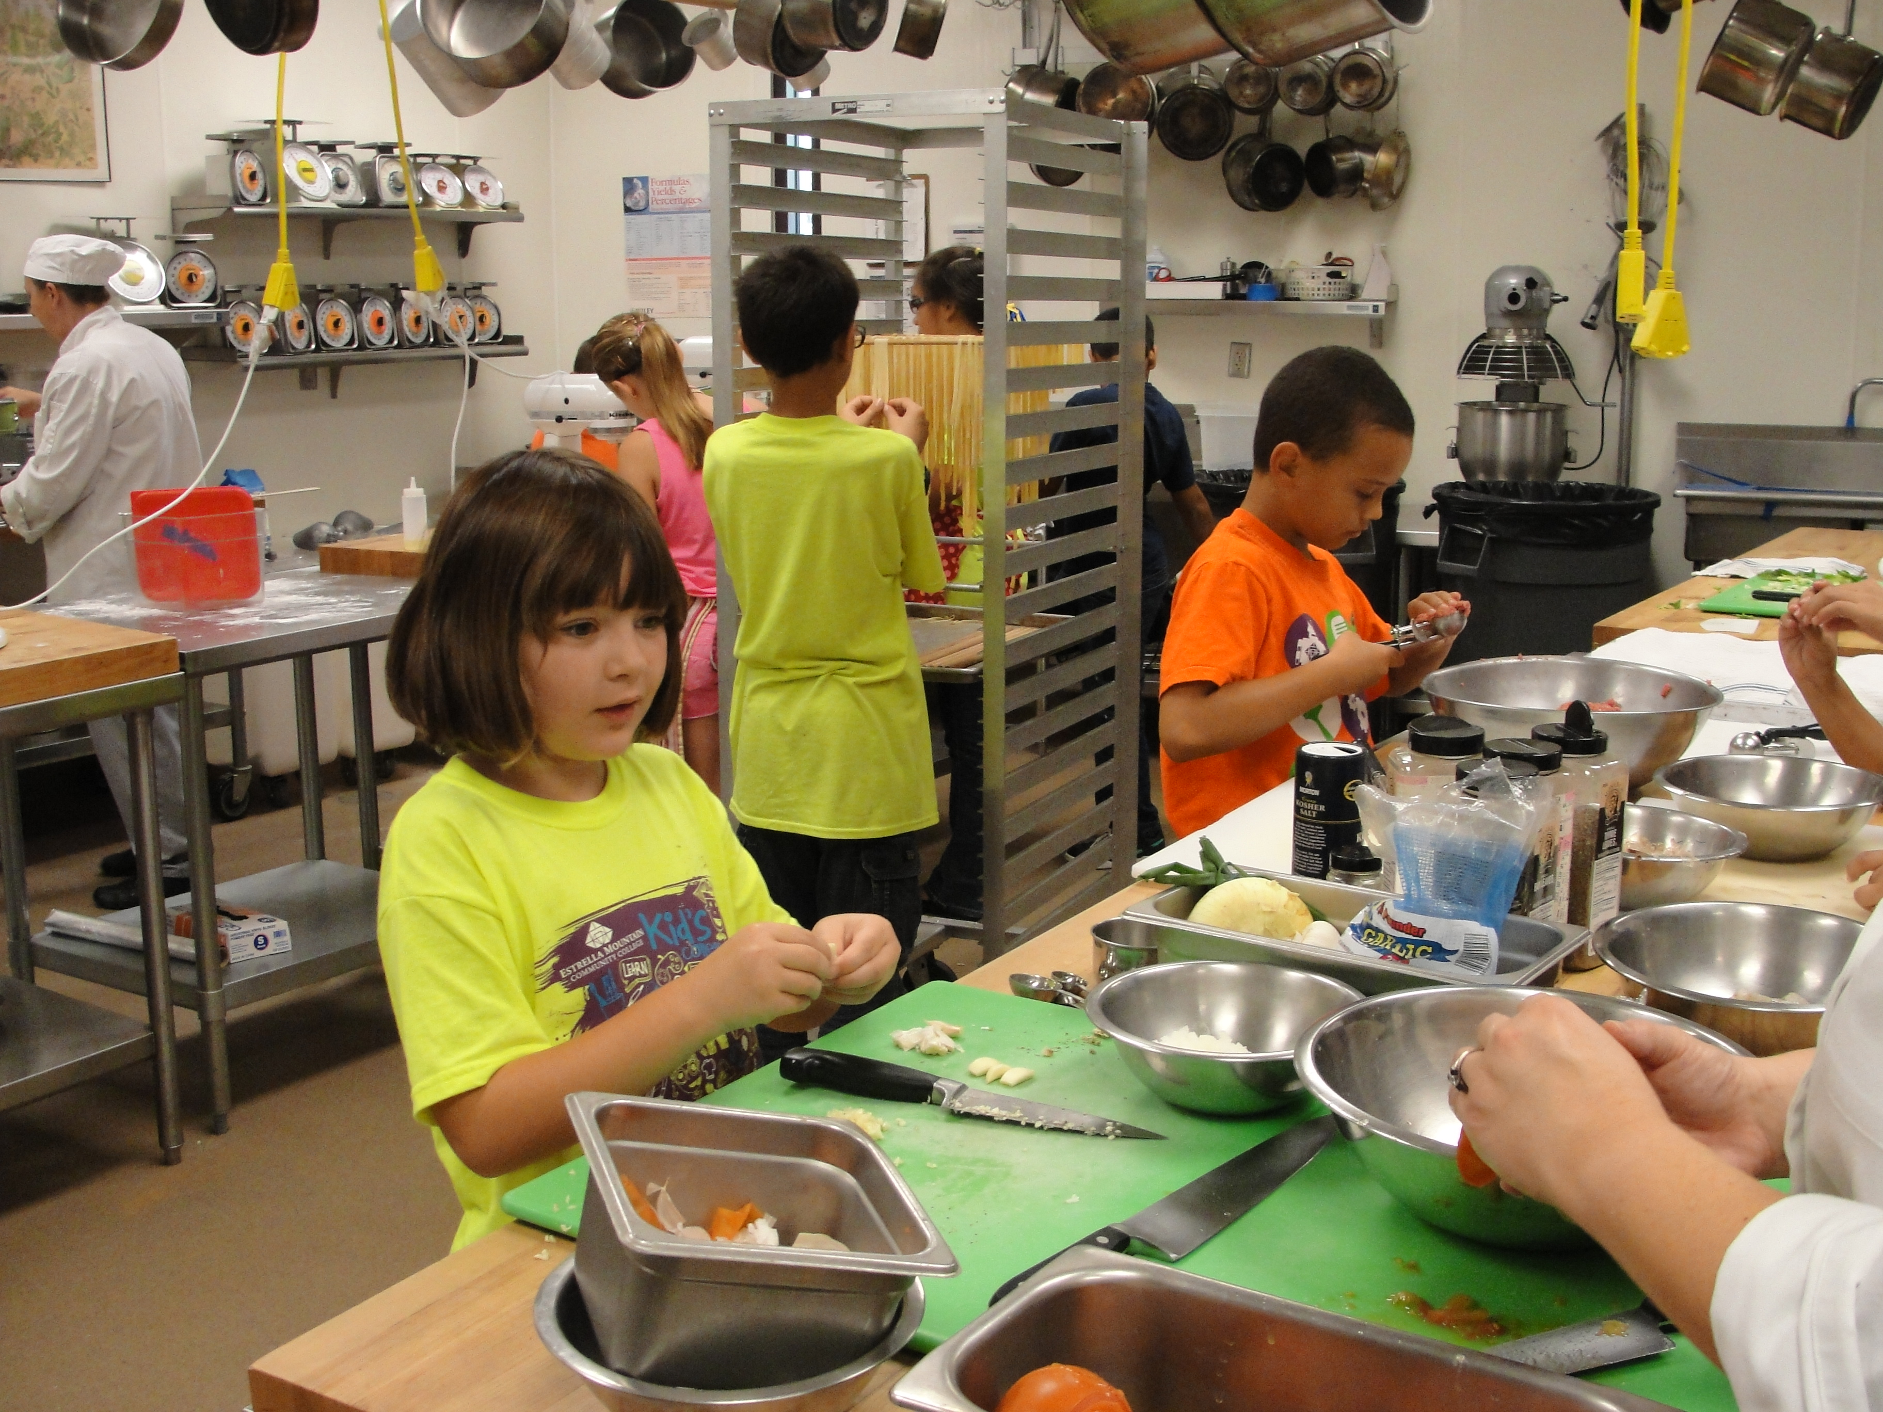
Your takeaway practice for week 7
Connecting – once a week with your buddy
Leadership Reflecting Journaling - daily
Practice, choose one of the following and keep doing it for the whole week - daily
  Self-compassion
  15 mins – https://soundcloud.com/mindfullivingcoach/self-compassion-meditation
  15 mins – https://soundcloud.com/awakeningcompassion/awakening-compassion-class-4
  20 mins – http://self-compassion.org/wp-content/uploads/meditations/LKM.self-compassion.MP3
  Mindful Loving Kindness exercise
  15 mins – https://archive.org/details/LovingKindness15Minsb
  20 mins – https://www.tarabrach.com/meditation-loving-presence-2/
Apply Mindful Centering – as needed
Apply Mindful Movement – as needed
For the next and final session: Bring all the questions you have
Notes:
Michelle
Your takeaway practice for week 7
Continue to connect with your buddy system.
Continue gratitude journalling and incorporate some leadership reflection. There are some journalling prompts on slide 10 to help you to explore self-awareness relating to leadership through self-reflective expressive writing.
Practice either a self-compassion exercise or mindful loving kindness exercise each day to cultivate positive emotions and boost wellbeing.
Apply Mindful Centering as needed - take short breaks and little time-outs to bring you to a place where you can think better and be in a position to make better decisions.
Apply Mindful Movement as needed. Try scheduling a mindful walk into your day.
For the next and final session. Bring all the questions you have.

Slide 15
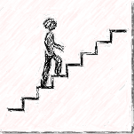


Reflect about today’s exercises
Notes:
Michelle
As usual, before going into small groups, let’s do a session debrief. Would anyone like to share their reflections about today’s exercises? (until about 20 minutes before the end of the session):
Mindful movement – what you experienced during the exercise today or how you do or plan to incorporate it into your day
Leadership (Reflecting) Journal
Better Decision Making
Loving Kindness
Take the next few minutes to debrief in small groups. As in previous weeks, when you’re done just leave the session.
Feel free to share:
What you noticed
What you had a hard time with
What you’re realizing
An intention you have for the week
Etc
*IF YOU NEED TO DROP OUT EARLY TO GET TO ANOTHER MEETING PLEASE DO SO NOW SO THERE IS A SMOOTHER EXPERIENCE WHEN THE BREAKOUT SESSIONS START

Slide 16


Be Mindful, Be Happy /
Prenez conscience, soyez heureux
Notes:
Thank you so much for being in this session today. There is just one more session to go which will be on Tuesday! I hope you have a great week everyone! I wish you all happiness.

