Slide 1
Theme and topic Beta template
Digital Transformation Office, TBS

Slide 2
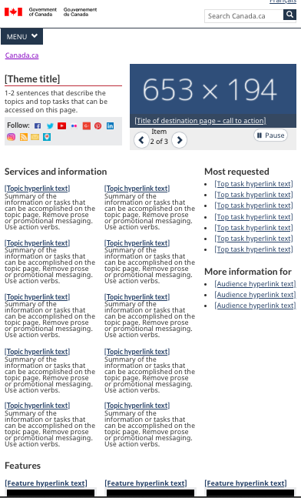
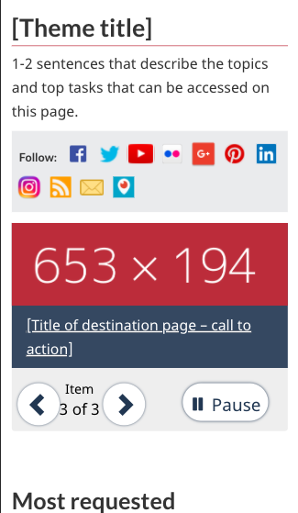
Current theme template

Slide 3
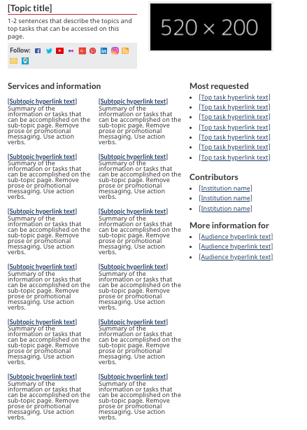
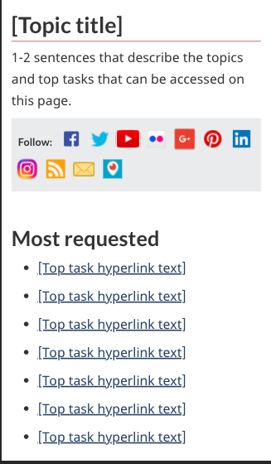
Current topic template

Slide 4
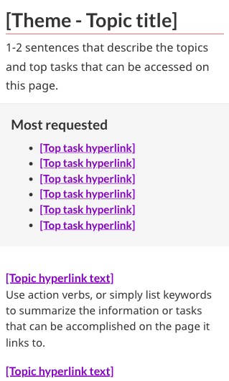
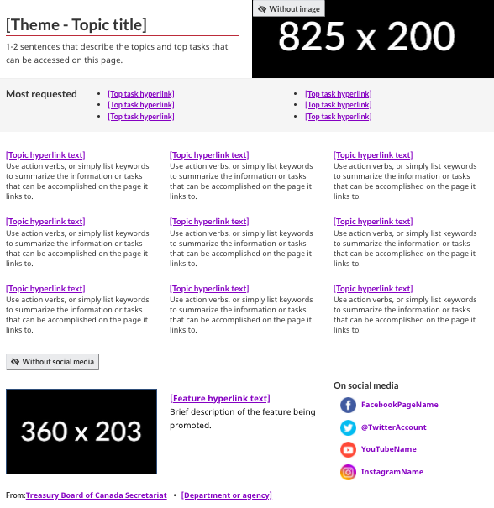
Revamped theme and topic template
Mobile
Desktop
To:

Slide 5
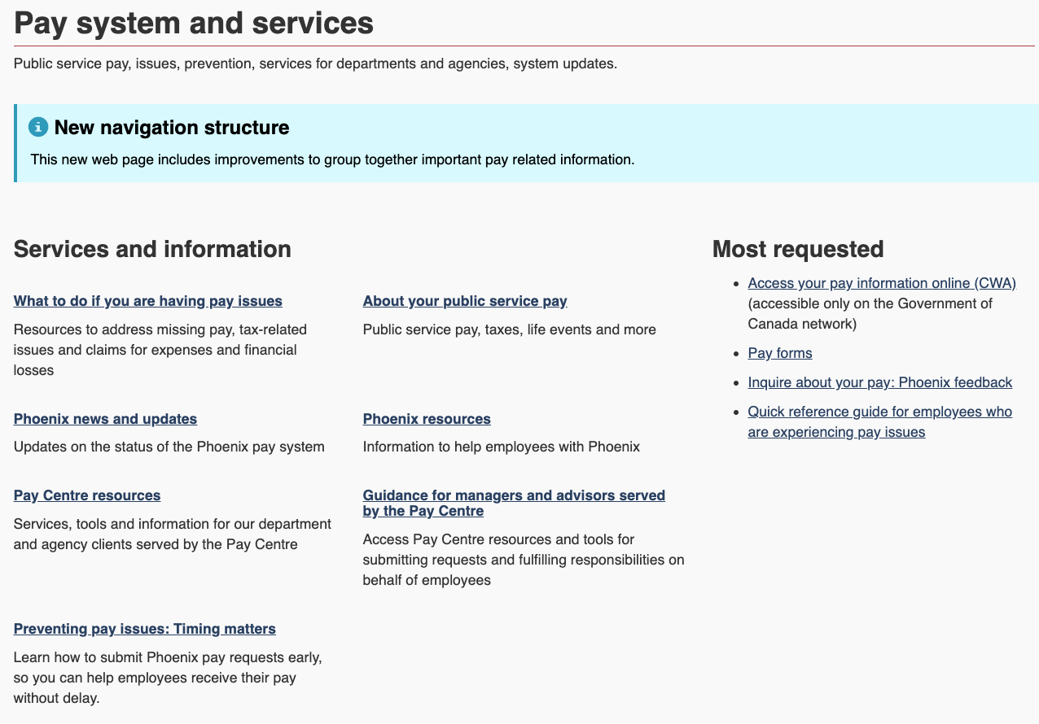
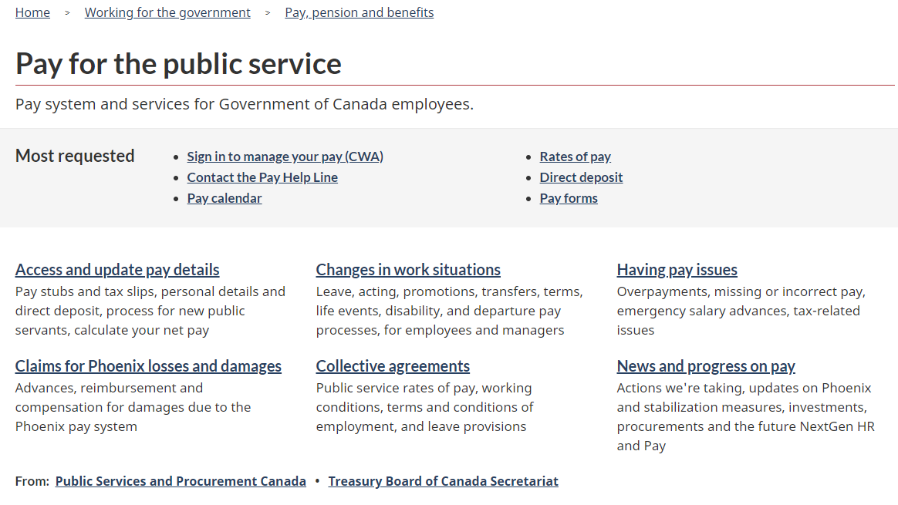
Prototyped and tested during Pay optimization project
New topic page worked very well to surface top tasks
Overall success went from 18% to 78%
New topic page played a significant role in the increase
We’re still working on the research summary

Slide 6
Most significant changes
Theme and topic pages are combined into a single template - less confusion
Overall design is closer to the Canada.ca home page
Most requested is now in a band at the top - more visible on desktop and mobile to surface top tasks
Removal of What we are doing and More information for sections
Contributors section sent to the bottom
More flexibility in the social media and promotion area
Theme and topic page

Slide 7
How to implement a beta template
Requires custom CSS for now - we’re working on bringing it into regular WET
Template was tested for accessibility and HTML validity
“Beta” means we’re scaling up the experiment - there may still be minor changes
DTO expects that departments report back on any issue you find with the template or its implementation

Slide 8
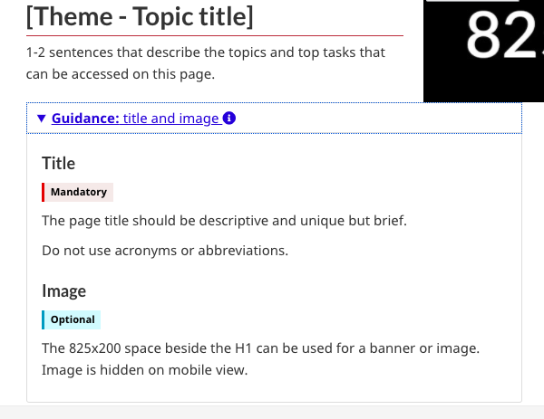
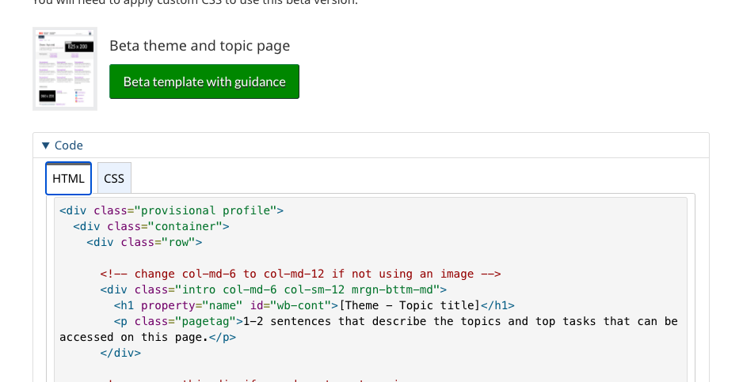
Getting the guidance
Theme and topic page: has code, custom CSS and some comments in the code
Coded layout: has detailed section for each section

Slide 9
Next steps
Get a few departments to start using it
Fix any outstanding issue with the template or its implementation
Work with PP to integrate in WET and in AEM
Once this is done:
Beta template will become the stable template
A deadline will be given to departments to implement it on all their topic pages

