Slide 1

MyESDC-MonEDSC
ESDC’s Employee Mobile App
August 31, 2021

Slide 2

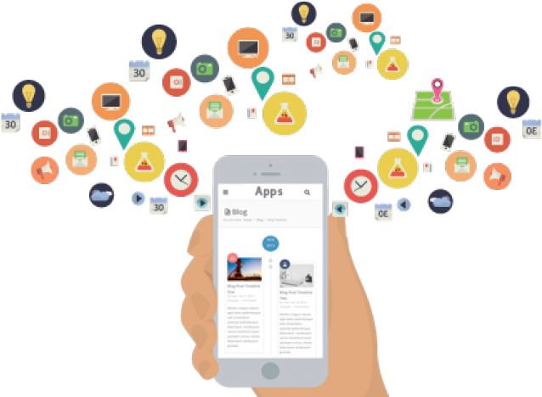
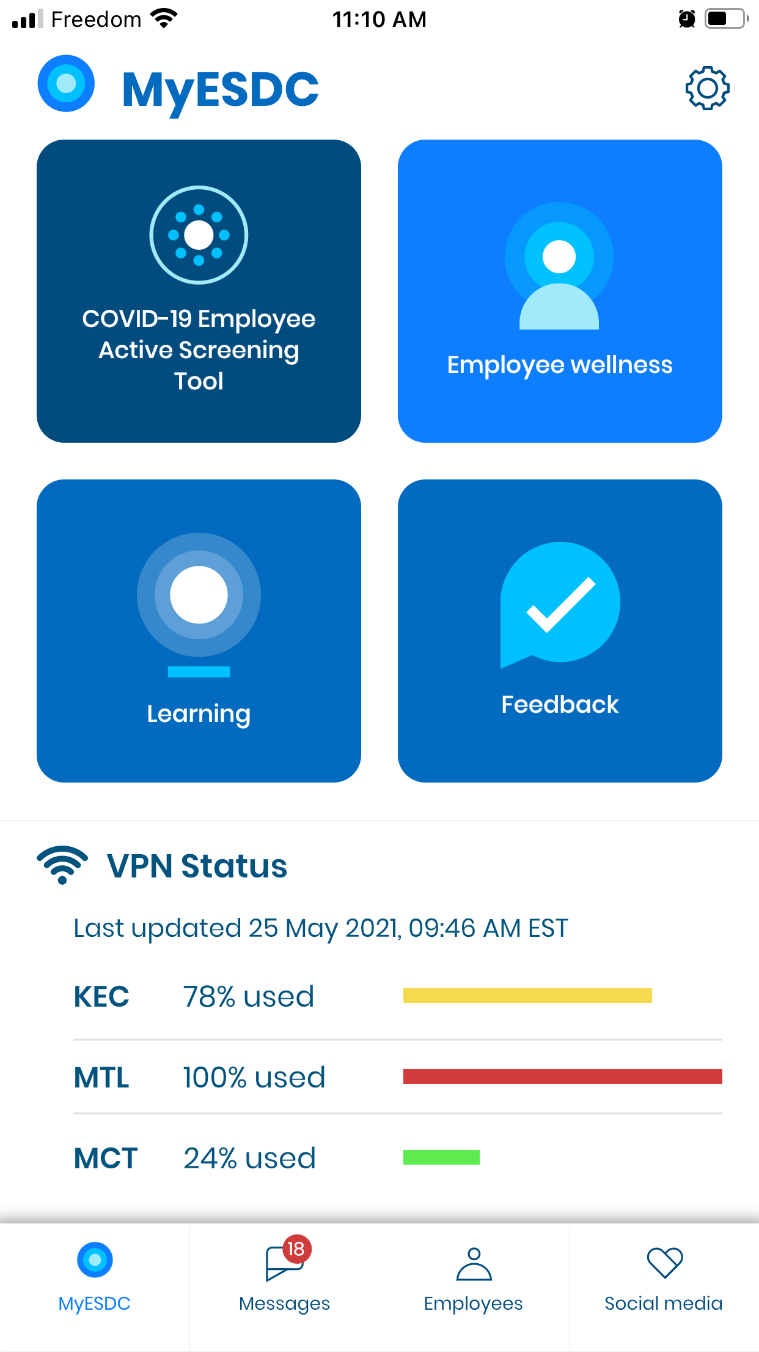
MyESDC Mobile App
  Project Vision: To provide ESDC employees with an off-network communication channel for essential information and tools anytime, anywhere.
Users:
ESDCs workforce (including Service Canada and the Labour Program) on personal or department issued mobile devices.

Slide 3
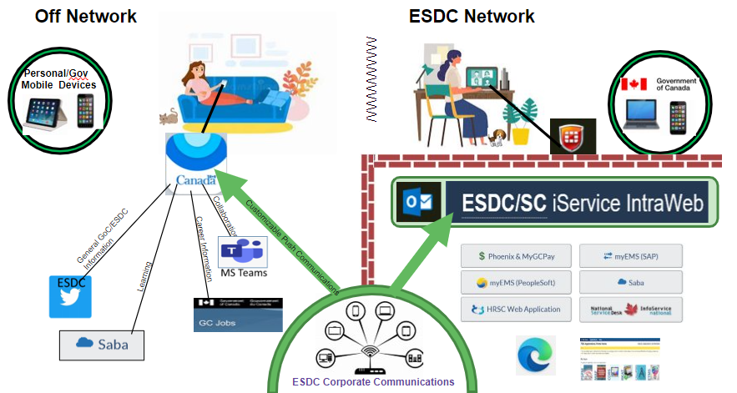
Communicating with ESDC Employees – MyESDC MVP

Slide 4



…what is it?
What it is…
What it is not…
Features…
An optional/complimentary communication tool (download & use is not mandatory);
A tool made by employees, for employees with future iterations based on user feedback;
Accessible & bilingual;
Accessible off-network 24/7; including during network outages;
A convenient, user-friendly conduit for employees to access GoC info/resources/tools.
A repository for collecting or processing personal or protected information (no personal info is collected or retained);
A replacement for existing communication tools;
A replica of information already in existence/available elsewhere;
A messaging or collaboration tool.
No sign-in/authentication required;
Direct access to COVID-19 Employee Active Screening Tool;
Notifications for urgent and non-urgent corporate messages;
Links to existing off-network tools/resources/ESDC social media;
Contact numbers to public service resources;
Real-time network status for all 3 VPN Servers;
User feedback function.

Slide 5


Consultation & Employee Engagement Strategy
Rapid Stakeholder Engagement: Oct-Nov, 2020
Consultation with DND on the HR-GO App: Jan 2021
Consultation on the Job Bank App: March 2021
User Acceptance Testing (UAT): May 2020
Broader Employee Consultation & Engagement: June 2021 and onward
MyESDC
(MVP1)
Soft Launch – June 2021
Iphone photo: This Photo by Unknown Author is licensed under CC BY-SA-NC

Slide 6
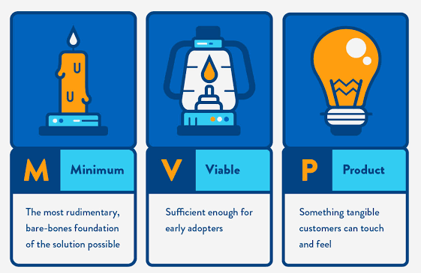
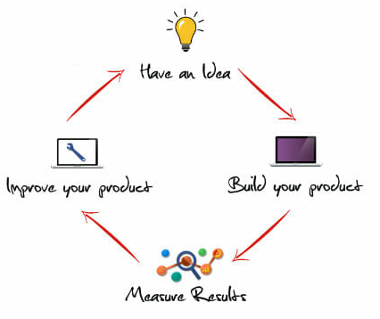
Minimum Viable Product (MVP), not Perfection!
  A risk mitigation measure to reduce project complexity & opportunity to “test” the idea without a full upfront investment.
Notes:
Want our product to be a minimum viable product so we can quickly get it released without a full upfront investment, test it early, collect feedback and consider that feedback when improving our product. We are not looking for perfection. If we wait too long before we get an initial tangible product out, the product may be obsolete by the time we release it.

Slide 7
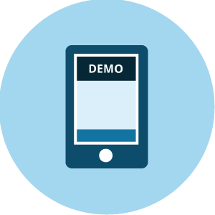
MyESDC App Demo
The idea has come to life!!
Let’s take a look at how the App works…

Slide 8


Information for Users of the MyESDC App?
Users can go to the new MyESDC application iService page for:
    Background information;
    FAQs;
    Online intake form for sending messages;
Users are able to go to the Google Play and Apple stores to download the App free of charge.

Slide 9
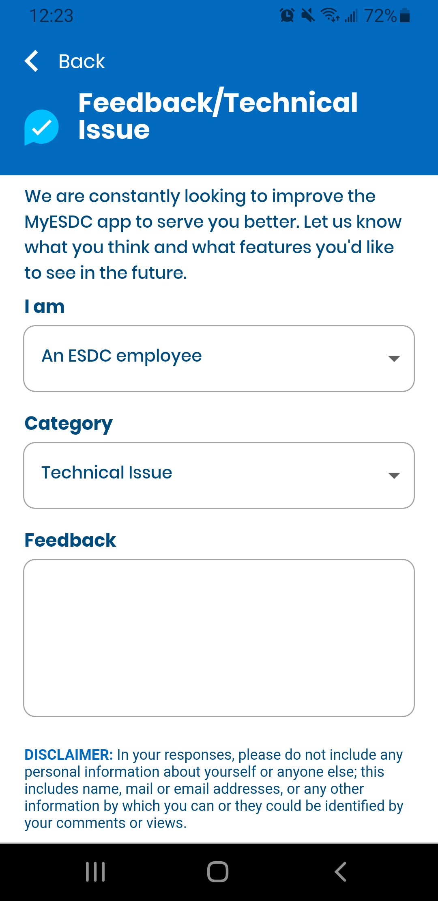
How can an employee get support?
Two (2) options:
- by following the instructions on iService page (below), OR
- by using the Feedback feature of the application

Slide 10
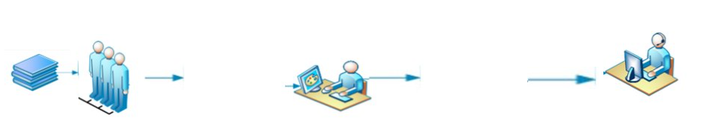
Roles & Responsibilities
  Content Submission
  (Business Lines)
  Completes intake form/checklist;
  Develops message/notification with review from PASRB or Regional Communications as appropriate;
  Seeks approval on use of (trademark) icons (if required) when requesting new access/links;
  Seeks Business Line approval;
  Submits approved content to the App Product Owner.
  App Product Owner and Publisher
  (ADM, HRSB)
  Director level (TBD), HRSB;
  Reviews, edits and/or provides final approval for the content submitted by a Content Approver;
  Confirms on Intake Form that request meets Checklist for Submission;
  Publishes the content to the live web server.
  App Support and Maintenance
  (IITB)
  SME engaged in the day-to-day operations of App;
  Reviews, edits and/or adjusts the content approved by the App Product Owner to ensure compliance with Web Content Accessibility Guidelines (WCAG) 2.1 policies and procedures;
  Act as back up publisher to HRSB.

Slide 11
Where do we go from here?
We will continue growing and improving… and we need your input!

Slide 12
MyESDC 2.0 Future Release
Many new and quickly evolving functional opportunities being identified (i.e. ERMS, LifeWorks, Onboarding, recruitment, IT Outages etc.);
The MyESDC App continues to be updated based on user’s feedback received via the GD Mailbox and the App itself;
Receiving very positive user feedback comments via MyESDC GD Mailbox and the App so far;
We are aiming to release version 2.0 during NPSW 2022.

Slide 13
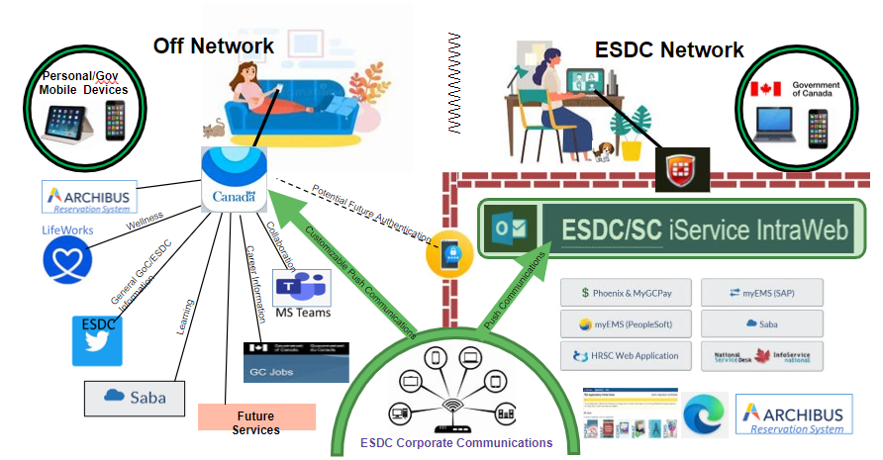
Communicating with ESDC Employees – MyESDC Future Releases

Slide 14

Questions? Feedback?

