Slide 1
FM-Business Capability Model (BCM)

Slide 2
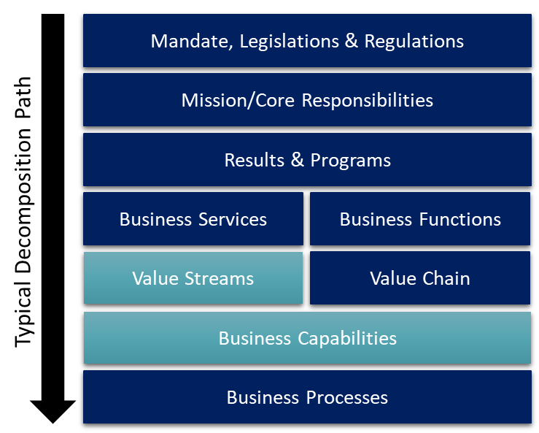
Business Capability Model (BCM)
Overview
A Business Capability Model facilitates strategic discussion on identifying key capabilities required by a business or an organization
Decomposes the functional areas of an enterprise and describes the primary business functions. It helps describe, discuss, understand and optimize what an enterprise does to execute on its mission and reach its strategic objectives (core business abilities/capabilities), rather than how it does it (business processes)

Slide 3
Business Capability Model (BCM)
Overview cont’d…
Key reasons we need to utilize a BCM:
Provides us with a model to quickly identify the business areas where the capabilities with the most value can be delivered
Brings together the business and IT discussion quickly to achieve a joint level of understanding (common language)
Helps develop a coherent and comprehensive view of business motivation, capabilities, processes, data and resources
Each business capability has a maturity level that can be different across various sections of the same organization, one business unit’s capability may be more mature than that of another business unit
Business capabilities are composed of a number of sub-elements; the four primary elements are the people/staff, the processes that are followed, the information that is used and the systems/solutions that are leveraged that, together activate the business capability and provide it with a capacity and maturity
Approach
Please shade the areas of the BCM that your proposed initiative or investment will impact (next slide).

Slide 4
FM Business Capability Model (BCM)
*To be completed by the department as part of the submission process. Please shade the areas impacted.
DRAFT
Legend
Level 1
Level 2
Impact
Finance and Budget
Procurement
Non Tax Revenue
Human Resources
Asset Management
Materials Management
Supply Chain Management
Analytics and Reporting
Accounting and Financial Close
Supplier Data Management
Customer Data Management
Organisational Management
Asset Master Record
Material Master Record
Business Planning
Business Intelligence
Accounts Payable
Operational Procurement
Revenue Management
Personnel Administration
Asset Operations and Maintenance
Core Inventory Management
Warehouse Management
Planning and Analysis
Accounts Receivable
Sourcing
Order Management
Payroll
Asset Insights
Transportation Management
Operational Reporting
Asset Accounting
Catalog Management
Billing
Talent Management
Environment, Health, and Safety
Yard Logistics
Predictive Analytics
Financial Planning and Analysis
Contract Management
Credit Management
Time and Attendance
Defence Maintenance & Configuration
Defence Supply & Replenishment
Machine Learning Services
Funds Management
Application Platform
Invoice Management
People Analytics
Defence Operational Readiness
Enterprise Data Warehouse
Application Platform
Portfolio and Project Management
Spend Analysis
Delegated Signatories
Robotic Process Automation
Manufacturing
Content, Collaboration and Output Management
Treasury Management
Collaborative Networking
Defence Organizational Management
Bill of Materials
IT Management
Database and Data Management
Travel Expense Management
Interface Management
Production Planning
Application Lifecycle Management
Information Governance
Grants Management
Process Management and Integration
Production Execution
IT Infrastructure Management
Data Quality
Real Estate Management
User Experience
Quality Management
Master Data Management
Salary Forecasting
Security
Access and Identity Management
Data Migration and Replication
Enterprise Risk and Compliance

