Slide 1
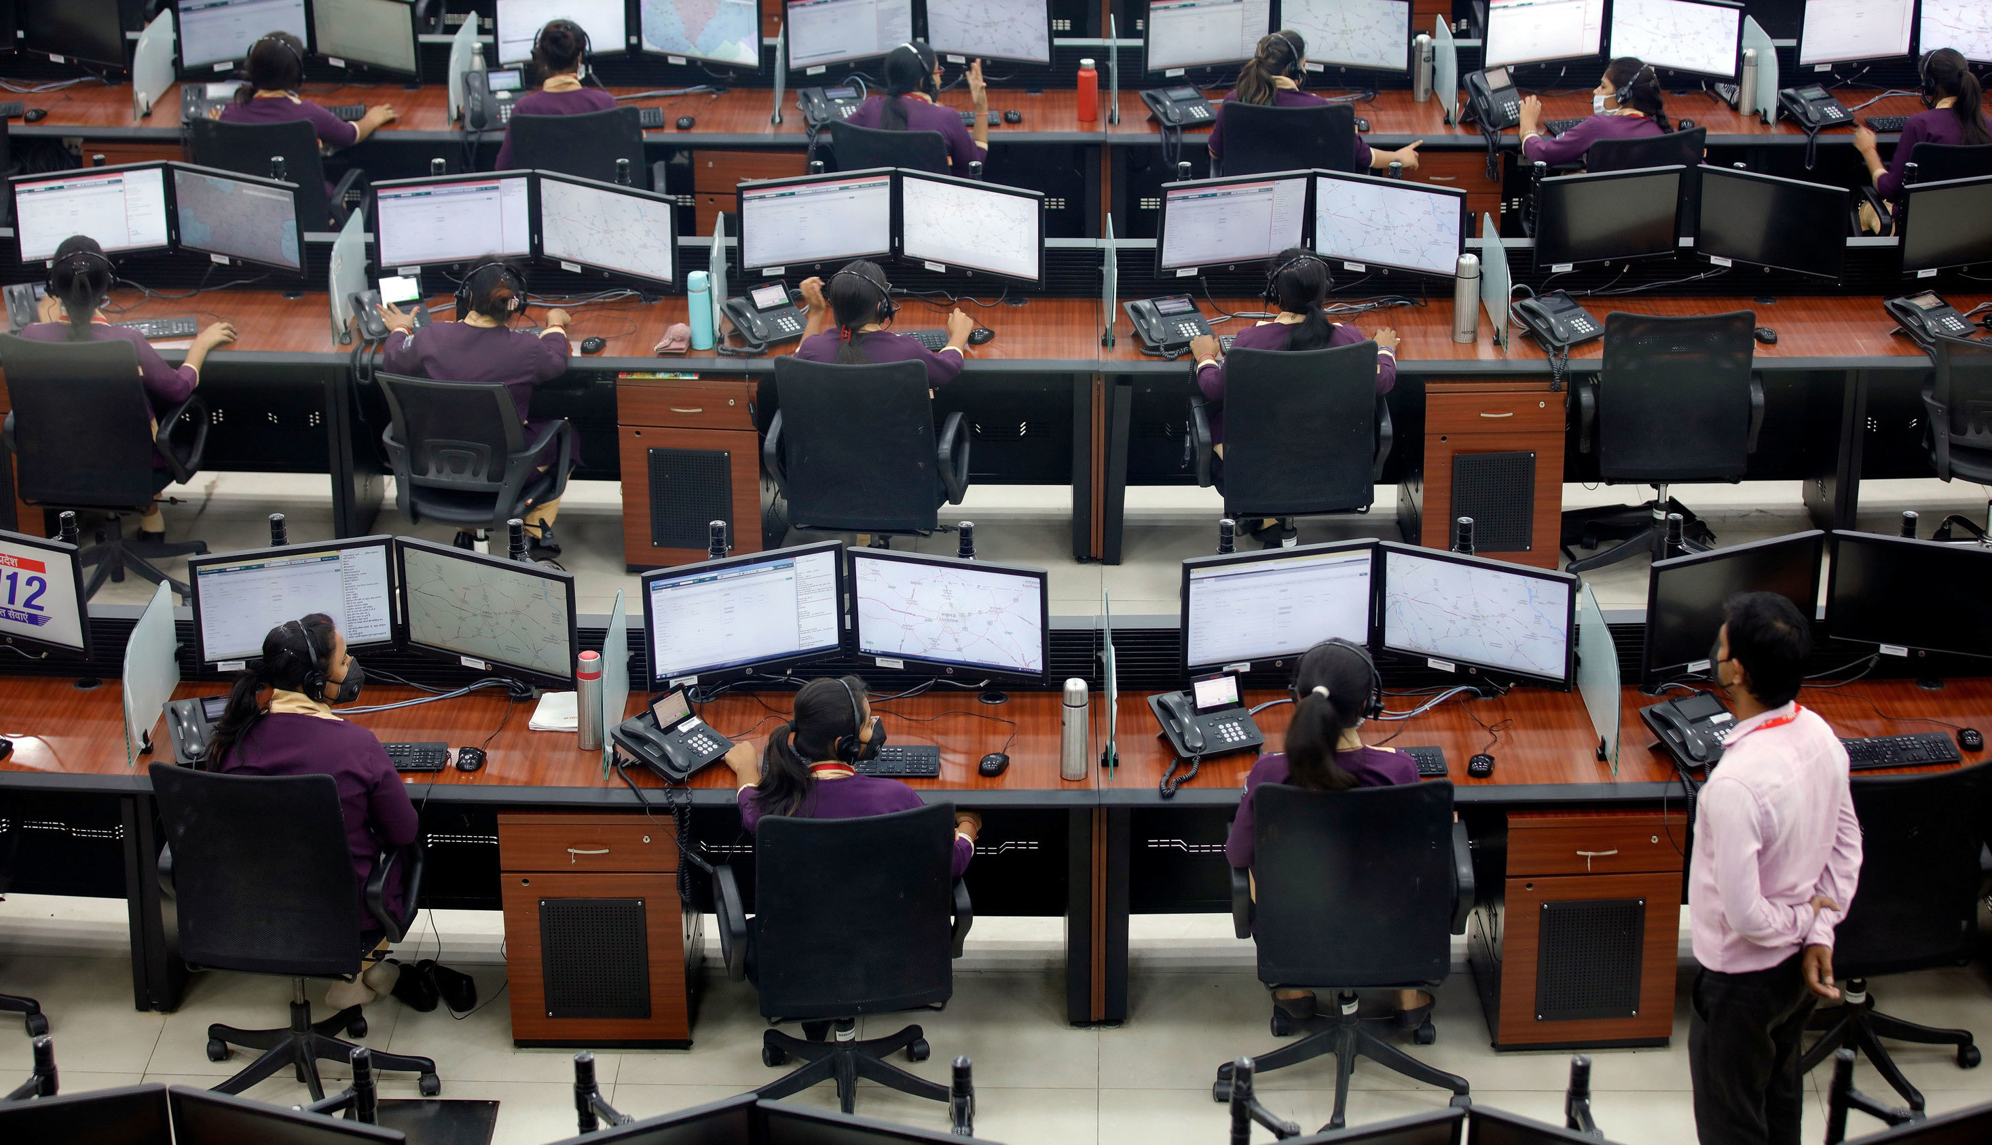
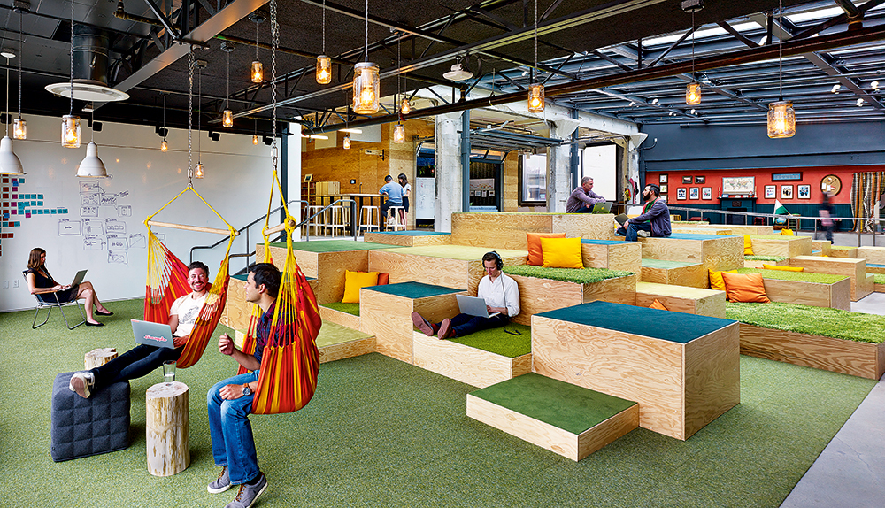
GCworkplace before 2020
What public servants thought we were doing
What leadership thought we were doing
What the public thought we were doing
What we thought we were doing
What we were actually doing
Why we were doing it

Slide 2
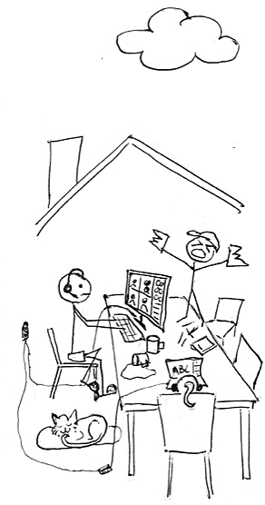
…
…
…
2021
2022
2020

Slide 3
Now
Return to Office Mandate
(Hybrid Work)
50% Portfolio
Reduction
Everyone, everywhere: unassigned.

Slide 4
Workplace Experience
positive workplace experience = happier employees
happier employees = more engaged teams
more engaged teams = increased productivity
increased productivity = better service to Canadians

Slide 5
Workplace Experience
Factors
Prescribed vs Flexible in-office days
Variety and/or choice of work location
Flexibility
Culture
Active and visible sponsors and champions
Culture of trust and support
GCworkplace vs WP2.0 vs
traditional spaces (high panel)
Space
Utilization
Assigned vs unassigned
Activity-based working vs hotelling

Slide 6
Workplace Experience
Considerations
Current
space
Sense of belonging
Onsite
support
Space
booking

Slide 7
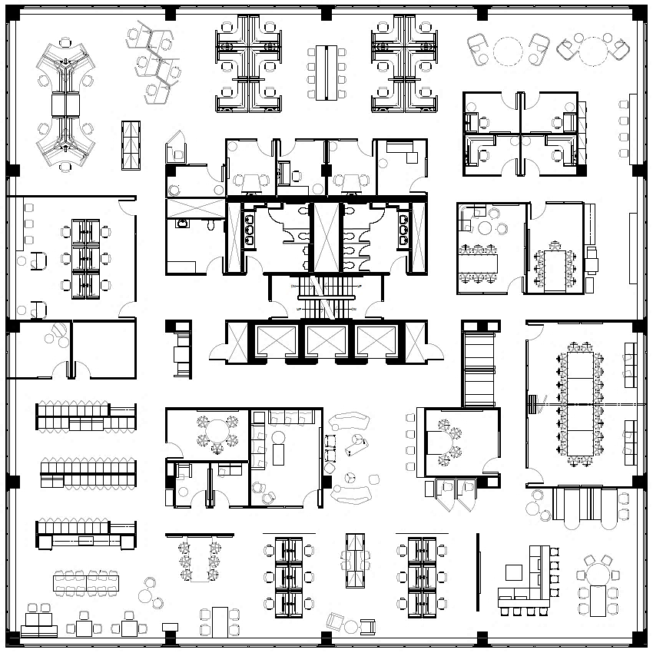
Sense of belonging
Office
TEAM A
Home
TEAM B
GCcoworking
Other
TEAM C

Slide 8
Onsite support
Full Service
Office coordinator/concierge
Self-Service
Integrated instructional signage
&
HOW TO…
1. -----------------
2. ------------
3. -------------
Welcome!

Slide 9
Space booking
WHEN
WHY
>
POPULATION
MAX OCCUPANCY
HOW
vs
Traditional
workplace
employee experience
&
managing occupancy
▼ DESIGNED FOR ▼
Activity-Based Working
1:1 assigned workstations/offices
▼ BOOKING STRATEGY ▼
FULL
General
Admission
Workstation
for the day
Tue, Mar. 7
GENERAL ADMISSION
GENERAL ADMISSION to 5th Floor is Booked
- 47 of 150 remaining -

Slide 10
Now what?

Slide 11
3 BIG
QUESTIONS

Slide 12
DRAFT
WHAT WORKPLACE UTILIZATION CONCEPT IS PSPC PROMOTING GOING FORWARD?
1
ACTIVITY-BASED WORKING
‘general admission’ booking
or
HOTELLING/ ‘HOT DESKING’
‘desk for the day’ booking
RECOMMENDED
As the original utilization concept for GCworkplace, ABW is an inherently accessible, inclusive and ergonomic concept which provides all users with flexibility, variety and choice throughout the day, for various activities. This is not the case with hotelling (same desk all day).
IMPACTS TO AMWS BUSINESS
Efficiency in space utilization which will impact space reduction
GCworkplace Design strategy and tools
Change management tools and services

Slide 13
DRAFT
WHAT PORTFOLIO UTILIZATION STRATEGY IS PSPC PROMOTING GOING FORWARD?
2
CENTRALIZED ‘NEIGHBOURHOODS’
acts as teams’ headquarters
or
ALL SPACES, ALL SHARED
no ‘neighbourhoods’ are pre-defined
RECOMMENDED
While choice and flexibility are great, too much choice in location can lead to losing a sense of belonging, especially for someone’s primary workplace. This in turn reduces the ability to gather teams in a common, central location and dilutes the concept of meaningful time in the office.
IMPACTS TO AMWS BUSINESS
GCcoworking strategy
Space allocation strategy and tools
Portfolio reduction strategy
GCworkplace Design strategy (lockers, etc)
Change management tools and services

Slide 14
DRAFT
WHAT WORKPLACE EXPERIENCE SUPPORT SHOULD PSPC BE PROVIDING TO CLIENTS?
3
INTEGRATED SERVICE
always included when needed
or
OPTIONAL SERVICES
at additional fee when wanted
RECOMMENDED
Because workplace modernization disrupts the WAY we work and use space, support to clients on workplace strategy, workplace experience and/or change management should be included and available when needed rather than optional for a fee when wanted, whether as part of a project or not. This would also help PSPC to deliver on its own mandate.
IMPACTS TO AMWS BUSINESS
Portfolio reduction strategy
Strategic Workplace Advisory tools and services
Change management tools and services

Slide 15
DRAFT
Ratings by Utilization Types
WORKPLACE UTILIZATION | ACTIVITY-BASED |  | HOTELLING / ‘HOT-DESKING’
PORTFOLIO UTILIZATION | Centralized ‘Neighbourhoods’ | All Spaces All Shared | Centralized ‘Neighbourhoods’ | All Spaces All Shared
Promotes meaningful time in office | ● ● ● | ● | ● ● ● | ●
Ability for teams to gather regularly in-person | ● ● ● | ● | ● ● ● | ●
Improves onboarding of new employees | ● ● ● | ● ● | ● ● | ●
Promotes ad-hoc collaboration | ● ● ● | ● ● | ● ● | ●
Accessible and Inclusive | ● ● | ● ● | ● ● | ● ●
Predictability of work location | ● ● | ● | ● ● | ●
+
+
+
+

