Slide 1
Managing Workplace Change
A guide for managing change and supporting team members
Date : February 2023

Slide 2
How to use this document
Instructions – Remove this page before using
OBJECTIVE and FOR WHO: To present managers and supervisors in an organization to help them understand their role in a transition to the optimized workplace. May also be shared as a deck among them.
WHEN: As early as possible, following the presentation to leadership.
HOW: Presented by project sponsor at executive committees, or forums. It is critical that this be presented by an executive, ideally the executive sponsor.
* The French version of this document is available here: FR version

Slide 3
Presentation Objectives
Contextualize your workplace change in the context of the goals of DEPARTMENT X and the Government of Canada
Describe your role as a people manager during a potentially difficult change

Slide 4
The Government of Canada’s Office Space Portfolio
In Budget 2024, the Government of Canada outlined its plan of converting underused federal offices into homes. This plan consists in part of reducing its office space portfolio by 50% over ten years. This optimization of the government’s office portfolio will consist of divesting of underused and vacant space. In addition to being a response to the government’s common hybrid work model, this plan also requires to apply implement unassigned seating in office space by default, which means that
Workstations will be unassigned
Closed offices will be focus rooms or meeting rooms, accessible to all
While every organization and every group is going to be impacted differently by this policy, it is important to recognize that these policies could constitute a major change for our people. It is important to reflect on your role as a leader in your organization in navigating this change.

Slide 5
Unassigned Office Space Seating by Default: The Impact on the Government of Canada’s Office Portfolio
Assigned Utilization
Unassigned Utilization
Divested with potential for converting into homes

Slide 6
Our vision
Insert the project’s vision

Slide 7
What does it mean for our organization
Now
20XX
Address
New address
Number of floors
New number of floors
Unassigned workpoints
Assigned 1:1 workstations
New workplace utilization strategies
Quiet zones
Neighbourhoods
Booking system
Personnal storage

Slide 8
Timeline
Date or month
Date or month
Removal of personnal & business assests
Move or Implementation of optimized workplace and new utilization strategies
Ongoing communications
Date or month
Date or month
Date or month
All-staff Town Hall
Guidance and Familiarization Activities
Post-implementation survey, adjustments and reinforcement

Slide 9
My role as Sponsor of the optimization project
Build the governance around the project and supervise the project team
Oversee the Change management strategy
Show my commitment to this project and lead by example - I will release my assigned office
Communicate the vision, inform and provide updates on the project
Make sure you are well equipped to support your teams

Slide 10
Change management Strategy Blueprint
Insert your CM Strategy Blueprint

Slide 11
Your manager’s Change management toolkit

Slide 12
Why are managers so important during change?
Research indicates people managers has been named a top contributor to change management success. Here is why:
1
2
3
4
Employees Trust you
You are the preferred sender
You build support
You are close to where the change happens
Notes:
Source : CLARC: The Role of People Managers in Change Management (prosci.com)

Slide 13
Your role
People Managers play a critical role in leading and supporting team members through change. Helping employees cope with change means managing fears and anxieties—supporting through uncertainty.
During the Workplace Optimization Project, your role as manager extends beyond your current daily responsibilities as you begin to communicate, mentor, coach and engage employees through our change journey into a successful adoption and sustainment of our new workplace.
As a people manager, you will have 5 have five unique and important roles to play:
Communicator
Advocate
Coach
Share personalized messages with your team members about what is changing and why.
Demonstrate your support for the change to help others get on board.
Teach employees about the change process and any tools and trainings related to change.
Liaison
Resistance Manager
To stay informed on the change as a people manager, ensure you read all project communications and resources, as well as attend all information sessions.
The more information you have, the more you will be able to share.
Provide feedback to the project team and raise any valid concerns from team members.
Note barriers to adoption and manage resistance and rumours as they occur.

Slide 14
The benefits of communicating during a change
Reduces Uncertainty and Anxiety
Clear communication helps reduce uncertainty and anxiety among employees
Builds Trust and Transparency
Transparent communication fosters trust and prevents rumors
Engages and Motivates
Engaged employees are more motivated and have greater job satisfaction

Slide 15
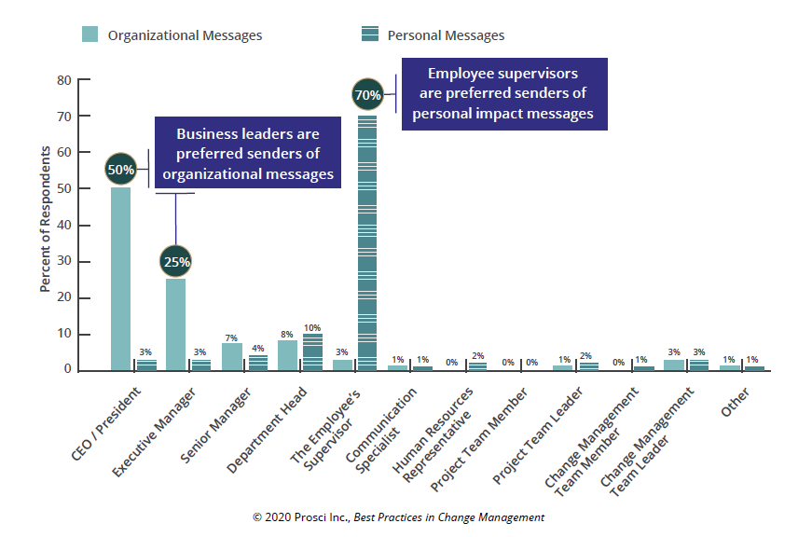
Your Employees Want to Hear About Change From You
Notes:
Why is communication such a vital part of your role in this change? Because employees want to hear from you. For any orgrazational changes that impact an employee personally, they want to hear about that from their manager.

Slide 16
Advocate and lead by example
Actions speak louder than words. Your approach to engaging with the new workplace is the most meaningful communication with your employees.
Once you have determined how you want to engage with the new workplace, ensure you are leading by example. Follow your agreed upon rules for workplace etiquette.
Don’t ignore the change. Confront it directly and take ownership of it to ensure your team can meet its challenges.

Slide 17
Coaching and managing resistance

Slide 18
Considering our Employees Needs – the Change Curve Model
Commitment
Denial
Learning how to work with the change
Performance
Initial shock and disbelief
Exploration
Employee understanding, excitement and questioning
Resistance
Feelings of fear and anger leading to protest
Time
Notes:
The Kubler-Ross Change Curve can help us better understand what our employees might be going through. Our reactions to a difficult change can go through a series of stages: Denial, Frustration, Depression, Experimentation, Experimentation, Decision, Integration.

Slide 19
Practice Compassion and Grace
A compassionate leader genuinely cares for their team and empathizes with their emotions and struggles. They show understanding and support while being optimistic about the future.
A graceful leader handles difficult situations with poise and dignity and can easily adapt to unexpected events.
Reflect on your own difficult passage through the Change Curve (either this change or another) when dealing with your employees and let this be a source of empathy
Notes:
Keep in mind that one-on-one time will need to be spent with your employees, navigating the workplace together.

Slide 20
Supporting Your Employees Through the Change Curve
An employee is in denial
Listen, ask questions and explain the how and why of the change
Emphasize the importance of transition and encourage them to take the time they need
An employee is frustrated or depressed
Gather resources, ask the project team for help
Remain empathetic but be confident in a positive change outcome
An employee is experimenting
Provide training resources and reading material
Hold regular team meetings and invite them to share their excitement with others
An employee is decided or integrated
Create opportunities for discussion and collaboration, invite all employees to events related to the change
Explore ways to improve the transition for others

Slide 21
Supporting Employees
Supporting your team through change can feel like an overwhelming task, especially when the reality of the change is higher than expected. Here are 8 basic tips that can assist you in supporting your team:
Establish trust: create a safe and respectful place to share.
Frequent check-ins: set-up times to discuss the change with individuals both formally and informally, as well as a team.
Transparency: speak to facts and be honest when you don’t know the answer. Support employees through solutioning.
Social Interaction: combat anxieties and fears with engaging activities between team members.
Rules of engagement: use the correct tools and platforms when communicating and engaging.
Empathy: understand the needs of others and be in tune with diversity and inclusivity challenges.
Be Intentional: make good use of time, be clear and leverage all resources.
Recognition and praise: celebrate small wins for all employees, regardless of their rate of adoption.
The Building Blocks
Establish Trust
Transparency
Frequent Check-ins
Social Interaction
Rules of Engagement
Empathy
Recognition and Praise
Being Intentional

Slide 22
Equiping Yourself to Succeed
Attend all project specific engagement activities
Review all project specific communications, tools and training materials
Understand the provided schedule and upcoming milestones impacting your team
Attend and leverage existing management network meetings
Attend
Review
You
Know where all resources are housed such as a MS Teams Channel, website, or newsletter
Participate and share in any information gathering activities
Plan
Anticipate
Establish team member touchpoints
Get to know your integrated project team and enabling sector reps
Establish a reoccurring team meeting
Anticipate team-specific questions and be prepared to ask the project team
Anticipate your questions and get answers prior to engaging your team
Keep your team charters up to date
Notes:
In order to properly support your employees, ensure you are actively engaging with the change process. Review project communications, anticipate problems, plan for success, and attend events and information sessions where possible.

Slide 23
Next Steps
Engage with the change process and keep up to date on news and information regarding the workplace change
Embrace your roles as a manager during this workplace change
Consider pursuing the following topics through your learning plan. Multiple courses are available at the Canada School of Public service on these topics:
Emotional intelligence
Change management

