Slide 1
Gateways to employment after graduation
A presentation by the Indigenous Centre of Expertise for the Indigenous Student Employment Opportunity
August 2025
Notes:
✅ Slide 1: Title Slide – Gateways to Employment After Graduation
Speaking Note:
"Welcome everyone, and thank you for joining us today! This session is brought to you by the Indigenous Centre of Expertise as part of the Indigenous Student Employment Opportunity. We’re here to explore some of the key pathways into employment with the federal public service once your studies come to an end."

Slide 2
Session overview
Options to find employment in the federal government
Where to find employment opportunities
GC Jobs Applications
How to shine in an Assessment
Notes:
✅ Slide 2: Session Overview
Speaking Note:
"Today, we’ll walk through practical tools and strategies to help you transition from your student role to a more permanent position in the public service. We’ll cover bridging, job search strategies, the application process, and tips for assessments and interviews. Let’s get started!"

Slide 3
Approaches to getting hired
Seek out a “bridging” opportunity
Apply to specific job opportunities on GC Jobs
Network for more opportunities!
Notes:
✅ Slide 3 & 4 : Approaches to Getting Hired – Bridging
Speaking Note:
"Let’s begin with bridging. The bridging mechanism allows students to transition into federal jobs after graduation, often without going through a full external competition. If you're eligible, this can be a fantastic opportunity to secure a temporary or permanent role. The Indigenous Career Pathways program is here to help you connect with hiring managers—so be sure to add your profile if you’re graduating soon!"

Slide 4
Bridging
The bridging mechanism facilitates the hiring of students into positions in the federal public service after the completion of their educational program.
If you are hired as a student, you could be bridged into a temporary or permanent position!
The Indigenous Career Pathways is your gateway to market your bridging eligibility to hiring managers across the Government. If you are graduating soon, consider adding your profile to the list!
Notes:
✅ Slide 3 & 4 : Approaches to Getting Hired – Bridging
Speaking Note:
"Let’s begin with bridging. The bridging mechanism allows students to transition into federal jobs after graduation, often without going through a full external competition. If you're eligible, this can be a fantastic opportunity to secure a temporary or permanent role. The Indigenous Career Pathways program is here to help you connect with hiring managers—so be sure to add your profile if you’re graduating soon!"

Slide 5



Where to find employment opportunities
Follow the GC Jobs social media channels for job postings, updates and alerts:
  Facebook Instagram X (anciennement Twitter)
Become a member of the Facebook groups:
  GC Jobs for Students and Newly Graduated Students
  GOC Informal Retention of Indigenous Employees
Be flexible in your job search, apply to all areas of work that interest you.
Notes:
✅ Slide 5: Where to Find Employment Opportunities
Speaking Note:
"Be proactive in your job search. Follow GC Jobs on social media for alerts and updates, and don’t underestimate the value of informal networks like the Facebook groups listed here. Stay open-minded — sometimes the best opportunities come from places you hadn’t considered."

Slide 6
GC Jobs – How do I apply?
Go to GC Jobs
1
Click on “How to apply”
2
Register for job alerts
3
Notes:
✅ Slide 6 -7 GC Jobs – How to Apply & Access GC Jobs
Speaking Note:
"Visit Canada.ca/GCJobs and create an account to start your job search. You can also register to received the job alerts. You will then receive emails notifications that alert you to new job postings matching your specified criteria. These alerts are a free service that helps job seekers stay informed about relevant opportunities within the federal government. Use filters like job type and location to narrow your search. The earlier you get familiar with the platform, the more comfortable you’ll be when you see a posting you’re excited about."

Slide 7
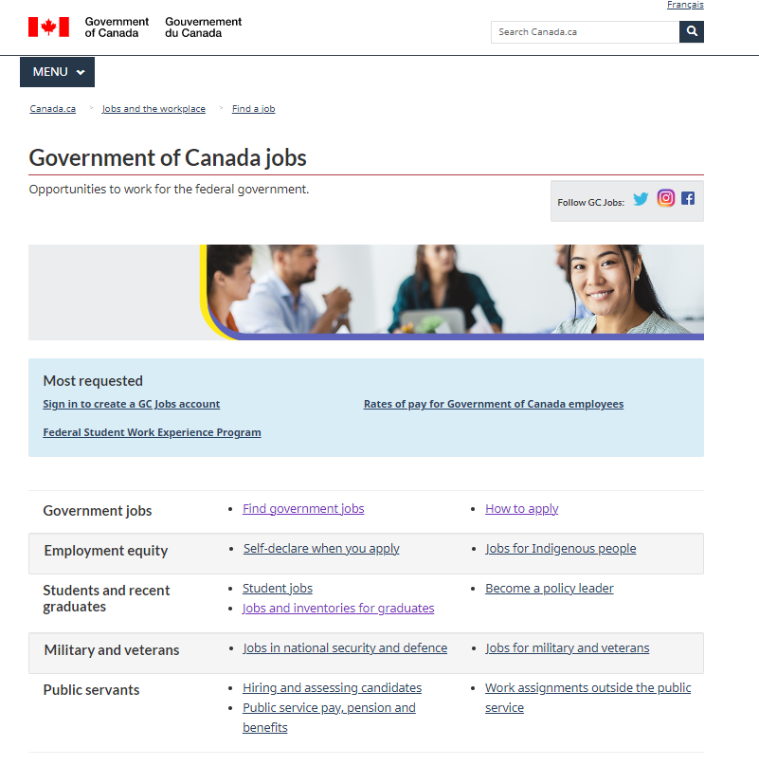
Access GC Jobs
Visit Canada.ca/GCJobs
Create an account
Search for specific job opportunities
Notes:
✅ Slide 6 -7 GC Jobs – How to Apply & Access GC Jobs
Speaking Note:
"Visit Canada.ca/GCJobs and create an account to start your job search. You can also register to received the job alerts. You will then receive emails notifications that alert you to new job postings matching your specified criteria. These alerts are a free service that helps job seekers stay informed about relevant opportunities within the federal government. Use filters like job type and location to narrow your search. The earlier you get familiar with the platform, the more comfortable you’ll be when you see a posting you’re excited about."
The GCJobs site provides you with all the access to the different employment opportunities within the Core Federal Public Service.
Certain government organizations do not have to post their job opportunities on the GC Jobs website. Some do, but many don’t. You may want to visit these organizations’ websites
GC Connex and GC Collab is accessible to employees (and students, casuals) for temporary opportunities or lateral movement.
Make contacts, network through events and associations, or groups on the various GC platforms (Gcconnex, GCCollab)
You can also apply for specific job opportunities through the GC Jobs portal. Although you don’t need to create an account to search, you can search any time you want, you do need to create an account to apply. So you may benefit from creating one before you start searching. That way you can apply as soon as you find an interesting opportunity.

Slide 8
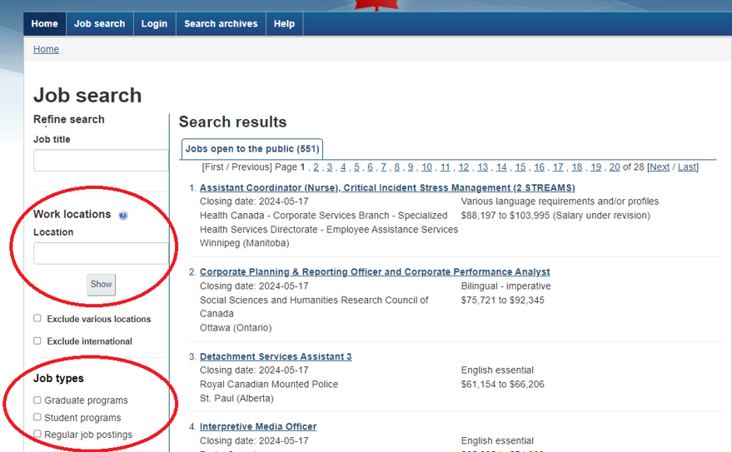
Job search
Use filters such as work locations or job types to refine your search
Notes:
✅ Slide 8: GC Jobs – Job search
Speaking Note:
Here you see all the jobs available to the public across the country.
Use filters like job type and location to narrow your search. The earlier you get familiar with the platform, the more comfortable you’ll be when you see a posting you’re excited about."
Each job offer has different eligibility criteria, be sure to consult the “Who can apply" section.
Here you see all the jobs available to the public across the country.
You can now browse for job ads and use filters to refine your search.
To do so, you can filter by location (1) or by job type (2).
Each job offer has different eligibility criteria, be sure to consult the “Who can apply" section.

Slide 9
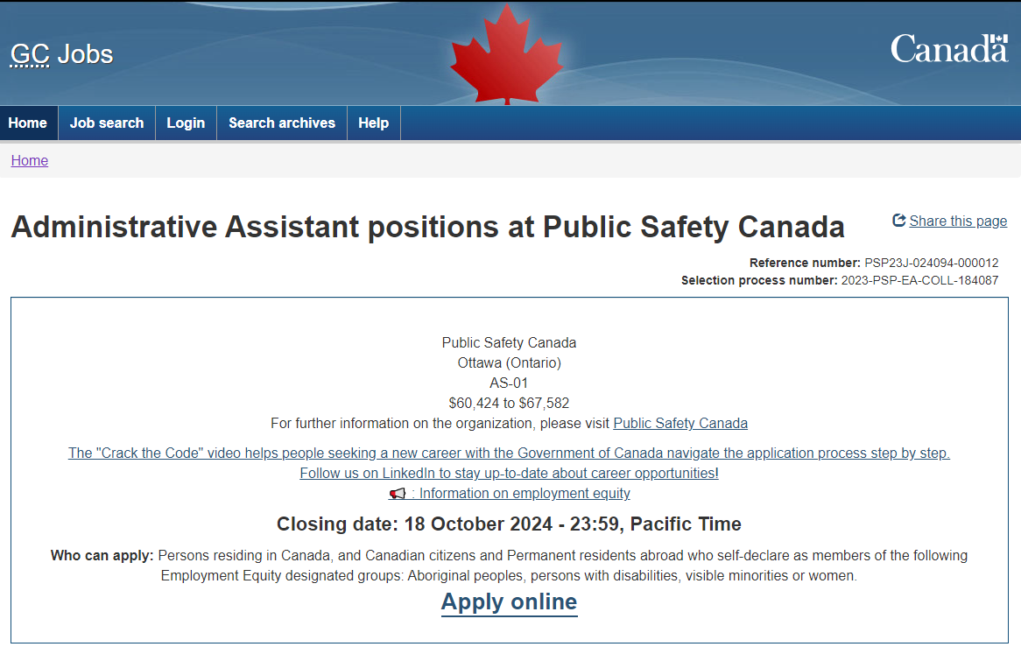
Understanding job posters
Notes:
✅ Slide 9: GC Jobs – Understanding Job posters
Speaking Note:
Reading a job poster can be overwhelming at first, but understanding the information and the terminology— will give you an edge. It’s worth taking time to read carefully.
By clicking on the job advertisement, you will have information related to :
The hiring organization
The location of the position
The occupational group of the position
The salary of the position
The closing date : It is very important to apply before that date
And who can apply : It can be internal to the public service or open to the public. It may also be restricted to one or more departments or to a geographic area. If you are not sure, you can ask for more information by emailing the contact listed at the bottom of the page.

Slide 10

Job poster terminology
Tenure
Intent of the process
Essential for the job
May be needed for the job (assets)
English essential or Bilingual imperative (for example: BBB/BBB)
How to read a job advertisement
Notes:
✅ Slide 10: GC Jobs – Job poster terminology
Speaking Note:
Tenure: means the period of employment. For example, specified period with specific starting and ending dates or indeterminate where there is no defined end date, acting, etc.
Intent of the selection process: means the objective of the hiring initiative. For example, to create a pool of qualified candidates.
Essential for the job: the minimum qualifications or criteria that are necessary for the position
May be needed: the qualifications or criteria that may be required for the position
Bilingual imperative: means that the language requirements of the position must be met at the time of appointment

Slide 11
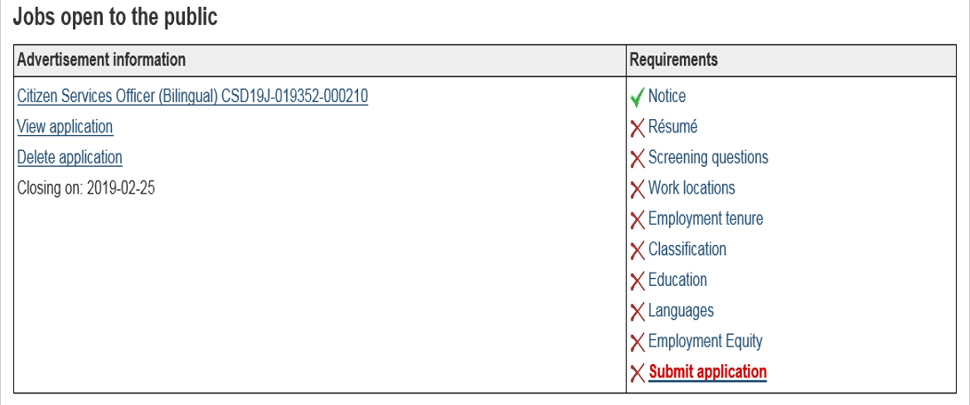
Completing a job application
Applying for Government of Canada jobs: What to expect
Notes:
✅ Slide 11: Completing a Job Application
Speaking Note:
Once you click on Apply Now, you will be redirected to this screen which will allow you to ensure that you have completed all the sections. In most cases, you won’t need a covering letter to submit your application. Instead, you will be asked to fill screening questions that will help employers narrow-down on the right candidate. Once you’ve completed the information for a requirement, a green check mark will appear to indicate that the section is complete.

Slide 12


Your resume
Provide enough detailed information so that hiring managers can determine if you meet the requirements of the job.
Helpful resources for resume building:
  Action Verbs
  Highlight Your Achievements
  School to Work Transition Tool
  Resume Builder
Make sure you include:
  Name and contact information
  Highlights of qualifications / Skills summary
  Education
  Work Experience
  Certifications
  Awards, scholarships received
  Volunteer experience
Notes:
✅ Slide 12: Your resume
Speaking Note:
"Your résumé should give hiring managers a clear, detailed view of your qualifications. Use action verbs, highlight achievements, and don’t forget to include volunteer work and awards — all of it counts!“ Use past tense and action verbs. Give clear examples Highlights of qualifications (e.g. X years of experience, computer skills, languages spoken, linguistic profile)

Slide 13
Writing a strong bio or cover letter introduction
A good bio or cover letter intro should:
  Highlight who you are (background, field of study, interests)
  Share what drives you (values, passions, career goals)
  Demonstrate your value (what you bring to a team or organization)
Structure (3 - 5 sentences):
  Who you are – “I’m a recent graduate from [program/school] with a strong interest in…”
  What motivates you – “I’m passionate about… and committed to …”
  What you offer – “Through [experience], I’ve developed skills in… and I’m excited to contribute…”
Optional: Mention your employment equity group if you feel comfortable (e.g., “As an Indigenous graduate, I value opportunities that contribute to reconciliation and representation.”)
A good resource to get you started: How to Write Your Professional Bio
Notes:
✅ Slide 13: Writing a Strong Bio or Cover Letter Introduction
Speaking Note:
"A well-crafted bio or cover letter tells your story in a meaningful way. Who you are, what motivates you, and how you can contribute — that’s what hiring managers want to see. Use your own words to keep it authentic."

Slide 14
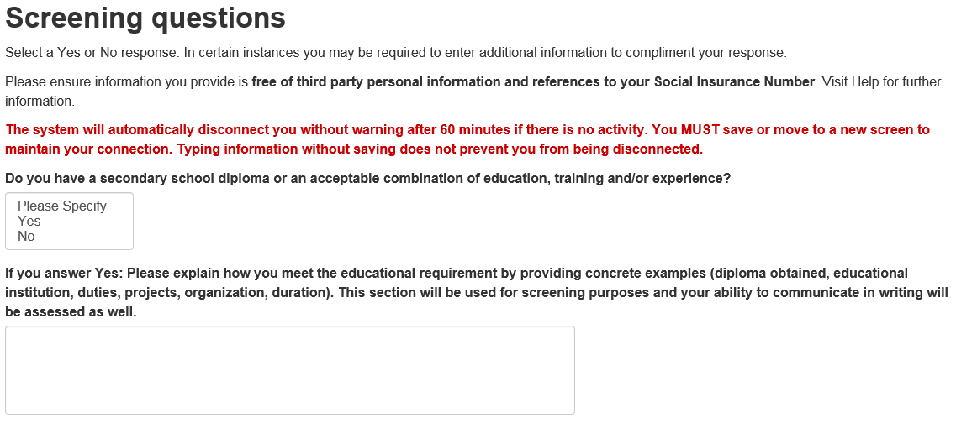
Answering screening questions
Notes:
✅ Slides 14 – 15: Answering Screening Questions
Speaking Note:
"Screening questions are critical. Read them carefully and respond with specifics — avoid generic answers or just writing 'see résumé.' This is your chance to clearly demonstrate how you meet the job requirements."
- To increase the likelihood of being selected, use specific and concrete examples of your work experience.
- Make sure to specify when and where you acquired the experience. It is also important to focus on what you accomplished, and the results you obtained.

Slide 15
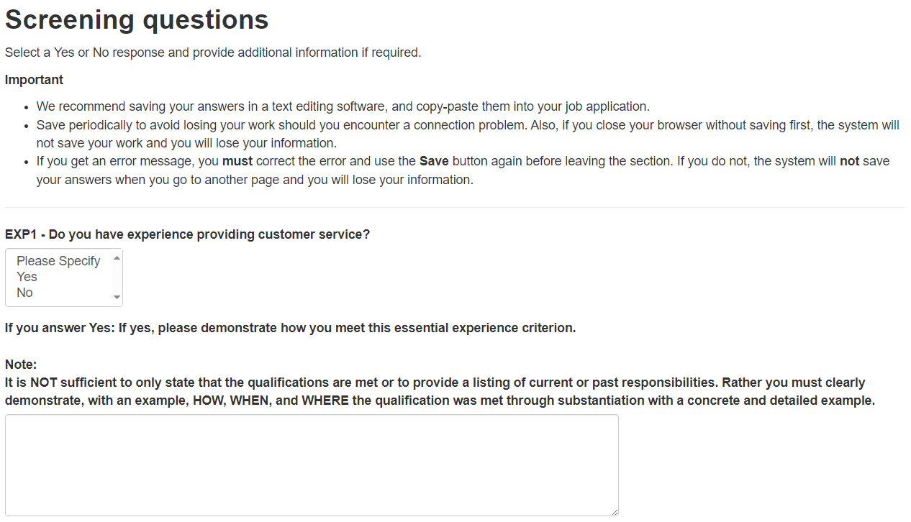
Answering screening questions (2)
Notes:
✅ Slides 14 – 15: Answering Screening Questions
Speaking Note:
"Screening questions are critical. Read them carefully and respond with specifics — avoid generic answers or just writing 'see résumé.' This is your chance to clearly demonstrate how you meet the job requirements."
- To increase the likelihood of being selected, use specific and concrete examples of your work experience.
- Make sure to specify when and where you acquired the experience. It is also important to focus on what you accomplished, and the results you obtained.

Slide 16
Submitting a job application
Read carefully and…
  Follow the instructions on the advertisement
  Apply before the deadline
  Submit only what is required
  Ensure that the information in your cover letter matches your resume
  Be clear and precise
  Remember that accommodations are there to help you
Key words are not enough! Nor to write “See résumé”.
Notes:
✅ Slide 16: Submitting a Job Application
Speaking Note:
"Follow instructions closely, submit everything on time, and only what is required. Accuracy and attention to detail really matter in this step."
Read the entire job advertisement including the notes. Be sure your application is in before the deadline! Don’t wait until the last minute to start the application process – certain jobs will ask you to answer specific questions with concrete examples as part of the application process - allow yourself sufficient time to address all the questions.
Key words are not enough. You must provide specific examples in your application to demonstrate how you meet the essential qualifications listed
Use specific and concrete examples of your work experience.
Dates and where the experience was acquired are also important. E.g.: “In my role of __ at Employer X, I wrote reports related to the _ system. For example, in January 2012, I wrote a report on the benefits of improving the system. In order to do this, I had to conduct research through several academic journal studies in order to determine that...”
Focus on what YOU did, and what results YOU accomplished.
Submit only what was asked (e.g. sometimes a cover letter is not required)
Ensure information on your cover letter and resume match
Be succinct but it is okay to go over the industry standard of a two-page resume and one-page cover letter

Slide 17

Official languages
You can use French or English at any stage in the hiring process wherever you are in Canada.
In the Public Service of Canada, all positions are identified as either unilingual or bilingual.
Unilingual positions are specified as either "English essential", "French essential", or "English or French essential".
Bilingual positions require the use of both English and French.
For bilingual positions, there are three second language skills: reading, writing and oral interaction.
Bilingual Positions in the Public Service: FAQs
Notes:
✅ Slide 17: Official Languages
Speaking Note:
"You can apply and be assessed in the official language of your choice at any time during the selection process (assessments can be done through an exam, an interview).
— English or French — anywhere in Canada. For bilingual positions, remember that reading, writing, and oral skills are assessed separately."
Your job interview, any tests you are required to pass, any email exchanges or phone conversations with human resources or the hiring manager, can be done in either French or English.
The exception, of course, is the Second Language Evaluation (SLE) exams!
Second language evaluation in the public service - Canada.ca

Slide 18
Self-declaring
When you apply to any Government of Canada job, you’ll be asked to fill out a self-declaration form to identify yourself as a member of an employment equity group.
What’s to know about self-declaring:
  it is voluntary
  it is highly encouraged
  it is a way to fully demonstrate your skills and abilities
  it helps increase the representation in the federal public service
You can self-declare if you identify as:
  Women
  Indigenous (Aboriginal) peoples (First Nations, Inuk or Métis)
  Person with a disability
  Member of a visible minority
Some jobs are only open to Indigenous candidates, so self-declaring ensures that you will be considered for these opportunities.
Notes:
✅ Slides 18: Self-Declaring
Speaking Note:
"Self-declaring as part of an employment equity group is voluntary, but highly encouraged. It allows your application to be considered for Indigenous-only job opportunities, and helps increase representation across the public service."

Slide 19



You have applied … now what?
1. Your application is included (if you’ve answered ‘yes’ to screening questions) and will be retained for more in-depth assessment by the hiring organization.
2. The hiring organization screens and assesses candidates and you may be contacted for a test or interview.
3. A job offer is made to the successful candidate.
Notes:
✅ Slide 19: You Have Applied… Now What?
Speaking Note:
"Once your application is submitted, it goes through a screening process. If you’re successful, you may be invited for a test or interview, and then the hiring decision is made."
What to expect after you apply
Your application will be placed in the student inventory you applied to
When there are job openings, managers will use the inventory to fill their positions
You’ll be notified by email if you’re matched with a job opportunity, or if your application status changes
If your application is selected for further consideration, you’ll be contacted by a manager for next steps, such as a test or interview.
*Please keep your job profile up to date to ensure accuracy. As a student, things change all the time. For example, some programs that students work on are higher level for managers would like someone in 3rd or 4th year.

Slide 20





Assessment accommodations
Assessment accommodations remove obstacles from the selection process so that you can demonstrate your abilities to your fullest capacity.
If you are contacted for a test or interview and require adjustments to the way you are assessed, you should inform the hiring organization of your needs.
Notes:
✅ Slide 20: Assessment Accommodations
Speaking Note:
"If you need accommodations at any stage of the assessment process, don’t hesitate to ask. The goal is to ensure everyone can participate fairly."
As an applicant, you can request accommodation, if you have a temporary or permanent limitation (visible or invisible) that may impact your performance during an assessment, such as an exam or interview. Accommodations are available to those who need them from the time you apply to being on the job.
Accommodation is a modification or a change made to an procedure, format or content. They do not alter the qualification being assessed nor the proficiency level required but rather the way a qualification is being assessed or the setting (for ex. in a closed room rather than a common room). It is designed to remove barriers to a fair assessment and allow candidates to fully demonstrate their abilities.
Settings: To alter the setting of the assessment. For example, changing the test location if it is not wheelchair-accessible, providing a table and a chair that provide greater physical support, or altering the lighting conditions in the assessment room.
Response format: To allow individuals with disabilities to give responses using their preferred communication modality. For example, having the respondent use a tape recorder, a computer, a Braillewriter, or its own adaptive equipment to answer questions.
Scheduling and Timing: Another accommodation strategy is to alter the timing of the assessment such as extended time to complete a test or an interview and/or more breaks during a longer assessment period. It may also include scheduling an assessment session at the most appropriate time of day for a person.
Presentation Format: To alter the medium used to present the instructions or questions to the person. For example, a test booklet may be produced in Braille, large print or audio format. A reader could also be appropriate for persons who are blind. Another example would be to provide instructions through the use of sign language or in writing.
It is not limited to disabilities – accommodations can also be for:
Religious reasons
Personal needs – e.g. I know a colleague took a test while pregnant and she asked to be able to have food in the room.

Slide 21

How to shine in an assessment
Demonstrating self-awareness
Building a library of experiences
Overcoming barriers
Notes:
✅ Slide 21: How to Shine in an Assessment
Speaking Note:
"Confidence comes from preparation. Practice describing your accomplishments and linking them to the job competencies — in your own words. That personal connection makes your responses stand out."

Slide 22
Demonstrating Self-Awareness
Reflect on what you perceive to be your strengths and areas you’d like to develop
Think of situations that challenged you. What did you do about it? What did you learn about yourself? What would you do differently as a result?
Don’t simply repeat competencies, tell a story
Notes:
✅ Slide 22: Demonstrating Self-Awareness
Speaking Note:
"Let’s pause here for a quick moment to reflect. If you’ve already started exploring jobs or thinking about next steps, what part of the process feels the most uncertain or confusing to you? Take a second to jot it down — this might help you identify what to focus on as you move forward."

Slide 23
What are competencies?
Communication: speaking, listening, writing.
Interpersonal: consensus building, networking, negotiating, being a team player.
Thinking: strategic, analytical, creative.
Organizational: planning work, organizing resources, getting the job done, measuring progress, dealing with crises, taking calculated risks.
Leadership: Key Leadership Competencies (e.g., create vision and strategy)
Client service: service orientation, building partnerships, managing expectations, committing to quality.
Business: finance, decision-making, accountability.
Technical: working with computer technology, using equipment, working with data, demonstrating professional expertise.
Notes:
✅ Slide 23: What Are Competencies?
Speaking Note:
"Competencies are skills, behaviours, and attributes that help you succeed in the job. Think of past experiences where you demonstrated initiative, teamwork, creativity — all of these can showcase your readiness."

Slide 24

Building a library of experiences
Think of a significant life moment, such as when you
  Resolved a significant ethical dilemma
  Used creativity and innovation to move an initiative forward
  Acted in partnership or led a team to success
Write a vignette on the chosen significant moment
  What was the situation? Who were the major players involved?
  What did you do to resolve each issue? How and why did you do it this way?
  What was the result? What did you learn? What would you do differently?
Notes:
✅ Slide 24: Building a library of experiences
Speaking Note:
"As you prepare for the job application and interview process, one of the best things you can do is start building your 'library of experience.' This means collecting and reflecting on key moments from your life — especially those where you showed leadership, problem-solving, or adaptability.

Slide 25
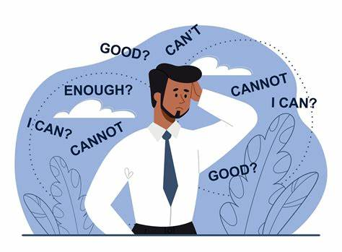
Overcoming barriers
The best way to improve your comfort and reduce self-doubt in assessments is to be well-prepared and to practice!
To build your confidence, practice communicating your accomplishments and link them to the competencies assessed, in your own words, to make them authentic.
Before the assessment, reflect on your library of experiences and how it relates to the job you want.
Notes:
✅ Slide 25: Overcoming barriers
Speaking Note:
Practice and preparation are key to building confidence and reducing self-doubt in assessments. Reflect on your experiences, link your accomplishments to the competencies, and articulate them authentically to ensure you're well-prepared.

Slide 26
How to structure your responses
DO | DON’T
For each situation, explain the context, what you did, who was involved, and what was the outcome | Describe at length the context, situation, project, or issue
Use the STAR method (Situation, Task, Action, Result) | Give overly technical or detailed factors which may not reflect the targeted job or competency
Explain what you learned and would’ve done differently | Be overly general or theoretical
Notes:
✅ Slide 26: How to structure your responses
Speaking Note:
When sharing experiences, DO use the STAR method to clearly explain the situation, your task, the actions you took, and the positive results, ensuring you also highlight what you learned. DON'T get bogged down in excessive context or technical details and avoid being too general or theoretical; focus on specific, relevant contributions.

Slide 27
Example: “Tell me about a time you resolved a conflict.”
S – Situation
During a summer student placement at a federal department, I was part of a small team working on a research report for senior management. One of my colleagues and I disagreed strongly on the direction the final recommendations should take, and the disagreement was starting to delay our progress.
T – Task
As the report’s deadline was approaching, I knew I had to help resolve the situation quickly. My task was to ensure we stayed on track while maintaining a respectful and collaborative working relationship with my colleague.
A – Action
I initiated a one-on-one conversation with my colleague, away from the team setting, to better understand their perspective. I listened actively, validated their concerns, and then calmly shared my viewpoint. I proposed that we map out both of our approaches and evaluate them against the report’s objectives. We also asked our supervisor for feedback on which approach better aligned with the department’s goals.
R – Result
Through open communication and compromise, we combined aspects of both our ideas. Our final report was well received by management, and my colleague and I developed a stronger working relationship. I learned that addressing conflict directly, with empathy and openness, can lead to better outcomes and stronger teamwork.
Notes:
✅ Slide 27 : Structuring Your Responses – STAR Method
Speaking Note:
"Use the STAR method — Situation, Task, Action, Result — to structure your answers. It keeps your response clear and focused. We’ve included a sample to guide you."
Example of an ineffective response
I was in-charge of communications for a student group. The group was realigning its vision to reflect some changes. I am part of the working group tasked to help conduct consultations. We typically work within tight deadlines.
We drafted a communications piece and suggested innovative ways to present the new vision. Decision-makers usually endorses our initiatives as it did this time. In this way, we contributed expertise and insight to the development of organizational strategies.
Example of an effective response
Context: This occurred September to November 2022. I was in- charge of communications for a student volunteer interest group. The group was renewing its vision statement and guiding principles to reflect societal changes.
Complexity: I participated in a working group tasked to devise a strategy for consultations. The group consisted of representatives from different academic disciplines from various socio-economic backgrounds and with different, sometimes conflicting interests (explain). The timelines were tight.
Difficulty: Since I was doing this for the first time, I was excited, yet anxious about:
the process and result
dealing with unfamiliar colleagues and academic officials (i.e., senior management)
the discussion of (organizational) changes that could affect me personally
What I did (extent and depth):
Immediately, I conducted research on the societal changes prompting this new vision. After seeking ideas from the working group, I drafted a concise presentation for academic officials on our guiding principles and how they align with the organization, to promote engagement and buy-in.
The presentation included:
A rationale for the changes, the process to implement them, and the opportunities they present.
A definition of an “organizational vision” and how best to express the vision.
The results from consultations = reflections on the vision statements and any perceived challenges and how to overcome them.
I also suggested applying a voice-over or converting the content into a video to enhance accessibility and engagement.
The outcome
Academic officials (senior management) endorsed the presentation and different methods of delivery. They supplied the resources to publish the information on the website within three weeks. Many students provided their opinions and gave useful feedback.
What I learned: I could succeed in an unknown area; In reaching out to unfamiliar colleagues, I developed relationships that could help me in the future
What I could have done differently: In my communications, make a clearer link to how our new priorities would improve outcomes for the student experience. Instead of being anxious, trust that we can deal effectively with change.

Slide 28
Sample interview questions
How do you handle pressure or stress?
  Tip: Know the tools you use to stay calm
  Answer: Tell a story of an especially stressful situation where you managed to stay level-headed
Tell me about a time you worked with someone who had a very different style than yours?
  Tip: Demonstrate that you're collaborative
  Answer: Use an example when you delivered a solid output together
Describe a time you received harsh feedback.
  Tip: Show that you have the humility and self-awareness to hear criticism, learn from it, and put it into action
  Answer: Describe a time when you acted on the feedback quickly
Notes:
✅ Slide 28: Sample Interview Questions
Speaking Note:
"Interviews may include questions about how you handle stress, work with others, or respond to feedback. Prepare real-life examples that show your growth and strengths — and don’t be afraid to be honest."

Slide 29

Network!
Be proud and talk about your talent and experience any chance you get
Reach out to anyone you have met and ask if you can send your resume for possible opportunities or referrals
Become a member of the Informal Facebook group GOC Informal Retention of Indigenous Employees. Many opportunities are posted here and it’s a great place to network.
Make sure you contact the Indigenous Centre of Expertise so we can add you to the ICP.
Stand out! Speak to leaders; participate in events; ask questions; and conduct yourself professionally.
Notes:
✅ Slide 29: Network!
Speaking Note:
"Your network is powerful. Stay in touch with people you meet during your placement. Talk about your goals and ask about opportunities. The Indigenous Centre of Expertise and Facebook groups are great places to stay connected."

Slide 30
Resources for development
Learning French or English:
  Mauril App | Learn French and English for free
  Resources of the Language Portal of Canada
  Language maintenance tools – CSPS
Interviewing skills
  Career Development for Canadian Public Servants (apolitical.co)
  How to master interview skills in the Canadian public service
  How to ace an interview in the Canadian public service
  Applying to Government of Canada Jobs
  Alex's Tips on How to Apply to a GC Job
Notes:
✅ Slide 30: Resources for Development
Speaking Note:
"Take advantage of resources like the Mauril app to learn official languages, practice interviews, and explore career development tools. There are many ways to keep growing — even after your placement ends."

Slide 31

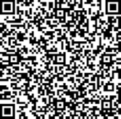
Your feedback is important!
Thank you for participating in our activity!
Please take a few minutes to answer out short questionnaire
Notes:
✅ Slide 31: Your feedback is important!
Speaking Note:
"Thank you so much for being here today! Before you go, please take 5 minutes to fill out our anonymous survey — your feedback helps us improve and shape future events."

Slide 32
End of the presentation
Ekosani / Hei Hei / Kukwstsétsemc / Mahseecho / Marci Cho / Meegwetch / Miigwech / Mutna / ᓇᑯᕐᒦᒃ (Nakurmik) / Niá:wen / Quanaqqutit / Qujanaq / Qujannamiik / ᖁᐊᓇᖅᑯᑎᑦ /
Wela'lin / Woliwon
Any questions?
Contact the Indigenous Centre of Expertise: cfp.cea-icoe.psc@cfp-psc.gc.ca or staffing expert Natasha Agnew at NATASHA.AGNEW@HRSDC-RHDCC.GC.CA

