Slide 1
COVID-19 Task Success Survey Theme Management Committee
Treasury Board of Canada Secretariat
Digital Transformation Office - Canada.ca
July 20, 2020

Slide 2
Task success survey for COVID-19 content
Visitors tell us what they came to do and if they could (task success)
Builds off Top task study run with Gerry McGovern in June (identifying tasks)
Phase 1: Survey design assessment - June 25 to June 29, ~8,000 participants
Phase 2: Interim - ongoing from June 30, ~7,500 participants to date - CURRENT
Phase 3: Refined survey - continually run from end of phase 2
In each phase we’re collecting crucial metrics:
Task (selected or write-in)
Task success
Comments
Notes:
We are not asking for personal information in the feedback. In the event that we receive unsolicited personal information, here is what we have been advised to do by:
Privacy Management Division, Health Canada
National Security Management Division, Health Canada
IT Security, Health Canada

Slide 3
Phase 1: Survey assessment - analysis ongoing
We tested 4 variations to validate these hypotheses:
H: Asking about satisfaction will have no effect on reported task success or ease.
H: Reported satisfaction is the same whether asked first or after reporting task
H: Survey completion rates will be higher if the first question is about satisfaction rather than about their task.
H: Asking about task completion on a scale with ease will be equivalent to asking task success separately.
H: Reported satisfaction will be correlated with reported ease and task completion.
H: Fewer questions in a survey will results in a higher number of quality write-in comments
Notes:
We are not asking for personal information in the feedback. In the event that we receive unsolicited personal information, here is what we have been advised to do by:
Privacy Management Division, Health Canada
National Security Management Division, Health Canada
IT Security, Health Canada

Slide 4
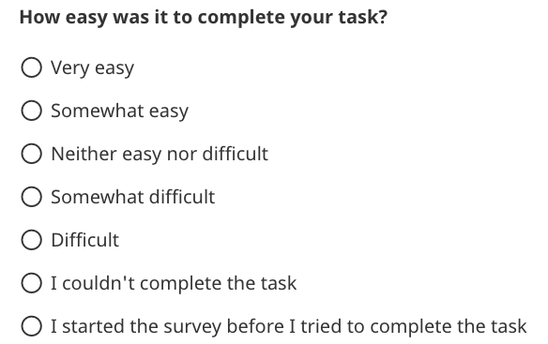
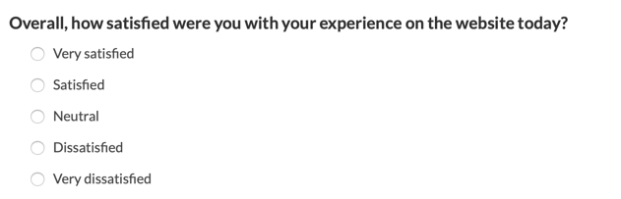
4 different variants
Ease scale - Vars A, B, C
“Couldn’t complete” is an option in the ease question
Variant A: Satisfaction at start, completion in ease scale
Variant B: No satisfaction question, completion in ease scale
Variant C: Satisfaction after task, completion in ease scale
Variant D: No satisfaction question, no ease question, completion is a separate question
Successful completion
Satisfaction - Vars A, C
Unsuccessful
Separate completion question - Var D
Successful completion
Unsuccessful

Slide 5
Results of the experimentation:
Asking satisfaction first does affect reported ease - when asked about satisfaction first, significantly more reported the task as being easy.
Reported satisfaction does vary if asked first rather than later - significantly more reported themselves as satisfied when asked first compared to those asked after responding to questions about their task.
Survey completion rates are not higher if satisfaction is asked first - more did answer the first question when it was about satisfaction rather than their task, but fewer ended up finishing the survey.
Reported task success on an ease scale is not equivalent to asking task success separately - reported task success was significantly higher when asked on a scale with ease.
Satisfaction is moderately correlated with ease and task success - r=.53 if satisfaction is asked first, .61 if satisfaction is asked after task and ease.
Fewer questions in the survey doesn’t result in more comments, but we get higher quality comments when asking people who were unsuccessful or found their task difficult.
Notes:
Answering satisfaction first may make people need to be internally consistent on next question. Whereas if ease is asked first, then they are not constrained.

Slide 6
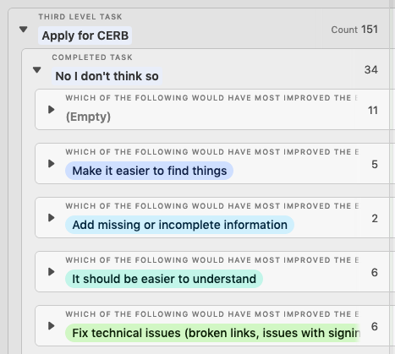
Feedback received in the Improvement step
An open text box for feedback about the experience was available to both people who were successful and those who weren’t.
People who were not able to complete their task were 2.5x more likely to leave feedback.
After ‘Yes’ | After ‘No’
13.4% | 32.3%

Slide 7
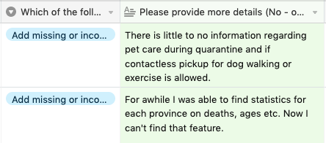
Quality of feedback after asking about ease
Feedback from people who were unsuccessful at their task tends to be direct and actionable.
The open text field for people who were successful included many flattering comments - but unfortunately adds extra processing work for comments that generally won’t help improve the experience.
Unusable - Very easy | Unusable - Somewhat easy
63.4% (71) | 26.9% (18)
Notes:
Tendency to leave positive feedback about the experience.

Slide 8
Changes made for phase 2
Removed satisfaction (later added after the task question)
Left ease, but only for those who accomplished their task
Separated task completion from ease
Updated and added tasks (based on “Other” choices)
Encouraged people to complete their task first if they chose “I started the survey before I completed”
Possible future changes:
Other task modifications - as needed (removing little-used tasks)
Wider deployment

Slide 9
Survey phase 2 - 1 variant
Tasks and success

Slide 10
High-level tasks: Traffic and success
Task | Chosen | Success
Financial advice and support (CERB, CEWS, CESB, other) | 36.2% | 76.0%
Other: | 18.7% | 64.6%
Outbreak status, statistics, deaths and cases | 12.3% | 76.2%
Travel and immigration during the pandemic | 10.2% | 59.7%
Employment Insurance (EI) | 6.9% | 86.8%
Government of Canada COVID-19 strategy | 4.3% | 79.3%
Workplaces and businesses during the pandemic | 3.0% | 79.8%
Guidelines about COVID (public spaces, health professionals) | 2.3% | 74.7%
Prevention, transmission and treatment of COVID | 1.6% | 83.3%
Symptoms of COVID and wellbeing | 1.5% | 85.0%
Testing for COVID | 1.3% | 51.1%
Myths, scams and reporting misleading information about COVID | 1.1% | 75.0%

Slide 11
High-level tasks compared to Gerry McGovern survey
Task | Gerry McGovern | Top task survey
Financial advice and support (CERB, CEWS, CESB, other) | 40% | 36.2%
Other: | n/a | 18.7%
Outbreak status, statistics, deaths and cases | 17% | 12.3%
Travel and immigration during the pandemic | 13% | 10.2%
Employment Insurance (EI) | n/a | 6.9%
Government of Canada COVID-19 strategy | 14% | 4.3%
Workplaces and businesses during the pandemic | 12% | 3.0%
Guidelines about COVID (public spaces, health professionals) | 13% | 2.3%
Prevention, transmission and treatment of COVID (includes vaccines) | 23% | 1.6%
Symptoms of COVID and wellbeing | 4% | 1.5%
Testing for COVID | 6% | 1.3%
Myths, scams and reporting misleading information about COVID | 4% | 1.1%
Notes:
The categories don’t always align 1:1 between these surveys.

Slide 12
Finance: Breakdown
Top frustrations
Confusion between CERB/EI
Many clicks needed to re-apply for CERB/EI
Issues with logging in to an account
Task | Chosen | Success
Canada Emergency Response Benefit (CERB) | 58.7% | 80.1%
Employment Insurance (EI) | 15.0% | 83.2%
Canada Emergency Student Benefit (CESB) | 7.2% | 66.7%
Canada Emergency Wage Subsidy (CEWS) | 5.9% | 67.5%
Support for individuals | 4.1% | 64.0%
Support for self-employed | 3.2% | 63.4%
Support for seniors | 2.2% | 60.7%
Support for people with disabilities | 2.0% | 37.9%
Support for businesses | 1.4% | 11/17
Managing personal finances (savings, pensions, retirement) | 0.3% | 2/4
Support for specific industry and sectors | 0.1% | 2/3
“Difficult to find the application page, and specifically which government page to go through (CRA vs. Service Canada).”
“It became unclear as to whether I was actually applying for CERB because it looked like I was applying for EI. I had exhausted EI benefits on a recent claim.”
Notes:
Other frustrations included finding information on the CERB extension, program eligibility, wording of the EI questions.

Slide 13
CERB, CESB, CEWS
Task | Chosen | Success
Submit CERB / EI internet report through Service Canada | 30.30% | 93.8%
Re-apply for CERB through CRA | 28.00% | 82.3%
Apply for CERB | 24.50% | 75.7%
Check eligibility for CERB | 9.90% | 78.4%
Missing CERB/EI payment | 3.30% | 34.6%
Find out how much money you can get | 2.10% | 12/16
Contact someone about my case | 1.50% | 2/13
Repay some or all of the CERB | 0.50% | 2/3
Task | Chosen | Success
Apply for CESB | 43.0% | 57.9%
Re-apply for CESB | 39.4% | 73.2%
Check eligibility for CESB | 14.8% | 11/15
Find out how much money you can get | 1.4% | 1/1
Missing CESB payment | 0.7% | 1/1
Task | Chosen | Success
Apply for CEWS | 33.3% | 72.0%
Check your eligibility for CEWS | 27.5% | 57.1%
Re-apply for CEWS | 13.7% | 10/10
Check if your employees are eligible for CEWS | 11.8% | 4/8
Calculate how much money you can get | 10.8% | 4/5
Missing CEWS payment | 1.0% | 0/1
Contact someone about my case | 1.0% | 0/1

Slide 14
Outbreak status, statistics, deaths and cases
Top frustrations
Looking for local data
Find daily case updates
Be able to compare the data (recent last week, yesterday)
Be able to download data
Task | Chosen | Success
Statistics on COVID-19 cases (location, hospitalizations, recoveries, deaths) | 40.7% | 79.7%
Number of COVID-19 cases in Canada | 34.4% | 85.9%
Latest news (alerts, daily briefings, updates) | 17.1% | 63.8%
Modelling of disease spread and possible end date | 3.6% | 15/18
Number of tests completed | 1.6% | 5/6
COVID notification mobile app | 1.5% | 5/10
COVID-19 virus mutation or new strains | 1.0% | 3/4
“Map does not provide enough options to get the information wanted.”
“It would be nice to see how specific areas/cities in each province are affected/at high risk.”

Slide 15
Travel and immigration during the pandemic
Task | Chosen | Success
Restrictions on travel to Canada | 24.8% | 62.6%
Immigration (study, work, visiting, applications, status) | 22.4% | 60.2%
Travel inside Canada | 14.6% | 60.0%
Quarantine when entering Canada | 13.2% | 58.8%
Canada-U.S. border restrictions | 11.0% | 60.5%
Travel outside Canada | 8.6% | 59.3%
Exemptions for essential workers (border, quarantine) | 2.0% | 8/8
Support for Canadians abroad | 1.8% | 4/4
Apply for a passport | 1.6% | 3/5
Top frustrations
Clear information on restrictions for travelling to Canada
Delays and status of immigration applications and processing
When and how to quarantine
Travel between provinces
“I don't have a home in Canada. I want to know which Hotel is approved by the Quarantine Office (or the Chief Public Health Officer of Canada) so I don't get a rejection when I land.”

Slide 16
Workplaces and businesses during the pandemic
Task | Chosen | Success
Workplace and business reopening guidance, signage, tools | 28.5% | 81.5%
Employee rights (return to work policy, protocols, unsafe conditions) | 23.6% | 90.5%
Training and retraining | 10.6% | 8/9
Ways to retain employees | 9.8% | 8/11
Essential services / key / critical workers | 8.1% | 4/6
Income tax filing and payment | 8.1% | 4/5
Access and use of personal protective equipment | 6.5% | 4/4
Guidance for specific industry and sectors | 4.9% | 2/3
Top frustrations
Fewer write-in comments on these topics.
Questions on CEWS (extension and eligibility)
What is mandatory for employers to do?
“There should be concrete, practical guidelines with examples, scenarios. I can't distinguish between misinformation and recommendations and mandatory guidelines. for example, is it masks are mandatory at ALL times, or when distancing is not possible?“

Slide 17
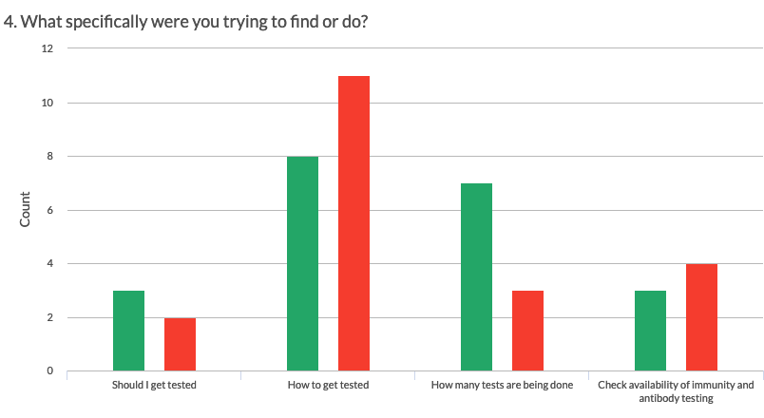
Testing task
Notes:
From the few comments received
How to get tested: People were looking for the locations of testing facilities and finding that information hard to find (based on 5 comments).
Immunity and antibody testing: It should be easier to understand (based on 2 comments).

Slide 18
Success over time
Task | June 25 - 29 1,265 | July 1 - 7 2,019 | July 8 - 14 1,269 | July 15 - 19 728
Financial advice and support (CERB, CEWS, CESB, other) | 77.2% | 77.0% | 75.6% | 73.4%
Other | 70.9% | 66.2% | 69.6% | 43.2%
Outbreak status, statistics, deaths and cases | 75.7% | 76.8% | 77.0% | 75.0%
Travel and immigration during the pandemic | 57.1% | 59.0% | 63.0% | 54.8%
Employment insurance |  |  |  | 87.3%
Government of Canada COVID-19 strategy | 76.8% | 77.9% | 87.2% | 66.7%
Workplaces and businesses during the pandemic | 70.3% | 73.3% | 88.9% | 92.3%
Guidelines about COVID (public spaces, health professionals) | 63.6% | 69.4% | 82.4% | 83.3%
Prevention, transmission and treatment of COVID | 73.9% | 91.4% | 81.3% | 71.4%
Symptoms of COVID and wellbeing | 82.4% | 84.0% | 84.0% | 90.0%
Myths, scams and reporting misleading information about COVID | 81.3% | 77.3% | 63.6% | 85.7%
Testing for COVID | 63.2% | 52.0% | 46.2% | 57.1%
Medical supplies for use against COVID | 38.5% | 61.1% | 80.0% | 50.0%
Notes:
It’s interesting, because in the past, I’d say that things shouldn’t really change unless your content was changing. But now, significant things are changing outside of the website, which is going to have a major impact on what people are looking for. The site has to be changing constantly to adapt.

Slide 19
Current plans

Slide 20
Sharing the COVID-19 top task survey data
The dataset will be exported as CSV files and published to the GC Wiki: https://wiki.gccollab.ca/Covid_19_DTO-BTN/User_research

Slide 21
Future plans - Task success surveys
Continual refinement of tasks and process
Principal Publisher building new survey tool (departmental tasks)
Eventual deployment across institutions
Streamline processing by:
Leveraging Adobe Analytics
Developing tools to store, process, and present written-comments
Machine learning for tagging
interface to review comments and adjust tags

Slide 22
Thank you

Slide 23
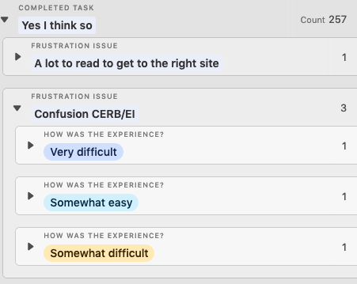
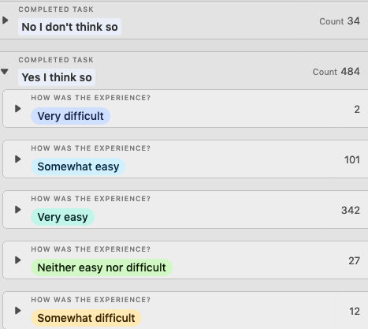
Frustrations and ease
Task: Apply for CERB
Task: Submit CERB/EI report
Notes:
When comments are tagged with frustrations we can clearly understand specific weak points in the tasks.
Ease may help prioritize what issues to focus on - but can we really understand the difference between a task that was ranked very or somewhat difficult?
Does ease help me better prioritize compared to a single value assigned to a frustration?
Simple: 3 people successfully re-applied for CERB but were confused with EI.
Harder: 3 people successfully re-applied for CERB but were confused with EI. 1 person rated it as very difficult, 1 as somewhat difficult, etc.
Ease is probably a metric best used on its own to track performance over a longer period of time. In the example on the right for the task of Submitting a CERB/EI report, it will be very attractive to report the high “very easy” rating. Perhaps to the detriment of the smaller number of people who could not complete the task.

Slide 24
Tips for reporting and sharing task data
Group tasks and sub-tasks by quantity
Understand your top tasks - Are they what you expected? Are there new tasks?
Group tasks by success
Understand which tasks are failing
For tasks that are failing, use the frustrations tagging to understand why
Sharing reports - Think about who needs what
Not everyone needs all of the data. Receiving a large spreadsheet is overwhelming to make sense of. Think about your audience.
Web manager: List of the department’s top tasks and sub-tasks and a list of where people are failing
Product owner: List of the products’s sub-tasks, success, ease, and frustrations
Content owner: List of the the success, frustrations and comments related to a page, section, or task

