Slide 1
Use of Generative AI (ChatGPT)
Best practices for GC Task Success Survey or Page feedback tool analysis
Digital Transformation Office • #CanadaDotCa • October 2023
Notes:
Opening slide

Slide 2
Overview
What we’ve heard
Analyzing feedback manually is time consuming
You asked:
Can we use ChatGPT (or similar generative AI tools) to analyze comments from the GC Task Success Survey or Page feedback tool data?

Slide 3
Can we use ChatGPT?
Yes, but in a responsible way
This means:
Not training models with our data
Preparing clean datasets before entering them into these tools
Being mindful of bias and inaccuracies in results
Notes:
Being mindful that not all communities of people want their proprietary data used in AI - for example Indigenous people have expressed concern about data sovereignty when it comes to using AI.

Slide 4
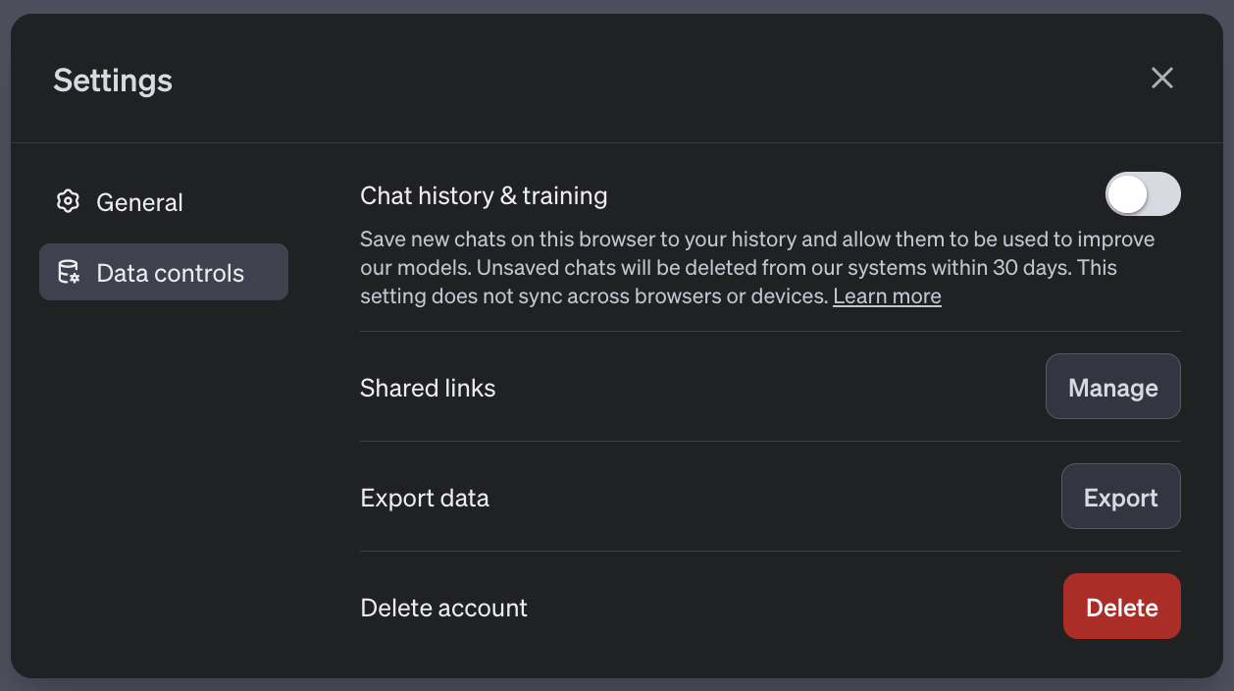
Before using ChatGPT
Update your ChatGPT settings
Turn off chat history and training
Under Settings, Data controls, turn off “Chat history & training”
To avoid this data being used to train models

Slide 5
Remove personal information
Review your dataset for comments with personal information
We want to ensure dataset do no include personal information to comply with the Privacy Act because
Servers outside of Canada are not subject to the Canadian federal government privacy, security, legal, and information management requirements
Threat actors could harvest this sensitive information to impersonate individuals or spread false information
It is part of good data collection practices where information is collected and used responsibly
Preparing your data

Slide 6
Remove personal information
Exclude comments that have personal information
Names and addresses (the name of the individual where it appears with other related personal information or where the disclosure of the name itself would reveal information about the individual)
Phone numbers, email addresses, date of birth
Identifying account numbers (SIN, passport, business number, file numbers, case numbers, etc.)
What is personal information? Office of the Privacy Commissioner of Canada
Preparing your data

Slide 7
Cleaning your data
Tips for preparing (cleaning) data
Identify comments that may include names or addresses by doing keyword searches for
“name / my name”
“address / my address”
“email / my email”
“contact me”
You may want to omit comments with scrubbed words (###) if context for the comment has been lost
Scan feedback for irrelevant feedback such as spam

Slide 8
Improving personal information filters
DTO regularly reviews and updates the scrubbing script for the TSS and Page feedback tool.
We’ll be looking at additional ways to prevent or scrub personal information entering the datasets.
The script currently removes:
phone numbers
email addresses
social insurance numbers
passport numbers
postal codes
some names

Slide 9
Start with standardized prompts
Different prompts can result in different outputs
Your team may want to use the exact same prompts to promote consistency in outputs.
Spend time making sure that the prompts results in the desired output.
Even when using the same prompt and dataset, your outputs may vary.
Outputs will also vary between the free version of ChatGPT 3.5 and the paid 4.0 version.

Slide 10
Start with standardized prompts
Example prompt
I will paste comments collected on Government of Canada web pages related to [your topic].
Act as a data analyst to summarize:
top 5 issues encountered by users, along with a representative comment for that issue, the number of comments found on each issue
ideas on how to solve these issues
Give me your reply in a table format.
Tell the AI who it is.
Tell the AI what you want it to do
Give step-by-step instructions
Add your own constraints
Test your prompt
Notes:
https://www.oneusefulthing.org/p/now-is-the-time-for-grimoires
Tell the AI who it is.
Tell the AI what you want it to do
Step-by-step instructions.
Add your own constraints.
Test your prompt

Slide 11
Iterate on prompts
Refine your results to focus on specific issues and gain more clarity
Ignore comments related to X “Now that you’ve provided that summary of the top issues, ignore these ones”
Ignore scrubbed words "Ignore ### from this analysis”
Include more detail “Provide more detail about each issue, with a count of how many comments seem to be about this issue”
Refining your results with additional prompts
Notes:
https://www.oneusefulthing.org/p/now-is-the-time-for-grimoires
Tell the AI who it is.
Tell the AI what you want it to do
Step-by-step instructions.
Add your own constraints.
Test your prompt

Slide 12
Best practices for reviewing AI results
Check for biased results
A majority of the training dataset fed into the LLMs (Large Language Models) come from the open Internet.
Generated content may be biased if the training dataset lacks balanced representation of data points.
Language bias. ChatGPT may not process non-English comments as well. Try submitting a sample of French comments and check whether the results are reliable.
Training models may be biased

Slide 13
Best practices for reviewing AI results
Check for inaccurate results
Generative AI can, with apparent confidence, lie or generate inaccurate outputs.
Always keep in mind that its outputs can be:
wrong
illogical

Slide 14
Best practices for reviewing AI results
Build human reviews into your process
Check that ChatGPT is consistently outputting responses in line with what trained human analysts do.
Stop using ChatGPT when/if it starts deviating from how humans would do it and when the accuracy or the quality of the output decreases.
Re-assess and adapt your processes as necessary.

Slide 15
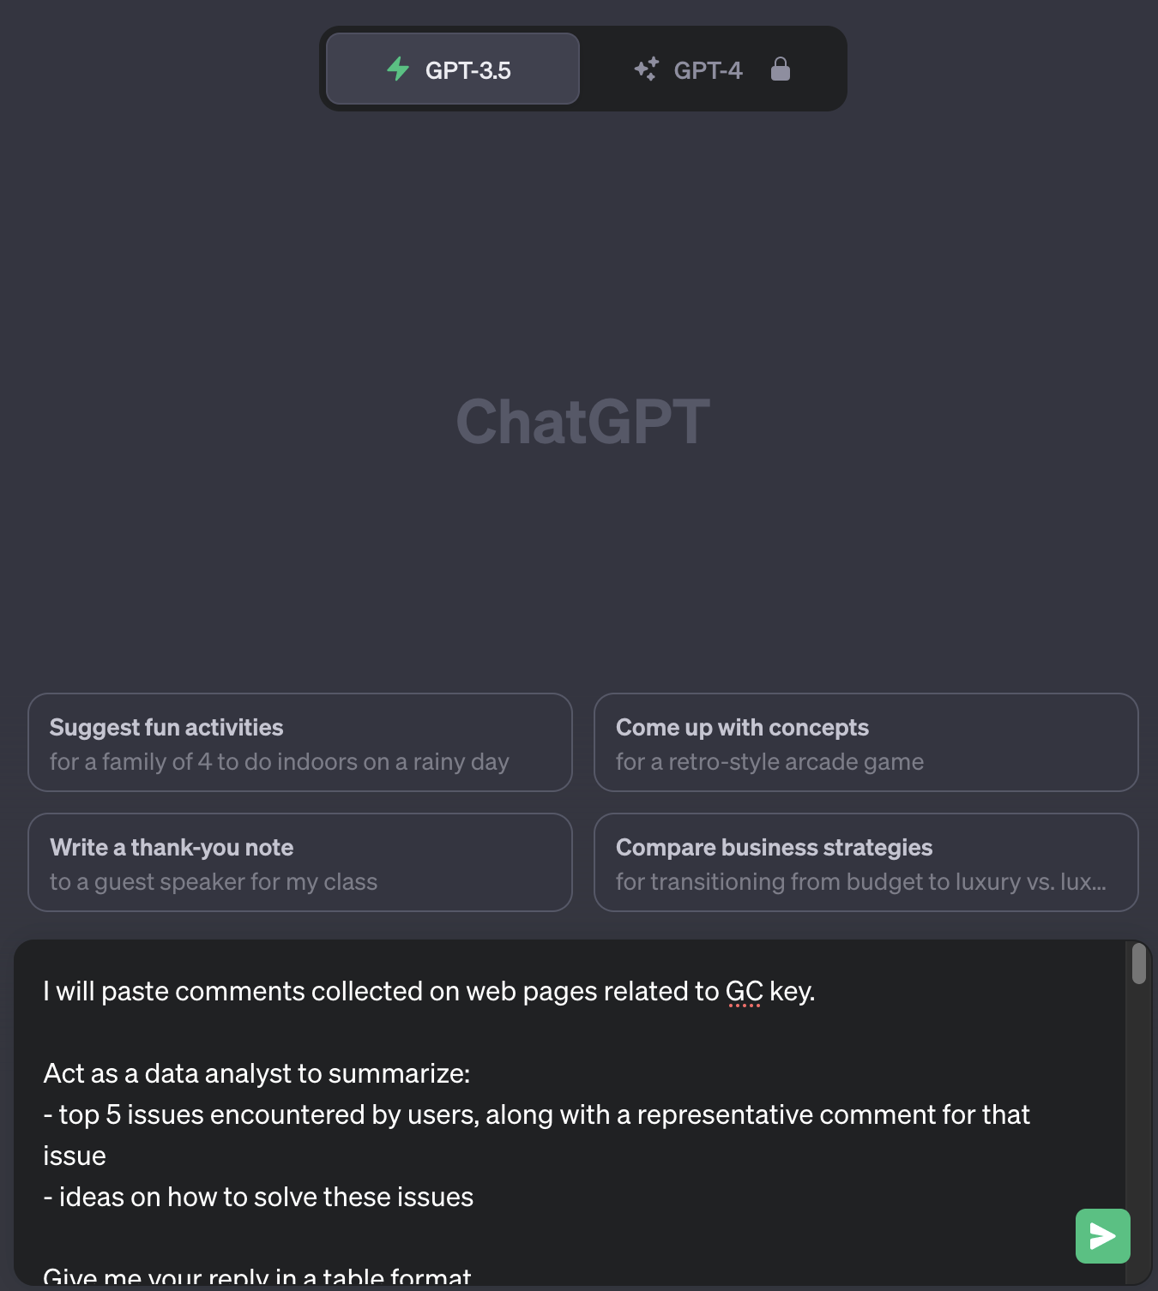
Demo
https://chat.openai.com/

Slide 16
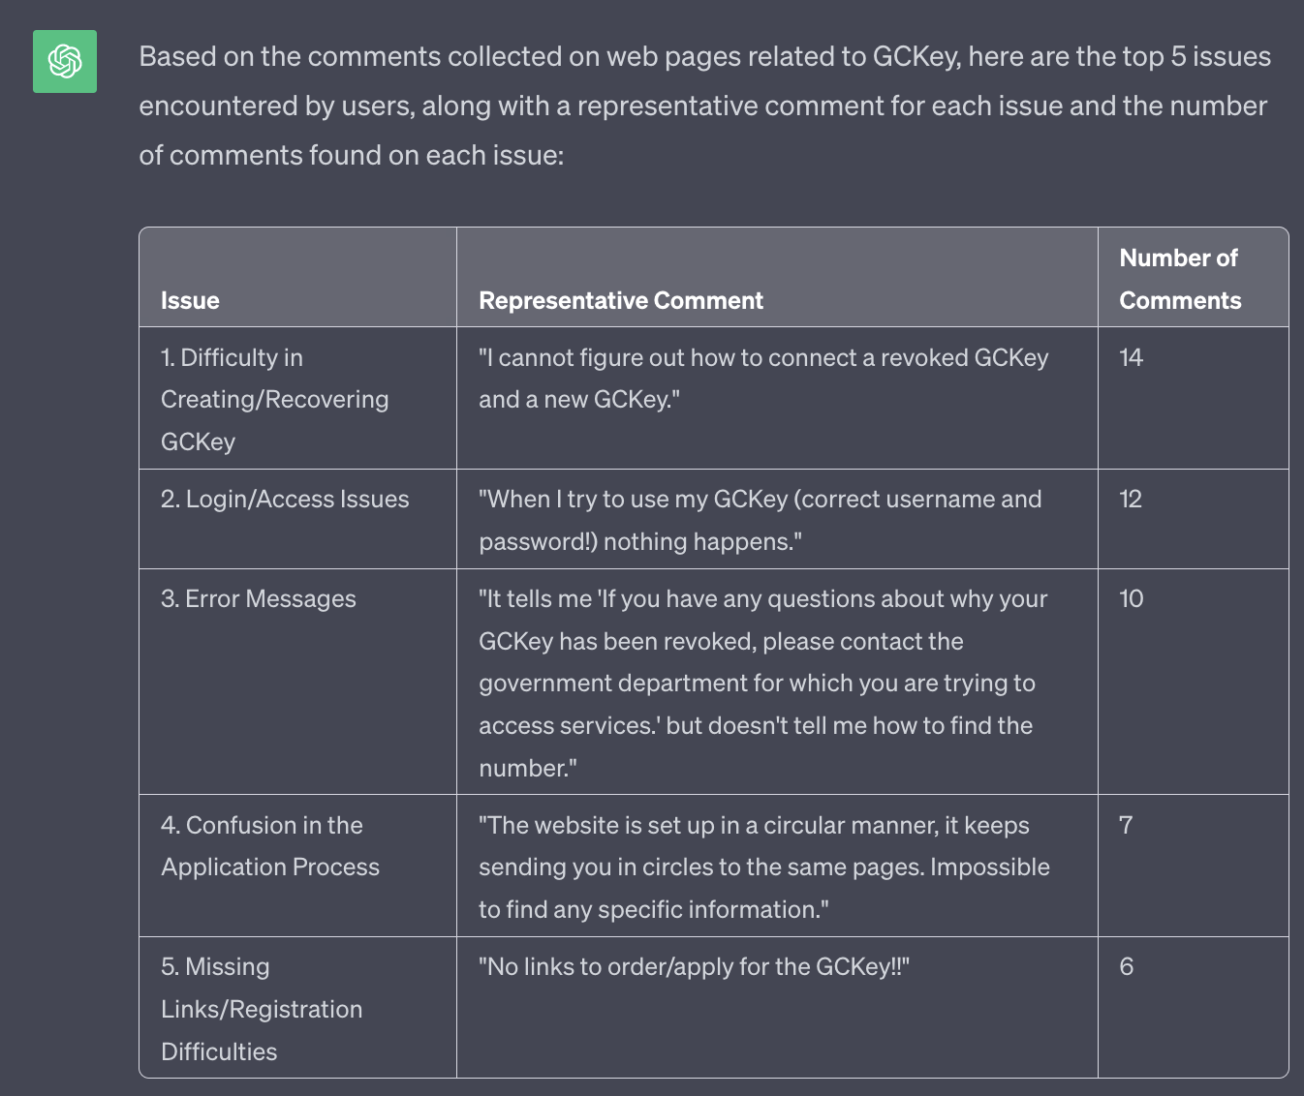
Demo
ChatGPT 3.5

Slide 17
More questions?
Other use cases? AI Policy team at TBS
ai-ia@tbs-sct.gc.ca
Guide on the use of Generative AI
https://www.canada.ca/en/government/system/digital-government/digital-government-innovations/responsible-use-ai/guide-use-generative-ai.html
GCComms Slack channel #artitficial-intelligence-ai-intelligence-artificielle
Generative AI tools
OpenAI (ChatGPT)
Bing.com

