Slide 1
L&D Detective
®
Measurement Mysteries

Slide 2
Program Management
Instructional Design
Measurement
& Evaluation
Learning Solutions
Learning Operations
Facilitation
Leadership Development
Learning Technology
Onboarding
Impact
Analytics
Curriculum Development
Notes:
I am Kevin M. Yates, the L&D Detective.
I am called the L&D Detective because I investigate the impact of training and learning.
These are companies for which I have worked and the roles in which I have served.
My work experience informs the work I do as the L&D Detective.

Slide 3
How do you define impact for training and learning?
Notes:
Different people define impact in different ways.
How do you define impact for training and learning?
Note: Audience uses chat to indicate their answer.
Note: Webinar host reads five definitions.

Slide 4
Impact is training and learning’s contribution to workplace performance.
Notes:
I define impact as training and learning’s contribution to workplace performance.
I use the word “contribution” intentionally because it takes more than training and learning to achieve a business goal.
It takes a village to achieve business goals..

Slide 5
The formula for workplace performance
Human Performance
Business Performance
Workplace Performance
Notes:
Workplace performance is a combination of human performance and business performance
When I investigate impact, I am investigating training and learning’s contribution to workplace performance.
I take into consideration what has potential and power to contribute to workplace performance including but not limited to training and learning as an experience and L&D as a function..

Slide 6
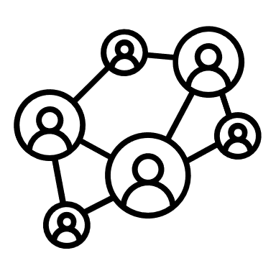
Human performance contributors
Workload
Workplace Culture
Rewards & Recognition
Manager Coaching & Support
Tools & Technology
Natural Ability
Compensation
Training & Development
Workload
Workplace Culture
Manager Coaching & Support
Rewards & Recognition
Natural Ability
Tools & Technology
Compensation
Training & Development
Notes:
These are some, not all, of the influences that have potential and power to contribute to human performance.
This is not an all-inclusive list and you may be able to think of other contributors to human performance.
These contributors influence human performance.
When I measure impact, I am taking into consideration human performance contributors.

Slide 7
Business performance contributors (example of teams)
Operations
Research & Development
L&D
Human Resources
Product Development
Marketing
Customer Retention
Technology
Workload
Workplace Culture
Manager Coaching & Support
Rewards & Recognition
Natural Ability
Tools & Technology
Compensation
Training & Development
Notes:
These are examples of the teams that have power and potential to influence business performance.
This is not an all inclusive list.
You may be able to think of teams in your business that contribute to business performance.
When I am investigating impact, I take into consideration contributors for human and business performance.

Slide 8
Performance ecosystem
Training &
Development
L&D
Notes:
The performance ecosystem is a combination of human performance contributors and business performance contributors.
Training and learning as an experience, and L&D as a function are part of the ecosystem and not the only influence on workplace performance.
The goal for measuring impact is investigating how elements in the performance ecosystem contribute to human performance and business performance.

Slide 9
L&D Detective®
I investigate training and learning’s contribution to workplace performance.

Slide 10
What makes measurement successful?
Conduct a performance needs analysis.
Define impact before you try to measure it.
Select a metric that gives a signal for performance impact.
Align and agree on what impact looks like.
Notes:
Let’s take a look at what makes measuring the impact of training and learning successful.
A performance needs analysis is different from a training needs analysis.
Traditional training needs analysis focuses on tactics and logistics.
Performance needs analysis is focused on the skills, capabilities, and behaviors that are needed to archive a business goal.
One of the biggest challenges I regularly encounter is that L&D teams do not define impact before trying to measure it.
It’s critically important to know what you’re trying to measure before you chase after it.
Proactively defining what impact looks like when it shows up real-time, day-to-day on the job helps make measuring impact possible.
The most credible, reliable signal for impact are metrics the business uses to measure its performance.
LMS data is useful in the right context but it does not give insight into impact on workplace performance.
Learning surveys are useful in the right context but they do not give insight into impact on workplace performance.
We must align and agree with business partners and stakeholders on what impact looks like when it shows up real-time, day-to-day on the job.
Proactive agreement ensures we’re measuring the right thing.
Alignment and agreement manages expectations for what we can and cannot measure.

Slide 11
If you do not plan for impact in the beginning, it will be difficult to measure in the end.
Notes:
The biggest point of failure for measuring impact is not planning for impact in the beginning.
Before anything is designed, utilized, consumed, or attendended, we must proactively plan for impact in the beginning.
Planning for impact in the beginning makes it easier to measure in the end.
We’re going to focus today on how to plan for impact in the beginning so it’s easier to measure in the end.
We’ll use a case study to illustrate how to proactively plan for measuring the impact of training and learning.

Slide 12
Notes:
Note: This video introduces the case study.
Here’s what we know from video:
Mobile4Earth is launching a new AI-powered phone.
The last time a new phone was launched, there was a decrease in metrics that measure customer service metrics.
They want to prevent a decrease in customer service metrics with the launch of the new phone.
Napal is an L&D consultant.
Carlos is a business manager and submitted a training request using L&D’s new performance needs analysis.

Slide 13
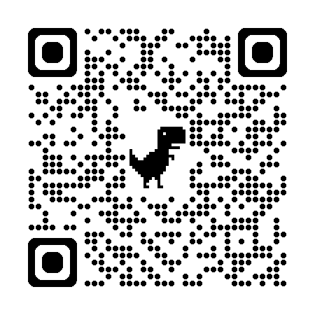
kevinmyates.com/pna1
Notes:
Let’s take a look at the performance needs analysis Carlos submitted.
Note: Webinar attendees will be asked to use their mobile to scan the QR code to see what Carlos submitted.
Note: If webinar attendees do not have a mobile device, they can go to the URL to see what Carlos submitted.
Did you notice how the questions are focused on performance?
The performance needs analysis is incomplete.
There are some questions Carlos could answer and some he could not.
Nepal scheduled a follow-up discussion with Carlos to get the answers to questions Carlos did not answer.

Slide 14
Performance Needs Analysis
Prepared by: Carlos Rivera Department: Products & Innovation Project Number: 05893
What is the business goal?
We want a half-day training program for customer service representatives that helps them handle calls for our new AI phone. The training needs to have role-play and tests to ensure they prove their knowledge.
What is the opportunity or problem to solve?
The opportunity is ensuring customer service reps are ready for the release of our new AI-powered phone.
Whose performance is needed?
We need L&D to perform the training for customer service reps.

Slide 15
Performance Needs Analysis
What are the performance requirements for achieving the business goal?
I’m not sure how to answer this question.
What difference in performance is needed to achieve the business goal?
I’m not sure how to answer this question.
What are the potential risks to performance?
The risks are that if customer service reps are not able to resolve customer calls for the new phone, our reputation as the industry leader in customer service will be lost.

Slide 16
Performance Needs Analysis
What has potential to activate or maintain performance?
I don’t know how to answer this question.
Who is contributions to the business goal and how?
The training team will help us achieve the business goal with training programs that help customer service representatives support the new phone.
What are the key performance indicators that measure performance?
We’ll use the surveys you guys send out.

Slide 17
Notes:
Note: This video shows the discussion between Napal and Carlos.
Observations from the discussion:
Carlos was focused on training. Nepal was focused on performance.
The move from a training-focused discussion to a performance-focused discussion is a shift for training requesters and L&D.
Nepal’s goal is getting as many answers as he can from Carlos.
It’s more than likely that you will have to speak with more than one business partner or stakeholder to get all the answers.

Slide 18
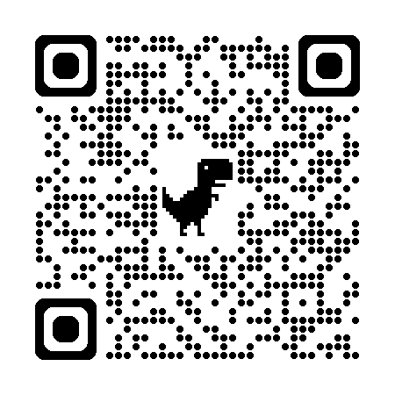
kevinmyates.com/v2email1
Notes:
Carlos committed to getting answers to questions he could not answer.
He sent an email to Theodore, and HR business partner, to answer questions about performance expectations.
Note: Webinar attendees will be asked to use their mobile to scan the QR code to see what Carlos submitted.
Note: If webinar attendees do not have a mobile device, they can go to the URL to see what Carlos submitted.
Did you see where Theodore identified specific performance expectations?
Performance is the foundation for planning for impact in the beginning so it’s easier to measure in the end.

Slide 19
Email between Carlos, Theodore, and Napal
From: Carlos Rivera
To: Theodore Von
Cc: Napal Arun
Subject: Customer Service Reps Performance Expectations
Hello Theodore. We’re working with L&D to create training for our customer service representatives. The training will be for the release of our new AI-powered phone, the M4E 300. We’re working with Napal on the L&D team, and I’ve copied him on this message.
Napal asked about performance expectations for customer service reps. Do you have a job description or something similar you can share? Please let us know and thank you for your help.
Carlos Rivera
Products & Innovation
Mobile4Earth

Slide 20
Email between Carlos, Theodore, and Napal
From: Napal Arun
To: Theodore Von
Cc: Carlos Rivera
Subject: Re: Customer Service Reps Performance Expectations
Hello Theodore. We’re conducting a performance needs analysis for the training request from Carlos. We’re looking for something that describes skills, behaviors, and capabilities customer service reps need to perform their jobs.
Ideally, we need something that describes performance expectations for customer service reps. Do you have something we can use?
Napal Arun
L&D Learning & Performance Consultant
Mobile4Earth

Slide 21
Email between Carlos, Theodore, and Napal
From: Theodore Von
To: Napal Arun
Cc: Carlos Rivera
Subject: Re: Customer Service Rep Performance Expectations
Hello Napal. Thank you for the clarification. A job description might be too broad and general. Take a look at the performance expectations grid below for customer service reps and let me know if you need anything else.
(see table on next slide)

Slide 22
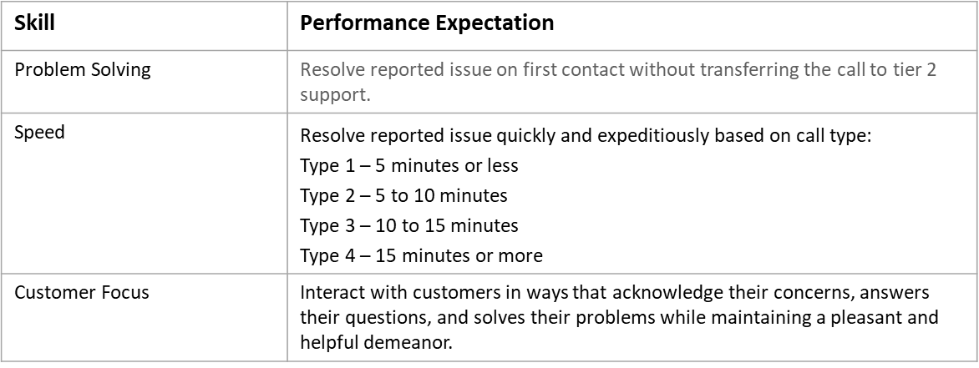
Email between Carlos, Theodore, and Napal
Theodore Von
HR Business Partner
Mobile4Earth

Slide 23
Impact targets (example of metrics)
Employee Engagement
Time
Repeat Customers
Market Share
Customer Satisfaction
Order Fulfillment
Production
Sales
Turnover
Speed
Quality
Errors
Notes:
The most credible, reliable, relevant signal for impact is metrics the business uses to measure its performance.
These are examples of the kinds of metrics that businesses use to measure business performance.
Did you notice how this does not include LMS data?
Did you notice how this does not include survey results?
LMS data and learning survey results are helpful in the right context but they do not give insight into impact on business performance.
Let’s take a look at a discussion between Napal, Theodore, the HR business partner, and Emily who is on the business analytics team.

Slide 25
How often are you asked to isolate the impact of training?
Notes:
📣 This is Slido interaction slide, please don't delete it. ✅ Click on 'Present with WooClap' and the poll will launch automatically when you get to this slide.

Slide 27
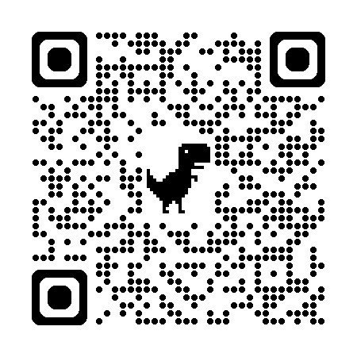
kevinmyates.com/pna2

Slide 28
Performance Needs Analysis
Prepared by: Napal Arun Department: L&D Project Number: 05893
What is the business goal?
Maintain customer service experience scores for first call resolution, customer call time, and customer care and tone at 90% favourability.
What is the opportunity or problem to solve?
The Products & Innovation team is releasing a new AI-powered mobile phone. Customer service experience scores dropped below target goal of 90% favourability with release of the last new phone. Customer service representatives were not prepared or ready. The opportunity is ensuring customer service representatives are ready for release of the new AI-powered phone.
Whose performance is needed?
Customer service representatives for mobile phone support in all regions and offices.

Slide 29
Performance Needs Analysis
What are the performance requirements for achieving the business goal?
Skill | Performance Expectation
Problem Solving | Resolve reported issue on first contact without transferring the call to tier 2 support.
Speed | Resolve reported issue quickly and expeditiously based on call type: Type 1 – 5 minutes or less Type 2 – 5 to 10 minutes Type 3 – 10 to 15 minutes Type 4 – 15 minutes or more
Customer Focus | Interact with customers in ways that acknowledge their concerns, answers their questions, and solves their problems while maintaining a pleasant and helpful demeanor.

Slide 30
Performance Need Analysis
What difference in performance is needed to achieve the business goal?
In this instance, there is no change needed in performance. The goal is sustaining customer service representative performance so that customer experience scores are maintained at 90% goal.
What are the potential risks to performance?
Risks to customer service representative performance include:
The M4E 300 being released before customer service representatives are ready for support.
Customer service reps not having access to frequently asked questions, problems, and appropriate resolutions.
Customers asking questions or reporting problems for which there is no documented answer or resolution.

Slide 31
Performance Needs Analysis
What has potential to activate or maintain performance?
Access to frequently asked questions, reported problems, and resolutions
Manager coaching and support
Incentives, rewards, and recognition
Products & Innovation team is conducting hands-on labs for the new phone.
Who is contributing to the business goal and how?
Technology team is implementing a new knowledge system for the M4E 300 for customer service reps.
Benefits team is exploring incentives and rewards for customer service reps who meet or exceed performance expectations.
Customer service managers are getting trained on how to use the new phone.
What are the key performance indicators that measure performance?
First call resolution
Customer call time
Customer care and tone

Slide 32
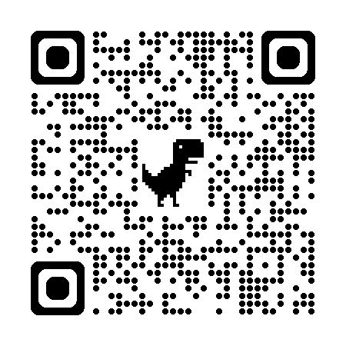
kevinmyates.com/v2email2

Slide 33
Email between Napal, Carlos, and Jessica
From: Napal Arun
To: Carlos Rivera
Cc: Jessica Finley
Subject: Proposal for Supporting Release of the M4E 300
Hello Carlos. We have reviewed your training request in preparation for release of the M4E 300. Please see our proposal below. I am copying Jessica Finley, the Customer Service Director.

Slide 34
Email between Napal, Carlos, and Jessica
Business Goal
Maintain customer service experience scores for first call resolution, customer call time, and customer care and tone at 90% favourability.
Customer Service Representative Performance Expectations

Slide 35
Email between Napal, Carlos, and Jessica
Impact Target KPIs
KPI | Source | Owner
First Call Resolution | Business Performance KPI Dashboard | Emma Tisdale, Business Performance Metrics Team
Customer Call Time
Customer Care & Tone
Notes:
Performance expectations for problem solving impacts first call resolution
Performance expectations for speed impacts customer call time
Performance expectations for customer focus impacts customer care and tone
Impact Measurement
We will evaluate training and learning’s contribution to maintaining customer experience scores for first call resolution, customer call time, and customer care and tone.
Note: Isolating training and learning’s unique contribution is not an option due to the need for training customer service representatives across regions and offices in the same time period.

Slide 36
Email between Napal, Carlos, and Jessica
Solutions & Performance Contributors
Solution | Description | Contributor
Videos | Illustrates features and functionality for the M4E 300 | L&D
Training | Instructor-led classroom programs for customer service reps and managers | L&D
Ask M4E 300 | Knowledge base with FAQs and problem resolutions | Technology
Rewards & Recognition | Incentive program for customer service reps who meet or exceed performance expectations | Benefits
Hands-On Labs | Experimentation centers for using the M4E 300 | Products & Innovation

Slide 37
Email between Napal, Carlos, and Jessica
Timelines
Times | Actions
Week 1 | Release features and functionality videos
Weeks 2 & 3 | Complete training for customer service managers
Weeks 3 & 4 | Complete training for customer service reps
Week 1 post M4E 300 launch | Measure and report results
Week 2 post M4E 300 launch | Measure and report results
Please confirm your approval and let me know if you have any questions.
Napal Arun
L&D Learning & Performance Consultant
Mobile4Earth

Slide 38
Email between Napal, Carlos, and Jessica
From: Carlos Rivera
To: Napal Arun
Cc: Jessica Finley
Subject: Re: Proposal for Supporting Release of the M4E 300
Hello Napal. Thanks for following up with your recommendations. You have my approval to move forward. I welcome any feedback from Jessica.
Carlos Rivera
Products & Innovation
Mobile4Earth

Slide 39
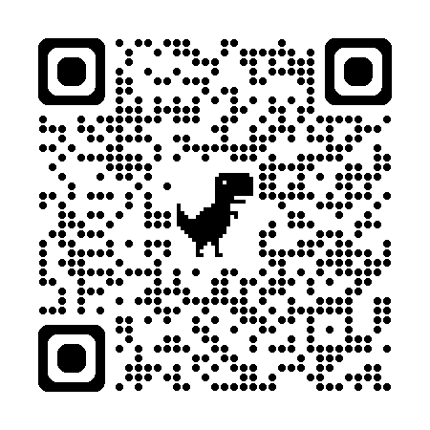
kevinmyates.com/v2impactdesign

Slide 40
Impact-Based Design Document
Prepared by: Napal Arun Department: L&D Project Number: 05893
What is the business goal?
Alignment with Learning Solutions:
The business goal is maintaing customer service experience scores for first call resolution, customer call time, and customer care and tone at 90% favourability.
Learning solutions should include:
messaging in program descriptions that highlight how the training supports the maintenance of these customer service experience scores.
Scripts for discussion guides, eLearning simulations, and manager coaching sessions should state and reinforce the business goal.
Training content should be anchored in skills and behaviors that support the business goal, including problem-solving, speed, and customer focus.
Illustrate through examples and role-plays what happens when these skills and behaviors are applied successfully to maintain performance standards.

Slide 41
Impact-Based Design Document
Contextualization in the Learning Experience
Create scenarios and simulations that replicate challenges experienced during previous product releases where customer service representatives were unprepared.
Illustrate the impact of the expected performance outcomes on maintaining customer service experience scores.
Show how skill application can prevent drops in customer satisfaction during the rollout of the new AI-powered phone.
Whose performance is needed?
Design Considerations for the Target Audience:
Offer localized versions of training solutions for regions where English is a second language.
Consult with representatives from different regions to ensure cultural considerations are factored into the content.
Work closely with customer service managers to gather input on challenges and opportunities, incorporating their feedback into the design.
Engage customer service representatives to understand their perspective on challenges and opportunities, using their input to enhance the relevance of the training content

Slide 42
Impact-Based Design Document
What are the performance requirements for achieving the business goal?
Connection Between Learning Outcomes and Performance Targets
Skill | Performance Expectation
Problem Solving | Resolve reported issue on first contact without transferring the call to tier 2 support.
Speed | Resolve reported issue quickly and expeditiously based on call type: Type 1 – 5 minutes or less Type 2 – 5 to 10 minutes Type 3 – 10 to 15 minutes Type 4 – 15 minutes or more
Customer Focus | Interact with customers in ways that acknowledge their concerns, answers their questions, and solves their problems while maintaining a pleasant and helpful demeanor.
Use videos and role-plays to illustrate these behaviors and the resulting performance outcomes.
Demonstrate the negative impact on business goals when the required skills and behaviors are not used.

Slide 43
Impact-Based Design Document
What difference in performance is needed to achieve the business goal?
Approach to Closing the Performance Gap
Describe the potential consequences of failing to maintain required performance, such as a drop in customer service experience scores.
Provide examples of critical skills and behaviors that impact customer satisfaction.
Compare and contrast desired behaviors with those that could jeopardize the business goal.
Include knowledge checks that evaluate understanding of performance expectations.
What are the potential risks to performance?
Mitigation of Risks to Performance
Develop realistic scenarios in the eLearning simulation that reflect the challenges customer service representatives might face with the new phone.
Clearly define roles and responsibilities for managers and customer service representatives in maintaining customer service standards.
Capture feedback from customer service representatives and managers and use it to make necessary adjustments to the training content.

Slide 44
Impact-Based Design Document
What has potential to activate or maintain performance?
Strategies for Influencing Performance
Create discussion guides for managers and customer service representatives that set clear expectations for maintaining customer service standards.
Develop an eLearning simulation that covers potential challenges and scenarios specific to the new AI-powered phone.
Create facilitator guides for manager-led coaching sessions.
Make the eLearning simulation mandatory for all customer service representatives.

Slide 45
Impact-Based Design Document
Who is contributing to the business goal and how?
Collaboration with Cross-Functional Partners:
Align messaging and communication in discussion guides, eLearning simulations, and manager coaching sessions with the knowledge system implemented by the Technology team.
Collaborate with the Products & Innovation team to ensure that hands-on labs for the new phone are integrated into the training.
Work with the Benefits team to align the incentives and rewards system with performance targets.
Meet regularly with cross-functional teams to review progress towards the goal.
What are the key performance indicators that measure performance?
Metrics for Training and Learning’s Contribution
First call resolution
Customer call time
Customer care and tone
These KPIs give a signal for training and learning’s contribution to maintaining the desired customer service standards.

Slide 46
Executive Summary
Mobile4Earth launched a new AI-powered phone, the M4E300.
The goal is maintaining 90% favorability for customer service metrics when the M4E300 launches.
Multiple teams including Products & Innovation, Benefits, Technology, and L&D, are collectively contributing to goal.
One week post-launch: First Call Resolution 87% (↓2%), Customer Call Time 88% (↓3%), Customer Care & Tone 93% (↑5%).
Two weeks post-launch: First Call Resolution 89% (↑2%), Customer Call Time 90% (↑2%), Customer Care & Tone 91% (↓2%).
We are trending in the right direction towards goal and will continue monitoring collective contributions and performance for customer service metrics.

Slide 47
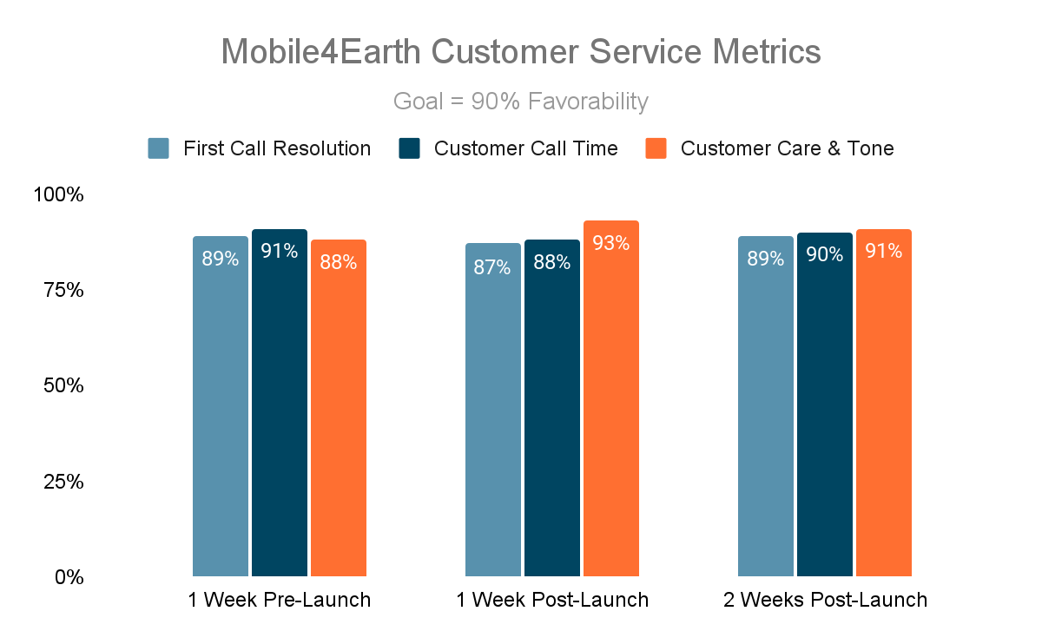
Executive Summary

Slide 48
If you do not plan for impact in the beginning, it will be difficult to measure in the end.

Slide 49
Impact is training and learning’s contribution to workplace performance.

Slide 50
Thank you
Email: kevin@kevinmyates.com

