Slide 1
Workplace Optimization Project
[PROJECT LOCATION]
DATE

Slide 2
How to use this document
Instructions - Remove this page before use
PURPOSE AND TARGET: The purpose of this presentation is to announce the optimization project to employees. It is a presentation that could be inserted into the agenda of an all-staff meeting or as an information session where the project is the only subject covered.
WHEN: This presentation takes place early in the project, once the key players have been identified, i.e., when the sponsor and key project team members have been appointed.
It's important that this event takes place soon after the executive and manager engagement activities, i.e., 48 to 72 hours later, to avoid the information being circulated informally. Make sure that executives and managers have received the FAQ and have had a chance to familiarize themselves with its content before the event.
HOW: First, you need to personalize and adapt the presentation to your organization's reality. Include real-life examples and situations inspired by the way staff in your organization work.
Use the notes section as a guide for preparing speaking notes for your presentation.
The executive and project sponsors are expected to co-host this session.
Allow time for questions. Avoid anonymous, publicly visible platforms (such as sli.do) for these, as they may distract from the topic at hand.
The French version of this document is available here: version FR

Slide 3
Agenda
Context
Our optimization project
New ways of using space
Timelines and next steps

Slide 4
Context: Budget 2024
The Government of Canada has announced that it will reduce its office portfolio.
50 %
Over 10 years
Housing and other community priorities
For the government to optimize its office portfolio while supporting community and housing priorities, departments and agencies need to change their ways of doing things and use space:
Adopting a hybrid work model
Making the transition to unassigned seating by default
Notes:
Budget 2024 indicates that the government is beginning a 50% reduction in office buildings, spread over the next 10 years.
This measure represents sound management of public resources, but it also aims to respond to the housing crisis. Surplus properties will be assessed with a view to returning them to Canadians for housing and other community priorities.
The government is therefore aiming to free up vacant and underutilized space. Departments and agencies should therefore adopt a hybrid working model if they haven't already done so, and make the transition to unassigned workstations.

Slide 5
What this means for [Name of organization]
Now
20XX
Address
New address
Number of floors
New number of floors
Unassigned seating
Assigned 1:1 workstations
New ways of using space

Slide 6
Beyond a workplace optimization
Offering a space better suited to our tasks
Ensuring the office facilitates in-person collaboration
Offering quiet spaces for individual tasks
Promoting accessibility and inclusion
Improving workstation ergonomics
Offering more options
Improving the workplace experience
Ensure that everyone get something out of it
Notes:
Here are a few points to consider in your speaking notes
Offer a space better suited to our tasks:
Recognize that you need to take more calls than before.
Give examples of what you observe in your organization. For example, several people are in Teams meetings at their desks rather than together in a room.
We can't assume that people go to the office to collaborate. Many do work at their work point all day long. So there needs to be a balance between space where you can concentrate and space where you can work as a team.
Promoting accessibility and inclusion:
Giving more access to rooms offers more options for people who, for example, live with hypersensitivity.
Indicate whether ergonomic furniture will be provided at each or a portion of the workstations.
Remember that accommodation obligations continue to be dealt with on a case-by-case basis.
Focus on improving the workplace experience:
We all have different needs and expectations when it comes to the workplace, and we believe that an unassigned shift model can offer different options so that there's something for everyone when you come into the office.

Slide 7
The workplace experience - our vision
Insert your organization's vision of workplace experience, if applicable.

Slide 8
New ways of using space

Slide 9
Unassigned seating
This means that:
Workstations and closed offices will be shared and available to all.
Every day, you can choose a workstation in the office that suits your needs and preferences.
This also means that:
You need to reserve your workpoint using an application (to manage floor capacity).
You must use a locker to store your business and personal belongings.
Image?
Notes:
Needs and preferences may be related to tasks (e.g. the need for two monitors) or to personal preferences: a workstation in a cooler area, or closer to the coffee machine!
Please note that booking applications are only used to manage capacity, so that everyone is guaranteed a spot to work. It is not used to check office attendance.

Slide 10
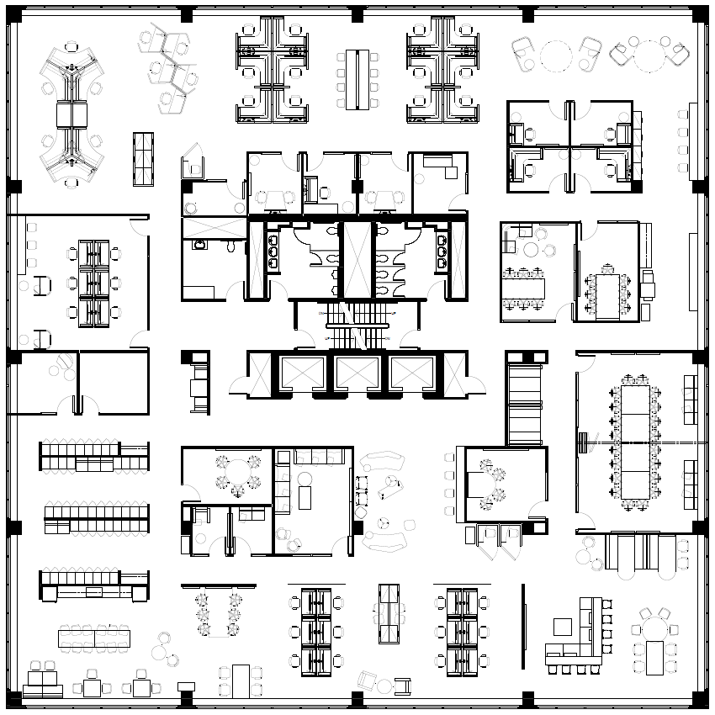
Quiet Zone
Quiet zone
A quiet zone will be created on each floor.
This portion of the floor is designed to encourage work and support the need for tranquility.
Notes:
Here are some examples of preferred activities in a quiet area:
Work on files or answer e-mails.
Take a course where all you have to do is listen.
Attend virtual meetings in which you don't have to intervene.
Activities to avoid in a quiet area include:
Take a phone call or Teams in which you will have to intervene frequently.
Extended conversations with colleagues.
If you're working in a quiet area and you receive a call or need to chat with a colleague for more than a few minutes, you need to move to respect your colleagues who have chosen this location for its tranquility.

Slide 11
Neighbourhood
The floors will be assigned to one or more branches.
The entire floor will be open to all - no floor sections or rooms reserved for specific teams.
It is permissible to work from a neighbourhood other than the one designated, for example, to collaborate with colleagues.
Example of neighborhoods
Branch A
Branches B and C
Branch D
Directorates E and F
Branch G
Open to all

Slide 12
Contribute to the success of the initiative
Experiment
Thinking of others
Being patient
Notes:
Experimenting:
We ask you to be open and start by trying it out, putting it to the test, and then giving us your feedback.
Many of you are probably listing the reasons why these ways of doing things don't work for you.
We understand that these are important changes that are probably in addition to other changes you are experiencing.
As mentioned above, we aim to improve your workplace experience. To do this, we ask you to come and try out the space, then come back to us with your feedback. There are some flexible elements to what we'll be putting in place.
For example: if there's a lot of collaboration and exchange on your floor, we may need to adjust the size of the quiet zone if it's too big.
Thinking of others:
Obviously, when we make the transition to shared spaces, the word shared says it all: we have to think of the people around us first, but also of the next person who will use or want to use the workstation we're in.
We're talking about cleanliness, noise and odors, but also about using the reservation tool properly, respecting room schedules and so on. As the project progresses, we'll be talking to you about community norms, and providing you with the guides you need to get used to the new ways of doing things and living together.
Finally: not everything will be perfect right from the start. We're all going to have to be patient and tolerant while we get used to our new normal.

Slide 13
Timeline
Date
Date
Closing the XYZ floor
Closing the XYZ floor
Communication and change management
Date
Date
Date
Removal of personal and business assets
Closing the XYZ floor
Optimization completed

Slide 14
Next steps
Involvement with committees and networks.
Organizing removal of business and personal assets.
Launch of our first communication tools.

Slide 15
Stay tuned
Write us at (insert e-mail address)
Visit the page (insert hyperlink to your intranet)

