Slide 1
Mindful Change Leadership Development Program
What’s with that?
Do we really need one?
Isn’t it just goofy chatty omhhhhh stuff?
Notes:
Update the Sli.do!!
During this session, we’ll review
Some contextual information about the MCLD program
The key findings for the 2022 English offering
How the MCLD program aligns with the key leadership competencies, the core competencies

Slide 2
HOLF!
Program Overview
Briefly, what is the primary goal of your leadership program? Why did you decide to create/purchase this program over and above what the CSPS offers?
Goal of the program / Benefits expected: To increase self-awareness by developing key skills: Focus, Clarity, Creativity, and Compassion in the service of others and become a better Change Leader, with the option to start a mindfulness practice.
The program came to life as a grass-roots initiative, thus not available anywhere.
Target Audience
Who is the program designed for (e.g., senior executives, managers, other)?
It’s designed for all, as a leader is not a position or a title, we all are leaders
Program Structure
What is the program's duration and format?
1.5 hours session during 8 weeks, plus additional homework to an approximate 2 to 3 hours a week (including the weekly session)
Curriculum and Content
What are the main topics covered in your program? Did you build it in house or purchase from a vendor? Why did you go the route you did?
Neuroplasticity, Mindful Change Leader, Compassionate Leadership, Understanding/Listening, Deciding, Cleaning Environment, SCARF model, SBN-RR Technique, LuvUrSelf (self-compassion), Presence, Win-Win-Win, Decisions, EQ (emotional intelligence), Resilience, and a bunch of Mindful related exercises
As mentioned, it’s a grass-roots program created and delivered by volunteers
There is no program like this offered
Resources
How many staff are dedicated to the program? How do they spend their time?
A mix of 10+ volunteer facilitators from different Departments and Agencies
Volunteering
Buy In
How did you get buy-in for the program? How did you sell it? How long did it take to start?
By personal realization, interest and passion
As the program’s success is by volunteer participation, it’s just a matter of promoting it using the GCTools platforms and sending it to some emailing lists
An Alpha pilot 2016, a Beta pilot 2017 (Registered 25/Completed 17… this by itself was already a success), an English pilot 2021 (R 105/C 66), English 2022 (R 239/C 130), French 2022 (R 109/C 50), English 2023 (R 290/C 150*estimated)… so in answering your question, a few tries.
Leadership Impact (if possible)
Can you share any examples of program graduates making a positive impact within your department?
"…in a way, your investment in becoming medicine... is a very important investment…" - Elder Malcom Saulis
"I found this course to be extremely powerful and grounding... this really helps to shape how I look at my relationships with my staff… it was excellent. "
"it was very powerful, very interesting, lots of insights. I learned a lot about myself. I found the exercises appropriate in me being more productive, more present in my relationships with my colleagues and also with my family.”
“This series is life changing. I hope to participate more in the future”
"These 8 weeks have been profound… in my view I think this should be mandatory for everyone. it's that powerful"
"Thank you for this valuable opportunity to grow personally and professionally. It has been an important adjunct to the transformational work we are doing at ISC.“
“I wanted to also share some specific gratitude... I found the sessions incredibly helpful, useful and well structured… it's already had a wonderful effect on my life”
Future Plans
Are there any upcoming enhancements or expansions to the program?
Right now the French offering is starting on Oct 16, for the next English offering (planned for the summer of 2024) some adjustments may take place and only small ones

Slide 3
https://collegeforadultlearning.edu.au/trends-mindfulness-enhance-adult-learning/
A regular mindful awareness practice can change how our body and brain respond to stress. There is evidence that it can strengthen connections in the prefrontal cortex and reduce reactivity in our limbic system, supporting self-reflection and self-regulation. These functions play a critical role in education. The prefrontal cortex must be engaged to focus and correct attention, and to also manage impulsive tendencies that can lead to distraction.

Slide 4
https://www.mindful.org/mindfulness-and-learning-whats-the-connection/
Evidence suggests that regular mindful awareness practice changes how our body and brain respond to stress, possibly strengthening connections in the prefrontal cortex and reducing reactivity in our limbic system, supporting self-reflection and self-regulation. These functions play a critical role in education. To learn, a student must engage her prefrontal cortex to focus and monitor her attention and to inhibit impulsive tendencies towards distraction. Given this, many children come to school with nervous systems that are unprepared to learn.

Slide 6
“Leadership is not a rank or a position, it is a choice - a choice to look after the person to the left of us & the person to the right of us.”
- S. Sinek
Notes:
Alejandro:
A quote from Simon Sinek, (read from the slide)
Strong leadership is one of the drivers of successful change, and leaders who support the people-side of change are essential to success.
This program delivers and promotes mindfulness practices to increase participants’ self-awareness and resilience, equipping leaders that can nurture mindfulness in their teams, with their colleagues and contribute to employee wellness and well-being.
This presentation will provide an overview of the results of this program

Slide 7
Mindful Change Leadership Development (MCLD) Program Goal
To increase self-awareness by developing key skills:
Focus,
Clarity,
Creativity, and
Compassion in the service of others
… with a positive impact on well-being and resiliency.
“Individuals with higher mindfulness have greater resilience, thereby increasing their life satisfaction.” - ScienceDirect
Invitation page and details: https://wiki.gccollab.ca/MCLD-DLCP
Notes:
:
When you think about your work and try to find a balance between work priorities, your relationships with colleagues and clients, along with home life responsibility, what strikes you as the key skills needed for this balance? Where would you like to improve?
Is it better presence, or more compassion? Is it increased self-awareness or tools for self-reflection?
We have found that this program helps to answer some of these questions and to improve the key skills of presence, self-compassion, relationality, life-work balance, self-awareness and more.
(click)
There are studies showing that individuals with higher levels of mindfulness tend to be more resilient. And also note that both mindfulness and resilience are important skills for improved well-being
By partaking in the program, you will likely increase the level of honesty and trust within yourself, and therefore with others, allowing for an authentic connection with the work that we do at the Government of Canada.

Slide 8
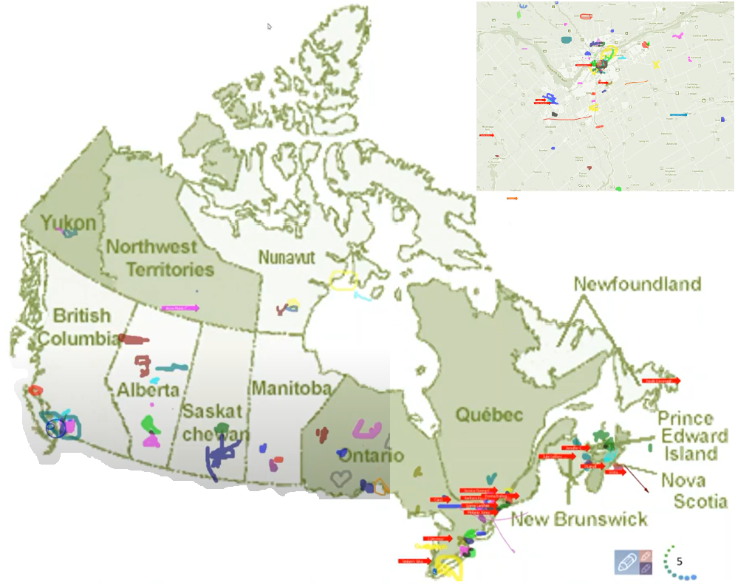
Map of Participation, 2022 English Offering
From across Canada:
From NCR:
Notes:
Alejandro:
The program had participants from across Government and across Canada, as you can see per the slide, the image was co-created at the beginning of the 2022 English offering

Slide 9
Sponsors / Hosts & Facilitators
Dates | Offering | Sponsored / Hosted by | Facilitators
2016 – Apr to Jun | Alpha Pilot | IOCN | 1
2017 – Apr to Jun | Beta Pilot | IOCN | 1
2021 – Apr to Jun | English Pilot | ISC/IOCN | 1
2022 – Apr to Jun | English | ISC/IOCN | 2
2022 – Oct to Nov | French | ISC/IOCN | 8
2023 – May to Jun | English | CICMHWW/IOCN | 10
* 2023 – Oct to Nov | French | CICMHWW/IOCN | tbd
* Planned
Notes:
Co-sponsored by the IOCN, the program is been on the making since 2016
Open to all via the GCTools platforms
As per the table, the program has been Co-delivered by 1, then 2, 8 and 10 co-facilitators.
English 2022 by 2 facilitators
French 2022 by 8 facilitators
English 2023 by 10 facilitators

Slide 10
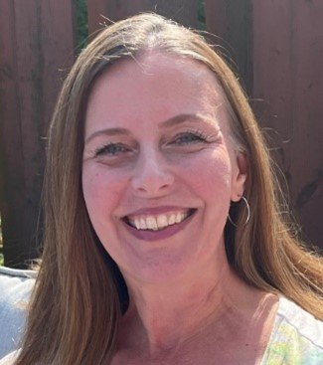
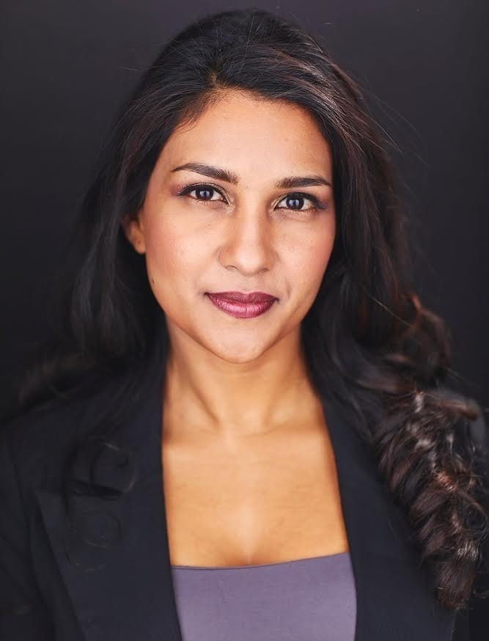
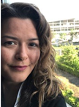
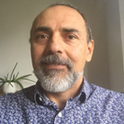
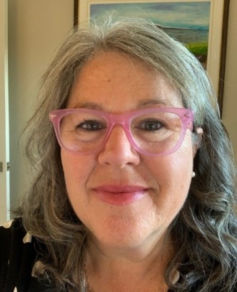
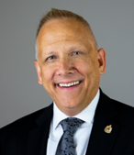
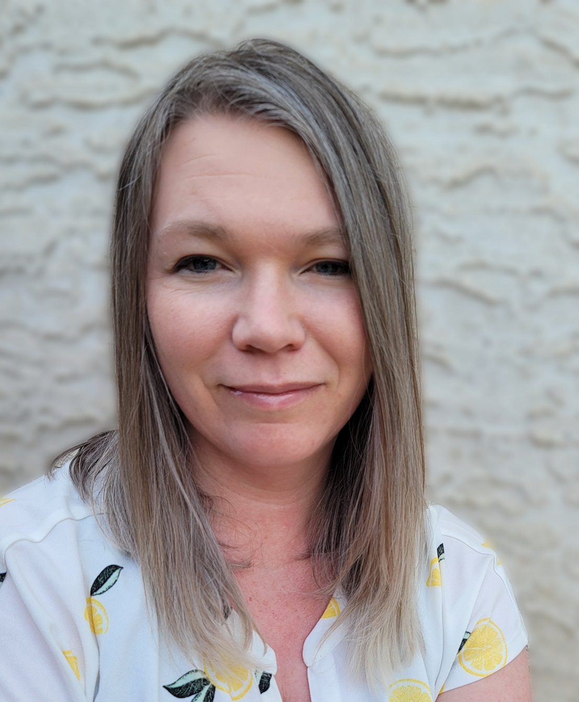
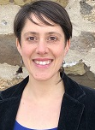
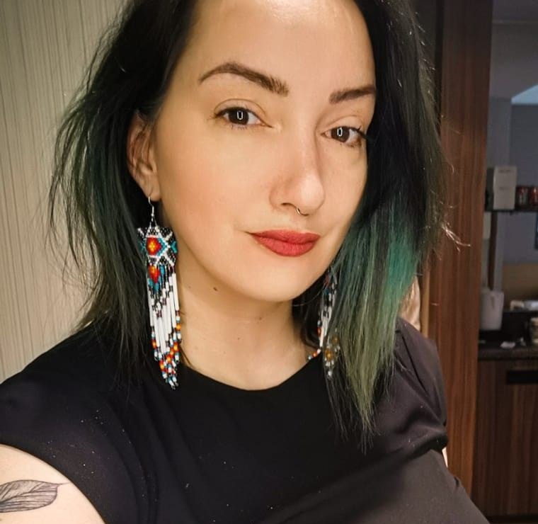
Delivered by a team of volunteer facilitators
Ginette
Casey-Marie
Alison
Carmen
Olivia
Alejandro
Marie-Lyne
Robert
Michelle
Annie-Claude
Dani
Sonya
Leena
Leanne
Your name?
Notes:
Ginette:
Here a partial list of facilitators from various government Departments/Agencies, including:
Service Canada
Governor General
Indigenous Services Canada
Public Services and Procurement Canada
Financial Transactions and Reports Analysis Centre of Canada
Canada Border Services Agency
Treasury Board of Canada Secretariat
Canada Revenue Agency

Slide 11
MCLD – Registration Summary
Completion: (Average: 53%) | 33% | 68% | 63% | 54% | 46% | 52%
Notes:
This graphics summarizes the number of registrants to the various offerings of the program, with the number of people completing and completion percentage.

Slide 12
Key Findings - MCLD English Program 2022
76% return success rate on self-assessments**
20.8%
23.0%
14.0%
20.5%
12.6%
, 3 months after
**From 130 participants completing the program, 99 answered
* People who answered "Almost Always", "Very Frequently", and "Somewhat Frequently"
Notes:
Alejandro:
Participants completed self-assessment questionnaires at program registration and again three months after the eight-week program, and we have compiled the data to evaluate the results and impacts of the Mindful Change Leadership Development program.
(click)
The blue columns represent the results of the self-assessment questionnaires completed at registration.
(click)
The green columns represent the final assessment, and the differences between them indicate behavioural changes.
A total of 130 participants completed the program, we received 99 final assessments (76% return on self-assessments), and the key findings per category are:
(click on each bullet)
An increase of 12.6% Increase in Employee Engagement – respondents show a sense of clarity of mind.
(Q2. I have difficulty distinguishing what day it is.)
A 23.0% Increase in Promoting Sounder Decision Making - people reported taking time to optimize their productivity.
(Q7. I take time each day to optimize my personal productivity)
Slightly over 20% decrease in Behavioural Risks - participants indicated being more aware of the task at hand.
(Q13. It seems I am running on automatic, without much awareness of what I am doing.)
Close to 21% Increase in Well-Being – respondents feel they are more present while at work and at home.
(Q1. I notice that I am distracted by thoughts about work after working hours or about home related things when I'm working.)
And 14.0% Increase in Resiliency - people reported an improvement in their ability to be present.
(Q21. I find myself listening to someone with one ear, doing something else at the same time.)
What we heard from participants was that the program was a life changing experience, it helped them increased their own sense of well-being; and gave them the tools and practices to use with their teams to support employee wellness and well-being.

Slide 13
Program - Key Results Improvements

Slide 14
Main Results of the MCLD Program, 2021 Pilot
19.3%
19.9%
25.0%
22.3%
, 3 months after
* People who answered "Almost Always" and "Very Frequently"
Notes:
:
Participants completed self-assessment questionnaires at program registration and again three months after the eight-week program, and we have compiled the data to evaluate the results and impacts of the Mindful Change Leadership Development program.
The blue columns represent the results of the self-assessment questionnaires completed at registration.
(click)
The green columns represent the final assessment, and the differences between them indicate behavioural changes.
A total of 68 participants completed the 8 week program, we received 56 final assessments, and the key findings per category are:
(click) Almost 20% increased Employee Engagement, respondents are more able to be fully present and attentive in meetings, conference calls and presentations.
(click) 25% Increase in Promoting Sounder Decision Making, people are more able to make time on most days to eliminate some tasks/meetings with limited productivity value.
(click) A little over 22% improvement in managing Behavioural Risks, respondents indicated they are more present completing tasks than potentially thinking about something else.
(click) Just above 19% Increase in Well-Being, participants feel they are more able to be themselves in the (virtual) workplace.
(Note that for the 2022 Program, we included « Resiliency » as a category on the self-assessment questionnaires)
What we heard from participants was that the program increased their own sense of well-being; and gave them the tools and practices to reflect these with their teams to support employee wellness and well-being.

Slide 15
Key Findings - MCLD French Program 2022
28.9%
15.1%
8.7%
3.4%
18.5%
**
, 3 months after
* People who answered "Almost Always“, "Very Frequently", and ** “Somewhat Frequently”, except for Behavioural Risk
Notes:
:
Participants completed self-assessment questionnaires at program registration and again three months after the eight-week program, and we have compiled the data to evaluate the results and impacts of the Mindful Change Leadership Development program.
The blue columns represent the results of the self-assessment questionnaires completed at registration.
The green columns represent the final assessment, and the differences between them indicate behavioural changes.
A total of 50 participants completed the program, we received 32 final assessments, and the key findings per category are:
An increase of 18.5% Increase in Employee Engagement – respondents show more engagement paying attention to the things they were doing at the moment.
(Q8. I find myself doing things without paying attention.)
A 8.7% Increase in Promoting Sounder Decision Making - people reported being more focus throughout on projects.
(Q5. I find it difficult to stay focused on a project from beginning to end. )
Some decrease of 3.4% in Behavioural Risks - participants indicated being more clear and focused on what they could influence rather than worrying about they couldn’t.
(Q16. I influence where I can, rather than worrying about what I can’t influence.)
Close to 30% Increase in Well-Being – respondents feel a sense of work balance by being more present while at work and at home.
(Q1. I notice that I am distracted by thoughts about work after working hours or about home related things when I'm working.)
Slightly over 15% Increase in Resiliency - people report an improvement in their ability to be present.
(Q21. I find myself listening to someone with one ear, doing something else at the same time.)
What we heard from participants was that the program was a life changing experience, it helped them increased their own sense of well-being; and gave them the tools and practices to use with their teams to support employee wellness and well-being.

Slide 16
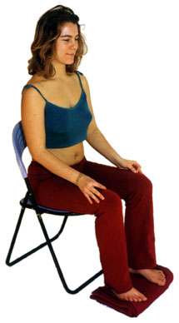
Mindfulness Exercise – Body Scan
Time required: 5 minutes
Take advantage of the opportunity to experience this exercise
Sit as comfortable as possible in a straight position
Feel free to close your eyes
Follow my voice as I lead you through the exercise
Then, we will do a short debrief of what you noticed.
Notes:
With your back straight, sit as comfortable as possible
Gently bring attention to your breath, no need to change the way you’re breathing, just notice it
Stay there for a few seconds
Now, direct your breath and attention to
Your toes, breath in, breath out
Your feet, in and out, notice what you feel
Every time your attention wanders away, just bring it back gently
Your lower leg, in and out and your upper leg, and notice what you feel
Direct your breath towards your waist, in and out
Your lower back, your abdoment
Your upper back, chest
Now direct your breath and attention to your shoulders, breath in, breath out, and notice
Your arms, your hands and fingers, in and out
Back to your shoulders, and neck, noticing
Your head, your scalf, breath in and out
Focus on your face, your eyes, nose and mouth. Your jaw, noticing
Stay there for a few seconds, breathing in and out
Now, come back… and open your eyes.
Debrief: What did you notice?

Slide 17
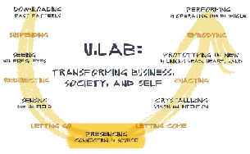
Organizations with Mindfulness Programs
http://www.siyli.org
www.Mindfulnet.org
http://instituteformindfulleadership.org
Notes:
Ginette:
Although this slide was created about 6 years ago (2017’ish), it is still very relevant. You see many different logos here, you may be familiar to more than one of them. Many of these are big companies, and there is a reason why they are implementing mindfulness programs.
Let me draw your attention to a couple of examples
((pick two that you like the most))
On the NBA, Phil Jackson, first with the Chicago Bulls and then with LA Lakers obtained 11 championships, having Michael Jordan, Koby Bryant and the alike do mindfulness exercises. They call it being in “the zone”. He asked NBA players to work on mindfulness exercises he called it being in the Zone – if you read the book 11 rings it will explain more about this.
Also, the Golden State Warriors, have a Mindful Mindset on Four Core values, in order:
1. Joy;
2. Mindfulness;
3. Compassion for team members and for the game of basketball; and
4. Competition
To me that speaks volumes
Google – who has not used google? it is big player in the booming of Mindfulness. Chad-Meng Tan started a mindfulness program in Google with great success that other silicon valley companies asked for it, they created a non for profit organization called Search Inside Yourself (SIY) book and it grew so big that now there is a SIY Leadership Institute (SIYLI).
SIYLI now delivering Mindfulness programs across the world, certifying teachers, implementing programs into organizations and also some countries like Bhutan - https://siyli.org/bhutan-government-employees/
OR
Karen May, VP People Development, executives start meetings with mindfulness time - https://youtu.be/zVlXE1UtJKY?t=421
World Economic Forum – The Forum engages the foremost political, business and other leaders of society to shape global, regional and industry agendas. Janice Marturano, ex VP General Mills and now president of the Institute for Mindful Leadership, presented at that forum - https://www.youtube.com/watch?v=v0CNZLIkIqw
U.Lab / MIT – Senior business management savvy, including mindfulness -they call it presencing- as part of the new way of doing ethical business. You will find the mindfulness theory particularly at the bottom of the circle. The U model takes us from Ego-System to Eco-System - https://www.youtube.com/watch?v=GcbB1I__BmM
Mindful Nation UK – Is co-chaired by the three main political parties in UK with the intention to apply mindfulness programs in the areas of National education, health, the workplace and the criminal justice system. - https://www.themindfulnessinitiative.org/mindful-nation-report
---
Resources in English:
Phil Jackson’s eleven Rings – with Chicago Bulls and LA Lakers obtained 11 championships - https://www.amazon.ca/Eleven-Rings-Success-Phil-Jackson/dp/0143125346
Golden State Warriors, Four Core values - http://yogadork.com/2015/12/09/the-golden-state-warriors-record-breaking-mindful-mindset/
Article – mentions some details about the Mindfulness programs at Google, Aetna, General Mills, Intel, Target & Green Mountain Coffee Roastershttps://hbr.org/2015/12/why-google-target-and-general-mills-are-investing-in-mindfulness
http://www.siyli.org
http://www.Mindfulnet.org
http://instituteformindfulleadership.org

Slide 18
Which Mindful Change Leadership skills support the Key Leadership Competencies?
 | Focus | Clarity | Creativity | Compassion in the service of others
Create Vision and Strategy
Mobilize People
Uphold Integrity and Respect
Collaborate with Partners and Stakeholders
Promote Innovation and Guide Change
Achieve Results
Notes:
Robert:
In the following table, we have the Key Leadership Competency profile from TBS on the left column, and on the top row we have the Mindful Change Leadership skills
This table indicates which competencies is supported by which skill
(click) – in the case of the “Create Vision and Strategy” competency is supported primarily by Clarity and Compassion in the service of others
(click) – “Mobilize people” competency is supported by Focus, Clarity and Compassion in the service of others
(click) and so on and so forth
Now, you may think, well, actually all of the competencies are supported by all of the skills, in a sense yes, the table indicates the skill most predominant or directly related to the competency.
Resources…
Key Leadership Competency profile and examples of effective and ineffective behaviours…
Create Vision and Strategy
Leaders define the future and chart a path forward. They are adept at understanding and communicating context, factoring in the economic, social and political environment. Intellectually agile, they leverage their deep and broad knowledge, build on diverse ideas and perspectives and create consensus around compelling visions. Leaders balance organizational and government-wide priorities and improve outcomes for Canada and Canadians.
Mobilize People
Leaders inspire and motivate the people they lead. They manage performance, provide constructive and respectful feedback to encourage and enable performance excellence. They lead by example, setting goals for themselves that are more demanding than those that they set for others.
Uphold Integrity and Respect
Leaders exemplify ethical practices, professionalism and personal integrity. They create respectful and trusting work environments where sound advice is valued. They encourage the expression of diverse opinions and perspectives, while fostering collegiality. Leaders are self-aware and seek out opportunities for personal growth.
Collaborate with Partners and Stakeholders
Leaders are deliberate and resourceful about seeking the widest possible spectrum of perspectives. They demonstrate openness and flexibility to forge consensus and improve outcomes. They bring a whole-of-government perspective to their interactions. In negotiating solutions, they are open to alternatives and skillful at managing expectations. Leaders share recognition with their teams and partners.
Promote Innovation and Guide Change
Leaders have the courage and resilience to challenge convention. They create an environment that supports bold thinking, experimentation and intelligent risk taking. They use setbacks as a valuable source of insight and learning. Leaders take change in their stride, aligning and adjusting milestones and targets to maintain forward momentum.
Achieve Results
Leaders mobilize and manage resources to deliver on the priorities of the Government, improve outcomes and add value. They consider context, risks and business intelligence to support high-quality and timely decisions. They anticipate, plan, monitor progress and adjust as needed. Leaders take personal responsibility for their actions and outcomes of their decisions.
From: https://www.canada.ca/en/treasury-board-secretariat/services/professional-development/key-leadership-competency-profile/examples-effective-ineffective-behaviours.html

Slide 19
Which Mindful Change Leadership skills support the Core Competencies?
 | Focus | Clarity | Creativity | Compassion in the service of others
Demonstrating integrity and respect
Thinking things through
Working effectively with others
Showing initiative and being action oriented
Notes:
http://myssc-monspc.ssc-spc.gc.ca/en/theacademy/my-faculties/faculty-behavioral-competencies
In this table, showing the Treasury Board of Canada’s Core Competencies, developed within the context of the Performance Management Program:
We can see how Clarity and Compassion in the Service of others supports Demonstrating integrity and respect
How Focus, Clarity and Compassion in the service of others supports Thinking things through
That Working effectively with others is supported by Focus, Creativity and Compassion, and that
Showing initiative and being action oriented is supported by the same Focus, Creativity and Compassion,

Slide 20
MCLD Program Testimonials
"…in a way, your investment in becoming medicine... is a very important investment…" - Elder Malcom Saulis
"I found this course to be extremely powerful and grounding... this really helps to shape how I look at my relationships with my staff… it was excellent. "
"it was very powerful, very interesting, lots of insights. I learned a lot about myself. I found the exercises appropriate in me being more productive, more present in my relationships with my colleagues and also with my family.”
“This series is life changing. I hope to participate more in the future”
"These 8 weeks have been profound… in my view I think this should be mandatory for everyone. it's that powerful"
"Thank you for this valuable opportunity to grow personally and professionally. It has been an important adjunct to the transformational work we are doing“
“I wanted to also share some specific gratitude... I found the sessions incredibly helpful, useful and well structured… it's already had a wonderful effect on my life”
Notes:
From this set of testimonials, I’ll allow myself to read the first one in full… from Elder Malcom Saulis: "... in a way, your investment in becoming medicine for yourself and for the rest of the world is something that I'm grateful to be witness to as an occasional participant in this program... any kind of investment like this in order to open your mind, your heart and your spirit to the presence of a larger world, which is either spiritual or physical, is a very important investment, and I applaud you for the investment that you've made." - Elder Malcom Saulis, session 8, 5456

Slide 21
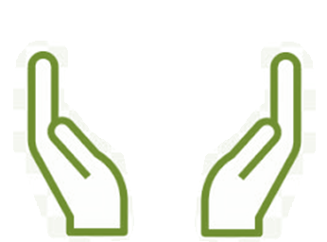
What’s Needed For Success ?
Grass Roots
Voluntary Participation
Support from Management
Notes:
The sessions and take-home activities require up to 3 hours approx per week, including the weekly session. And that’s a fairly significant investment by participants.
Two components which will be key for ensuring the continued success of the program are maintaining voluntary participation and support from management.
(These 2 success factors are emphasized during the promotion of the program, and employees are encouraged to discuss with their managers to get their support)

