Slide 1
TOWARDS SUSTAINABLE FISHERY MANAGEMET
Detecting vessels’ behavior using Artificial Intelligence and Satellite data

Slide 2
The Problem and The Solution
The problem
Canadian fishery officers are heavily present on the water, in the air and in port in order to monitor and inspect fishing activities
Using only this heavy presence to investigate fishing activities is clearly an expensive and time-intensive process.
The SOLUTION
Give Canadian fishery officers bird’s eye view over what is happening in the sea
Create an AI-powered Maritime E-Surveillance System to support to maritime surveillance of fishing activities / vessels activities.

Slide 3
How the AI-powered Maritime E-Surveillance System works
1- Vessels Movement Data
2 – Applying Predictive models
3 – Improved Conservation
Ocean vessel movements are captured using satellite. The following sources are used:
Automatic Identification System (AIS)
Vessel Monitoring System (VMS)
Data sources are passed into Machine Learning (ML) models to identify behavioral markers of fishing.
Department of Fisheries and Oceans Canada uses the insights to manage enforcement efforts more effectively.

Slide 4
A Close-up look at the Predictive Models
AIS Data
VMS Data
Predictive Model to predict vessels positions indicative of fishing activity and hence predict the fishing effort within a specified region of interest.
Predictive Model to find spatial hot spots of fishing activities, and hence find anomalous behaviour and focus enforcement efforts
Predictive Model to find main routes traveled by vessels to analyze vessels movement according to its category
*Fishing activity, shown in red, is most common for speeds in the range of 2 to 5 knots and is also associated with larger deviations in speed and course.
* Tracking the global footprint of fisheries, David A. Kroodsma et al, SCIENCE 23 FEB 2018 : 904-908

Slide 5
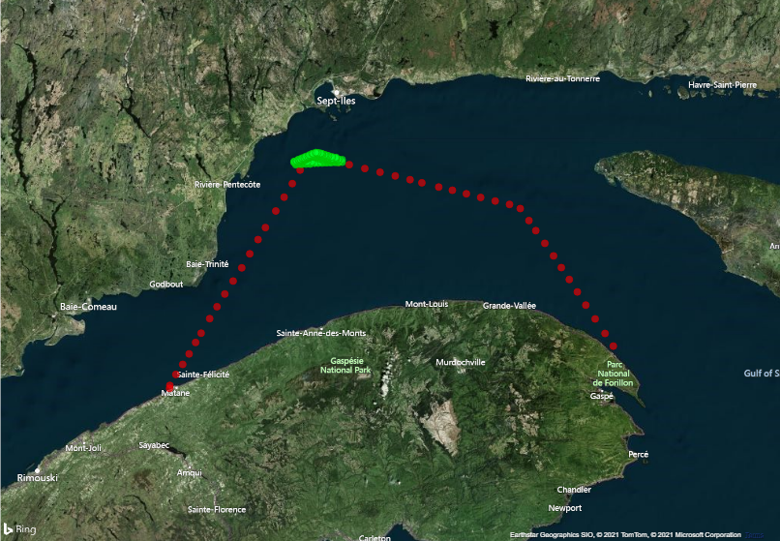
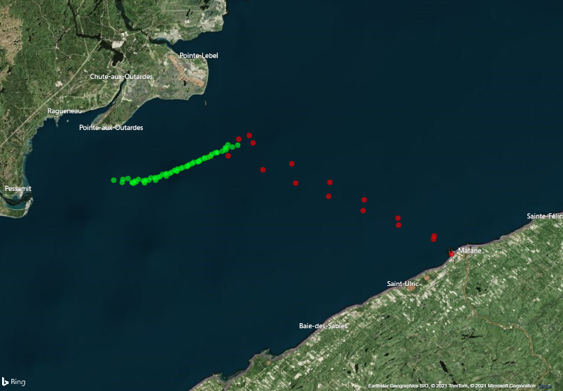
Predictive model for the Detection of Fishing Activities
Example of two different fishing vessels trips. Green points on the vessel tracks indicate fishing activity
(as predicted by a neural network model)*
* Images from the actual system under development. Due to privacy reasons, vessels IDs were removed from the images

Slide 6
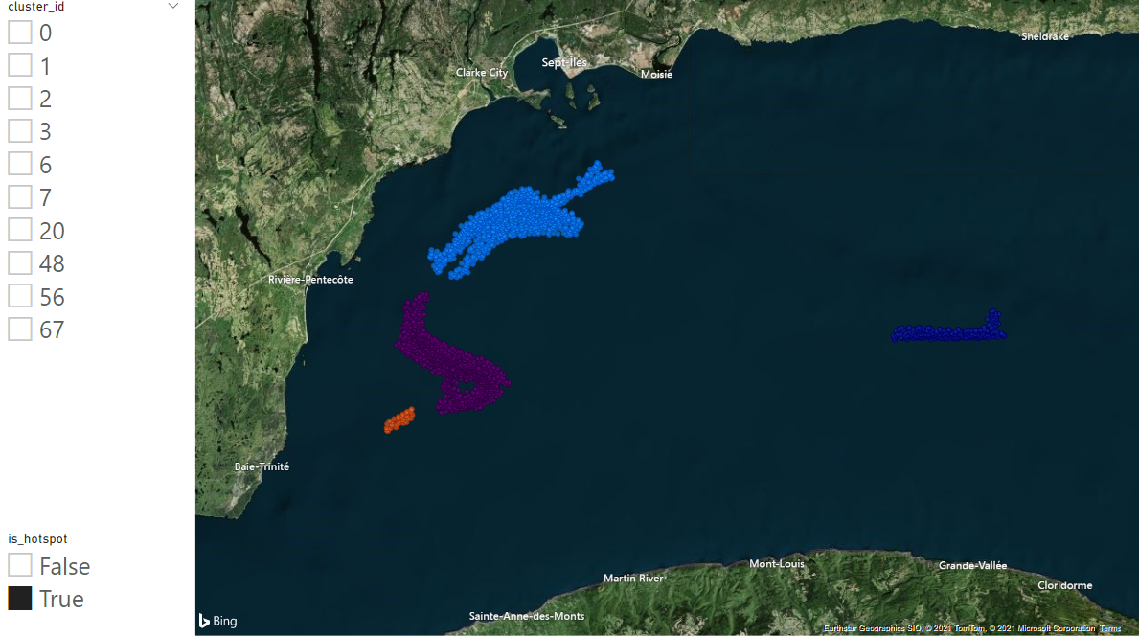
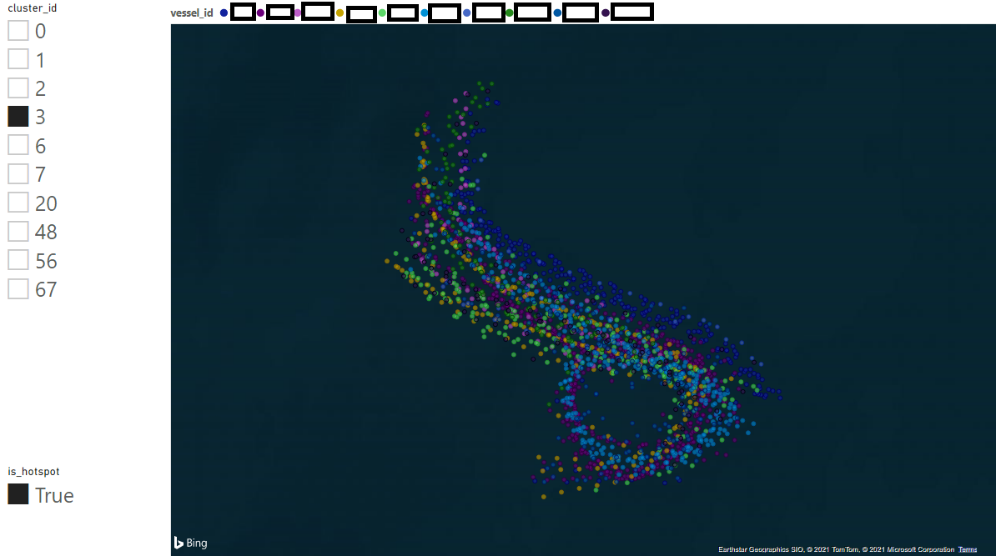
Predictive Model for the Detection of Fishing Hot Spots areas
Fishing hotspot detection over a two week period *
Exploration of the vessel composition of a hotspot *
* Screenshots from the actual system under development. Due to privacy reasons, vessels IDs were removed from the images.

Slide 7
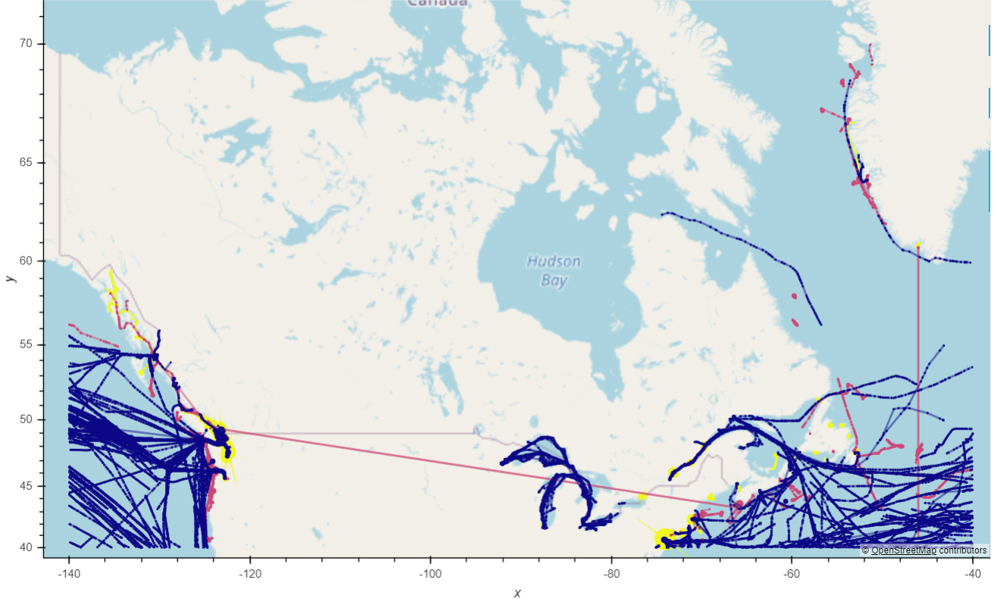
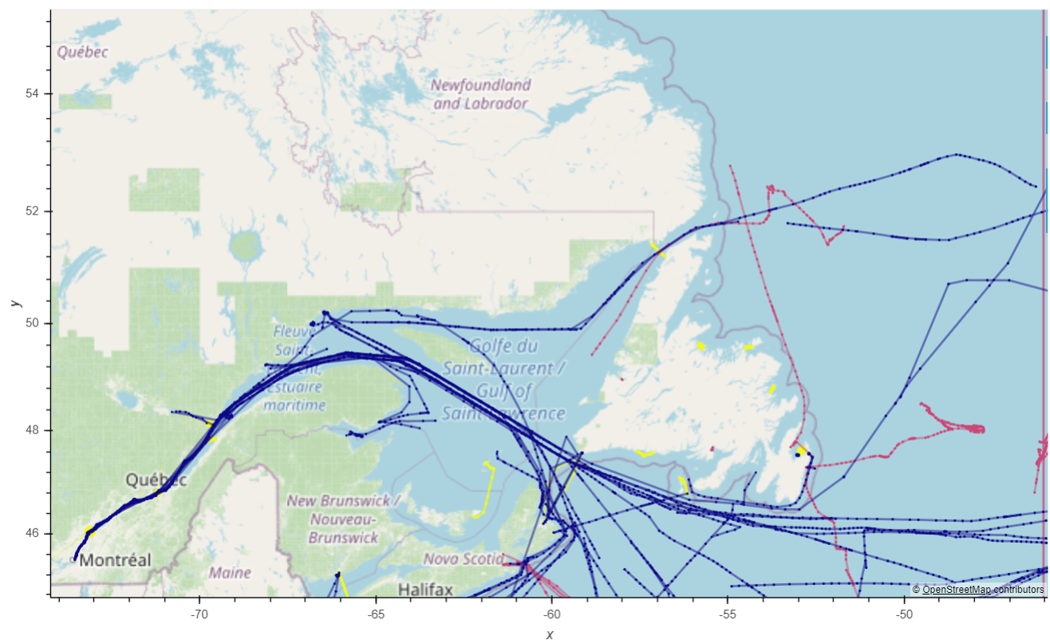
Predictive Model for Vessel Trajectories Aggregation
A national view of vessel traffic*
View of the St. Lawrence gulf area *
* Images from the actual system under development. Color Scheme: Blue – Cargo, Yellow – Passenger, Magenta – Fishing. Due to privacy reasons, vessels IDs were removed from the images.

Slide 8
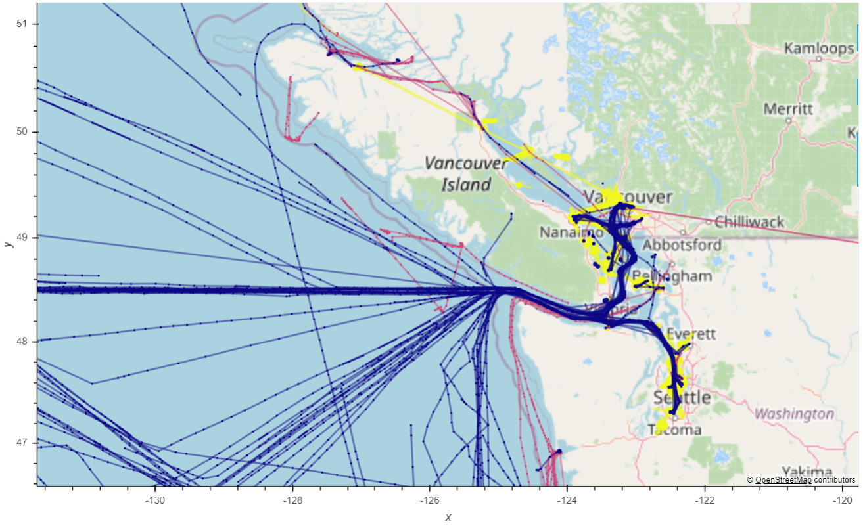
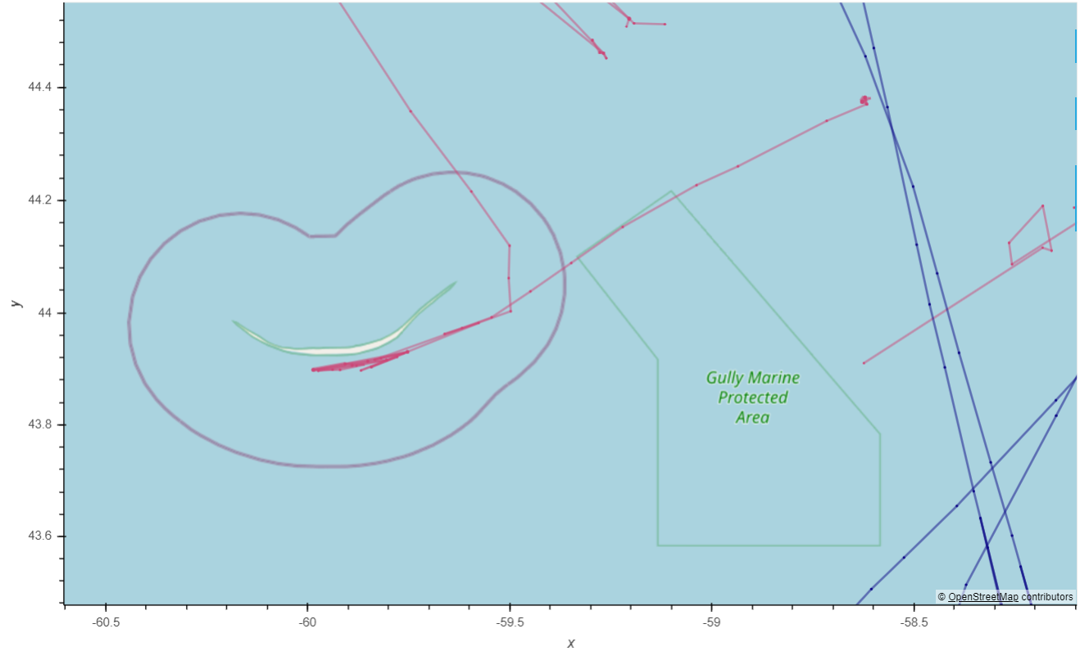
Vessels Tracks Visualization
A view of the Vancouver hub *
A view of a fishing vessel close to a marine protected zone *
* Images from the actual system under development. Color Scheme: Blue – Cargo, Yellow – Passenger, Magenta – Fishing. Due to privacy reasons, vessels IDs were removed from the images.

