Slide 1
National Mobility Bank
A Staffing Redesign Initiative

Slide 2
OVERVIEW OF SESSION
Background on the National Mobility Bank project
National Mobility Bank
What it is
Candidate Form demo
Manager Search Form demo
Resources
Question period

Slide 3
STAFFING REDESIGN PROJECT
Born out of general frustration with the staffing program
Received broad support and sponsorship from executives
Aligns with the Agency’s People First Philosophy
WHAT WE HEARD FOR EMPLOYEE MOBILITY
Employees want:
Greater access to opportunities
A simplified application process
When asked what the worst thing we could do to staffing would be, managers and employees were unanimous in saying: « nothing ».

Slide 4
WHAT IS THE MOBILITY BANK?
Tool created for employees and students, allowing them to move beyond their own branch or region.
Showcasing their interests, skills and education to staffing managers.
Allows managers to search for interested candidates that meet their search criteria.
Easy to access and to use.

Slide 5
HOW IT WAS DEVELOPED
National consultations to establish filters and parameters
Agile partnership with IT Branch for development
Adjustment to deliverables, schedule and budget
Testing
Soft launch | National launch

Slide 6
THE MOBILITY BANK CANDIDATE FORM - DEMO

Slide 7
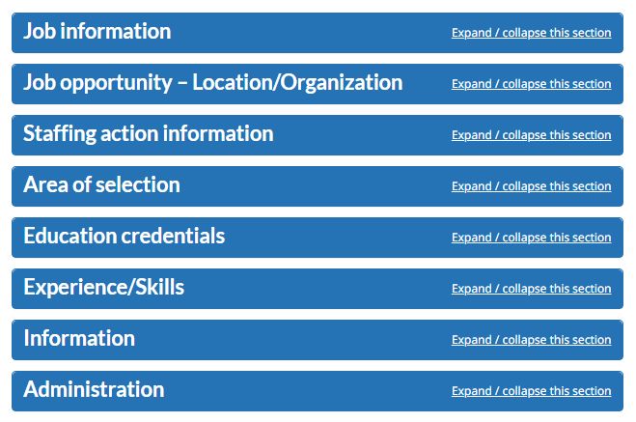
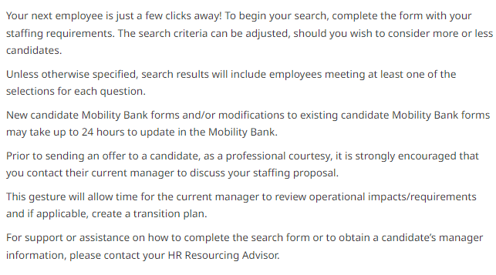
THE MOBILITY BANK MANAGER FORM - DEMO

Slide 8
ONCE A MATCH IS MADE
Letter of interest
Assessment if required
Appointment
Maintaining the candidate profile

Slide 9
RESOURCES
National Mobility Bank Management Hub page
National Mobility Bank InfoZone page
National Mobility Bank Wiki page
Includes FAQs, an employee guide and video tutorials

Slide 10
THANK YOU!
Making staffing better, together
Fast, fair, simple
STAFFING REDESIGN DIVISION

