Slide 1
ChatGPT for #GCDigital
How this technology could impact our work
David Pepin
Free Agent February 2023
pepin.david@gmail.com @quidampepin

Slide 2
My hot take
What to expect in this presentation
ChatGPT is a powerful tool that can help us in the design process.
But it can’t be trusted to deliver accurate answers to users.
Use it with caution.

Slide 3
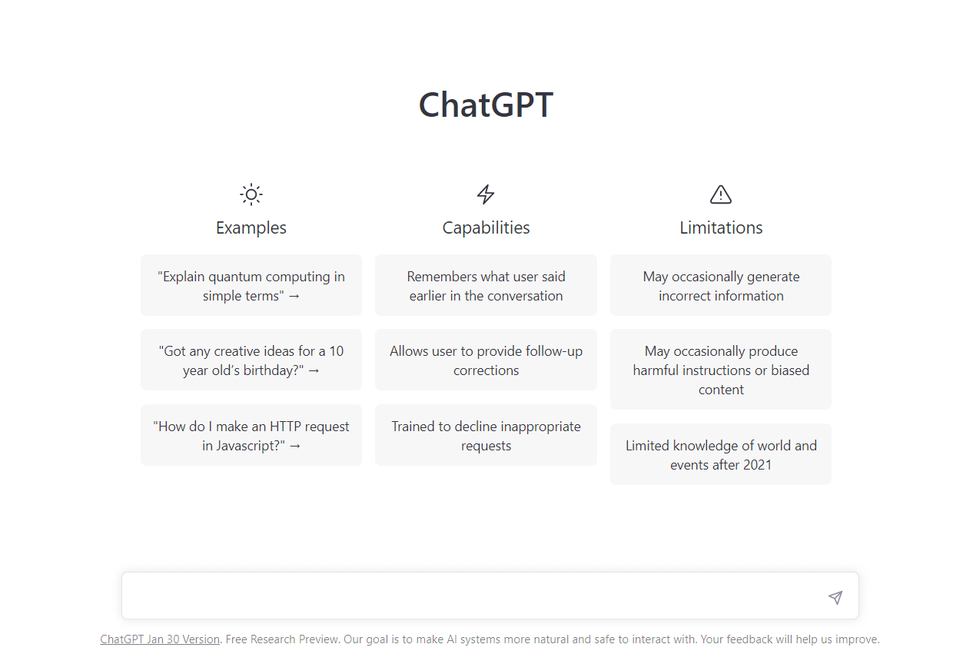
Purpose and context
ChatGPT took the world by storm at the end of 2022.
It almost seemed magical: you could ask anything, and it would reply back, almost like a human.
This deck documents the exploration of these questions:
Could ChatGPT help us in the UX design process?
How might this technology impact our work?

Slide 4
What is ChatGPT
ChatGPT (short for Chat Generative Pre-trained Transformer) is a natural language processing tool, developed by OpenAI.
It uses machine learning algorithms to generate human-like responses to text input.
Natural language processing
Text input
Human-like output

Slide 5
How does it work
Natural language processing (NLP) is a field of artificial intelligence (AI)
NLP algorithms are trained on large datasets of human language
Uses statistical techniques to understand and generate human-like responses to text input
ChatGPT is pre-trained on a very large dataset of human language
It generates content by predicting “the next best word”
In other words: it doesn’t think, it doesn’t know anything - but it’s trained with enough data to generate a plausible response, in context.

Slide 6
ChatGPT in the design process
Leveraging a new technology
Overall impressions
Research
Content
Prototype and code
Learnings on how to prompt

Slide 7
Aspects of UX Design
I experimented different prompts in these categories
Content
Research
Prototype and code

Slide 8
Overall impressions
What it can and cannot do

Slide 9
Caveats and caution
You can use ChatGPT as a tool to help you, not replace you
Always review and edit the output from ChatGPT - you can’t trust it for accuracy
Language models often internalize biases from their training data - use output with caution
The sources in the training data that influence the output are not explicit - no attribution to “inspirations” - can be risky to use the output
ChatGPT has a free version - for now. We don’t know if it’ll last
The field is progressing very rapidly - there may be better models available in the near future

Slide 10
Pros and cons
Useful, but limited
Pros
Handles a variety of language tasks
Very quick language generation
Can get you a first draft in seconds
Conversational: remembers previous prompts so you can refine
Cons
No way to know what sources were used to influence the output
Has no “knowledge” per se
Outputs a lot trivial or general content
Very good at outputting BS with confidence
It’s like an assistant that can quickly perform a very wide range of language tasks, including coding, with extreme velocity, but no sense of what’s appropriate of accurate.
It won’t get annoyed, tired or bored. But it won’t always be right, even though it’ll look like it!
Notes:
Christine Lemmer-Webber - “mansplaining as a service”- https://octodon.social/@cwebber/109462369670144568

Slide 11
Research
Generate usability testing scenarios
Summarize feedback
Create personas
Imagine user flows
Brainstorm options

Slide 12
Generate usability testing scenarios
Prompt
Prompt:
I'm a UX researcher. I'm trying to assess if the Government of Canada web pages about the Child care benefit really help people get their answers. To do this, I will conduct moderated usability testing with real participants. I need help generate task scenarios to test.
The tasks should cover:
- Eligibility
- How much can be received
- How to apply
- What to do to keep receiving it
Each task scenario should be written at the 2nd person. It should be concrete, and there should be a clear answer the participant could provide.
Sample scenarios:
If you were separated and sharing custody, could the two of you choose what percentage of the Canada Child Benefit each of you will get?
Does it take longer to get your first Canada Child Benefit payment if you apply by mail than if you register/use My Account and apply online?
Generate 10 usability testing scenarios following these instructions.

Slide 13
Generate usability testing scenarios
Output
You have recently had a baby and are wondering if you are eligible for the Canada Child Benefit. How would you find out if you are eligible and what information would you need to apply?
You have received the Canada Child Benefit for the past year, but your income has recently increased. How would you find out if this change affects your eligibility for the benefit and how would you update your information?
You are planning on applying for the Canada Child Benefit and are wondering how much you can expect to receive. How would you find out how much you are eligible to receive and what factors are taken into consideration when calculating the amount?
You are ready to apply for the Canada Child Benefit and want to know the different options for submitting your application. How would you find out how to apply and what documents and information you need to provide?
You have been receiving the Canada Child Benefit for a few months and are wondering if there is anything you need to do to continue receiving it. How would you find out what steps you need to take to maintain your eligibility for the benefit?
You have recently moved to a new province and are wondering if this affects your eligibility for the Canada Child Benefit. How would you find out if your new location changes your eligibility and what steps you need to take to update your information?
You are considering applying for the Canada Child Benefit but are not sure if you meet the income requirements. How would you find out what the income limits are and how your income is calculated for the benefit?
You have heard that the Canada Child Benefit amount is adjusted based on the number of children in your family. How would you find out how the number of children in your family affects the amount you receive and how this is calculated?
You have recently had another child and want to know how this affects your Canada Child Benefit payments. How would you find out if you need to update your information and how this will affect the amount you receive?
You have been receiving the Canada Child Benefit for a few years and are wondering if there have been any changes to the program or eligibility requirements. How would you find out if there have been any updates and how they might affect your benefit payments?

Slide 14
Summarize feedback
Prompt
Prompt:
I will paste comments collected on pages related to Employment Insurance.
Give me this info about that data:
- top 5 issues encountered by users, along with a representative comment for that issue
- ideas on how to solve these issues
Give me your reply in a table format.
(then copied the first 100 comments)

Slide 15
Summarize feedback
Output
Issue | Representative comment | Ideas for Solution
Applying for benefits | "I need to apply for benefits" | Provide clear instructions and a link on how to apply for benefits on the Employment Insurance (EI) website.
Difficulty finding where to apply for benefits | "Why is it so difficult to find where to apply for EI! I keep being lead in a circle though these information documents but can't find where to actually apply!" | Make the link to apply for benefits more prominent on the EI website.
Difficulty navigating the EI website | "Doing this on my phone and went in contacts to get a phone number and I canâ€™t figure out how to get back to where I was" | Improve the navigation and design of the EI website to make it easier for users to find and access the information they need.
Unable to access or reactivate a previous EI claim | "Trying to reactivate old claim will not except the information I am providing" | Make it clear on the EI website how to access or reactivate a previous claim, and provide assistance for users who are experiencing difficulties doing so.
Difficulty contacting a representative for assistance | "Need to speak to a representative" | Provide clear information on the EI website on how to contact a representative for assistance, including phone numbers and email addresses. Consider offering live chat.
Notes:
Note: is that accurate? Can you trust it? Worth exploring.

Slide 16
Summarize feedback
Thoughts
Promising use: feed a large quantity of comments and instantly get a “snapshot”
Is it accurate? Can you trust it? Would need to compare with human analysis
What do you lose, what do you gain, compared to a human analysis?
Is it ethical to feed the algorithm comments from users, who never agreed to this?
Would probably we preferable to have a local version of a similar tool:
can configure it to feed more comments
can tweak parameters
ensures comments are not used by OpenAI
Notes:
Note: is that accurate? Can you trust it? Worth exploring.

Slide 17
Create personas
Prompt
Prompt: Here's the description of a page I'm working on (Health Infobase - Health data in Canada): Data tools, infographics, charts and blogs about health data in Canada. The data products accessible from this page cover a wide range of topics (covid-19, mental health, opioids, all sorts of diseases and infections, determinants of health, etc.). The products are designed for the general public, health data enthusiasts, and public health specialists. Most products show key insights from the data, some way to explore the data (interactive visualization), and access to raw data.
Create 5 behavioral personas for that content.
For each persona, include:
A representative title (for example: the Health journalist)
Goals
Needs
Opportunities
Challenges
Data tasks (what do they want to do with the data)
Design implications
Start with the first persona.

Slide 18
Create personas
Output
Title: The Health Data Enthusiast
Goals: To stay up-to-date on the latest health data trends and findings in Canada, to learn more about health data analysis and visualization techniques, and to share their knowledge with others.
Needs: Access to high-quality, reliable health data sources, easy-to-use data visualization tools, and clear, concise explanations of the data.
Opportunities: The Health Infobase provides a wide range of data products on a variety of health topics, allowing the Health Data Enthusiast to explore and learn about different areas of health data. The interactive visualizations and access to raw data also provide opportunities for hands-on learning and experimentation.
Challenges: Sifting through large amounts of data and understanding technical terms and concepts can be overwhelming for the Health Data Enthusiast. It may also be challenging to find data products that are tailored to their level of expertise.
Data tasks: The Health Data Enthusiast may want to explore different data products, filter and sort data, create custom visualizations, and download raw data for further analysis.
Design implications: It is important for the design of the Health Infobase to be user-friendly and intuitive, with clear navigation and explanations of the data. Providing a range of data products at different levels of complexity and offering tools and resources for learning about health data analysis and visualization can also be helpful for the Health Data Enthusiast.
5 personas
Health Data Enthusiast
The Public Health Specialist
The Health Journalist
The Concerned Citizen
The Health Professional
Notes:
Note: not overly usefl - but not very different from a costly report done by a consultant for PHAC…

Slide 19
Imagine user flows
Prompt
Prompt:
You're a service designer. You're working on improving the way people can get access to the Guaranteed Income supplement from the Government of Canada.
Create the complete user flow for that service.
For each step, include opportunities and challenges.
Give your answer in a table format.

Slide 20
Imagine user flows
Output
Step | Opportunities | Challenges
1. Determine eligibility for GIS | Providing clear and accurate information on the eligibility criteria can help users understand whether they may be eligible for GIS. | Some users may have difficulty understanding the eligibility criteria or may not have all the necessary documentation to determine their eligibility.
2. Complete the application form | Providing clear instructions and examples on the application form can help users complete it accurately and efficiently. | Some users may have difficulty completing the application form due to a lack of understanding or difficulty with reading or writing.
3. Submit the application form | Offering multiple options for submitting the application form (e.g. online, by mail, in person) can make it more convenient for users. | Some users may have difficulty accessing the necessary technology or transportation to submit the application form.
4. Wait for a response | Providing regular updates on the status of the application can help reduce anxiety for users who are waiting for a response. | The waiting period for a response may be lengthy, which can be frustrating for users.
5. Attend an in-person appointment (if required) | Providing clear information on the location and purpose of the in-person appointment can help users prepare and feel more comfortable attending. | Some users may have difficulty accessing the location of the appointment or may have mobility issues that prevent them from attending.
6. Receive the GIS payment | Providing clear instructions on how and when users will receive their GIS payment can help them plan and budget. | Some users may have difficulty setting up a bank account or may not have access to a bank account, which could impact their ability to receive the payment.

Slide 21
Brainstorm options
Prompt
Prompt:
In the government of Canada, digital transformation is often hard and complex. It's difficult to work across silos (between departments and within departments), approvals take forever, evidence is often ignored, and small agile teams often have a hard time navigating big waterfall organizations. You are tasked with helping the management team come up with innovative ideas to help solve these issues.
Generate 10 ideas to help with these issues.

Slide 22
Brainstorm options
Output
Implement agile methodologies: Agile methodologies, such as Scrum and Kanban, prioritize flexibility and rapid iteration. (...)
Use design thinking: Design thinking is a human-centered approach to problem-solving that can help teams identify and solve complex challenges. (...)
Establish clear decision-making processes: By creating clear processes for making decisions, teams can move forward more quickly and effectively. (...)
Encourage open communication: Encouraging open communication and collaboration can help teams work more effectively across silos and within departments.(...)
Leverage data and analytics: By using data and analytics to inform decision-making, teams can make more informed and evidence-based decisions.
Foster a culture of innovation: Encouraging a culture of innovation can help teams think outside the box and come up with creative solutions to complex challenges. (...)
Establish cross-functional teams: By bringing together experts from different departments and areas of expertise, cross-functional teams can work more effectively to tackle complex challenges. (...)
Implement tools and technologies: There are many tools and technologies available that can help teams work more effectively and efficiently. (...)
Establish clear goals and objectives: By setting clear goals and objectives, teams can better understand what they are working towards and how their efforts fit into the bigger picture. (...)
Encourage continuous learning: By encouraging a culture of continuous learning, teams can stay up-to-date with the latest trends and best practices in their field.

Slide 23
Content
Plain language existing content
Translate
Paraphrase
Summarize complex information
Group items (IA)
Get examples for micro-copy and messages

Slide 24
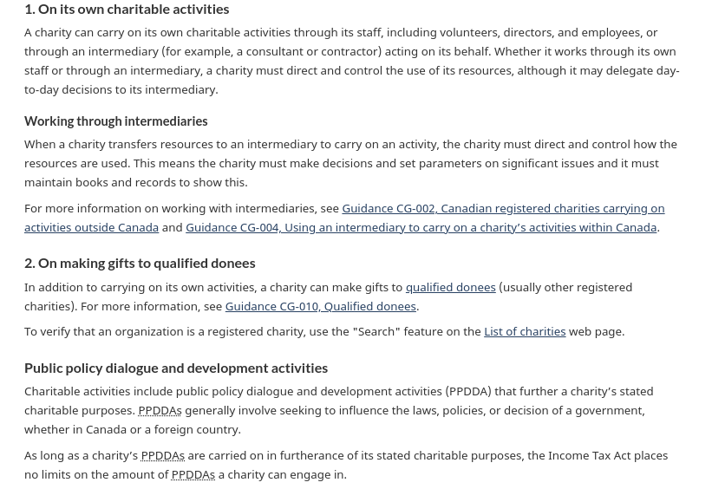
Plain language existing content
Prompt
Prompt:
Rewrite the following content in plain language. Use these instructions:
- aim for grade 8
- avoid passive voice, unless it's more clear that way
- avoid jargon and complex words
- use short sentences and short paragraphs
- separate the content in logical sections, with meaningful and descriptive headings
- include references to additional information (I then pasted the content)
Hemingway: grade 12

Slide 25
Plain language existing content
Output
How charities can help
Charities can help by doing things themselves or by hiring someone else to do them. In either case, the charity must be in charge and make sure the money is used correctly. If a charity hires someone else to do the work, it must still make important decisions and keep records to show this.
Giving money to other charities
Charities can also give money to other registered charities. To check if an organization is a registered charity, use the "Search" feature on the List of charities web page.
Influencing government decisions
Charities can try to influence government decisions as long as it helps them achieve their goals. This is called "public policy dialogue and development activities" or PPDDAs. There is no limit on how much a charity can do this.
For more information on these topics, see the following resources:
Guidance CG-002, Canadian registered charities carrying on activities outside Canada
Guidance CG-004, Using an intermediary to carry on a charity’s activities within Canada
Guidance CG-010, Qualified donees
Guidance CG-027, Public policy dialogue and development activities
Hemingway: grade 9

Slide 26
Plain language existing content
Thoughts
Promising use: very quickly rewrite something
Can give good hints on how to simplify wording
Obviously still need human review: what if something important lost in translation?

Slide 27
Translation
Prompt
<h1 class="gc-thickline mrgn-tp-0">Design process</h1>
<div class="visible-xs visible-sm">
<h2 class="h3">On this page</h2>
<ul>
<li><a href="#data_product">From data to product</a></li>
<li><a href="#roadmap">Product roadmap</a></li>
</ul>
</div>
<p>This design process is not a mandatory process. It’s a suggested process to help you design the best possible product.</p>
<h2 id="data_product">From data to product</h2>
<p>The design process should always have the<strong> end user</strong> in mind: </p>
<ul>
<li><strong>Who </strong>is the product for? </li>
<li>What will they <strong>do </strong>with the data?</li>
<li>How can the product help them get <strong>what they need</strong> from the data? </li>
</ul>
Prompt:
Translate the content of this HTML in French, and give me back the translated HTML:

Slide 28
Translation
Output
<h1 class="gc-thickline mrgn-tp-0">Processus de design</h1>
<div class="visible-xs visible-sm">
<h2 class="h3">Sur cette page</h2>
<ul>
<li><a href="#data_product">De la donnée au produit</a></li>
<li><a href="#roadmap">Feuille de route du produit</a></li>
</ul>
</div>
<p>Ce processus de design n'est pas un processus obligatoire. C'est un processus suggéré pour vous aider à concevoir le meilleur produit possible.</p>
<h2 id="data_product">De la donnée au produit</h2>
<p>Le processus de design doit toujours avoir l'<strong>utilisateur final</strong> à l'esprit :</p>
<ul>
<li><strong>Qui</strong> est le produit pour ?</li>
<li>Qu'est-ce qu'ils vont <strong>faire</strong> avec les données ?</li>
<li>Comment le produit peut-il les aider à obtenir <strong>ce dont ils ont besoin</strong> à partir des données ?</li>
</ul>
Notes:
Note: translation is sub-par

Slide 29
Paraphrase
Prompt
Prompt:
Could you paraphrase this:
The exact amount you receive will be determined once your application is processed.
Up to 15 weeks of sickness benefits are available. The number of weeks of benefits you get depends on how long you’re unable to work for medical reasons. You could receive 55% of your insurable earnings* up to a maximum of $650 a week. The amount you receive depends on your insurable earnings before taxes in the past 52 weeks or since the start of your last claim, whichever is shorter.
*Insurable earnings include most of the different types of compensation from employment, such as wages, tips, bonuses and commissions. The Canada Revenue Agency determines what types of earnings are insurable.

Slide 30
Paraphrase
Output
If you are unable to work due to medical reasons, you may be eligible to receive sickness benefits for up to 15 weeks. The amount of benefits you receive will be based on your previous insurable earnings, which includes most types of income from employment like wages, tips, bonuses, and commissions. The Canada Revenue Agency determines which types of earnings are considered insurable. You may receive up to 55% of your insurable earnings, up to a maximum of $650 per week. The amount you receive will be determined once your application has been processed.

Slide 31
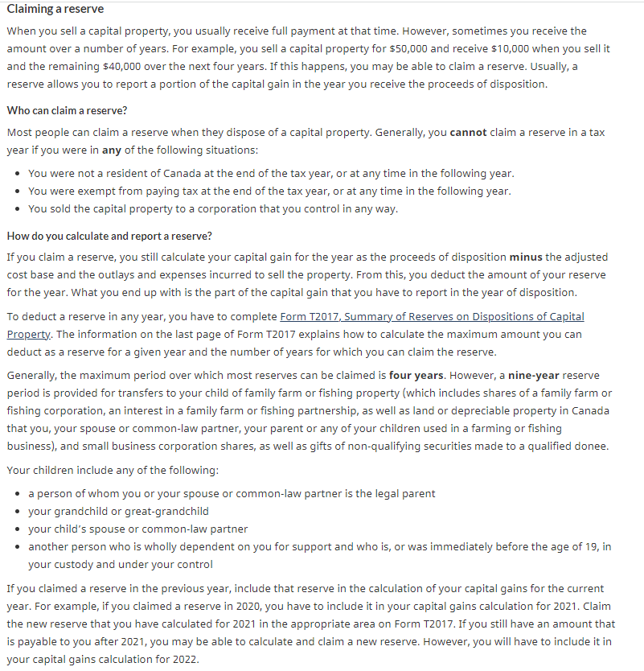
Summarize complex information
Prompt
Prompt:
Could you summarize this complex information in a digestible manner?

Slide 32
Summarize complex information
Output
A reserve is a way to report a portion of the capital gain from the sale of a capital property in the year that the proceeds of the sale are received, rather than in the year the property is sold. Most people can claim a reserve when they dispose of a capital property, as long as they are Canadian residents and not exempt from paying tax. A reserve can be claimed over a maximum period of four years, except in the case of transfers of family farm or fishing property or small business corporation shares to a child, or gifts of non-qualifying securities to a qualified donee, in which case the maximum reserve period is nine years. To claim a reserve, you must complete Form T2017 and follow the instructions for calculating the maximum reserve amount and the number of years for which it can be claimed. Any reserve claimed in a previous year must be included in the calculation of capital gains for the current year. A capital gain from a reserve qualifies for the capital gains deduction only if the original capital gain was from a property eligible for the deduction. If you donate a non-qualifying security to a qualified donee and have a capital gain, you may be able to claim a reserve in order to postpone the inclusion of the capital gain in income.

Slide 33
Group items (IA)
Prompt
Blood and metabolic diseases
Cancer
Cardiovascular diseases
Chronic diseases
COVID-19
Developmental disorder
Digestive diseases
Disabilities
Musculo-skeletal disorders
Neurological diseases
Respiratory diseases
Sexually transmitted infections
Antimicrobial
Prescription drugs
Vaccines
Hospitals
Obesity
Physical activity
Radon
Sleep
Wildfires
Brain injuries
Consumer product injuries
Death
Drowning
Self-harm and suicide
Violence
Child maltreatment
Mental illness
Positive mental health
Self-harm and suicide
Violence
BIPOC
Birth
Children
Family
Inequalities
Maternity
Alcohol
Cannabis
Opioids
Smoking and vaping
Stimulants
Supervised consumption sites
Prompt:
Group the following tags in 5 to 8 top categories.
Answer in a table format. Left column: Top categories. Right column: topics.

Slide 34
Group items (IA)
Outcome
Top categories | Tags
Health conditions | Blood and metabolic diseases, Cancer, Cardiovascular diseases, Chronic diseases, COVID-19, Developmental disorder, Digestive diseases, Disabilities, Musculo-skeletal disorders Neurological diseases Respiratory diseases, Sexually transmitted infections
Medical treatments | Antimicrobial, Prescription drugs, Vaccines, Hospitals
Health behaviors | Obesity, Physical activity, Radon, Sleep, Wildfires, Alcohol, Cannabis, Opioids, Smoking and vaping, Stimulants, Supervised consumption sites
Health outcomes | Brain injuries, Consumer product injuries, Death Drowning, Self-harm and suicide, Violence, Child maltreatment
Mental health | Mental illness, Positive mental health, Self-harm and suicide, Violence
Demographics | BIPOC, Birth, Children, Family, Inequalities, Maternity
Notes:
Note: not exactly how I have grouped things myself, but not a bad starting point.

Slide 35
Get examples for micro-copy and messages
Prompt
Prompt:
Write 3 error messages for when the user enters a wrong password.
Make the messages short, useful, and helpful.
Use 3 different tones: serious, casual, silly.

Slide 36
Get examples for micro-copy and messages
Output
Serious: "Incorrect password. Please try again or contact the system administrator for assistance."
Casual: "Oops, that password isn't quite right. Give it another shot or maybe try resetting your password."
Silly: "Wrong-o! That password is not the one. Maybe try something else, like 'password123' or 'qwertyuiop'?"

Slide 37
Prototype and code
Create SVGs for Figma
Generate HTML
Help with CSS
Understand Regex
Write metadata
Write structured data
Repetitive coding tasks
Explain a piece of code
Code a form in JS
Create Python scripts

Slide 38
Create SVGs for Figma
Prompt
Prompt:
I'm working on a prototype in Figma for a web app. Could you create 3 minimalistic SVG icons for me:
- Home
- Twitter
- Email

Slide 39
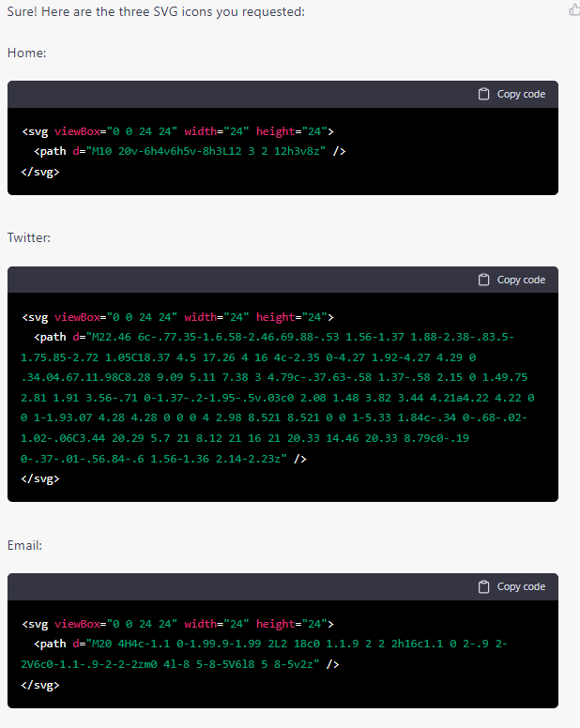
Create SVGs for Figma
Output

Slide 40
Generate HTML
Prompt
# This is my heading text
After several unsuccessful attempts in the past, I decided to create a personal publishing space. Why not just talk about a blog? Because it won't just be a space for posting blog posts. There will also be short fiction texts, as well as notes, to quickly share a link or an idea.
## My favorite subjects
Much of what I plan to write is related to my work:
content design
UX
Government of Canada web presence and service delivery
evidence-based continuous improvement
I intend to do it while respecting my code of ethics, of course (I want to write a post on this question, but in the meantime this post written by Sean Boots reflects my position quite well: [Principles for blogging as a public servant](https://sboots.ca/2020/01/21/principles-for-blogging-as-a-public-servant/).
## Not limited to work
But I will not limit myself to my work, particularly in the Fiction section. I'll talk about whatever I want to, in my own way.
In short, this should be a rather eclectic publishing space.
Prompt:
Turn this into HTML code:

Slide 41
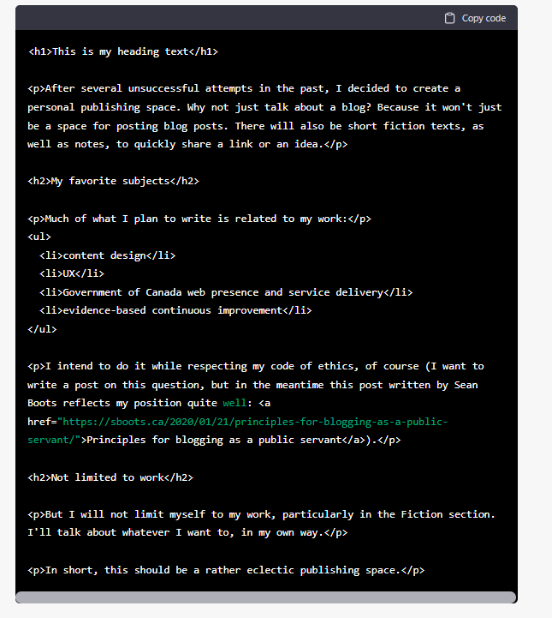
Generate HTML
Output

Slide 42
Help with CSS
Prompt
Prompt:
I have this code for a button:
<button type="submit" class="apply-button">Apply</button>
Could you generate the CSS for the apply-button class so that:
- the font is a bit bigger than the rest of the text
- the background color is #26374A
- the font text is white
- there's a bit of spacing all around the text
- the button has a radius that makes it look like a pill

Slide 43
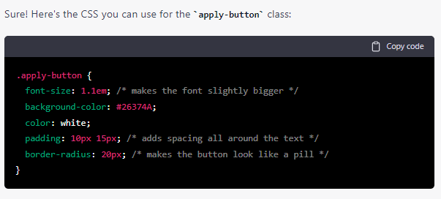
Help with CSS
Output
Notes:
Note: makes manual prototyping quick

Slide 44
Understand Regex
Prompt and output: explain a Regex
Output: …
In other words, this regular expression requires that the string:
Contains at least one lowercase letter
Contains at least one uppercase letter
Contains at least one digit
Is between 6 and 12 characters in length
…
Prompt (explain a Regex):
Could you explain this regex to me, and show me examples of what would match it and not match it?
^(?=.*[a-z])(?=.*[A-Z])(?=.*\d).{6,12}$

Slide 45
Understand Regex
Prompt and output - generate Regex
Prompt (Create a Regex):
Create a Regex to verify if a password matches these things:
- Contains at least one lowercase letter
- Contains at least one uppercase letter
- Contains at least one digit
- Is between 6 and 12 characters in length
Regex created from instructions:
Notes:
Note: Regex remains a mystery to me…

Slide 46
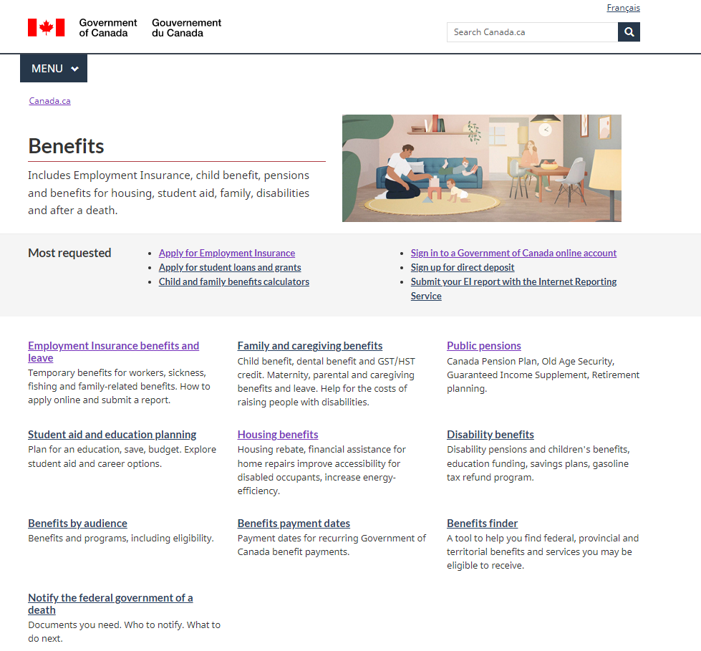
Write metadata
Prompt
Prompt:
I will paste the content of an HTML page. Please fill out these metadata fields. Use meaningful and representative keywords:
<meta name="description" content=""/>
<meta name="keywords" content=""/>
(then pasted the content of the Benefits theme page)

Slide 47
Write metadata
Output
<meta name="description" content="Information and access to Canadian government benefits, including Employment Insurance, child benefit, pensions, student aid, and assistance for housing, families, and individuals with disabilities. Includes information on how to apply for benefits and payment dates for recurring payments. Also includes a benefits finder tool and information on how to notify the government of a death." />
<meta name="keywords" content="Canadian government benefits, Employment Insurance, child benefit, pensions, student aid, housing assistance, family benefits, disability benefits, benefit payment dates, benefits finder, notify government of death" />

Slide 48
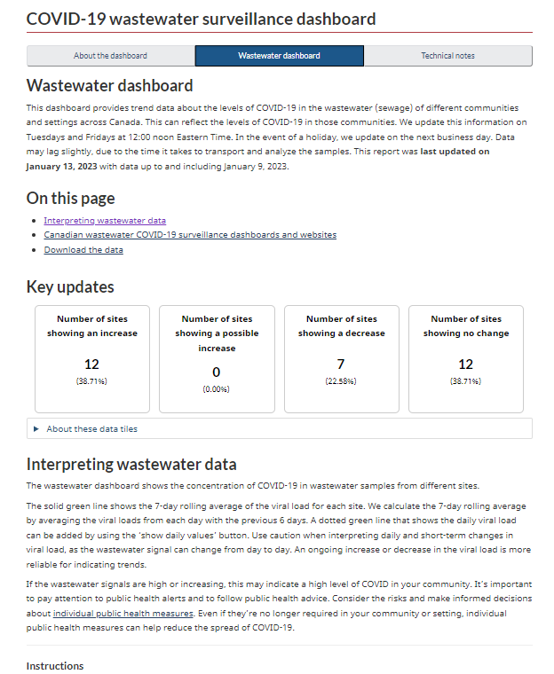
Write structured data
Prompt
Prompt: I will paste some HTML. Write structured data for it, using the FAQ schema. Include the following questions, and give a short, plain language answer:
- What is the COVID-19 wastewater dashboard?
- How to interpret wastewater data?
- Where is the data from?
(I then pasted the content of the page)

Slide 49
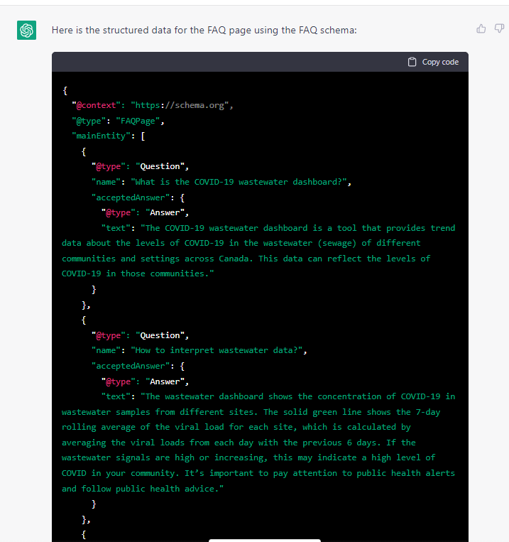
Write structured data
Output
Valid JSON-LD code to paste in HTML
Notes:
Note: it works. But is manual JSON-LD code the way to go?

Slide 50
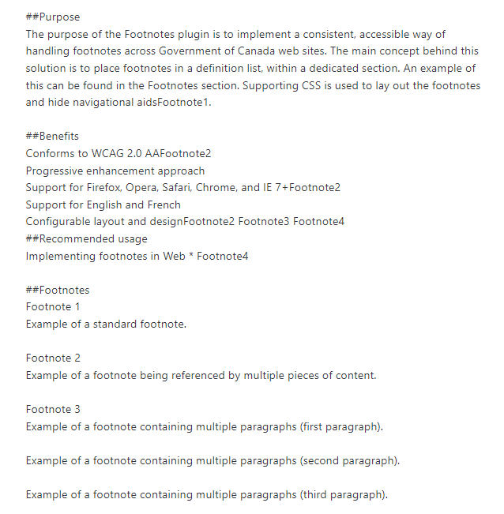
Repetitive coding tasks
Prompt
Prompt: Here's the code to add foonote in the body of and HTML page:
<sup id="fn1-rf"><a class="fn-lnk" href="#fn1"><span class="wb-inv">Footnote </span>1</a></sup>
And the code to add the foonote at the end:
<aside class="wb-fnote" role="note">
<dl>
<dt>Footnote 1</dt>
<dd id="fn1">
<p>Example of a standard footnote.</p>
<p class="fn-rtn"><a href="#fn1-rf"><span class="wb-inv">Return to footnote </span>1<span class="wb-inv"> referrer</span></a></p>
</dd>
</dl>
</aside>
Use this sample to give me the HTML version of this text:

Slide 51
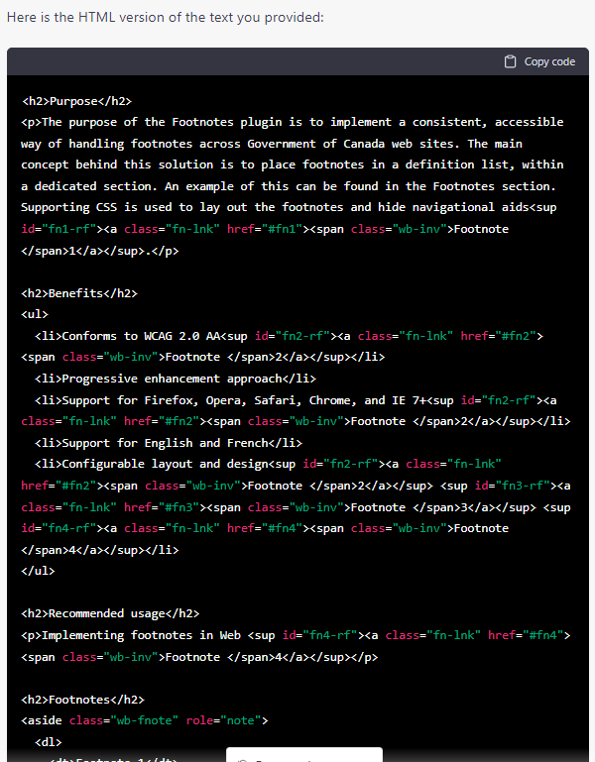
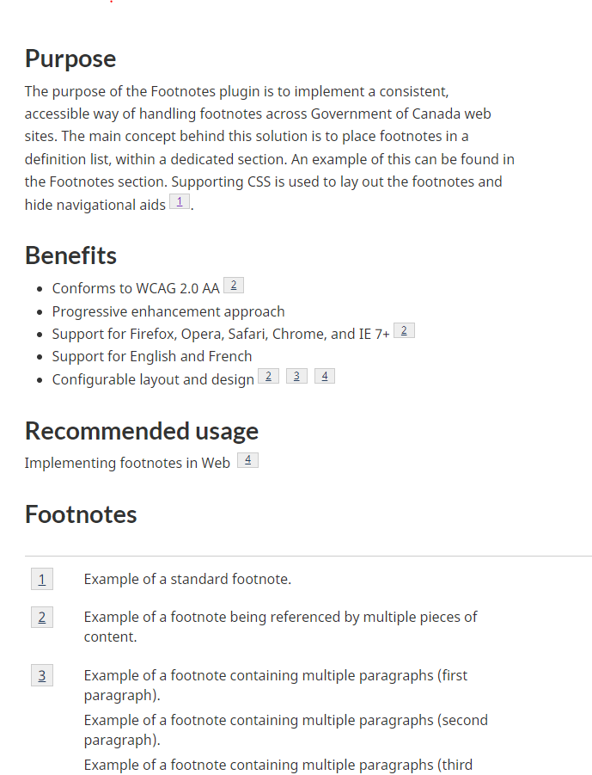
Repetitive coding tasks
Output

Slide 52
Explain a piece of code
Prompt
from nltk.tokenize import RegexpTokenizer
tokenizer = RegexpTokenizer('\w+')
tokens = tokenizer.tokenize(revised_text)
words = []
for word in tokens:
words.append(word.lower())
#remove stop words from the tokens to get only the meaningful words
nltk.download('stopwords')
sw_en = nltk.corpus.stopwords.words('english')
words_ns_en = []
for word in words:
if word not in sw_en:
words_ns_en.append(word)
#get the 15 most used words in the text
from nltk import FreqDist
fdist1_en = FreqDist(words_ns_en)
most_common_en = fdist1_en.most_common(20)
mc_en = pd.DataFrame(most_common_en, columns =['Word', 'Count'])
mc_en = mc_en[['Count', 'Word']]
Prompt:
Explain in simple terms what this code does:

Slide 53
Explain a piece of code
Output
This code is preprocessing some text. It does the following:
Tokenizes the text using a regular expression, which means it divides the text into individual units called tokens. The regular expression used here is '\w+', which will match any alphanumeric word character (letter or digit) and remove all other punctuation.
Converts all of the tokens to lowercase.
Removes stop words from the text. Stop words are common words that add little meaning to a text, such as "a", "and", "the", etc. The code downloads a list of stop words in English from the Natural Language Toolkit (nltk) library, and then removes those words from the list of tokens.
Counts the frequency of each remaining word in the text and gets the 20 most common words. It stores these words and their counts in a Pandas dataframe. Finally, the dataframe is rearranged so that the "Count" column appears before the "Word" column.

Slide 54
Code a form in JS
Prompt
Prompt:
I want to add a simple calculation on a webpage. I want:
- a single form field where you enter your salary
- a button to submit
- an output shown on submission, calculating 55% of the entered salary
Can you give me the HTML and JS to do that?

Slide 55
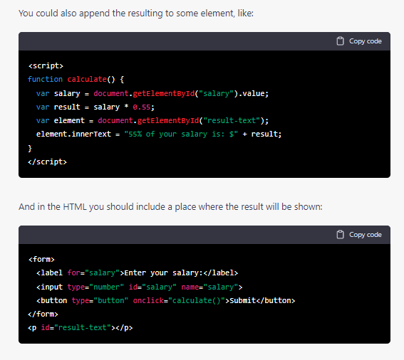
Code a form in JS
Output
Notes:
Note: again, good for quick prototyping and proof of concept. I don’t have the technical skills to know if that code is optimal.

Slide 56
Code a form in JS
Thoughts
Promising use: very quickly get working code
If you’re not a coder, you have no way of knowing if it’s “good code” - could that code cause issues, or be harmful?
Sometimes, it will be just plain wrong - and if pushed, it’ll double down or keep giving more errors
Notes:
Note: again, good for quick prototyping and proof of concept. I don’t have the technical skills to know if that code is optimal.

Slide 57
Create Python scripts
Prompt
Prompt:
Create rock paper scissors game in Python. Make it so I can see what the computer chose. And to best of 3 rounds.

Slide 58
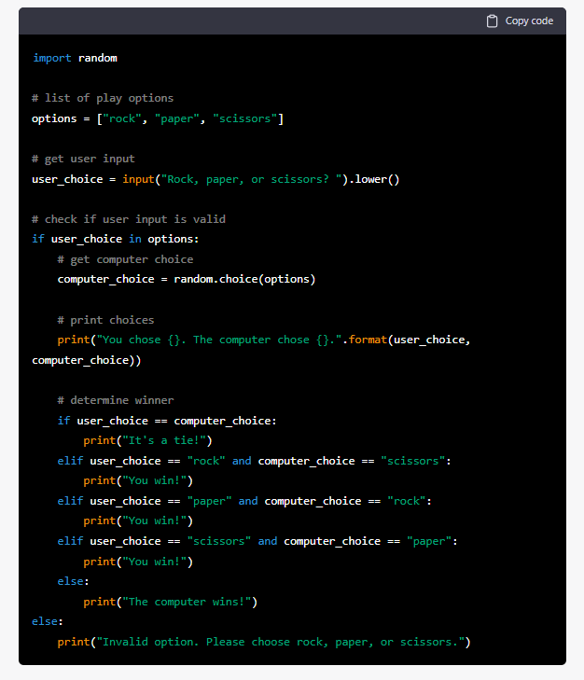
Create Python scripts
Output

Slide 59
Learnings on how to prompt
Getting the most out of it

Slide 60
Writing good prompts
It’s all about asking it in the right way!
Keep prompts concise and clear
Provide enough context for ChatGPT to generate a relevant response
Test different prompts to see which ones yield the most useful responses from ChatGPT
Use prompts as a starting point - tweak and refine until you get closer to what you want

Slide 61
Combine and refine
This is a conversational tool
A good prompt is just a starting point - you can ask it to refine, start again, add, fix, etc.
If you want it to do a new task, start a new chat (the previous prompts may have an impact on what you’re doing)
You can combine techniques (summarize this, turn it into a web page, simplify the wording, create the HTML, etc.)

Slide 62
Potential impact on GC web design
Imagining the future
Impact on content management and search
Pressure for new or better chatbots
Impact of automation on design jobs
What role is left for humans?

Slide 63
Impact on content management and search
Should content be treated as data?
If more people get answers directly from conversational chatbots (Google Bard, Bing Chat), what does it mean for the user experience?
Would treating content as data help machines get the right answer (structured data, knowledge graphs?)
How do we treat content as data for all gov in a fragmented publishing environment?

Slide 64
Pressure for new or better chatbots
Can executives resist the Sirens’ call?
Clunky gov chatbots may be compared to fluid agents like ChatGPT - it may impact users’ expectations of what a chatbot can do, “raising the bar”, in terms of conversational skills
Issue: ChatGPT sounds that good because it's not tied to specific knowledge; it "generates" plausible content based on massive input. What makes it impressive makes it unreliable for providing answers.
How do we prepare for this? Should we reconsider building our own chatbots?

Slide 65
Impact of automation on design jobs
Will some roles be obsolete?
Simple conformity tasks are easily automatable. Things like readability scores and adherence to style guide rules.
Imagine AI connected to a good design system - you could have a set of pages built in a few clicks, from rough notes
“Gatekeeping” and rule-checking jobs might eventually be at risk

Slide 66
What role is left for humans?
What will be abundant? What will be scarce?
AI-assisted technical skills (in research, content, coding, etc.) may become abundant and cheap
In comparison, analytical and relational skills may be become scarce and valued
Understanding problems, context, environment, users, allies, risks, and challenges: that’s where we humans can shine.

Slide 67
Conclusion
What next?
Key takeaways
Credits and references

Slide 68
Key takeaways
TL;DR
Don't believe the AI hype without critical thinking: it's interesting, but it's not magical, and has some very real issues (accuracy, ethics, etc.)
But don't resist progress: it can speed up some tasks dramatically and efficiently
Experiment and learn how to prompt, understand its capacities and limits, and think of the potential impacts on our jobs

Slide 69
Credits and references
Going further
Resources
ChatGPT Is a Blurry JPEG of the Web (Ted Chiang, New Yorker)
Challenging the AI Hype (Emily Bender, interview on KIRA7)
On NYT Magazine on AI: Resist the Urge to be Impressed (Emily Bender, Medium)
“Everyone Used to Be a Designer” (Corneliux, Medium)
Changing role of websites in the AI age (Paul Boag, Twitter thread)
Effective Altruism Is Pushing a Dangerous Brand of ‘AI Safety’ (Timnit Gebry, Wired)
What comes after the attention economy? (Podcast with Alistair Croll, Betakit)
ChatGPT is a robot con artist, and we’re suckers for trusting it (Adam Rogers, Business Insider)
AIPRM for ChatGPT (curated prompts for ChatGPT)
Credits
Icons taken from flaticons.com
Special thanks to Catalina Perez (DTO) for the discussions on the politics of ChatGPT and design in gov

