Slide 1
The Standard Cost Model and the Regulatory Costing Calculator
Calculating Compliance and Administrative Burden Costs

Slide 2
Agenda
1
Review methodology underpinning the Calculator
2
Overview of the Calculator
3
Entering and editing information in the Calculator (Hands On)
4
Using Results from the Calculator for the Small Business Lens and the
One-for-One Rule (Hands On)
5
Questions and Comments

Slide 3
The Standard Cost Model
The Standard Cost Model (SCM) is designed to measure the administrative consequences for businesses. It was developed in the Netherlands and has been widely used by the OECD, the World Bank and in the EU.
The SCM has been developed to provide a simplified, consistent method for estimating the administrative costs imposed on business by central government. It takes a pragmatic approach to measurement and provides estimates that are consistent across policy areas.
The SCM method is a way of breaking down regulation into a range of manageable components that can be measured. The SCM does not focus on the policy objectives of each regulation. As such, the measurement focuses only on the administrative activities that must be undertaken in order to comply with regulation and not whether the regulation itself is reasonable or not.
*From “International Standard Cost Model Manual: Measuring and reducing administrative burden for businesses”

Slide 4
SCM –Anatomy of Administrative Burden
Activity Level
Regulation
Information Obligation 1
Information Obligation 2
Information Obligation N
Data Requirement 1
Data Requirement 2
Data Requirement N
Activity 1
Activity 2
Activity N
1. Internal costs
-Hourly rate
-Time
-Overhead
2. External costs
-Hourly rate
-Time
3. Aquisitions
(monetary value)
Costing for the one-for-one rule occurs at the activity level
Data Requirement Level
The administrative burden baseline (ABB) counts data requirements

Slide 5
SCM – The Basic Formula
Price
Tariff
Time
Quantity
Population
Frequency
Price: Price consists of:
Tariff (cost of labour): wage costs plus overhead for administrative activities done internally or hourly cost for external service providers.
Time: the amount of time (in hours) required to complete the administrative activity.
Quantity: Quantity is comprised by:
the size of the population of businesses affected and,
the frequency that the activity must be completed each year
EKEY POINTD
The standard cost model was designed to measure an existing stock of administrative burden. The one-for-one rule is intended to measure changes in administrative burden, and be incorporated into cost benefit analysis. This has necessitated some adjustments to the basic SCM model.

Slide 6
Factor Considerations
The four factors for costing an administrative burden activity (number of businesses, frequency, hourly cost of labour, time) are to subject to some interpretation. For instance:
An activity that 200 businesses must complete once every two years may be better represented by an activity that occurs once a year by 100 businesses
The objective of setting these inputs should be match as close as to what is observed in the real world as possible.
Case A
2*$30*100 * 1=$6000
Case B
2*$30*200 *0.5 = $6000
Notes:
If the above activity was a survey that all businesses responded to twice a year at the same time, Case B is appropriate. If it was a licence renewal application that are received at a steady rate Case A would be appropriate.

Slide 7
Annualized cost of a Regulation
…the cost of the administrative burden imposed by a regulation is the sum of the cost of each activity expected to be completed during the first 10 years after the regulation is registered and is calculated in accordance with the following formula:
A × 0.142378 ÷ 1.07^{B – 2012}
Where
A is the activity cost which is the sum of the cost for each activity for each period, calculated in accordance with the below (following) formula
B is the year that the regulation is registered
To allow comparisons of INs and OUTs across time, all costs are discounted to a base year of 2012.
TBS discount rate of 7%
1+Discount Rate = 1.07
$$Annuity Factor: \frac{r∗{\left(1+r\right)}^{Years}}{{\left(1+r\right)}^{Years}−1}$$

Slide 8
Red Tape Reduction Regulations, Costing an Activity
All costs are normalized by frequency – each activity occurs once over a period. The length of a period is adjusted according to frequency to allow for this. For instance if a frequency was 4 times/year the period length would be adjusted to 3 months.
A = C × D × E ÷ 1.07^{F ÷ G}
Where
C is the estimated hourly cost of labour in a period so that a business is able to complete the activity imposed by the regulation within that period; (cost per unit for compliance costs)
D is the estimated number of hours …; (number of units for compliance costs)
E is the estimated number of businesses…;
F is the specific period out of the total number of periods…(times per year * number of years); and
G is the number of times that the activity is required to be completed per year;

Slide 9
The Regulation Expressed as One Equation
Annuity Factor
$$\sum_{n=1}^{N}{\left\{\underset{A}{\underbrace{\sum_{p=0}^{P_{n}}{\left\{\frac{{\overset{C}{\overbrace{Wage}}}_{n,p}∗{\overset{D}{\overbrace{Hours}}}_{n,p}∗{\overset{E}{\overbrace{Businesses}}}_{n,p}}{{1.07}^{\frac{p}{{freq}_{n}}}}\right\}}}}\right\}}∗\underset{Z}{\underbrace{0.142378÷{1.07}^{B−2012}}}$$
Multiply the total present value by this to get the annualized value
Common Discount Base Year
Makes all INs and OUTs comparable
N = the number of activities required by the regulation
n = the activity being costed
P_{n} = the number of periods in activity n (10 x freq)
p = F = the period being costed (0 to P_{n})
freq = G = frequency
Wage – the cost of labour to complete activity n in period p
Hours – the time required to complete activity n in period p
Businesses – the number of businesses that will perform activity n in period p

Slide 10
Steps to Appling the SCM
Step 1: Set the Context
Step 2: Define Regulated Businesses
Step 3: Identify Requirements
- Describe the regulation being proposed and how business will be impacted
- Select and divide impacted businesses into stakeholder groups,
estimate populations, and growth projections
-Determine compliance activities and capital/material costs
-Identify information obligations, data requirements and related activities.
Step 4: Associate Changes
Step 5: Estimate Cost Parameters
6. Review and Confirm Results
- Match businesses to requirements, determine size of businesses (small / medium & large), and percent impacted
-Timing - upfront / ongoing / custom
-Unit/Labour cost
- Average #units/time (hours) required
- Frequency
- Documentation
- Ensure that results “make sense”, and are in-line with expectations.

Slide 11
Quick Quiz!
Frequency
Your department is changing a form for an application that typically receives 50 applications a year from 20 registered businesses. What frequency would you set to cost this change?
Periods
An activity happens 10 times a year. How many periods would its cost be assessed for?
How would you change this for 100 businesses?
Price
Price of an activity is composed of what two components?
The tariff is wage plus what additional factor?

Slide 12
What is the Regulatory Costing Calculator (RCC)
Is a Microsoft Excel application. It uses formulas, forms and Visual Basic for Applications (VBA) code to
automate and facilitate the calculation of AB and compliance costs for departments and agencies,
ensure AB is calculated according to required methodology, and
standardize the format of calculations, making it easy for central agency to perform challenge and oversight functions.
Required
RCC must be used to estimate administrative cost impacts under 141 Rule & SBL
RCC can be used to estimate compliance costs impacts under SBL
completed RCC must be submitted to TBS-RAS as a part of the regulatory submission package
Including all assumptions used in calculations
EKEY POINTD
Use of the Calculator strengthens the legitimacy of estimates of administrative and compliance cost. It ensures consistent results by application of a common methodology . This allows for results under the one-for-one rule and small business lens to be aggregated and reported across multiple regulations and departments.

Slide 13
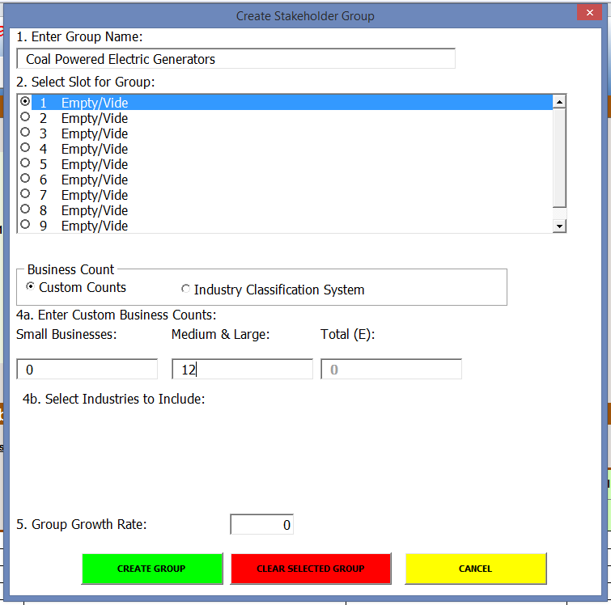
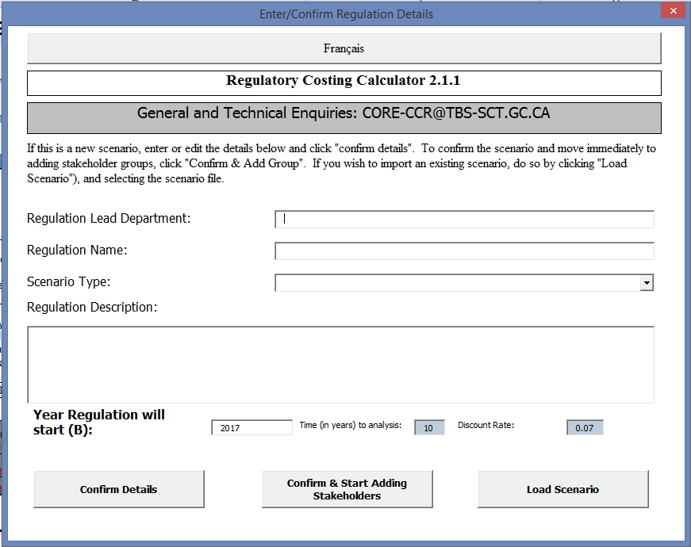
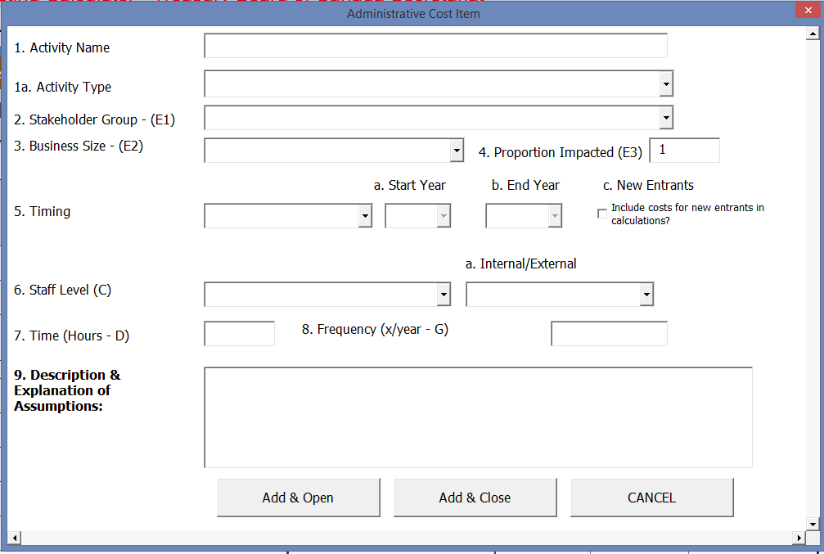
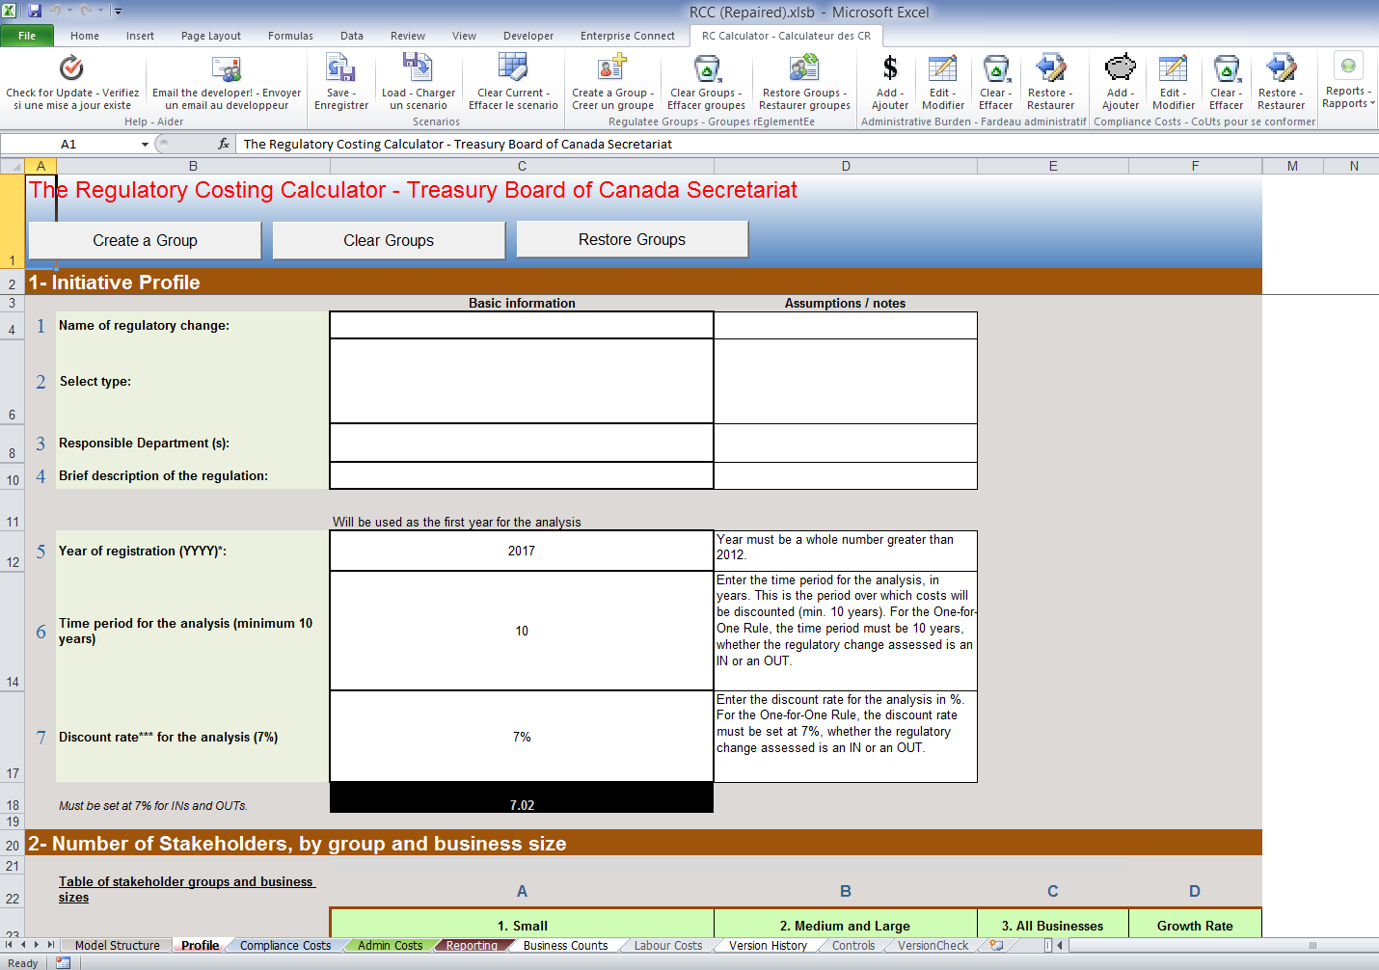
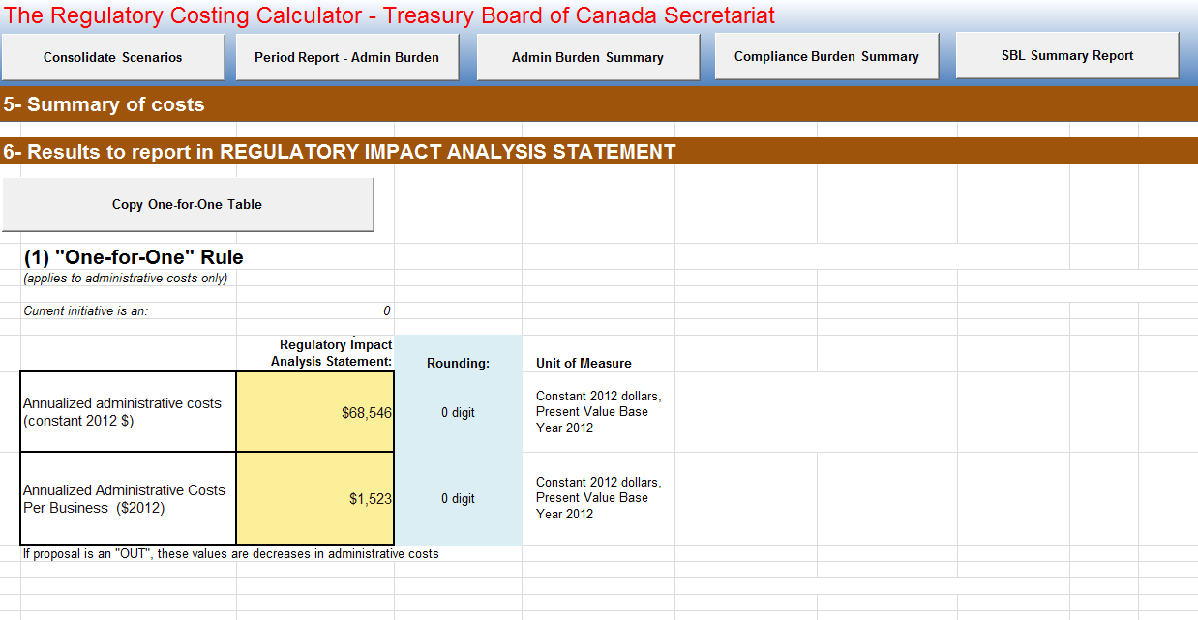
Regulatory Costing Calculator Overview

Slide 14
Calculator Controls – Triggering Functions & Entering Data
The RCC has a customized menu in Excel’s Ribbon Bar. Most functions needed to use the RCC can be accessed here.
These functions can also be triggered by using control buttons that are located in the various tabs of the RCC where the associated information is stored.
The RCC has multiple forms that can be used to add the required inputs.
Most of the time this data can also be entered/edited directly in the spreadsheet rather than using the built in forms.

Slide 15
Tips on the Calculator - Timing
TIMING: The Calculator determines when costs are incurred according to timing. There are three types of timing:
Upfront: For actions that occur at the very beginning of the 10 year assessment (p=0). These costs occur only once.
Ongoing: Costs to perform reoccurring activities that occur at regular intervals over the 10 year assessment. These costs are assumed to occur at the end of the period assessed and occur 10 * frequency times.
i.e. an ongoing activity with a frequency of 3 would occur once at the end of every 4 month period, 30 times over 10 years.
Custom: An ongoing cost that occurs over a sub-set of the 10 year assessment. If custom timing is selected then the user must select a start year and an end year to assess costs over.

Slide 16
Tips on the Calculator – Business Counts
BUSINESS COUNTS OVER TIME: The number of businesses impacted by a cost at any time will be impacted by the business growth rate.
(Business in Period p = Businesses in period 0 *(1+ growth rate)^(p/ frequency)
NEW ENTRANTS: The Calculator can assess costs for new entrants. This done in one of two ways depending on the timing:
Upfront timing: Including new entrants results in the upfront cost ALSO being an ONGOING cost applied to new entrants (start-up cost).
For ongoing and custom timing: Including new entrants results in the cost being applied ONLY to new entrants (useful for costing grandfathering schemes).
New entrants in period p = (businesses in period p – businesses in period p minus one).

Slide 17
Fictional Example Walk Through of Costing – Regulating Self-Driving Vehicles (HANDS ON)
A regulation has been proposed to ensure safe operation of self-driving vehicles (SDV) across provincial and international boundaries.
Car Dealerships that retail SDV will be impacted.
10% of Transport Companies are expected to be impacted by licencing and reporting requirements.
The regulation has been triaged as high.
Small, medium and large businesses will be impacted.
ELETS TAKE A LOOKD
TASK – Download the Calculator (save to desktop)

Slide 18
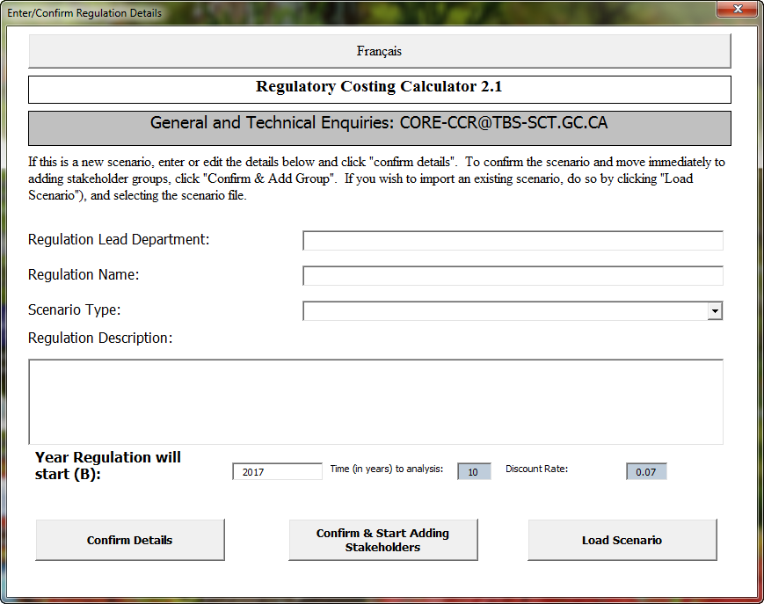
Step 1: Opening the Calculator & Setting the Context
TASK- Add the below information to the Calculator
Enter “Autonomous Vehicles Agency of Canada”
Regulation Controlling The Sale and Use of Self-Driving Vehicles for Interprovincial and International Commercial use in Canada
“IN”
Review & edit the information entered. This includes:
1: Regulatory Description
2: Regulatory Objective
3: Business Impact
Depending on your security settings, you may need to enable both editing and contents of the RCC file in Excel to be able to properly use it. Once this has been done the RCC will display a pop-up form.

Slide 19
Step 2 – Identify Regulated Community (A)
The RCC has a dataset of business counts based on Statistics Canada data organized according to the North American Industrial Classification System (NAICS).
These are located in the “Business Counts” tab of the RCC. If there are industrial classifications listed that will be affected by the proposed regulation, identify them by putting a “1” beside them in column “A”.
TASK- Identify NAICS
From the “Business Counts” tab, select the following NAICS:
441110 - New Car Dealers
484 - Truck Transportation
From the “Profile” tab, press the “Update Industry” Button
User Tip: When looking for NAICS codes, it’s useful to use the “find” function (Ctrl-F) in Excel

Slide 20
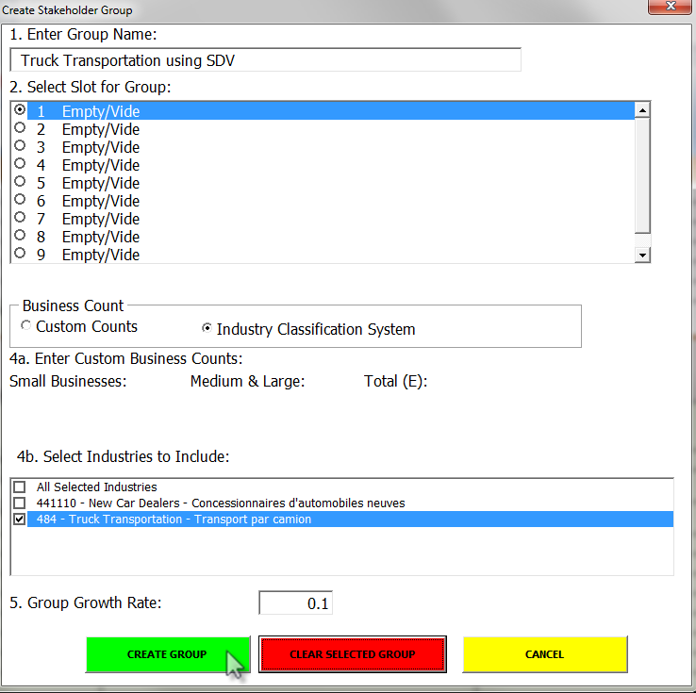
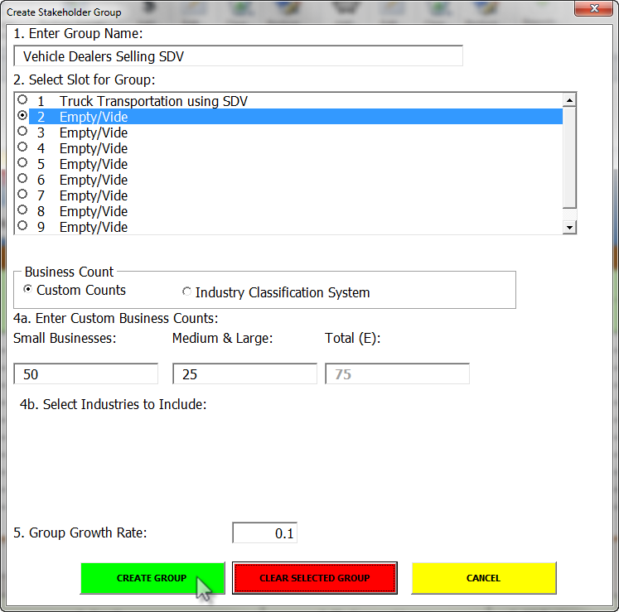
Step 2 – Identifying Regulated Community (B)
TASK – Add Stakeholder Groups
1. From the RC Calculator Menu press “Create a Group”, add the information below, and press “Create Group”.
2. From the “Profile” tab, press the “Create a Group” Button, use custom counts to create the group below.

Slide 21
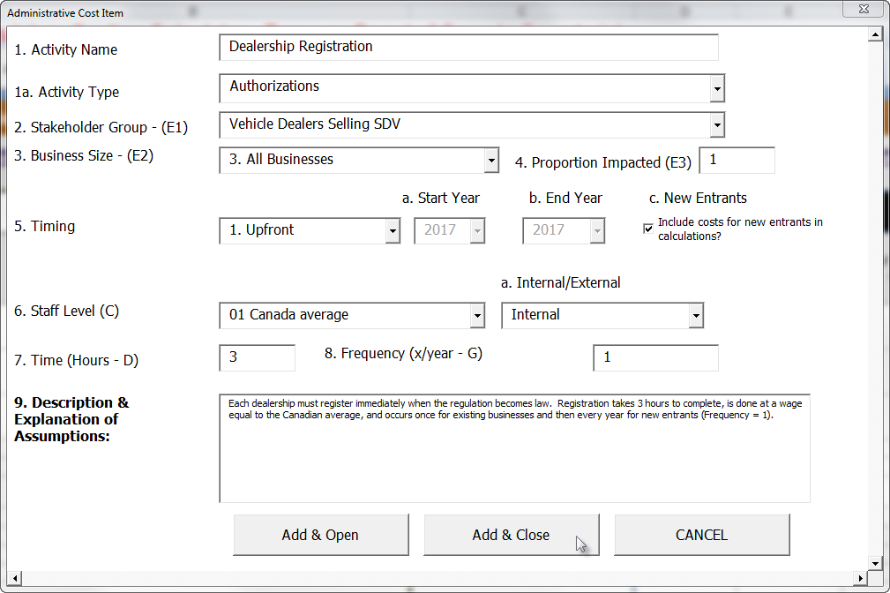
Steps 3, 4, & 5: Specify and Associate Changes and Estimate Parameters (A) - AB
TASK – Add Activity 1
Press “Add” from the “Administrative Burden” Group and enter the details as shown.
Review the information as it has been entered in the spreadsheet “Admin Costs” tab.

Slide 22
Steps 3, 4, & 5: Specify and Associate Changes and Estimate Parameters (B) – AB
TASK - ADD THE FOLLOWING COSTS TO THE CALCULATOR
Activity 2: 10% of each Transporter must apply for a licence to operate SDV to transport goods. Licences need to be applied for every two years (Frequency = 0.5). Internal testing has determined the licencing procedure takes an hour to complete and it is assumed an a supervisor in transportation would complete it.
Activity 3: Transport companies must report every 6 months (Frequency = 2) a summary of all accidents resulting in property damage or injury where a SDV was involved. Surveyed companies have responded that they expect it will take about 4 hours to complete the report and will be done by administrative staff.

Slide 23
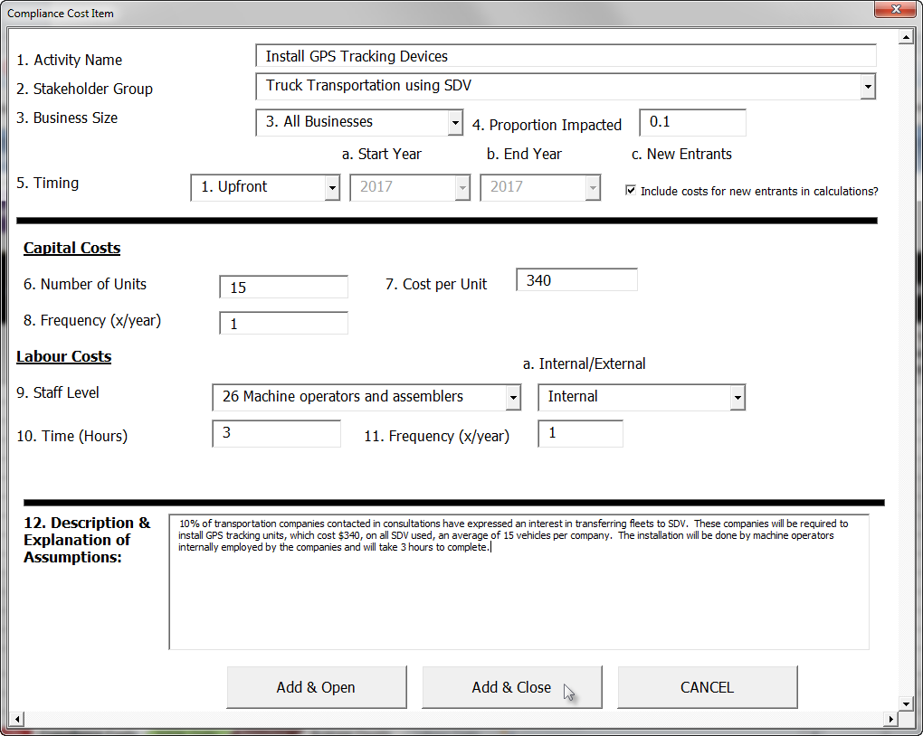
Steps 3, 4, & 5: Specify and Associate Changes – Compliance Cost
TASK – Add a Compliance Cost
Press “Add” from the “Compliance Costs” Group and enter the details as shown.
Review the information as it has been entered in the spreadsheet “Compliance Costs” tab.

Slide 24
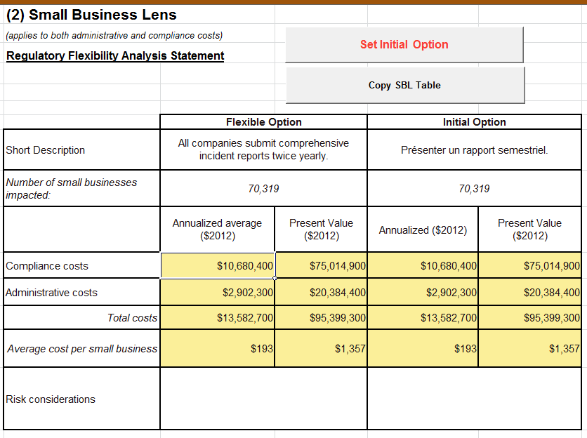
Small Business Initial Option + Saving a Scenario
TASK – Set Initial Option
From the Reporting tab, find the Small Business Lens Table. Click the “Set Initial Option” Button. This places a copy of the information of the impacts of the regulation on small business into the “Initial Option” table.
TASK – Save the Scenario
Click on the “Save” button in the Scenario group on the RC Calculator Menu. Save a scenario file called “SDV –Regulation Initial Option” on your desktop.

Slide 25
Small Business Lens – A Flexible Scenario
Small business transporters indicate that they do not experience a high level of incidences, and that requiring an incident report every 6 months is excessive, given they would often have nothing to report.
Further research has indicated that small businesses in other jurisdictions similar to Canada with SDV have, on average, 1 incident a year.
Your department has proposed to allow small businesses to report incidents by phone, up to 48 hours after they occur, a process that will take about an hour, and be done by administrative support staff.

Slide 26
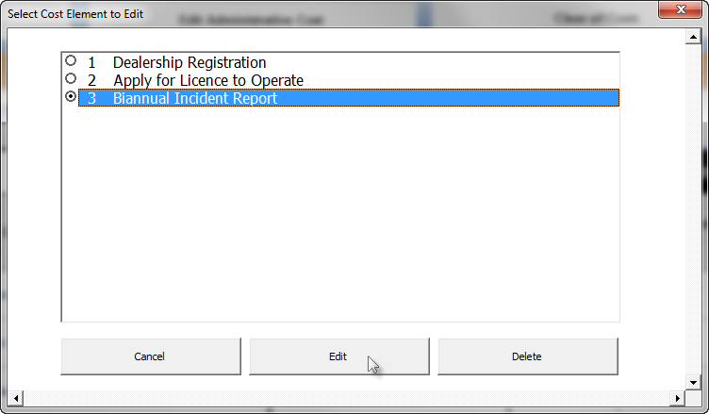
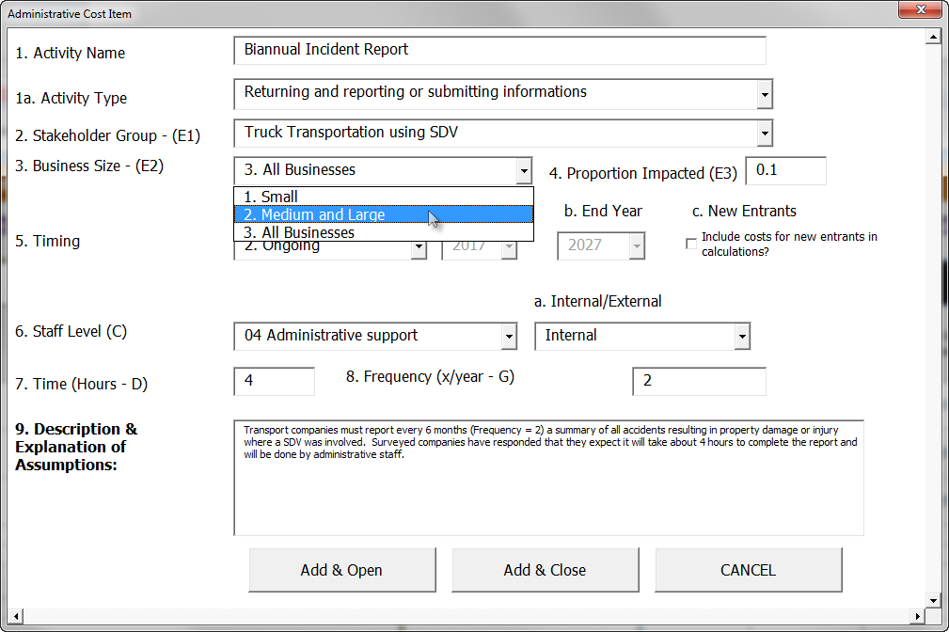
Edit an Activity
TASK - Press the “Edit Activity Cost” Button on the “Admin Costs” tab, Select the “Biannual Incident Report”, click “Edit”, and Change the business size from “All Businesses” to “Medium and Large”.
TASK – Add a new Administrative action for small businesses that matches the flexible option described.
TASK – Save a new scenario file called “SDV –Regulation Flexible Option” on your desktop.

Slide 27
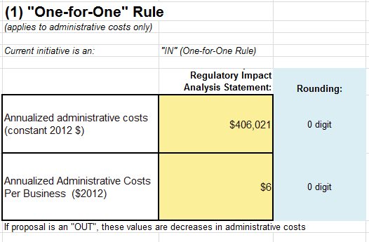
Step 6 – Review and Confirm Results – Extracting Results for the One-for-One Rule and Small Business Lens
Review the various results as they appear in the “Reporting” Tab in the RCC.
Check your one-for-one results against the following:
WORD
TASK – Copy SBL and One-for-One Tables
Click on the “Copy One-for-One Table” button.
Create a new a word document and paste the table.
Click on the “Copy SLB Table” button, paste it into the new word document.

Slide 28
Step 6 – Review and Confirm Results – RCC Reporting Features
TASK - REPORTING: From the “Reporting” Tab or the RC Calculator Ribbon, create and review the:
Period Report, Admin Burden Summary, Compliance Review Summary, and SBL Report
Compare the Period Report to slides 6 & 7 (equations for calculating AB)
Create Reports
REVIEW RESULTS

Slide 29
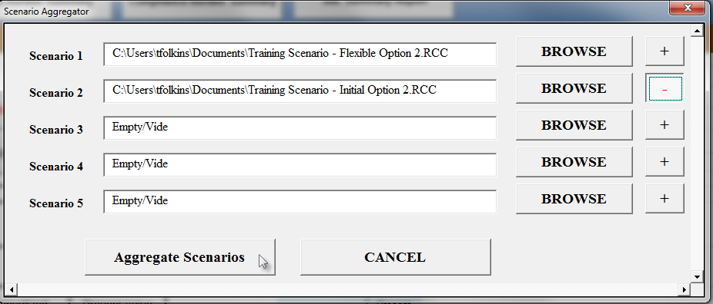
Step 6 – Review and Confirm Results – Consolidate Scenarios Report
TASK – Consolidated Scenarios
Click on the “Consolidate Scenarios” button.
Click “Browse” and Select the Flexible Option scenario file you previous saved on your desktop for “Scenario One”.
Select the Initial option for “Scenario 2”, press the “+” button (turns it to a negative “-”), and press “Aggregate Scenarios”.
Review the results. How else could you use this reporting feature?

Slide 30
QUESTIONS

Slide 31
More Resources
Regulatory Tools and Guides
The CBA Community of Practice
Courses and Others - GCCampus
http://www.tbs-sct.gc.ca/hgw-cgf/priorities-priorites/rtrap-parfa/guides/index-eng.asp
http://gcconnex.gc.ca/groups/profile/162404/cost-benefit-analysis-community-of-practice
Functional Specialists –> Regulators
https://learn-apprendre.csps-efpc.gc.ca/application/en
END

