Slide 1
IOCN -- RICO
A short presentation to introduce SCO to the IOCN and the ongoing work

Slide 2
The IOCN – Mandate and Vision
Our Mandate
Foster a strong organization development and change management learning community;
Advise the leadership of the Public Service dealing with change; and
Advocate and promote organization development and change management throughout the Public Service of Canada
Our Vision
The Interdepartmental Organizational Change Network is a strong, dynamic and recognized network that promotes Public Service values, people engagement and sound organization effectiveness and change management practices.

Slide 3
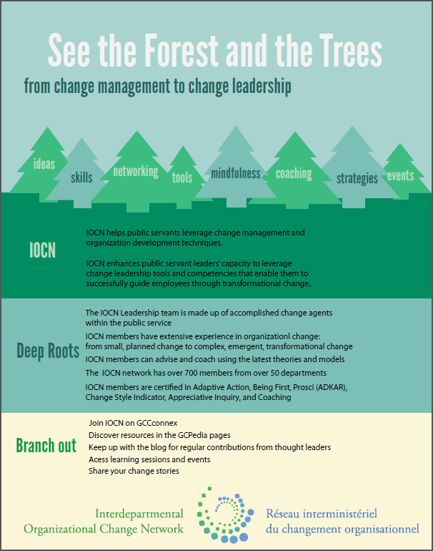
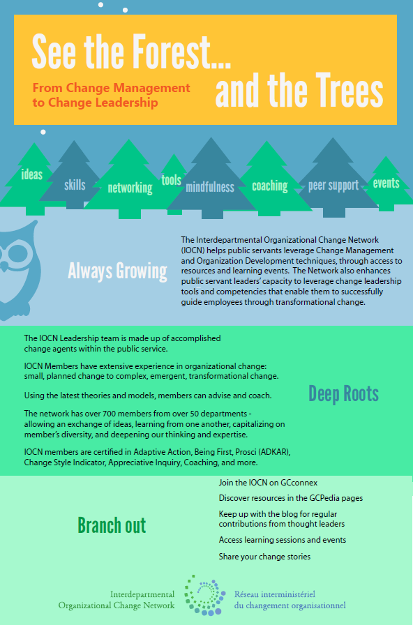
The IOCN in an infographic… Work on progress…

Slide 4
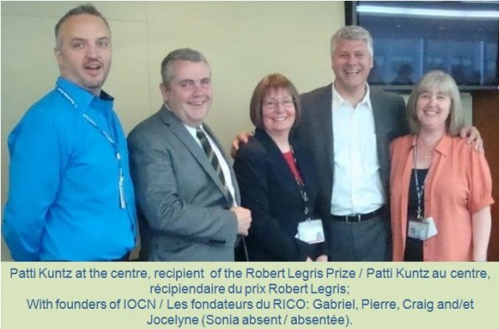
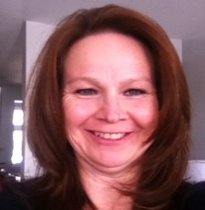
The IOCN, its origins
500+
850+
Membership…
75
125+
500+
250+
490+
t
2001-2002
IOCN was formed
2008 AGzz joins the LT
2013 Mindfulness
Use of Webex
2014-2015 Mindfulness is adopted by the LT
CClark starts blogging
2014 *“Merged” into GCConnex
2016 BP2020 Innov Fair
Blogging 101 + Bloggers U.Lab – Ottawa Hub
2009-2010 GCPedia, GCForums (& GCConnex)
* “Merged”:
“Organizational Change” GCConnex group was created long ago 2010, practically no members joined (it was GCForums time)
2014 GCForums got closed in support for GCConnex
“CM → CL” group was created in 2014, and quickly grew its membership. Chris Lawson asked me to take over the group as he was leaving SSC
Rather than force members to join the “Organizational Change” GCConnex group that was previously created , the LT invited all members to join the “CM → CL” GCConnex group, as it made more sense.
Chris Clark Connie Goulet Virgnie Carrier Stacey Ileleji Alejandro Gonzalez
The actual Leadership Team (LT)
Notes:
Alejandro Gonzalez ”last week “ (next showing date 2016-08-29 16:02) Yey!! Just reached the 800 members mark!! Change Management --> Change Leadership / Gestion du changement --> Leadership du changement
Alejandro Gonzalez 2015-06-10 09:26 - WOW!! 400+ members @ Change Management --> Change Leadership / Gestion du changement --> Leadership du changement http://i.gc20.ca/CMCL-GCLC
Alejandro Gonzalez 2015-06-10 11:01 Celebrating 250 members on Mindfulness 2020 Pleine-conscience group http://i.gc20.ca/MF2020PC
These are the updates I posted in GCForums
530+ members - membresalejandro.gonzalez@cic.gc.ca199 18/06/2013 10:38:08
465 members as of today...alejandro.gonzalez@cic.gc.ca099 29/12/2011 11:51:10
Nice 400 members mark reached!alejandro.gonzalez@cic.gc.ca171 15/09/2011 08:42:20
Update: 360+ of us up to June 2011alejandro.gonzalez@cic.gc.ca028 08/07/2011 15:17:57
Update: 300 of us up to March 2011.alejandro.gonzalez@cic.gc.ca064 08/03/2011 14:13:40
Update: 241 of us up to November 2010.alejandro.gonzalez@cic.gc.ca050 02/12/2010 16:24:17
Update: 252 of us up to September 2010.alejandro.gonzalez@cic.gc.ca289 18/11/2010 11:25:49
Update: 137 of us up to July 2010.alejandro.gonzalez@cic.gc.ca052 23/07/2010 12:00:41
64 of us to datealejandro.gonzalez@cic.gc.ca188 13/04/2010 15:33:27

Slide 5
IOCN – Events (with recordings):
Understanding Change Management, an introduction,
Mindfulness in the Workplace (recordings),
Change Saturation webinar and smartshop w/HRCouncil - OCHRO,
Lean 101 for CM Practitioners w/TC,
Integrating CM into PM w/DND,
Adaptive Change w/CSPS,
Blogging 101, and
Micro Missions w/TBS – eg. IOCN infographic.
Additionally, Some Partner Events (CSPS - Contributing to Change and Transformation in the Government of Canada, LOPCP - Change Management Workshop and others).
Notes:
This are events that were delivered

Slide 6
Projects
CM Fair and CM Compendium of Tools – IOCN, LT and HRCouncil
BP2020 fair – by Stacey Ileleji and Suesan Danesh
To be published shortly
Navigating Change to Workplace 2.0 – provided input and CM tools, by LT
NRCan sounding board – provided advice, by LT
Notes:
This are projects we participated on.

Slide 7
IOCN’s Ongoing Initiatives
Bloggers – by Chris Clark
Presencing / u.lab – by Susan Johnston
Mindful Leadership Program – 8 week by Alejandro
AMindfulLeader.org event – by Alejandro
CSPS collaboration – by the LT
HRCouncil CoP Hub participation
My review of CSPS’s CM courses
Occasional delivering sessions to GoC
Notes:
These are on going, things we’re working on… let me explain each one briefly in the next slides…

Slide 8
Bloggers
Chris started blogging a year ago, has created 43 blogs (on both groups) and now he leads a team of 3 bloggers
Culture Change Leadership: Meeting Unmet Needs By Chris Clark
Perspectives and Positive Emotions By Claude Renaud
The Change Journey - An Introduction
By Lucy Cove
Tables and Comfy Chairs: a case study
By Terri Tomchyshyn
Notes:
Not updated, since there are other blogs posted since the last time I updated this slide.

Slide 9
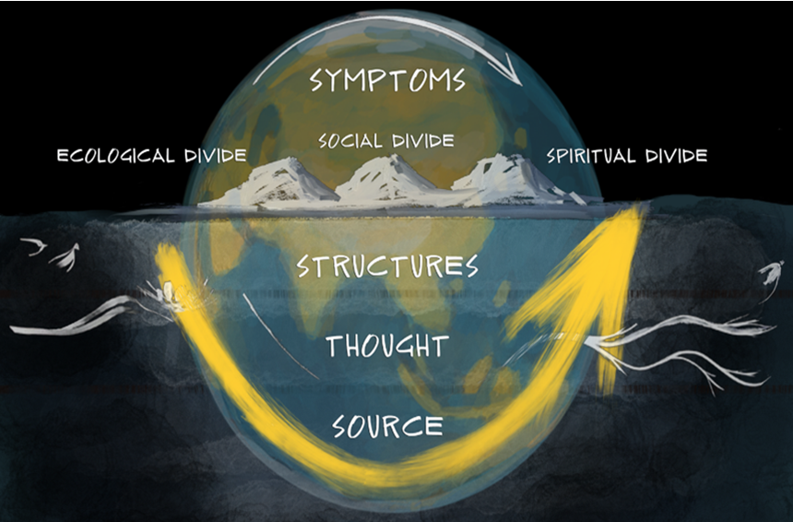
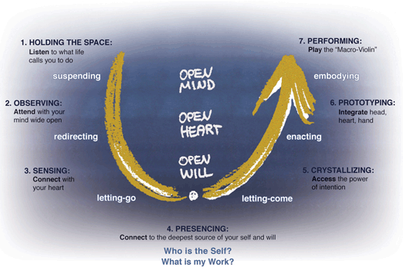
Presencing / u.lab: Leading From the Emerging Future – as in Innovation, in coordination with Ottawa Hub
“Presencing is a blending of the words “presence” and “sensing.” It means to sense, tune in, and act from one’s highest future potential—the future that depends on us to bring it into being.” *
In a way, this is a synonym to being mindful
* pag 7. Intro. Theory U. Otto Scharmer
Notes:
Interesting to read…
“It can be likened to how we look at the work of an artist. At least three perspectives are possible:
• We can focus on the thing that results from the creative process—say, a painting.
• We can focus on the process of painting.
• Or we can observe the artist as she stands in front of a blank canvas.
In other words, we can look at the work of art after it has been created (the thing), during its creation (the process), or before creation begins (the blank canvas or source dimension).
If we apply this artist analogy to leadership, we can look at the leader’s work from three different angles.
• First, we can look at what leaders do. Tons of books have been written from that point of view.
• Second, we can look at the how, the processes leaders use. That’s the perspective we’ve used in management and leadership research for more than two decades. We have analyzed all aspects and functional areas of managers’ and leaders’ work from the process point of view. Numerous useful insights have resulted from that line of work.
• Yet we have never systematically looked at the leaders’ work from the third, or blank-canvas, perspective.
The question we have left unasked is: “What sources are leaders actually operating from?” I first began noticing this blind spot when talking with the late CEO of Hanover Insurance, Bill O’Brien. He told me that his greatest insight after years of conducting organizational learning projects and facilitating corporate change is that the success of an intervention depends on the interior condition of the intervener.” pag. 6 Intro. Theory U. Otto Scharmer.
The obstacles, the shadows, inevitable comes when crossing that threshold
VoJ – Voice of Judgement
VoC – Voice of Cynicism
VoF – Voice of Fear

Slide 10
Mindful Leadership Program
Consists of three components: *
An introductory session called “Mindfulness at Work”
Aimed at anyone who may be interested
An introductory session called “Mindful Leadership”
Open to everyone who sees themselves as leaders
Will schedule a session shortly
A 6-8 week program called “Mindfulness Challenge”
Using an agile design
Working on its second iteration
* Need some input to rebrand and realign these sessions
Notes:
Occasional delivering sessions to GoC
Immigration, Refugees & Citizenship Canada – various sessions delivered (1 hour, 1.5 hours, “plug-ins”)
Department of Fisheries & Oceans – virtual webex (15 mins)
Aboriginal Affairs & Northern Development Canada
Heritage Canada
National Research Council
HR Council CoP Hub
PSC – BP2020 Wellbeing Forum (at the same time as the BP2020 Fair)
BP2020 Atlantic Innovation Fair – virtual webex (30 mins)
Service Canada – co-delivered with Christine Gagnon
PSC – During National Public Service Week
Members of the Mindfulness 2020 Pleine-conscience
Got an invitation to present to ISED (Industry Canada) details to be discussed
Total of 1,065 participants so far.

Slide 11
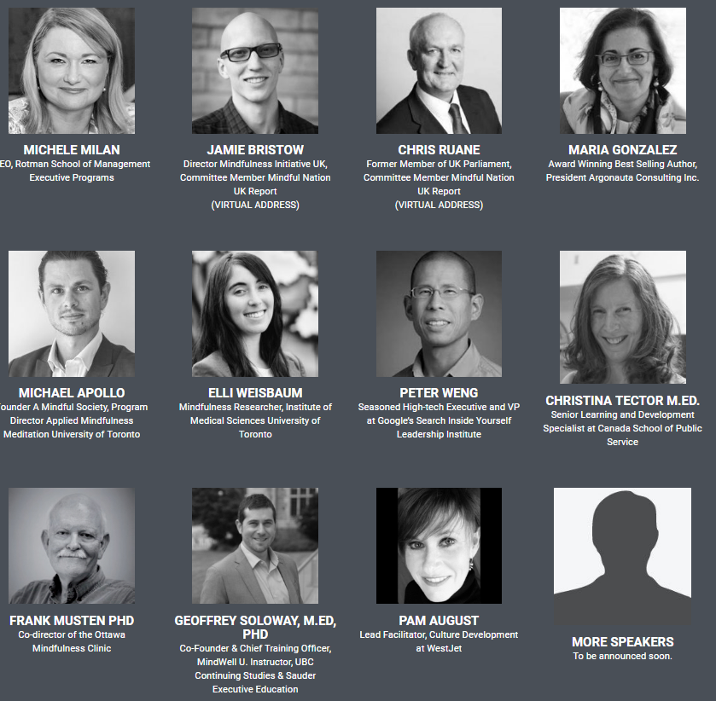
AMindfulLeader.com Changing the Way We Think About Leadership
Will occur in Ottawa, 2 November 2016
The LT will receive a small recognition as a “Change Champion”
Some of the presenters include:

Slide 12
CSPS collaboration with the LT
WS# | Key Themes
1. | Overview of CM “The what and why of change and CM”
2. | Working with your Stakeholders
3. | The Ying and Yang of Change “The forces at play that can make or break your change”
4. | Who are your fans? “Sponsors, champions and great governance”
WS# | Key Themes
6. | Engagement Practices
7. | Integrated Strategy for Change “Putting it all together”
9. | Why aren’t people changing? “The people side of change”
10. | Transformation and Culture Change “We’ve checked all the boxes, why is it not working?”
** | CM 911 – Emergency Unstick!
On the works, exploring its match with the SCO CM model
Notes:
As I get more familiar with the SCO model, I’ll explore how to make it fit into this initiative…
Change Management Needs Questionnaire - Assess the change management needs for your service or project and identify key areas that require attention.
Change Management Task List for SSC Services and Projects - Include these typical change management tasks in your service or project plans and adjust accordingly to ensure change management and partner readiness activities are integrated into your SSC services and projects.
Stakeholder Identification and Impact Analysis - Conduct a Stakeholder Impact Analysis to complement your typical project stakeholder analysis (i.e. power/influence and interest) but with a focus on the impact, i.e. how will this change affect the various stakeholder groups including clients/partners and service providers.
Change Management Tactics Checklist - Reference this checklist of potential change management, engagement, communications and training tools and tactics and contact your SCO and Comms advisors for guidance on how we can prepare people for your change and mitigate the change risks.
Change Management Plan / Roadmap - Map out your Change Management Plan to show the key change, engagement, communication and training activities by stakeholder group.
People Readiness Assessment - Assess the readiness of your stakeholders with this quick and easy questionnaire.
People Readiness Dashboard - Augment your regular service or project reporting with this dashboard to assess people readiness.
Change Management Lessons Learned - Gather lessons learned from the change team and various stakeholders to share best practices as well as suggested changes to the change management process to build change management competency and continuous improvement into the organization.

Slide 13
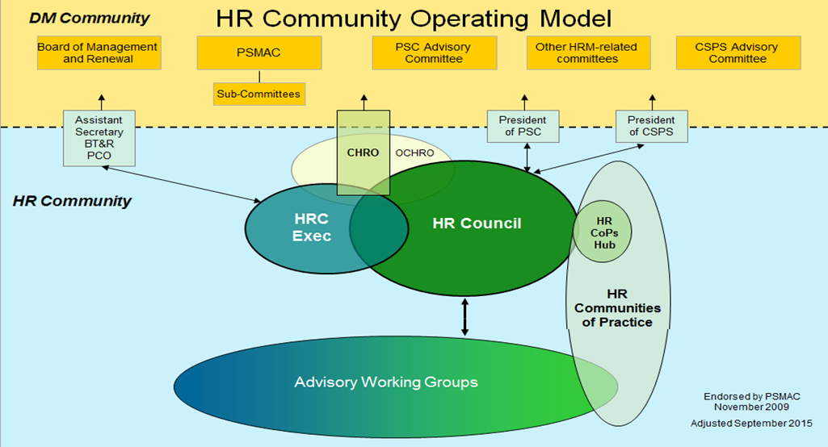
HRCouncil CoP Hub participation
HRCouncil CoP Hub - “A Community of Practice is a group of professionals who share a passion, goal, or concern for a specific topic and who interact on an ongoing basis to deepen their knowledge and expertise in this area. They are essential for bringing ideas, concepts and strategies to life by putting their efforts together for the good of the Public Service of Canada.” – total of 17 CoP
Notes:
List of HR CoP
(ACM) Association of Compensation Managers
(Career) Interdepartmental Community of Practice on Career
(DTA) Inclusive Work Environment and Duty to Accommodate
(DM) Disability Management Practitioners’
(FWWN) Federal Workplace Well-Being Network
(HoLF) Heads of Learning Forum
(HRPIN) Human Resources Planning Interdepartmental Network
(ICMS) Informal Conflict Management System
(IDNEE) Interdepartmental Network on Employment Equity
(INEAP) Interdepartmental Network of Internal Employee Assistance Programs
(IOCN) Interdepartmental Organizational Change Network
(LRC) Labour Relations Council
(NSC) National Staffing Council
(OCC) Organization and Classification Council
(OHS) Occupational Health and Safety
(OL) Official Languages
(TM) Talent Management

Slide 14
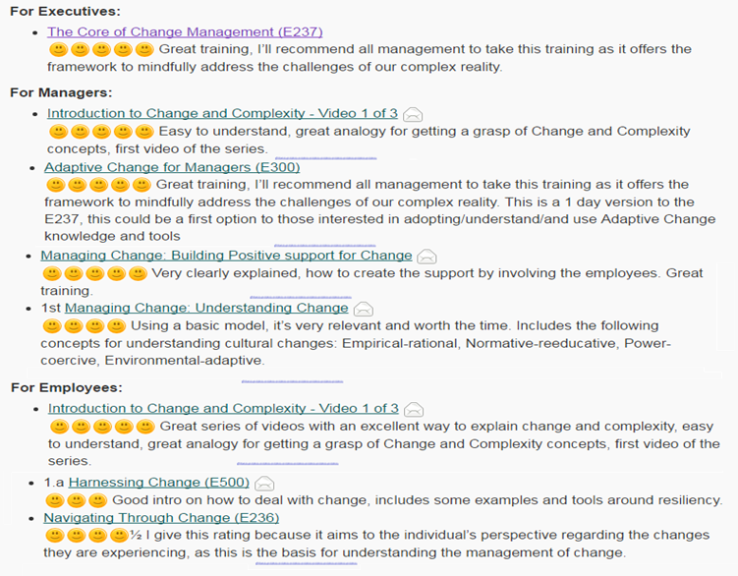
My review of CSPS’s CM courses
https://gcconnex.gc.ca/blog/view/22845159/csps-cm-training-courses-my-review

Slide 15
IOCN - Strengths
We do things out of love and passion
We are a diverse team
We come from a diverse background
We work in various areas within the GoC
Our growth is very organic
We are quite flexible
We work hard

Slide 16
IOCN - Challenges
Time – as the LT and coordinators do the work out of the corner of their desks, except now for Alejandro
Boardroom for events – typically 20 to 40 with some events have reached up to 70 people
We see a clear tendency to participate via Webex
Webex room – for 2 to 5 people
Translation budget
Lack of awareness at mid, senior and executive levels

