Slide 1
The Linkable File Environment: Analytical Opportunities For Program Evaluation
A Short Overview

Slide 2
The Linkable File Environment (LFE)
Business Register (BR)
Longl. Employment Analysis Program
GIFI-T1-T2
Exporter Register
PD7
Importer Register
Direct Investments Abroad / Canada
Intellectual Property
Electronic Commerce
Regulatory Compliance Costs
Advanced Technology
Innovation
Trade in Commercial Services
Financing & Growth SME
Innovation & Business Strategy
Digital Tech & Internet Use
PMF
CIPO
USPTO
R&D in CDN Industry
SR&ED
FDIC
Commercialization of innovation
T4
TED
Diversity and Skills Database
Canadian Patent Research Database
BIGS
Covers all Canadian businesses
Over 30 data sources
Facilitates the creation of linked survey
and administrative data files to inform on business and economic issues.
Analytical Opportunities:
Assess business performance for reporting purposes
Program impact evaluation
Customized tabulations
Administrative source
Survey source

Slide 3
What data is available for analytical insights and decision making?
Individual Characteristics
Business Characteristics
Employment
$
Gender
Age
Revenue
Understanding
Not ONLY business impacts but allows for analysis of employer-employees and ownership individual characteristics
…
…
Immigrant
Status
Program
Labour Market Experience
Industry
Indigenous
Status
Business Type

Slide 4
Case Study: Linking program data to the LFE for program evaluation
Setting Up the LFE Linkage
Develop Benchmark Indicators
for Businesses
Assess Program Impacts on Business Performance
Identify programs and data files
Transmit data to Statistics Canada
Database will be created
Businesses will be linked to the BR
GBA+ Analysis
Descriptive and Analytical Statistics
For example:
identify high growth business
survival rate,
urban/rural,
Industry
size of business
measuring proxy for productivity revenue growth
employment growth
R&D expenditures
salaries
Match recipients with similar group of businesses
Businesses that never received support
Rejected applicants
Businesses that have not yet received support
2. Compare program users outcomes over time before matching and after matching
3. Establish a causal relationship between program participation and outcome

Slide 5
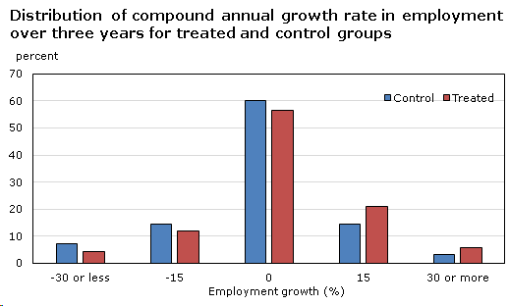
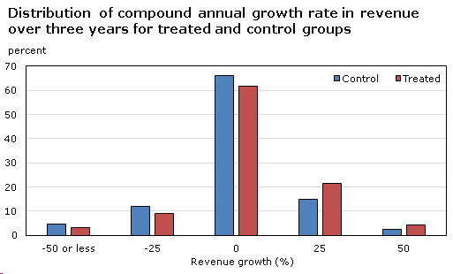
Analytical Insights from BIGS: Business Support Showing Positive Impact on Employment and Revenue
Source: Demers, F. 2021. The Impact of Business Innovation and Growth Support on Employment and Revenue of Manufacturing Enterprises, 1 to 3 Years After Receipt of Support. Reports on Special Business Projects, Catalogue no. 18-001-X. Statistics Canada. Ottawa.

Slide 6
Process to Initiate an LFE Project
Cost Recovery
Meet with Statistics Canada to discuss your information needs
Data Dictionaries
to identify variables
of interest
Project Proposal Process
Sign Letter of Agreement
Work with
Statistics Canada throughout the project cycle
Tables and Reports Transferred
Data Access Centres
1
2
3
4
5
6
Create a detailed research proposal
Submit application via Micro Data Access Portal
If approved,
applicants must become deemed employees
Required access
to files
is granted
Work with
Statistics Canada throughout the project cycle
Analysis and Output vetted by Statistics Canada before releasing

