Slide 1
PARENT RESOURCES AND CANADA.CA SEARCH
TASKING for departments
Contributions from: TBS-DTO, HC PHAC, PCO, Principal Publisher, and the Theme Management Committee May 28, 2020

Slide 2
SUPPORTING CANADIAN PARENTS THROUGH COVID-19
Parents need support during COVID-19: they have to manage child care and education often while working and managing their household
The government of Canada already has educational resources that are written for teachers, parents and kids.
We intend to surface and promote this information for parents to use with their kids during this time at home.

Slide 3
TASKING
Step 1: Identify and tag key 10 kid activity containing web pages.
Apply the designated metadata tags
Subject: Home education (GC core subject thesaurus)
Enseignement à domicile
Audience field: children
Enfants
Step 2: Confirm completion of this task through Slack Channel (#parent-resources)
This could look like…
Response PCO: NIL pages listed and tagged.
Response DFO: 8 pages listed and tagged.
Do not tag content that is specific to COVID-19 parenting this is out of scope.
Notes:
If you need access to #slack - email marybeth.baker@pco-bcp.gc.ca from your canada.ca or gc.ca email account.

Slide 4
APPLICATION IN AEM

Slide 5
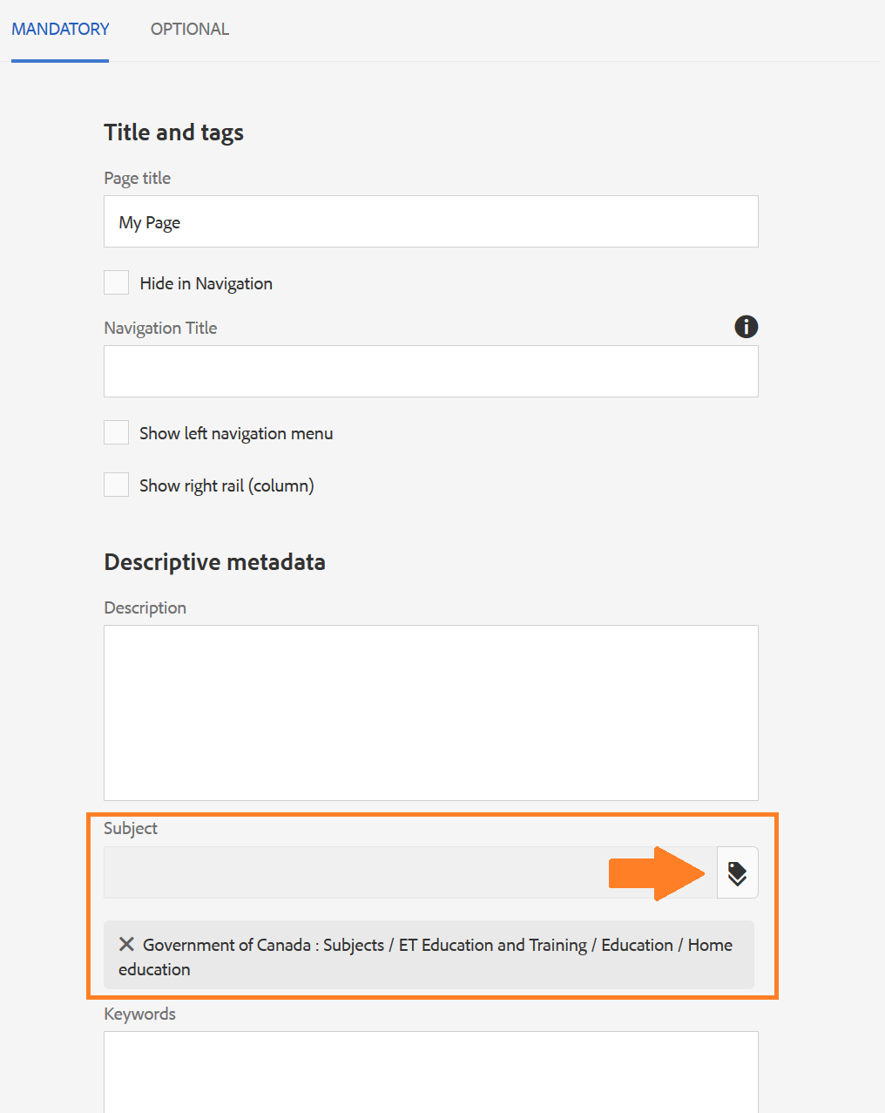
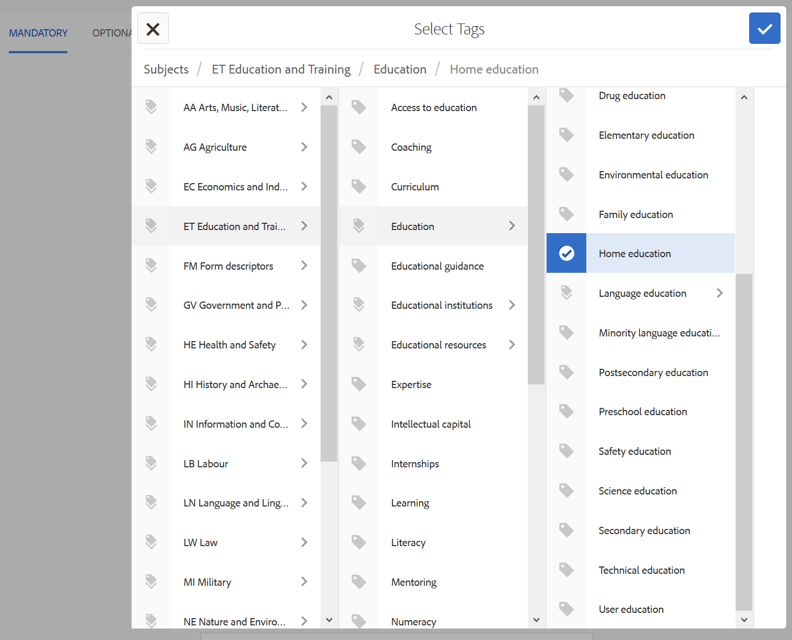
APPLY THE HOME EDUCATION SUBJECT METADATA TAG
HTML source code
<meta name="dcterms.subject" title="gccore" content="ET Education and Training;Education;Home education"/>

Slide 6
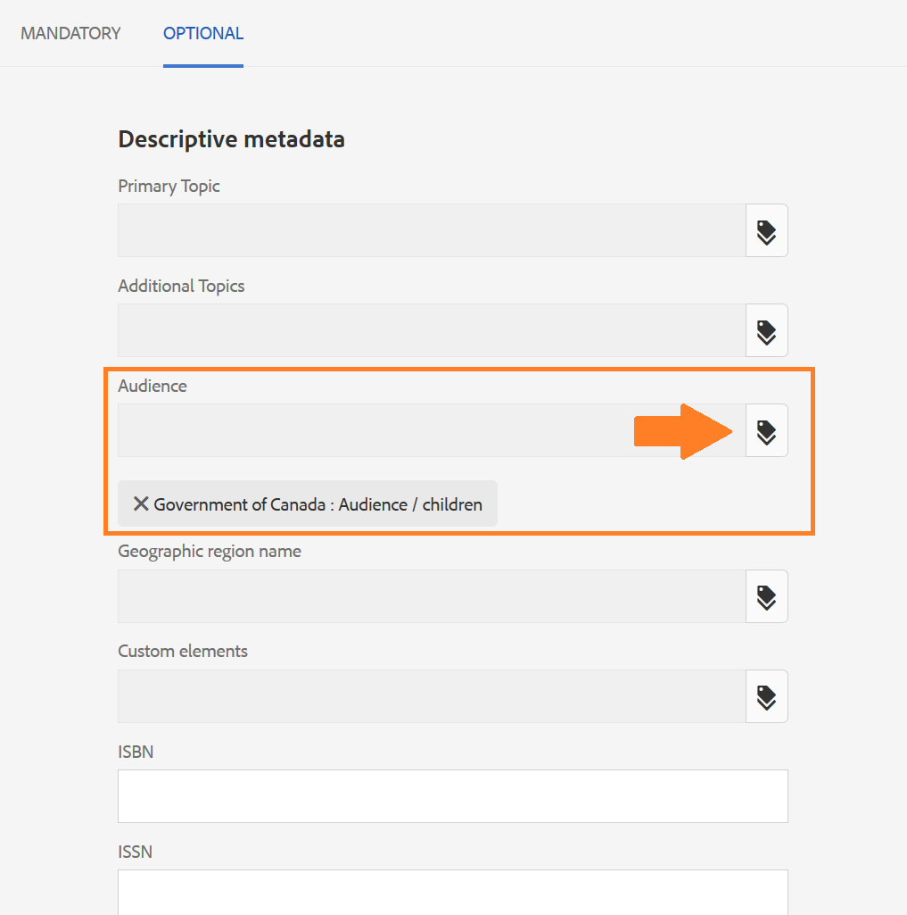
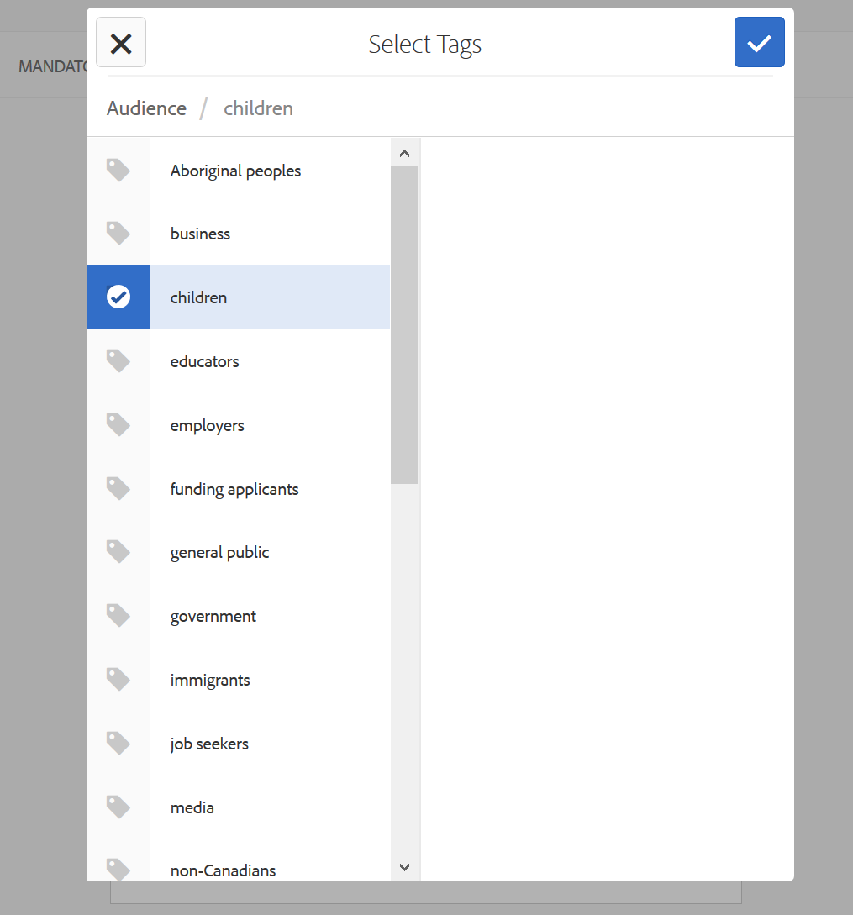
APPLY THE CHILDREN AUDIENCE METADATA TAG
HTML source code
<meta name="dcterms.audience" content="children"/>

