Slide 1
Journey to DevOps COTS and SSC

Slide 2
Our journey
Automation experiments
Automated
releases
2015
2016
2017
2018
2019
2020
Program infrastructure
Scripted releases
CI/CD with
GCcode
Splunk / DevOps / Agile / Scrum / CMDB

Slide 3
2015 | Infrastructure Landscape
Reference Architecture:
(servers and configuration)
Production Environments:
Five migrated to Borden End-State
Six built using SCCM and Reference Cloning
Notes:
Graphic; cookie cutter
Problem: Installation and configuration of Gcdocs gold build is a 5+ day effort from vanilla to gold build for 1 server. 10 days for our largest environments.
Fact: gold build is a template we configure on every Gcdocs environment
Gcdocs program was transitioned to PSPC in 2014, legacy data center, architecture was not sufficient for the usage profiles.
Migration to the SSC EDC at Borden

Slide 4
2015 | Basic Scripting
Improvements:
SCCM scripts to install core software and services
Collection of ‘helper’ scripts using Batch and PowerShell
Challenges:
Many manual steps to assign an environment to a specific cluster
Notes:
Helper scripts automated individual tasks. They performed tasks such as setting file permissions, COTS config file manipulation..
Scripts were executed manually by Administrators
Many steps were still manual and required extensive build documentation / COTS training.

Slide 5
2016 | Rapid growth
9
26
100+
160+
+9
+15
Client dev
environments
Production
environments
New VMs
Total VMs
Monthly feature releases scheduled to all production environments
Notes:
Arrows pointing up
SSC build cycle was: “how long?” -> Sergey?
Gcdocs ASP build cycle was: “how long?” -> dinesh? Guy S?
Monthly releases: maintenance window defined from Friday evening to Sunday afternoon. During a release the service needs to be stopped. Build books need to be documented and then executed manually, once per environment. A release can take 30-120 mins per environment.

Slide 6
2016 | Automation Experimentation
Health Check tool:
automated testing, monitoring and reporting
Monthly release automation experiments:
iMacro Firefox Extension for GUI manipulation
Batch files for manually triggering parts of the release
Notes:
Doctor graphic: stethoscope?
10% time for everyone to innovate helped us develop these improvements.
10m per environment for manual health check. Could take 1-2 hours.
Health Check tool runs in 2-5 minutes, runs in the background and allows support team to work on other tickets and then address the health check report after execution.
Monthly release automation would standardize delivery to all environments, automated and script the delivery of all development and changes

Slide 7
2017 | Datacenter Move
Data Center Migration – Borden to Barrie
supported by scripting tools
PowerShell scripts
Firewall Dataflow validation tool using PortQuery
Notes:
Graphic: Pickup / transport trucks
160 VM to migrate to a new data center. IP addresses were changing (storage servers) and would need to be updated. All firewall rules needed to be validated and tested.
Powershell scripts were used to stop/start services.
Firewall scripts were used to quickly test firewall rules and provide necessary data for SSC service lines to identify and correct config errors

Slide 8
2017 | Continued growth
18
31
35+
200+
+9
+5
Client dev
environments
Production
environments
New VMs
Total VMs
Monthly feature releases scheduled to all production environments
Notes:
Every time a problem occurred or configuration wasn’t consistent, it significantly increased our time to troubleshoot and find root cause.
We needed standard environments to deliver our services. Manually executing changes or other work on this volume of servers/environments was not reasonable.
We needed automation. Or we were going to drown in technical debt.

Slide 9
2017 | Scripted Releases
Monthly release automation:
Creation of scripting servers
Master PowerShell script introduced
Refinement of core iMacro scripts
Creation of common framework for updates and HealthCheck
Notes:
Scripting server in each SSC network zone. The scripting server was provided full access to all servers in the zone.

Slide 10
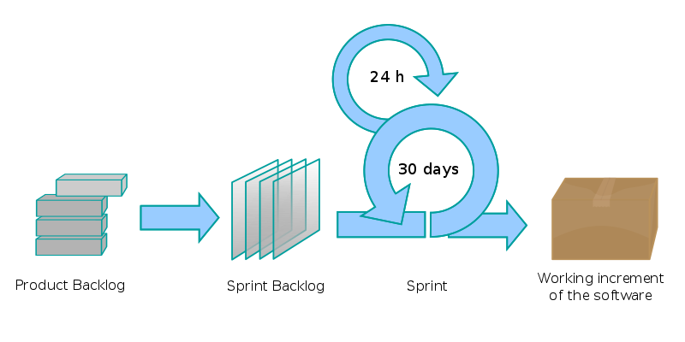
2018 | Adopting Agile
DevOps team formed
Multi-functional
Scrum framework adopted
Continuous improvement mindset
Notes:
Work planning was chaotic, teams were all working very hard to deliver, but alignment wasn’t always easy, and handoffs were frequently forced between functional teams.
DevOps team combined functions to reduce handoffs, improve the ability to empower teams to own their produce/service and responsibilities to deliver to our clients/users. The desire to automate everything we do was already there, so devops was a natural next step.
Challenge; infrastructure automation was not feasible, so we focused on what we could control.

Slide 11
2018 | …Continued growth
32
34
85+
300+
+14
+3
Client dev
environments
Production
environments
New VMs
Total VMs
Monthly feature releases scheduled to all production environments
Notes:
If it wasn’t sustainable before, its only getting more challenging.
With Agile we found improvement and stabilization, efficiencies in our team.

Slide 12
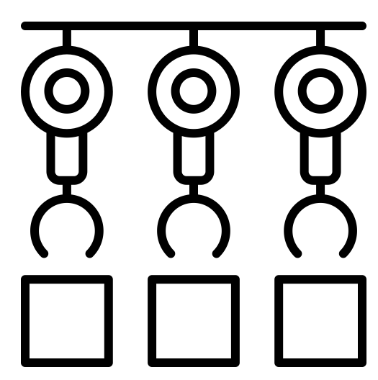
2018 | Fully Automated Releases
Refined Monthly release framework
Reduced duplication of code
Multi-threaded execution
Simplified framework to enable more developers to script their work
Notes:
Graphic: binary something
With a fully automated release package, the release is automated to execute in the middle of the night, and hten logs are reviewed to ensure there were no errors. Health Check tool validates core functions are working properly.
A release that used to take up to Sunday morning was now complete by 6am Saturday morning with minimal downtime for the users.

Slide 13
2018 | Major version Change – GCdocs 16
Challenges
In place upgrade is not possible
Requires a parallel install and reconfigure
Many new configurations required
Solution
Automation was added to our Definition of Done
Notes:
The upgrade is complex. Before devops, we would have developed and documented a process to do this manually, and then looked at how to automated the process. With automation in our definition of done, the goal was to deliver the upgrade, and automating the process was the first challenge tackled. This helped avoid waste, manual steps that were not required with automated tools didn’t have any time invested. The team was able to focus on how to deliver value, in this case the upgrade, to our clients rather than the cumbersome manual config work.
Complex tasks done manually and repeated ~60 times are likely to be done with mistakes, we will have 60 different upgrades. This would result in ongoing problem and issue management for months after upgrades.

Slide 14
2019 | ……Continued growth
43
38
30+
330+
+11
+4
Client dev
environments
Production
environments
New VMs
Total VMs
Monthly feature releases scheduled to all production environments
Notes:
We started enhancing the build scripts

Slide 15
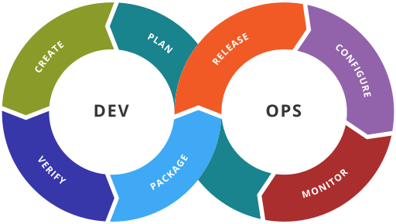
2019 | Devops Pipeline
DevOps
Enable more independent DevOps teams in the GCdocs Program
Notes:
Graphic: devops infinity
To remove handoffs, we need to improve the pipeline so more teams can independently experiment, develop and deploy features (code, modules, anything) to gcdocs environments. The goal is to allow us to add/remove Gcdocs service teams who are independent and able to deliver to our clients and the user.

Slide 16
2019 | CI/CD with Gccode
Integration between Gccode (gitlab) and Script Server Runners
Implementation of CI/CD for Gcdocs
Invest in Test Driven Development and Business Driven Development

Slide 17
Future | CMDB, Cloud
Cloud exploration
Architecture, training/skills
Business plan, costs
CMDB implementation
Eliminate spreadsheets
Single source of truth

Slide 18
Questions or Comments?

