Slide 1
PERFORMANCE MEASUREMENT COVID-19 Canada’s Response
DRAFT - Performance measurement strategy for digital environment.
Theme Management Committee Meeting March 31, 2020

Slide 2
BACKGROUND
Canada.ca/coronavirus provides access to the authoritative source of federal information about COVID-19.
While health content is at the heart of COVID-19, content has quickly evolved to cover multiple themes and topics (Annex A)
Information developed represents the all of Government response needed to address the health, social and economic impacts of the Pandemic.
Notes:
While Health content is at the heart of the COVID-19 web presence, it now crosses multiple themes on Canada.ca. It truly represents the all of Government response needed to address the health, social and economic impacts of the Pandemic.

Slide 3
COVID-19 PERFORMANCE MEASUREMENT STRATEGY
For Canadians:
Clear and easy to understand information and services
Single trusted source
Consistent user experience
For Theme Leads and Departments:
Reports on task completion success
Analytics identifying priority web page (traffic and trends)
Clear approach to measurement (KPIs)
Supplying support for evidence-based decisions on content development/location

Slide 4
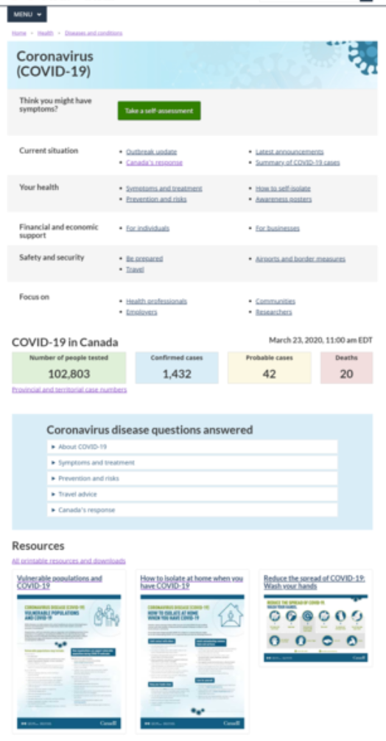
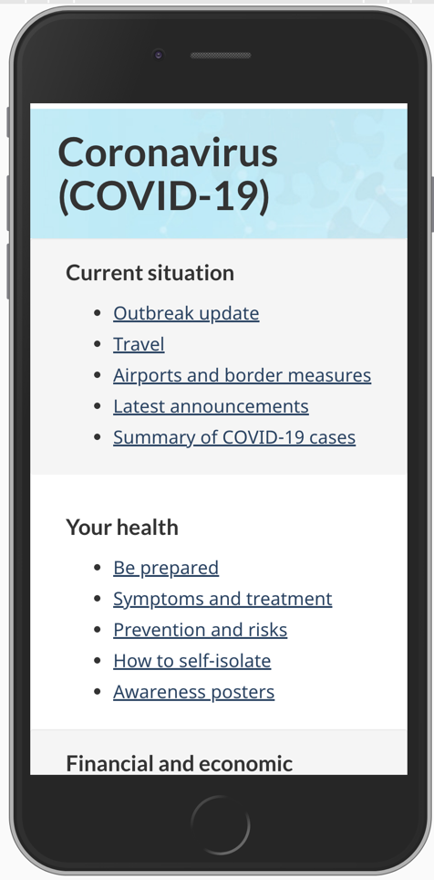
EXAMPLE: OPTIMIZED WEB SPACE BASED ON EVIDENCE
DATA TO SUPPORT DECISION:
Usability testing indicated users had a 90% success rate finding the answers they were seeking on COVID-19.
Previous research also supports task-based design.
Design is iterative - can enable addition or removal of links as needed.
Concept is scalable, easy to scroll through.

Slide 5
CHALLENGE
To create performance measurement reporting that will support all theme leads and partners in their effort to drive consistent GC-wide evidence-based decisions around content development and placement online.
Given the scope of the file, the number of Departments involved, and how quickly the information evolves, it is difficult to apply data to decisions during the content development stage.

Slide 6
OBJECTIVES
To ensure the most sought-after COVID-19 related content on Federal Department websites is easily found, understood and used.
To equip departments with messaging and data to support evidence-based decisions.

Slide 7
PROPOSED IMPLEMENTATION
Phase I – with capacity (ASAP)
Phase 2 – with capacity
Finalize strategy and overall approach for Theme Leads and Partners
Assess and apply segmentation for analytics based on categories within the task-based structure
Collaborate on the validation of content map and consider analytics impact
Continue support on application of correct UTM content tagging
Continue support on application of quality metadata
Continue user testing
Streamline reporting
Provide data to OGDs that will support consistent evidence-based decisions on content types across Canada.ca
Continue to provide data to optimize key task-based content

Slide 8
PROPOSED KEY PERFORMANCE INDICATORS (KPIs)
Task success rate
Click-through rate
Visits to content topics
Reduction in number of calls and email (ratio of traffic to calls/email)
Specific goals for success should be developed for each KPI as it pertains to reporting needs, whether at the Department, Theme or All of Government level (i.e. x% reduction in calls over x [period of time]).

Slide 9
KPI - TASK SUCCESS RATE
Purpose: Illustrate findability and usability of content, and identify top tasks and priorities for optimization
Rationale: the best method of determining if the content is meeting user needs is to get direct feedback
Next steps: Assessing tools for blanket coverage reporting and testing (currently only specific pages/apps are being user tested)
Notes:
Patrick/Nicolas – can help with survey

Slide 10
KPI – CLICK-THROUGH RATE (CTR)
Purpose: indicate if users are finding content of interest to them, identify top tasks and priorities for optimization.
Rational: If CTR increases, it indicates the page/outreach method is meeting the needs of more Canadians
Next steps: benchmark and share report
Notes:
Patrick/Nicolas – can help with survey

Slide 11
KPI - VISITS TO CONTENT TOPICS
Purpose: Identify highest priority content for optimization
Rationale: Bucketing content views by topic helps identify trends for optimization
Next steps: identify content pages by IA map
Notes:
Patrick/Nicolas – can help with survey

Slide 12
KPI - RATIO OF CALLS/EMAILS VS. WEB VISITS
Purpose: Illustrate where improved findability and usability of web content could reduce number of calls/emails received
Rationale: well-structured web content will reduce high volume of off-line support. Using a ratio will reduce noise from external changes (natural spikes, reduction in user interest)
Next steps: Identify and collect full picture of call center data and web visits across GC institutions
Notes:
Patrick/Nicolas – can help with survey

Slide 13
UTM TAGGING – outside Canada.ca driving to Canada.ca
APPLY UNIQUE TAGS TO:
REMEMBER TO (Annex B):
Multiple pages residing outside Canada.ca each linking to the main COVID-19 landing page
Email messages to stakeholder groups
Specific social media posts vs. tracking channel
NOTE: Never use the Vanity URL as the hyperlink embedded in the content
Use covid-1920 for the campaign name
Place target link (if you have one) after the utm code, and at the very end of the href (or it will not work)
Identify language (en for English and fr for French)
Use underscores for spaces (there are no spaces or capital letters in UTM codes)

Slide 14
DATA SOURCES
Usability testing results (UX teams)
Visits/page views by high-level topic (web analytics)
Navigation paths from landing page and between topics (web analytics)
External search (Search Console), Google trends (online), and onsite search queries (web analytics)
Page metadata (AEM)
Call center call volume with topic breakdown (Service Canada)
Page analytics (tagging/reporting)
UTM tagging (HC/PHAC – web analytics - refers)

Slide 15
REPORTING / COMMUNICATIONS APPROACH
Reports to be generated and distributed regularly to meet needs of senior management where decisions are required for:
content development
content updates
regular performance measurement reporting
Briefing Theme Leads on performance measurement results and key advice on how to apply data to decision making.

Slide 16
REPORTING
Internal (PHAC/HC, TBS, PP – Senior Management)
External (Heads of Comms, Theme Leads, Partner Departments)
Current frequency:
Adhoc reporting as required
Daily (traffic reporting, usability findings)
Weekly (separate reporting on traffic/trends, usability findings)
Monthly (overall traffic trends and larger-scale usability results)

Slide 17
ROLES
PRINCIPAL PUBLISHER (PP)
Lead on GC-wide analytics reporting, segmentation advice
THEME LEADS
Communicating the approach and guidance to theme partners
Supporting evidence-based decisions
Applying and measuring against KPIs for Theme space and home Department
Identify areas requiring support by TMC
PHAC/HC
Lead on developing performance measurement strategy, KPIs and coordination of efforts between departments on reporting and sharing common key insights
TBS-DTO
Lead on usability testing and advice around top task success and landing page of COVID-19

Slide 18
ANNEX A: COVID-19 AFFECTS MAJORITY OF CANADA.CA THEMES
Health
Travel
Jobs
Immigration
Business
Benefits
Taxes
National security
Policing, Justice and Emergencies
Science
Public service
Canada and the world
Culture, history, sport
Money and Finance
Transport
Indigenous Services
Legend
Has Covid-19 content now
Anticipate Covid-19 content soon
Notes:
This image illustrates the different themes on Canada.ca and the scope of content we are needing to generate. Green represents where content exists already, while blue represents anticipated content.

Slide 19
ANNEX B: UTM Guidance and contact
A UTM generator guide is available from Health Canada, complete with examples, to help you create your link. Access UTM generator from TMC Wiki page: https://wiki.gccollab.ca/Covid_19_DTO-BTN
Please send your completed UTM codes and/or questions, to Health Canada’s performance measurement team:
hc.healthwebanalytics-analysewebdelasante.sc@canada.ca

