Slide 1
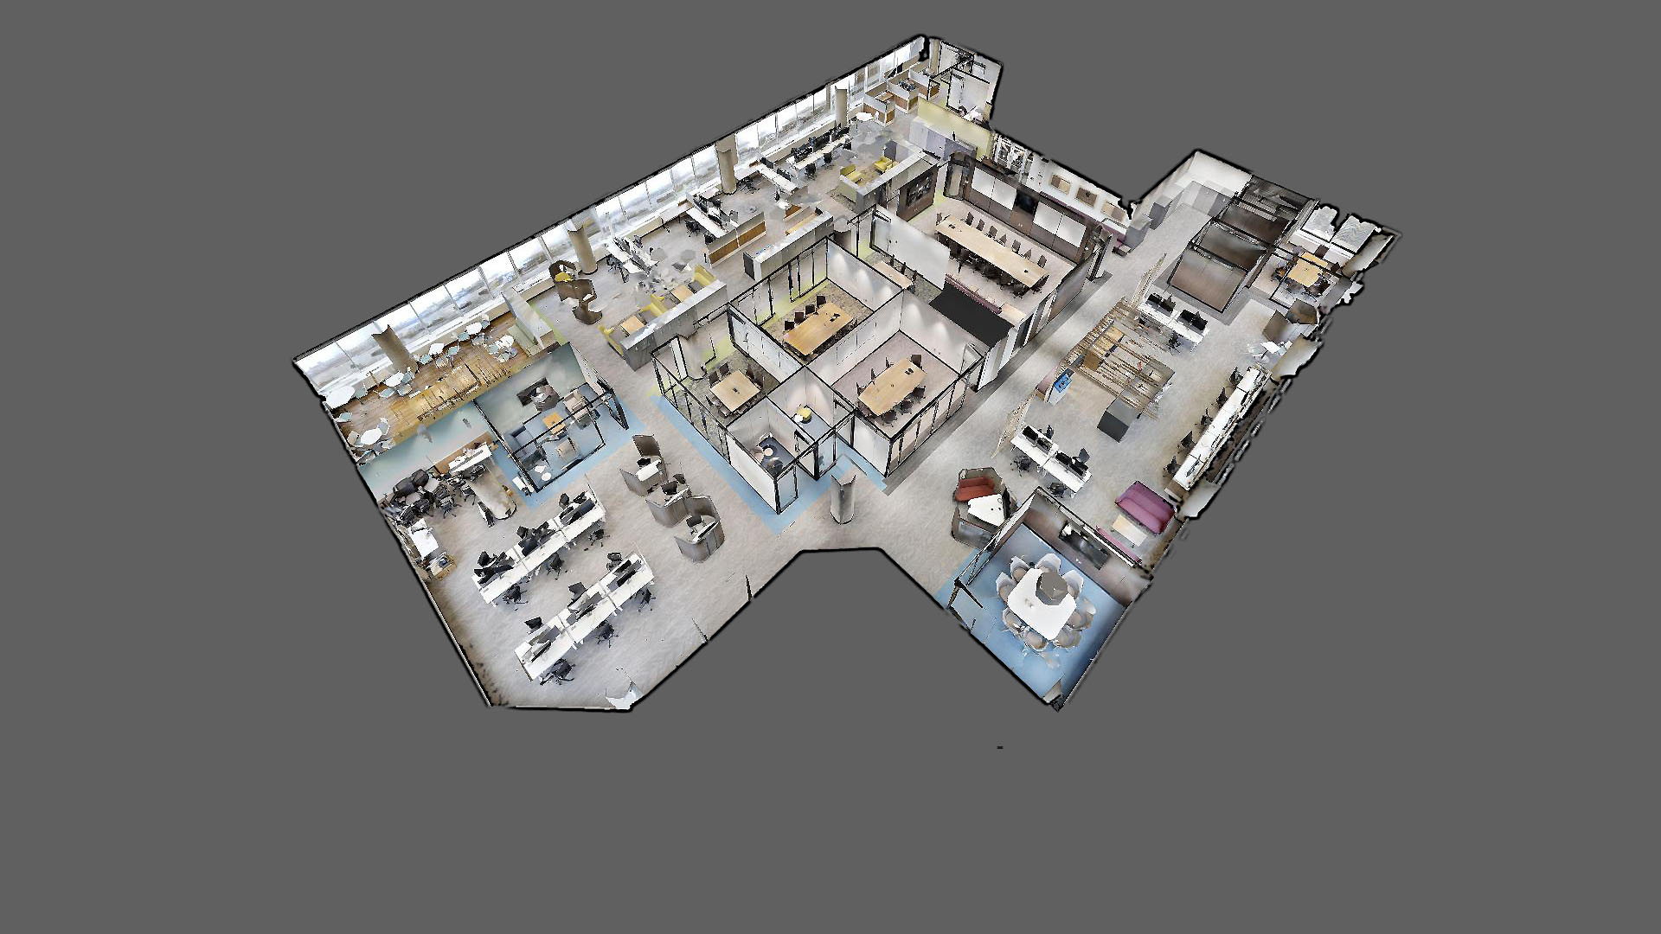
11 Laurier Suite 9A1
Notes:
In May 2018, Real Property Services’ ADM Offices (K. Radford / M.Mills) as well as a section of the Strategic Planning, Administration and Renewal Sector moved in this space - 9A1 PDP tower A.
The space uses 928.5 m2.
85 employees have been assigned to this floor, making the utilization ratio at 10.9 Um2 per FTE.
After some time to adjust, the space could host approximately 15 additional occupants – on an occasional basis – which would bring utilization to 9.3 m2 per FTE.
This would represent a 36% reduction in space use compared to the WP 2.0 standards and a 42% reduction to the 16 m2 usable per FTE which most departments are currently using for the legacy environments.

Slide 2
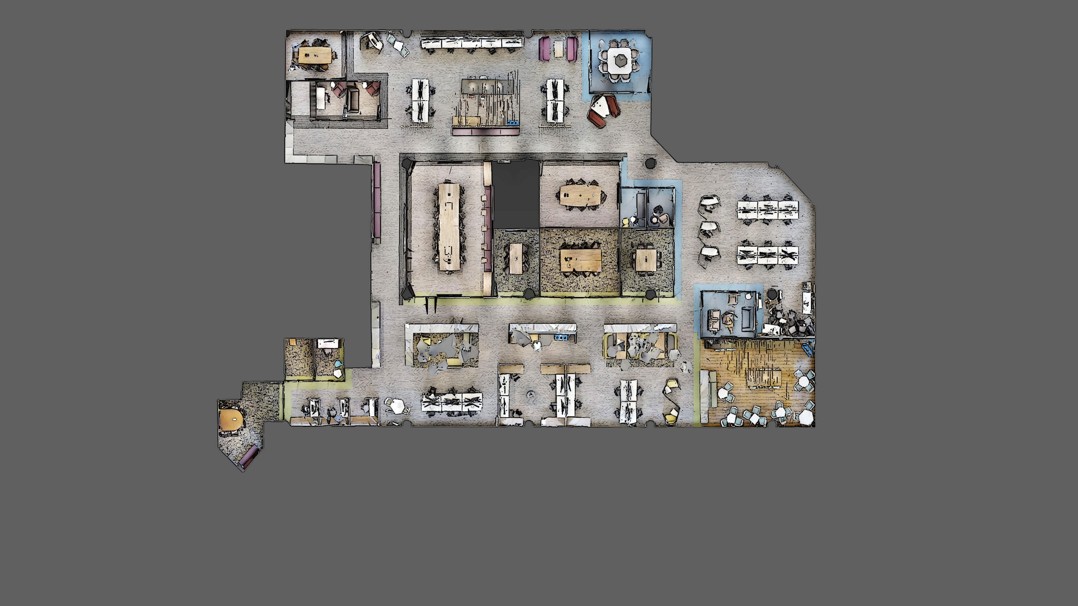
Plan
Notes:
The floor is a GCworkplace design which contributes to a more efficient use of space, as all workpoints are shared. In this presentation you will see many different wokrpoints, each has a different usage, depending on the type of work you will be doing. It is activity-based, and it allows the employee to decide where and how they wish to work to be as productive and efficient as possible.
GCworkplace is very flexible. In this case, the client chose to make an executive zone instead of an interactive zone. There is an eco system inside the executive zone, and includes collaborative and individual work points.

Slide 3
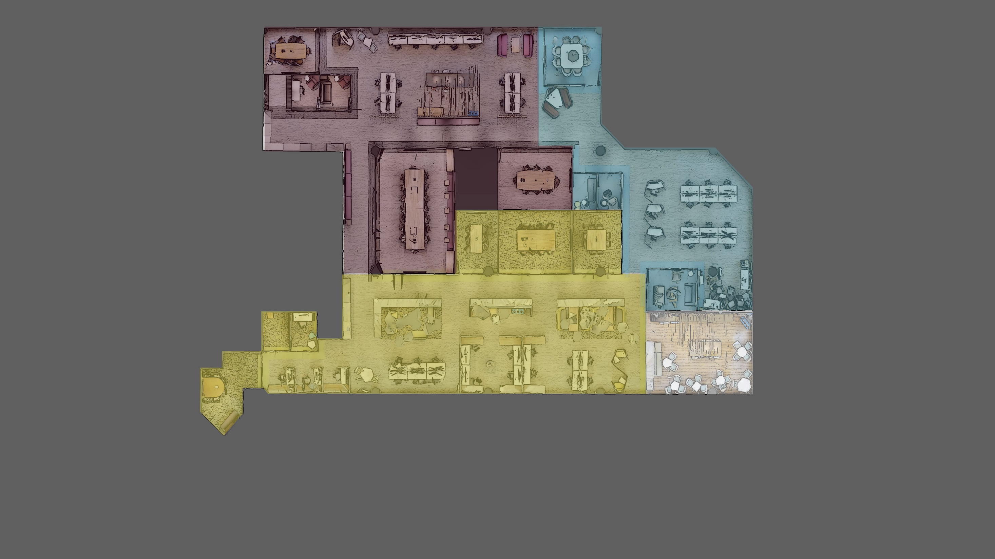
Executive – Exécutive
Quiet
Tranquille
Interactive – Interactif
Zones
Notes:
GCworkplace is planned in a way that noise-generating workpoints, such as collaborative workpoints, are away from individual workpoints in order to manage acoustics and better support concentration and collaboration. GCworkplace is designed in three functional zones – Quiet, Transitional and Interactive - which ensures that activities are grouped together to reducing noise disruptions.
The space is divided in 3 zones. You can always know in which zone you are if you keep an eye on the carpet. Green is collaborative, blue is quiet and grey & burgundy is executive.
A Quiet Zone includes open, semi-enclosed, and enclosed individual workpoints. In these zones, the intent is to encourage individual focus work, and to support the need for quiet or private spaces.
A Transitional Zone includes a variety of open and enclosed spaces where less intense concentration is supported. Transitional Zones may include open individual and collaborative workpoints, semi-enclosed collaboration, and Support Spaces such as Lockers or Shared Equipment Area.
In an Interactive Zone, socialization and group collaboration is promoted and strongly encouraged. By providing a variety of group workpoints, and locating these activities away from the Quiet Zone, it is possible to achieve a balance within the workplace which supports all types of work activities and workstyle

Slide 4
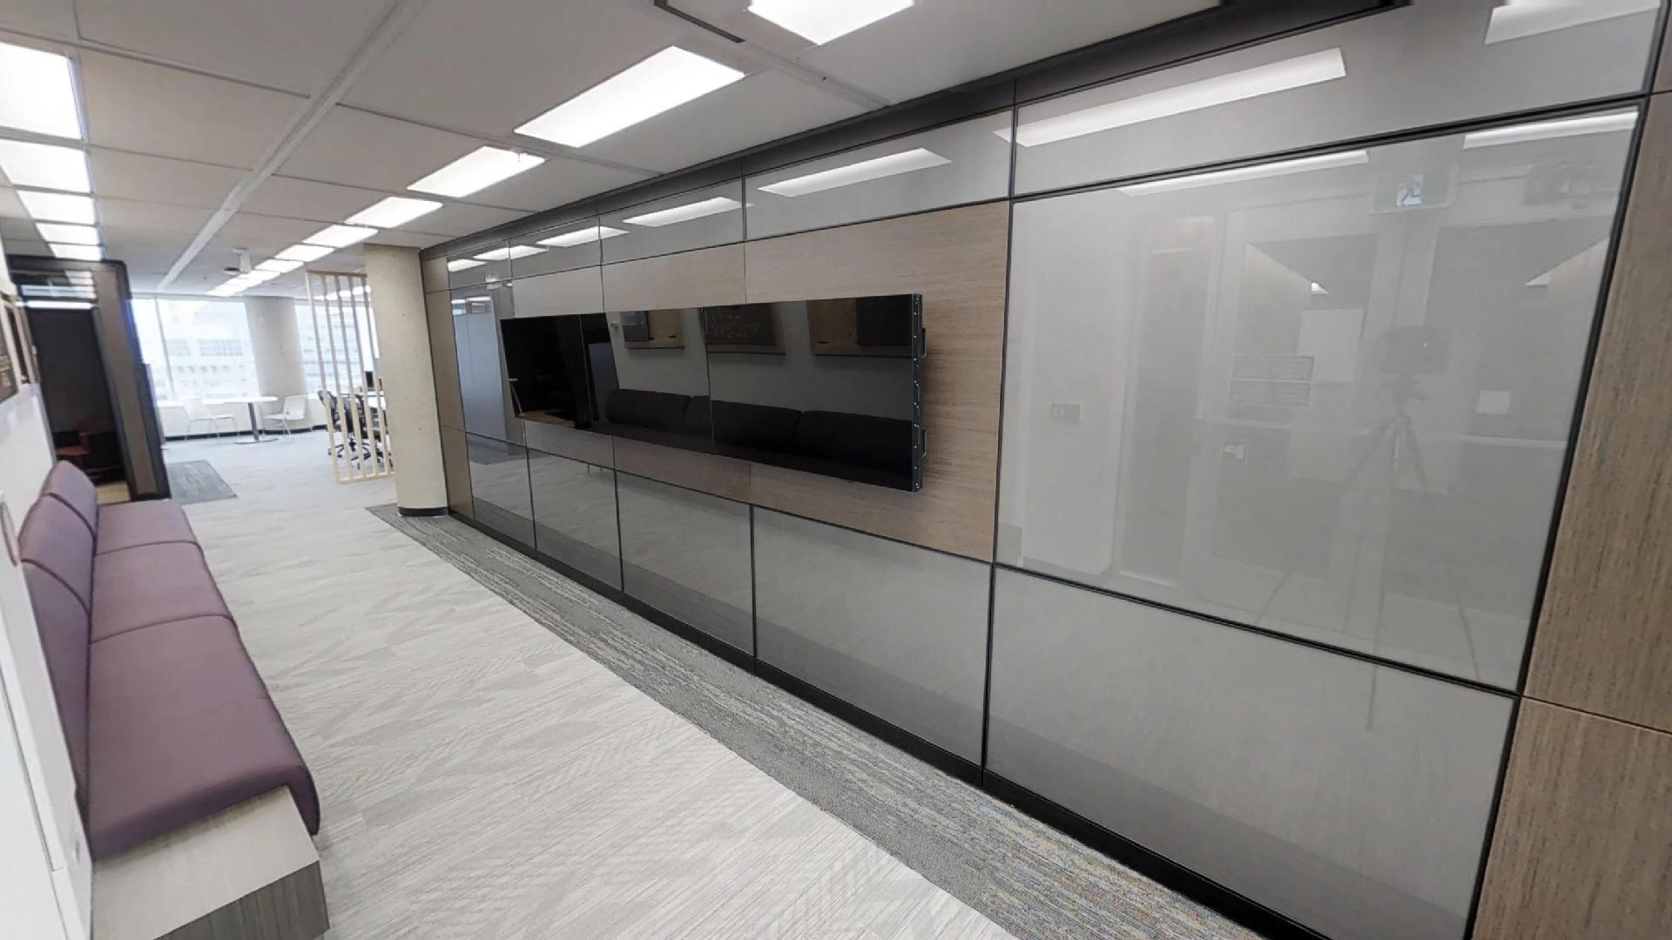
Entrée Entrance
Notes:
You can see on the featured wall the names of the recipient of the Pierre Letellier Award.
The Pierre Letellier Award is given to RPS employees who demonstrate excellent professional and personal skills, as well as exceptional performance in the workplace.
Pierre Letellier was a dedicated and well respected public servant who exemplified the qualities of being an inspiring team player, an effective communicator, a calm approachable person, and a morale booster.
The space is divided in 3 zones. You can always know in which zone you are if you keep an eye on the carpet. Green is transitional, blue is quiet and grey & burgundy is executive.

Slide 5
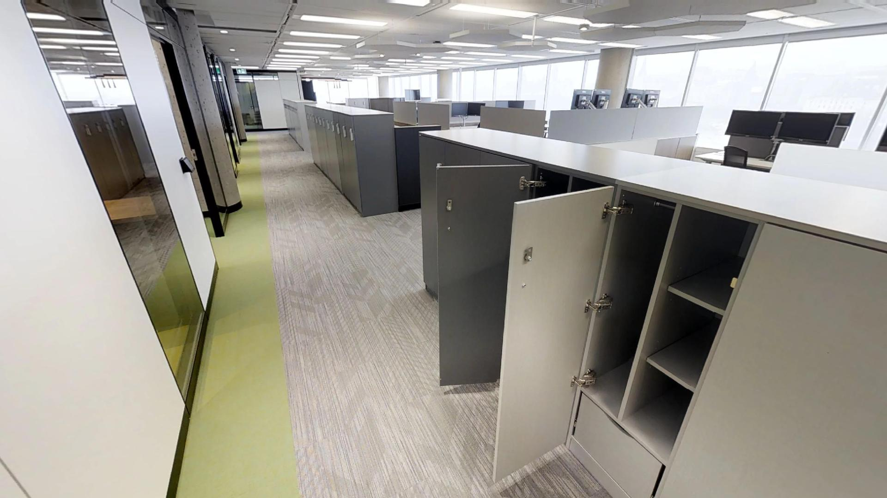
Casiers Lockers
Notes:
In a GCworkplace environment, lockers are located outside of individual workpoints, and centralized in areas adjacent to circulation paths for easy access. Because workpoints are shared and cleared at the end of the workday, lockers are used to store personal and work related effects. Lockers here are keypad enabled – which removes the requirement for a dedicated role for key management

Slide 6
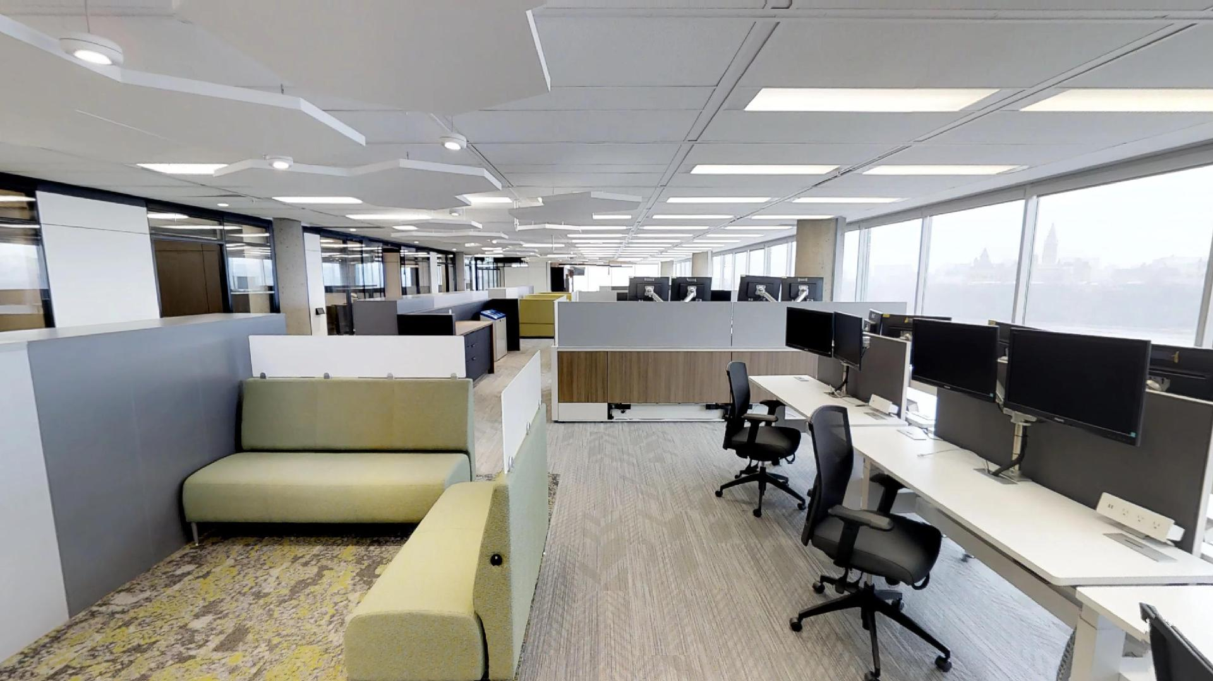
Zone Transitionnelle Transitional Zone
Notes:
The floor has:
46 height adjustable and fully accessible workstations for interactive desk work
6 Pods with privacy elements
5 Collaboration spaces, serving at least 4 employees each
10 Meeting rooms, including an executive boardroom and a GCSI Secret discussion room
6 Quiet rooms, one equipped for personal health rejuvenation, and one walk mill (treadmill with desk)
In the corner (behind/back of the room), you can find a project room, and GCSI terminals.
The floor has a total of 4 GCSI terminals and one secret meeting room to serve 30 or more registered users, on an as required basis. Because they are fully shareable, there is no longer a requirement to support widespread installation of a separate network infrastructure.
You will also find an active workstation.

Slide 7
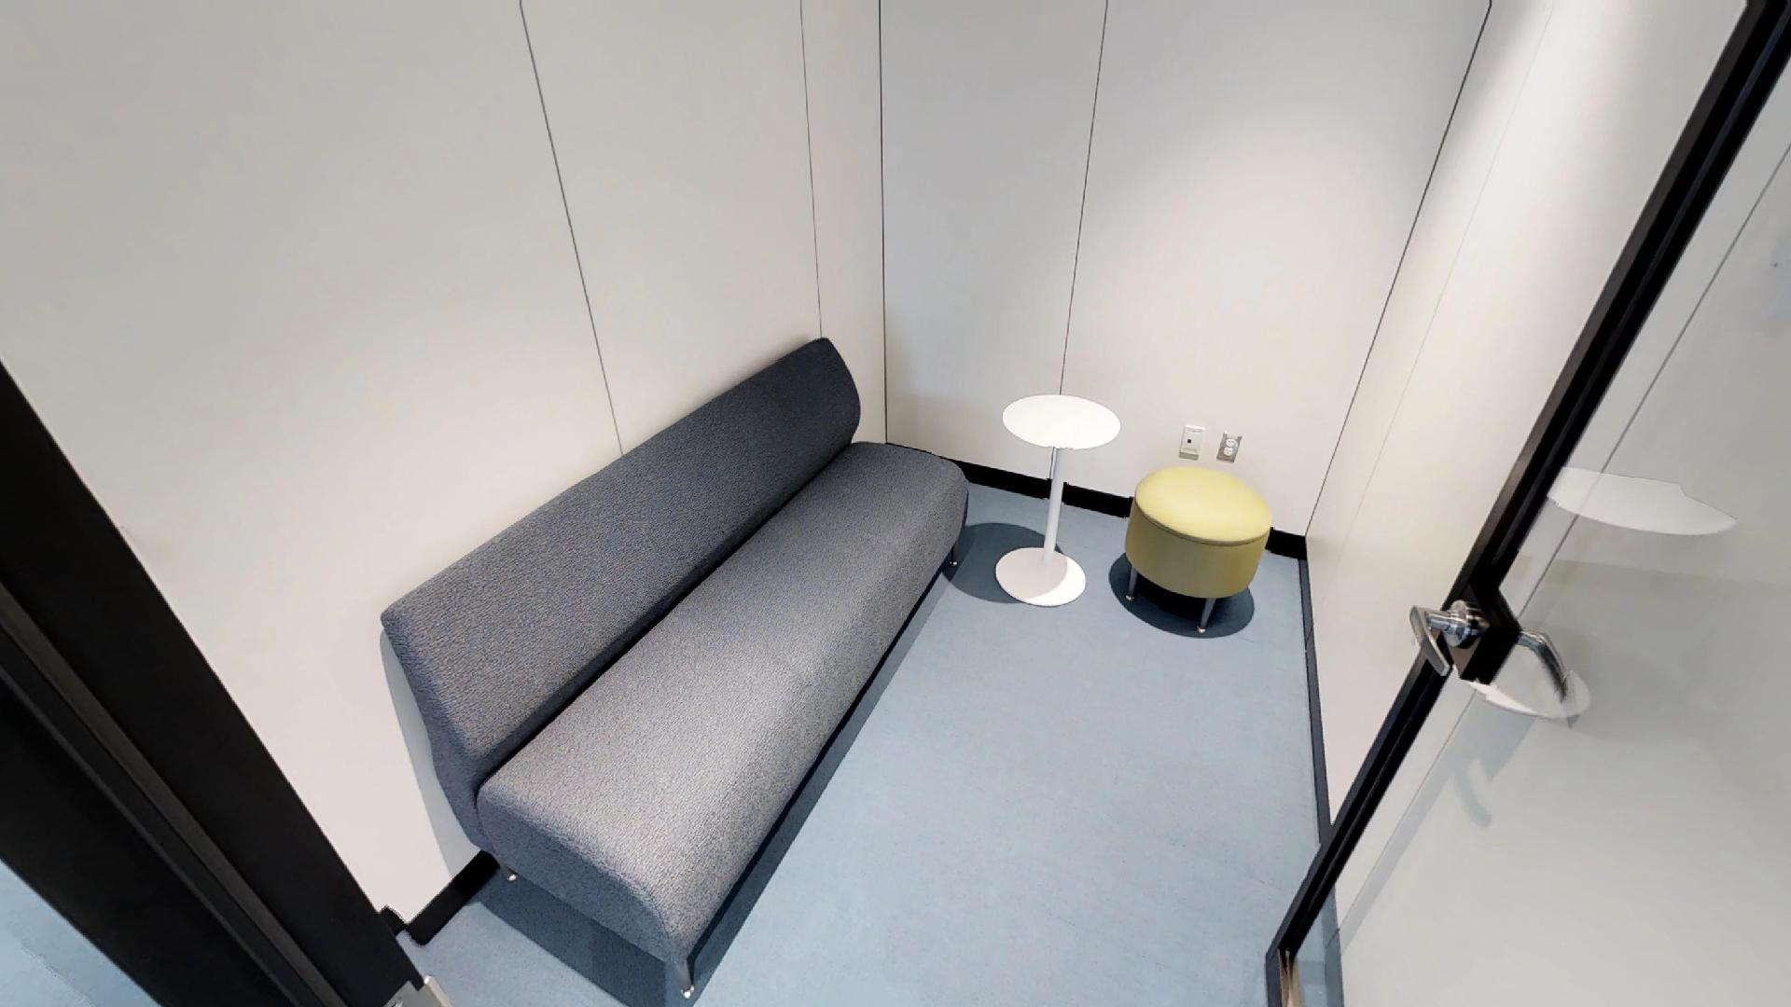
Cabine Téléphonique Phone Booth
Notes:
You will see in the phone booth behind us one of the original mail chute of the building. It was kept and integrated as part of the design.
INDIVIDUAL WORKPOINTS
Individual workpoints may be open, semi-enclosed, or enclosed. Primary individual workpoints are used to perform most common tasks requiring varying levels of focus and privacy. These include workstations of various sizes and configurations, Enclosed individual workpoints provide the greatest level of privacy and are best suited for highly focused work or work performed by people in need of individual accommodations. Secondary individual workpoints support activities that may occur for shorter periods of time throughout the day.
Primary/Individual Enclosed: The phonebooth is an enclosed or semi-enclosed area with acoustic protection for phone calls.

Slide 8
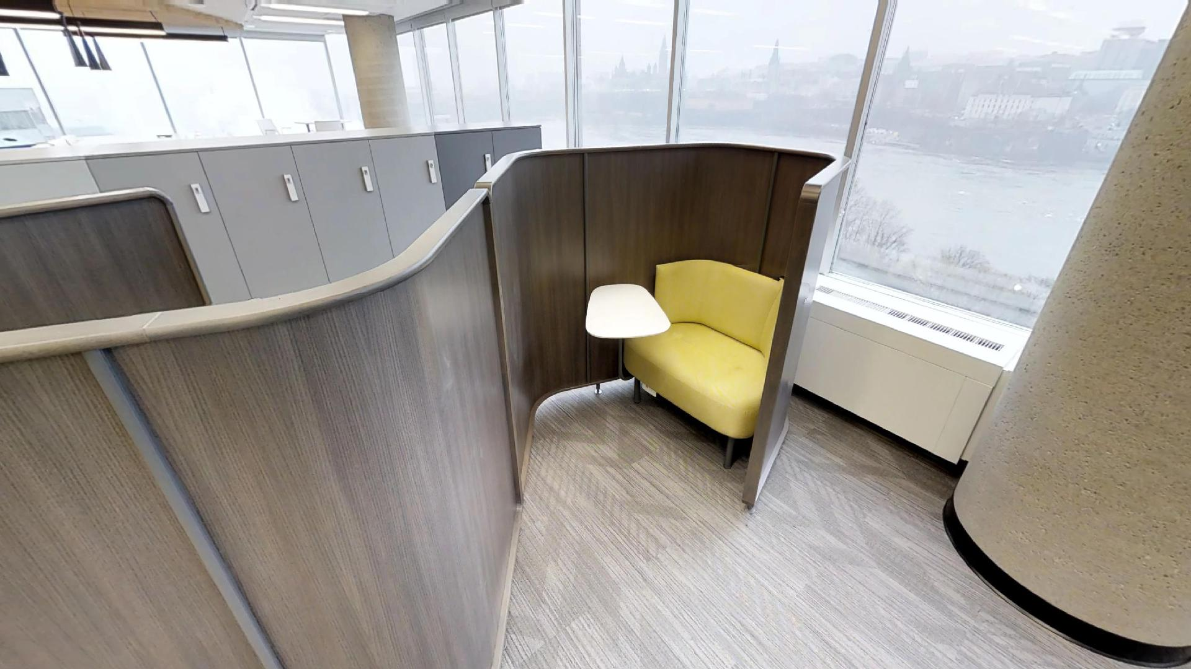
Capsule de Concentration Focus Pod
Notes:
Primary/Individual Focus pods: The semi-enclosed work pod is for mid- to long term focused work.

Slide 9
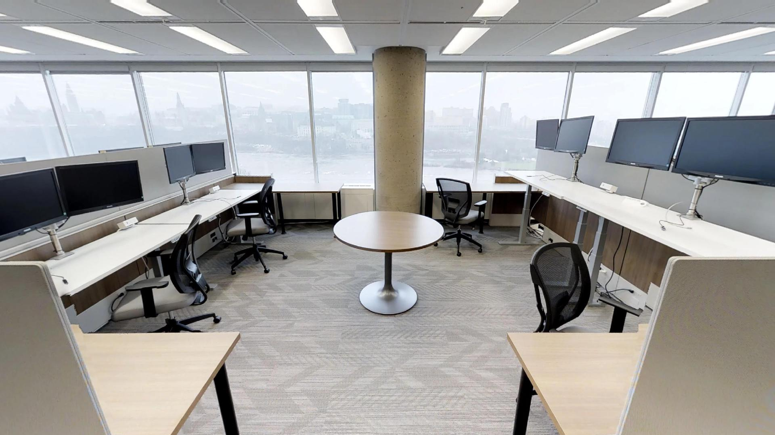
Stations de Travail Workstations
Notes:
Primary/Individual: The workstations are mid-to long term workspace with access to others if required. Here we can see the adjustable desks.
We used multi layered blinds to provide increased lighting and thermal comfort control for employee.
This floor only has one printer for the 85 to 100 employees, making a significant leap on the former 2012 Federal Sustainable Development Strategy target of one printer for every 10 employees.
You will notice that most of the enclosed rooms, including meeting rooms, are located in the middle of the floor to ensure we leave as much natural light come in as possible.
FUN FACT - HEALTHY
In the pre-Workplace Satisfaction Survey (while occupying 3B3), employees ranked air quality and office lighting as the 2 most important elements contributing to their wellness. Post-Workplace Satisfaction Surveys will be administered 3 months after the move, 6 months after and one year after.

Slide 10
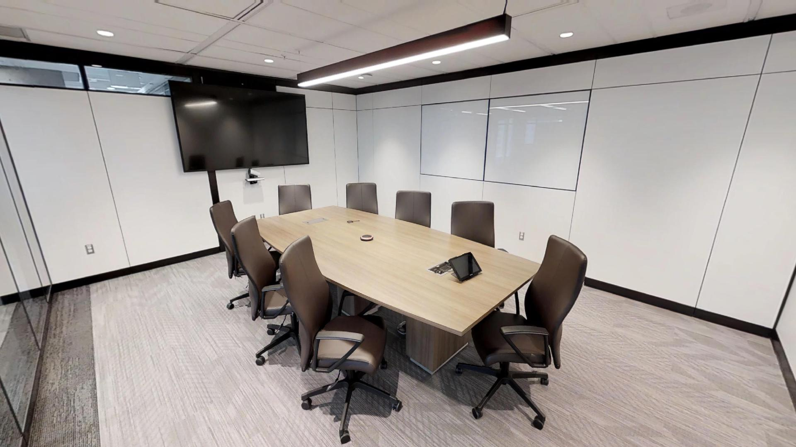
Salle de Réunion Moyenne Medium Meeting Room
Notes:
In transitional zones such as this one, socialization and group collaboration is promoted and strongly encouraged. Providing a variety of group workpoints, and locating these activities away from the Quiet Zone, it is possible to achieve a balance within the workplace which supports all types of work activities and work styles.
COLLABORATIVE WORKPOINTS
GCworkplace features a wide variety of both open and enclosed collaborative workpoints, promoting spontaneous interaction and ideas sharing as well as planned collaborative activities. The use of shared monitors and smart screens, writeable surfaces and reconfigurable furnishings allow groups to make the most of shared spaces. Collaborative workpoints provide a variety of formal and informal meeting spaces.
Enclosed/Collaborative: The medium meeting room is an enclosed meeting room for up to 12 people.
There are two Business Centers on this floor. Employees can find supplies and common work tools in these locations.

Slide 11
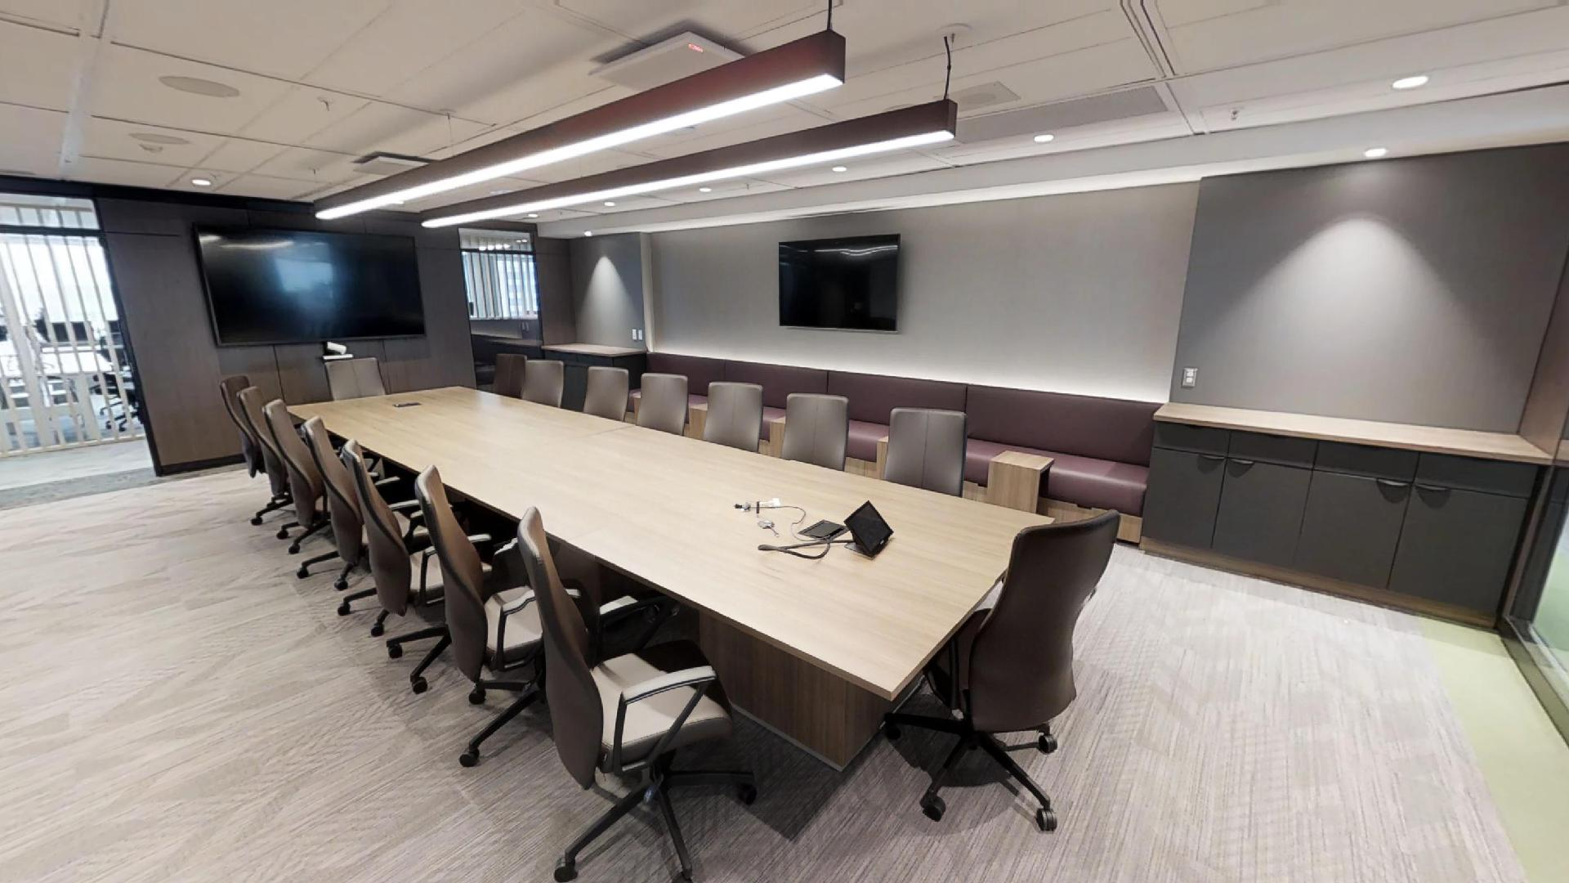
Grande Salle de Réunion Large Meeting Room
Notes:
Enclosed/Transitional: The large meeting room is an enclosed meeting room for up to 20 people.
In the larger boardrooms – benching system were added to maximize listening spaces.
They are all bookable and equipped with AV and ClickShare.
FUN FACT - GREEN
In the pre-Workplace Satisfaction Survey (while occupying 3B3), 93% of agree that they were provided the right tools to support the paper free environment and 90% agree that their workplace is primarily paperless.

Slide 12
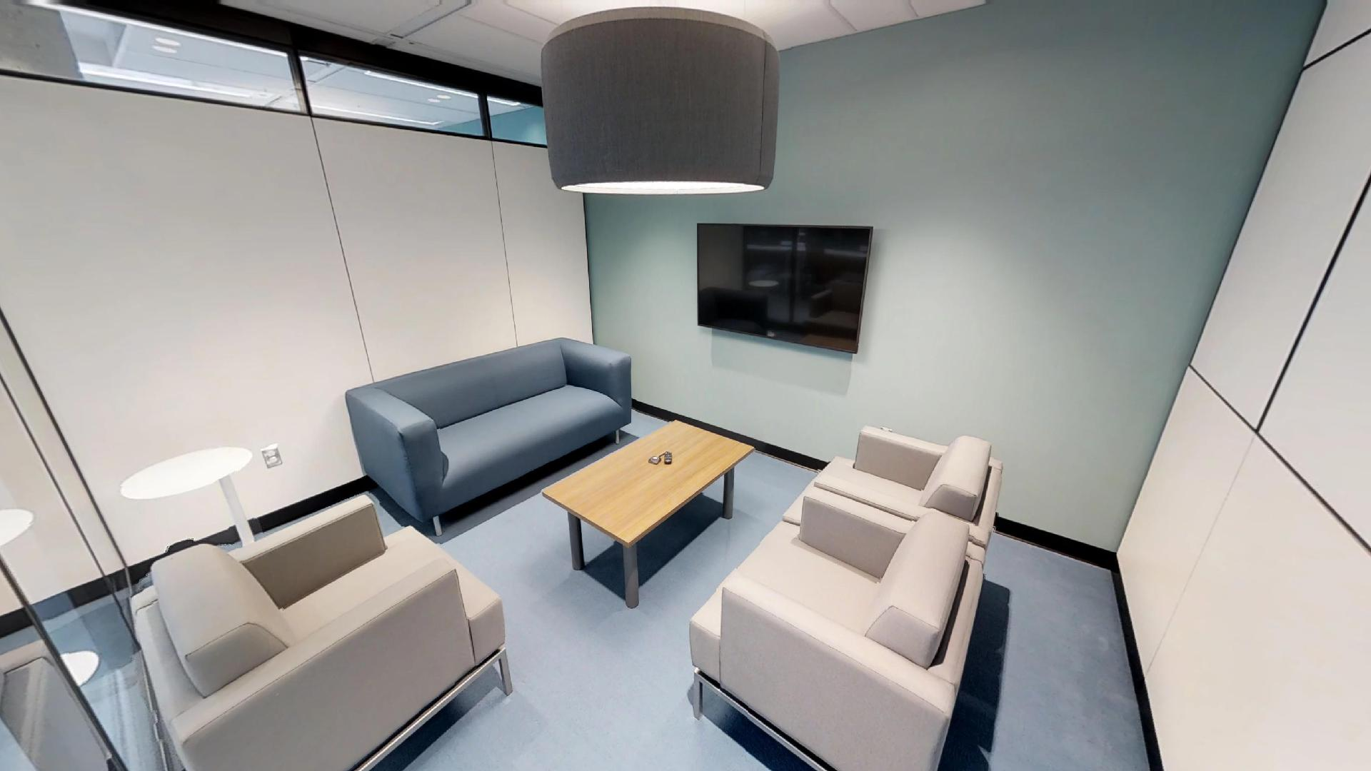
Salle de Travail Work Room
Notes:
Enclosed/collaborative: the work room is an enclosed room for team work or meetings for up to 4 people

Slide 13
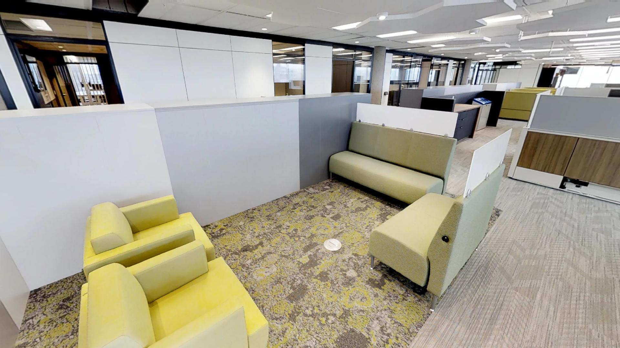
Enclave Huddle
Notes:
Open collaborative: The huddle is an informal open or semi enclosed area for short- to mid-term meetings

Slide 14
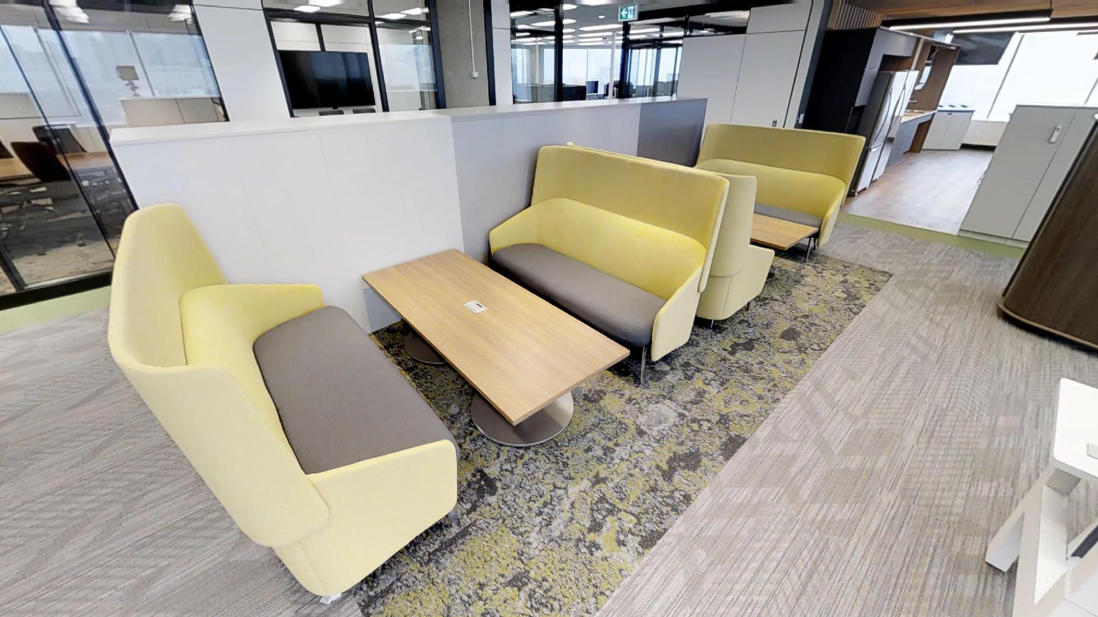
Enclave Huddle
Notes:
Open collaborative: The huddle is an informal open or semi-enclosed area for short- to mid-term meetings.

Slide 15
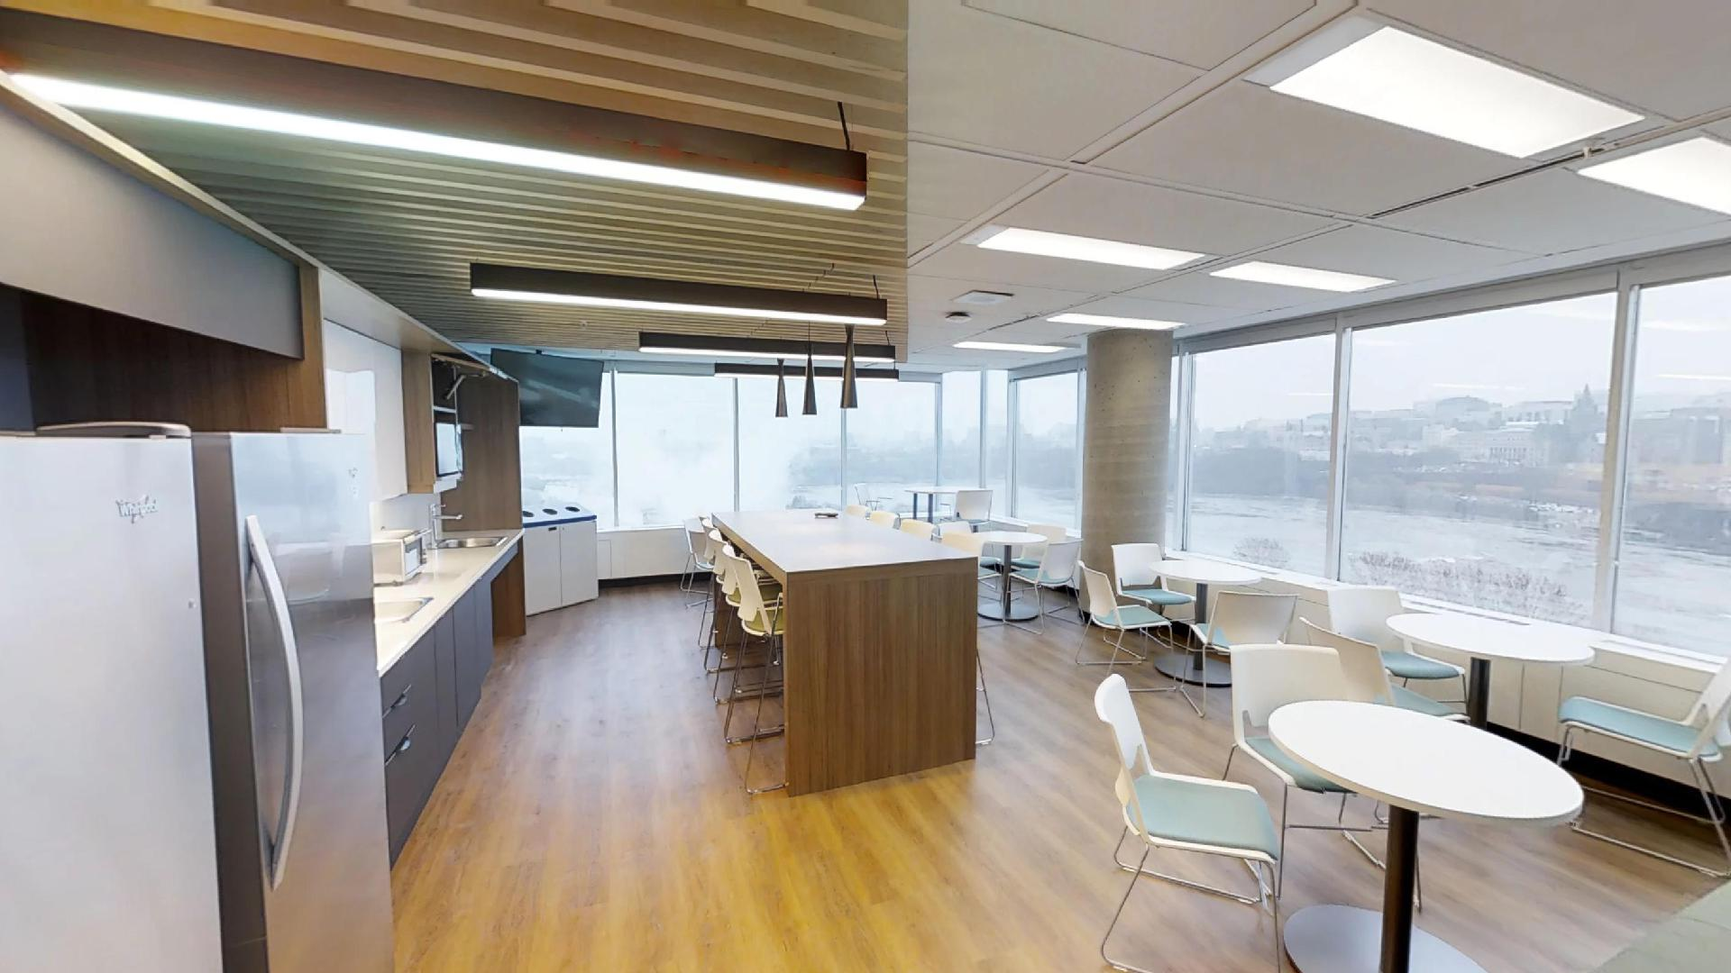
Cuisinette et Salon Kitchenette and Lounge
Notes:
The kitchenette provides a view of the Ottawa River, Supreme Court (and Parliament). Before the floor was renovated, there were offices in this corner. Now, this magnificent view can be shared with all employees and visitors on the floor.
Canadian wood (maple) was used in the construction and design features – here in the kitchenette and you will see it elsewhere on the floor as well.
Just a note on accessibility here. You will notice that the two micro-waves are at different heights and the two sinks as well. While two sinks is not ‘standard’, it’s a small detail to add but greatly appreciated by employees.
Seating in the kitchen can be used as workpoints. We made sure to add power along the windows so people can plug in if they need to work here for some time during the day.

Slide 16
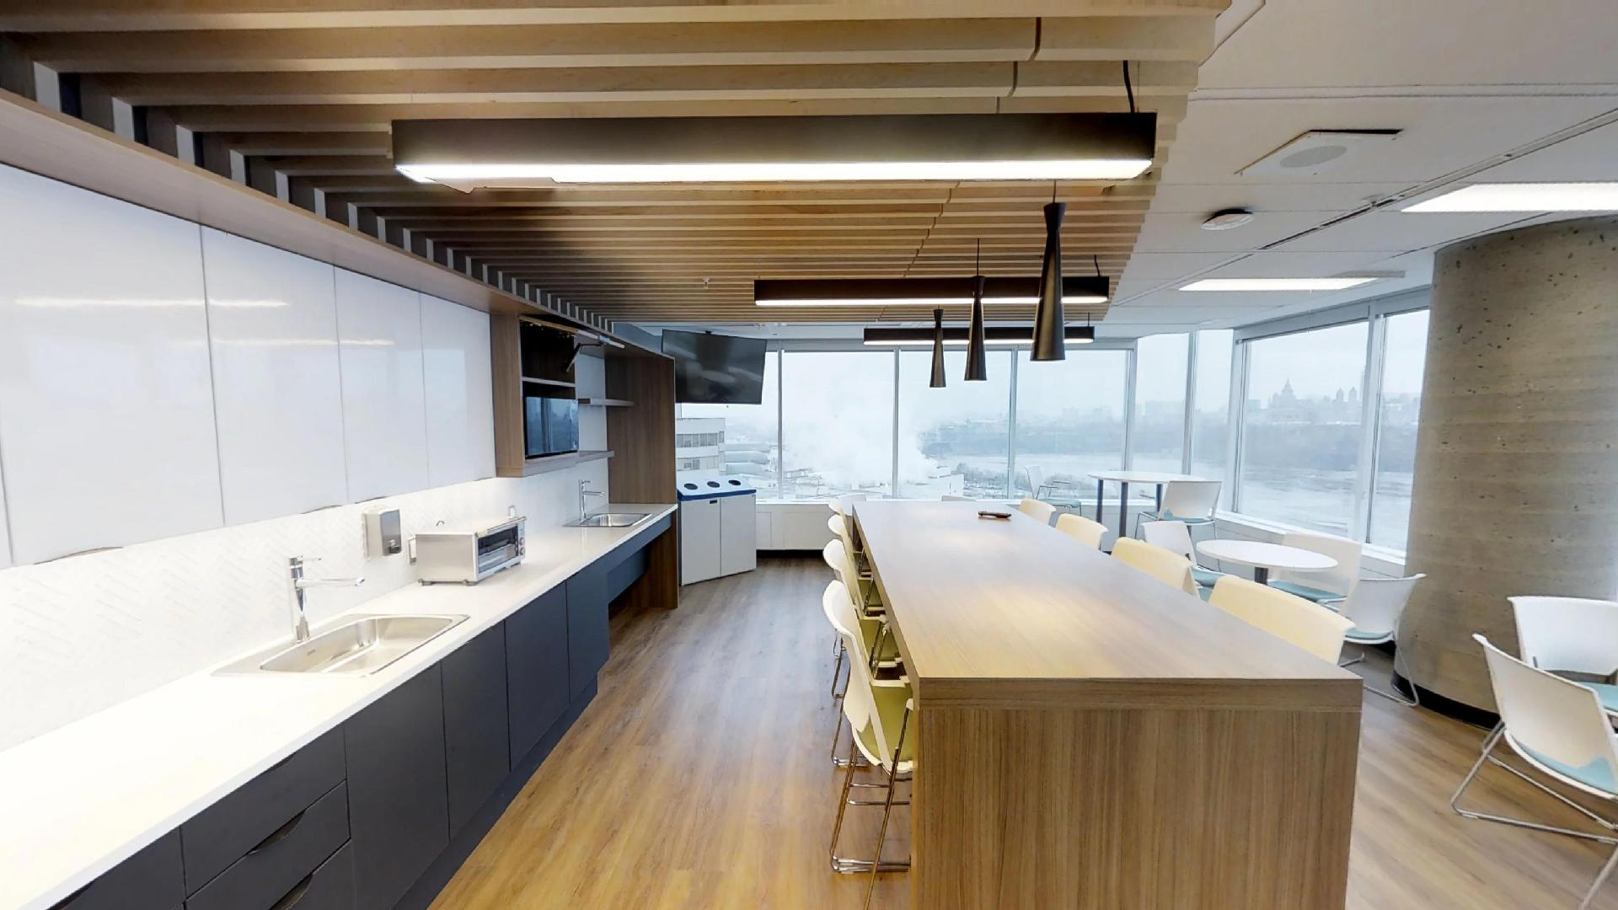
Cuisinette et Salon Kitchenette and Lounge

Slide 17
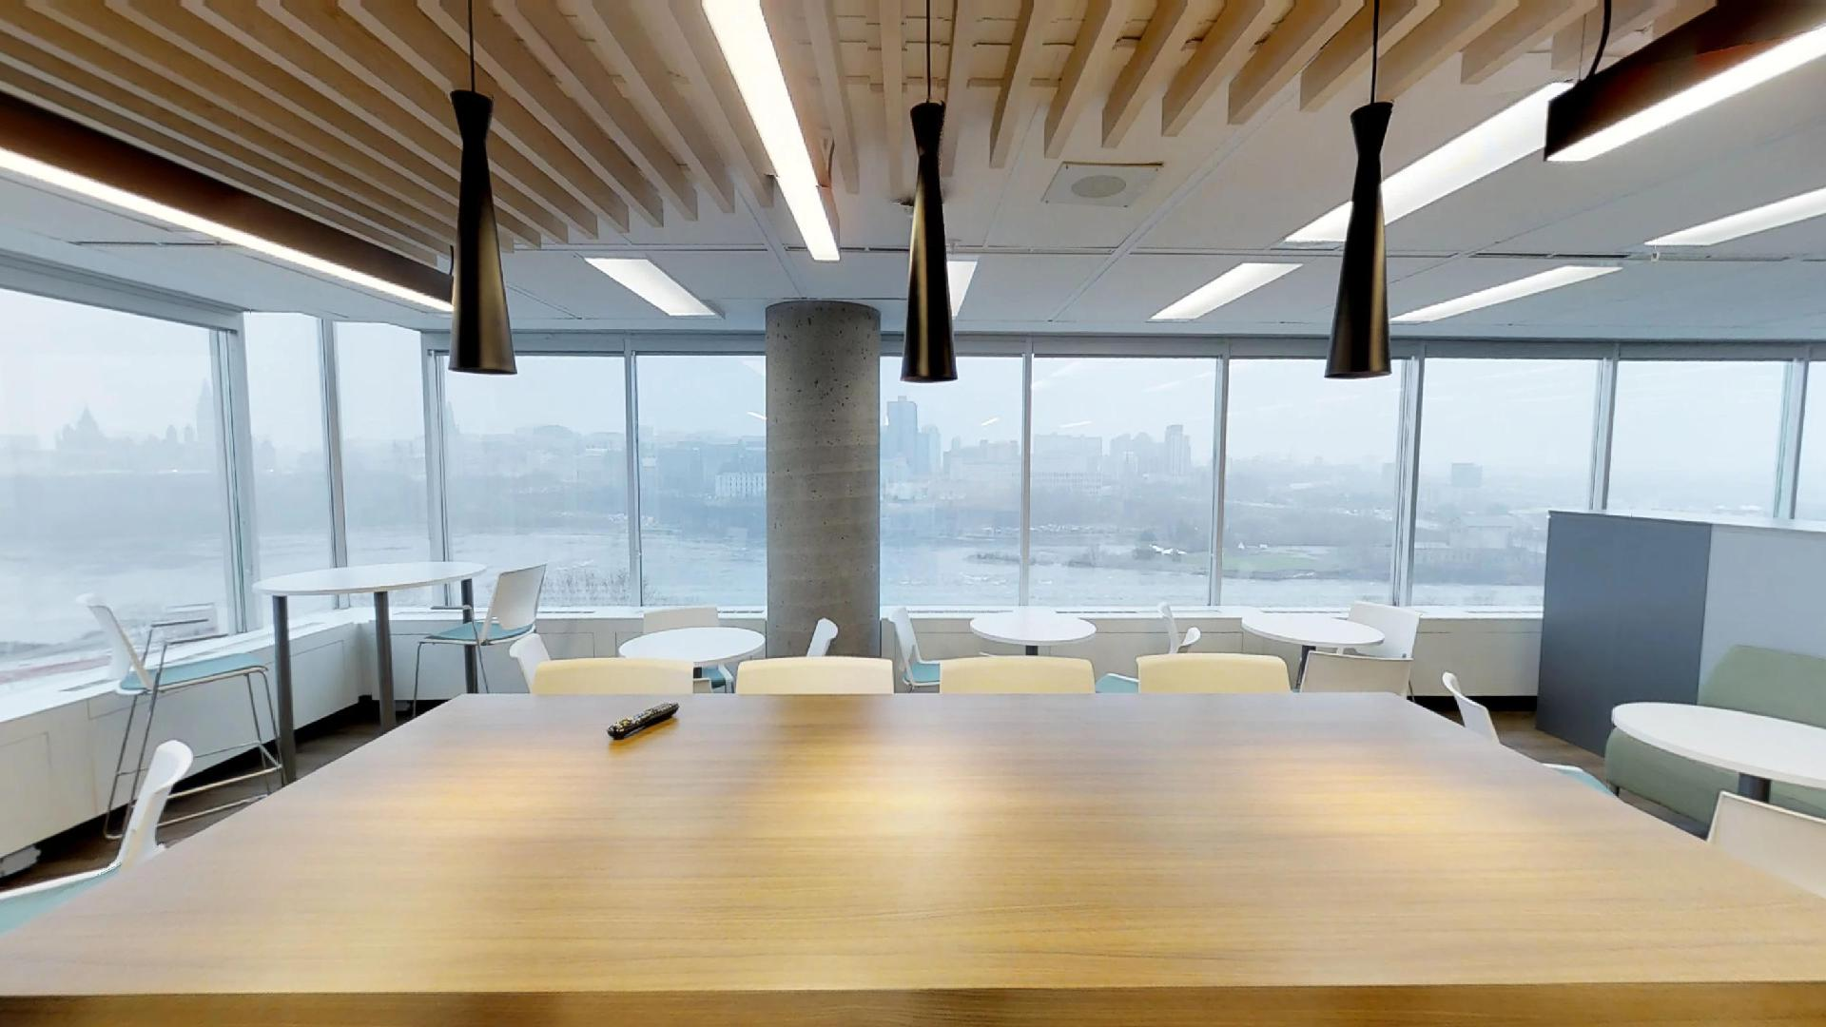
Cuisinette et Salon Kitchenette and Lounge

Slide 18
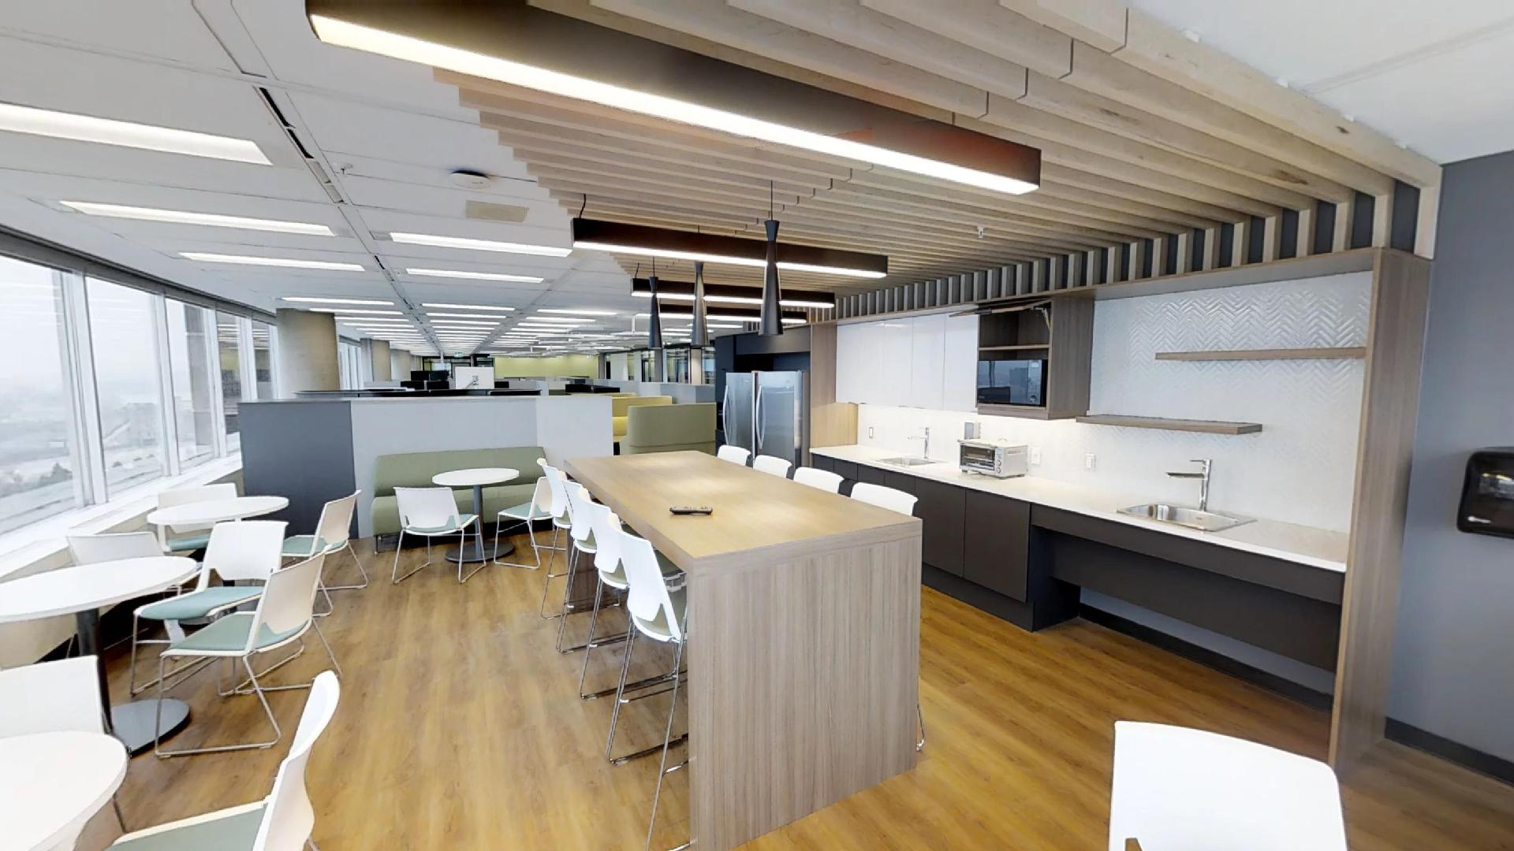
Cuisinette et Salon Kitchenette and Lounge

Slide 19
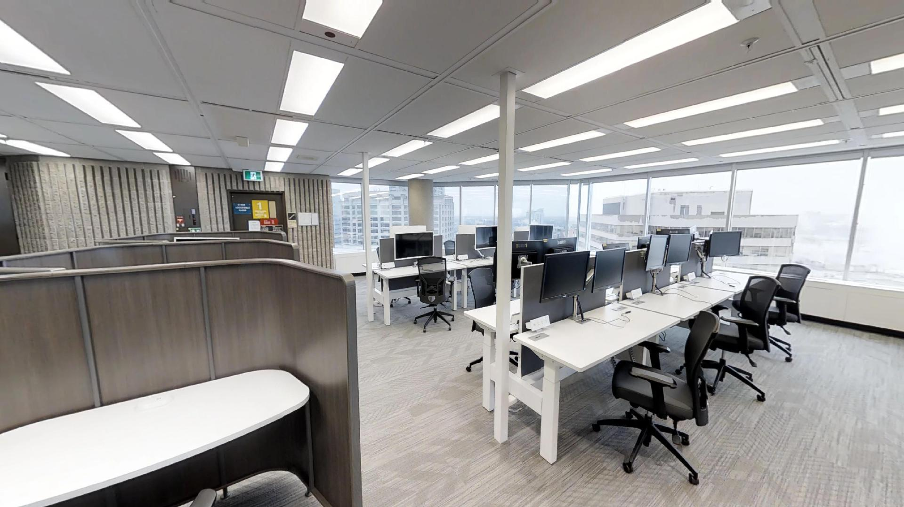
Zone Tranquille Quiet Zone
Notes:
We will now proceed to the quiet zone.
Determining zones and identifying them as such help inform users how the space should be used.
The Quiet Zone includes open, semi-enclosed, and enclosed individual workpoints. In these zones, the intent is to encourage individual focus work, to support the need for quiet or private spaces, in an area that should be free of distractions.
Noise levels here are expected to be lower than anywhere else on the floor. A behavioral shift must happen when entering this zone, and usually employers will put up signs to remind employees to stay quiet.

Slide 20
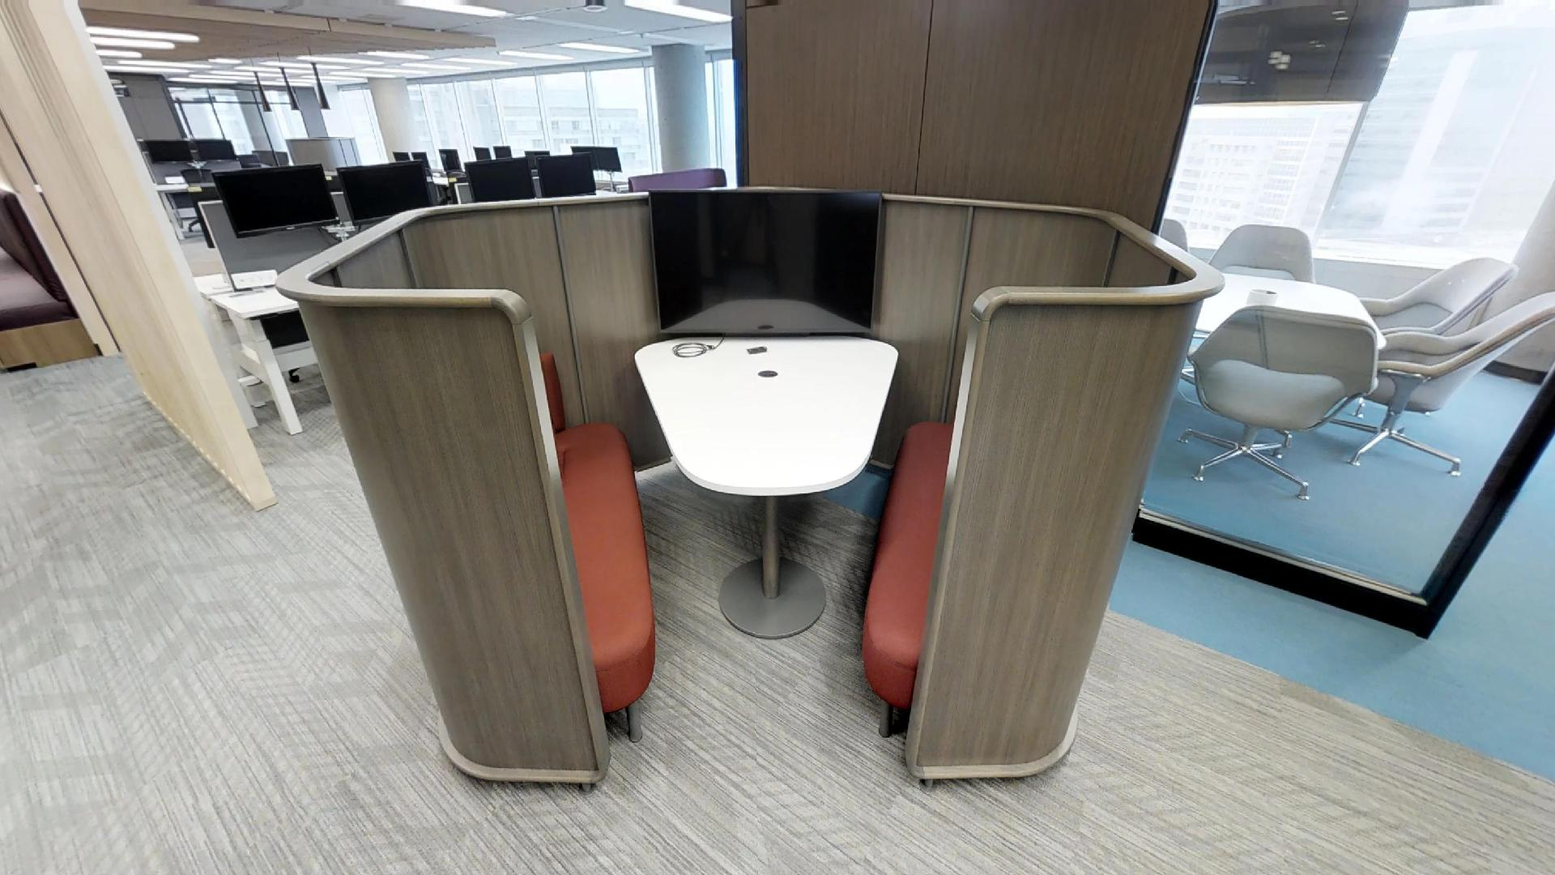
Enclave Huddle
Notes:
Stop #5: In-between Quiet and Executive zones.
Again, this is huddle workpoint, a semi-enclosed area for short to mid-term meetings.
We’ve seen many meeting rooms up to here.
They are all bookable and equipped with AV and ClickShare.
Wi-Fi is available everywhere on the floor.

Slide 21
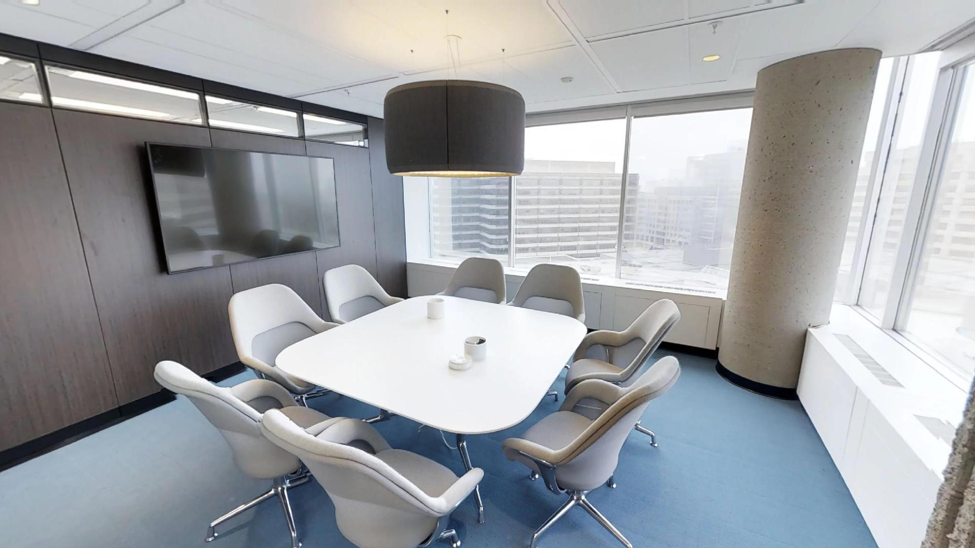
Salle de Travail Work Room
Notes:
This room (908) - which we call a work room, has definitively a different feel to it.
FUN FACT – EMPLOYEE ENGAGEMENT
The names of all the rooms and meeting rooms you have seen have been selected by employees through a contest. Each zone has a theme:
Collab zone: Famous Historic Canadian Sites
Quiet zone: Canadian Rivers
Executive zone: Famous Landmarks in Canada
What a great way to engage employees in the process!

Slide 22
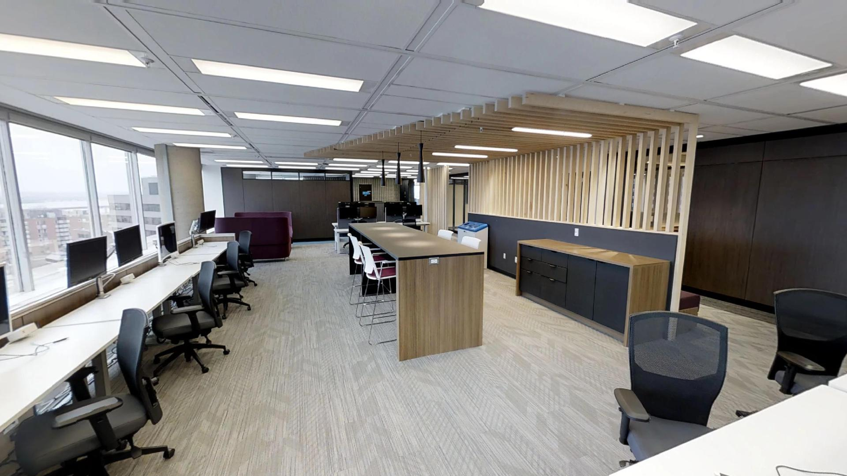
Zone Exécutive Executive Zone
Notes:
Stop #6: Executive Zone (specialized area) – In this particular case, it was an ADMO suite, first time testing it with GCworkplace.
A particular aspect of this space is that it includes an ADM, an AADM, one DG and a few directors with their respective support teams.
This zone is where you would usually find ADMO’s team.
The zone is designed for ADMs touching down and meeting people.
It also offers a variety of work points that all occupants of the floor are welcome to use.

Slide 23
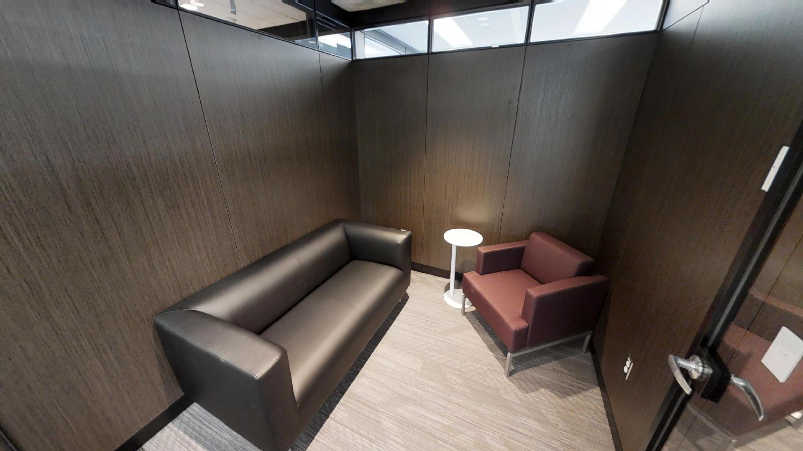
Point de Réflexion Reflection Point
Notes:
A reflection point is secondary individual workstation. A refuge for quiet contemplation or wellness needs (yoga, prayer, etc)

Slide 24
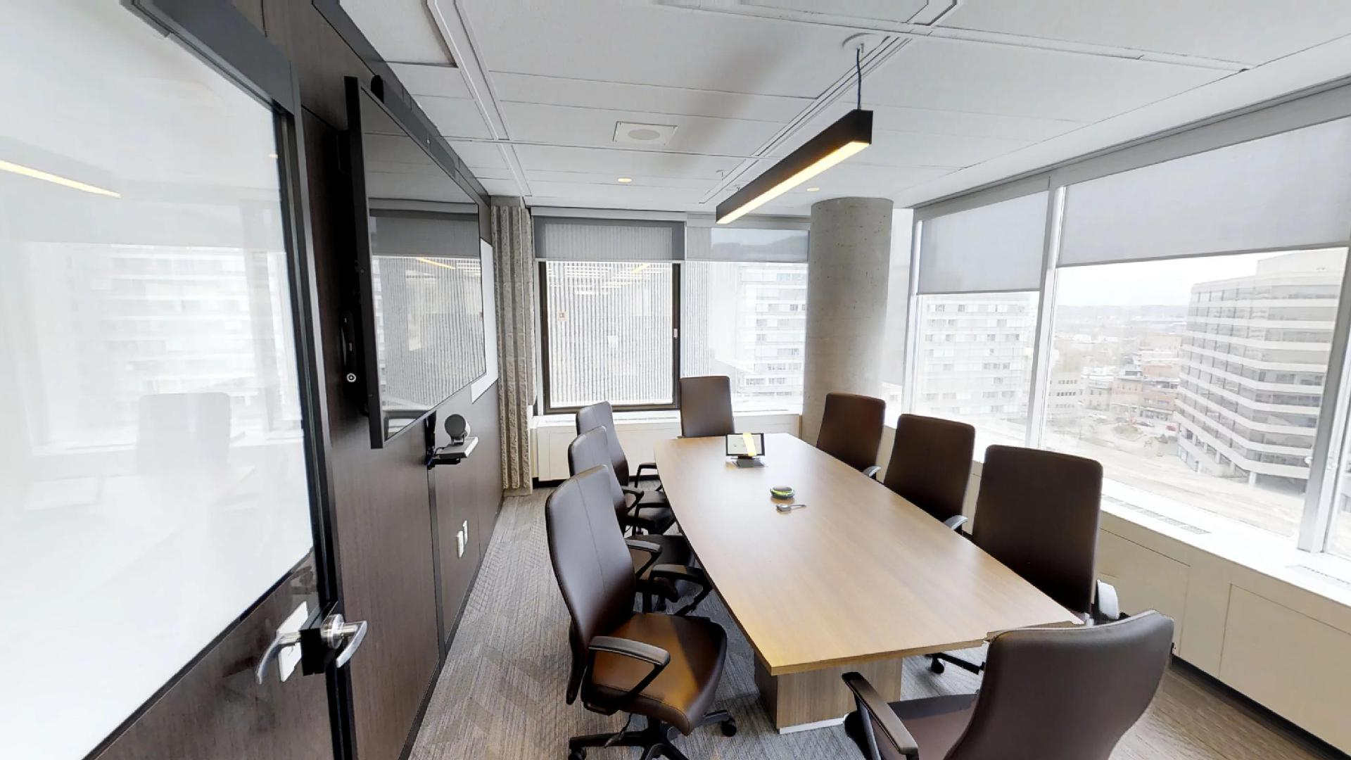
Salle de Travail Work Room
Notes:
Another enclosed collaboration space: a work room or project room.

Slide 25
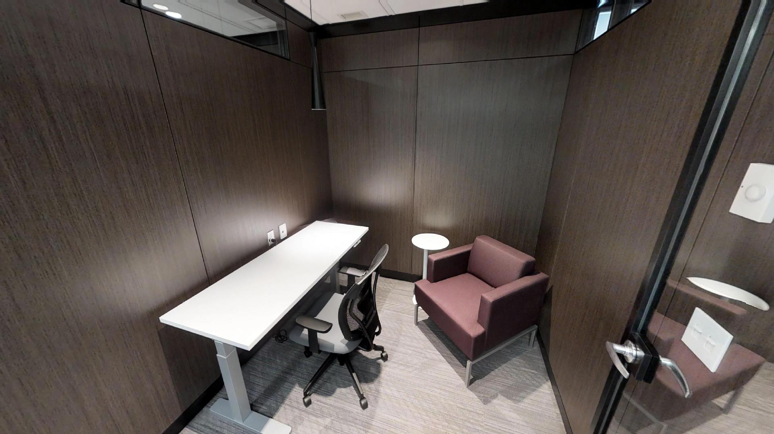
Cabine Téléphonique Phone Booth
Notes:
Primary/Individual Enclosed: The phonebooth is an enclosed or semi-enclosed area with acoustic protection for phone calls.

Slide 26
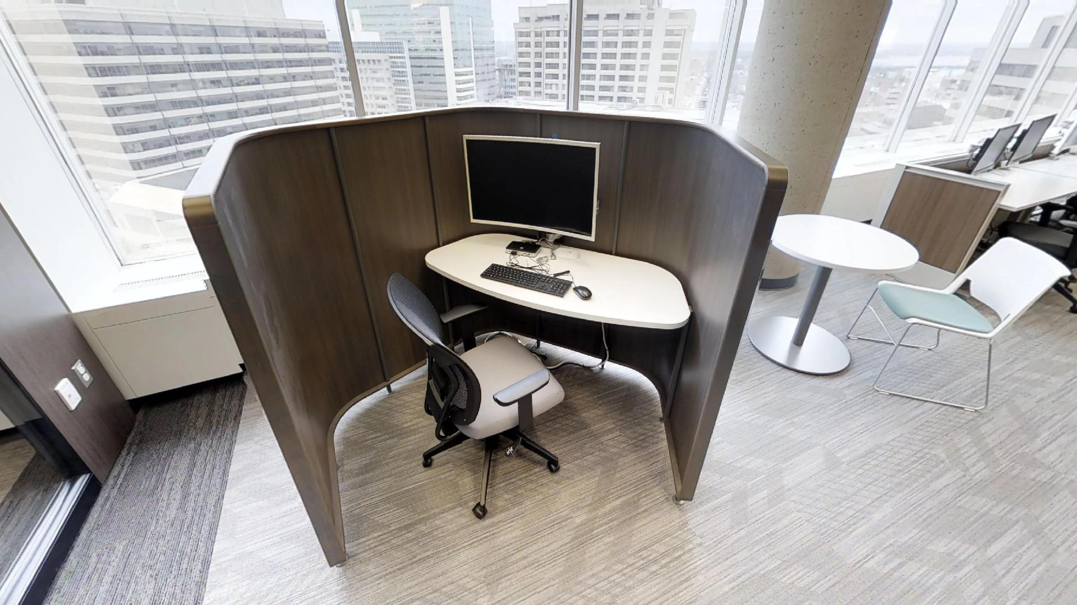
Capsule de Concentration Focus Pod
Notes:
Primary/Individual Focus pods: The semi-enclosed work pod is for mid- to long term focused work.

Slide 27
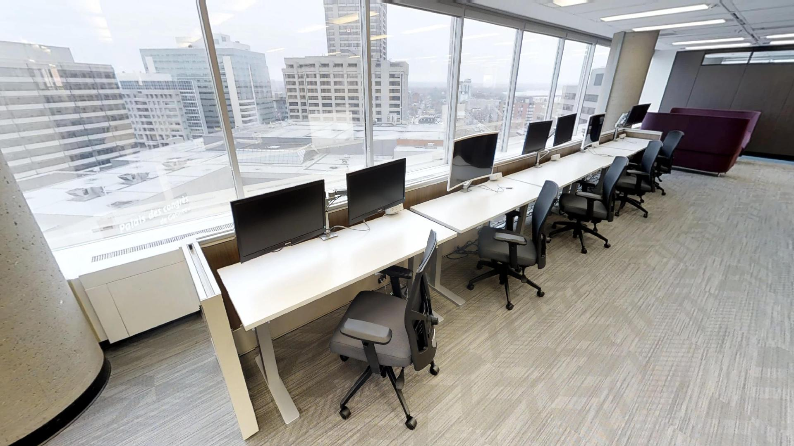
Stations de Travail Workstations
Notes:
Primary/Individual: The workstations are mid-to long term workspace with access to others if required. Here we can see the adjustable desks.

Slide 28
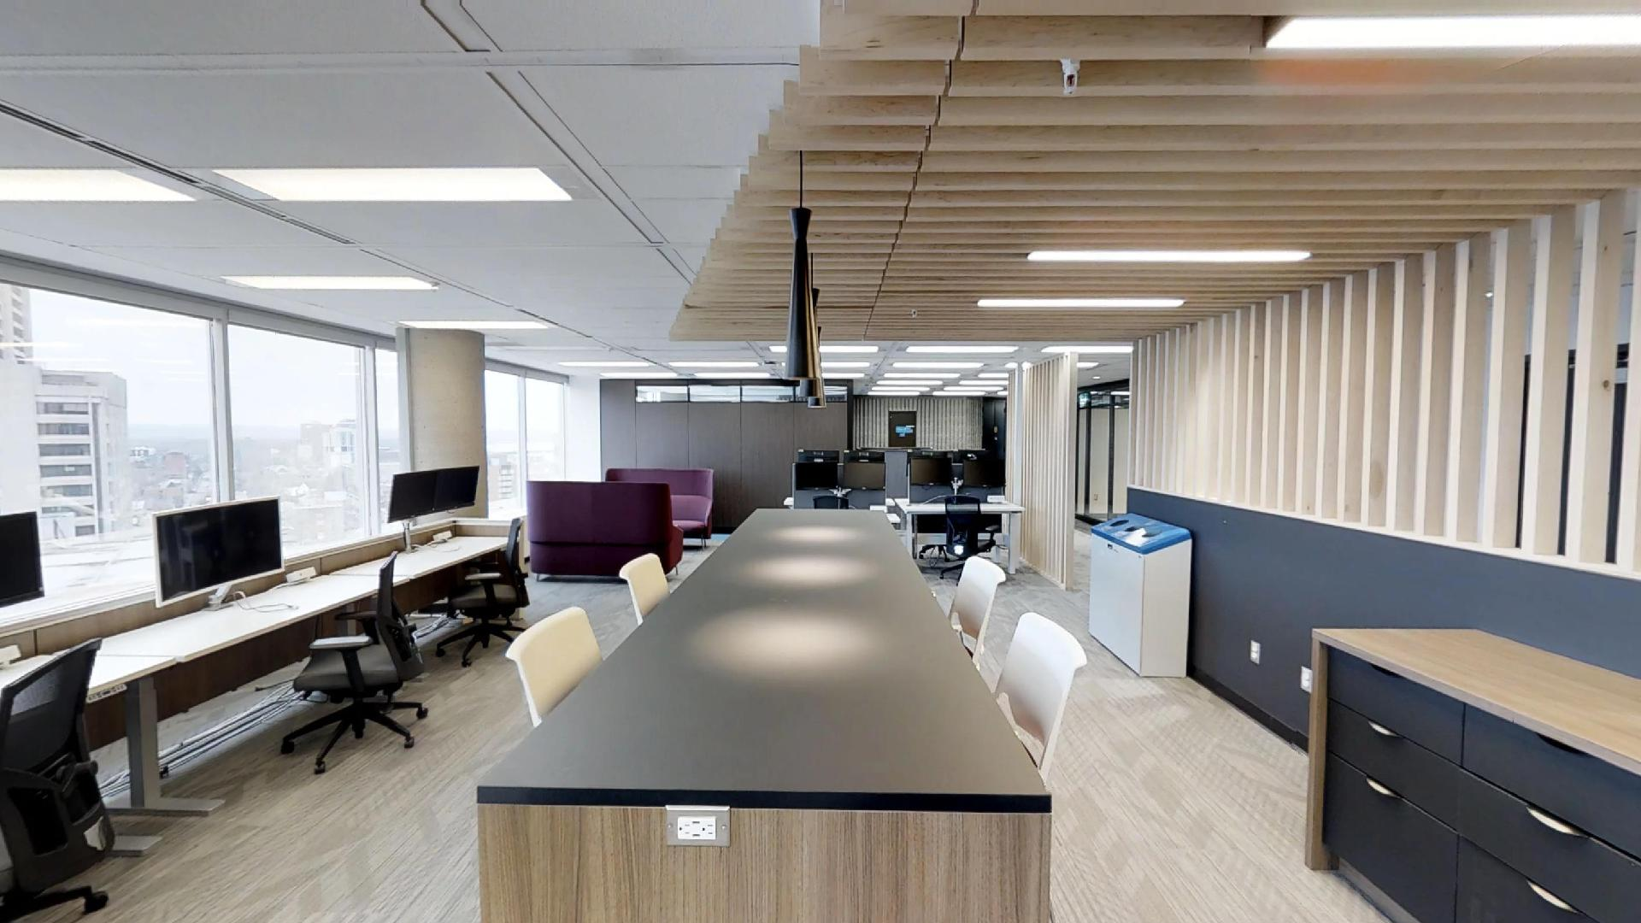
Point de Discussion Chat Point
Notes:
A Chat point is an area for brief impromptu conversations. Can also be used as a workstation for people who are more efficient with noise around them (café feel)

Slide 29
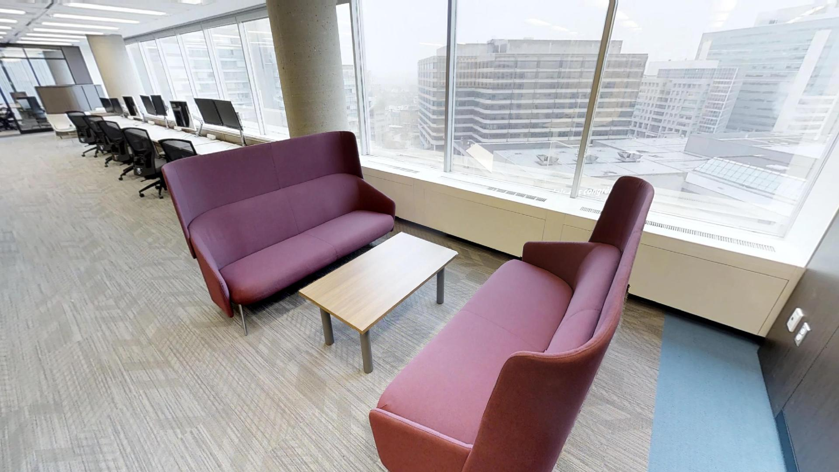
Enclave Huddle
Notes:
This is another huddle workpoint, a semi-enclosed area for short to mid-term meetings.

Slide 30
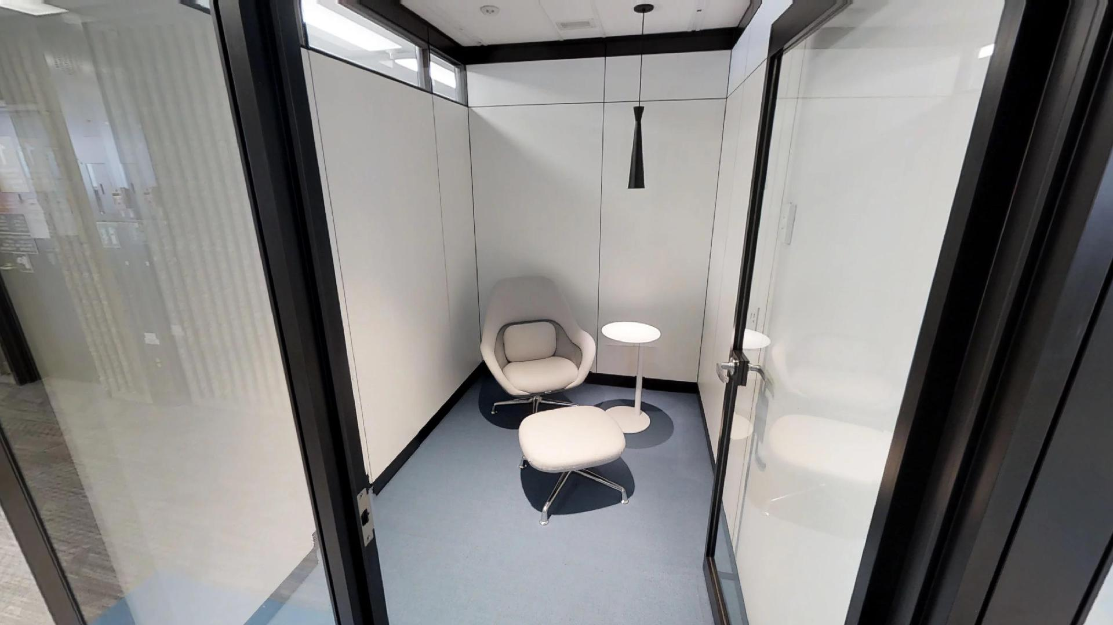
Cabine Téléphonique Phone Booth
Notes:
Primary/Individual Enclosed: The phonebooth is an enclosed or semi-enclosed area with acoustic protection for phone calls.

Slide 31
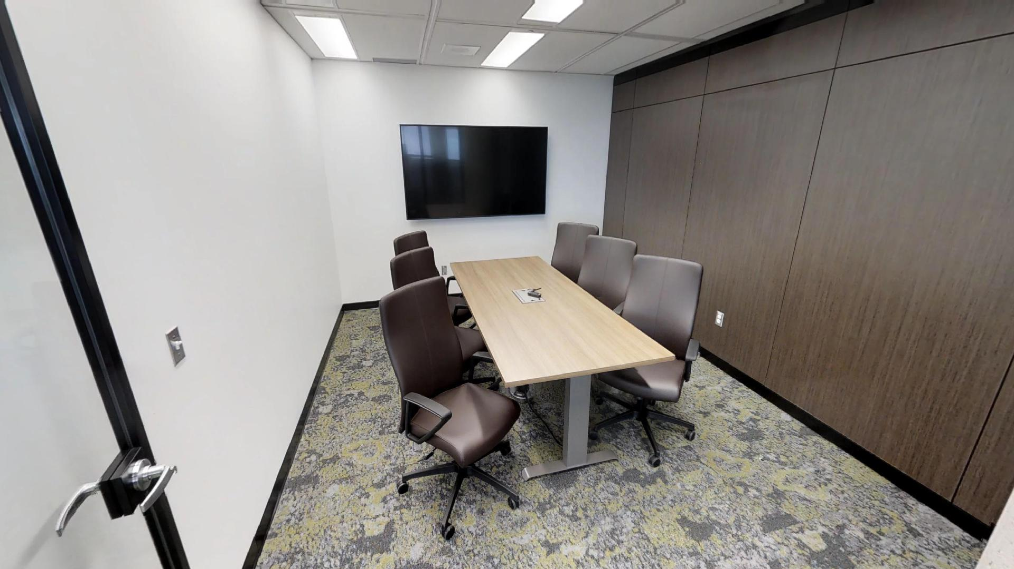
Salle de Travail Work Room
Notes:
Enclosed/collaborative: the work room is an enclosed room for team work or meetings for up to 6 people

Slide 32
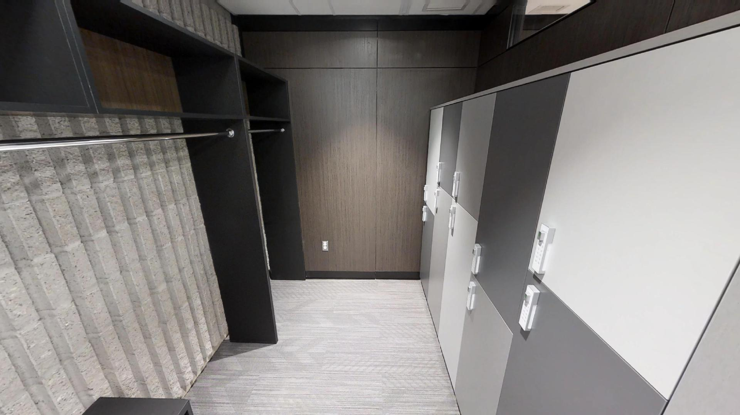
Vestiaire Cloak Room
Notes:
Stop #6: Cloak Room
Additional space is dedicated for coats/boots.
Visitors can access daily cubbies if needed.
Note that the space to hang coats is divided between smokers and non-smokers. Additional ventilation was added in this room for this particular reason.
FUN FACT – LOCKERS
The coordination team did a call-out to distribute cubbies to those who felt they didn’t need a full size locker. The team was convinced nobody would step forward and feared that they would have to assign cubbies against people’s will. On the contrary, there was more volunteers than available cubbies. Their experience on 3B3 made many employees realize how little space they require when they are mobile and paperless!

