Slide 1
GC Jobs Transformation
Overview
June 2019

Slide 2
The Public service commission (psc)…
is the staffing authority in the federal public service as per the Public Service Employment Act (PSEA). PSC promotes and safeguards a non-partisan, merit-based and representative public service that serves all Canadians.
facilitates the recruitment of talented Canadians from across the country on behalf of departments.
continually strives to renew its recruitment services.
The vision of the PSC is Building tomorrow’s public service today.

Slide 3
Our goal with GC JobS Transformation is…
…to provide the GC with a flexible, innovative, inclusive and user-centric recruitment solution that attracts talent and meets the needs of job seekers, hiring managers and human resource professionals.

Slide 4
Partnership with tbs…
Through a strong partnership with TBS, we ensure alignment with the Next Generation HR and Pay initiative towards a common goal of a seamless end-to-end solution that puts users front and centre.
Collaborating with NextGen leads at the ADM and DG level to ensure a unified approach
Leveraging existing governance such as the NextGen ADM committee and PSRS Interdepartmental Steering Committee
Establishing a horizontal integration function to facilitate working level collaboration with NextGen on business needs (e.g. business requirement integration points)

Slide 5
Our approach
The pre-project phase is all about collecting information:
-from job seekers, hiring managers, HR professionals and stakeholders about their needs.
-from industry about what currently exists in the private sector in terms of recruitment solutions.
Phase 0 Pre-Project Discovery
(Part 1: 2018-19)
Phase 0 Pre-Project Discovery
(Part 2: 2019-20)
Evaluate and review options analysis to determine the best way forward, whether it is to buy, build or a combination of both.
Testing with selected departments.
Phase 1 Pilot Deployment
(2020-21)
PSC will deploy an inclusive, modern, user-centric and seamless digital recruitment solution, a phased approach will be used to ensure that the platform and functionality are stable.
Phase 2 Implementation
(2021-22 and beyond)
In this phase PSC will continue to solicit feedback on the new recruitment solution to make further enhancements in key areas and improve the user experience.

Slide 6
our work is Based on GC Digital Standards
Design with users
Build in accessibility from the start
Iterate and improve frequently
Empower staff to deliver services
Work in the open by default
Be good data stewards
Use open standards and solutions
Design ethical services
Address security and privacy risks
Collaborate widely

Slide 7
we envision a modern recruitment solution That Provides:
A seamless, intuitive experience for job seekers, hiring managers and HR professionals
All Canadians with a more direct and equitable means of searching for and applying to government jobs
Support to persons with priority entitlement, including medically-released veterans
A single solution that is suitable for all departments and agencies
Seamless interoperability with existing and future GC HR programs and systems
Alignment with digital principles of the GC to support the OneGC Digital Exchange Platform
Safeguarded and improved reporting to Parliament

Slide 8
GC Jobs in Numbers
115
1.8M
DEPARTMENTS & AGENCIES
2000
ACTIVE APPLICANT ACCOUNT
7K
HR PROFESSIONAL USE THE SYSTEM
JOB ADVERTISEMENTS
655K
2017-18
9M
500K
USERS HAVING LOGGED IN OVER THE LAST YEAR
JOB APPLICATIONS
VIEWS PER YEAR

Slide 9
What we’ve heard from users…
“Simpler advertisements simpler language”
“Flexibility in advertising options
(e.g. social media)”
“More interactive and engaging job site”
“Better screening
mechanisms”
“More regular updates on the application status”
“Improved timeline to shortlist candidates”
“Better understanding
of the supply side of the Labour market”
“Ability to reuse information”
“Mechanisms
to attract passive candidates”
“Better understanding of process and timelines”
“Improved communication mechanisms with candidates”
“Improved awareness of opportunities”
“Centralized access
to job pools”

Slide 10
features we are interested in:
Reusability of application and candidates information to more than one hiring process
Multi-Channel access
(i.e. accessible via different devices)
Reporting & monitoring and performance measurement
Job seekers profile
(applicant passport)
Skills Inventory
Communication tools
Services Centre and Contact Management
(e.g help desk/user, customer support, etc.)
Self-serve options
(for all target groups)
Collaborative space for HR and hiring managers
Labour market information
Status dashboards
Outreach options (posting job opportunities on social media)

Slide 11
Some key non-functional requirements
Must scale in proportion with changing volume requirements
Must meet government requirements in terms of cybersecurity, information management, accessibility and bilingualism
Must adapt in consequences to changes in the legislative environment
Must interoperate with other systems through APIs
Must meet user expectations in terms of speed and responsiveness

Slide 12
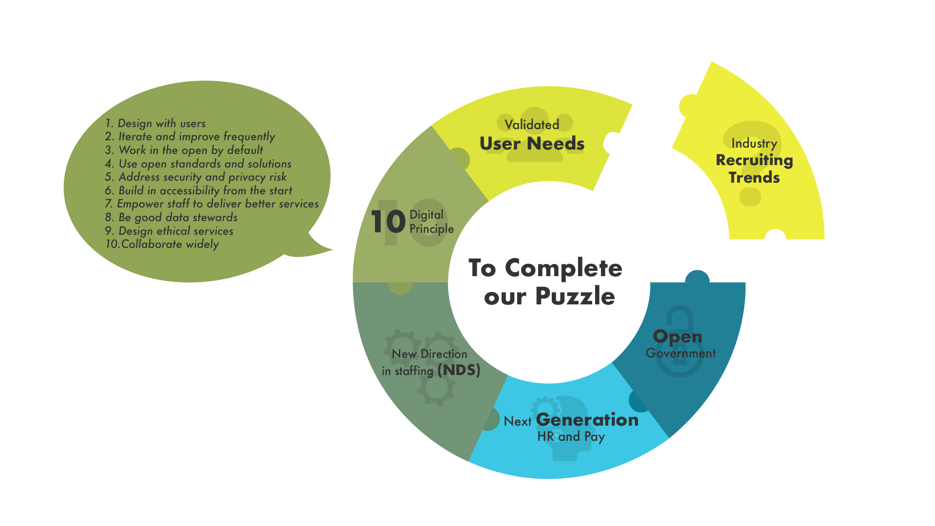
To complete our puzzle A Dialogue with Industry on trends and solutions
Notes:
Danielle:
Our missing piece is discovering more on industry recruiting trends. Information gathered through this RFI will assist in testing and further refining the requirements for the future iterations of GC Jobs.

Slide 13
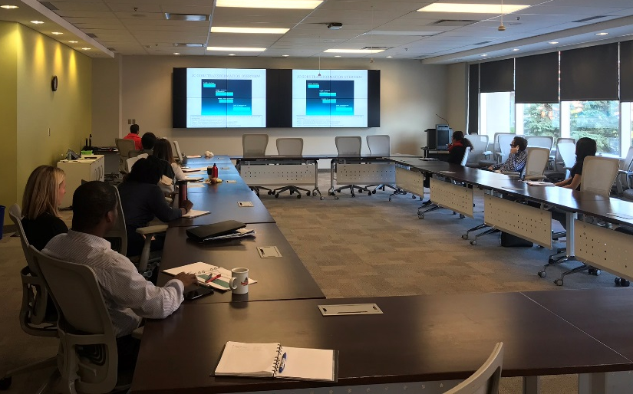
RFI & Webinar
Industry Cold Calls
Concept Case Approved
Vendor Demos
Options Analysis
Nov 15
Dec 5 - 14
RFI
RFI Webinar
Business Capabilities Retreat
Sep 24
Oct 24
Dec 10-13
Nov 16
Sep
Oct
Nov
Dec
2018
2019
On November 16, PSC hosted a Webinar to provide an overview of the project to industry leaders, allowing them also to ask questions about the recently issued GC Jobs Transformation Project Request for Information (RFI).
All questions and responses during this session were published online via https://buyandsell.gc.ca

Slide 14
Vendor Demos
Over 7 in-person Vendor Demos were held in December and January. The demos will provide the project team with important information on recruitment trends, possible challenges we may face, and help refine the requirements of future GC Jobs iterations.
Over 20 participants across PSC, as well as NextGen HR and Pay representatives attended the demonstrations.
Oversight
Central Programs & Regions
Operations
Priority Entitlement
Psychology Centre
IT
Enterprise Architecture

Slide 15
Vendor Demos Highlights
Job Seeker/Hiring Manager/HR Advisor
Skills inventories and gender bias scans to support the creation of job requisitions
Resume parsing to auto-populate tombstone information in candidate profiles
Integrated interview scheduler and in-tool collaboration capabilities
Capability to upload documents - such as diplomas - and reuse information in profile
Personalized views for HR, e.g. status, requisition #, etc.
Quick “card format” view of job requisition summaries to browse jobs
Graphic timeline views of candidates’ employment history
Ability to quick apply simply by providing an email address
“Carousel view” of resumes for comparability and side-by-side view of assessment results
“Opportunity graphs” for candidates based on historical activity and AI

Slide 16
Vendor Demos
General highlights
Labour market information of availability of candidates within a geographic area
Interoperability with other systems and platforms
Organization specific branding and multimedia options, e.g. employer videos
Ability to create evergreen requisitions for program inventories
Easily configurable workflows and automated status updates and views for various user types
Tools to track all communications with the candidates and hiring team
Front end generally compatible with high accessibility standards
(WCAG 2.0 AA)
“Candidate pipeline” summaries that
show which part of the process is
taking more time
Fully mobile responsive, including ability to apply for jobs
Online and mobile job offer and electronic signing capabilities

Slide 17
NEXT Steps in Phase 0
Our focus for the coming year:
Further discovery through proof of concept testing
Business Case, Project Charter and Treasury Board Submission
Business transformation work, including learning strategy for modern recruitment
Engage with us!
#GCJobsTransformation
canada.ca
GCcollab
GCwiki

