Slide 1
Page success widget
Update: Feedback and analysis
Update to Theme Management Committee (TMC)
on June 12, 2020 by Health Canada

Slide 2
Contents
Pilot details
Processing approach
Analysis results and application
Knowledge gained
Next steps

Slide 3
Pilot background
On May 11, 2020, a feedback widget was launched at the bottom of two COVID-related web pages to:
test a new approach for measuring task success
learn how Canadians report success
identify current issues or problems to guide online fixes or improvements
Pages:
Symptoms and treatment
Prevention and risks

Slide 4
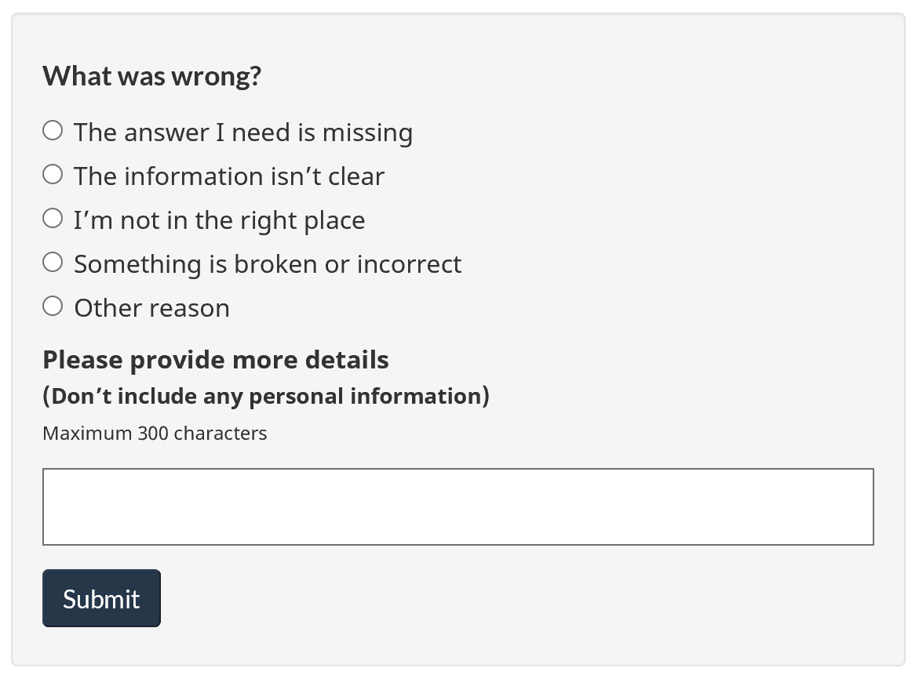
Feedback widget
Widget built by Service Canada/Principal Publisher in AEM to embed into pages and capture feedback from Canadians.
Feedback is automatically sent to a generic email account at Health Canada.
Process was put in place to handle feedback that may include unsolicited personal information or threatening messages.

Slide 5
Response rate
Widget launched May 11.
As of June 10th:
5083 responses
164 average responses per day
3,022 yes / 2,061 no
0.65% of visits click Yes or No
From May 11-24

Slide 6
Processing approach

Slide 7
Selected dataset for analysis
Selected submissions received from May 11-25, 2020 for qualitative analysis.
Number of “No” responses received during this time:
Page | English | French | Total
Prevention and risks | 320 | 120 | 440
Symptoms and treatment | 365 | 210 | 575
Total Feedback Received | 685 | 330 | 1015

Slide 8
Processing and tagging feedback
Receive feedback from widget through email
Sort “No” responses from “Yes” responses
Log “Yes” responses (number received)
Manually copy/paste “No” responses into spreadsheet
remove unsolicited personal information before adding to spreadsheet
record items that had unsolicited personal information
do not copy/paste any responses which include threats in spreadsheet
Delete feedback emails once recorded
Develop & refine topic tags (controlled vocabulary)
establish consistent tags over time as feedback is reviewed
align tags with other reporting/studies, such as Call Centre tags, Gerry McGovern Top task studies
keep tags fairly broad for efficiency
Tag each feedback response by topic tag (from controlled vocabulary)
If nothing was provided in text box, record as “No details”
If feedback is unclear, record as “Feedback unclear”

Slide 9
Auto-tagging of feedback - rules
Create “rules”.
Study patterns in text and create lists of “include” and “exclude” terms.
For example, if text:
includes any of ”symptom, fever, temperature”, then tag = Symptoms.
also includes any of “treatment, take it down, bed rest”, then tag = Treatment (not Symptoms).
includes any of “treatment, take it down, bed rest”, then tag = Treatment
also includes any of “vaccine, immunize”, then tag = Vaccine (not Treatment)
Symptoms - include | Symptoms - exclude | Treatment - include | Treatment - exclude | Vaccine - include | Vaccine - exclude
symptom fever temperature | treat, treatment take it down bed rest medicine, medication | treat, treatment take it down bed rest medicine, medication | vaccine immunize | vaccine immunize

Slide 10
Auto-tagging of feedback - examples
Examples:
“What temperature is considered a fever?”
“Have fever for four days. How to take it down”
“how do you treat covid 19 related symptoms”
“Can a person with covid that has a fever take fever reducing medications?”
Symptoms - include | Symptoms - exclude | Treatment - include | Treatment - exclude | Vaccine - include | Vaccine - exclude
symptom fever temperature | treat, treatment take it down bed rest medicine, medication | treat, treatment take it down bed rest medicine, medication | vaccine immunize | vaccine immunize

Slide 11
Qualitative analysis tool
Tool: NVIVO (Government-approved tool)
Purpose: Qualitative data analysis software
Goal: To provide high-level thematic analysis of the web page feedback.
Process:
Comment tagging was manually conducted based on frequency of key terms and themes that were prevalent throughout the submissions.
Topics or themes included sub categories which fit within a particular theme.
Once the information was categorized and tagged qualitative analysis was conducted.

Slide 12
Data analysis considerations
Content:
No content updates were made to the selected pages during the preliminary analysis period (May 11 to 25) that would impact accuracy or trends in feedback.
Feedback submission tool:
Order of radio button options under “What was wrong?” could affect options selected.
Radio button selection not mandatory.
People can enter feedback in text box whether or not radio button selected.

Slide 13
Analysis results and application

Slide 14
Top themes emerged during tagging

Slide 15
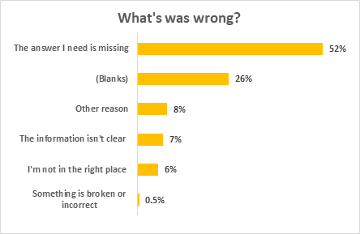
Analysis results - radio buttons
If the person did not find what they were looking for, they were prompted to identify what was wrong.
However, this data alone doesn’t give us much of an understanding of issues or problems the person was having.
Blanks = radio button not selected, but could have added information in the text box.

Slide 16
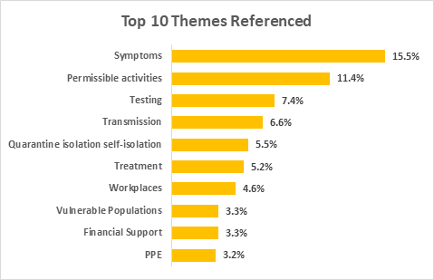
Analysis results - open text box
A text box allowed people to submit details describing, in their own words, what was wrong with the page.
Of the 1015 feedback submissions, 782 (77%) provided more detail in the open-ended response.
We start to get more of a picture of what the issues were for people during their visit.

Slide 17
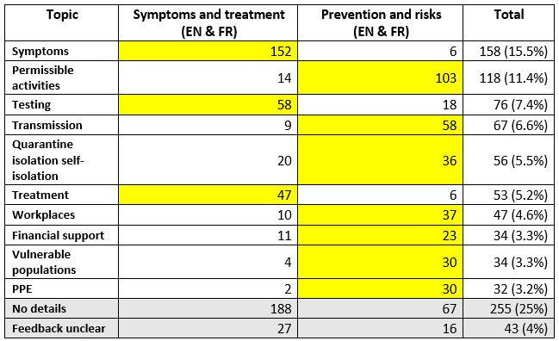
Analysis results - By web page
This detail enables Health to:
triage efforts based on level of frequency
identify areas for improvement
identify potential gaps in content
understand if a page has more broad issues to assess
The yellow highlighted sections identify most frequently raised issues.

Slide 18
Results: Symptoms and treatment page
Symptoms:
identifying that not all symptoms are listed
listed a symptom or asked if a symptom is related to COVID-19 (pink eye, diarrhea, hives etc.)
asked about fever and temperature details
Testing:
where to go or who to contact for testing
how long it takes to have the test completed and receive results
a few individuals asked for their test results directly within the feedback
identified interest for more testing to be done
The list of symptoms doesn’t include any of the new ones I’ve been hearing about (loss of smell/taste, purple rash, etc).
The temperature is missing
If the nasal test is taken today when will I know the results?
Where can I find out my test results

Slide 19
Recommendations: Symptoms page
Consider:
updating list of symptoms and/or clarifying reason for differences compared to other common sources of information
adding what temperature would be considered a fever for COVID-19

Slide 20
Recommendations: Symptoms page
Consider adding information on:
where to go or who to contact for testing (in general)
how long it typically takes to complete the test and receive results
testing protocols and approach
Consider terminology used:
web page uses “diagnosing” and does not use “test” or “testing”
over 85% of feedback related to testing used “test” or “testing”; 0% used “diagnosing”

Slide 21
Results: Prevention and risks page
Permissible Activities:
Asked if they are able to do specific activities during this time.
Items mentioned include:
Visiting with family and friends, weddings
Moving, carpooling
Cottages, camping
Golf, swimming, yard work
Grocery shopping
Are we able to visit immediate family if physical distancing is maintained and group size is less than 10 people?
My daughter is moving into her first appartment may 31st. She needs help moving in furniture and boxes! Is there any exemption to this, we don't want to get a fine of $1000
Just want to know when people can see their grandchildren
J'aimerais savoir s'il est possible de faire du co-voiturage d'une durée de 1h30 environ
We have wedding event on June 26. I know 50 persons are allowed in gathering but how it will work ? I need detail. Also outside catering is allowed or not...
si j'amene une personne qui est assise en arriere de ma voiture coté droit pour un rendez-vous médicale suis je légal
I need specific wording to share with my fmily about why they cants be in our house

Slide 22
Recommendations: Prevention and risks page
Consider revising labels or headings:
use labels or headings that match what people are looking for
people are looking for answers about “what activities they can or can’t do”, and not “measures to reduce COVID-19 in their community”
Consider linking to other trusted sites:
provincial/territorial or municipal sites may have information on permissible activities

Slide 23
Approach to implementation
Once results are available, recommendations are created and decisions are considered on how and when to share with content owners.
Frequency:
bi-weekly analysis and sharing
adhoc notice if critical items have been flagged
Triaging:
explore triaging by level of complexity (quick fix, simple, complex, further study recommended)
submitted initial recommendations by level of importance (based on top level themes and frequency)
Integrating other advice/results:
assess other available page analysis and data-driven recommendations
compare with other relevant data, such as call centre data

Slide 24
Knowledge gained and next steps

Slide 25
Knowledge gained
Recommendations:
Need automated backend to move submissions directly into a database for sustainability and to leverage the feedback sooner - in development
Further exploration of automated tagging tools
Identify qualitative analysis tools (ideally one that could match with automatic curation of submissions)
Ensure team capacity to gather, analyse and provide recommendations quickly
Manage expectations on time required to tag and analyze data (automated tagging & qualitative analysis tools do not do all the work)
Prioritize web pages to embed Widget on
Identify deployment schedule/strategy
Benefits:
Get meaningful feedback from people via the text box in direct relation to the content and what they are looking for
Identify terms used by Canadians (via the text box) to support plain language
Potential to respond more quickly to the information needs of Canadians
Feedback widget embedded in page creates seamless experience for people
2 weeks appeared to be enough time to identify patterns and areas for improvement on high traffic pages

Slide 26
Next steps
Pause pilot and remove widget
Analyse remaining feedback (2.5 weeks backlog)
Compare results with previous analysis (see if there are differences)
Consider if any usability testing is applicable
Support program/policy on potential content updates
Relaunch pilot for re-test phase (consider length of time required)
Continue supporting central agencies on developing automated process
Research deployment methodology for broader application of tool

Slide 27
Annex

Slide 28
Annex A Results: Prevention page
Transmission (2nd highest frequency for page):
how long the virus stays on objects
what activities might risk transmitting the virus
for example, people wondered if the following could transmit the virus:
Paper/cardboard, plastic
Cash, clothing, door handles
Food and drinks
Smoke
Water and swimming
Sexual activity
I would like to know, if I go to the grocery store or for a walk, can I transmit the virus on my shoes or jacket and come home and infect others in the house, is leaving my shoes at the door enough or do I have to disinfect them.
In a clothing retail facility, can the virus be passed on to a garment that someone has tried on and then passed on to the next person trying it on?
Où, comment puis-je obtenir réponse à une question très précise : Le Coronavirus peut-il se transmettre sexuellement lors de : - baisers - cunnilingus - fellation par exemple... ?
Do we need to be concerned with people dropping light cigarette butts over their balcony and it falling onto our patio

