Slide 1
Job Bank Mobile App
UNCLASSIFIED
September 2021

Slide 2
The beginning

Slide 3
ESDC Going Mobile
The Service Transformation Plan detailed the path forward to achieving the ESDC Service Strategy goals. One of the early commitments to deliver tangible service improvements is the development of a mobile app that meets evolving client needs.
Convenience – simple access to programs and services while on-the-go
Access – an alternative point of access to obtain services from and communicate with government
Experience – meets the expectations of the clients based on their experience with other client facing organizations

Slide 4
The process

Slide 5
Recap: Start of Job Bank Mobile App

Slide 6
Project management

Slide 7
Mobile App Deployment
Soft Launch
Iterative Development & Releases
Iterative Development & Testing
Official Promotion
Soft Launch – February 28th, 2018
Simultaneously release on the App Store and Google Play
App is searchable and available for download by the public
Uptake will be closely monitored and feedback will be responded to
Iterative Development – March-Nov 2018
Iterative updates will be made based on user feedback and observed usage patterns
Fast-paced successive rounds of design, development, testing and refinement, and will help mature the app, develop release rigor and position ESDC for the hard launch
Official Promotion – November 8th, 2018
Official announcement via news release, social media posts, video featuring the Minister, and a marketing video (Refer to Annex B)
A dedicated policy team in Job Bank
Briefing notes, - scope – ressources – stakeholders, critical path,
Project trackers (list of stakeholders dates)
Communication with other stakeholders .

Slide 8
stakeholders

Slide 9
Stakeholders
Minister office
Citizen Service Branch
Innovation, Information and Technology Branch
Support from other departments such as Health Canada (2013)
Research and consultation: Applause, Forrester, Student Focus groups, PwC workshops, Surveys in Canada.ca, usability testing, accessibility.

Slide 10
obstacles

Slide 11
Big obstacles
Testing the app in an open market informed our understanding of usability, performance, and user acceptance in a real-world setting.
Funneling user feedback in order to efficiently prioritize audience needs.
+ 30 iterations to launch
10 updates were made based on user feedback before the official announcement and promotion.

Slide 12
A piece of advice

Slide 13
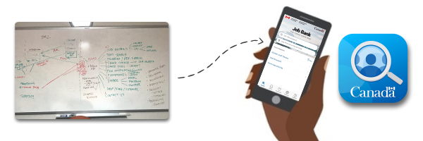
Is it “App Worthy”?
Are you solving for a problem that:
Exists in my everyday? (e.g. checking the weather, managing my money)
Requires urgency or convenience to address?
Can be better understood with context? (e.g. situation, preferences, history)
Can be more easily solved with a smartphone? (e.g. by taking advantage of voice, gestures, GPS, camera, offline, near-field, accelerometer)
Is partially solved already? (e.g. device notifications, contacts, calendar, weather, map, uber, messenger, Facebook)

Slide 14
features

Slide 15
Job Bank Mobile App Features
Synchronization

Slide 16
promotion

Slide 17
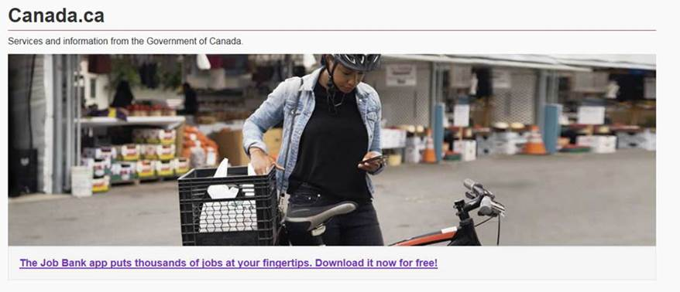
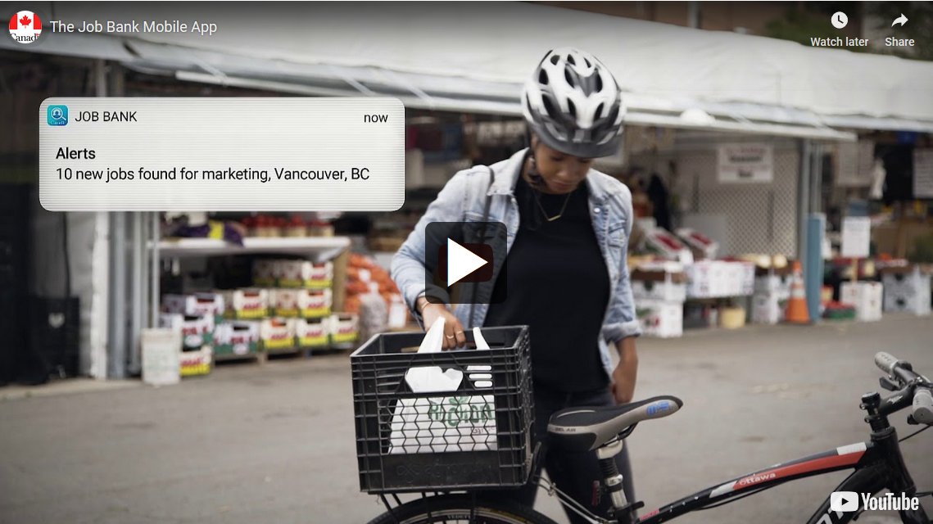
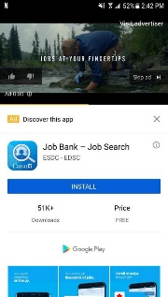
Official Launch & Promotion
November 8, 2018:
Official launch & announcement of the mobile app via:
News release on Canada.ca
Social media posts (Facebook, Twitter, Instagram)
Video featuring Minister Hajdu
Promotional Video for marketing
December 5-21, 2019:
The app was featured on the Canada.ca home page
January 14-February 10, 2019: Four-week advertising campaign via promotion tactics such as:
Google Universal App
Snapchat
in-app advertising
May 4th, 2021:

