Slide 1
#GCDigital Design System
Update for January 10, 2018

Slide 2
Mission Statement
Make a design system for the Government of Canada’s digital collaboration tools that can also be reused and applied to other public or internal digital services and products.
This system will help to ensure a seamless experience for users across platforms, will be easy to use, and quick for developers and designers to implement. The design system will provide a basic framework with guiding principles and components, with the ability to be adapted to other brands and needs.

Slide 3
Guiding Principles
Simple and flexible
Fun to use
Re-usable
Diverse
Technology agnostic
Open
Notes:
Simple and flexible: a lightweight system that allows individual teams to adapt branding and other design elements to suit a specific project. The system will provide guidelines for all necessary elements without being restrictive.
Fun to use: the system itself will have a pleasing design that is easy for developers and designers to navigate and adapt to their needs. Using the system will make their jobs easier rather than add an extra burden or obligations to follow.
Re-usable: all components and principles included in the design system are generic enough to suit a variety of needs for multiple teams. Code and design elements can easily be extracted to create new products. Communications guidelines are easy to understand and follow.
Diverse: The design system will cover a variety of needs and types of products. The system will also cover necessary government obligations such as official languages and accessibility.
Technology agnostic: the design system is applicable regardless of which technology framework the team decides to use for their project.
Open: the design system will be open and accessible to anyone who wishes to use it. All code is open source, and other guidelines and elements are free to copy.

Slide 4
What we’ve done so far
Extensive research on process, examples
UI inventory to identify key priorities for Phase I
Established partnerships, developed concept and requirements for the system
Built GCpedia page for resources, updates and key information
All design files and code held in Github repo
Determined elements required for different phases
Mood boards, typography mock-ups, sample documentation
Notes:
Explain parts checklist in more detail, how we used it to guide requirements.

Slide 5
Phase I:
First prototype. Visuals and basic elements.
Basic elements required for designing any application.
Includes elements that are useful to all partners.
Phase II
Second draft of design system.
Includes second priority items, more layouts and editorial elements.
Design elements more specific to GCTools rebuild.
Phase II
Includes third level priority items (nice to haves)
More focus on process and guidelines
Full website/application where documentation is housed.
Ongoing:
Continuous improvement/updates to design system
Promoting/pitching system to other users
Opportunity for extended partnerships

Slide 6
Phase I: Key Pieces
Visual Language (colour, typography, iconography, motion, space)
UI Elements (paragraph, headers, lists, links)
Resources (PSD, Illustrator and Sketch files)
UI Components (breadcrumbs, footers, headers, navigation, menus, etc.)
Key Items
Buttons
Cards
Forms
Notifications
Notes:
Determined using the parts checklist, review of our (incomplete) UI inventory
Also determined by our priorities and key tasks for the GCTools rebuild.

Slide 7
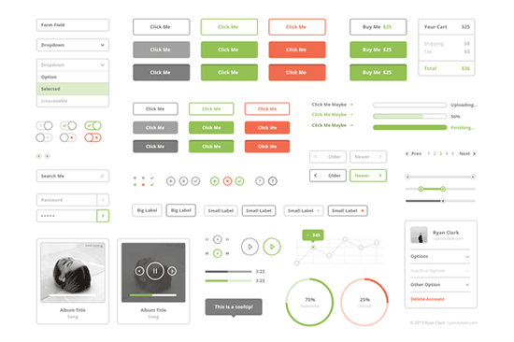
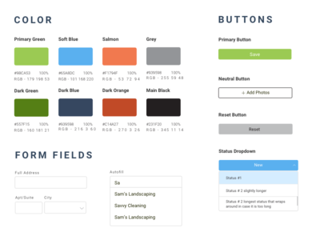
So what exactly are we building?

Slide 8
Mood Boards
Notes:
Feedback questions:
Which of these boards best represents the GCTools?
If websites were designed using these styles which one would you most likely want to use for work?
What elements from each board do you like/dislike?
Are there other sites or applications that you use that you love the interface or the look?
What kinds of sites and applications fit into this particular board?

Slide 9
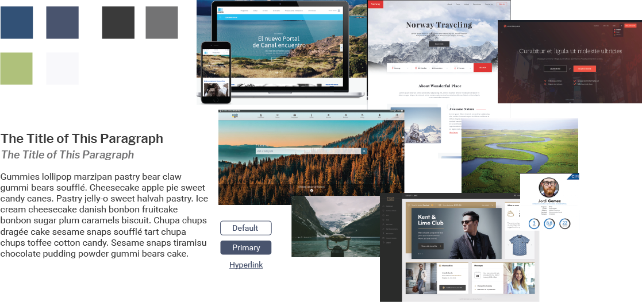
Why use mood boards?
Notes:
Nick to talk about mood boards.
Used as inspiration for overall look and feel of a product, doesn’t necessarily represent final design. Branding v. interface elements.
Can look at specific elements separately as well, combine different boards.

Slide 10
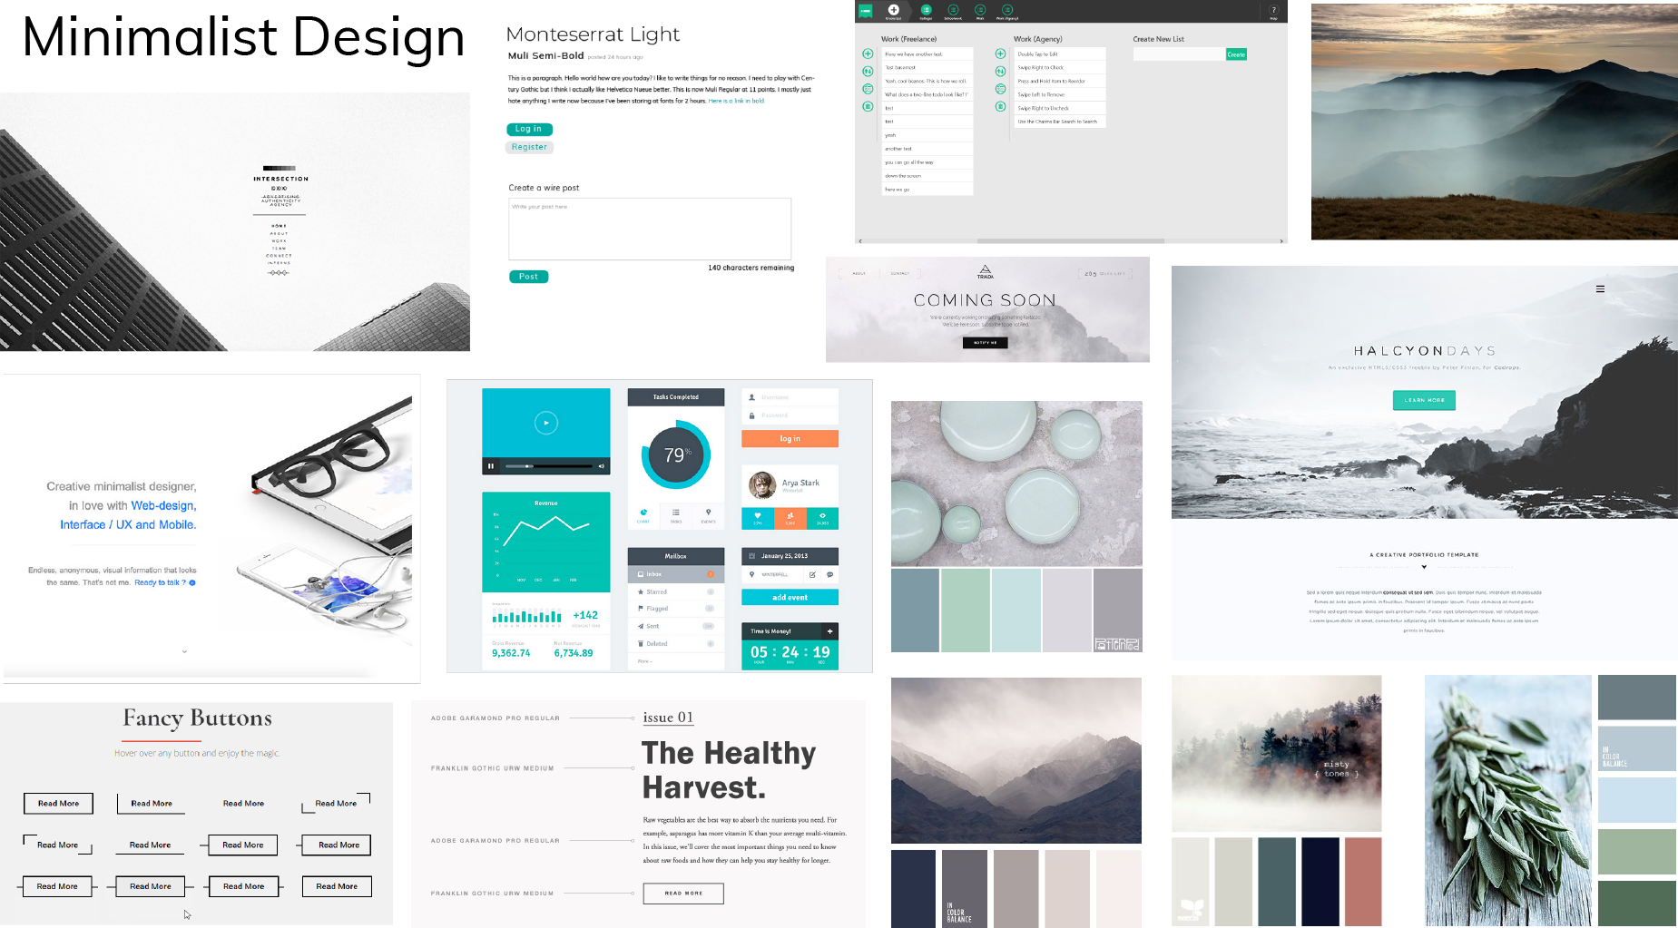
Notes:
What I started with. Clean, simple design that really represents tech and a work environment.
Used for many common workplace or task-based websites and apps.
Can be easily combined with a more colourful colour palette.
Clean and simple type, UI elements, buttons etc.
Text-based with simple images to enhance the content.

Slide 11
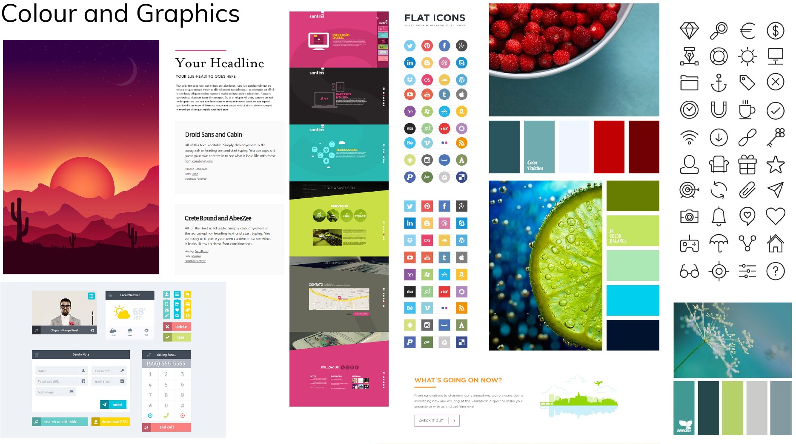
Notes:
Bright colours, fun, punchy graphics.
Used often for social websites and applications, or entertainment-based.
Uses icons and illustrations more than text.

Slide 12
Notes:
Warm, nature inspired. Calming
Serif fonts, grounding colours.
Heavily image-based.
Very Canadian. Canadian wilderness app and B.C. Tourism typeface.

Slide 13
Notes:
Neutral tones, architecture inspired.
Less common for apps and websites but used for luxury products.
Dark themes.
Good combination of icons, images and text.
Calming and rich colours.

Slide 14
Typography
Notes:
All open-source fonts.
Serif v. sans-serif
Designed for readability, especially since our applications are highly text-focused and content based. People will be scanning and reading through information.
Getting fonts right will be key to our applications. Need to consider overall usability, as well as how it will look with other elements (i.e. buttons, forms, etc.)
Matches look of particular mood boards i.e. minimalist or nature.
Display/heading fonts must have a certain amount of contrast with paragraph fonts.
In our case, staying away from anything “too fancy” such as script or block fonts. May use serif headings based on theme, but sans-serif are generally a best practice for web.

Slide 15
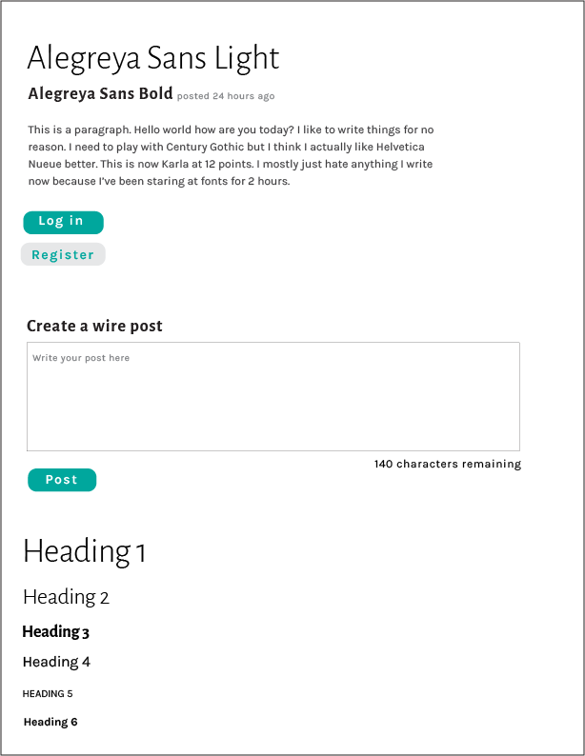
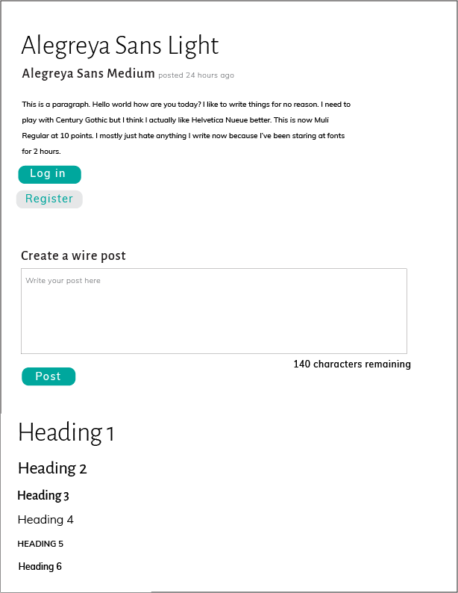
Notes:
Based on minimalist mood board.
Clean lines, lots of white space, nothing too heavy.
Maximum of two fonts, just with different weights.
Spacing optimized for readability (about 30%)
Can easily add colour.
Still contrast between headings and body text, but not in-your face

Slide 16
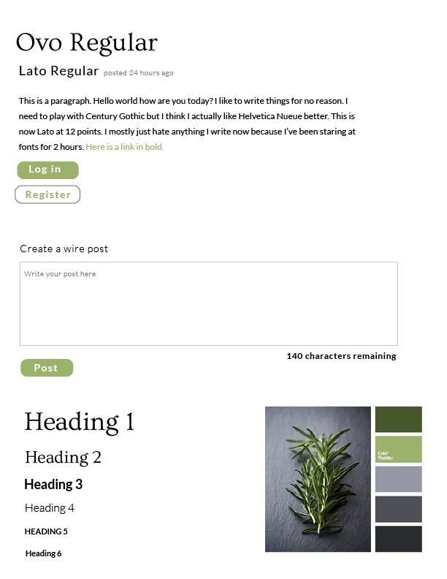
Notes:
Based on a mix of minimalist and nature mood board. Serif font for headings gives it a more earthy, elegant feel and provides a bit more contrast in a theme that is more complex than the minimalist design.

Slide 17
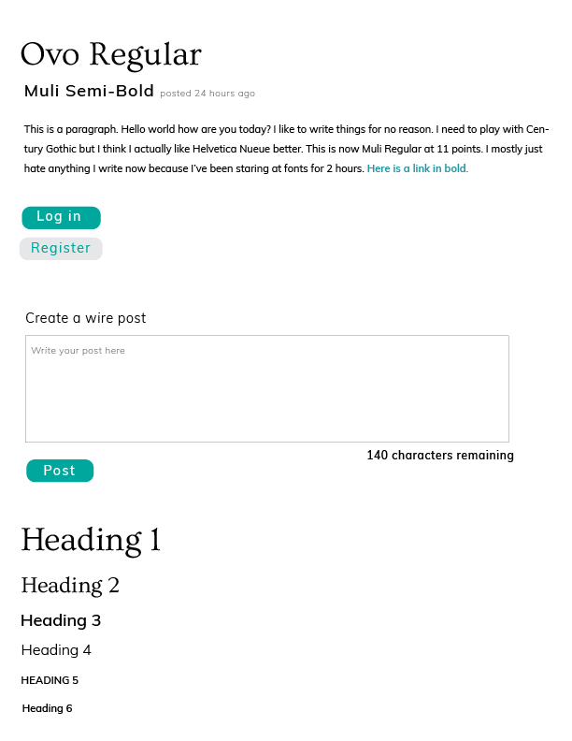
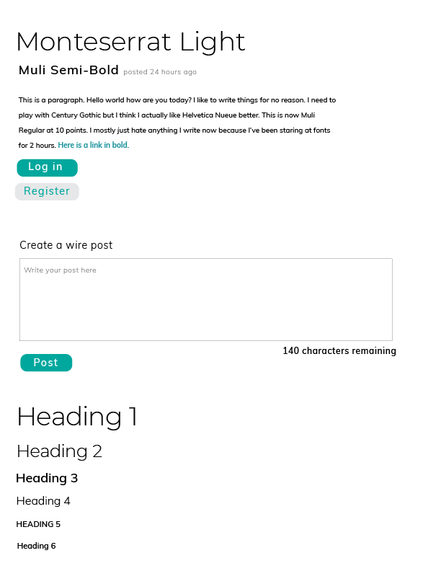
Notes:
Based on minimalist mood board.
Clean lines, lots of white space, nothing too heavy.
Maximum of two fonts, just with different weights.
Spacing optimized for readability (about 30%)
Can easily add colour.
Still contrast between headings and body text, but not in-your face

Slide 18
Documentation

Slide 19
https://s-duffey.gitbooks.io/-gcdigital-design-system/content/typography.html

Slide 20
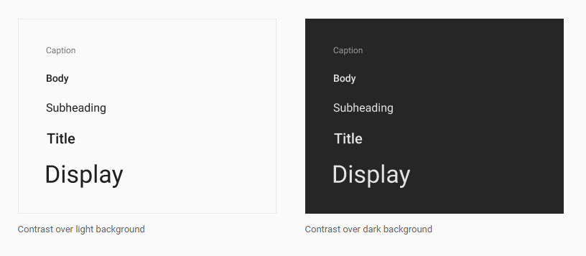
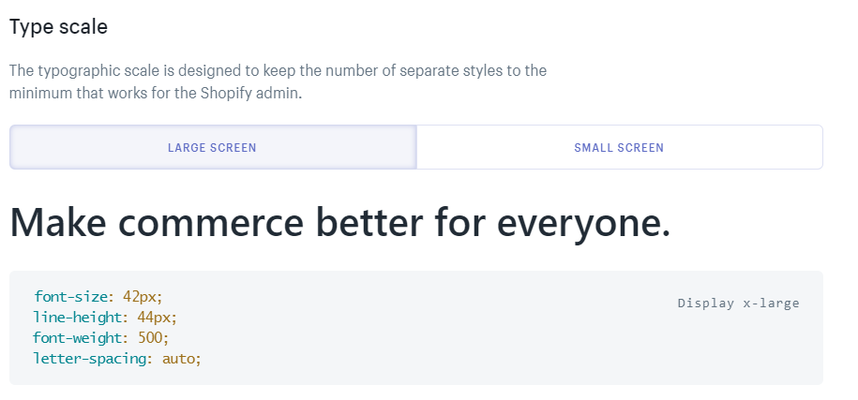
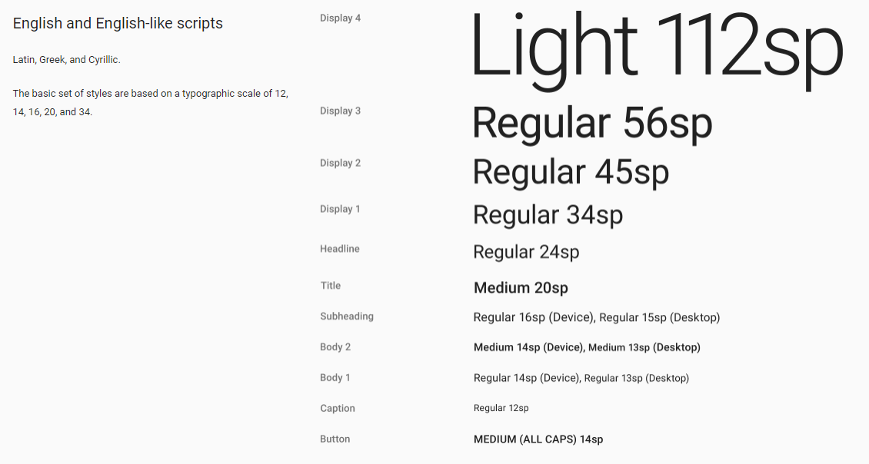
Examples
Google Material Design: Typography
Microsoft Typography
Shopify Polaris: Typography
Semantic.ui: Typography
Notes:
Documentation will eventually live on a “site” that will include images, examples, do’s and don’ts, download files, and code.
Some examples on right, show how each element looks on its own as well as how it looks used in an application.
Provides a brief summary of the section. Comprehensive, even if someone only looked at typography for example, and not buttons, they would still know how to use type on buttons.

Slide 21
What’s next?
Will be considering feedback and applying to any new mock-ups and elements we make.
Writing documentation, research on what needs to go in documentation.
Sprint launch this afternoon with partners. We are going to start building elements based on a theme (i.e. forms)
Official updates and presentations are going on GCpedia, mock-up files and documentation will be available on Github.
Subtle promotion via partners, Sierra’s blog post, Twitter etc.

Slide 22
Questions?

