Slide 1
“Leadership is not a rank or a position, it is a choice - a choice to look after the person to the left of us & the person to the right of us.”
- S. Sinek
Notes:
:
Strong leadership is one of the drivers of successful change, and leaders who support the people-side of change are essential to success.
This program delivers and promotes mindfulness practices to increase participants’ self-awareness and resilience, equipping leaders that can nurture mindfulness in their teams, and contribute to employee wellness and well-being.
This presentation will provide an overview of the program, share the highlights of the program

Slide 2
Information session: Mindful Change Leadership Development program
Date to be added
Notes:
:
The Mindful Change Leadership Development Program has been in development since 2016 and was launched by ISC as a pilot project, in April 2021, and then delivered in 2022 as a program.
The program is sponsored mainly by ISC and supported by other government Departments including A, B, C, D
Invitation is also extended to all other Government employees by the Interdepartmental Organizational Change Network, via its GCTools groups
A little bit about us, the presenters/facilitators of this program:
Alejandro Gonzalez joined the Public Service in 2007, he is being leading Mindfulness at work sessions since 2013. He has taken various mindfulness related trainings with special interest in Mindful, Change & Leadership. He’s now working with Indigenous Services Canada for the Organizational Development and Change Management Unit, under the Communities Infrastructure Branch. Alejandro is also the co-chair for the Interdepartmental Organizational Change Network (IOCN), he’s eager to offer this program again.
Carmen Stefan Danner is a Team Leader with ESDC and had worked in various federal government departments during his 22 years with the Public Service of Canada. He has many years of client service experience in both private and public sectors. Committed to growing personally, developing his interpersonal and managerial skills and helping others to do the same, participated in the program of last year and he is excited to be co-facilitating this program.

Slide 3
Objective
Offer participants an overview of the Mindful Change Leadership Development (MCLD) program
Notes:
:

Slide 4
Agenda (not necessary in this order)
Share the results of the MCLD program
Share a definition of Mindfulness and Mindful Change Leadership
Experience quick mindful exercises
Overview of the MCLD program
Q&A
Notes:
(paraphrase from slide)
Please write down your questions, at the end there will be time for Q&A
Raising hand
Comments via the chat
Anonymously via Sli.do (provide the Sli.do link and code)

Slide 5
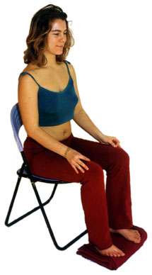
Exercise – Exploring Mindfulness – Body Scan
Time required: 5 minutes
If you haven’t, take advantage of the opportunity to experience this exercise
Sit as comfortable as possible in a straight position
Feel free to close your eyes
Follow my voice as I lead you through the exercise
Then, we will do a short debrief of what you noticed.
Debrief / Débriefer
Notes:
:
To start, let’s experience a mindful exercise…
If you haven’t, take advantage of the opportunity to experience this exercise
Sit as comfortable as possible in a way that allows you to stay awake and attentive
Put your feet flat on the ground, your palms on you lap, upside or downside as it feels more comfortable
Feel free to close your eyes, or semi close them
Follow my voice as I lead you through the exercise
Gently bring attention to your breath, no need to change the way you’re breathing, just notice it
Now, direct your breath and attention and focus on…
Your face, your eyes, nose and mouth. Your jaw, noticing
Your head, your scalf, breath in and out
Now direct your breath and attention to your shoulders, breath in, breath out, and notice
Your arms, your hands and fingers, in and out
Every time your attention wanders away, just bring it back gently
Back to your shoulders, and neck, noticing
Your upper back, chest
Your lower back, your abdoment
Direct your breath towards your waist, in and out
Your lower leg, in and out and your upper leg, and notice what you feel
Your feet, in and out, notice what you feel
Your toes, breath in, breath out
Stay there for a few seconds, breathing in and out
When you feel like, open your eyes and come back
Debrief: Use the chat to mention What did you notice?
We’ll read some of your comments later during this session

Slide 6
Mindful Change Leadership Development Program (MCLD) Goal
To increase self-awareness by developing key skills:
Focus
Clarity
Creativity
Compassion in the service of others
… with a positive impact on well-being and resiliency.
“Individuals with higher mindfulness have greater resilience, thereby increasing their life satisfaction.” - ScienceDirect
Notes:
:
When you think about your work and try to find a balance between work priorities, your relationships with colleagues and clients, along with home life responsibility, what strikes you as the key skills needed for this balance? Where would you like to improve?
Is it better presence, or more compassion? Is it increased self-awareness or tools for self-reflection?
We believe that this program helps to answer some of these questions and to improve the key skills of presence, self-compassion, relationality, life-work balance, self-awareness and more.
(click)
There are studies showing that individuals with higher levels of mindfulness tend to be more resilient. And also note that both mindfulness and resilience are important skills for improved well-being
By partaking in the program, you will likely increase the level of honesty and trust within yourself, and therefore with others, allowing for an authentic connection with the work that we do at across the Government of Canada.

Slide 7
Highlights of the MCLD 2021
n=99
Program delivered, once a week, from April to June 2021
Invitation went to ISC, CIRNAC and then to all GC departments
99 Pre-assessments received
68 Participants completed the program from across Canada
Notes:
:
We ran a pilot of the program in April 2021, and almost 70% of those who expressed interest completed the 8-week program.

Slide 8
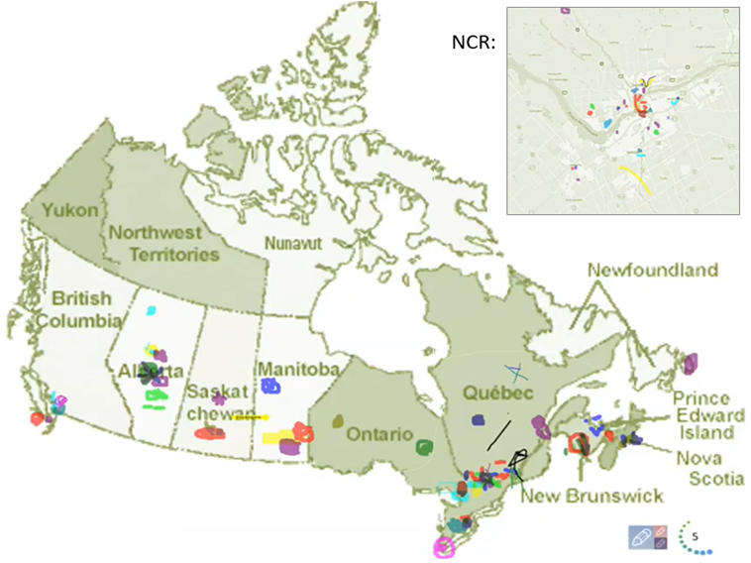
Map of Participation, Pilot’s First Session
8
Notes:
:
The program had participants from across Canada, This slide was co-created at the beginning of the 2021 Pilot. And we will work to promote the program in the North

Slide 9
Main Results of the MCLD Program
19.3%
19.9%
25.0%
22.3%
, 3 months after
* People who answered "Almost Always" and "Very Frequently"
Notes:
:
Participants completed self-assessment questionnaires at program registration and again three months after the eight-week program, and we have compiled the data to evaluate the results and impacts of the Mindful Change Leadership Development program.
The blue columns represent the results of the self-assessment questionnaires completed at registration.
(click)
The green columns represent the final assessment, and the differences between them indicate behavioural changes.
A total of 68 participants completed the 8 week program, we received 56 final assessments, and the key findings per category are:
(click) Almost 20% increased Employee Engagement, respondents are more able to be fully present and attentive in meetings, conference calls and presentations.
(click) 25% Increase in Promoting Sounder Decision Making, people are more able to make time on most days to eliminate some tasks/meetings with limited productivity value.
(click) A little over 22% improvement in managing Behavioural Risks, respondents indicated they are more present completing tasks than potentially thinking about something else.
(click) Just above 19% Increase in Well-Being, participants feel they are more able to be themselves in the (virtual) workplace.
(Note that for the 2022 Program, we included « Resiliency » as a category on the self-assessment questionnaires)
What we heard from participants was that the program increased their own sense of well-being; and gave them the tools and practices to reflect these with their teams to support employee wellness and well-being.

Slide 10
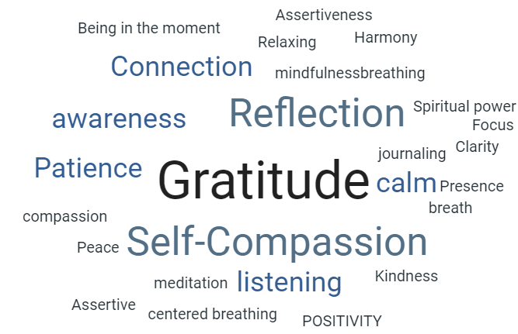
MCLD 2022
239 Participants registered:
23 Participants interested in co-facilitating:
French: 10
English: 3
Bilingual: 10
Notes:
:
The 2022 English offering ran from April 25 to June 13 and had 239 registered participants from over 60 departments.
23 participants are interested in co-facilitating future offerings of the program, in the languages indicated which will increasing facilitation capacity and collaboration across the public service
Although the offering was delivered in English, at the beginning of every session we reminded people they could use the official language of their choice.
During the registration process, participants were asked about their preference for the Buddy System, thus people were able to have deeper discussions in their preferred language.
(click)
On the right, you can see participants’ responses, when asked to describe in one word, “What’s the skill you improved the most, or the best, during the MCLD Program?”
They are also expressing, as of the result of the practices learned in this program, that they are feeling more grounded and mentally present in their work. The surprise for many participants are the positive changes in their emotional presence and meaningful relatedness, both at work and at home. These are essential skills in the furtherance of any person.

Slide 11
MCLD Testimonials
"…in a way, your investment in becoming medicine... is a very important investment…" - Elder Malcom Saulis
"I found this course to be extremely powerful and grounding... this really helps to shape how I look at my relationships with my staff… it was excellent. " - participant
"it was very powerful, very interesting, lots of insights. I learned a lot about myself. I found the exercises appropriate in me being more productive, more present in my relationships with my colleagues and also with my family.” – participant
“This series is life changing. I hope to participate more in the future” – participant
"Thank you Alejandro for this valuable opportunity to grow personally and professionally. It has been an important adjunct to the transformational work we are doing at ISC." - participant
Notes:
:
From this set of testimonials, I’ll allow myself to read one in full…
"... in a way, your investment in becoming medicine for yourself and for the rest of the world is something that I'm grateful to be witness to as an occasional participant in this program... any kind of investment like this in order to open your mind, your heart and your spirit to the presence of a larger world, which is either spiritual or physical, is a very important investment, and I applaud you for the investment that you've made." - Elder Malcom Saulis, session 8, 5456

Slide 12
Exercise – Noticing
Time required: 3 minutes
The trick is to shift from “doing” to “being”
Let’s start by doing the following...
Sit as comfortable as possible in a straight position
It helps if you close or semi-close your eyes
Let’s not worry about time
And take a minute, only a minute...
To breathe, just to breathe
That simple
I’ll let you know when the minute is over.
Just continue focusing on your breathing
We’ll do a short debrief of what you noticed
Debrief
Notes:
:
let’s give a try to another mindful exercise…
As with the first exercise, sit as comfortable as possible in a position that allows you to be awake, attentive and comfortable at the same time
You can put your feet flat on the ground, your palms on you lap, upside or downside as it feels more comfortable
Feel free to close your eyes, or semi close them
Follow my voice as I lead you through the exercise
Gently bring attention to your breath, no need to change the way you’re breathing, just notice it
Let’s not worry about time
Just focus on
Breathing in
Breathing out
If at any time your mind wanders away, being gently with yourself, acknowledge that thought, let it be, and bring back your attention to your focus of attention, your breathing
Breathing in
Breathing out
I’ll let you know when the minute is over
Just continue focusing on your breathing
Debrief: Use the chat to mention What did you notice?
We’ll read some of your comments later during this session

Slide 13
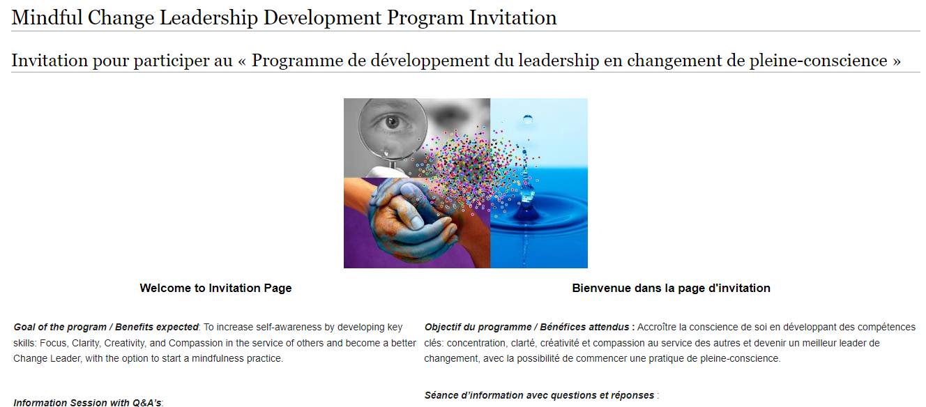
Commitment, Program Overview & FAQ
https://wiki.gccollab.ca/Mindful_Change_Leadership_Development_Program_Invitation
Notes:
:
“This program is aimed at someone who wants it” (not necessary for that who needs it)
https://wiki.gccollab.ca/Mindful_Change_Leadership_Development_Program_Invitation
https://gccollab.ca/groups/profile/7978973/mcld-program-cohort-cop-coi-program-dlpc-cohorte-cdp-et-cdi

Slide 14
What’s Needed For Success?
Voluntary Participation
Support from Management
Notes:
:
The sessions and take-home activities require a fairly significant investment by participants, and two components which will be key for ensuring the continued success of the program are maintaining voluntary participation and support from management.
(These 2 success factors are emphasized during the promotion of the program, and employees are encouraged to discuss with their managers to get their support)

Slide 15
Notes:
:
In the meantime that people raise their hand to ask questions), we’ll reflect back on some of the comments put on the chat…. (mention some of the comments for both exercises)
And now, we open the floor for questions, please observe:
One question at a time
Alternating with the chat
and Sli.do, for those who prefer anonymity (provide the Sli.do link and code)

Slide 16
Be Mindful, Be Happy /
Prenez conscience, soyez heureux

