Slide 1




Welcome to GCworkplace
IT'S TIME TO ADOPT WISE METHODS AND WORKSPACES

Slide 2




The landscape is changing.
Are we ready to change the way we work?
BEHAVIOURAL SHIFT
EMPOWERMENT
A WORKFORCE IN FLUX:
GENERATION Z
MEASURING PERFORMANCE
The idea that work and private life existed in two separate universe is being challenged by technology
Modern tools and a culture of trust can empower employees to decide where and how they are most productive
Are we anticipating their needs?
Success is not measured on the physical presence of staff but rather on results, creativity and commitment
2
Notes:
The federal government office landscape is changing significantly.
Success is no longer measured on the physical presence of staff but rather on results, creativity and commitment.
The idea that work and private life exist in two separate universes is being challenged by technology.
Modern tools and a culture of trust can empower employees to decide where and how they are most productive.
Looking to the future, our work environments need to reflect, accommodate and support the diversity of our people and their contributions.
For example, we have multiple generations in the workplace. Each new generation brings new ideas, abilities, and expectations; and the previous generations have a wealth of knowledge and experience that is incredibly valuable.
The Government of Canada as an employer needs to remain relevant and adaptable. We need to be able to attract and retain the new generations of workers as well as the experienced professionals who have come up through the ranks.
We need to meet the demands of a modern Canada; we need to create a confident and high performing workforce; and we need to mobilize the diversity of talent we have to serve the country’s evolving needs.

Slide 3



The workplace of the future: What we’ve heard
EMPLOYEES WANT…
DEPARTMENTS WANT…
GOVERNMENT WANTS…
“One GC” experience
Have tech that allows them to be mobile and collaborate with colleagues in other departments
Flexibility to work from anywhere
Management support for their wellbeing
Spaces that are accessible and meets their diverse needs
Strong PSES scores and to be an employer of choice, competitive in recruitment and retention
Their business needs to be reflected in the outcome of the modern workplace
Modernise when they are ready to do so
Strong partnerships and support
Consideration for their realities, responsiveness to their accommodation needs, and predictability of project delivery
High-performing modern public service
Departments working together on policy and operations
Barriers removed to serving Canadians, including the Canada Digital First Strategy
Strong leadership in the real property sector, greening, innovation, collaboration
For departments to be good neighbors with all levels of government
3

Slide 4



A vision for the Government of Canada workplace
LESSONS LEARNED FROM WP 2.0
ENGAGEMENT THROUGH BP2020
LOOKING AT GLOBAL WORKPLACE TRENDS AND INNOVATIONS
4
Notes:
The GCworkplace vision was developed and refined based on three main elements:
1- From lessons learned from past initiatives (i.e. Workplace 2.0),
2- From what we collectively heard through the BP2020 consultations and other engagement sessions.
3- From what we learned by looking at trends and innovations in workplaces across the world.

Slide 5


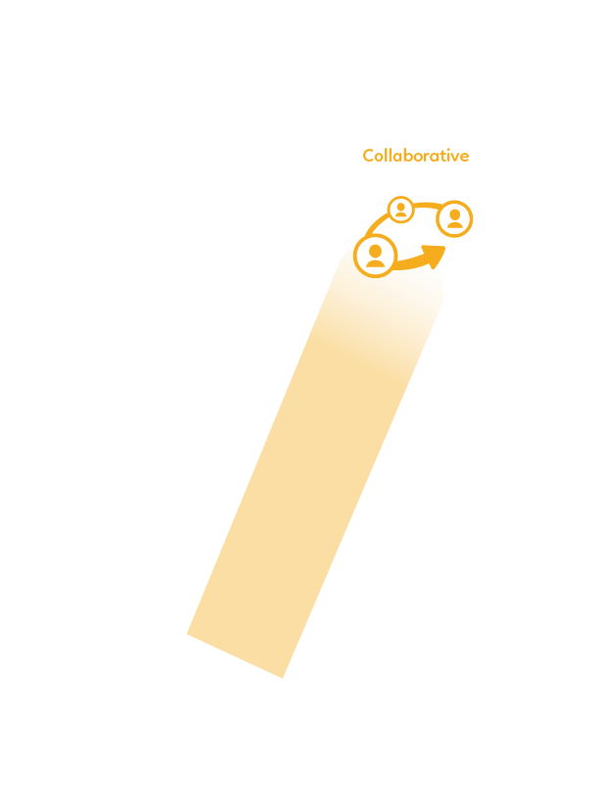





GCworkplace vision
A modern GCworkplace
for the new agile, inclusive, and equipped public service.
5
Notes:
GC-wide engagement and engagement though BP2020 has allowed us to identify seven dimensions that define what modern means for our workplace.
In addition, we surveyed 1,300 employees from across Canada told us what they wanted … and they ranked these 7 dimensions in order of importance
• FLEXIBLE –work anywhere, anytime, with anyone – came first
• HEALTHY –supporting a culture of mental and physical wellbeing
EFFICIENT –supports employee productivity and reduces barriers to collaboration
• INCLUSIVE –offers choices to suit all needs and preferences
COLLABORATIVE –engage with others to drive innovation
• DIGITAL –use modern tools to support productivity and connect teams
• GREEN –designed for energy efficiency and sustainability
The vision for our workplace is:
employee-centric
principle-based
anchored in public service values

Slide 6





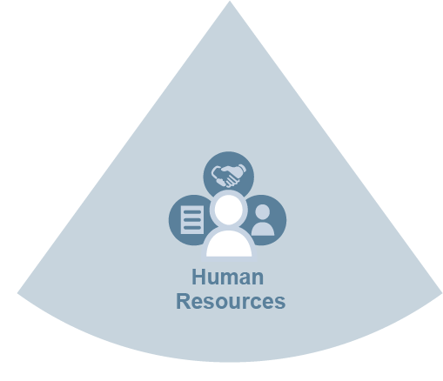
An integrated approach
Going beyond space,
towards an integrated vision
for workplace modernization
Each key enabler is integral to the function of the others. They need to support one another and integrate their modernizations strategies to equip GC employees with the right tool and process to support fundamental changes in the way we work.
6
Notes:
Strategy 2 – Promoting an integrated approach
With GCworkplace, we are going beyond buildings and space, and moving towards a more holistic vision of the workplace modernization.
What’s a modern workspace without the right tools and processes to support new ways of working?
The key enablers of the modern workplace–Information Technology, Information Management, Human Resources (including Occupational Health and Safety), Security, and Facilities–must be aligned to the organization’s vision for the workplace.
The modernization strategies must be integrated to equip GC employees with the right tools and processes to support fundamental changes in the way we work.
To support departments that are ready to modernize, PSPC has developed the GCworkplace Transformation Playbook

Slide 7
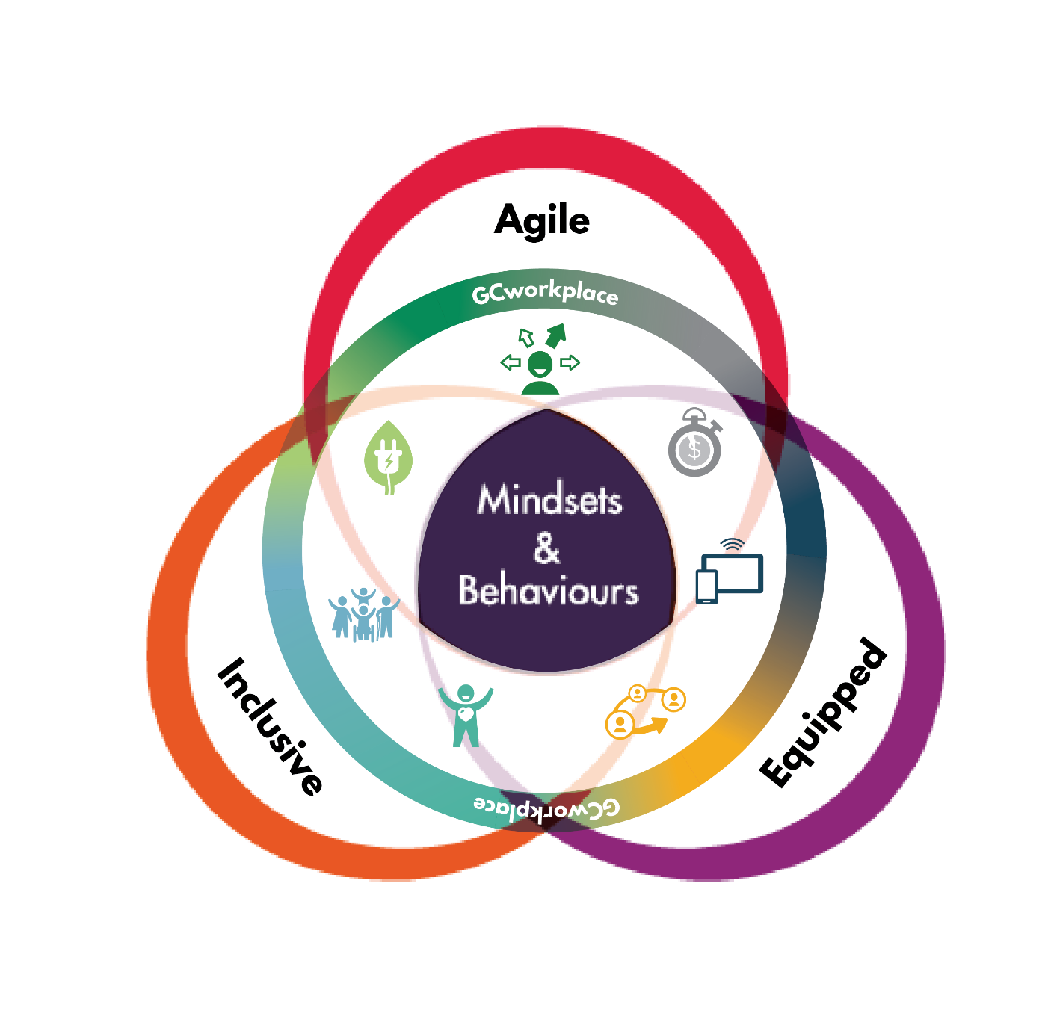
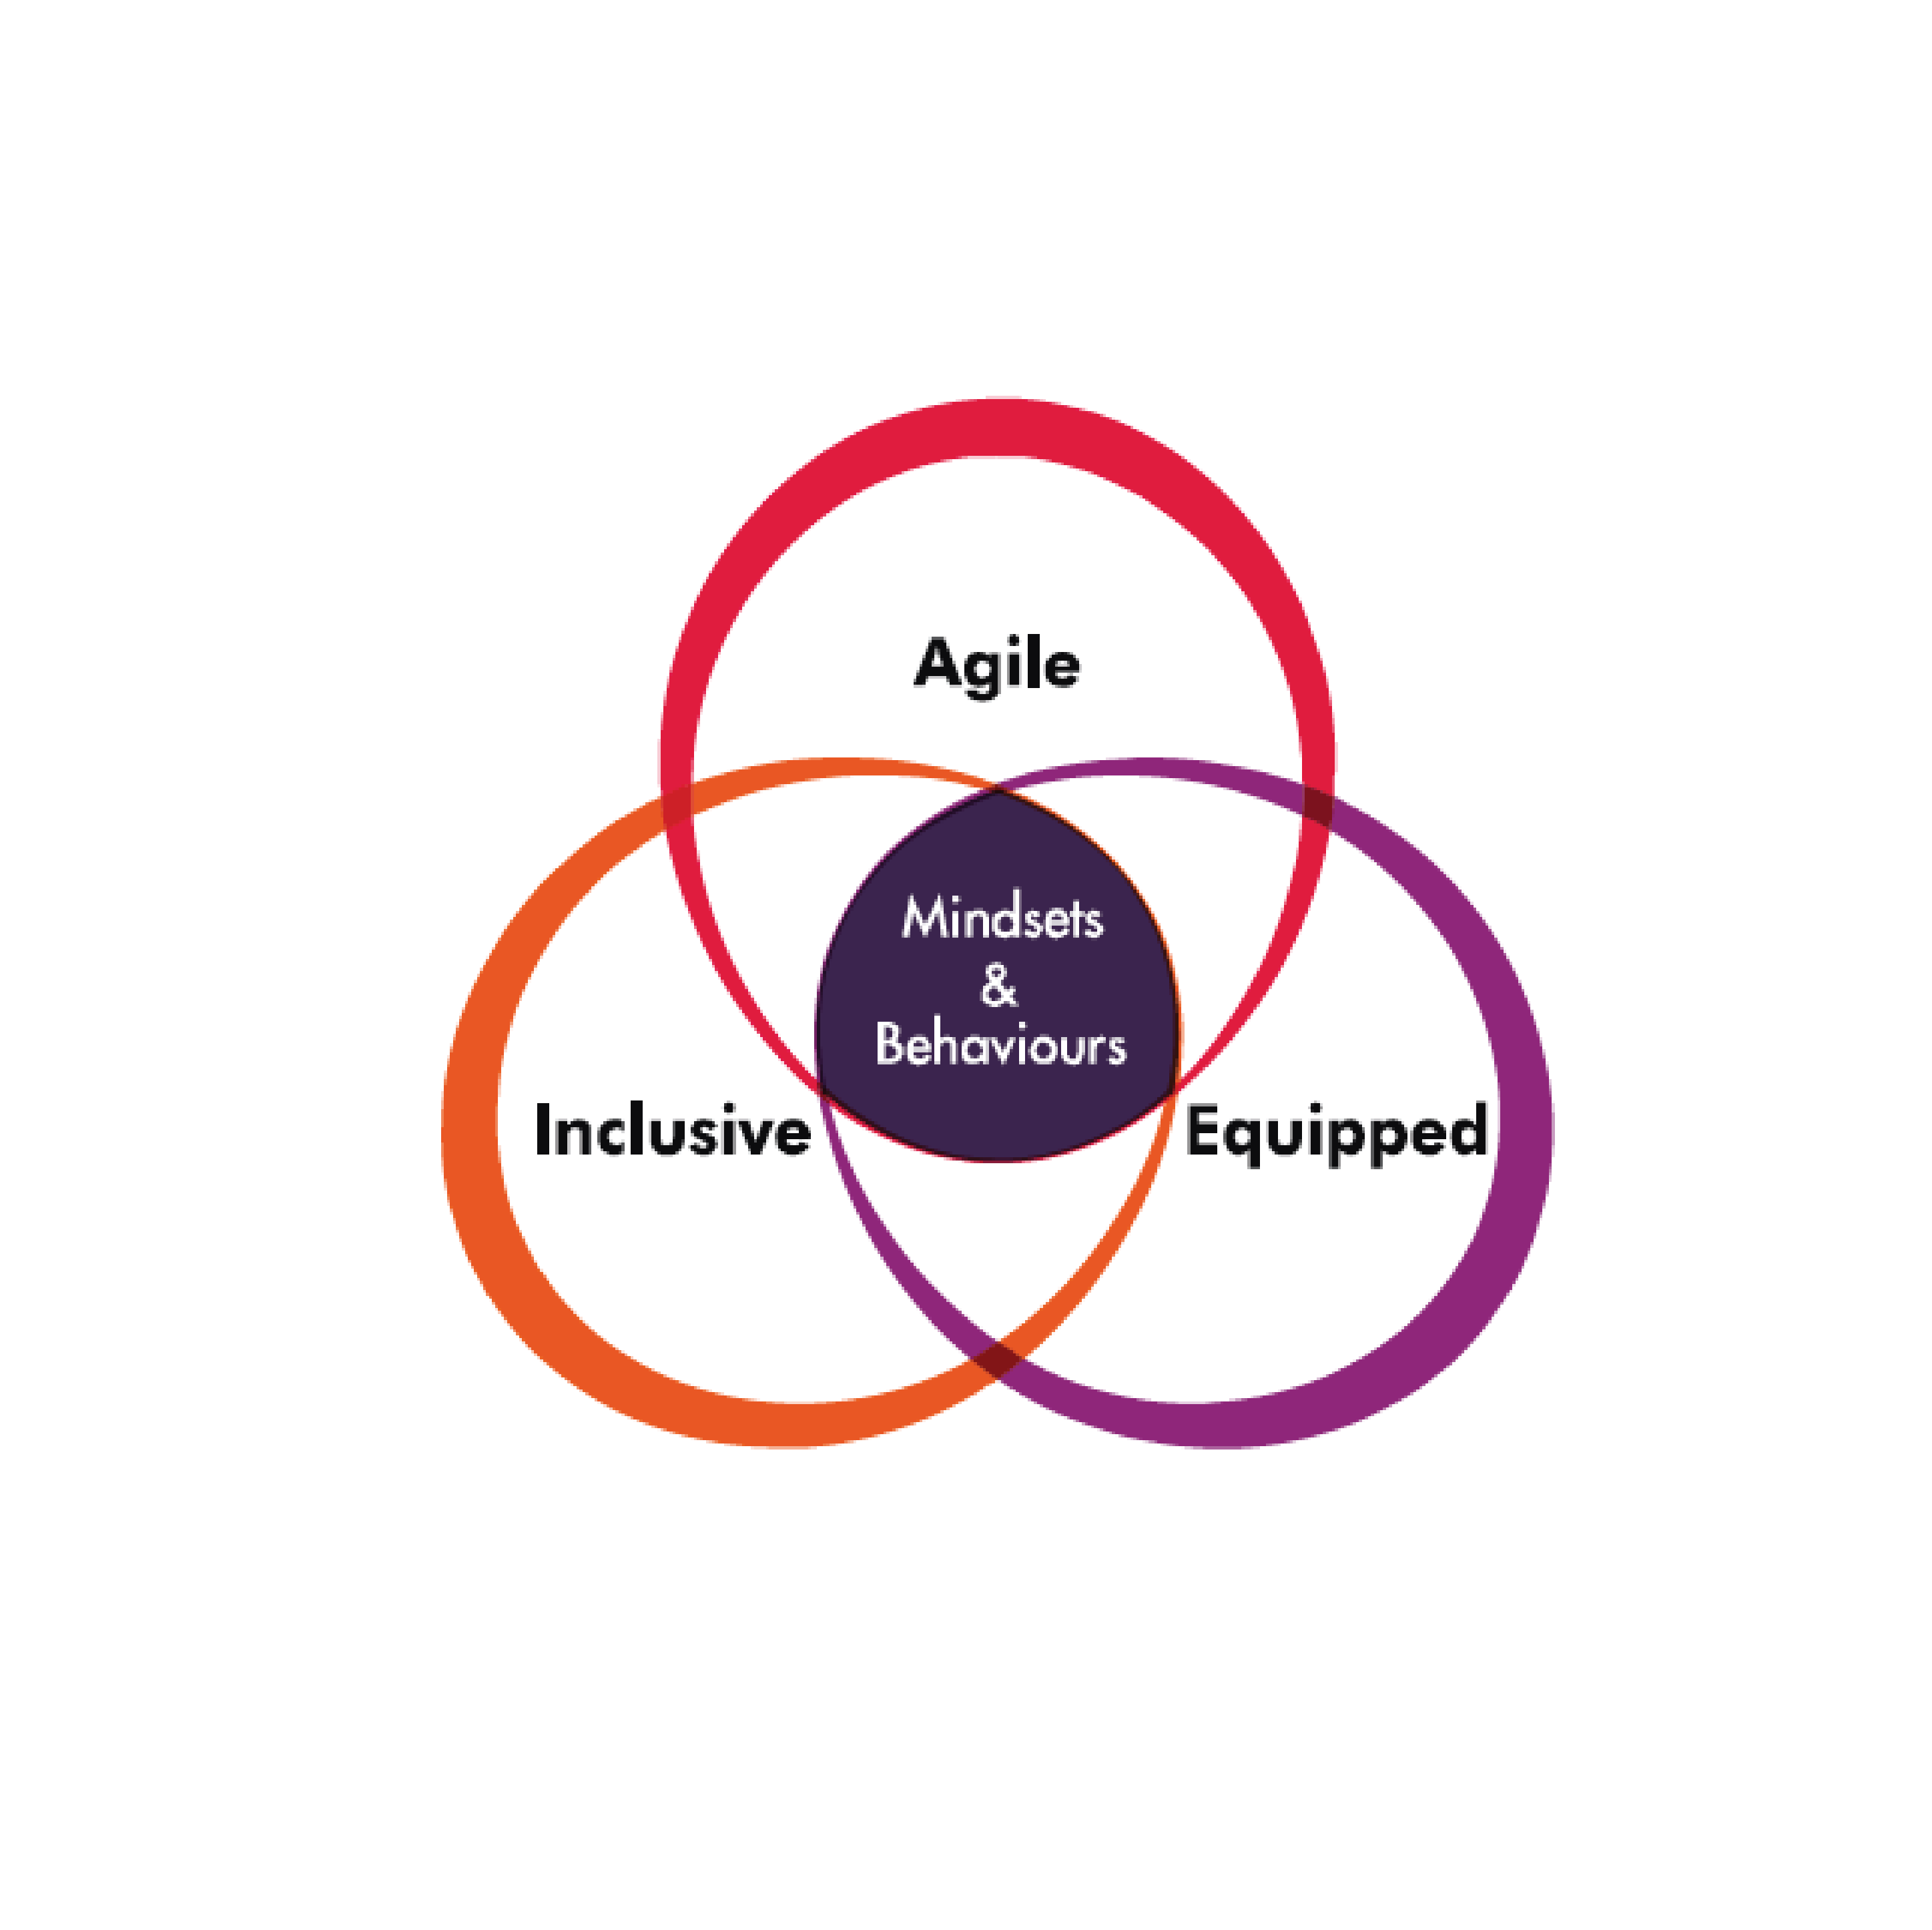


GCworkplace and Beyond 2020 – one direction
Where the vision for the workforce goes, the vision for the workplace goes
Beyond 2020
7
Notes:
The workplace is a tool that departments can use to support Public Service Renewal and to embrace the Public Service vision for the workforce.

Slide 8
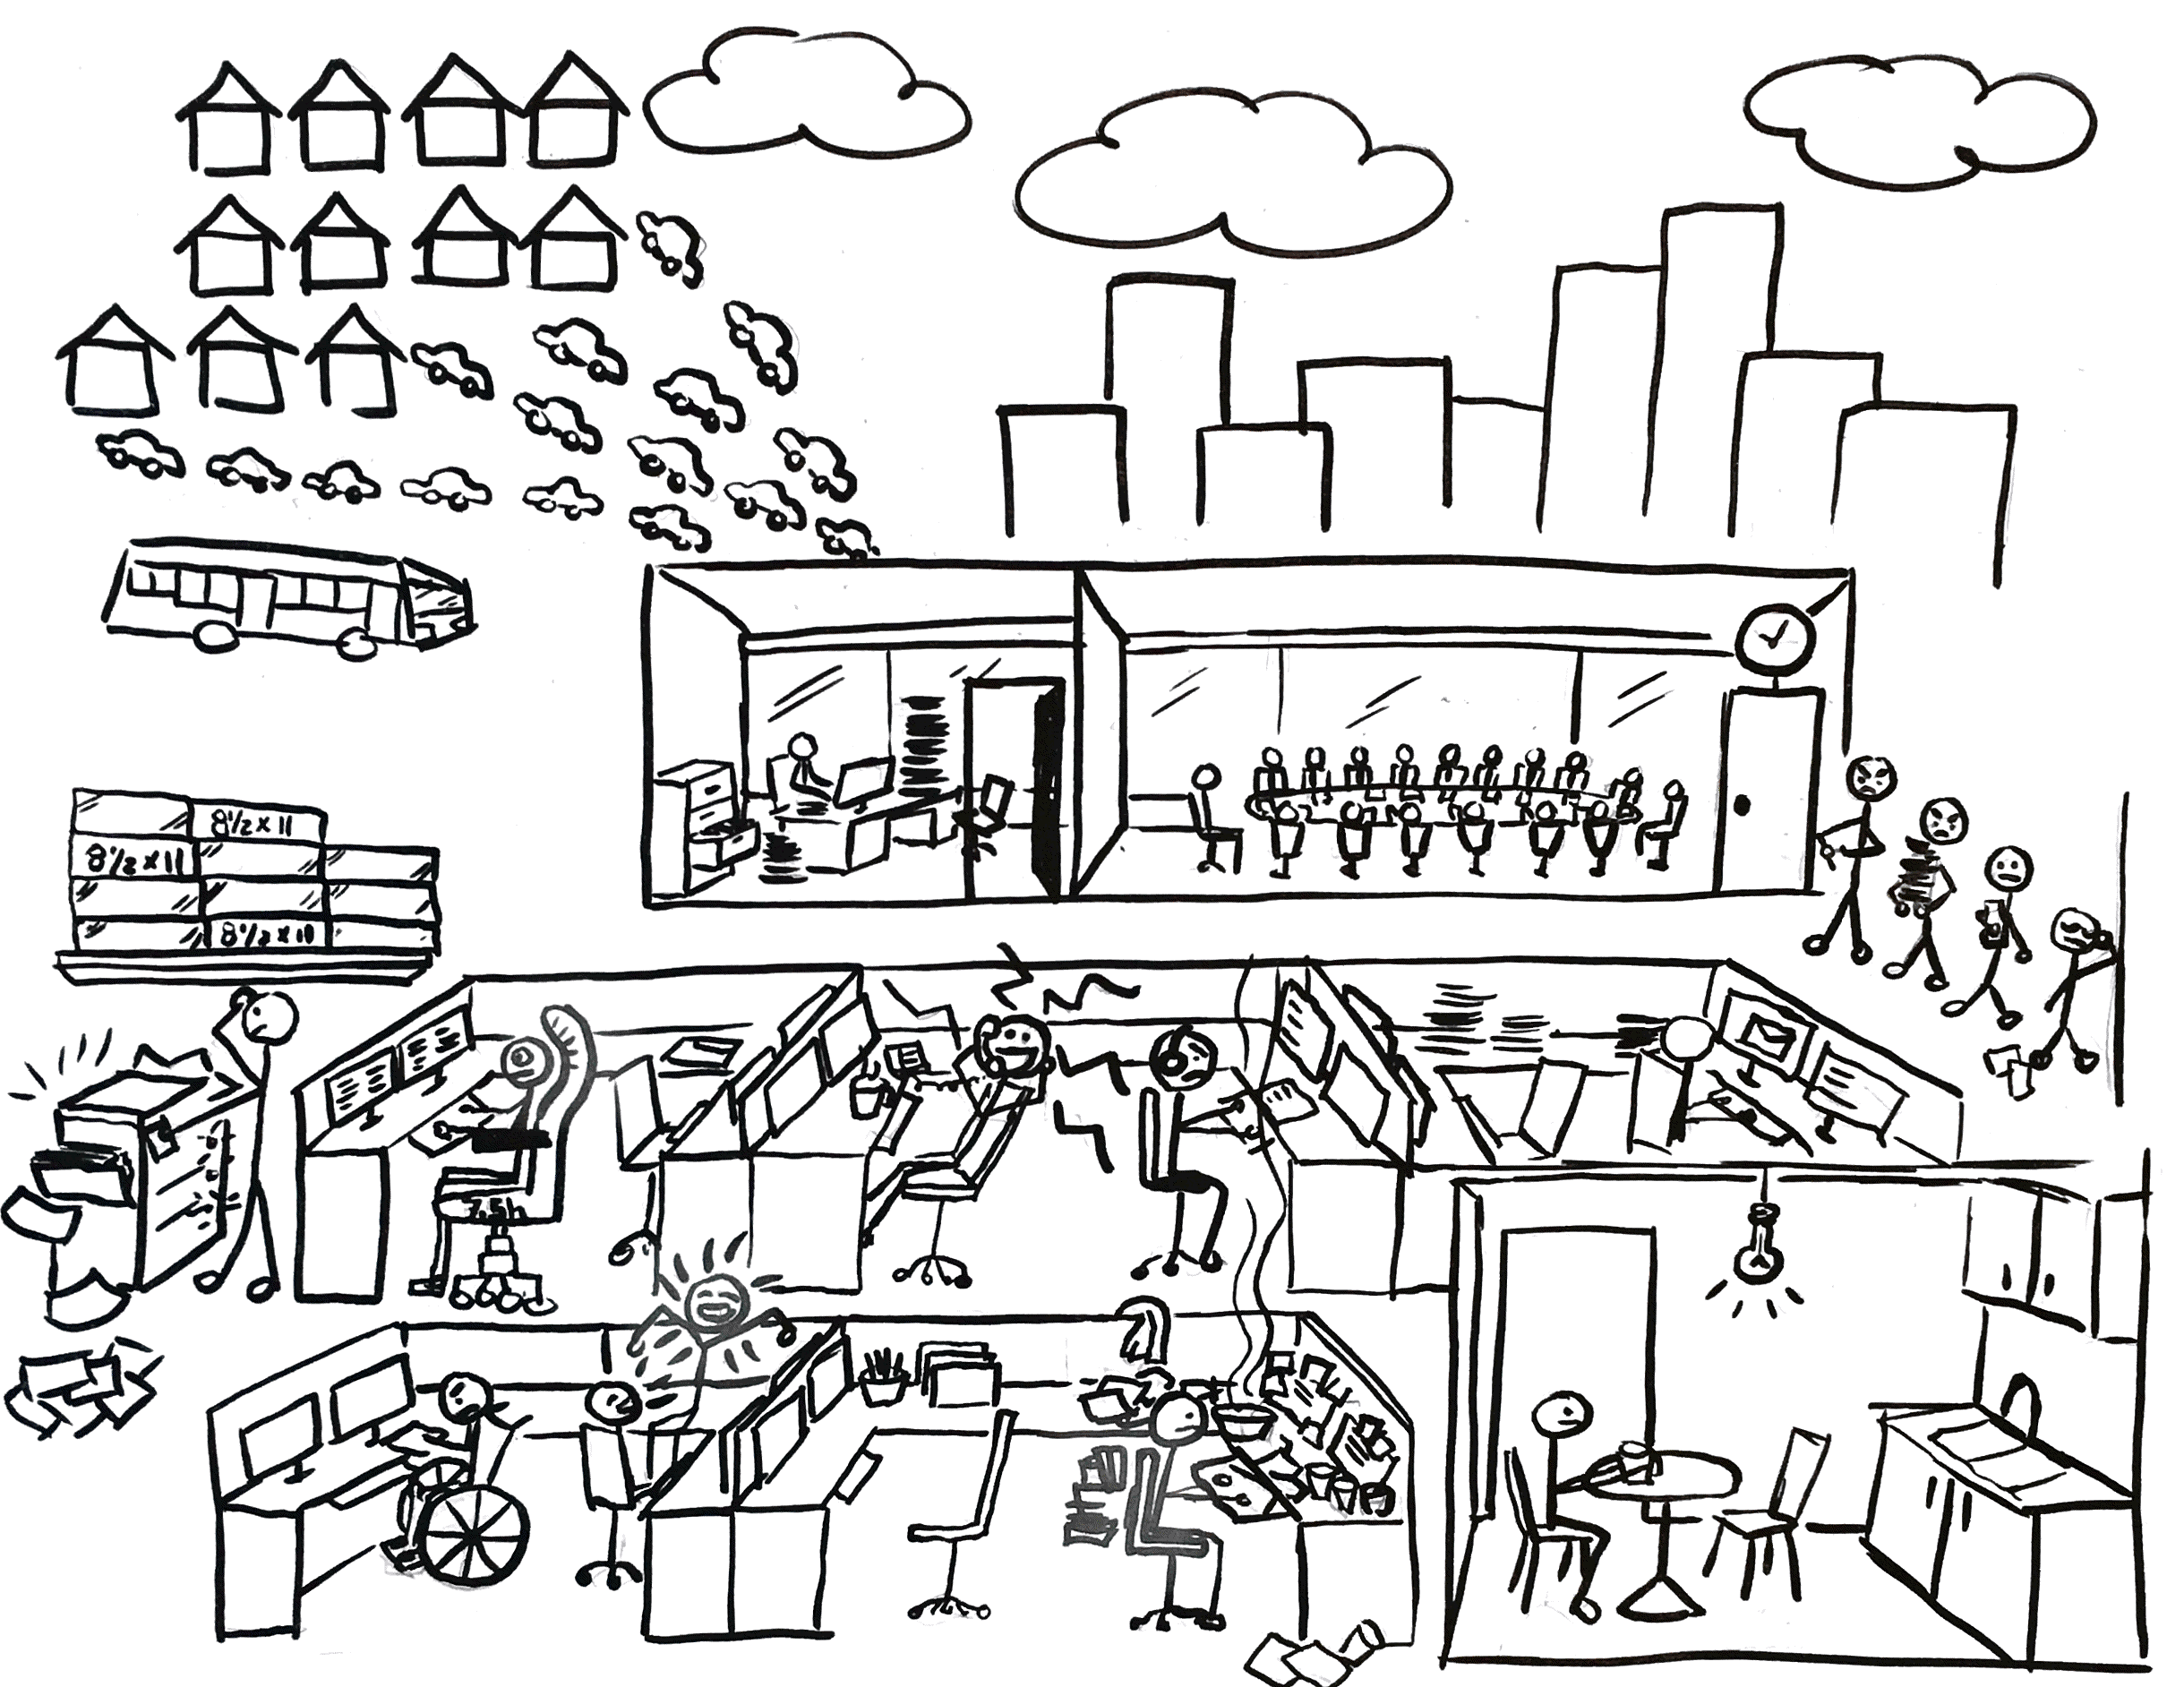
Past workplace
FACTS
Taken together, Public Services and Procurement Canada employees travel the globe 3 X to get to work at the Place du Portage complex every day.
Paper document storage burden
Average daily utilization rate of Portage IV = 47%
Illustration by Véronique Boton, PSPC.
8

Slide 9
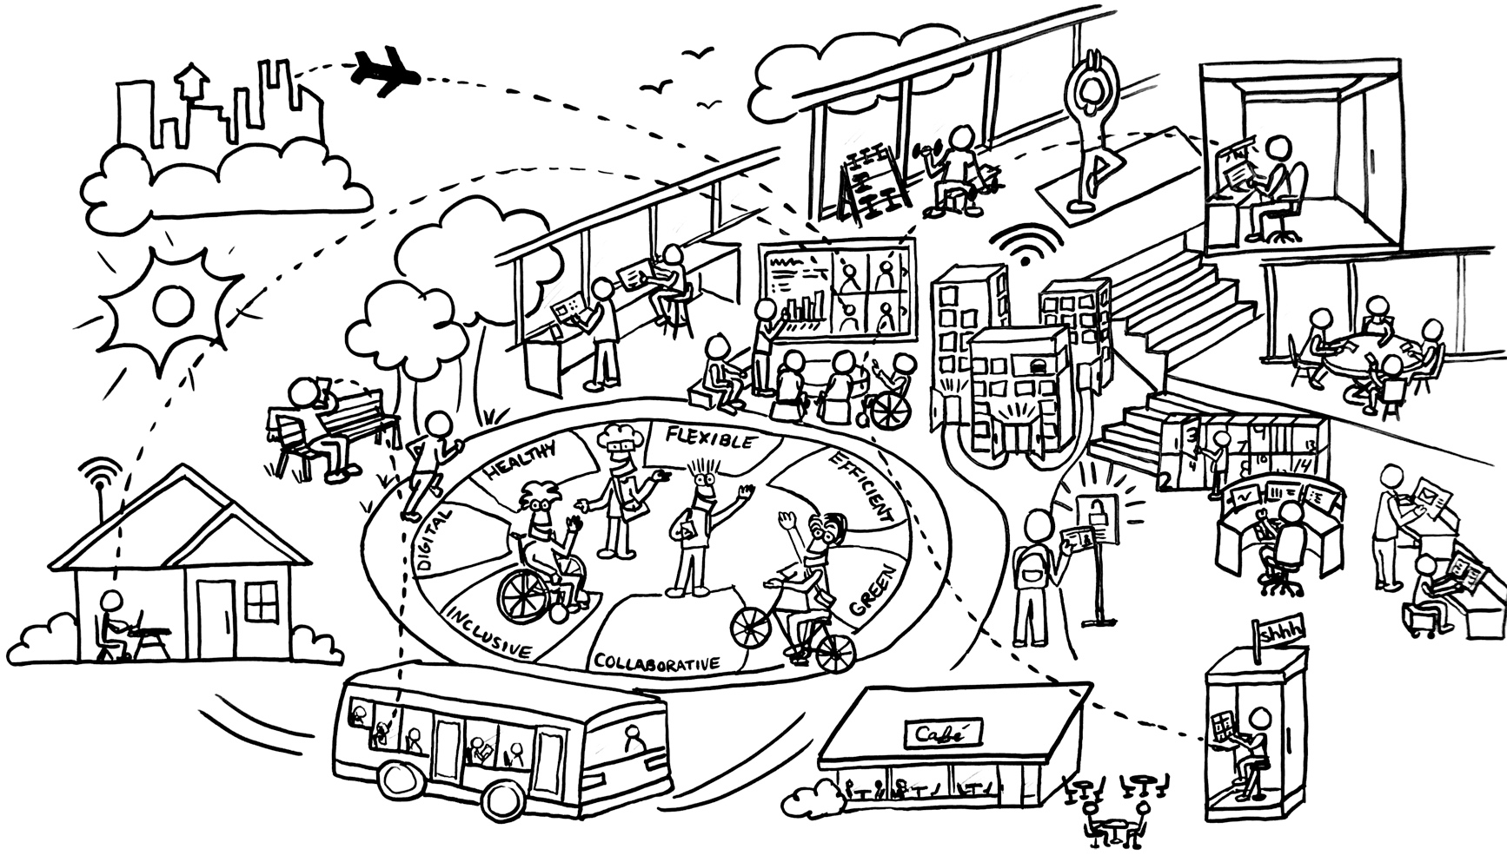
GCworkplace is designed to service modern Canada
OUR PURPOSE
Providing greater flexibility in where and how employees work so they can be as productive as possible in delivering programs and services to Canadians.
OUR PEOPLE
Creating a modern workplace that puts employee experiences and quality of service at the core.
OUR PLACE
Retooling work environments to encourage collaboration, using technology in smarter ways, and fostering a culture of health and well-being.
Illustration by Véronique Boton, PSPC.
9

Slide 10
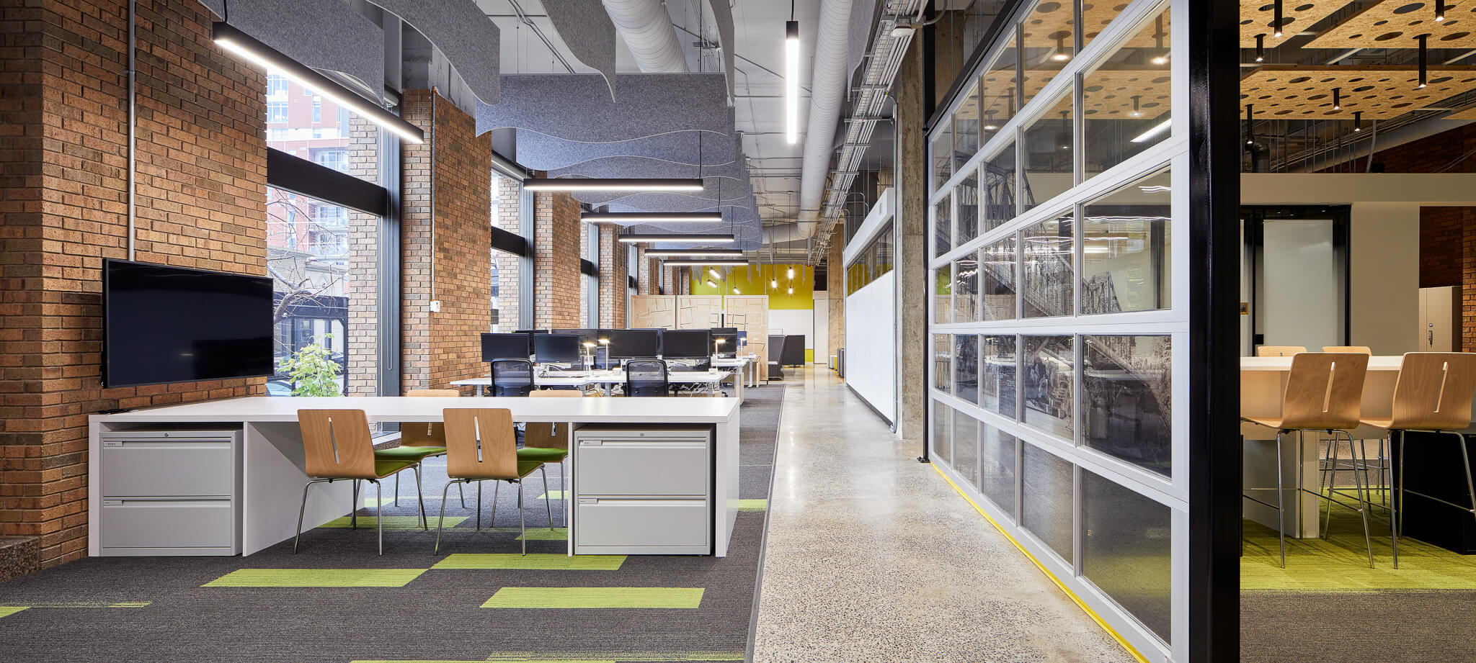
GCworkplace delivers what our public service needs
Provides flexibility and empowers employees
Fosters collaboration at all levels
Supports employees health and well being
Allows the GC to attract and retain the best talent
Optimizes efficiency of our facilities and utilization rates
10
Notes:
Digital tools and a culture of trust provides employees with mobility and flexibility and it empowers them to work how and where they can be more productive.
Fosters collaboration within teams, within the department, across departments and more.
The flexibility allows for work-life balance integration. One example is that it returns commuting time back to our employees by allowing them to work where they want. The flexibility and the user-centered designs also allow employees to choose how and where to work not only based on their activity, task or deliverable, but also based on how they mentally feel on any given day.
Positions us to attract new, young talent as people retire. Puts the GC in the race as an employer of choice with other private and innovative companies.
Optimizes existing properties/facilities and creates better operational efficiency; saves money by reducing empty office spaces.

Slide 11
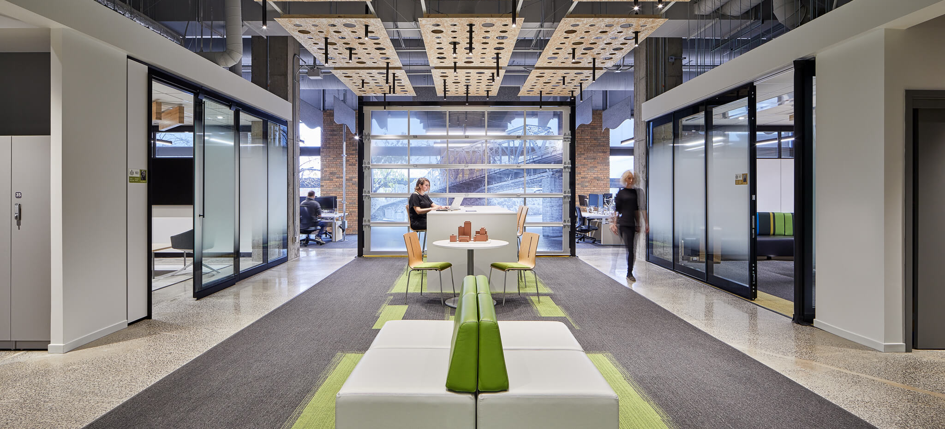
EQUAL ACCESS TO SPACE
DESIGNED FOR ACTIVITIES
WORK ANYWHERE, ANYTIME, WITH ANYONE
EQUIPPED & CONNECTED
INCLUSIVE & ADAPTABLE
11

Slide 12
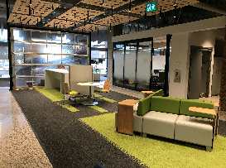
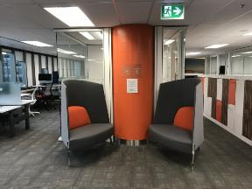
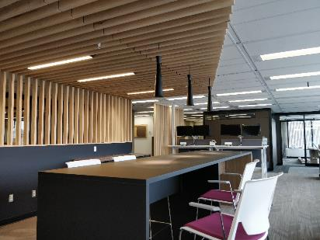

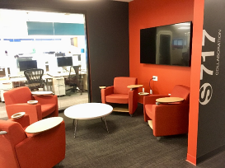
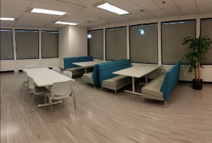
The Future is now
PSPC - Les Terrasses de la Chaudière (Gatineau)
Department of Justice - St Andrews Tower (Ottawa)
PSPC - PdP III – 9A1 (Gatineau)
WINNER
Best Offices Ottawa 2018
WINNER Corenet Global REmmy Award
2018
PSPC - Place Bonaventure (Montréal)
Canada Revenue Agency -
Place de Ville (Ottawa)
112
Notes:
We are experimenting on ourselves so we are able to show leadership and are able to champion this.
Enabling pockets of early adoptions across the GC - and providing opportunities to departments to get a glimpse at modern workplaces.

Slide 13
Top key success factors for workplace change
Establish leadership and governance to develop and manage your Workplace Strategy.
Engaging employees by way of activities, meaningful consultations and discussions at all levels on the issues that matter most.
Clearly articulating a vision for the workplace that is aligned to vision and benefits for the organisation.
Empowering and equipping managers and supervisors to support their employees through the change.
Demonstrating active and visible leadership (champions and ambassadors) supporting the vision and the aspects of change throughout the life of the modernization initiative.
Creating opportunities to experience the change through pilots, pathfinders and demonstration: seeing is believing, experiencing is knowing.
13

Slide 14
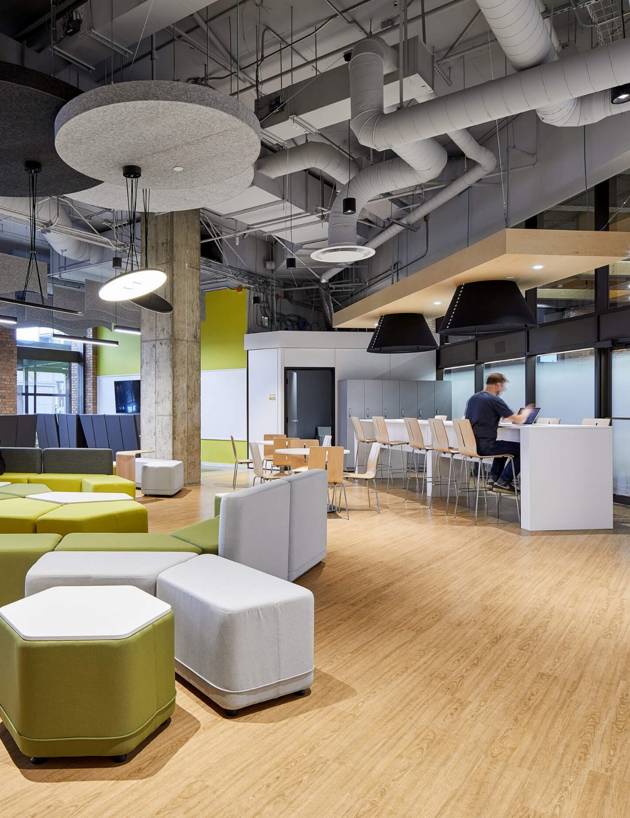
Thank you!
14

