Slide 1
Public Safety Canada Departmental Showcase August 8, 2023 Sécurité publique Canada Vitrine ministérielle Le 8 août 2023

Slide 2
What do you know about Public Safety?
www.slido.com
code: #2502932

Slide 3
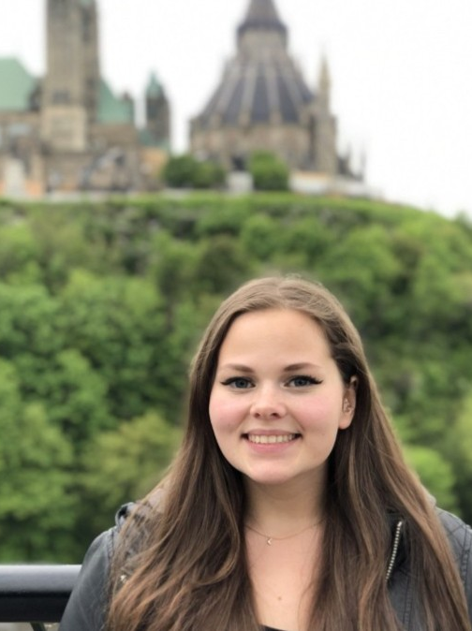
Moderator: Elena Martynova
Elena joined Public Safety Canada in May 2022 and is currently an A/Senior Policy Analyst in the Intelligence Policy Division, National Security Policy Directorate.
Elle est également coresponsable du pilier Communauté et appartenance dans le cadre du réseau des jeunes professionnels de la sécurité publique.

Slide 4
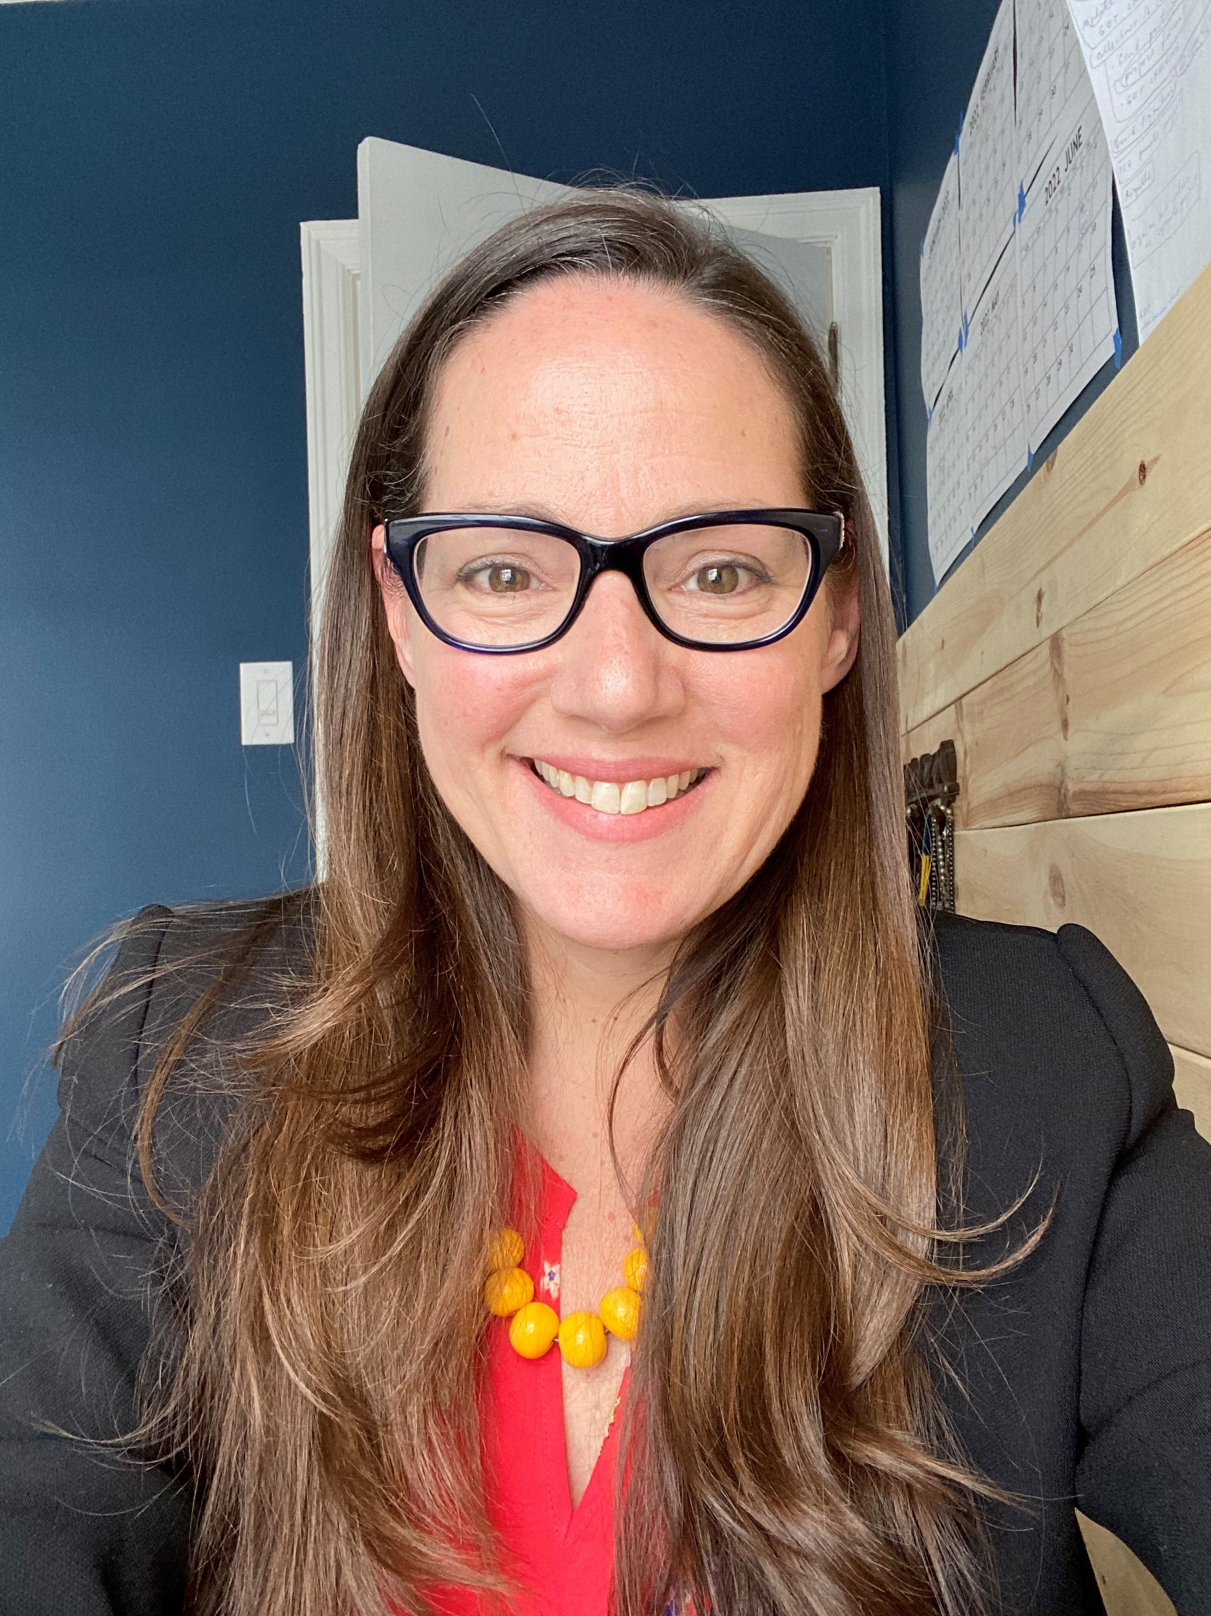
Our Panelists / Nos panélistes
Chris Moran
Justine Zebrowski
Faelan Quinn

Slide 5
Chris Moran (she/her)
Chris joined Public Safety Canada in December 2021 as the Assistant Deputy Minister of the Indigenous Affairs Branch.
En plus de son travail quotidien, elle est également notre championne de l'engagement ministériel.

Slide 6
What we are all about at Public Safety!
Mandate
Keep Canadians safe from a range of risks such as natural disasters, crime and terrorism.
Inception
The Department and Public Safety Portfolio were created in 2003.
It’s our 20th anniversary!
Programs
We provide leadership and file coordination on highly visible and key areas including in National Security, Emergency Management, Law Enforcement, Corrections, Crime Prevention, Border Management and Interoperability

Slide 7
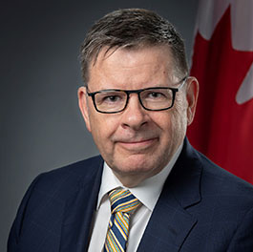
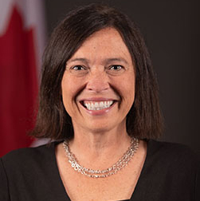
Organizational Structure
Deputy Minister
Shawn Tupper
Associate Deputy Minister
Tricia Geddes
Branches
Directorates
Corporate Management Branch
Department Legal Services Unit
Crime Prevention Branch
Internal Audit and Evaluation Directorate
Emergency Management and Programs Branch
Indigenous Affairs Branch
National and Cyber Security Branch
Portfolio Affairs and Communications Branch

Slide 8
Public Safety Portfolio
Public Safety Partner Agencies
Canada Border Services Agency (CBSA)
Royal Canadian Mounted Police (RCMP)
Parole Board of Canada (PBC)
Correctional Service of Canada (CSC)
Canadian Security Intelligence Service (CSIS)
Public Safety Review bodies
RCMP External Review Committee (ERC)
Civilian Review and Complaints Commission for the Royal Canadian Mounted Police (CRCC)
Office of the Correctional Investigator (OCI)

Slide 9
What makes Public Safety Great?
« Exposition à diverses questions clés et aux partenaires du portefeuille. »
« Les gens, la culture et la variété des dossiers. »
“The opportunity to contribute to the safety of Canadians…and actually see the change!”
“Senior Management really cares about the work and it’s people.”

Slide 10
Justine Zebrowski (she/her)
Justine joined Public Safety Canada in 2020 and is currently a Program Advisor in the Critical Infrastructure Directorate under the National and Cyber Security Branch.
En plus de son travail quotidien, Justine est également coresponsable de l'initiative Espace positif pour la sécurité publique.

Slide 11
Critical Infrastructure Directorate (CID)
Directorate
Division
Section
CI Policy
CI Cyber
Partnerships
CI
Partnerships
CI PARTNERSHIPS
CI POLICY & ANALYSIS
RRAP
CI
Exercises
VRAC
CID

Slide 12
Secteurs d'infrastructures critiques
Énergie et
Services publics
Finance
Alimentation
Gouvernement
Santé
Technologies de
l’information
et de la communication
Sécurité
Transports
Secteur
manufacturier
Eau

Slide 13
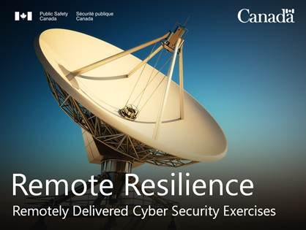
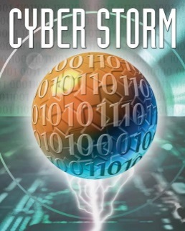
Cyber Exercises

Slide 14
National Critical Infrastructure
Cyber-Physical Exercise Program

Slide 15
Faelan Quinn (they/them)
Faelan joined Public Safety Canada in May 2018 and is currently an Administrative Assistant in the Assistant Deputy Minister’s Office in the Portfolio Affairs and Communications Branch.
En plus de leur travail quotidien, Faelan est également coresponsable de l'initiative Espace positif pour la sécurité publique.

Slide 16
Thank you! Merci!
Questions?
Contact
Public Safety Young Professionals’ Network /
Réseau des jeunes professionnels de la sécurité publique
ps.youngprofessionalnetwork-reseaudejeunesprofessionnels.sp@ps-sp.gc.ca

