Slide 1
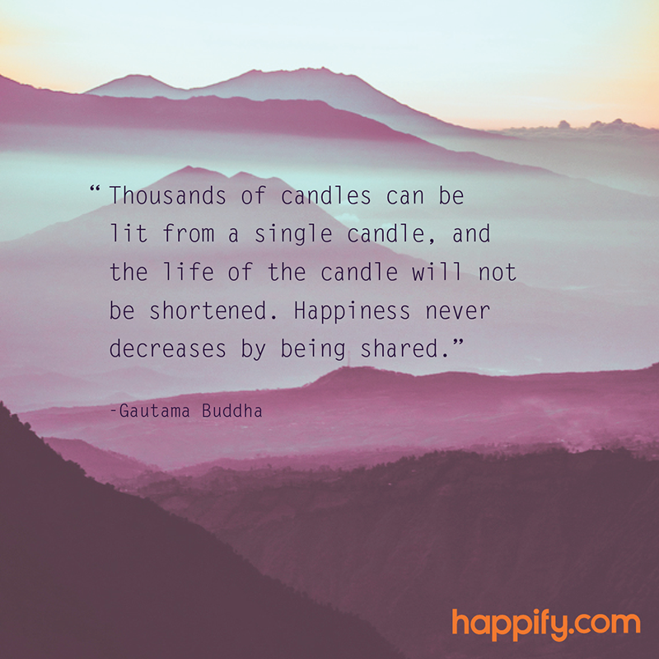
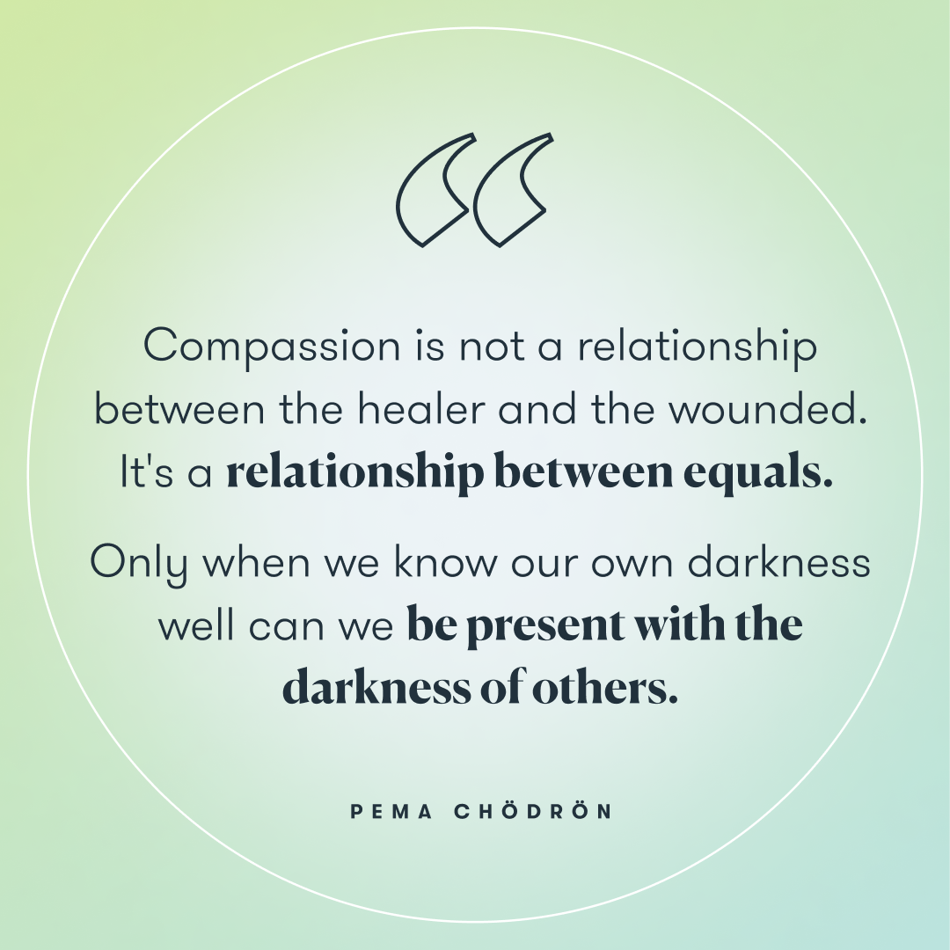
Today we will do a Mindfulness Water drinking exercise, please go grab a small glass of water
Notes:
(Friendly reminder: prep for sharing audio & video, including English CC and 100% font size)
Choose from these three videos:
3 min - L’autocompassion - https://www.youtube.com/watch?v=ErzUlNhtz5Q
3 min - Qu’est-ce que la compassion envers soi-même? - https://www.youtube.com/watch?v=skw9M-mC9v4
3 mins - Kristin Neff’s What is Self-Compassion - Part 1: https://www.youtube.com/watch?v=Tyl6YXp1Y6M (soutitres en français)
5 mins - Une pause d’autocompassion - https://vimeo.com/470384287
8 mins - La pause d'auto-compassion : https://www.youtube.com/watch?v=Fevw8ahkeeU
2 mins - How to Practice Mindful Emailing: https://www.youtube.com/watch?v=qBBy5Jx_xrQ - soutitres en français
3 mins - Updated the Monkey and Panda story: https://www.youtube.com/watch?v=5nsySCMH36s - soutitres en français
5 mins - Apprendre à être bienveillant envers soi même - https://www.youtube.com/watch?v=RKZ7MGQQXXI

Slide 2
Mindful Change Leadership Development Program
Week 4 (of 8)
May 29, 2023
Notes:
J’aimerais vous rappeler que vous pouvez utiliser la langue de votre choix pour exprimer vos commentaires ou vos questions au courant de la session.
By now, you know you can use the language of your choice to express your comments or questions

Slide 3
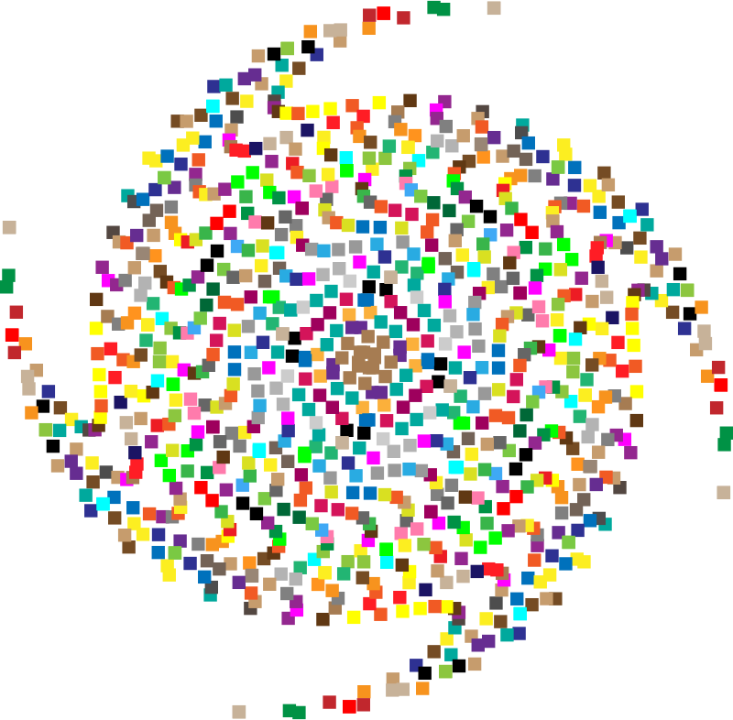
Mindful Breathing Exercise – Centering
Notes:
Let's start by doing a mindfulness breathing exercise.
Sit as comfortably as possible in a position that allows you to be awake, attentive or attentive and at ease at the same time.
You can put your feet flat on the floor; and rest your hands on your knees, palms up or down, whichever is more comfortable for you.
Feel free to close your eyes or close them halfway.
Follow my voice, which will guide you during the exercise.
Gently pay attention to your breathing. No need to change the way you breathe; just notice your breathing.
Don't worry about time.
Just pay attention:
On inspiration
At expiration
If at any point your mind wanders, be kind to your reason, acknowledge that thought, let it go, and bring your attention back to the object of your attention, which is your breath. .
Inspiration
Expiry
Now we are going to take a full minute of self-awareness breathing.
I'll have you sign when the moment has passed.
Just keep focusing on your breathing.

Slide 4
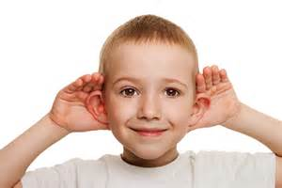
Debrief from last week (3)
Any Insights you’d like to share
Your Buddy Sytem
Your practice
Debrief
anyone need re-pairing?
Notes:
Please raise your hand to speak, or type in the chat… let’s have about 3 people sharing any insights you experienced or noticed from last week’s practice
Including
the gratitude journaling.
the Mindfulness Breathing or Body Scan,
The Mindful Listening
The mindful decision making/taking
I wish you happiness
(clic)
And ayone who may need re-pairing, either because you haven’t been able to agree on when to meet, or someone abandonned the program?
Just consider, you have the list of people involved, email them if you see need. And don’t need to cc us in the discussion except to confirm the change, so we can update the Buddy System file.

Slide 5
Agenda – week 4
Centering breathing exercise
Debrief from last week 3
Today’s intentions: Compassion & Clarity
Mindfulness – Water drinking
Mindful Cleaning Your Environment
Mindful Self-Compassion
Self-Compassion theory
A definition
The five myths of Self-Compassion
Your take away assignment
Notes:
Carmen

Slide 6
Mindfulness – Water drinking
With your back straight, sit as comfortable as possible
Gently bring attention to your breath
Let’s take a moment to think about the origins of this water
As you continue breathing...
Think about the time it took for this water to come to you...
Notes:
(while guiding this exercise, take the time needed, go slow, pause… we should take good 5 minutes to do this)
With your water glass in your hand think about the origins of water continue your breathing and focus or the water
Think about the journey the water made to come to you, about its source, and its cycle, it evaporates, turns into a cloud, it rains, it’s captured in lakes and rivers, it is then taken and brought home, it may go through a treatment plant, and arrive with us either via the tap water or bought in a plastic bottle for us to drink
And now, appreciating how lucky we are, to have clean water to drink at will, take a sip, take the extra time to savor it, feel its temperature, feel how it hydrates your, and enjoy absorbing it
And when you’re ready, I invite you to open your eyes and come back

Slide 7
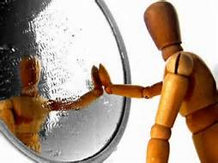
Self-compassion – a definition
Self-compassion is extending compassion to one's self in instances of perceived inadequacy, failure, or general suffering.
Dr. Kristin Neff has defined self-compassion as being composed of three main components - self-kindness, common humanity, and mindfulness.
Self-kindness: being kind and warm to oneself;
Common humanity: understanding that suffering and personal failure is part of the shared human experience; and
Mindfulness: being mindful of your negative thoughts and emotions to be observed with openness, so that they are held in mindful awareness, with no judgment.
Kristin Neff’s https://www.youtube.com/watch?v=Tyl6YXp1Y6M
Notes:
(read the 2 main bullets)
The “happily ever after” I believed when I was a kid does not really exists, we all need to face challenges daily and personal failure is part of the human existence. We all are complex human being, and we face challenges day and night, human experience is hard and by definition we fail. How do we take that failure?
(read the second bullet’s subbullets)
Here, Kristin Neff’s video on Self-Compassion - Part 1: https://www.youtube.com/watch?v=Tyl6YXp1Y6M (soutitres en français)
Ressources en anglais :
From WikiPedia https://en.wikipedia.org/wiki/Self-compassion
Kristin Neff’s What is Self-Compassion - Part 1: https://www.youtube.com/watch?v=Tyl6YXp1Y6M (soutitres en français)
I can’t give what I don’t have… book: https://www.amazon.ca/Cant-Give-What-Dont-Have-ebook/dp/B07CYC32WT
Ressources :
compassion - https://fr.wikipedia.org/wiki/Compassion
suffering - https://fr.wikipedia.org/wiki/Souffrance
Kristin Neff - https://fr.wikipedia.org/wiki/Kristin_Neff
Mindfulness - https://fr.wikipedia.org/wiki/Pleine_conscience

Slide 8
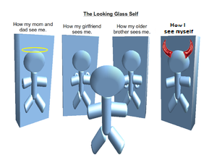
The Five Myths of Self-Compassion (1/2)
Most people don’t have any problem with seeing compassion as a thoroughly commendable quality.
It refer to the following good qualities: kindness, mercy, tenderness, benevolence, understanding, empathy, sympathy, and fellow-feeling, along with an impulse to help other living creatures, human or animal, in distress.
But for many, self-compassion carries the whiff of all those other bad “self” terms: self-pity, self-serving, self-indulgent, self-centered, just plain selfish. Even many generations still seem to believe that if we aren’t blaming and punishing ourselves for something, we risk moral complacency, runaway egotism, and the sin of false pride.
The Five Myths of Self-Compassion – article, addresses these legends:
Self-compassion is a form of self-pity
Self-compassion means weakness
Self-compassion will make me complacent
Self-compassion is narcissistic
Self-compassion is selfish
Greater Good Science Center - Kristin Neff’s article: http://greatergood.berkeley.edu/article/item/the_five_myths_of_self_compassion
Notes:
According to Dr. Kristin Neff there are 5 myths of self compassion
People do not see any problem seeing compassion as a thoroughly commendable quality particularly unto others.
Compassion refers to good qualities, like kindness, understanding, empathy, with an impulse to help
However, self-compassion may be seen as bad, like self-pity, or selfish… even to the point that if we aren’t blaming and punishing ourselves for something, we risk moral complacency, and the sin of false pride.
These are the five myths of self-compassion
(read the 5 myths of self-compassion)
Ressources en anglais :
The Five Myths of Self-Compassion - http://greatergood.berkeley.edu/article/item/the_five_myths_of_self_compassion
Ressources :
Article de Kristin Neff* « La physiologie de l'auto-compassion » - https://meditation-pleine-conscience-la-rochelle.fr/content/article-de-kristin-neff-%C2%AB%C2%A0la-physiologie-de-lauto-compassion%C2%A0%C2%BB

Slide 9
The Five Myths of Self-Compassion (2/2)
Or how I see myself
Greater Good Science Center - Kristin Neff’s article: http://greatergood.berkeley.edu/article/item/the_five_myths_of_self_compassion
Notes:
What I’m about to say may resonate, or maybe different for each one of us, the point is about perspectives on how we are seen
In this example:
(click)
How my mom and dad see me – specially when young, as an angel, extremely good kid
(click)
How my girlfriend/wife sees me – particularly during the “honey moon phase”, as strong, brilliant, cute, funny, smart
(click)
How my older brother sees me – typically my older brother used to see me as weak
(click)
How I see myself – usually I’m the hardest person to judge my own self, maybe because from my perspective I see outside usually seeing others… if this is also your case, it is time fix that and start seeing ourselves for who we really are

Slide 10
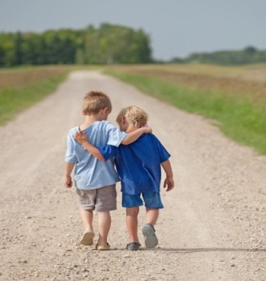
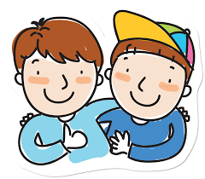
Mindful – self-compassion
If you want to hear it from Kristin Neff: Self-compassion Break: https://self-compassion.org/wp-content/uploads/2020/08/self-compassion.break__01-cleanedbydan.mp3 Time required – 5 minutes
Notes:
(Choose one of these)
Kristin Neff’s recording on Self-compassion break, 5 mins: https://self-compassion.org/wp-content/uploads/2020/08/self-compassion.break__01-cleanedbydan.mp3 OR
Or, you can guide participants through a self-compassion exercise, as follows…
I’ll guide us doing a similar loving-kindness meditation
First, think of something that hooked you, something that bugs you and keeps repeating in yourself, in your mind, ideally try this with something light…
Remember, We all are in the same boat (pausing between phrases, do 2 in the personal form “I”, then 2 in the plural form “we”)
My I (we all) be safe
May I (we all) be peaceful
May I (we) be kind to myself (ourselves)
May I accept myself as I am (may we accept ourselves as we are)
Ressuorces en anglais :
From: https://centerformsc.org/practice-msc/guided-meditations-and-exercises/
Self-compassion break, 5 mins: https://self-compassion.org/wp-content/uploads/2020/08/self-compassion.break__01-cleanedbydan.mp3
Self-compassion, 20 minutes - http://self-compassion.org/wp-content/uploads/meditations/LKM.self-compassion.MP3
Ressources en français :
5 mins - Une pause d’autocompassion - https://vimeo.com/470384287
8 mins - La pause d'auto-compassion : https://www.youtube.com/watch?v=Fevw8ahkeeU
Méditation guidée: votre moment d’auto-compassion (17 mins) - https://www.youtube.com/watch?v=nQSAcY-7Xic

Slide 11
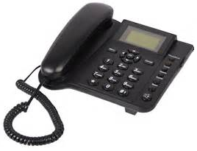
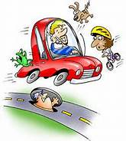
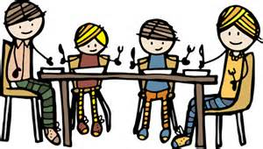
Mindful Cleaning Your Environment
Take on the mini-challenge to be mindful around the distractions
Day 17/21 days challenge - KindSpring - Make A Mindful Phone Call
Practice Digital Mindfulness
How to Practice Mindful Emailing and How to Manage Emails Mindfully
Check the story of the Monkey and the Panda, use it as for inspiration: https://www.youtube.com/watch?v=5nsySCMH36s
Notes:
Now I would like to switch topics to cleaning our environments
(click)
When taking calls phone calls - get rid of distractions when speaking to people, also when using MSTeams, try smiling when you are on camera it makes a difference. make a phone call today with a determination to stay as mindful and present as you can through all of it. Maybe this means you resist the temptation of the so called “multitasking” while you’re talking. Maybe it means you take a few moments to genuinely inquire about the other person’s day. And if it’s a particularly challenging phone call, maybe you practice holding back your sharp retorts, and try to respond with empathy while still being true to yourself.
(click)
Practicing digital mindfulness – some of the articles state that you should get rid of your screens one to two hours before going to bed, and even a few minutes before going to bed is a good idea to help with mindfulness sleep. Sometimes I am guilty of this to be on my screen while in bed. Who can relate to this? Also be mindful of the notifications, now I unsubscribed from those automatic notifications that don’t add value to my life.
(click)
Be mindful about emailing – when I was working in an IT shop where I emailed that I would take away the rights to a certain site. I practice having a colleague review the email before sending. I keep it in draft for a day or two if I can to make sure that I am being mindful towards the recipients. Here a video on « How to Practice Mindful Emailing » - https://www.youtube.com/watch?v=qBBy5Jx_xrQ - soutitres en français
(click)
When eating, turn off the TV, don’t read, and take the time to be present.
(click)
While driving be mindful of the present moment, avoid distractions
Let’s look at the following video « The Monkey and Panda story » with hopes that it will inspire us - https://www.youtube.com/watch?v=5nsySCMH36s - soutitres en français
Resources en anglais :
Phone call: https://gcconnex.gc.ca/blog/view/14813318/day-1721-days-challenge-kindspring-make-a-mindful-phone-call
Digital Mindfulness: https://learn.rumie.org/jR/bytes/practice-digital-mindfulness-for-wellbeing How to Manage Emails Mindfully: https://www.mindspacewellbeing.com/fr/communiquer-en-pleine-conscience/
Ressources en français :
La pleine conscience numérique, étape ultime de la transformation - https://www.sysk.fr/2018/11/13/pleine-conscience-numerique-transformation/
Plus de conscience dans nos emails ? - https://positiveleadership.fr/plus-de-conscience-dans-nos-emails

Slide 12
Reflect about the 3 exercises
Notes:
Well, now I would like to give the floor to 2 or 3 people who would like to make referrals to the plenary. If you're first, just open your mic and speak, if you're second or third, please raise your hand.
((prepare for chat rooms)
And now, you will have the opportunity to hold a reception, in small groups of 4 to 6 people who will be assigned at random. Just be aware and share the time available among you
Debriefing on water driving exercise, self-compassion, mindful cleaning of your environment (multimedia and others)
Talk about how the experience went for you.
What did you learn ?
What did you notice?
What was difficult or excessively easy?
(opens chat rooms)
Once complete, you can simply exit the WebEx
I wish you happiness! / Je te souhaite du bonheur!

Slide 13
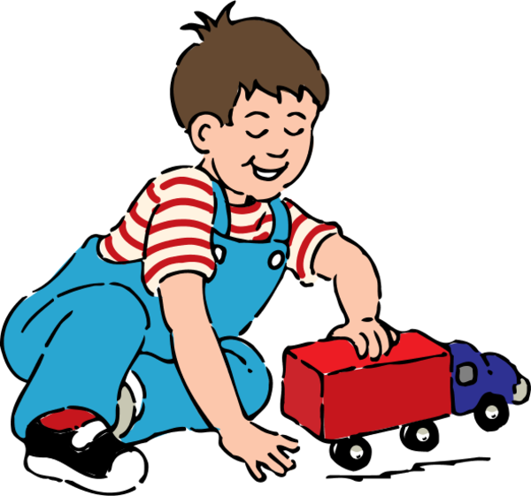
Your take away practice for week 4
Connecting – once a week with you buddy
Gratitude Journaling – daily
Practice up to 15 mins… chose one of the following and keep doing it for the whole week - daily
Body scan or Breathing 15 mins – https://www.rightlifeproject.com/meditate (may need to scroll down) 15 mins – https://soundcloud.com/dharma-gus/15-min-body-scan-augusta-mbsr
Self-compassion 10 mins – https://soundcloud.com/breathworks-mindfulness/mindfulness-for-women-track-5-self-compassion-meditation 10 mins – https://soundcloud.com/user-640851605/self-compassion-giving-and-receiving-meditation-10-minutes 15 mins – https://soundcloud.com/mindfullivingcoach/self-compassion-meditation 15 mins – https://soundcloud.com/awakeningcompassion/awakening-compassion-class-4 20 mins – http://self-compassion.org/wp-content/uploads/meditations/LKM.self-compassion.MP3
Apply Mindful Cleaning Your Environment – as possible
Notes:
(read/paraphase from the slide)
Try to practice for longer period of time every day if possible, if you feel comfortable or challenged enough – if you feel that’s not possible, try to practice as much as you can, it is always better to practice say 2 minutes every day than nothing at all. It is also better to practice 2 mintues mindfulness exercises throughout the day. As you can tell, here the idea is to practice.
Resources in English:
- Body scan or Breathing 15 mins – https://www.rightlifeproject.com/meditate (may need to scroll down) 15 mins – https://soundcloud.com/dharma-gus/15-min-body-scan-augusta-mbsr
- Self-compassion 10 mins – https://soundcloud.com/breathworks-mindfulness/mindfulness-for-women-track-5-self-compassion-meditation 10 mins – https://soundcloud.com/user-640851605/self-compassion-giving-and-receiving-meditation-10-minutes 15 mins – https://soundcloud.com/mindfullivingcoach/self-compassion-meditation 15 mins – https://soundcloud.com/awakeningcompassion/awakening-compassion-class-4 20 mins – http://self-compassion.org/wp-content/uploads/meditations/LKM.self-compassion.MP3
Ressources en français :
Scan corporel ou respiration 10 min – Pleine Conscience Débutant : https://www.youtube.com/watch?v=PLyuSZhyBV4 10 min – Pleine conscience pour débutants 🎧🎙 Cédric Michel : https://www.youtube.com/watch?v=PTsk8VHCZjM 20 min – (1) Méditation Guidée Pleine Conscience (Scan Corporel) : https://www.youtube.com/watch?v=UnK47wWTVZk 20 min – (1) Méditation bodyscan : https://www.youtube.com/watch?v=gN5_D4xeo9c
Autocompassion 5 min – Une pause d’autocompassion : https://vimeo.com/470384287 8 min – La pause d’autocompassion : https://www.youtube.com/watch?v=Fevw8ahkeeU 10 min – Viens méditer avec Mon équilibre UL | Carmen Pedneault – Autocompassion: https://www.youtube.com/watch?v=DQQniKP5GHI 15 min – Pratique d’autocompassion : https://vimeo.com/466742570 17 min – Méditation guidée : votre moment d’autocompassion : https://www.youtube.com/watch?v=nQSAcY-7Xic 18 min – Pleine Conscience pour Bien Démarrer la Journée ☀️ : https://www.youtube.com/watch?v=spFKZfWn07k 20 min – Pleine Conscience Paix Intérieure : https://www.youtube.com/watch?v=aH7Yfzf8-kk 30 min – Développer l’autocompassion : https://www.youtube.com/watch?v=umZpaiLuqCM

Slide 14
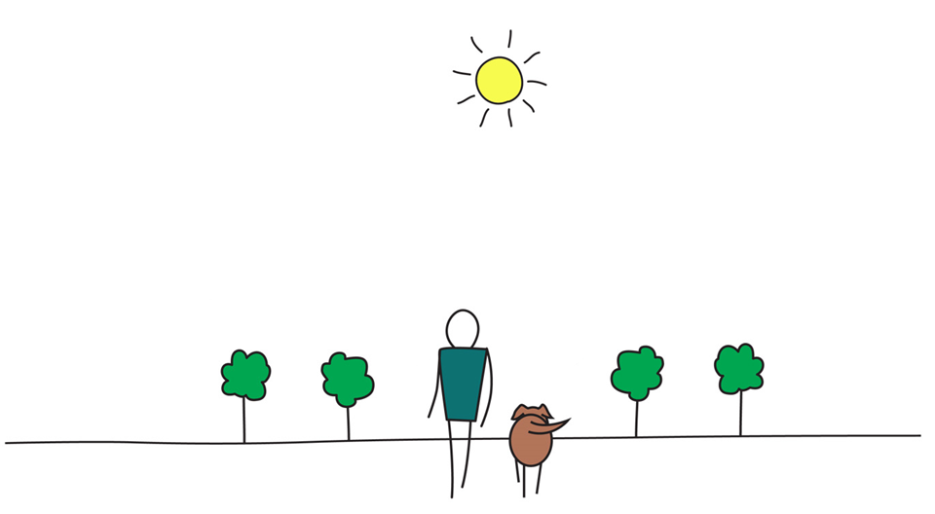
Be Mindful, Be Happy /
Prenez conscience, soyez heureux

