Slide 1
Advancing Enterprise Solutions
Presentation to DM CEPP [date]
For Discussion

Slide 2
What is enterprise?
Enterprise is generally defined as “an organization” or “organizational unit”
In the GC, ‘enterprise’ refers to a whole-of-government holistic approach.
An enterprise approach can be applied various facets, like governance, solutions, standards and culture
GOVERNANCE
CULTURE
SOLUTIONS

Slide 3
How is enterprise addressed in the GC?*
CIO of Canada
Providing direction on the enterprise-wide transition to digital government
Approving an annual, forward-looking three-year enterprise-wide plan that establishes the strategic direction for the integrated management of service, information, data, IT, and cyber security (i.e., Digital Operations Strategic Plan)
Setting direction and expectations in
enterprise architecture
technology, and
information and data standards for quality, accessibility, and data interoperability
Deputy Heads:
Approving an annual forward-looking three-year departmental plan [aligned] with the CIO of Canada’s enterprise-wide integrated plan….
Using enterprise or shared IT solutions, assets, and services to avoid duplication, when available and appropriate
Departmental CIOs:
Adopting, as applicable, enterprise solutions within their respective department.
Participating, as a service provider or as a service client, in the conception, planning, evolution and oversight of enterprise-wide IT services and solutions.
* TB Policy on Service and Digital ; TB Directive on Service and Digital
Notes:
SOURCE: TB Policy and Directive on Service and Digital
TB Secretary responsible for:
4.1.1.1.1 Strategic direction for the management of external and internal enterprise services, information, data, information technology (IT) and cyber security;
CIO of Canada responsible for:
4.1.2.2 Providing direction on the enterprise-wide transition to digital government …
4.1.2.3 Prescribing expectations with regard to enterprise architecture.
4.1.2.4 Establishing and chairing an enterprise architecture review board that is mandated to define current and target architecture standards for the Government of Canada and review departmental proposals for alignment.
4.1.2.5 Establishing priorities for IT investments (including cyber security investments) that are enterprise-wide in nature or that require the support of Shared Services Canada (SSC)
4.1.2.7 Approving an annual, forward-looking three-year enterprise-wide plan that establishes the strategic direction for the integrated management of service, information, data, IT, and cyber security …
4.3.1.1 Prescribing enterprise-wide information and data standards for quality, accessibility, and data interoperability, including common architecture taxonomies and classifications, quality requirements, and life cycle management direction.
4.4.1 [setting] Enterprise direction in technology
use of specific IT business processes, technologies, applications and IT resource management approaches, including direction for their life cycle management as defined in the Policy on Management of Materiel
enterprise-wide advice for IT solution procurement that maximizes flexibility for the Government of Canada
direction and defining enterprise-wide requirements for Information and Communication Technologies (ICT) accessibility
advice to the President of the Treasury Board to support the Treasury Board’s review of the SSC Investment Plan to ensure that the plan is aligned with established strategic direction and enterprise-wide priorities and to assess progress
4.4.1.10 Providing direction and defining enterprise-wide requirements for the management of identities, credentials, and access for the Government of Canada and departments
4.5.1.1 Providing enterprise-wide leadership on the development and sustainability of the information and IT functional community by using talent management and community development strategies.
4.5.1.2 Providing enterprise-wide leadership on knowledge standards for the information and IT community, including determining the acceptable combination of education, training and experience required for the Treasury Board Executive Group (EX) Qualification Standard
Deputy Heads responsible for:
4.1.3.6 Ensuring departmental participation in enterprise governance to support the development and implementation of enterprise-wide policy instruments and architecture
4.1.3.7 Approving an annual forward-looking three-year departmental plan for the integrated management of service, information, data, IT, and cyber security, which aligns with the CIO of Canada’s enterprise-wide integrated plan
4.4.2.3 Using enterprise or shared IT solutions, assets, and services to avoid duplication, when available and appropriate
4.5.2.1 Ensuring departmental workforce awareness, capacity, and capability to meet departmental and enterprise service, information, data, IT, and cyber security requirements
4.5.2.2 Supporting the CIO of Canada’s enterprise-wide talent management and community development initiatives
PSPC is responsible for:
5.3.2 Providing common enterprise solutions and services related to the following: electronic document records management systems, case and workflow tracking solutions, and collaboration platforms.

Slide 4
Why focus on enterprise solutions?
To “operate as one” and advance the CEPP mandate we propose to focus on enterprise solutions linked to business capabilities
Enterprise solutions are internal and external Government of Canada assets that can be re-used in and across multiple parts of the organization.
Business capabilities are an expression of what a business does and can do.
Business processes support business capabilities and express how the capability is delivered.

Slide 5
Enterprise Back-Office Applications*
PSPC
TBS
PSC
GCDOCS
Shared Case Management
BuyandSell.ca
Termium
eProcurement Solution
National Service Call Centre
WebEx
Shared Travel Services
Phoenix
myGCHR
Compensation Web Apps
Financial management transformation
GCTools
Project & portfolio management (IT Plan, APM, IT expenditures, Project Oversight, Business Services)
Callipers
Executive Talent Management System
Public Service Performance Management
TBS Application Portal
GC Interoperability Platform
Enterprise Grants & Contributions System
Wellness Productivity System
Identity Credential and Access Management System
Credential Broker Services
Internal Credential Management
Open Government Portal
Access to Information Portal
Talent Cloud
Jobs.gc.ca
ESDC
Canada.ca
SSC
Email
GCSRA
GCSI
GEDS
GCKey
CSPS
Integrated Learning Management System / Gccampus
* Non-exhaustive list - http://www.gcpedia.gc.ca/wiki/List_of_Enterprise_Applications

Slide 6
What is needed for Enterprise Solutions to work in the GC?
What are the roles and responsibilities and who decides who fills them?
What is the financial and funding model for an enterprise solution?
Which business capabilities should be addressed first?
How will user expectations be addressed?
What is the path to enterprise-wide adoption?
GOVERNANCE
Is everyone ready to buy-in to enterprise solutions?
How do we ensure participation?
How will open and transparent input be gathered?
What are the mind-set and skills needed to foster an enterprise solution culture?
CULTURE
SOLUTIONS
Which business problem are we solving?
Who can access the Enterprise Solution?
What data and technology standards are required?
Is the implementation secure enough?
Will it always be reliably online?
Notes:
In order for ES to successful, there are many factors that need to be included in the solution.
Connectivity: Technology underpinnings that make it easy to consume
Clarity: Documented qualities that describe the solution
Community: Involvement and participation for those who need / want to.

Slide 7
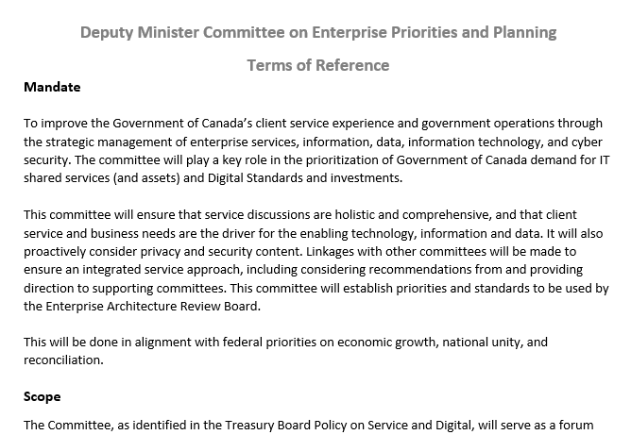
Who decides what becomes an enterprise solution?
DM CEPP has the mandate to establish and govern the direction and priorities for modern GC enterprise solutions
DM CEPP will:
Establish priorities and standards to be used by the Enterprise Architecture Review Board
Review and endorse prioritization of core systems for modernization
Establish priorities for IT shared services and assets, and enterprise-wide IT investments and procurements

Slide 8
How can enterprise solutions be used?
Different models are appropriate for different situations:
Star | Ownership: Consistent Operation: Consistent User Experience: Consistent Capabilities: Consistent | Minimal / no value added having more than one choice Frees up your resources to focus only your business needs Successful when scope is very tight | Current GC Example: PSPM Real World Example: Windows patching
Franchise | Ownership: Varies Operation: Varies User Experience: Consistent Capabilities: Consistent | Repeatable, trusted processes Allows for local instances, but can harness the power of the collective Can be clustered for even greater efficiency | Current GC Example: MS Teams Real World Example: McDonald’s
Federated | Ownership: Varies Operation: Varies User Experience: Varies Capabilities: Consistent | Reusable, loosely coupled systems Share reusable artifacts for key functionality Allows for flexibility and autonomy in delivery | Current GC Example: GCDOCs Real World Example: Uber Eats

Slide 9
What are the benefits to this approach?
A more cohesive digital experience for clients, users and other stakeholders
Increased interoperability and collaboration between government services and programs
Reduced total cost of ownership for provision external and internal services
Ability to leverage modern skill sets across the Government of Canada
Operate as one, to better serve all
Notes:
SOURCE: TB Policy and Directive on Service and Digital
TB Secretary responsible for:
4.1.1.1.1 Strategic direction for the management of external and internal enterprise services, information, data, information technology (IT) and cyber security;
CIO of Canada responsible for:
4.1.2.2 Providing direction on the enterprise-wide transition to digital government …
4.1.2.3 Prescribing expectations with regard to enterprise architecture.
4.1.2.4 Establishing and chairing an enterprise architecture review board that is mandated to define current and target architecture standards for the Government of Canada and review departmental proposals for alignment.
4.1.2.5 Establishing priorities for IT investments (including cyber security investments) that are enterprise-wide in nature or that require the support of Shared Services Canada (SSC)
4.1.2.7 Approving an annual, forward-looking three-year enterprise-wide plan that establishes the strategic direction for the integrated management of service, information, data, IT, and cyber security …
4.3.1.1 Prescribing enterprise-wide information and data standards for quality, accessibility, and data interoperability, including common architecture taxonomies and classifications, quality requirements, and life cycle management direction.
4.4.1 [setting] Enterprise direction in technology
use of specific IT business processes, technologies, applications and IT resource management approaches, including direction for their life cycle management as defined in the Policy on Management of Materiel
enterprise-wide advice for IT solution procurement that maximizes flexibility for the Government of Canada
direction and defining enterprise-wide requirements for Information and Communication Technologies (ICT) accessibility
advice to the President of the Treasury Board to support the Treasury Board’s review of the SSC Investment Plan to ensure that the plan is aligned with established strategic direction and enterprise-wide priorities and to assess progress
4.4.1.10 Providing direction and defining enterprise-wide requirements for the management of identities, credentials, and access for the Government of Canada and departments
4.5.1.1 Providing enterprise-wide leadership on the development and sustainability of the information and IT functional community by using talent management and community development strategies.
4.5.1.2 Providing enterprise-wide leadership on knowledge standards for the information and IT community, including determining the acceptable combination of education, training and experience required for the Treasury Board Executive Group (EX) Qualification Standard
Deputy Heads responsible for:
4.1.3.6 Ensuring departmental participation in enterprise governance to support the development and implementation of enterprise-wide policy instruments and architecture
4.1.3.7 Approving an annual forward-looking three-year departmental plan for the integrated management of service, information, data, IT, and cyber security, which aligns with the CIO of Canada’s enterprise-wide integrated plan
4.4.2.3 Using enterprise or shared IT solutions, assets, and services to avoid duplication, when available and appropriate
4.5.2.1 Ensuring departmental workforce awareness, capacity, and capability to meet departmental and enterprise service, information, data, IT, and cyber security requirements
4.5.2.2 Supporting the CIO of Canada’s enterprise-wide talent management and community development initiatives
PSPC is responsible for:
5.3.2 Providing common enterprise solutions and services related to the following: electronic document records management systems, case and workflow tracking solutions, and collaboration platforms.

Slide 10
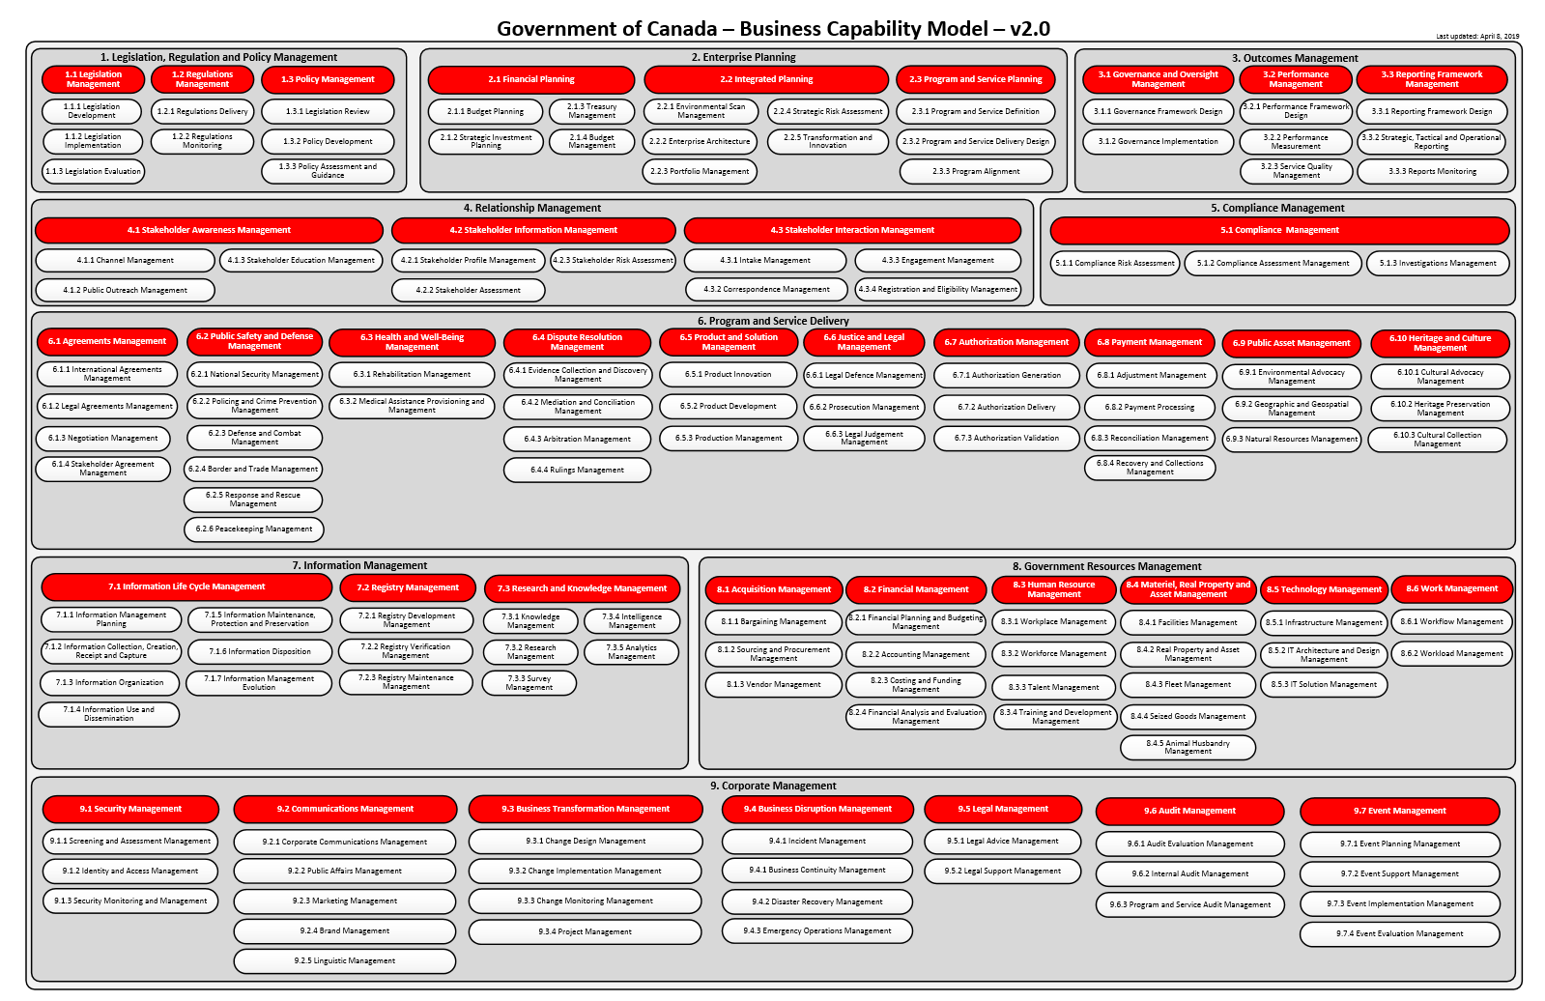
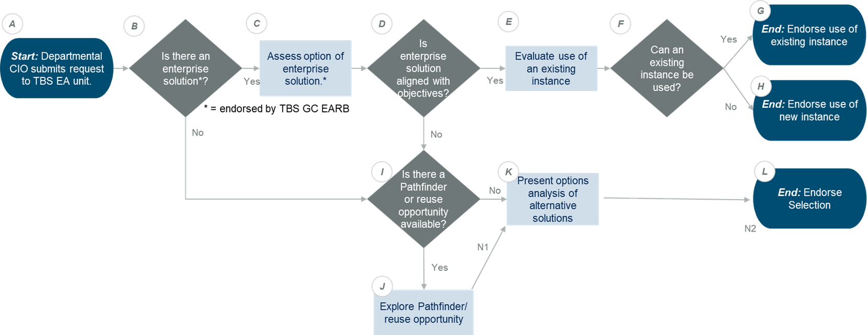
What do we have today?
GC Business Capability Model*
GC EARB Decision Framework**
* see Annex A
** see Annex B
Provides a structured view of what the enterprise does with multiple levels of granularity.
When more than one department have a need for a common business capability there is an opportunity for an Enterprise Solution.
Defines decision framework for alignment of solutions to enterprise direction and standards
Clarifies how and when to adopt an enterprise solution
Helps align investments in digital initiatives that address similar business capabilities

Slide 11
Opportunities
Business Capability: Audit Management (9.6)
Current status: Audit management software in use by ~1,000 users in over 35 large departments / organizations across the GC.
TBS Office of the Comptroller General’s (OCG) Internal Audit Sector has proposed a single GC enterprise solution using TeamMate+ (TM+) to improve cross-departmental audits functionality and data sharing
TBS OCG would fill the role of Business Owner.
An IT organization is required to fill the role of Service Provider (i.e., implement and operate the system)
If no action is taken: 35 separate instances of TM+ software will be implemented, increasing the size and risk of the GC’s application portfolio.
Business Capability: Training and Development Management (8.3.4)
CSPS has proposed a Digital Learning and Development Platform for GC employees.​
CSPS is the Business Owner.
There are 3 options:
Single shared solution​ (i.e., “star”)
Departmental “schools” on common shared solution ​ (i.e., “federated”)
Separate solutions for each department’s internal requirements -- increasing the size and risk of the GC’s application portfolio.

Slide 12
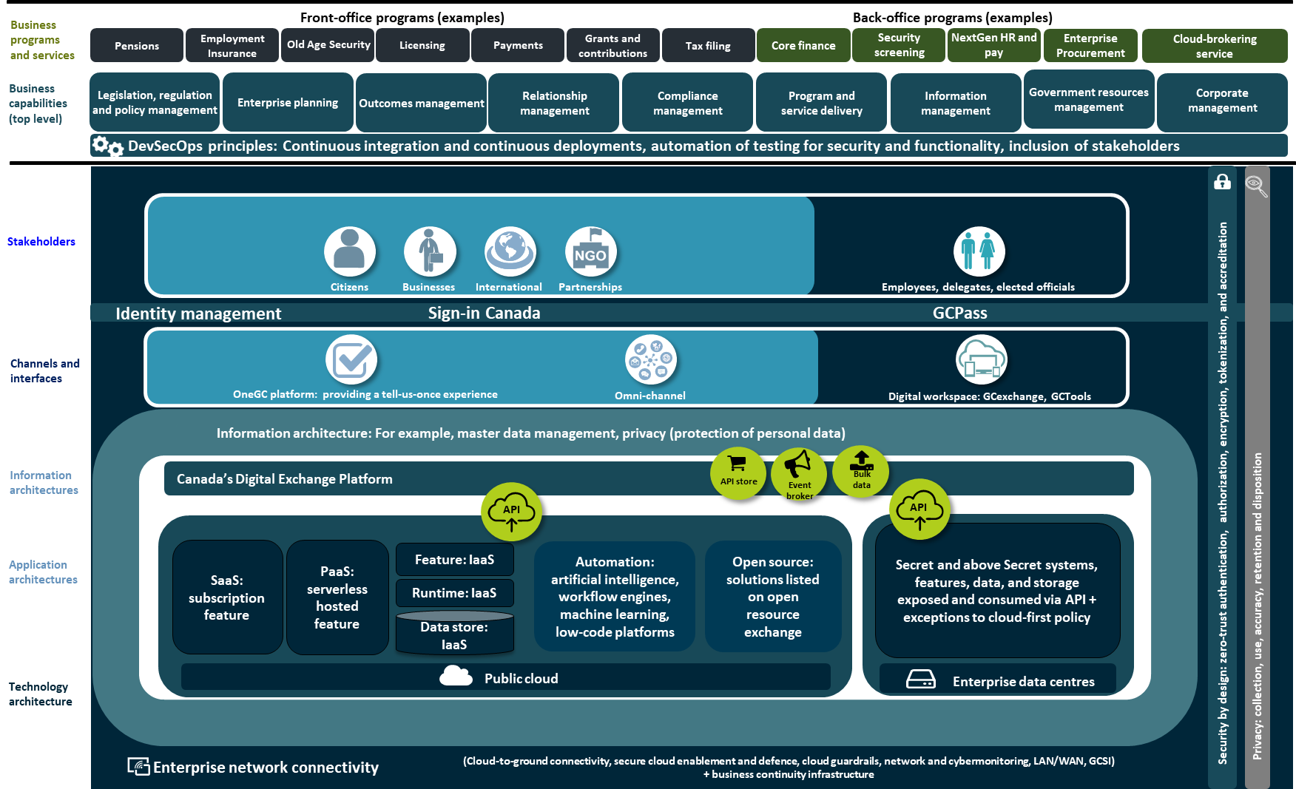
What does the future look like?
Defines a whole-of-government approach for the digital enablement of services
Aligned to business services and based on re-useable components linked to business capabilities
Focus on users and service delivery
Reduces the silos and unnecessary redundancy within the current GC ecosystem
GC Enterprise Architecture Target State

Slide 13
What do we do next?
Establish priority business capabilities with potential for high-value enterprise solutions (e.g., identity management, audit management)
Define business owner role and designate departments to lead discovery-phase for select enterprise solutions under oversight of DM CEPP and GC EARB.
Build a roadmap for DM CEPP enterprise solutions to establish prioritization of enterprise-wide IT investments and procurements

Slide 14
ANNEXES

Slide 15
Annex A: GC Business Capability Model v2.0
SOURCE: GCBCM_GCMCA_v2_VisualModel_20190617_EN.pdf (gcconnex.gc.ca)

Slide 16
Annex B: GC EARB Decision Making Framework

Slide 17
Annex C: GC Enterprise Architecture Target State
Notes:
Policy says….
Prescribing expectations with regard to enterprise architecture
[GC EARB] defines current and target architecture standards and review departmental proposals for alignment

