Slide 1
COVID-19 Communication in 11 Official Languages
August 17th, 2020

Slide 2
Regional Context – Northwest Territories
33 communities spread over 1.3 million kms
12 communities are fly-in only
Digital infrastructure: speed + cost vary
Literacy levels: 70% of indigenous adults are below IALSS level 3 (international functional literacy standard) in English

Slide 3
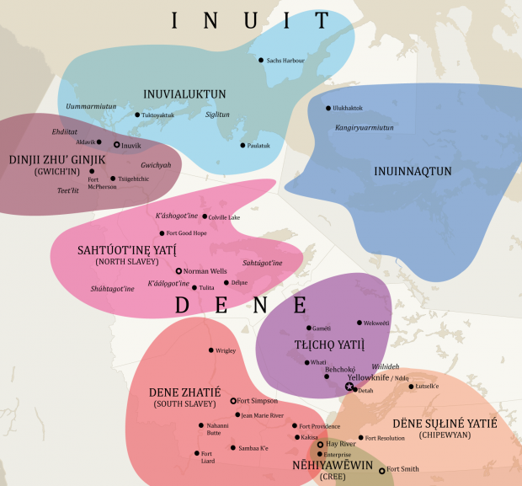
Languages
11 Official Languages
English
French
Chipewyan/Dené
Cree
Gwich’in
North Slavey
South Slavey
Tłįchǫ
Inuktitut
Inuinnaqtun
Inuvialuktun

Slide 4
Language challenges
Oral vs. Written/Read
Most who speak Indigenous languages cannot read/write them
Glyphs/Unicode Support
Our websites do not support Inuktitut/ Tłįchǫ Unicode fonts
Digital Literacy/Limitations
Elders/Communities have limited access to digital hardware/platforms
Translation Timing/Access
Access to translators is limited, turn around time varies

Slide 5
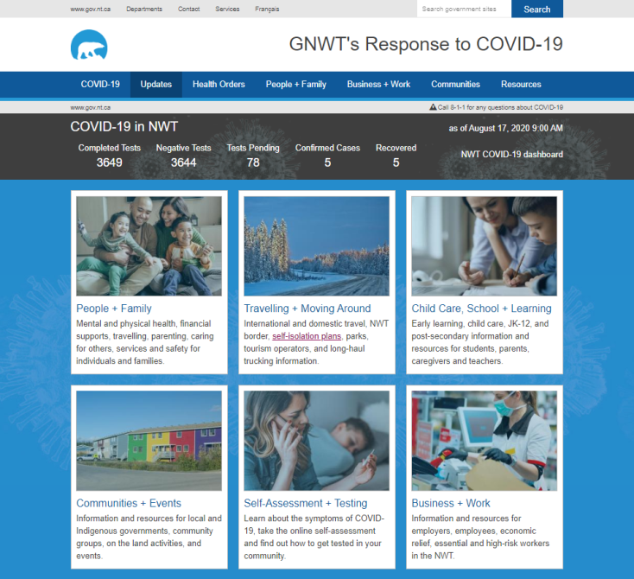
Distribution Channels
Leveraging existing structures
Government Services Officers (GSO’s)
Community Health Representatives (CHR’s)
Community + Indigenous Governments
Community Radio
Social Media
Print Media
Building new structures
COVID-19 Website
‘Community Kits’ (Google Drive)

Slide 6
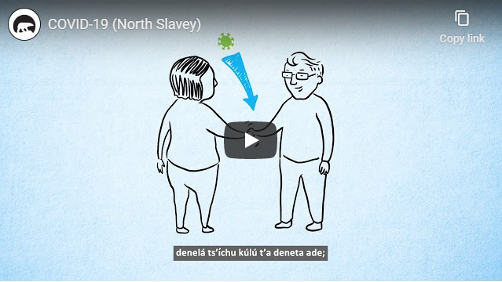
Traditional + New Media
Tactics
COVID-19 Website (Daily)
Radio Broadcasts (Daily/Weekly)
Audio Files (Download/Streaming)
Shareable PSA Videos (Social/Web)
CPHO/Premier Video Broadcasts (Social)
Fact Sheets (Download/Printable/Shareable)
Paid/Organic Social (Bi-weekly Ad Updates + Engaging Community)

Slide 7
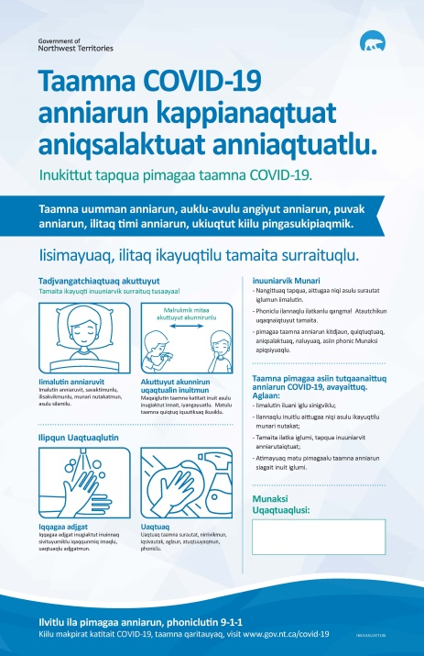
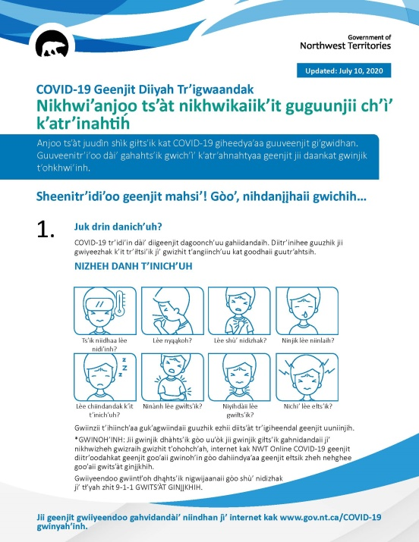
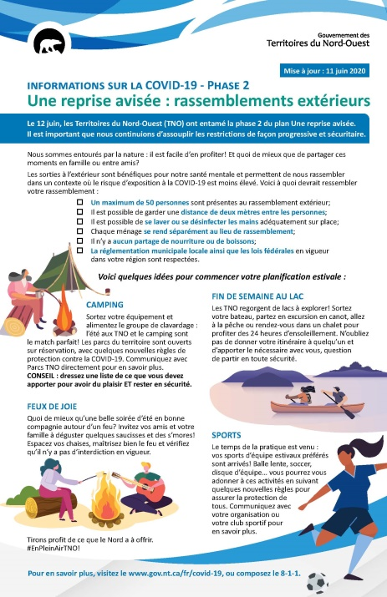
Traditional Media

Slide 8
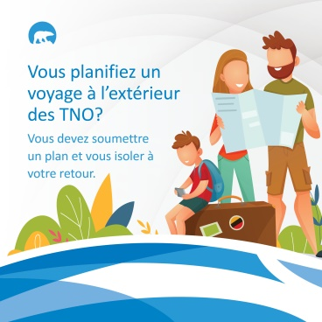
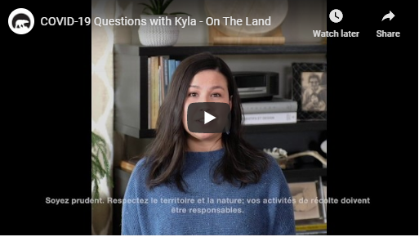
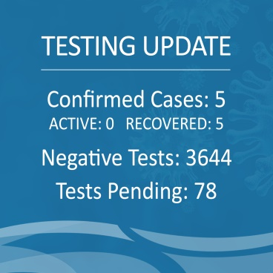
New Media

Slide 9
Lessons Learned
Understanding regional/local context to mitigate assumptions
Leveraging existing platforms and communication structures
Merging traditional and new media : reality of implementation
Active engagement on social platforms

