Slide 1
GCDigital Community in the Government of Canada
La communauté numérique au sein du gouvernement du Canada
GCDC 2023 Networking session
CDGC 2023 Session de réseautage
Welcome!
Bienvenue!
As people join, introduce yourself in chat:
Your organization?
Your role?
Favourite breakfast food?
What larger city is closest to your home?
Au fur et à mesure que des personnes se joignent à nous, présentez-vous dans le chat :
Votre organization?
Votre role?
Aliment préféré pour le déjeuner?
Quelle grande ville est la plus près de votre domicile?
QR
code
Access the English presentation on GCxchange
QR
code
Accéder à la présentation française sur GCéchange

Slide 2
Digital Community in the Government of Canada
Digital Talent & Leadership
Office of the Chief Information Officer of Canada
Treasury Board of Canada Secretariat
GC Data Conference 2023 – February 22 and 23, 2023

Slide 3
On the schedule:
9:30 – Welcome!
9:35 – What is the Digital Community?
9:40 – A sneak peek of the GC Digital Talent Strategy
9:45 – A sneak peek of the GC Digital Skills Strategy
9:50 – Let's get chatting
10:15 – Learn how to get involved and continue the conversation

Slide 4
What is the Digital Community?

Slide 5
Who we are: a leader for the digital community
Within the Office of the Chief Information Officer of Canada, the Digital Talent and Leadership Sector provides
direction, leadership, and guidance to the largest functional community in the Government of Canada.
What we do: our services
​
We find, develop, enable, and recognize digital practitioners, digital​
executives, and departmental CIOs by providing services, including:
Attract the digital talent you need through centralized recruitment campaigns​
Find the digital talent you need through pre-assessed recruitment pools
Assess, hire, and develop digital practitioners using job profiles
Guide digital career development using career pathways​
Learn digital skills using learning pathways​
Support the growth of your employees through personalized talent management​
Adopt modern ways of working using organizational models and guidance​
Understand your workforce using workforce analytics and dashboards​

Slide 6
What do we mean by digital talent?
Digital talent includes people who work in digital disciplines.​ They have the skills and experience in fields including but not limited to digital leadership, development, information & data, design, product, and IT/cyber security.
​
The driving forces to attract, develop, and enable digital talent
Digital Ambition
Canada's digital government
north star that will evolve funding, talent, and culture for a digital-first government
Policy on Service and Digital
Authority for the Chief Information Officer of Canada to support workforce capacity and capability of the digital functional community
GC Digital Standards
Lift GC-wide capability to deliver services that meet digital standards by introducing digital-era leadership and team practices
Collective bargaining
Digital Community Management Directorate represents OCIO in IT group collective bargaining
Growing evidence
In-house digital talent with the tools, environment, and culture to work in modern ways leads to robust services and cost savings

Slide 7
A sneak peek of the GC Digital Talent Strategy

Slide 8
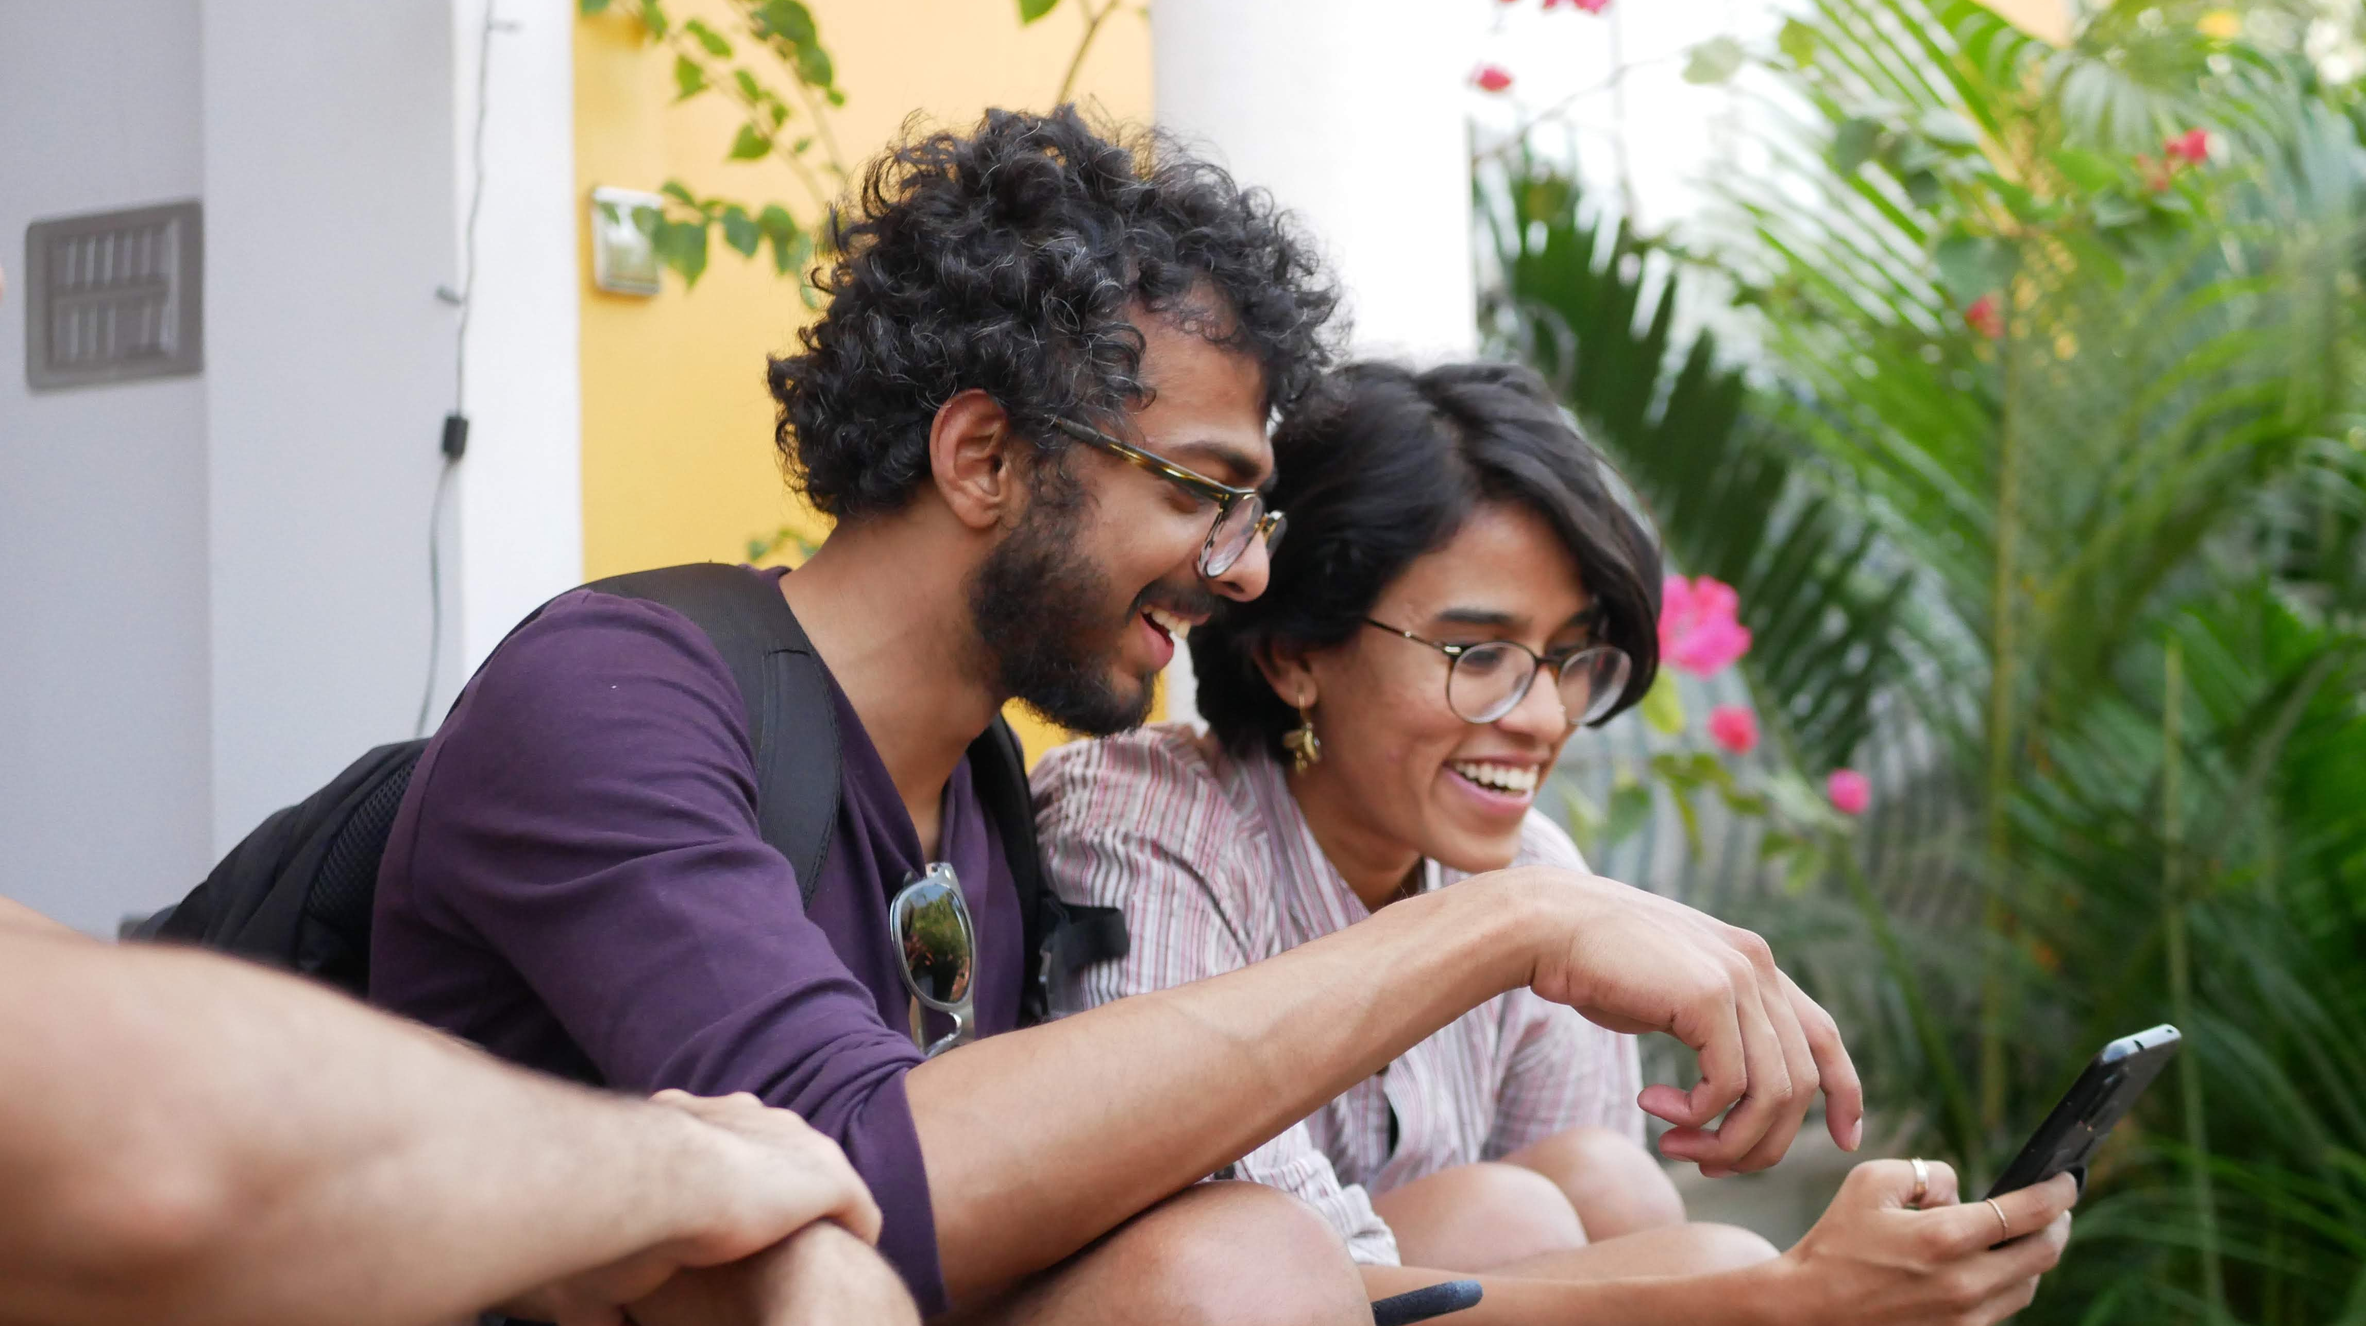
Digital is about good service
Canadians expect and need the government to build and deliver simple, secure, and efficient digital services and programs.
Top digital talent and leadership are required to make this a reality.
What challenges do we face?
How do we achieve this?
Position the public service as a workplace of choice:
Create an enterprise digital community culture
Create seamless employee recruiting, hiring, and development experiences
Develop digital talent and digital leadership
Increase diversity to reflect the diverse perspectives of people we serve
Work with industry to leverage the limited pool of digital talent
Attracting, retaining, and developing top talent
Rigid and complex hiring practices
Strong competition from industry and complex hiring processes in the GC

Slide 9
The GC Digital Talent Strategy: The Overview
GC Digital Community Culture: How we act
What we do
Enable the Enterprise
Build the
Community
Harness
Innovation
Defining and equipping the high performing digital organization
and its people
Growing, sustaining, developing, and diversifying
the digital community
Testing new ways
to support the digital community
Who we need
Partnerships
Building collaborative solutions together
What we need
Technology and data-enabled services
Scaling and simplifying our offerings

Slide 10
What we're building: The GC Digital Talent Strategy
GC Digital Community Culture: How we act
Put people first: Creating an environment where empathy drives how each person interacts
Diversity & inclusion: Removing barriers that exclude skilled digital talent, for the benefit of all Canadians
Service excellence: Providing
the best possible service to clients, both internal and external to government
Build trust: Breaking down silos and empowering innovation while celebrating diverse views and opinions
Collaborative: Enabling the right tools for talent, allocating resources flexibility using an iterative approach
Continuous learning: Designing and being supported throughout your career
Enable the Enterprise
Build the Community
Harness Innovation
Developing organizational tools and action-ready policy and guidance to build multidisciplinary teams, high performing digital organizations, and a modern enterprise
Helping orgs access modern tools and tech
Analyzing community analytics to better understand the digital workforce
Ensuring necessary digital talent are deployed on enterprise priorities
OCIO-led focused and prioritized recruitment
Training and reskilling in high impact areas
Proactive talent management and succession planning
Mobility opportunities (short-term opportunities, apprenticeship programs)
Developing digital C-Suite executives
Recognizing talent to highlight exceptional people and digital initiatives
Improving onboarding experiences for employees
Collaborating with and representing the community
Leading talent innovation for new sources of top talent: streamline hiring processes, improve student placements/bridging opportunities, build career development opportunities, rethink onboarding/employee experience
Leading experimentation and pilot projects for enterprise-wide avenues that will improve existing talent programs and services
Brainstorming and testing innovative approaches that target current and future digital professionals including whole-of-society efforts to increase skills, in collaboration with industry and other stakeholders
Partnerships
Collaborating with internal partners to scale and increase the GC’s digital capacity by sharing knowledge and enabling tools, hosting pilots, and delivering and scaling training opportunities
Building external partnerships to foster opportunities from industry and other stakeholders to explore untapped sources of talent including underrepresented communities
Broadening professional development opportunities for employees to access mentors, coaches, micro-mission opportunities, and gain experience in development programs across and beyond the GC
Technology and
data-enabled services
The pilot
The impact
Piloting the GC Digital Talent Platform as part of the ecosystem of tools in the GC to test and scale our ability to recruit and attract talent, and more
Streamlining, modernizing, and scaling robust employee recruitment, learning and development, and talent management to put high-value, human experiences first.

Slide 11
A sneak peek of the GC Digital Skills Strategy

Slide 12
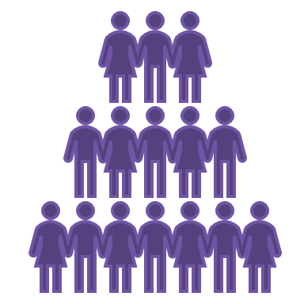
The situation
The opportunities
Digital skills are scarce, in-high demand, and pricy.
In-house skills development is the long-term strategy.
We need to make sure employees have the right digital skills, are in the right place and are supported by enabling leaders (Canada's Digital Ambition, 2022).
The gap
Collective strength
Across Canada, there is a digital skills shortage. The GC has a digital skills gap that we currently cannot measure.
As we are all facing the same challenges, there are many initiatives rethinking the way we acquire, develop and deploy talent across the public service. To go further, we must align these efforts, to learn from each other and scale projects that advance priorities.
Impact on services
People expect government services to be available digitally yet only 208 of the 1117 (19%) public-facing services in the GC Service Inventory are online from end-to-end.
Key questions:
What does the ecosystem for digital talent look like?​​
What are the “right” digital skills?​​
How do we measure the skills gap?​​
How do we develop skills at scale?​​
How do we manage digital skills?
Impact on service satisfaction
Canadians report mixed levels of satisfaction with the GC’s digital services: 68% cited one or more problems with digital government services, including:
the inability to remember sign-in information
long completion times for tasks
the inability to find information or services

Slide 13
What are digital skills?
Digital
An evolving collection of processes, practices, and behaviours for organizing and managing organizations as well as designing and delivering programs and services, made possible by information and communication technologies (ICTs)(CSPS Digital Academy).
Digital mindset
Skillset
Digital skills
Doing things differently in the internet era (asking different questions, involving people with different perspectives, finding new solutions to problems)​
Capacities developed over time that can be applied to work.​
​Behavioural and technical capacities that are human-centric, focused on value to Canadians, and enabled by technology.​
What does this look like?
An inclusive people centered culture where the public service is equipped to
respond to a changing world and deliver reliable, secure and efficient services.

Slide 14
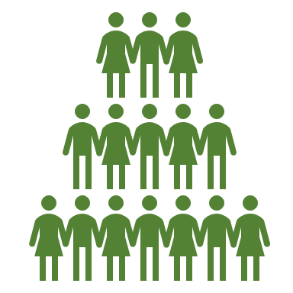
Who we are building for
The people we serve
As an employment insurance recipient, I want to easily check my Employment Insurance benefits online so that I know how much to expect and can easily create my budget for the month
~38 million individuals and 1.2 million businesses
All public servants
All executives and managers
~280,000+ public servants who must be flexible, collaborative, and digitally knowledgeable
~47 000+ executives and managers
who establish the culture
As a client service officer, I want to review resources on accessibility and a diversity mindset so that I can improve the touchpoints with clients and make sure my interactions meet their needs
As a leader responsible for a digital product, I want to learn how to lead multidisciplinary teams and agile governance, so that I help my team deliver, communicate, and report up in the most effective and efficient way possible
As a HR advisor, I want to hire, evaluate, and assess prospective employees based on their data literacy skills so that I can make sure that my program will be developed in evidence-based ways
As an executive, I want to create the enabling conditions for modern ways of working in my organization and teams so that they can leverage the new digital skills that they've developed in their day-to-day work and projects
As a policy analyst, I want to take a digital skills self-assessment then begin a learning path on privacy considerations with my team, so that we can understand and address the privacy implications of policy guidance that we're re-evaluating
As an executive, I want to plan and build my teams based on in-demand digital skills, like design thinking, innovation, and iterative methods, so that my current and future teams are well equipped to re-evaluate our service and become more user-centered

Slide 15
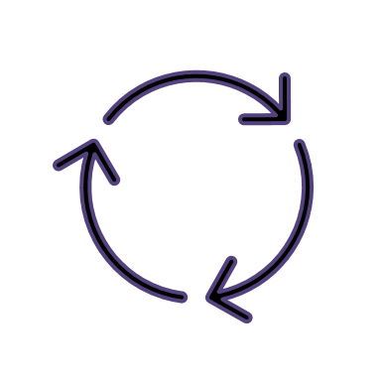
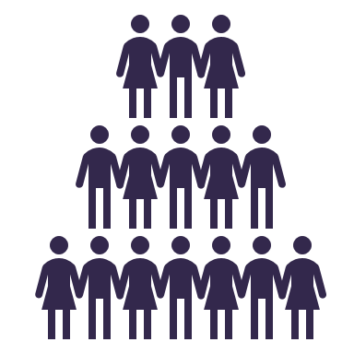
Digital Skills for all public servants (illustrative)
Behavioural digital skills
All public servants
Technical digital skills
Design thinking
Growth mindset
Diversity mindset
Cloud basics
Content accessibility
Data literacy
Iterative methods
Digital dexterity
Innovation
Cybersecurity basics
Hybrid
collaboration
Privacy
All Executives and Managers
Behavioural digital skills
Technical digital skills
Empowering others
Leading multidisciplinary teams
Service-oriented
Digital acumen
Data-informed decision-making
Data governance
C
C
Agile
governance
Cloud-enablement
Change leadership
Social intelligence
DRAFT

Slide 16
What we are building
Practical, action-ready tools and processes that will help you:
Plan the organization
HR planning tools, workforce analytics, skills data, reporting capabilities
Find the right people
Definitions of digital skills, competency levels, job descriptions, more hiring tools
Develop all public servants
Self-assessment and team-assessment of digital skills, learning paths on digital skills for all public servants
Understand the landscape
Workforce analytics, skills data, reporting on skills data, skills governance to measure and manage skills
Develop managers and executives
Self-assessment of digital skills, learning paths on digital skills for managers and executives
Recognize staff
Digital skills embedded in various HR systems

Slide 17
Let's get chatting

Slide 18
You will be sent to a breakout room with two other participants. Chat about the good, bad, and the better when it comes to data practices or/and data talent practices:
The good, the bad, and the better
The Good – things that went well and we should repeat and do more of it
The Bad – things that did not go so well or would be a bad idea
The Better – things that should be happening and possible solutions to those bad things
Write down notes in this Miro board (link).
After 10 minutes, you will join a new breakout room to continue this activity with two new folks.

Slide 19
Takeaways and voting

Slide 20
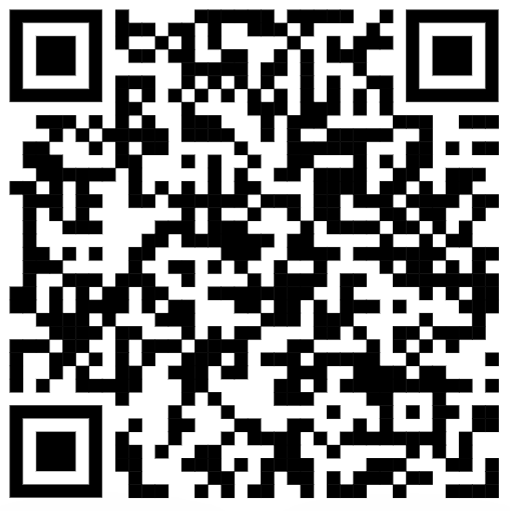
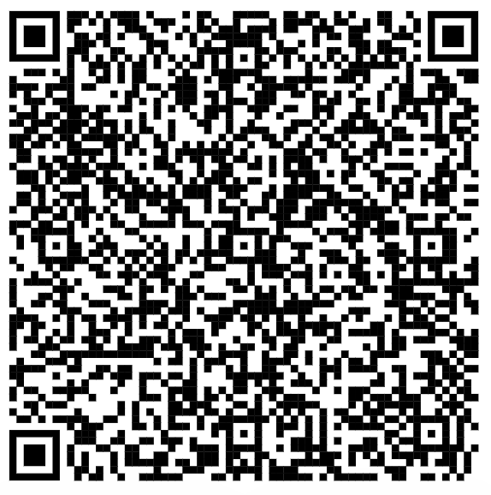
Learn more
Thank you!
How to get involved
Participate in future activities related to Digital Talent (providing feedback and ideas in future iterations) and Digital Skills (to further define the digital skills)
by filling in this Microsoft Form.
Check out the Digital Community's GCWiki space to learn more about the Digital Talent, Digital Skills, and ecosystem for digital talent initiatives.
Questions? Contact us at iCommunity-icollectivite@tbs-sct.gc.ca.​

