Slide 1
Get Updates on COVID-19
an email service from the Government of Canada that provides important information about the coronavirus outbreak

Slide 2
The Need
In March, the COVID-19 Canada.ca pages were receiving up to 13 million visits a day.
With 90% of traffic directed from Google, people were searching for reliable information.
2
Notes:
A similar service in the U.K. has grown by 95,000 subscribers since the beginning of the outbreak.

Slide 3
The Solution
Created a subscription email notification service
“Get Updates on COVID-19” provides members of the public with up-to-date, trusted and credible information to manage their health-and well-being and combat misinformation.
Notifications are designed to communicate clearly in a crisis and reflect the Canadian value of equity.
Available in both official languages, plain language, and stand alone.
Based on publicly available content.
Web-based - available anywhere, any time on any device.
3
Notes:
The service contrasts with the UK Notify service which provides notifications based on webpage updates.
A different approach was chosen to meet the identified need of helping Canadians sort through the mass of information available to find what they were searching for
The emails are simple and accessible. They are written based on guidelines that ensure clarity and reliability, keeping the language around a grade 8 level so they’re easy to understand
Insight from behavioural insights experts keeps the focus on key messages and behaviours.
The service is not app based and it does not issue emergency alerts.

Slide 4
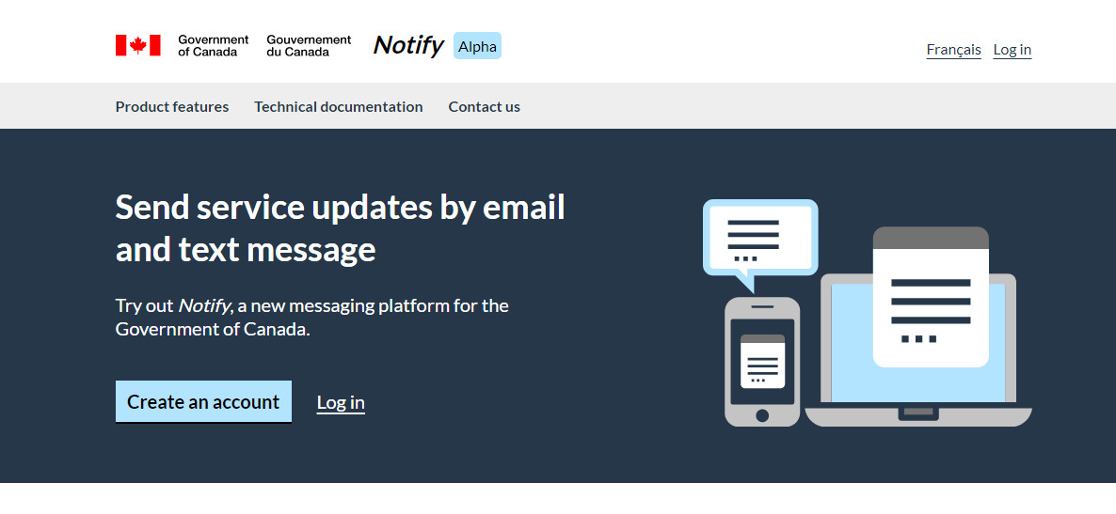
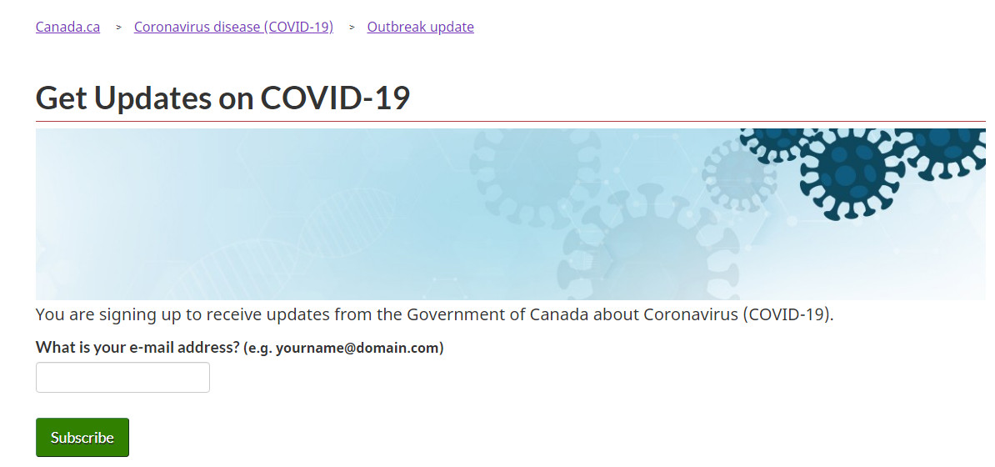
The Product
Leveraged existing tools to launch the service in two weeks
Canadian Digital Service provided the Notify platform based on open source code from GOV.UK.
Service Canada used existing canada.ca infrastructure to securely create and manage the subscription-based service.
Health Canada took on the role of service owner and collects subscriber information under its authorities.
Launched a minimum viable product in two weeks, adding new features and refining the service over time.
4

Slide 5
The Content
Data driven content focused on user-needs
Reliable & Trustworthy
Apolitical
Non-promotional
Evidence-based
User-Driven
Based on data analytics
Agile and responsive
Add new subjects of interest
Accessible
Simple language
Clear message
Publicly available web content
Click through rates for the service average over 11%, with some notifications up to 30%.
Average government click through rates are just under 4%, with all industries averaging under 3%.*
5
Notes:
The content is driven by data analytics from top searches, key questions from the 1-833 call line and the most up-to-date government content.
Analytics and feedback shows which messages resonate. The content of the notifications is constantly being adjusted to focus on the topics that matter most to subscribers.
*https://mailchimp.com/resources/email-marketing-benchmarks/

Slide 6
Growing the service
Partnered with departments to promote the service across canada.ca and social media
Sign up link posted on high traffic web pages
40% of visits come from webpages that aren’t Health Canada, highest coming from Canada Revenue Agency.
Joint official announcement by Ministers of Health and Digital Government.
Social media amplified by Government of Canada departments.
Blog posts on Canadian Digital Service blog.
6
Notes:
Nearly 40% of visits are from non Health Canada pages, of which, 30% are click throughs from Canada Revenue Agency.

Slide 7
The Timeline
Built in flexibility and pursued incremental change
March 18
April 3
May 15
Digital Surge Team created
First notification sent
Feedback forms added
March 23
Ongoing
April 29
Sign up pages published
Ministerial Announcement
Continue to adapt as the pandemic evolves
7
Notes:
Launched with minimum viable product in two weeks but built flexibility in up front to allow for new iterations of the product and expanded content over time.
Focus was on moving at the speed of trust - both within the public service and with the public
Began with health and public health content but allowed for content expansion in the future
Made improvements to the product such as adding feedback forms for users and unsubscribers over time

Slide 8
The Numbers
Within 2 months, over 47,000 subscribers and 500,000 notifications
82%
The most popular notification themes provide actionable advice on how to:
Prevent COVID-19
Support yourself and others
Take care of those who are sick
Top notification to date is how to safely shop, handle and prepare food with a click through rate of over 30%.
The unsubscribe rate has decreased over the life of the service to 0.4% in the second half of May.
find the service ‘informative’ to ‘very informative
66%
like that the service is a trusted source of information
73%
signed up specifically to receive information from the Government of Canada
8

Slide 9
The Team
Collaboration is the key to success
“Get Updates on COVID-19” was created based on global best practices and an open source platform.
The multidisciplinary team included Health Canada, Service Canada, the Canadian Digital Service and Treasury Board Secretariat.
9

Slide 10
Lessons Learned
Focus on people.
Listen to the data.
Keep it simple.
Leverage existing tools and products.
Bring partners in from the start.
Empower your team.
10
Notes:
Focus on people. Use simple, easy to understand language in an accessible email format.
Listen to the data. Use data analytics from top searches and key questions from the 1-833 call line to track trends in what people are worried about. Keeps content agile and responsive.
Keep it simple. Built minimum viable product required for launch. New features added iteratively, making improvements as go and refining the service.
Leverage existing tools and products. Building on existing and open tools and services meant we were able to build a turnkey service in a matter of days.
Bring partners in from the start. Partners were included from the beginning so despite moving quickly, we went through the security, legal, and privacy aspects diligently.
Empower your team. Team is a mix of skills and departments. Frequent check-ins, a willingness to learn and ask questions meant collaborative environment with shorter lead times and fewer follow ups.

