Slide 1
Accessibility requirements for December 2022
Recommended Canada.ca approach
Digital Transformation Office • #CanadaDotCa • November 2022
Notes:
Opening slide

Slide 2
3 key patterns
3 patterns that impact institutions on Canada.ca:
Institutional accessibility plan
Institutional accessibility feedback process description
Institutional accessibility feedback mechanism
These flow from the requirements under the Accessible Canada Act and Regulations. Overview of existing guidance
Publishing deadline: December 31, 2022
Notes:
Content example slide #1

Slide 3
Accessibility plans
What they are
A document that outlines an institution's plan regarding the accessibility of all its programs, products and services. Takes a total view of accessibility, from online to IRL, both public-facing and internal.
Accessibility plan is the first deliverable in a 3-year planning and reporting cycle (annual progress reports to come)
Notes:
Content example slide #1b

Slide 4
Accessibility feedback process description
What this is
A published description of how your institutional feedback process works. It must be published alongside your accessibility plan.
Notes:
Content example slide #1b

Slide 5
Accessibility feedback mechanism
What this is
A means for the users of an institution's programs and services to provide feedback about any aspect of the accessibility of its programs and services. The feedback mechanism must be always available, as feedback processes are meant to be ongoing.
An online form is only one aspect of the feedback mechanism, as people must be able to give feedback by a variety of means
Notes:
Content example slide #1b

Slide 6
Recommended approach
Notes:
Quote slide

Slide 7
Design considerations
General
The following working examples represent the recommended approach - not mandatory templates
Starting point - adjust as needed for your particular situation
Designed for simplicity and with a focus on top user tasks like providing feedback, reviewing the plan and understanding the process
Built with standard WET code elements to maximize WCAG conformance

Slide 8
Meeting accessibility requirements on institutional websites
Institutional landing page (ILP)
Accessibility page
Accessibility plan
Feedback mechanism
Description of feedback process
Recommended structure
Notes:
Content example slide #2

Slide 9
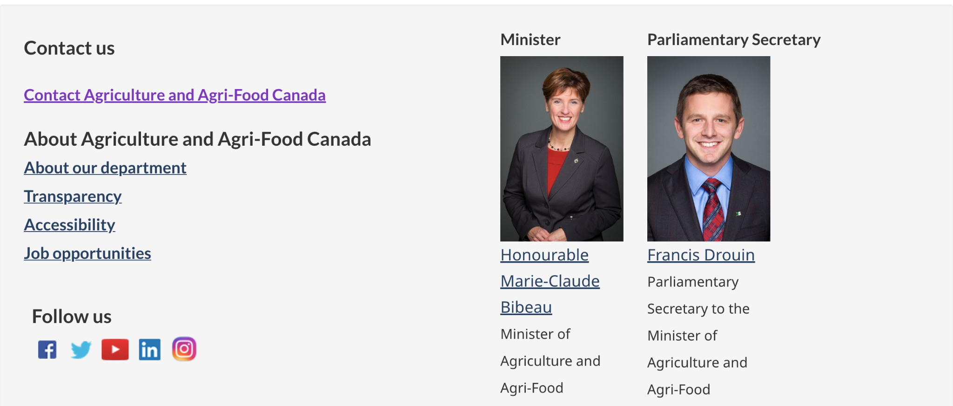
Accessibility link from ILP
Recommended link label is “Accessibility”
Example drawn from AAFC’s institutional landing page
Notes:
Content example slide #1b

Slide 10
Breadcrumb for accessibility products
Recommended

Slide 11
Design considerations
IA structure
While DTO recommends creating an accessibility node in your institution’s IA, it may also make sense to cross-link from elsewhere on your sites, such as:
Linking to the accessibility plan from a “Reports and plans” section
Linking to the accessibility feedback form from your “Contact us” pages

Slide 12
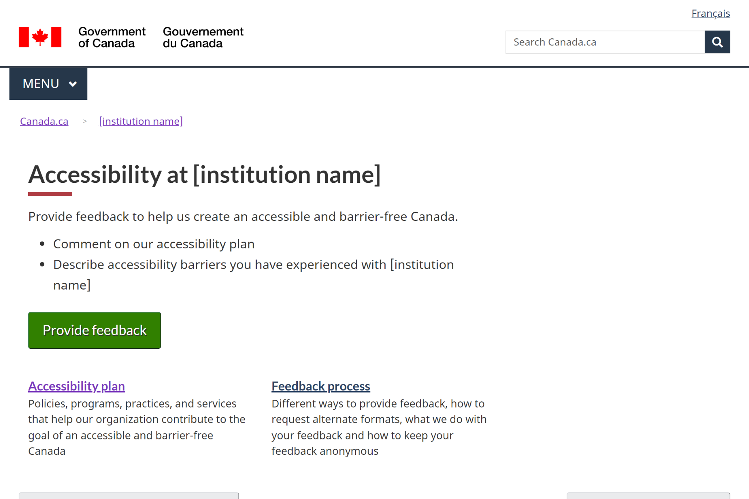
Accessibility page
Link to working examples
Recommended institutional accessibility page

Slide 13
Design considerations
Accessibility page
Likely top task will be giving feedback, so the page uses the Super-task button
Additional doormats can be added as needed
Other patterns can be used as well on this page (e.g. Most requested band, contextual features)
Design will likely evolve as future requirements come on line, e.g. accessibility statements required under the proposed ICT accessibility standard

Slide 14
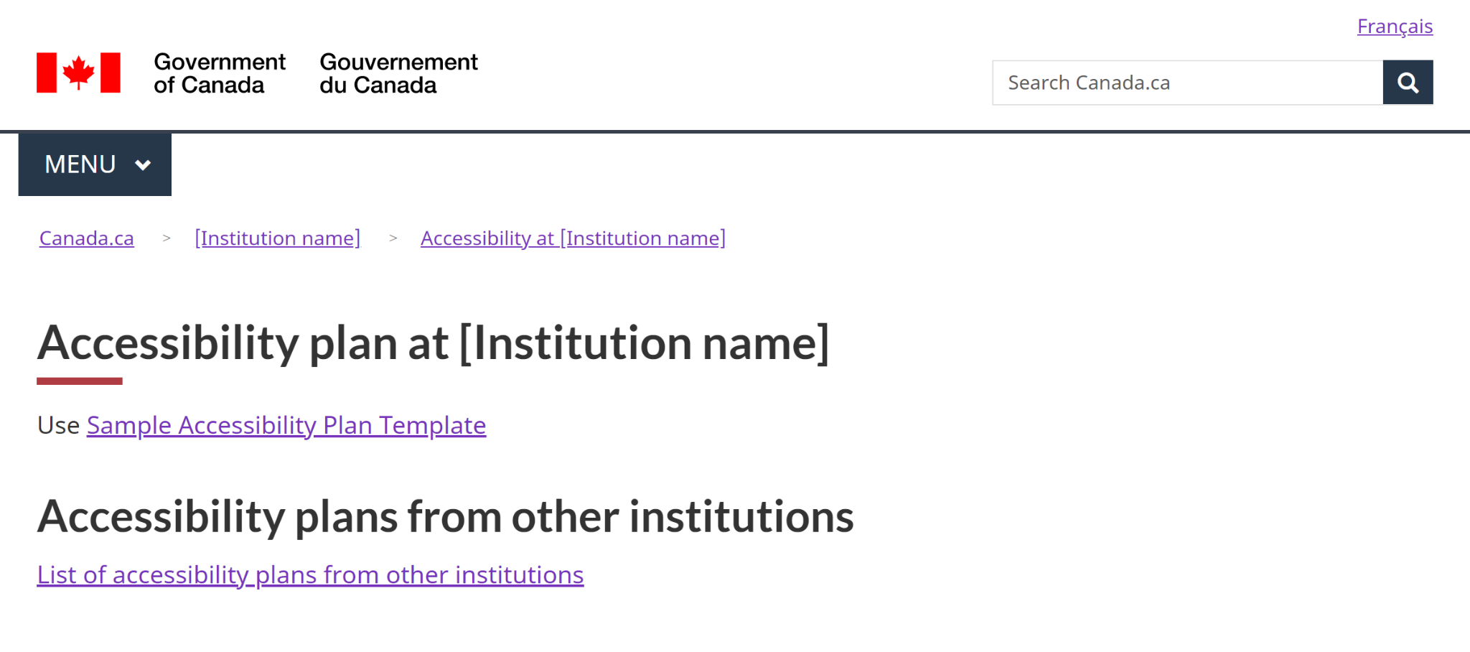
Accessibility plan
Link to working examples
Recommended approach

Slide 15
Design considerations
Accessibility plans 1/3
Ensure the plan meets the requirements outlined in Guidance on accessibility plans
This guidance includes a content template for the plan itself
People are encouraged to provide feedback on accessibility plans - ensure there is a link to the feedback process and/or feedback form from within the plan itself
Notes:
Content example slide #1b

Slide 16
Design considerations
Accessibility plans 2/3
To assist with findability, TBS is creating a central index for accessibility plans on the Open government site:
Include a link from your plan to the central index
Submit a metadata record for your plan
See annex for instructions
According to the Procedures for publishing, institutional accessibility plans are considered publications:
Request an ISSN and submit a copy to publications.gc.ca
See annex for instructions
Notes:
Content example slide #1b

Slide 17
Design considerations
Accessibility plans 3/3
Institutions must notify the Accessibility Commissioner at the Canadian Human Rights Commission within 48 hours of publishing their accessibility plans:
Send an email to Info.Com@chrc-ccdp.gc.ca or use the CHRC’s “My Accessibility Portal” service
Include a link or URL for the plan in the email you send
Notes:
Content example slide #1b

Slide 18
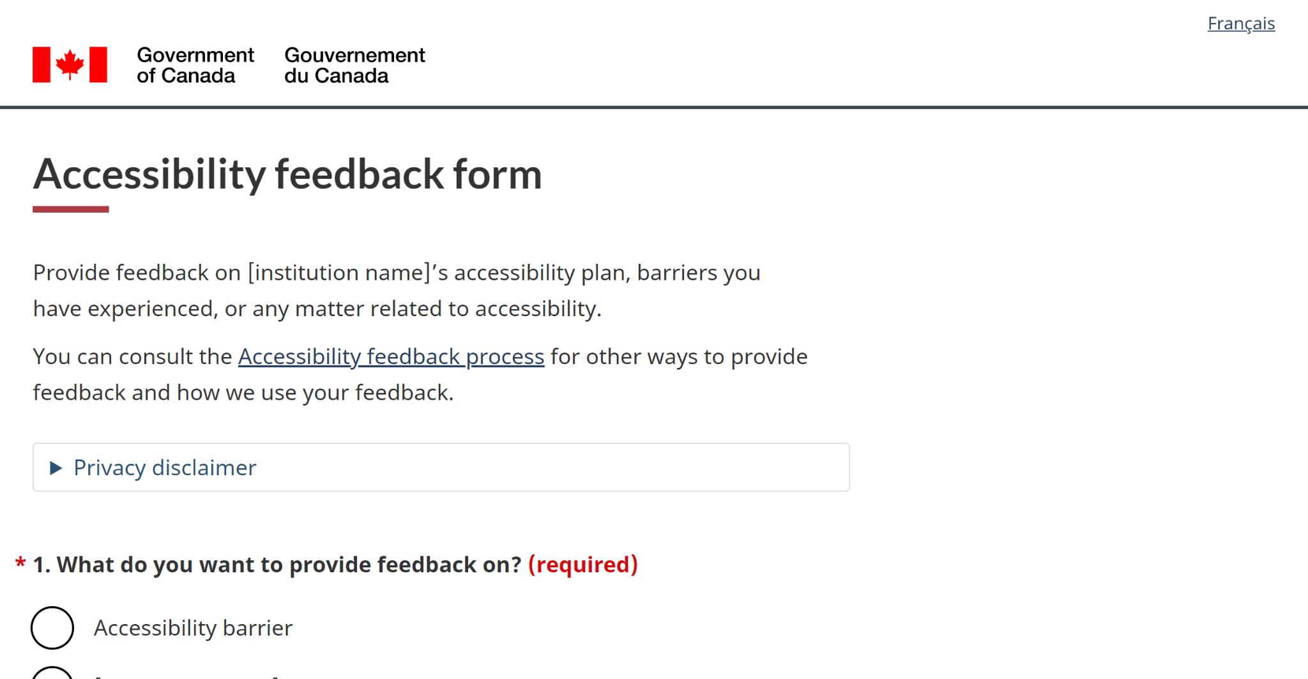
Accessibility feedback form
Link to working examples
Recommended feedback form

Slide 19
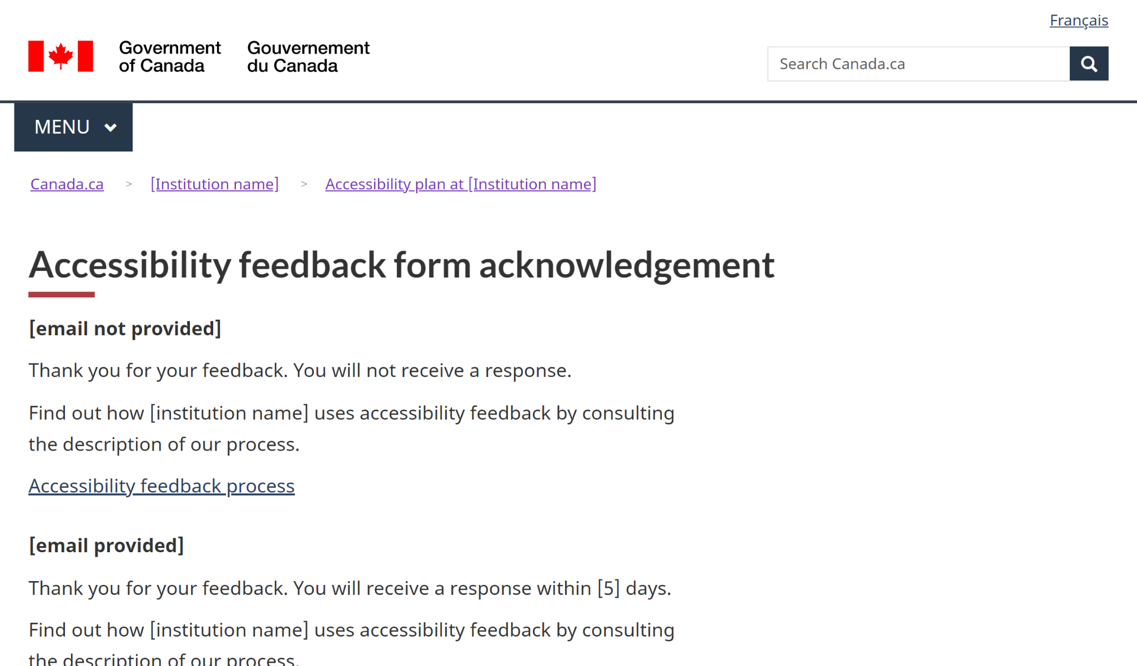
Accessibility feedback form
Link to working examples
Recommended acknowledgement page

Slide 20
Design considerations
Feedback form 1/2
You will need to hook the intake form up to something - a generic email, a ticketing system, etc. (remember to keep incoming feedback for 7 years!)
AEM users - send a ticket to Principal Publisher to leverage the “file and forget” solution for hooking forms up to an email address
People submitting feedback have the option to request a response - form design includes information on turnaround times in this scenario
Notes:
Content example slide #1b

Slide 21
Design considerations
Feedback form 2/2
Form has been designed to minimize the collection of personally identifiable information (PII):
When the user specifically requests a response, it only asks for an email address
Includes instructions for users to not include PII in the comment box
When creating your own implementation, consult with your organization’s ATIP coordinator.
Notes:
Content example slide #1b

Slide 22
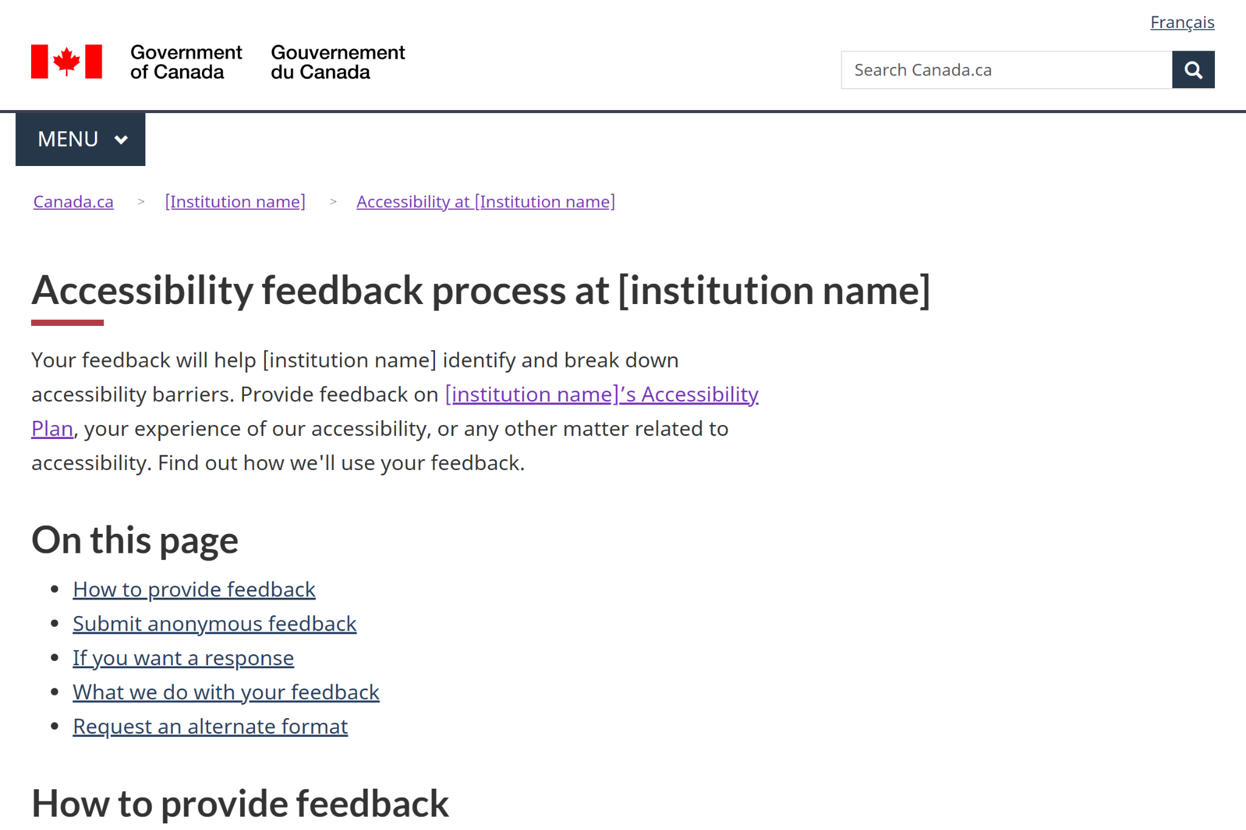
Accessibility feedback process description
Link to working examples
Recommended approach

Slide 23
Design considerations
Feedback process description 1/2
Designed to focus on top-of-mind user needs, rather than providing an exhaustive description of back-office procedures
Ensure the underlying process meets the requirements outlined in Guidance on feedback processes
People must be able to provide feedback by a variety of means, including email, telephone, snail mail
Feedback must be analyzed and reported on in future
Notes:
Content example slide #1b

Slide 24
Design considerations
Feedback process description 2/2
As with accessibility plans, institutions must notify the Accessibility Commissioner at the Canadian Human Rights Commission within 48 hours of publishing their process description
Send an email to Info.Com@chrc-ccdp.gc.ca or use the CHRC’s “My Accessibility Portal” service
Include a link or URL for the process description in the email you send
Notes:
Content example slide #1b

Slide 25
Next steps
These working examples are a first step:
Will monitor and iterate, based on data and evidence
As departments and agencies implement, provide comments and feedback to dto.btn@tbs-sct.gc.ca
Will integrate to the pattern and template library at design.canada.ca
Implementation and maturing the working examples

Slide 26
Annex
Notes:
Quote slide

Slide 27
Accessibility plans
Since institutional accessibility plans are considered official publications of the Government of Canada, a PDF version of the accessibility plan needs to be included in the catalogue at publications.gc.ca.
Follow these steps:
Obtain an ISSN from Library and Archives Canada: International Standard Serial Numbers (ISSN)
Obtain a GC catalogue number from PSPC: Catalogue numbers - Government of Canada Publications
Put both numbers in your Accessibility plans, as per PSPC guidance on copyright pages: Formatting the copyright page
Submit to PSPC for posting on publications.gc.ca via email: publications.acquisitions@pwgsc.gc.ca
Tip: given the subject matter of the accessibility plan, prepare an accessible PDF.
Procedures for publishing under the Policy on Communications and Federal Identity

Slide 28
Accessibility plans
To ensure your institutional accessibility plan is included in the central index on open.canada.ca, you need to submit a metadata record:
Create an registry account: visit http://registry.open.canada.ca/ and select “Request an Account”. It can take up to 24 hours for the account to be activated.
Once your account has been created, you will be able to create your record by populating the required metadata. Please note: you will require your institution’s IMSO approval for releasing a record. Once approval is given, you will not require an additional approval for future updates. We do not require you to provide the approval to us.
Select the Create Institutional Accessibility Plan asset on the registry landing page (Note: this option is currently not available but will be added to the landing page of the Open Government registry).
Create a metadata record on open.canada.ca

Slide 29
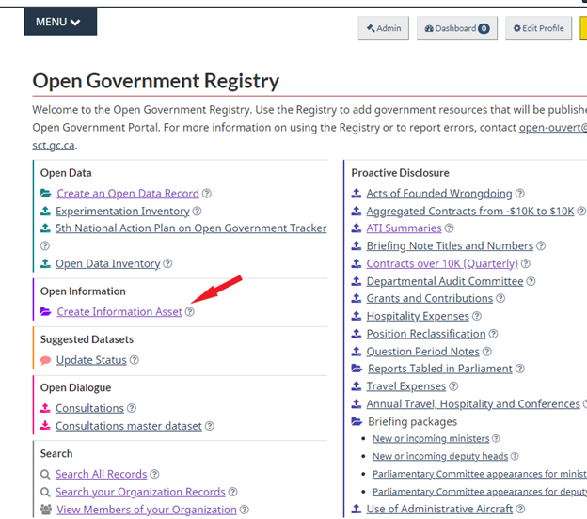
Accessibility plans
Create a metadata record on open.canada.ca

Slide 30
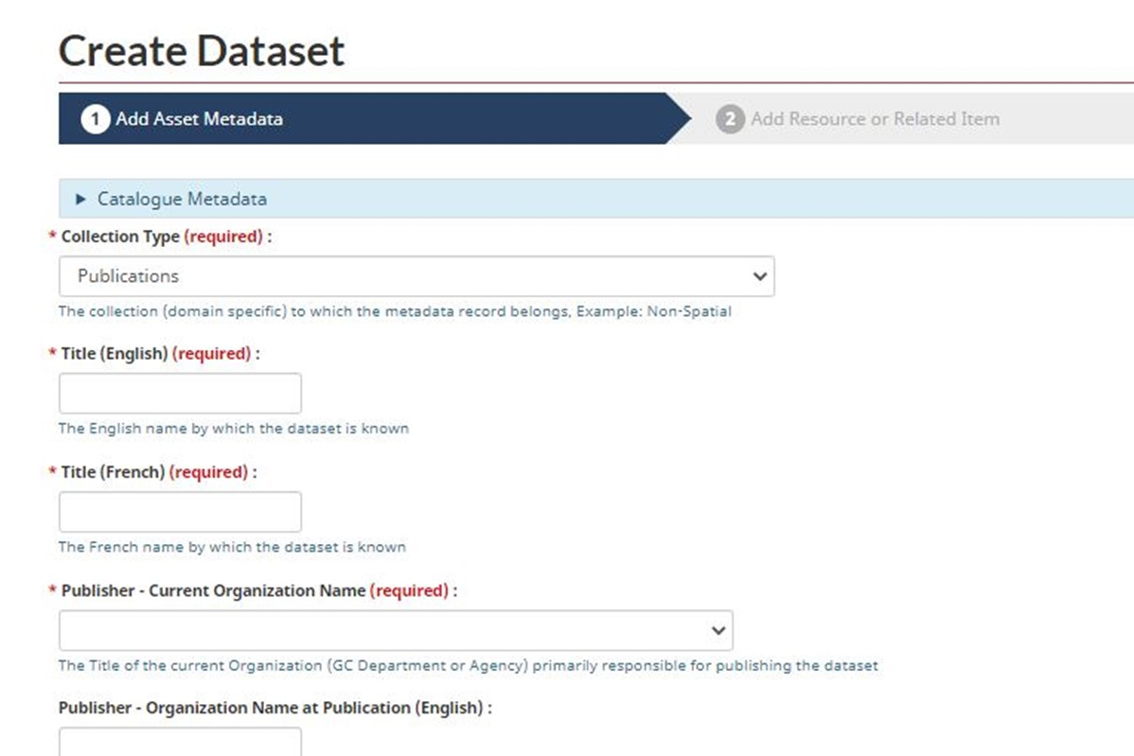
Accessibility plans
4. Your accessibility plan will be uploaded as a resource on the following page once the fields are completed.
The form allows you to describe each resource assigned to a dataset or asset.
A resource represents individual files or services in a dataset or asset entry.
Create a metadata record on open.canada.ca

Slide 31
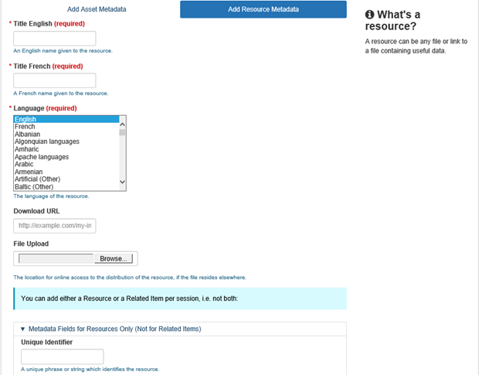
Accessibility plans
Create a metadata record on open.canada.ca

Slide 32
Accessibility plans
Once completed, your record will be placed in the Open Government Registry team’s queue for review and publication within 24 hours.
Please contact your institution’s open government representative should you have additional questions.
Create a metadata record on open.canada.ca

