Slide 1
Leadership Engagement for the Modernization of the Workplace
Template
Date: October 2020

Slide 2
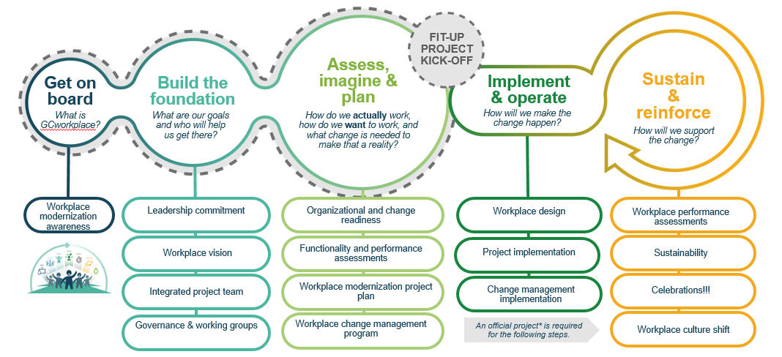
Introduction
WHAT: The intent of this presentation is to bring together the leadership and present a business case, in order to fully engage the top ranks of your organization in the workplace transformation.
WHO: This tool is to be used by the person tasked to coordinate the workplace transformation/modernization (often someone on the project team)
WHEN: The Workplace Modernization Roadmap is comprised of 5 main steps. Once you’ve been made fully aware of what GCworkplace is all about (Get on board), it’s time to move on to Build the Foundation.
This tool will help you build a business case to ensure leadership is engaged and committed to the workplace transformation.
Notes:
Link to the Communication Toolkit: https://www.gcpedia.gc.ca/wiki/GCworkplace/Communications_Tool_kit : Tools for change managers, change management practitioners and communications officers to engage, inform and support employees within their organization, including mythbusters, videos
Link to presentation on Gcworkplace demystified: https://gcdocs.gc.ca/tpsgc-pwgsc/llisapi.dll/open/304845206

Slide 3
Overview
Generic GCWorkplace presentation
Our current worksplace state
Temporary: Impact of pandemic situation
Opportunities for modernization and change
Current transformational initiatives

Slide 4
How to use this template
General
This presentation is separated into sections
Note: Instruction slide is HIDDEN and WILL NOT show in Presentation mode (unless you start the presentation on that slide)
Instructions
Save As before you get started
Based on your audience, REVIEW and DELETE the sections that are NOT required
To remove a section, right-click on the section and select “Remove Section & Slides”
Edit the Title slide based on your audience:
e.g. Enrol!, The importance of leadership engagement, Leadership engagement right at the start, etc…
Edit the Overview slide based on the sections you have selected to keep
Edit the slides 23, 25, 28, 31 and 32 while following the instructions provided on the slides of the template.
Use the notes already present in this document and add some more, according to your needs.

Slide 5
Checklist
 | Steps to follow before your final presentation
1 | Contact the T&E team for direction and guidance.
2 | Familiarize yourself with Section 1: Generic GCworkplace presentation. Don’t forget to visit our GCpedia page for more generic information.
3 | Watch the GC employees present ...GCworkplace youtube video on slide 17 to become even more acquainted with the concept.
4 | Take a look at your current situation in your organization. This will take some time and resources. Get some help, perhaps form a small working group!
5 | Do a retrospect of the current impacts of the pandemic on your organization. Tip: If a survey has been completed by your HR team, take a look at the results!
6 | Go through your Departmental Plan to align some of your strategic objectives with the GCworkplace objectives!
7 | If there are current transformational or modernization initiatives, here is an opportunity to present them or provide an update to the team!
8 | Finally, this is your chance to highlight the most convincing arguments and emphasize the importance to move towards a more modern workplace!

Slide 6
Generic GCworkplace presentation
Notes:
More Generic information is available on our GCPedia page: https://www.gcpedia.gc.ca/wiki/Gcworkplace

Slide 7
The GCworkplace vision

Slide 8
The landscape is changing
The COVID-19 pandemic has forced a behavioural shift and accelerated modernization; work and private life have started integrating, employees are equipped with modern tools and are being evaluated by more than just their physical presence in the office.
BEHAVIOURAL SHIFT
A WORKFORCE IN FLUX: GENERATION Z
MEASURING PERFORMANCE
EMPOWERMENT
The idea that work and private life exist in two separate universes has been challenged by technology
Modern tools and a culture of trust can empower employees to decide where and how they are most productive
Are their needs being anticipating?
Success is not measured on the physical presence of staff but rather on results, creativity and commitment
Notes:
To understand what the GCworkplace vision is all about, it’s important to know WHY it exists and the context in which it was created. When we take a look at the federal government office landscape, I think we can all agree that it has been changing, it is still changing, and it will keep on changing.
A behavioural shift is happening. The world around us is changing: Citizens are connected 24/7, their expectations are high and they want services in real-time. The idea that work and private life exist in two separate universes has been challenged by technology.
There are a lot of discussions around empowerment lately. With the right tools and their organization’s support, employees can be empowered to decide where and how they want to work to be as productive as they can be. The workplace can be tailored to the needs of employees, not the other way around.
Generation Z is made of people who were practically born with a cell phone in their hands, they are competitive and are known to constantly seek new ideas and experiences. The Government of Canada needs to be able to attract and retain the new generations of workers as well as the experienced professionals who have come up through the ranks. In order to do this, their needs must be anticipated.
Are we measuring performance the right way? Managing by results and deliverables instead of by physical presence. Success should no longer be measured on the physical presence of employees but rather on results, creativity and commitment.
How can the Government of Canada keep up to stay relevant?
The COVID-19 pandemic has forced a behavioural shift and accelerated modernization; work and private life have started integrating, employees are equipped with modern tools and are being evaluated by more than just their physical presence in the office. Our future workplace needs to reflect, accommodate and support the diversity of our people and their contributions.

Slide 9
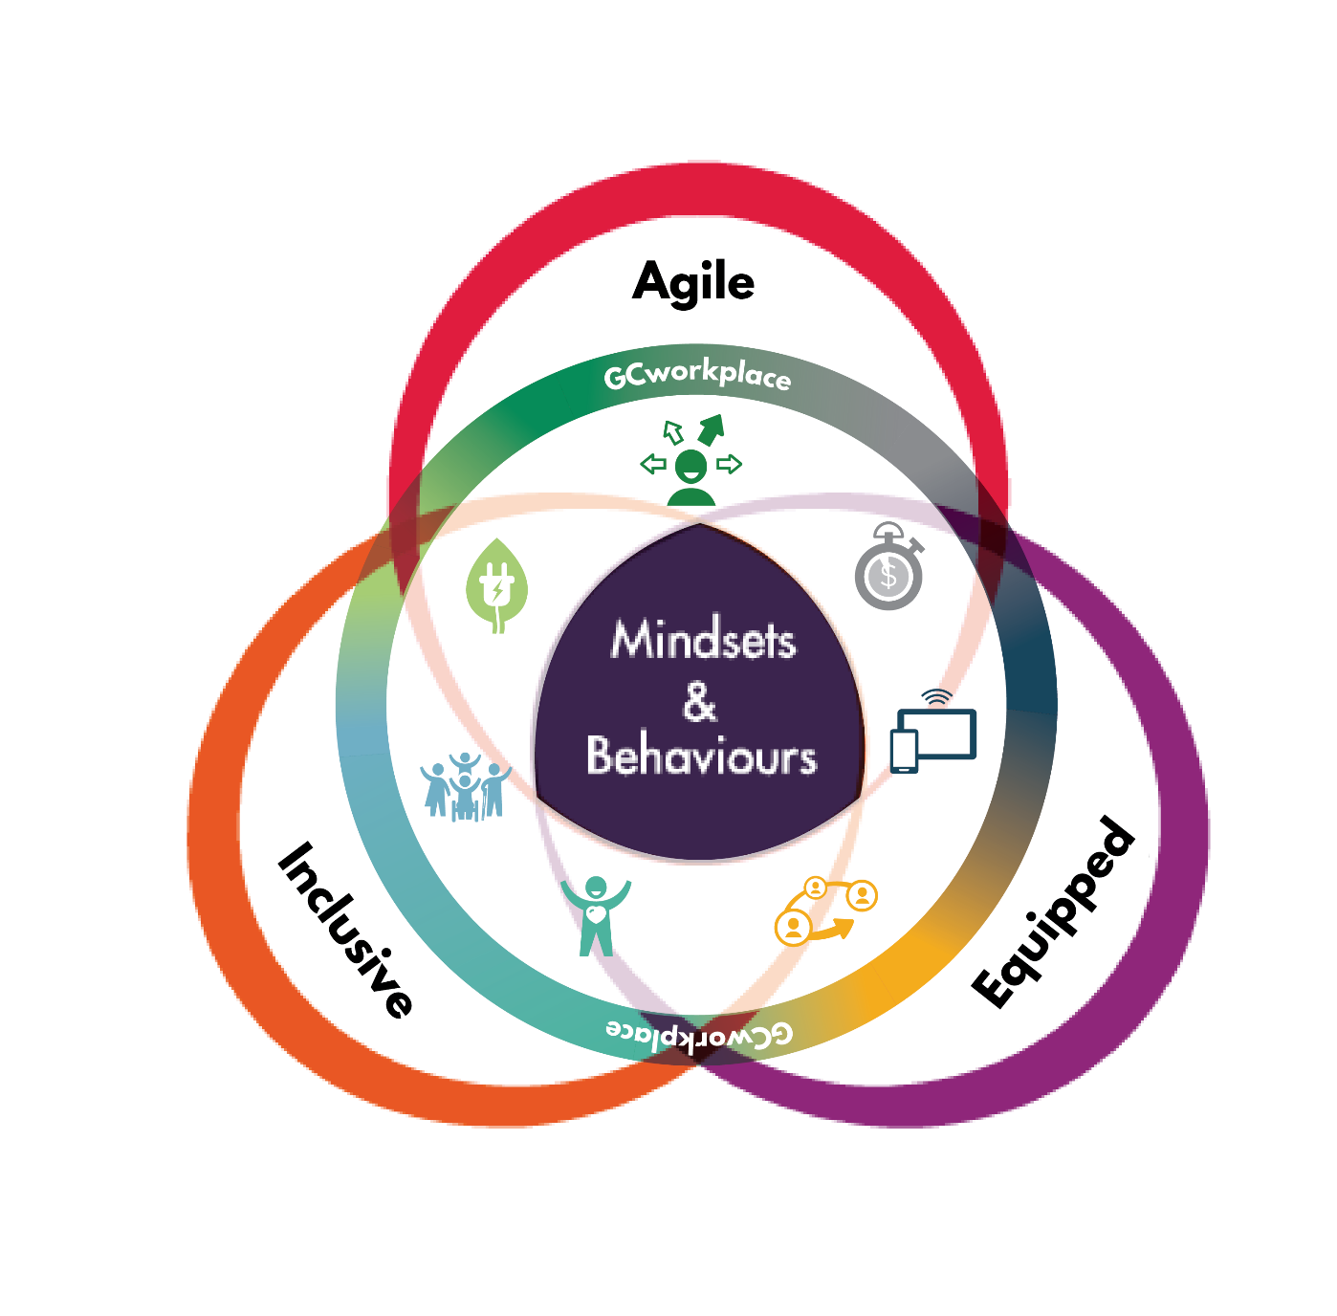
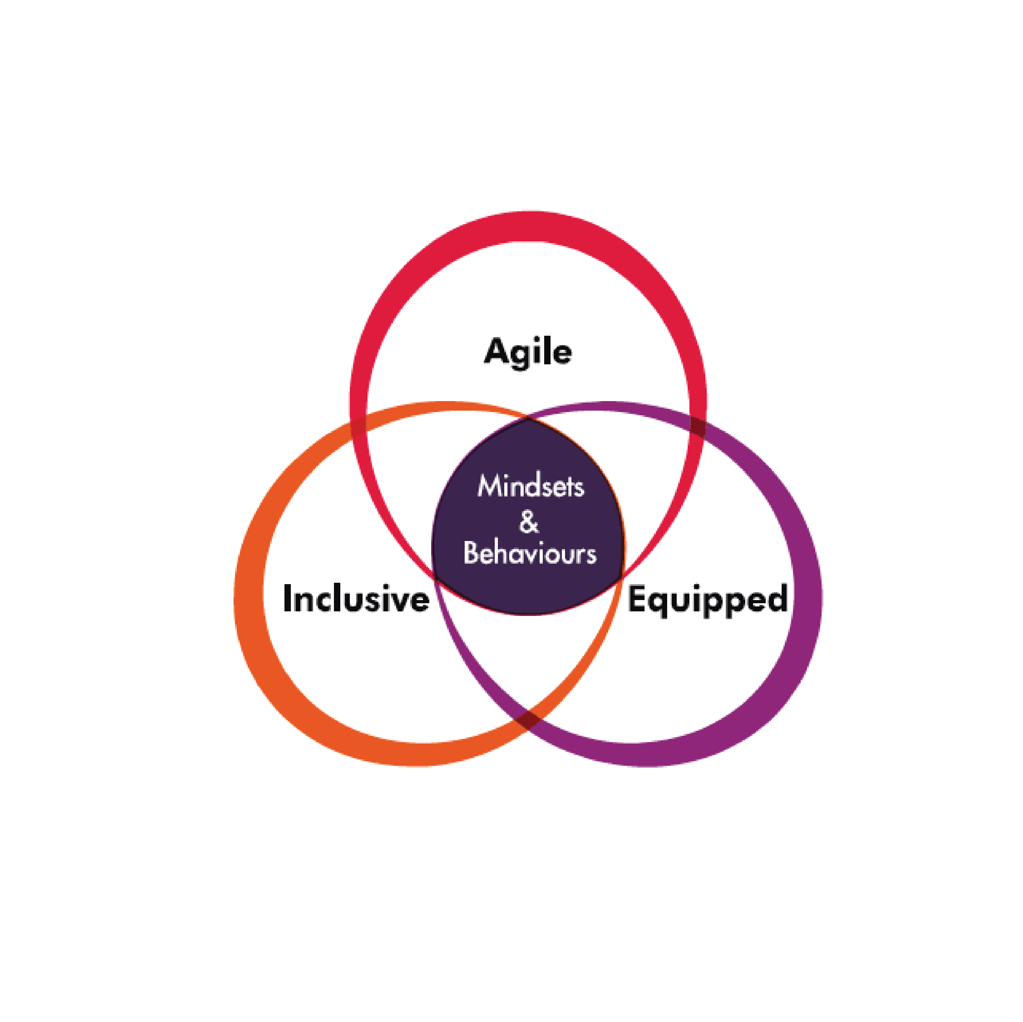
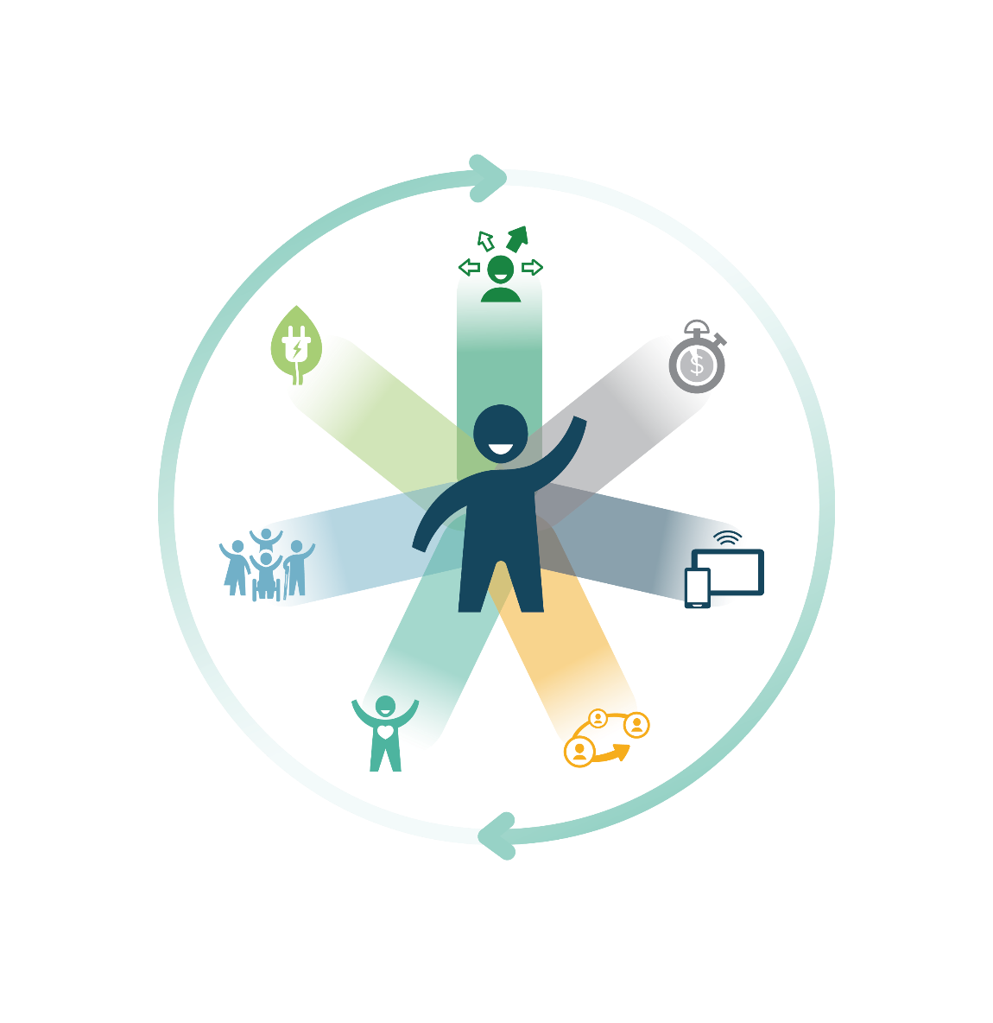
GCworkplace and Beyond2020: one direction
Where the vision for the workforce goes, the vision for the workplace goes
Beyond 2020
Notes:
The workplace is a tool that departments can use to support Public Service Renewal and to embrace the Public Service vision for the workforce.
GCworkplace vision
Fostering a culture of innovation, improving how we leverage digital technology to encourage government-wide collaboration, flexibility, and efficiency. It’s also about putting into place actions that integrate sustainability and improve the overall health and wellbeing of employees and ensuring inclusivity for all.
Beyond 2020
In a time that is increasingly characterized by data, digital, new workplace designs, flatter work cultures, and multiple generations working together, it is critical to examine and adopt the mindsets and behaviours that will meet the changing expectations of Canadians. The desired outcome is a Public Service that is more agile, more inclusive, and better equipped.

Slide 10
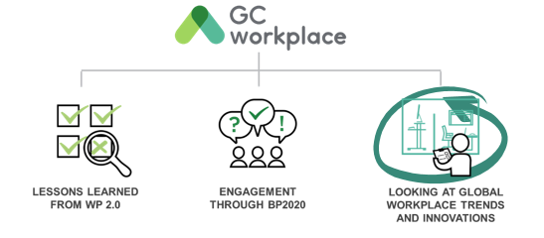
A vision for the Government of Canada workplace
Notes:
In order to develop and refine a vision for a MODERN WORKPLACE for the GC, three main elements were considered:
First, lessons learned from past initiatives (i.e. Workplace 2.0)
Key observations from WP2.0 sought to solve employee needs for quiet spaces, privacy, and concentration spaces.
From what was learned through the delivery of the first activity-based workplace pilot projects.
Second, alignment to the BP2020 vision: In 2013, the Clerk of the Privy Council, in collaboration with public servants across the country, established a vision for public service renewal called Blueprint2020 in which one of the four key priorities was a MODERN WORKPLACE. The GCworkplace vision is, in part, the result of what was collectively heard through the BP2020 consultations and engagement sessions.
And third, global trends: it was based on global trends at the time, [CLICK TO ANIMATE SLIDE], and the vision is constantly evolving to stay relevant in this climate of change.
Based on a European study conducted in 2017 by CAPX, The Digital Workplace in Europe: Bridging the Divide in 2025, https://digitalworkplace.global.fujitsu.com/wp-content/uploads/2018/01/Europe_Workplace_2025.pdf ‘’In less than a decade from now, flexible-working models will become standard practice across Europe. It will become essential for the businesses and public organizations in the region to provide a better work-life balance in order to recruit and retain millennial and Gen Z workers. This group views flexible working hours and the opportunity to get involved in other business and recreational activities as vital components of an attractive job role.
‘’European organizations are racing to be ready for the workplace revolution. In less than a decade, the whole concept of a nine-to-five, full-time job in a traditional office environment will be ripped up and largely forgotten.
By 2025, millennials will represent more than 50% of the European workforce, and will redefine corporate culture around flexible working models, a more open approach to collaboration, and a focus on data as the lifeblood of the business.
Freelance and remote working will establish themselves as the norm in major European economies, and businesses will dramatically overhaul the scale and appearance of their office footprint with a new focus on health and wellness.’’

Slide 11
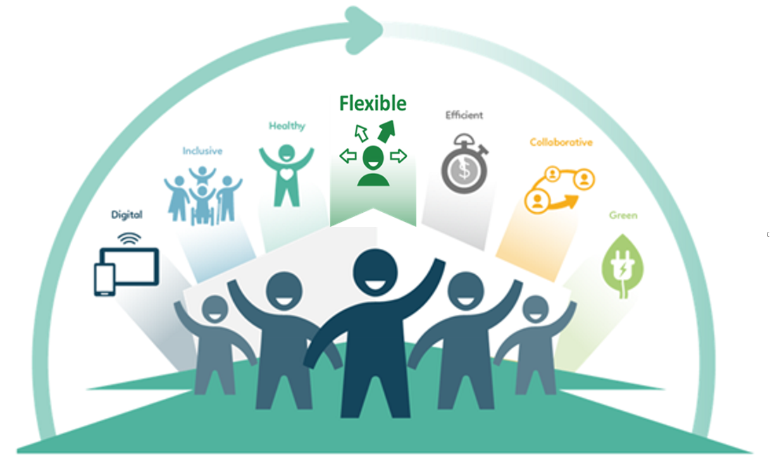
What is a GCworkplace?
GCworkplace is a modern, efficient and inclusive workplace which responds to the public service workforce’s needs and supports a flexible way of working.
GCworkplace is the term adopted by the Government of Canada for workplace modernization.
It is based on the implementation of activity-based working (ABW), which is a way of working that offers all employees shared use of a VARIETY of workpoints, allowing them to CHOOSE the optimal setting to perform their tasks and functions. It optimizes office space and is based on the seven DIMENSIONS of creating a flexible, healthy, efficient, inclusive, collaborative, green and technologically advanced digital space.
Notes:
When we think of a modern workplace, we think GCworkplace. But what IS GCworkplace?
Read the slide.
Through consultations, over 1,300 employees were surveyed from across Canada, and they ranked “flexibility" as the most important workplace dimension. [CLICK TO ANIMATE SLIDE

Slide 12
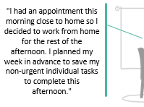
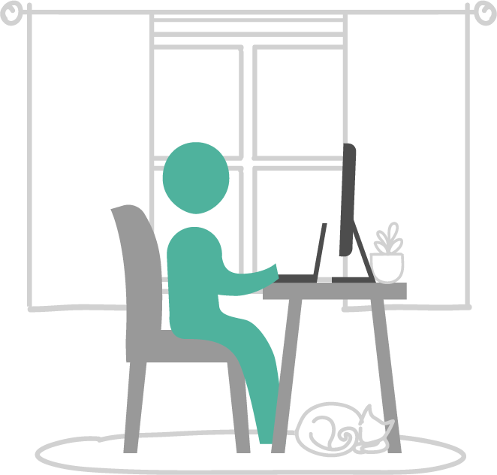
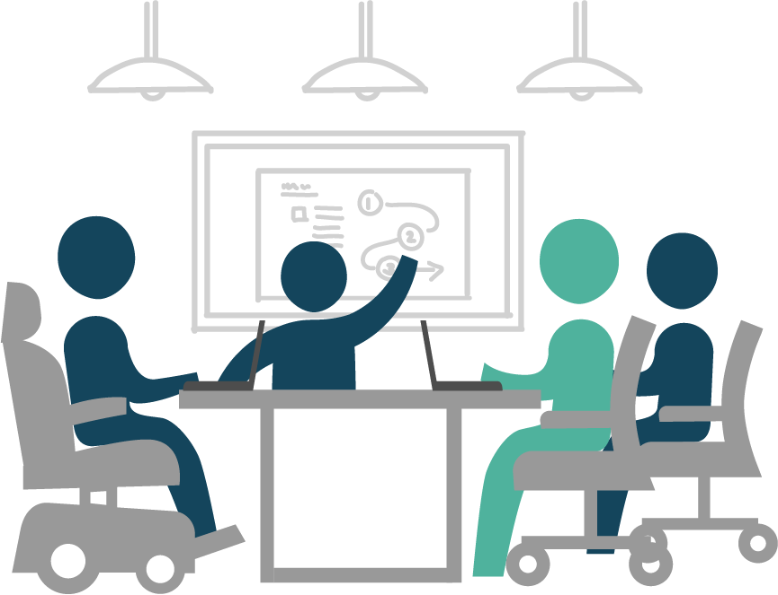
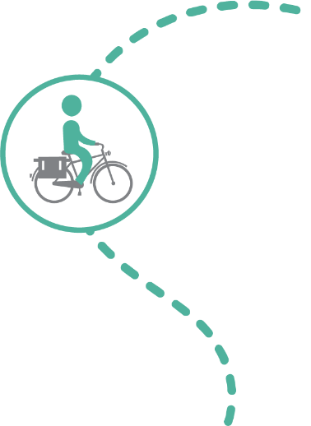
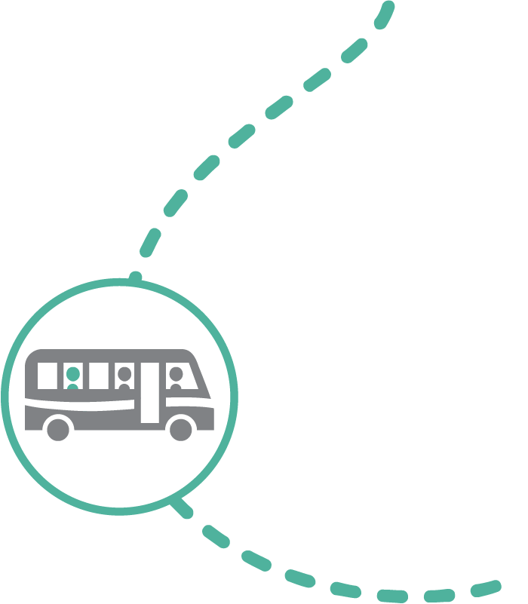
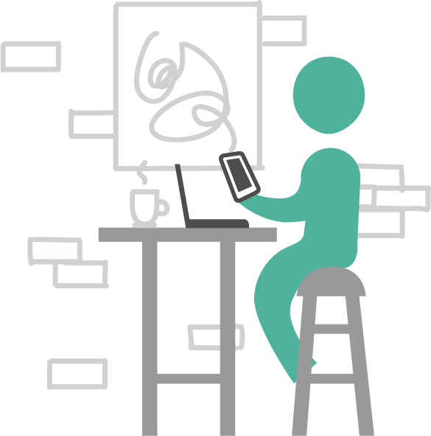
Understanding GCworkplace: Flexibility
Home
Office
"Today my team is brainstorming for a new communications tool that we will be developing. The office is the best place for today's tasks as we will need a lot of space and a large TV monitor."
Other
GCcoworking
"My day today is filled with client meetings! There are no GCcoworking locations nearby and I would lose a lot of time by commuting back and forth to the office so I will be working in a coffee shop in between my meetings."
"I'm working on a project with my colleague today, and since we both live in the same neighbourhood we decided to meet at our local GCcoworking site. This will save us 30 minutes of commute time to the office!"
Notes:
Flexibility means employees are empowered to decide where it makes the most sense for them to work. Let’s look at a few real-life testimonials.
[CLICK TO ANIMATE SLIDE]
"I had an appointment this morning close to home so I decided to work from home for the rest of the afternoon. I planned my week in advance to save my non-urgent individual tasks to complete this afternoon."
[CLICK TO ANIMATE SLIDE]
"I'm working on a project with my colleague today, and since we both live in the same neighbourhood we decided to meet at our local GCcoworking site. This will save us 30 minutes of commute time to the office!"
[CLICK TO ANIMATE SLIDE]
"Today my team is brainstorming for a new communications tool that we will be developing. The office is the best place for today's tasks as we will need a lot of space and a large TV monitor."
[CLICK TO ANIMATE SLIDE]
"My day today is filled with client meetings! There are no GCcoworking locations nearby and I would lose a lot of time by commuting back and forth to the office so I will be working in a coffee shop in between my meetings."
With these examples, we can see that having the flexibility to choose where and how you want to work allows for better productivity, and can contribute to work-life balance. Having flexibility is what allows employees to define their own ways of working; working where it makes the most sense for them.

Slide 13
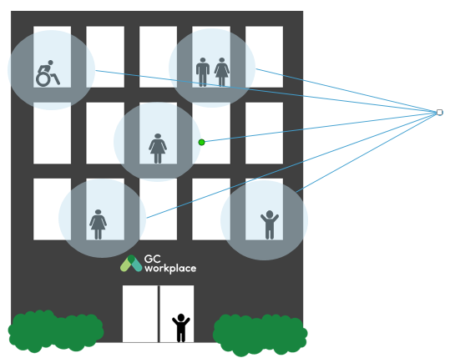
Understanding activity-based workplace and activity-based working
ACTIVITY-BASED WORKPLACE
ACTIVITY-BASED WORKING (ABW)
Notes:
This is an ACTIVITY-BASED WORKPLACE, an environment that supports a new way of working and is based on the principle of activity-based working (ABW). [CLICK TO ANIMATE SLIDE]
ACTIVITY-BASED WORKING (ABW) is a design concept that recognizes that through the course of any day, employees engage in many different activities and that they need and can choose different types of workpoints to accommodate these activities. An ABW environment focuses on the employees and provides the freedom to decide for themselves: how to work, where to work, which tools to use and with whom to collaborate to get the work done.
Source https://www.pure-net.org/images/Annual_Conference_2019/ABW_practice_guide_public.pdf p. 4. A way of working ABW is a way of working and not just a design concept. The core idea is that employees work in a mobile and flexible fashion, making their own decisions as to where and when to work. WHY DO IT? There is an obvious financial incentive for adopting ABW, as the concept allows organizations to make better use of their office space. Just as important, however, is the concept’s aim to empower employees by giving them more control over where and when they work.

Slide 14
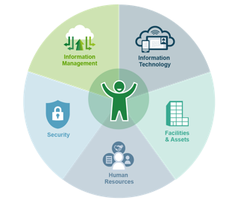
An integrated approach
Going beyond space, towards an integrated vision for workplace modernization
An integrated project includes managing all changes in:
the design of our workspaces;
the technology we use;
the processes that support our work;
the culture of our organizations;
the way we work.
Notes:
With GCworkplace, we are going beyond buildings and space, and moving towards a more holistic vision of the workplace modernization.
What’s a modern workspace without the right tools and processes to support new ways of working?
The key enablers of the modern workplace–Information Technology, Information Management, Human Resources (including Occupational Health and Safety), Security, and Facilities–must be aligned to the organization’s vision for the workplace.
The modernization strategies must be integrated to equip GC employees with the right tools and processes to support fundamental changes in the way we work.
To support departments that are ready to modernize, PSPC has developed the GCworkplace Transformation Playbook. This Playbook is designed to help organizations pinpoint where their workplace is today in reference to where they want their workplace to be tomorrow and beyond and begin to lay out the strategic and tactical actions they can take to move their organization forward. The Playbook will help you prepare for the future–the physical, technological, procedural, cultural and behavioral changes you’ll need to adopt to be successful.
And let’t not forget that the employee pictured here in the middle. They’re the main focus, the reason we are doing this.

Slide 15
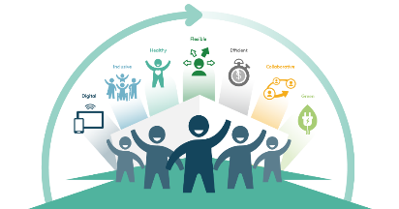
GCworkplace modernization roadmap
FIT-UP PROJECT
KICK-OFF
Assess, imagine & plan
Get on
board
Build the
foundation
Implement & operate
Sustain & reinforce
What is
GCworkplace?
What are our goals and who will help us get there?
How do we actually work, how do we want to work, and what change is needed to make that a reality?
How will we make the change happen?
How will we support
the change?
Workplace modernization awareness
Leadership commitment
Organizational and change readiness
Workplace design
Workplace performance assessments
Workplace vision
Functionality and performance assessments
Project implementation
Sustainability
Integrated project team
Workplace modernization project plan
Change management implementation
Celebrations!!!
Governance & working groups
Workplace change management program
An official project* is required for the following steps.
Workplace culture shift
Notes:
Visualisation od the modernization roadmap

Slide 16
GCworkplace design–5 Key design principles
USER-CENTRIC DESIGN
PROMOTE EQUAL ACCESS TO SPACE
DESIGN FOR ACTIVITIES
ZONE BY FUNCTION
PLAN FOR CHANGE
Notes:
There are 5 guiding design principles of GCworkplace:
USER-CENTRIC DESIGN Understanding the employee experience and involving end-users in the process
PROMOTE EQUAL ACCESS TO SPACE Allowing all employees to choose to work in an enclosed or open space (no longer based on level or seniority)
DESIGN FOR ACTIVITIES Allowing employees to untether from a fixed point and choose the optimal setting for their work activities throughout the day
ZONE BY FUNCTION Three zones which create different work settings – Quiet, Transitional, and Interactive.
PLAN FOR CHANGE A space that is modular and adaptive

Slide 17
Why GCworkplace YOU TUBE: GC employees present ...GCworkplace

Slide 18
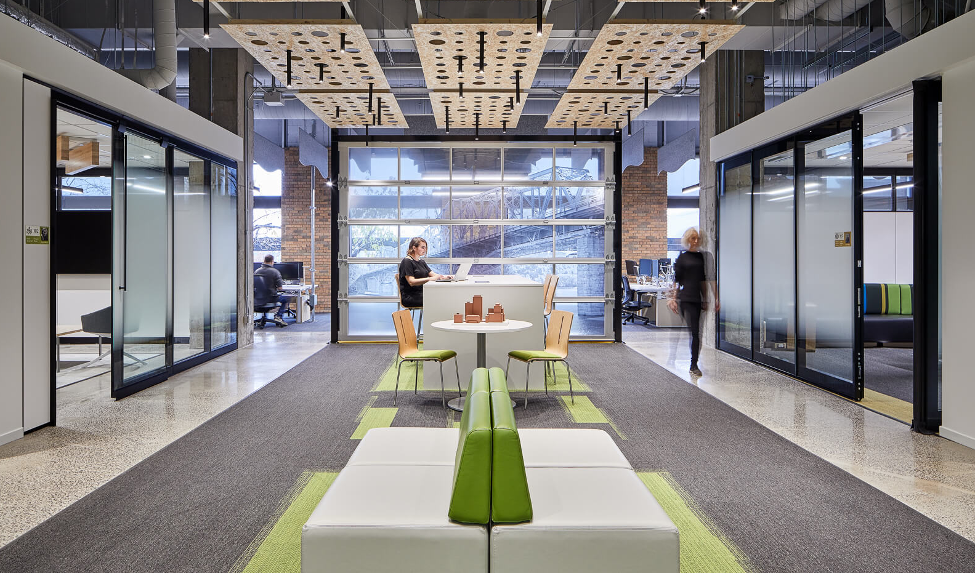
GCworkplace delivers what our public service needs
What’s in it for the employees
Empowers them to choose where and how to work to be most productive
Provides flexibility and greater variety of spaces
Offers modern, open, airy and bright spaces that inspire people
Supports employees health and well-being
Fosters collaboration at all levels
Increase personal productivity by providing better technology and work processes
What’s in it for the departments and agencies of the GC
Is designed to service modern Canada
Be an employer of choice, competitive in recruitment and retention
Business needs reflected in the outcome of the modern workplace
Optimizes efficiency of our facilities and utilization rates
What’s in it for the society
Reduction of commute times and greenhouse gas emissions
Contributes to sustainability goals through data-informed decision making on better ways to work, design, use and manage the workplace.
Notes:
Digital tools and a culture of trust provides employees with mobility and flexibility and it empowers them to work how and where they can be more productive.
Fosters collaboration within teams, within the department, across departments and more.
The flexibility allows for work-life balance integration. One example is that it returns commuting time back to our employees by allowing them to work where they want. The flexibility and the user-centered designs also allow employees to choose how and where to work not only based on their activity, task or deliverable, but also based on how they mentally feel on any given day.
Positions us to attract new, young talent as people retire. Puts the GC in the race as an employer of choice with other private and innovative companies.
Optimizes existing properties/facilities and creates better operational efficiency; saves money by reducing empty office spaces.

Slide 19
GLOBAL TRENDS
“Happy Customers start with Happy and Productive Employees. With Office 365 employees can work in innovative new ways using collaboration tools such as Teams, sharePoint and OneDrive.
“With the rise of mobile technology, today’s workforce has become more mobile, remote and, always-on requiring a flexible and collaborative work experience on any device, anytime, anywhere. This is a critical time for executives and IT leaders; the modern workplace has already arrived and is now a business imperative if you want to stay relevant to your employees and customers.”
“We believe that buildings should be developed with people’s health and wellness at the center of design. The WELL Building standard takes a holistic approach to health in the built environment addressing, behavior, operations and design.”
Notes:
Workplace modernization is a hot subject these days! Many consulting companies offer this service in Canada and in Europe. These are few examples.

Slide 20
Current Trends
Increased investment in IT infrastructure and mobile tools
More people working remotely, more co-working, less dedicated workstations = less utilization of existing layouts
The idea that “work is an activity, not a place” is taking hold in the public service
The workplace evolving towards greater agility and greater choice
Greater flexibility in the way, time and place we work allows as much or greater productivity than being in the office at all times
Employee health and well-being
Growing Gen Z workforce (digital natives)
The purpose of space is changing; how do we prepare for the “next normal”?
Notes:
Slide 6 of Update on Real Property in the Quebec Region, Presentation to the Quebec Federal Council’s Virtual Autumn 2020 Meeting
Real Property Services
November 26, 2020
We have been through the shut down.
We have cleaned the buildings.
We have prepared for the return.
But, the nature of work has moved on. People are not all moving to return to the office.
The discussion has moved on. The ‘new normal’ is not just the old way + distancing and masks.
It’s recognizing that what the office has been, almost since it’s conception, is no longer so simple as where we go to work.
Work is an activity, not a place.
But that begs the question – what is the role of the place, then?
This is what is meant by preparing the ‘next normal.’
If real property is to have a role in the future of work within the Canadian public service, it must defined what is the purpose of the real property assets.
This is the new challenge
Just as the office of old was not a good fit for all tasks and people, the current “everyone works from home” is also imperfect. The answer to the big question about the purpose of work space lies in between:
Collaboration: certain personalities benefit more from physical presence, and there are situations where bringing the team together aids in morale and group identity reinforcement
Flexibility: not all tasks can be accomplished from a variety of remote locations, and people benefit from a variety of environments
Innovation: creativity can be stimulated by interaction with others without the filter of technology

Slide 21
The Big Questions
More than ever, employers are seeking a modern, flexible type of workplace, and for government, that means a workplace that will enable employees to keep serving the Canadian public. By considering the potential shifts in how employees will work in a
post-COVID-19 world, it is important to carefully re-evaluate what the workplace will need to provide by questioning the status quo and rethinking our workplace strategy as a whole.
Will a traditional workplace still support our new way of working?
With many opting to work from home or alternate sites for individual tasks, will our workplace become a place for collaboration?
Will a co-working approach better support our employees by allowing them to select a site that is more conveniently located, perhaps closer to home?
Will we even need a physical workplace at all?
What will employees expect from their workplace?
What are the newly adopted behaviours and mentalities that will guide the way we work in the future?
FUTURE WORKPLACE
Notes:
Slide 5 of Update on Real Property in the Quebec Region, Presentation to the Quebec Federal Council’s Virtual Autumn 2020 Meeting
Real Property Services
November 26, 2020

Slide 22
Workplace Modernization Opportunity
What we know:
Space is the second highest cost after salary¹.
Less than 60% of space is occupied at any given time (pre-COVID).
PSPC’s 2017 studies of attendance at six departments showed an average of 53% utilization per day².
There is every reason to believe that mobility trends will increase from a pre-COVID-19 condition, especially in light of recent investments in IT infrastructure and mobile tools (laptops and smart phones) and a growing millennial workforce.
The trend is to have more people working remotely, more co-working, less dedicated workstations = less utilization of existing layouts.
TIME
OPPORTUNITY TO
ACCELERATE MODERNIZATION
READINESS
Leverage investments in enabling technology
Fewer paper-dependent processes
Traditional people- management culture has shifted
Leadership engagement to tackle these issues
Benefits: Efficiency gains
Increase space utilization and reduce office footprint up to 30%
Reduce government holding costs by disposing of underperforming office buildings (39% of owned assets)
Reduce greenhouse gas emissions by contributing to efficient operations and maintenance costs
Greater ease in absorbing program growth within space and in adapting to changing program needs
Benefits: Employees and employer
Modern workplace (air quality, natural light)
Promote accessibility, flexibility, and well-being
Competitive in the attraction and retention of talent
Flexibility to choose where and how they want to work (mobility, virtual private network [VPN])
Technology enabled workplace (Wi-Fi, business apps)
Ability to collaborate
The GCworkplace idea of “work is an activity, not a place” is taking hold in the public service as a result of recent events.
¹ Property Investment, David Isaac and John O’Leary, 2nd edition, 2011.
² Walkabouts were done six times per day, for two non-consecutive days (Tuesday and Thursday). This was done in early November of 2017, a typical work week in the fiscal year.

Slide 23
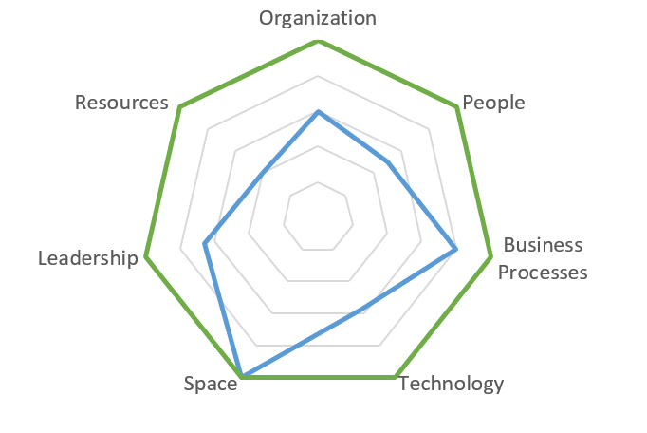
Impact of the current situation on the future workplace
Current
Workplace
(February 2020)
Transition (pandemic situation)
Future workplace?
How is the pandemic impacting our workplace?
What lessons have we learned in the last 11 months?
Which IT tools have been deployed and adopted?
How have employees adapted to a new way of working?
How can we use what we have learned to redefine the future workplace?
How can we keep the momentum?

Slide 24
Moving towards a future workplace
How has the pandemic impacted our workplace, our organization?
Assess the readiness of our organization pre-covid
What has changed?
Redefine our workplace, the way we work and do our business
Re-assess
(as required)
In the context on the Covid-19 pandemic situation, many recommendations being developed are temporary in nature, focused on making best use of current layouts, and making minimal modifications only where required, including simply how space is used rather than permanent changes to layout or design of furniture.
The return to the workplace will be progressive, and it is expected that only a fraction of the space will be occupied at one time. Under this assumption, the space will be used differently by those who return. Attempting to make permanent changes to office layout, furniture, or design in the immediate term may be time consuming, costly, and challenging, and, given the evolving context, may also prove ineffective or unnecessary; in some cases it may negatively impact building systems, egress, and other occupant health and safety measures.

Slide 25
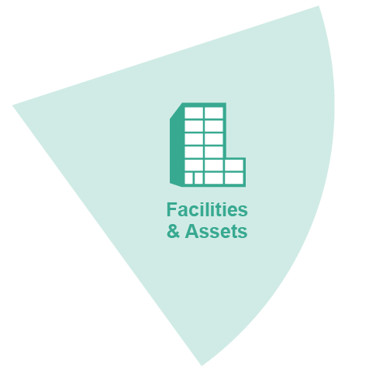
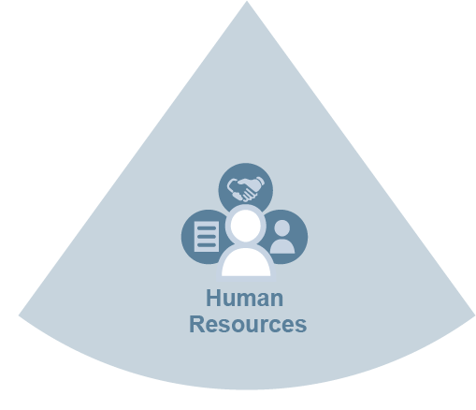
Key considerations that will support a positive employee experience
Flexible, accessible and inclusive workspaces
Virtual and physical space
Activity-based workspace allocation model
Common coworking spaces, campus style workspaces
Optimized real-estate model to balance physical and remote requirements
Tools and collaboration technologies enabling virtual workspaces
Data secure technology solutions
Transition to cloud computing
Distributed talent coast-to-coast
Development of future skills
Agility, culture and tools to mobilize and pivot quickly
Management of distributed team based on results
Positive employee experience
Notes:
Flexible and accessible workspaces and equipment to collaborate and accommodate fluctuations
Virtual and physical space
Common coworking spaces, campus style workspaces
A purpose or usage based space allocation model
Optimized real-estate model to balance digital, urban, and rural needs with physical and remote requirements
Tools and collaboration technologies enabling virtual workspaces
Data secure technology solutions
Transition to cloud computing
Acquiring the top talent
Distributed talent coast-to-coast
Learning the flow of work to develop future skills
Innovative and creative solutions, leveraging diversity of thought across the government
Agility, culture and tools to mobilize and pivot quickly
Management of distributed team based on results

Slide 26
Videos – GCworkplace and ADM RPS Suite (Place du Portage, 9th fl.)
https://f.io/xd0X_8sI (Google Chrome)
https://www.youtube.com/watch?v=NtKOVdOHIl4&feature=youtu.be (Google Chrome)

Slide 27
Mobility advantages - Clients Benefits/Considerations
No external swing space required, leverages teleworking to generate swing space in Phase I and II (no telework required for Phases III and IV).
No swing space lease and move costs for clients.
Minimizes employee moves to and from swing space.
Minimizes occupant disruption as employees are not relocated within the complex during phases 1 and 2 due to telework and co-working.

Slide 28
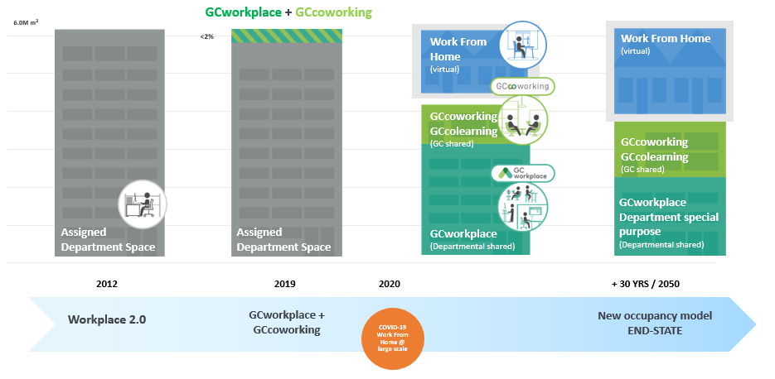
Looking Into the Future
Notes:
Slide 11 of Update on Real Property in the Quebec Region, Presentation to the Quebec Federal Council’s Virtual Autumn 2020 Meeting
Real Property Services
November 26, 2020
Version dated: October 22, 2020

Slide 29
Our current workplace state

Slide 30
Name of the organisation
I fill in the current state of my organisation.
- Snapshot of the current workspace being occupied by the organization
- Current rate of occupancy;
- Current mobility state;
- Current tool being used;
- Current challenges and advantages.
Notes:
In this slide, the client will fill out the current state of their organization.
On the Gcpedia page https://www.gcpedia.gc.ca/wiki/GCWorkplace_Change_Management_Playbook, you will find tools to help you assess the state of your organization. Filling out these tools can help you leverage this information.
Project readiness assessment tool
This assessment tool is used at the beginning of a workplace modernization project, it can identify the critical key enabling elements that are necessary to take on the project and ensure its success. It is usually completed by the project team in collaboration with the representatives of the key-enabling sectors (IT, IM, HR, Security, Facilities and Assets). https://www.gcpedia.gc.ca/wiki/GCWorkplace_Change_Management_Playbook
This tool provides a high-level portrait of the organization that can be used to:
- identify the organization’s readiness for change;
- identify potential challenges, gaps and opportunities that should be addressed before, or as part of, the workplace modernization project.

Slide 31
Impacts of pandemic situation

Slide 32
Impacts of pandemic situation
Temporary: Impacts of pandemic situation on new behaviors and new ways of working
Example: Include survey results during pandemic (Teleworking,
Collaborative tools, well-being, work-life balance, IM, etc)
Notes:
-Did you have your employees complete a survey during the pandemic? Do you have results that could complement this Business Case? Ex: 70% of the employees wish to continue teleworking after the pandemic is over; 65% of the employees are satisfied with the collaborative platforms used for meetings; etc.
Include pre and post COVID numbers.

Slide 33
Opportunities for Modernization and Change

Slide 34
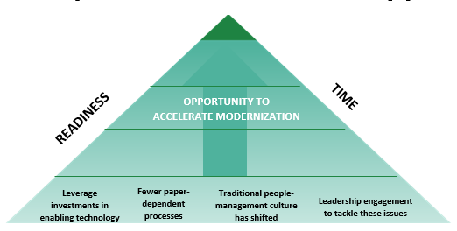
Workplace Modernization Opportunity
What we know:
Space is the second highest cost after salary¹.
Less than 60% of space is occupied at any given time (pre-COVID).
PSPC’s 2017 studies of attendance at six departments showed an average of 53% utilization per day².
There is every reason to believe that mobility trends will increase from a pre-COVID-19 condition, especially in light of recent investments in IT infrastructure and mobile tools (laptops and smart phones) and a growing millennial workforce.
The trend is to have more people working remotely, more co-working, less dedicated workstations = less utilization of existing layouts.
Benefits: Efficiency gains
Increase space utilization and reduce office footprint up to 30%
Reduce government holding costs by disposing of underperforming office buildings (39% of owned assets)
Reduce greenhouse gas emissions by contributing to efficient operations and maintenance costs
Greater ease in absorbing program growth within space and in adapting to changing program needs
Benefits: Employees and employer
Modern workplace (air quality, natural light)
Promote accessibility, flexibility, and well-being
Competitive in the attraction and retention of talent
Flexibility to choose where and how they want to work (mobility, virtual private network [VPN])
Technology enabled workplace (Wi-Fi, business apps)
Ability to collaborate
The GCworkplace idea of “work is an activity, not a place” is taking hold in the Public Service as a result of recent events.
¹ Property Investment, David Isaac and John O’Leary, 2nd edition, 2011.
² Walkabouts were done six times per day, for two non-consecutive days (Tuesday and Thursday). This was done in early November of 2017, a typical work week in the fiscal year.

Slide 35
Opportunities for Modernization and Change
Highlight a link between one of your organization’s strategic objective and GCworkplace objective!
Example: If one of the department’s strategic objectives is to become more innovative, leverage this objective with a similar objective of the Gcworkplace (ex: a modern workplace fostering a culture of innovation, improving how we leverage digital technology to encourage government-wide collaboration, flexibility and efficiency.) See next slide for an example
Notes:
Research you Departmental Plan (en début d’année) – which includes the vision, the strategic objectives and find the link between those and the Gcworkplace objectives,
For example, everyone in the Public Service must follow the PS Renewal Beyond 2020 Initiative https://www.canada.ca/en/privy-council/services/blueprint-2020/beyond-2020.html
- Demonstrate how GCworkplace can help you meet these strategic objectives (see next slide)

Slide 36
GCworkplace and Beyond2020: one direction
Where the vision for the workforce goes, the vision for the workplace goes
Beyond 2020
Notes:
The workplace is a tool that departments can use to support Public Service Renewal and to embrace the Public Service vision for the workforce.
GCworkplace vision
Fostering a culture of innovation, improving how we leverage digital technology to encourage government-wide collaboration, flexibility, and efficiency. It’s also about putting into place actions that integrate sustainability and improve the overall health and wellbeing of employees and ensuring inclusivity for all.
Beyond 2020
In a time that is increasingly characterized by data, digital, new workplace designs, flatter work cultures, and multiple generations working together, it is critical to examine and adopt the mindsets and behaviours that will meet the changing expectations of Canadians. The desired outcome is a Public Service that is more agile, more inclusive, and better equipped.

Slide 37
Current Transformational Initiatives

Slide 38
Current Transformational initiatives
Describe here current transformational initiatives happening in the organization and how an innovative workspace might enable them to be more productive.
Example: If an organisation has already in place, or plan to put in place one or more modernization strategy (HR? IT? IM? Facilities? Security?), leverage that initiative!

Slide 39
Summary
Closing arguments:
Highlight the most important elements;
Think of what will convince your audience!
Notes:
Bring out the most important facts and the highlights, what will convince your audience. Make a nice wrap-up.

