Slide 1
Instructions
Go to the calendar invite and click on 1 of the project team links
Please join your project if it is available, if not join one that interests you
Identify a note taker (ideally have good internet connection for screen sharing through MS teams)
Note taker
Please download the slide and screen share while taking group note
This is a 2 part reflection exercise
1 min internal reflection
5 min team reflection
Individually (1 min)
Reflect and/or answer the questions in quadrant 1/A (1 min)
As a project team (5 min)
Reflect and discuss your responses to 1/A as a group
Note taker please document the discussion in the slides where possible (eg. Key words/bullets)
Repeat for subsequent quadrants
Some questions where borrowed from WAGE. For more resources access WAGE’s website: https://cfc-swc.gc.ca/gba-acs/guide-en.html

Slide 2
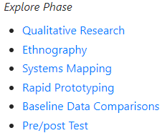
Explore phase
1. Our research question is informed by:
… who is being studied (by gender and other aspects of identity)? … the socio-historical experiences of those being studied? Are there biases in the literature that perpetuate stereotypes? … consultations (with internal and external stakeholders, subject matter experts, and those with lived experience) that inform problem definition and other aspects of the research process?
2. Our research design looks at:
… factors in addition to gender (e.g. ethnicity, geography, socio-economic status, ability, Indigenous and immigrant status)? … ways to enable investigation of differences among and between groups (by gender and other aspects of identity)? ... interventions that aim to reduce barriers for target groups while not adversely impacting others.
3. Our consultation strategy includes:
… enough individuals with context to explore the question? Will they help design for the “edges”, the most vulnerable? … a diverse mix of future recipients of the intervention as well as perspective on the potential adverse effects of specific interventions. … advisors on whether the sampling approach reinforces traditional notions of representation that focus on most commonly shared experiences?
4. GBA+ integration so far:
Where in our current project are the gaps in applying GBA+ thinking and methodology at this stage? What actions can we take to address these gaps?

Slide 3
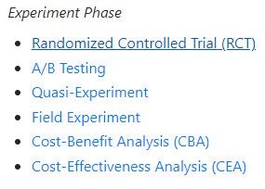
Experiment phase
A. Implementation:
The research design uses collection methods that support the gathering of data for disaggregation by gender as well as other aspects of identity. Does the data collection strategy provide opportunity for expression of diverse experiences and perspectives? Do you have means of monitoring if adverse effects are occurring during the trial?
B. Data analysis:
How will the analysis acknowledge differences within and differences between groups (by gender, and other aspects of identity)? Does the methodology address the gaps identified in the literature review. What limitation are there for the interpretation of results if there was unequal sampling or limited representativeness diverse groups?
C. Communicating findings:
Based on the results, are there implications for diverse groups of men and women? Based on the entire process what did the team learn or unlearn about the implications for diverse groups of men and women? Do power and inequality contribute to the findings? If so, how?
D. GBA+ integration so far:
Where in our current project are the gaps in applying GBA+ thinking and methodology at this stage? What actions can we take to address these gaps?
* It can always be beneficial to take a step back and reflect on the explore phase questions *

