Slide 1
Canada recovery benefits
For presentation at Theme Management Committee (TMC)
October 19, 2020

Slide 2
Overview
New benefits launched on October 2, 2020 (after getting Royal Assent)
Canada Recovery Benefit (CRB)
Canada Recovery Caregiving Benefit (CRCB)
Canada Recovery Sickness Benefit (CRSB)
ESDC led the policy and CRA is leading the administration of the benefits
Product team model
Product Manager, Content Designers, UX Lead, Interaction Designer, Conceptual Designer, Web Developers, Data/Analytics Lead, QA/Translation Lead
Notes:
CRA worked on launching 3 benefits simultaneously
Cross-functional team within our division

Slide 3
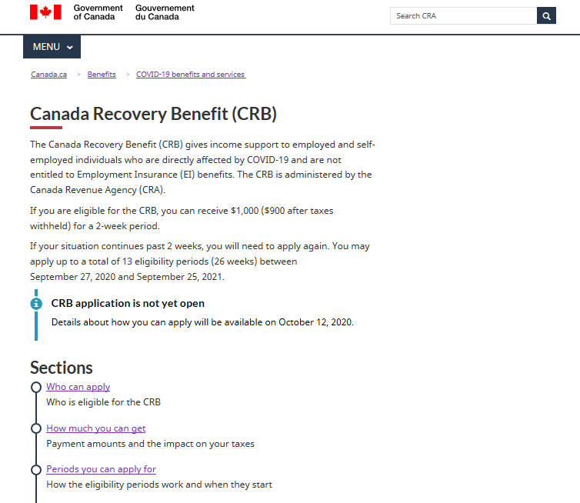
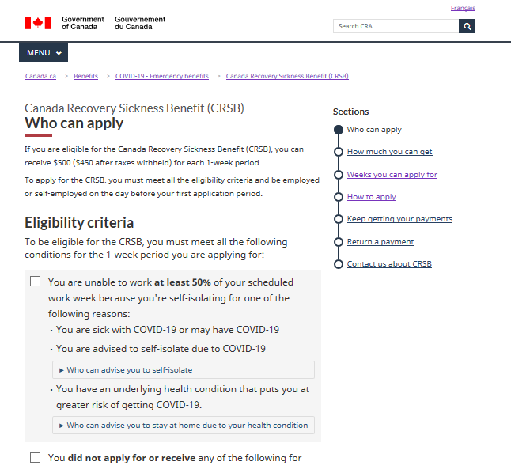
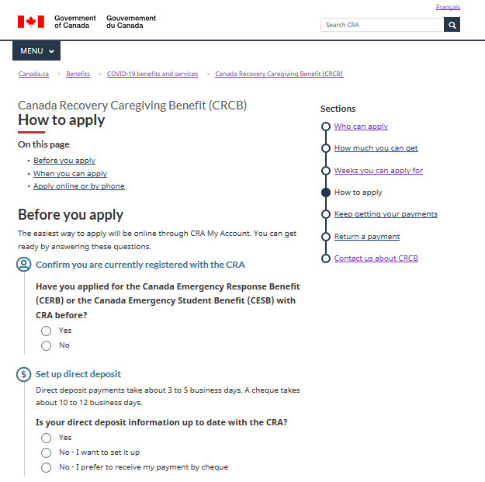
Development of benefits
Used lessons learned and same template as CERB and CESB
Call drivers, analytics and UX testing
Tried and tested template

Slide 4
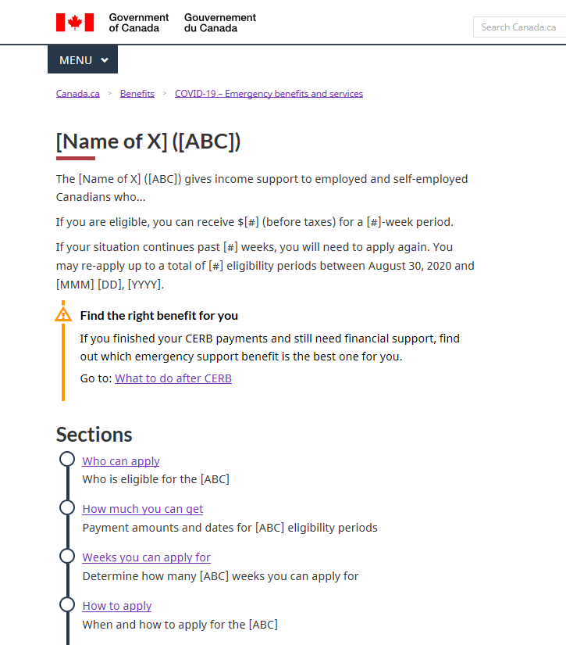
Development of benefits (cont’d)
UX tested the template with some new concepts
Test focused on the top tasks from CERB and CESB
Tested navigation and findability within the template
Tested the usability of the improved interactive elements, such as field flows and calendars

Slide 5
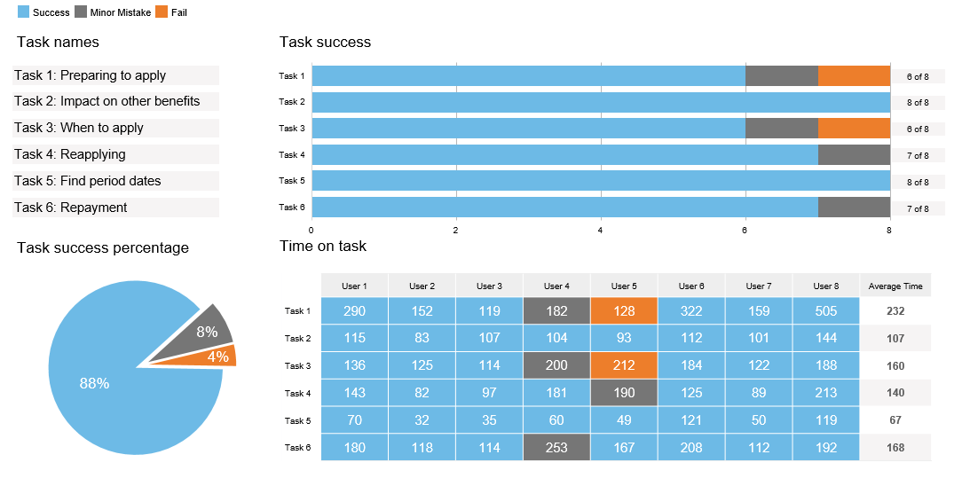
Development of benefits (cont’d)
Template UX testing results

Slide 6
Development of benefits (cont’d)
Held content design sessions and a QA session with partners
Product team + representation from programs and legal
3-hr content design sessions (x 3)
3-hr QA session (x 1) prior to approvals
TBS led UX testing of transition (CERB, EI, new benefits)
Helped with intragovernmental collaboration
Got everyone on the same page
Addressed content duplication
Smoother user journey across Canada.ca
Notes:
Content design process (Anne)
Usefulness of content design sessions with programs/legal (Anne)
Helped to have a “third party” department lead the testing, also one of authority to implement the changes

Slide 7
Post launch
Analytics so far
Traffic totals since launch (up to and including October 18)
CRB page set: 2.5M
CRCB page set: 272K
CRSB page set: 231K
Top pages for all benefits: Landing page, Who can apply, How to apply
Mobile traffic averaging between 66-70% for all 3 benefits
Search - average search result position for top 10 keywords:
CRB: 1.48
CRCB: 1.84
CRSB: 1.8
Notes:
Working on adding structured data to CRB pages

Slide 8
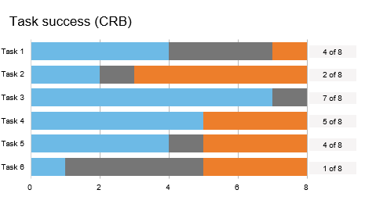
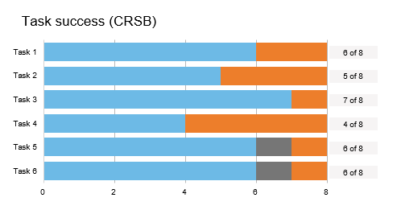
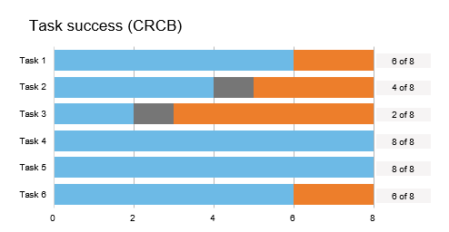
UX testing: Round 1
Testing was done post launch due to time crunch
Applied lessons learned from CERB/CESB UX testing rounds and TBS UX testing on transition
Tasks
Eligibility and initial application tasks
Focus on expected top tasks and actionable design questions
Results
Results are currently being analysed

Slide 9
Questions
Natasha Pecarski, Product Manager, CRA
Natasha.Pecarski@cra-arc.gc.ca
613-601-5216

