Slide 1
The Canada.ca Re-Procurement Project
GC Web Priorities
April 24, 2024

Slide 2
Canada.ca Platform – Core Technology
Current Core Technology
The Managed Web Service (MWS) platform is the core technology infrastructure in place that operates the Canada.ca website. It provides enabling technology and platform services to host and secure Canada.ca in the cloud.
The MWS contract has the advantage of one point of contact as one sole service provider is accountable for end-to-end services, rather than three separate points of contact.
Re-Procurement
The Need
Canada.ca has been operating on the MWS platform since 2015.
In 2023, Treasury Board Ministers approved an additional three years, plus three option years for the MWS contract. It will expire in six years (March 2029) with no extension years possible.
The Goals
Continue with the success of the current MWS platform, which provides 100% availability for the public to access Canada.ca’s trusted source of information.
Get the best procured solution to support the public and the departments serving them by following a fair and transparent procurement process.
Establish Canada.ca at the forefront of client service excellence with a whole-of-government approach, while remaining secure, reliable, scalable, privacy-driven, and barrier-free.
Procure for the future, ensuring that the next platform can meet evolving needs and align with the GC digital ecosystem.
Cybersecurity and content distribution network
Cloud hosting
Content management system and analytics
1 contract

Slide 3
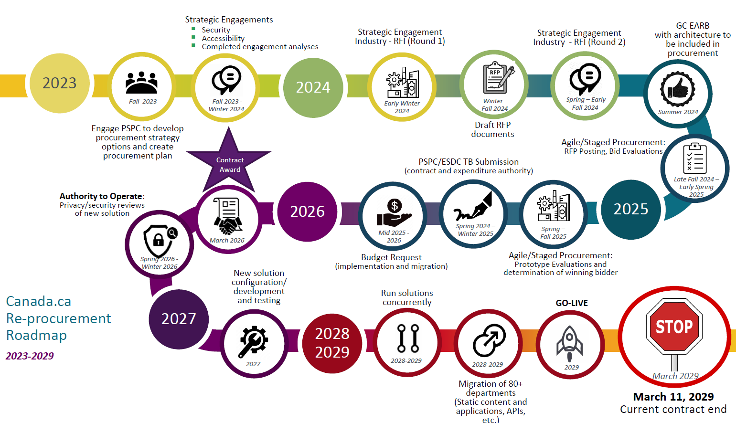

Slide 4
Canada.ca Re-Procurement Governance
Canada.ca Interdepartmental
Canada.ca Re-Procurement
Canada.ca Interdepartmental
OPERATIONS
PRINCIPAL
ENTERPRISE
Web Executive Board
Assistant Deputy Minister (ADM)
Canada.ca Re-Procurement ADM Committee (decision)
Co-chairs SC/CDS
Membership: SC, CDS, ESDC CIO
Canada.ca Re-procurement ADM Committee (steering)
Co-chairs SC/CDS
Membership: SC, CDS, ESDC CIO, ESDC CCXO, TBS OCIO, TBS CTO, TBS CISO, CCCS, PSPC
Deputy Minister Committee on Enterprise Priorities and Planning
(DM CEPP)
Web Priorities
Assistant Deputy Minister Committee on Service and Enterprise Priorities
(ADM SEP)
Working group(s)
(as needed)
Director General (DG)
Canada.ca Re-Procurement DG Committee (recommendations)
Co-chairs SC/CDS
Membership: SC, CDS, ESDC CIO
Canada.ca Re-procurement DG Committee (steering)
Co-chairs SC/CDS
Membership: SC, CDS, ESDC CIO, ESDC CCXO, TBS OCIO, TBS CTO, TBS CISO, CCCS, PSPC
GC Enterprise Architecture Review Board
(GC EARB)
Leverages existing governance
Other Government of Canada committees
(as needed)
Leverages existing governance
Canada.ca Re-procurement working group(s)
(as needed)
TBS, SC and PSPC to identify reps for working level team
SC will establish governance secretariat

Slide 5
GC Departmental Contributions
Priorities Brainstorming Session: Canada.ca Business Needs
The Digital Transformation Office conducted a brainstorming session with the Web Executive Board community (Director level) in September 2021.
Participants included Privy Council Office, Treasury Board of Canada Secretariat, Service Canada, Canadian Digital Service, Public Safety Canada, Finance Canada, Administrative Tribunals Support Service of Canada, Innovation, Science and Economic Development Canada, Canada Revenue Agency, Department of National Defence, Transport Canada, Health Canada/Public Health Agency of Canada, and Indigenous Services Canada.
Focus of the session was on (1) highlights and successes; (2) challenges and pain points; and (3) priorities for GC Web.
Survey on Business Capabilities for Canada.ca
The Digital Transformation Office conducted a survey with the GC web community in the spring of 2022.
47 participants across 31 GC institutions completed the survey.
The goal of survey was to gain a better understanding of the business and technical capabilities required to create, deliver and manage Web information services on Canada.ca.
Business capabilities included, but were not limited to: design, research, development, publishing, hosting, management, and performance measurement.
For the context of the survey, ‘Canada.ca’ = entire Government of Canada online presence.

Slide 6
New Revised Business Capabilities Being Explored
Personalization Engine
Capability: Allows departments to offer personalized content, experience, functionality, and suggestions that are tailored to public user attributes based on their profile, preferences, interaction history, pages viewed, etc.
Example: Predictive content recommendations based on user preferences.
Eligibility Screening
Capability: Allows departments to create evaluation processes that determine user qualifications or entitlements to GC services and benefits.
Example: Enhanced benefits calculator.
Rules Engine
Capability: Provides departments with the ability to create rules-based user experiences that enable dynamic content personalization based on user actions.
Example: Automated reminders for incomplete forms.
Application intake (forms/applications)
Capability: Allows departments to offer more user-friendly interactions, including prefilled forms, lists of benefits or services and access to application portals.
Example: Pre-filled forms.
Interaction and Service Analytics
Capability: Delivers comprehensive insights into user behaviors and preferences across different platforms coupled with AI-assisted analysis and reporting. This supports effective data-driven decisions and strategies to enhanced services.
Example: User Sentiment Analysis of specific GC services.
Recommendation Engine
Capability: Provides the ability to offer context-relevant and personalized recommendations typically for services, benefits or information that may be of interest to the client.
Example: A recommended benefit or service that may interest a public user.
Integration into Broader GC Digital Ecosystem
Capability: Enables departments to easily share content from other GC platforms to create harmonized government services across all channels. This interoperability helps in leveraging content more efficiently, reducing silos, and enhancing the overall user experience.
Example: Seamless whole-of-government engagement.
Dynamic survey widgets
Capability: An interactive and dynamic process to create and deploy surveys adapted to user responses in real-time.
Example: Dynamic wizard surveys.
Conversational platform (Chatbot)
Capability: Provides departments with the ability to create customized conversational experiences, including natural language processing (Large Language Models – AI) and common look and feel.
Example: Chatbot for service enrollment assistance that will put a user in touch with a service agent.
What was Heard:
Other capabilities flagged by departments
Captured in the Request for Information
To be considered for the
Request for Proposal
Experimentation / Testing
Experimental environments to support protype building within GC Digital Ecosystem
Editing of prototypes
Automations (Self-Serve)
Automated accessibility validation
Automated broken link identification
UX / Optimization
UX recruitment
Track experimentations
Integration with data stacks
Omni channel data pipelining
Archiving
Content life cycle management in alignment with GC requirements
Content/workflow Optimization
Flexible-dynamic workflows.
Highlighting microdata
Track changes/version control/QA
Language toggle
Bulk edits
Analytics (Evolved)
Data visualization
Custom reporting
Create unified client profiles across service channels
Integrated with CMS
Multiple Language
Translation of content
Publication/template support
Protected B
Security and privacy posture to support authenticated and transactional environments, content for forms, embargoed content, etc.

Slide 7
Industry Request for Information (RFI)
Strategic Goals
Purpose
Approach
Focus
Risk Mitigations
Timing
Led by:
Service Canada
Supported by:
PSPC
Leveraging:
Fairness Monitor
Have a fair and transparent engagement and procurement process with Industry.
Through Public Service and Procurement Canada (PSPC), work with Industry to select a vendor that will provide the GC with a digital platform that is at the forefront of government digital services and meets the evolved needs of the public and GC departments who serve them.
​
Gather an understanding of industry landscape, vendor capabilities, and costs. ​
Raise within the industry to build competition for the contract.
Inform the Request for Proposal (RFP) – the document against which the industry bids​.​
Initial engagement to inform procurement strategy.
Request for Information (RFI).
Background and initial questions to interested vendors.
Industry Day (presentation and feedback session with interested vendors).
Vendor one-on-ones sessions.
Contracting leading vendors to prototype their product for evaluation (possibly, depending on RFI informed procurement approach to be taken).
Learn about:
Current foundation plus.
Personalization of user experiences based on preferences and interactions.
Integrations into the broader GC digital ecosystem.
Benefit and program eligibility determinations.
API connections.
Rules and recommendations engines.
Survey widgets.
Accessibility.
Mitigates risk of failed RFP.
Mitigates risk of complaints.
Follow fair and transparent process with prevention of complaints with fairness monitor in place.
Follow PSPC procurement direction through partnership approach.
Leverage strategic engagement to ensure collaborative approach is taken that will capture needs, expectations, and requirements and relay as needed to Industry.
Collaborate in drafting the RFI to capture requirements.
March 2024: Post RFI.
Spring/Summer 2024: Draft requirements.
Summer 2024: Hold Industry Days/ One-on-Ones.
Summer/Fall 2024: Work with governance partners to finalize requirements.
Fall 2024: Share draft RFP with industry for feedback.
Fall 2024: Determine procurement strategy
Winter 2024/Spring 2025: Post the RFP. Evaluate the results. Proceed with chosen strategy.

Slide 8
Request for Information
Present updates on RFI results.
Next Steps
Requirements
Canada.ca Re-Procurement Project team to continue reviewing the workshop and survey result for impact on detailed requirements.
Return to GC Web Priorities Board for an overview of draft requirements.

Slide 9
Annexes:
Canada.ca - Capability Overview
Canada.ca - Evolving Service

Slide 10
Annex A
Canada.ca - Capability Overview
The Government of Canada’s main gateway to digital service experiences
Current Capabilities – Information-as-a-Service
Future Capabilities
Canada.ca User Experiences
What users are expecting and needing
Authoritative
GC’s trusted information accessible under one GC online presence
Reliable
100% availability of Canada.ca since 2015
Secure
100% secure despite record breaking cyber attempts.
Informative Interactions
Email notifications, geo-targeting, voice enablement
Findable
Content is found in top search results on major search engines and via voice platforms.
Personalization
Access to information and services based on user preferences, profiles, and interactions. Receive updates on program applications.
Interactive
Submit requests, surveys, applications across programs in an interactive way.
Go from self-serve web to call centre support to in-person with all parties aware of info.
Transactional
Complete service and program applications across service journey channels.
Tell-Us-Once
Provide information only once to the GC
Internal capabilities
Leveraging the current success
Flexible Look and Feel
- Major Campaigns -
Flexibility to meet needs of static info but also apply unique look and feel
(ex: Queen’s memorial banner)
Headless CMS
Enables the ability to share content simultaneously with multiple departments to multiple platforms and devices.
Real-Time Updates
Automates display of routinely changing data/info in real-time.
Integrations across platforms
APIs allow seamless integrations across the GC and systems
Scalability
Scales on demand to meet access demands and publishing
Additional internal capabilities to support the public
Personalization Engine
Customize the visitor experience based on preferences, profiles, languages, and interactions
Rules and Recommendation Engines
Supports the personalization of content and provides recommendations for programs based on profiles and interactions.
Analytical Insights
Measure, collect, assess, and report client’s interactions with service delivery officers across channels. Ability to have AI analytics to optimize client and service experiences.
Protected B
Security and privacy posture to support authenticated environments
Search Engine Optimization
Publishers can optimize content to increase pick-up by search engines
Content Fragments
Enables the reuse of content, independent of layout, in multiple places.​ Author in a single place and publish to many.​
Email Notification Service
Provides the public with information by subscription service .
Chatbot (Lite)
Available for the public to find info easily and quicker
Survey Widgets
Create and design responsive surveys. A dynamic range of output is displayed.
Integration into Broader GC Ecosystem
Continued integration with other systems on different platforms – including microservices.
Program & Benefit Eligibility Determination
Authenticated/non-authenticated support
e.g. Enhanced benefit calculator
Multiple Languages
Provide content in multiple languages
Self-Serve
Automated accessibility validations, etc.
Geo-targeting
Delivers different content to public based on geo locations (ex: BC Floods)
Voice Enablement
Website is optimized for voice assistants, like Google Assistant/Amazon Alexa)
Accessibility, Bilingualism, and Mobile
Platform automatically ensures the system supports content on all fronts
Evolving Technology
Technical versioning updates built into the contract, prevents technical debt/rust out
to become a global leader
Chabot with Natural Language
AI-driven chatbot conversations. Integrated and supported in service journey between self-serve web and call centre support.
Data Exchange Authorities and Platform
Ability to use and share user data and info across multiple departments while protecting privacy
Experimentation
Environments to support experimentations and protype building across the GC and programs.
UX/
Optimization
Omnichannel UX testing/recruitment and data pipelining
Publishing Surge Capacity
Common platform allowing additional publishing support across the GC during critical situations
Robust Security
100% uptime/availability since 2015, despite record breaking traffic and cyber-attempts
Built-in Web Analytics
Provides in-depth insight into visitor behavior, allowing for optimized web content performance, better business decisions, whole of government approach
Managed Web Service – Foundation of the GC Ecosystem with OneGC focus
Web publishing (CMS/analytics) | Cyber defence (with content distribution network) | Cloud hosting

Slide 11
Canada.ca - An Evolving Service
Annex B
2015-2019
2019 to 2027
2027+
Web Renewal Initiative
OneGC
Future State Architecture
Outcome: Acquired – Configured – Migrated
Outcome: Sustained – Modern – Adapted
Outcome: Personalized – Authenticated – Transactional
Managed Web Service (MWS)
Minimum viable service
Canada.ca Ecosystem
GC Enterprise Service
Personalization
Eligibility determination
Google Home
SEO
Submit request for service
Publication
Alexa
Mobile
Friendly
Apply for a benefit or report an incident
Open
Source
API
Publication
Client
Surveys
New insights through interaction and service analytics
Distribution
Web
Services
Real Time
Reporting
Analytics
Distribution
Chatbot with natural language
Cloud Storage
Active Cyber
Protection
Rules and recommendations engines
Scalability
On Demand
Encryption
Cloud Storage
Survey widgets
Open Data
Integration into broader ecosystem
Current state
38 migrated
institutions
83 institutions using
GC Newsroom
53 un-migrated
institutions

