Slide 1
Introducing the Canadian Centre for Climate Services
GC Data Conference 2022
February 2022

Slide 2
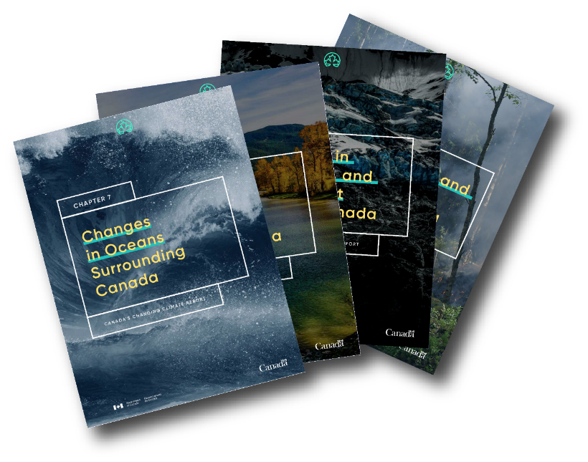
Canada’s Climate is Changing
Effects of widespread warming are evident in many parts of Canada and are projected to intensify in the future
These changes can bring significant impacts and risks
Infrastructure, health, food security, and economy can all be affected
Climate data and information helps to understand and plan for these changes, to reduce vulnerabilities and risks, adapt and build climate resiliency
Canada in a Changing Climate (2019 – onwards)
Several Reports
Climate Report, National Issues, Regional perspectives, Health, Map of Adaptation Actions
Source: Environment and Climate Change Canada (2019) Canada’s Changing Climate Report http://www.changingclimate.ca/CCCR2019
Notes:
[Canada’s climate is changing causing impacts of rising temperatures, shifting precipitation patterns, thawing permafrost, sea level rise as well as changes to extreme weather events such as heat waves, droughts and floods.
These changes can cause significant risks to our communities, economy, critical infrastructure, food security and health.
Many Canadians are vulnerable to these risks
As these risks continue to increase, more and more Canadians are recognizing the need to understand and adapt to climate change; however, one of the most significant barriers to adaptation identified is a lack of access to reliable and relevant climate data and information.]

Slide 3
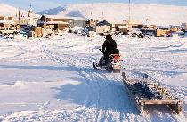
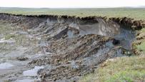
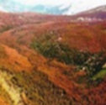
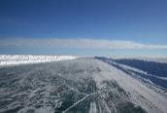
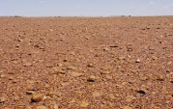
Climate Change Impacts
Figure Sources: Agriculture and Agri-food Canada, SmartICE, Wikipedia, Wikimedia, Ouranos, BC Hydro, flickr
Notes:
Regions across Canada are experiencing impacts as a result of climate change.
The type of impacts of interest to a particular region are often location-specific.
Coastal communities could be experiencing an increase in coastal erosion or coastal flooding as a result of rising sea-levels or extreme weather events.
Rural, agricultural communities could be experiencing impacts from changing drought conditions or changing growing seasons.
Northern communities could be experiencing impacts from permafrost degradation or changing sea ice conditions.
There is lot of concern relate to extreme weather events like storms and wildfires, however longer term more chronic impacts are also a concern. For example increasing temperatures can increase energy use and demand in the summer for cooling.

Slide 4
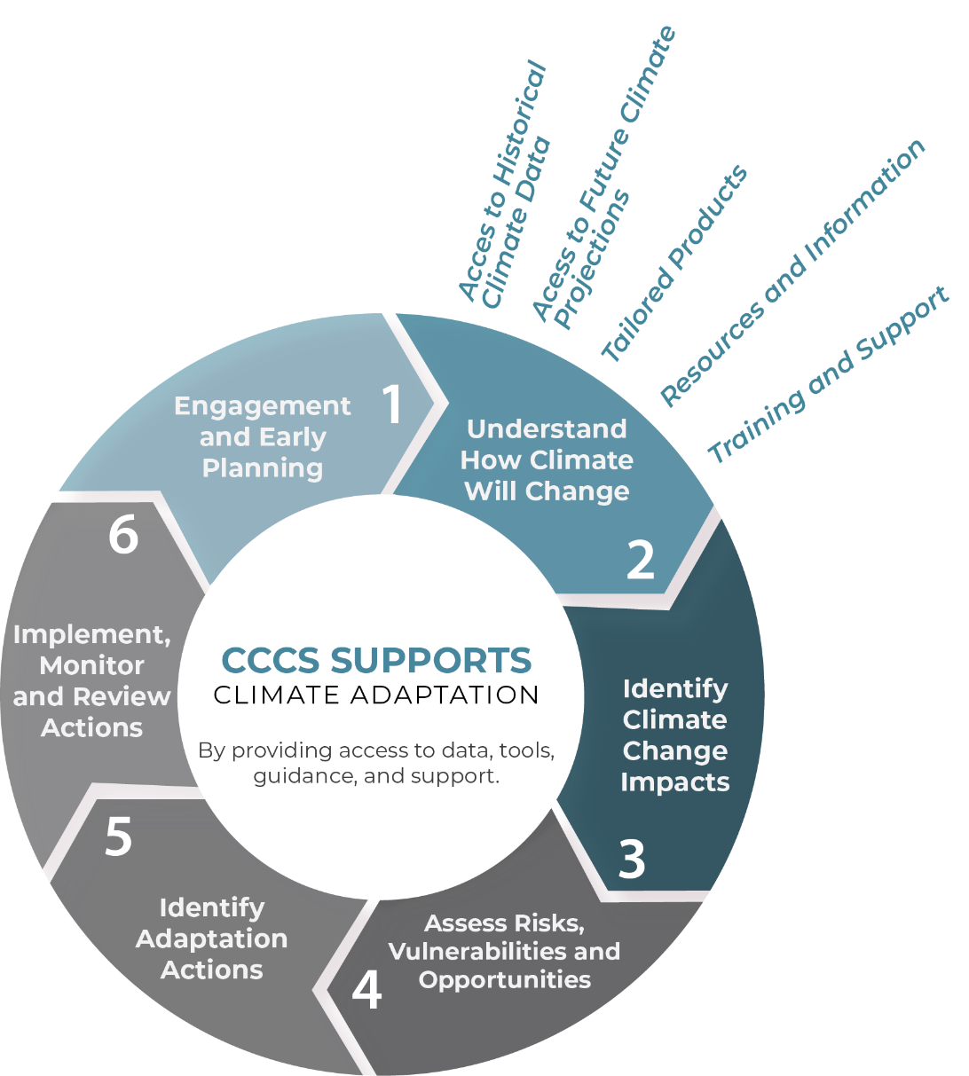
Climate Data Informs Adaptation
Role of Canadian Centre for Climate Services:
Access to historical climate data
Access to future climate projections
Tailored products
Resources and information
Training and support
Notes:
Climate information is needed to assess impacts, risks and opportunities
To prepare for the future and reduce the risks from climate change we need to adapt.
This figure shows the role of ‘climate information’ in the adaptation planning cycle:
Engagement and early planning
Understanding how climate will change
Identifying climate change impacts
Assessing risks, vulnerabilities and opportunities
Identifying adaptation actions
Implementing, monitoring and reviewing actions
Climate data and information is an important element of the data and information gathering step to make informed planning and management decisions.
Access to historical climate data
Access to future climate projections
Tailored products
Resources and information
Training and support
Sometimes the climate data and information is available but people are unaware or are uncertain how to use it.

Slide 5
Decision Makers Have Many Questions…
Will farming in a warmer climate benefit me or add additional risk?
I want to model future air-conditioning demands for my new building
I need to better understand the future risks of spring flooding in my community
We need to upgrade a sewer system, how should climate change factor in the design?
Notes:
The CCCS is founded on a strong user-centered approach.
Climate services include:
Increasing awareness and access to existing climate information and data in a manner and form that is understandable and useful to the audience
Providing support for incorporating climate change considerations into decisions through the Climate Services Support Desk and training sessions
Engaging with users to understand needs
Developing new products through collaboration with experts and users
The CCCS can help you find the data and information you need to inform your planning decisions and help you reduce risks from climate change.

Slide 6
Climate Services Can Help
Modelling & reanalysis
Hosting data
Creating tools to process data
Training and support
Decision making based on data
Observations
Turning climate data into information that supports decision making
Climate Scientists
Developers
Experts
Decision Makers (users)
Engaging with different stakeholders to continually drive innovation
Notes:
IPCC:
Climate services
Climate services refers to information and products that enhance users’ knowledge and understanding about the impacts of climate change and/or climate variability so as to aid decision-making of individuals and organizations and enable preparedness and early climate change action. Products can include climate data products
The climate service value chain: turning data into information that supports decision making
This diagram shows: taking raw observations, climate model output, and other large datasets into tools and products that can be used by decision makers. Engagement with users helps discover what users need, and this info is fed back up the value chain to inform the development of new data and products.
CCCS is like the ‘grease’ in this value chain, we connect key players and facilitate continual development and innovation of climate services across Canada

Slide 7
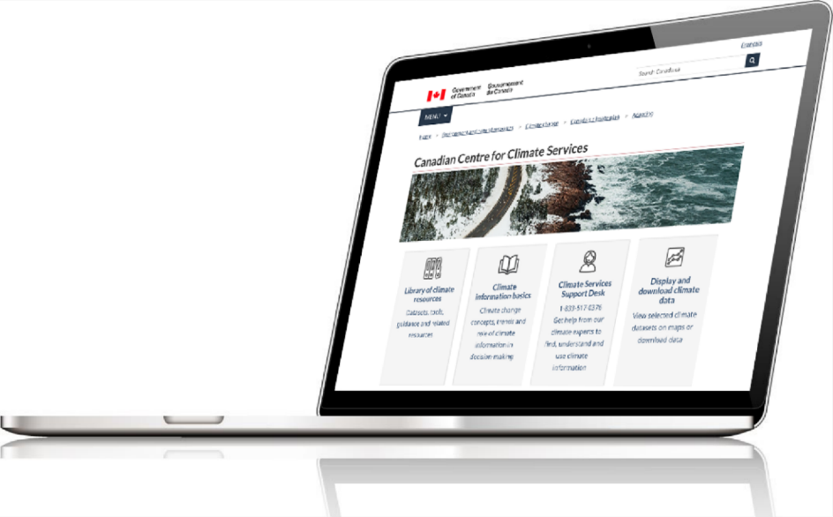
Canadian Centre for Climate Services
Provides Canadians with information and support to consider climate change in their decisions
1-833-517-0376
ccsc-cccs@ec.gc.ca
Canada.ca/climate-services
Notes:
The CCCS website is a place where you can access all of the products and services offered by the CCCS. It is designed to facilitate access to climate science and resources for a wide range in users, from climate basics through to data and resources that support adaptation decision-making.
Some key features include:
Library of Climate Resources to access over 300 resources consolidated across federal, provincial, and territorial governments, national professional organizations, climate consortia and established international organizations.
An interactive map to view historical data and future climate projections from ECCC
A data extractor to download ECCC climate data, https://climate-viewer.canada.ca/
Access to a suite of climate data portals supported by the CCCS that vary in complexity and are geared towards different levels of understanding and needs, including the Climate Atlas and ClimateData.ca

Slide 8
Our Services
Increasing awareness and access to climate data and information
Providing training and guidance on using climate data
Engaging with users to understand needs
Developing new products by collaborating with experts and users
Notes:
Points on CCCS services
The CCCS is founded on a strong user-centered approach.
Climate services include:
Increasing awareness and access to existing climate information and data in a manner and form that is understandable and useful to the audience
Providing support for incorporating climate change considerations into decisions through the Climate Services Support Desk and training sessions
Engaging with users to understand needs
Developing new products through collaboration with experts and users
The CCCS can help you find the data and information you need to inform your planning decisions and help you reduce risks from climate change.

Slide 9
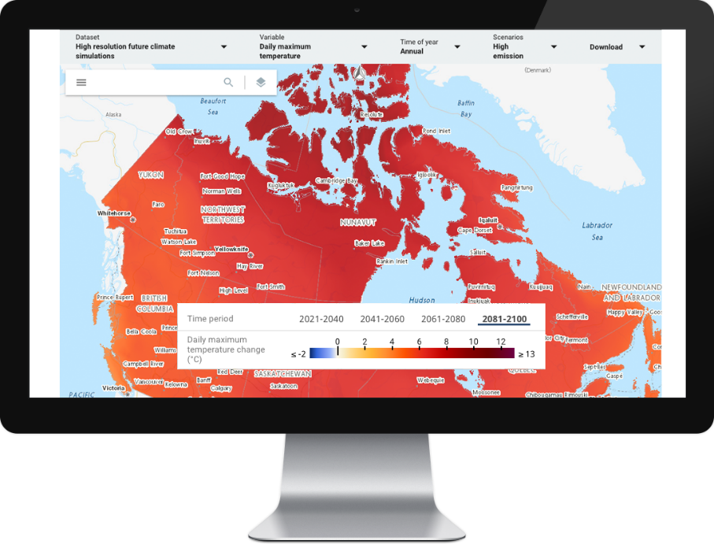
Climate Data Viewer and Extraction Tool
Climate-viewer.canada.ca
Climate Data Viewer
View mapped climate data from Environment and Climate Change Canada
Climate Data Extraction Tool
Download subsets of Environment and Climate Change Canada datasets
Notes:
The CCCS climate data viewer provides access to ECCC’s main climate datasets in the form of an interactive map.
Users can view historical or projected changes in temperature, precipitation, other climate variables for a single data point.
You can think of the data viewer as providing access to “catalogue” of ECCC datasets, with the ability to view the type of data available in the dataset.
The website also includes climate data extractor tool so that the data downloaded it for your own analysis.
The CCCS has been working with partners to take this information to the next level and develop trends for a large range of climate variables and indices.

Slide 10
Climate Services Support Desk
ccsc-cccs@ec.gc.ca
Helps users find the right datasets and information
Provides guidance for understanding and using data
Draws on a network of experts to respond to inquiries
Feedback
Your feedback is welcome. Leave us your comments and suggestions.
Inquiry
Get help from our climate experts to find, understand, and use climate information.
Notes:
The CCCS launched the Climate Services Support Desk in October 2018, staffed by experts ready to help users understand and use climate information to support adaptation decision-making.
The Support desk officials:
Provide one-on-one interaction to better understand the context of the request and help users find and use the right datasets and information
Are able to help a range of users from beginners looking for general information to experts looking for specific data
The Support desk draws on a network of experts to respond to inquiries.
Canadians can contact the Climate Services Support Desk by calling the number on the screen, emailing, or submitting an email form on the website.

Slide 11
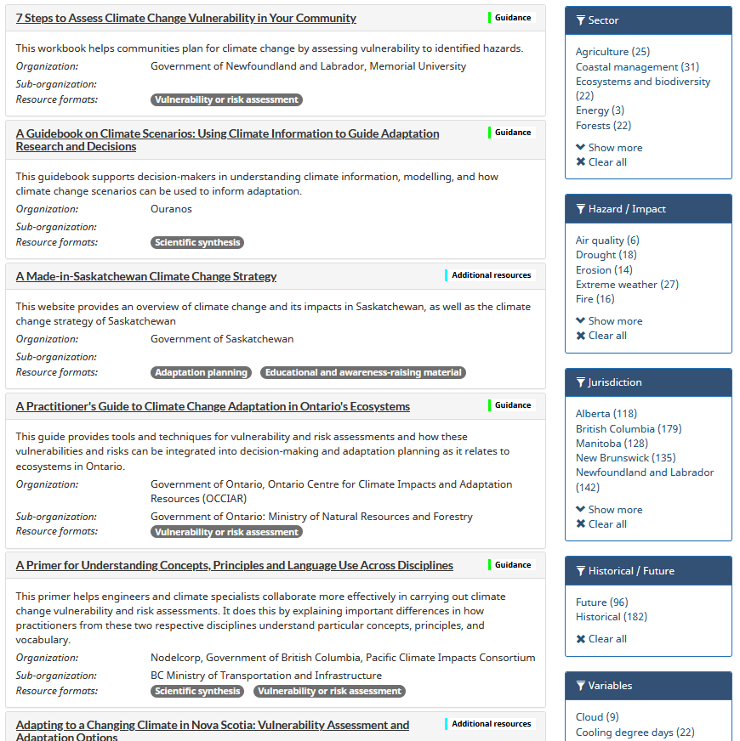
Library of Climate Resources
300+ links to climate datasets, tools, guidance and related resources
Collection of climate resilient standards
Useful for impact, vulnerability and risk assessments, and for adaptation planning
Search using filters or keywords
Library of Climate Resources
Datasets, tools, guidance and related resources
Notes:
Library of Climate Resources to access over 300 resources consolidated across federal, provincial, and territorial governments, national professional organizations, climate consortia and established international organizations.

Slide 12
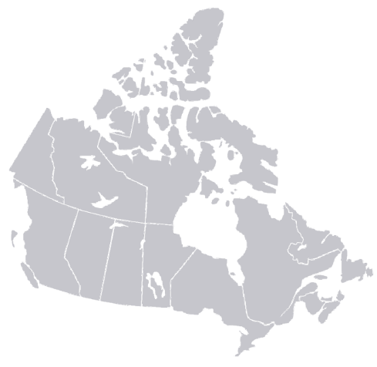
Network of Regional Climate Service Providers
CCCS supports and fosters the development of regional climate organizations to provide localized services
Notes:
The Canadian Centre for Climate Services (CCCS) works to jointly deliver climate services with regional climate organizations to provide locally relevant information to users across the country. This helps to provide users with the kinds of expertise and capacity that’s needed for their local contexts.
The Centre has finalized agreements with Ouranos (Quebec), Pacific Climate Impacts Consortium (PCIC) (BC and surrounding areas) and Climate West (Prairie region).
Recently, the Center has finalized an agreement for a new organization in the Atlantic region, to be called CLIMATlantic. This new organization is set to launch Fall 2021.
CCCS is also working with territories to foster the emergence of new climate expert organizations to provide regionally tailored services in collaboration with other providers to cover the North.

Slide 13
Ecosystem of Climate Data Portals The CCCS helps support a range of climate data platforms
ClimateAtlas.ca
Interactive climate data map and visualization tool
Narrative-driven text, and video content
Core educational content
ClimateData.ca
Access climate normals, downscaled future climate model data, IDF curves, and more.
Custom tools to analyze and extract data
Sector modules and case studies
Power Analytics & Visualization for Climate Science (PAVICS)
Advanced climate data tools for academia, climate scenario developers, and other expert users
Virtual laboratory facilitating the analysis of climate data
Notes:
FOR EXAMPLE – SOME GOOD EX. OF SOURCES OF CLIMATE INFO. THAT CCCS SUPPORTS – OTHERS OUT THERE, FROM BUNCH OF OTHER ACTORS…. THESE ARE 3 OF MANY SIMILAR SOURCES/ QUALITY OF CLIMATE INFO….
The CCCS supports a suite of climate data portals, which vary in complexity and are geared towards different levels of understanding and needs.
Climate Atlas
Introductory users - The Prairie Climate Centre’s Climate Atlas is a great resource to start learning about climate change, get the big picture on trends, and learn about how it may affect the region you live in through mapping and a storytelling approach.
The Climate Atlas provides an interactive map, summary reports, videos and stories to learn about climate change adaptation.
ClimateData.ca
Intermediate to Advanced users - ClimateData.ca is a great resource for those looking for higher resolution climate data (available at the 10x10 grid size) or that wish to explore climate data in more detail, and even undertake their own climate analyses.
ClimateData.ca allows users to download or display location-specific high-resolution data, adjusting and comparing climate variables, timescales and emission scenarios.
It also includes customized tools and sector tailored information.
PAVICS
For advanced users (researchers and climate scientists), - Power Analytics and Visualization for Climate Science (PAVICS) allows users to share scripts and datasets.
Professional tool, developed and maintained by Ouranos – for climate researchers and scientists – not for reserachers. PAVICS (ouranos.ca)

Slide 14
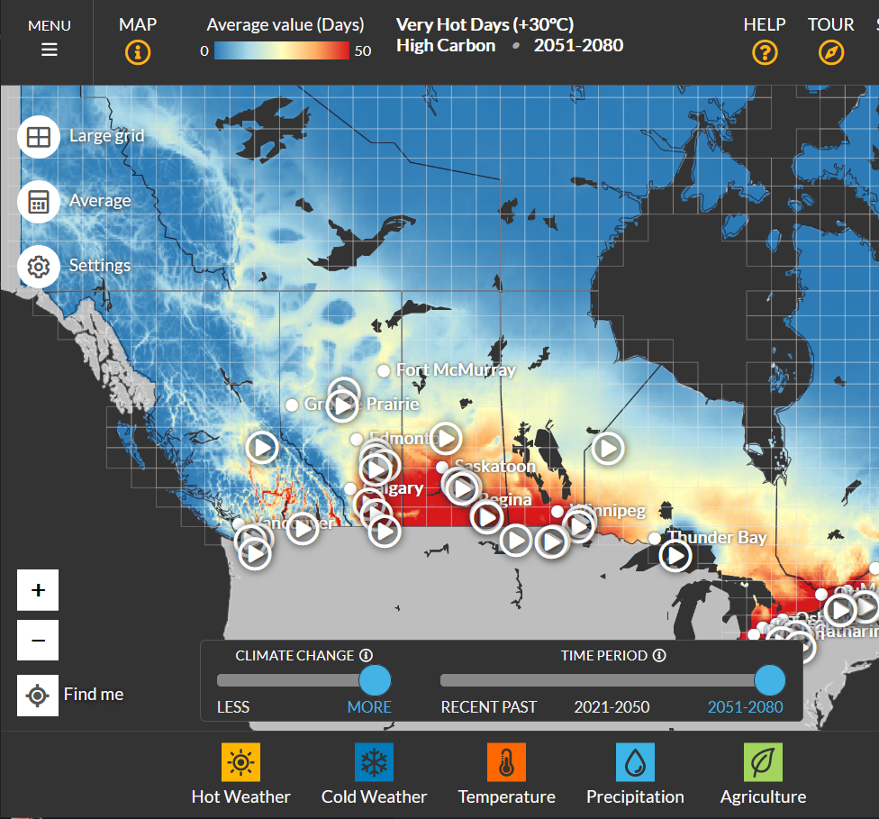
Climate Atlas
of Canada
ClimateAtlas.ca
Climate Data
Downscaled climate model data
Thousands of locations across all of Canada
Seasonal and annual data
Dozens of variables
Helpful Resources
Climate science articles, videos on climate change and “how to take climate action”
Downloadable climate data reports for your location
Notes:
The Climate Atlas of Canada, which was developed by the Prairies Climate Centre, is a great resource to start learning about climate change, get the big picture on trends, and learn about how it may affect the region you live in through mapping and a storytelling approach.
It’s simple and easy to use, providing climate data is available through an interactive map by small or large grid cell resolutions, for a number of temperature and precipitation variables and climate indices
Data is also available by province and by season
The Atlas includes a number of helpful resources to learn about climate change and adaptation, including:
Climate science articles and videos on climate information and “how to take climate action”
Reports summarizing issues
City climate reports

Slide 15
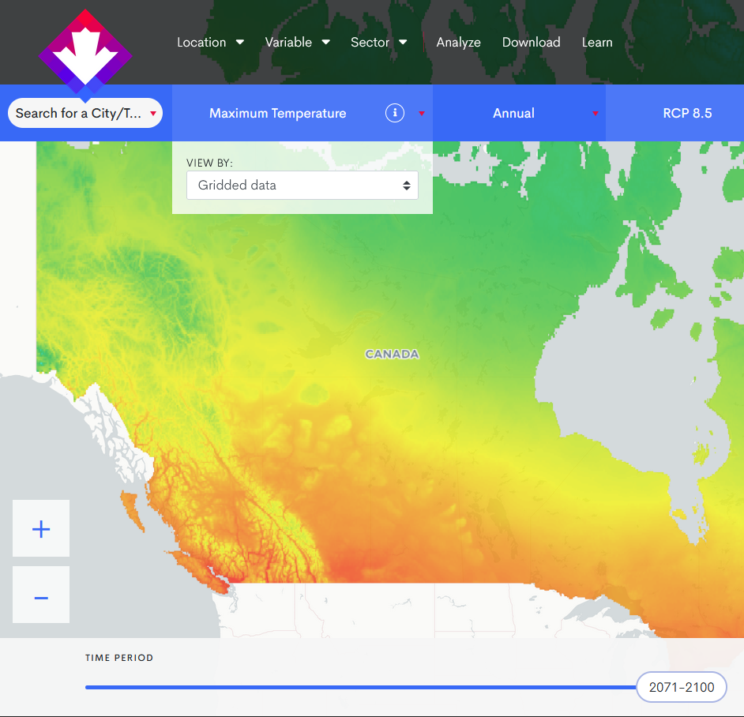
ClimateData.ca
Climate Data
Climate Data
High resolution climate data
Temperature and precipitation variables and climate indices
Sea level rise
Observed climate normals and daily data download
Intensity Duration Frequency (IDF) curves
Local and national scale charts and maps
Ability to compare emission scenarios
Customizable tools to analyze and extract data
Helpful Resources
Sector modules with tailored case studies
Learning Zone

Slide 16
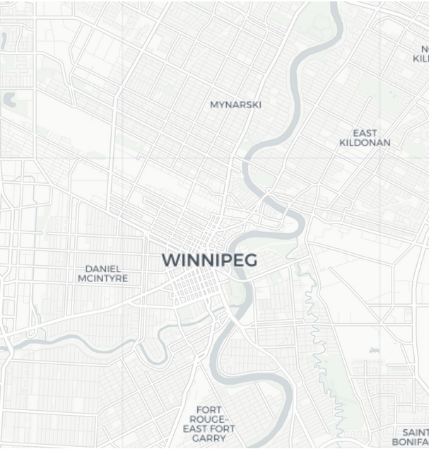
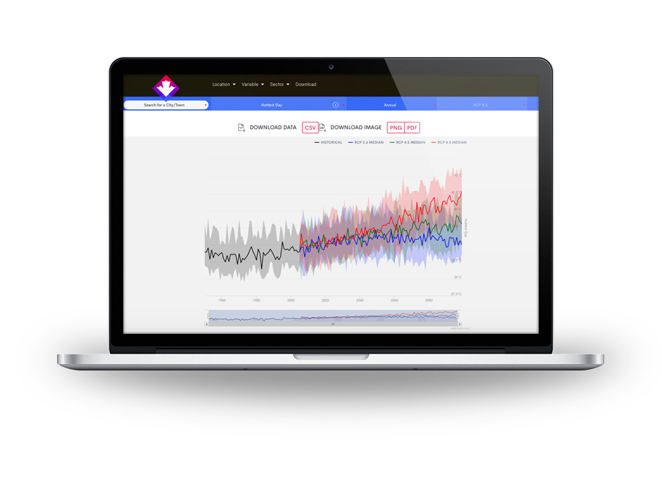
ClimateData.ca
Find Local Data
Select a variable, including historical station data and IDF curves
Select Annual, seasonal or month time steps
Select emission scenario
Download data
Download chart image
Adjust time scale to customize output

Slide 17
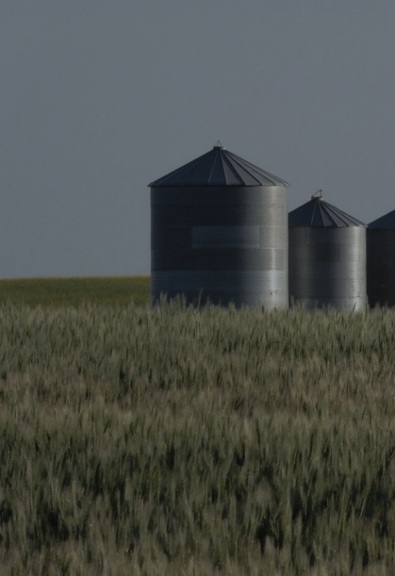
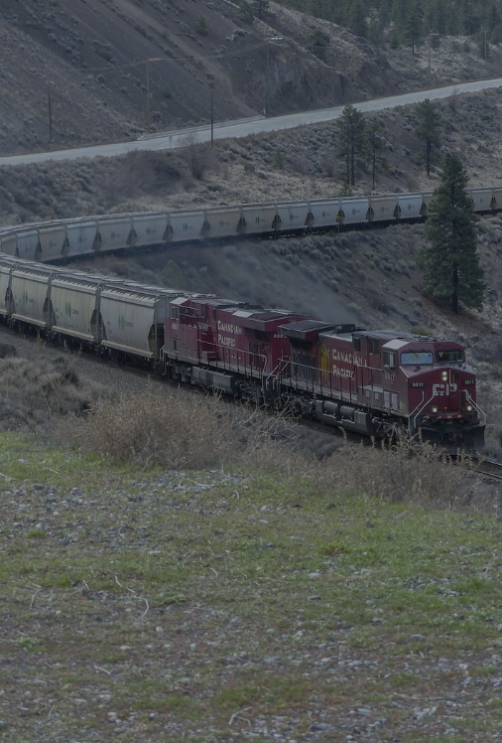
ClimateData.ca
Sector Modules
Coming soon!
Coming soon!
Health
Emergency Measures
Health Infrastructure
Public Health
Data by Health Region
Agriculture
Drought
Crop Pests
Risk Management
SPEI
Buildings
Extreme heat
Permafrost
Decision support tool
More soon…
Transportation
Winter Roads
Asphalt Performance Grading
Extreme Precipitation
More soon…
Notes:
The health sector includes:
Emergency measures
Health infrastructure
Public Health
Data by health region
Health sector modules
The agriculture sector includes:
Drought and agriculture
Crop pests and climate change
Risk management and in the grape and wine industry
Additional sectors will be added in subsequent updates to ClimateData.ca (building and transportation)

Slide 18
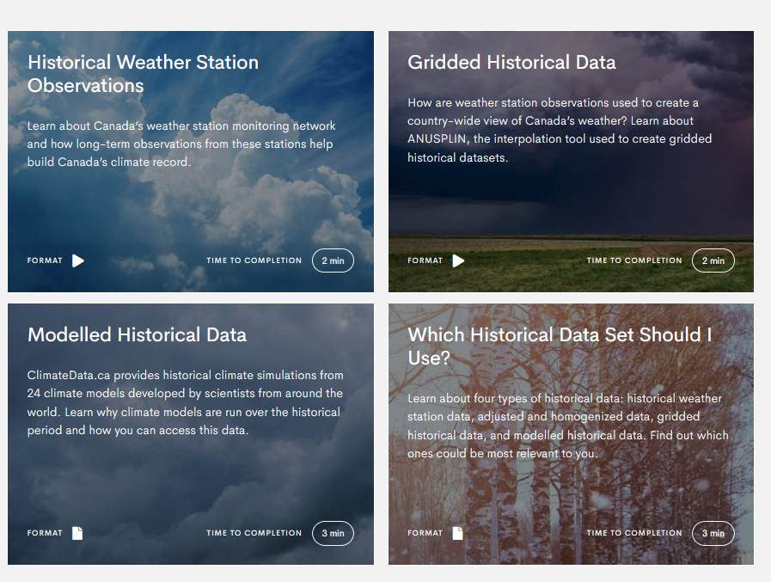
ClimateData.ca
Learning Zone
ClimateData.ca/learn/
Introduction to climate information for decision making
Understanding historical data
How to use ClimateData.ca
Downloadable training materials
More coming soon!
Notes:
Learning Zone - Section to learn more about the science behind climate data, choose and access Canadian climate data, and download pre-made materials for your own training sessions

Slide 19
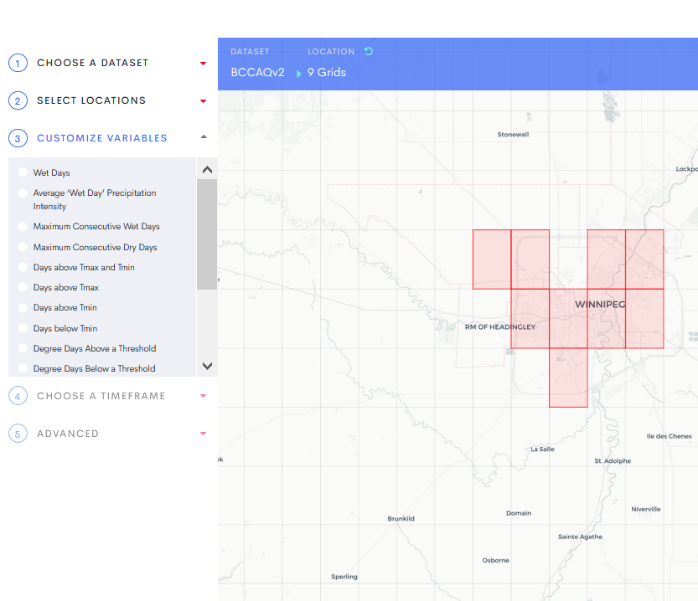
ClimateData.ca
Analysis Page
ClimateData.ca/analyze/
Choose data set
Select locations
Customize variables
Choose a timeframe
Select advanced options
More coming soon!

Slide 20
PAVICS
Pavics.Ouranos.ca
Virtual laboratory facilitating the analysis of climate data
Access observations, climate projections and reanalysis datasets
Use a Python programming environment to analyze data without downloading it
Power Analytics and Visualization for Climate Science
Notes:
Platform aims to improve the quality and reproducibility of climate studies by centralizing the collection and management of the data.
Helps increase the quality and diversity of standardized climate outputs through open collaboration. Researchers who develop specific techniques are encouraged to add their methods to a shared library, making them accessible to all users.
Standardizes many different formats of climate data, allowing organizations around the world to pool their data and tools, and acts as a climate data repository, saving each individual institution the effort, and storage necessary to obtain and maintain massive datasets.

Slide 21
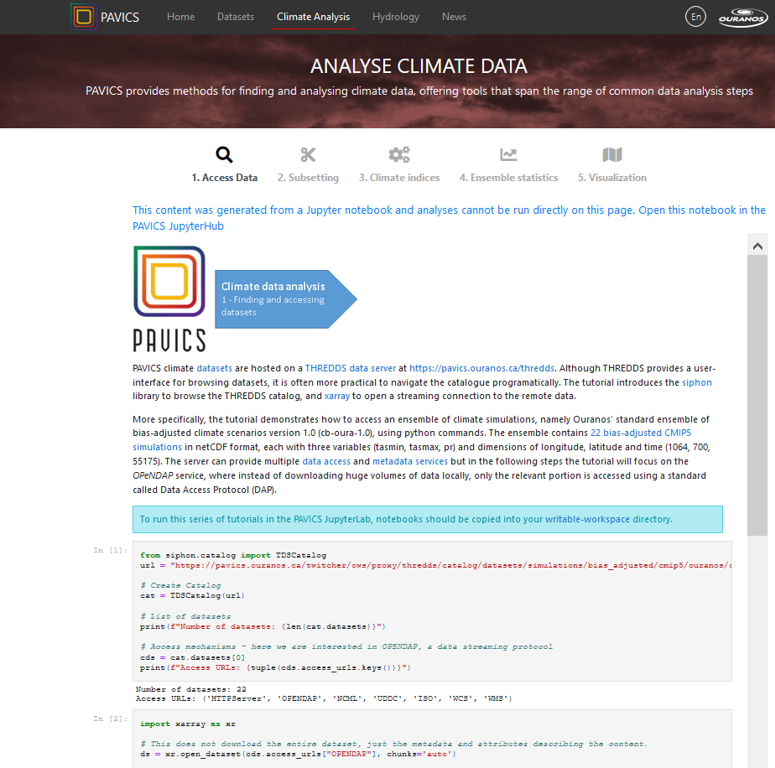
PAVICS
Analyze Climate Data
Access Data from THREDDS server
Spatio-temporal subsetting
Indicator calculations
Ensemble statistics
Data visualization

Slide 22
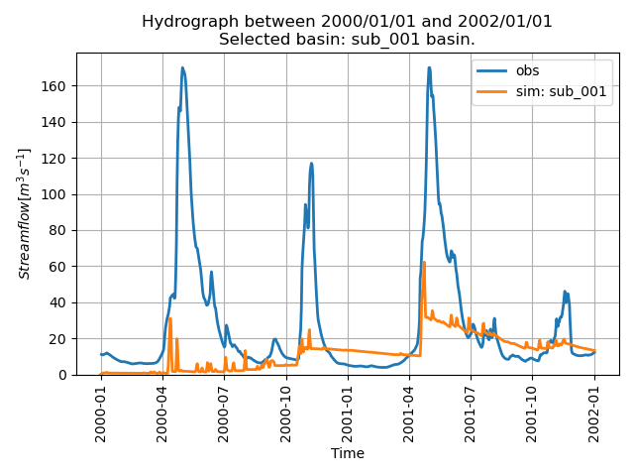
PAVICS
Run Hydrological Models
Simulate stream flow
Run analyses
Extract watershed properties
Estimate model parameters in ungauged basins
Make predictions from numerical weather forecasts

Slide 23
Tailored Products
Co-developed climate data and information products tailored to specific sectors
Custom reports
Custom maps and climate change indices
ClimateData.ca sector modules

Slide 24
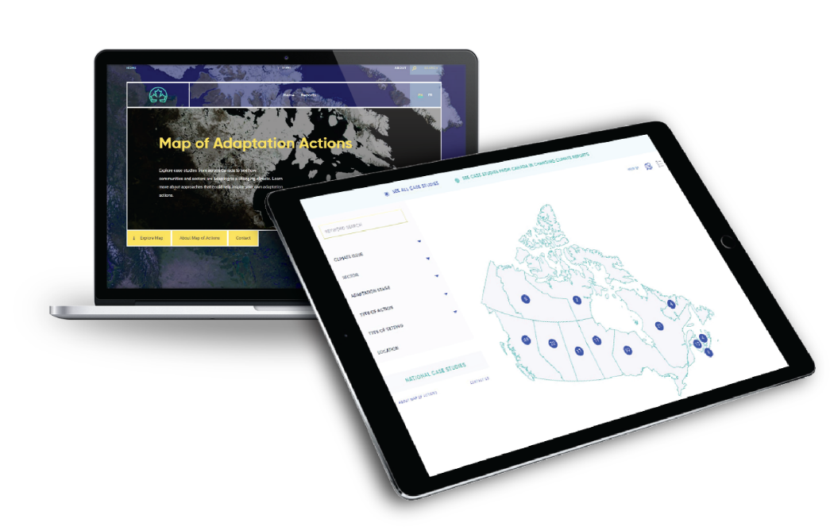
Changingclimate.ca
Map of Adaptation Actions
One-stop-shop for examples of climate change adaptation actions from across Canada.
Users can filter by climate issue (e.g. flooding, fire events, invasive species), sector (e.g. Agriculture and Food, Communities, Infrastructure), location, and more.
Submit your own adaptation examples for inclusion on the Map.
Contact Us @ ec.carteadapt-mapadapt.ec@canada.ca
Notes:
BACKGROUND
Natural Resources Canada (NRCan) and Environment and Climate Change Canada (ECCC) agreed to develop a single, national climate change adaptation case studies map. This collaboration furthers the Government of Canada’s interests in supporting adaptation action in Canada.
The Map combines two existing initiatives:
NRCan’s interactive, searchable map of case stories (short, non-technical case studies) embedded in reports from Canada in a Changing Climate: Advancing our Knowledge for Action, the national assessment of how and why Canada’s climate is changing; the impacts of these changes on our communities, environment, and economy; and how we are adapting. The national assessment is lead by NRCan’s Climate Change Impacts and Adaptation Division (CCIAD). Reports in this series are being delivered online at ChangingClimate.ca, along with the planned interactive map.
An interactive, searchable map of examples of adaptation actions from a wide range of sources across Canada, compiled and summarized for the Canadian Centre for Climate Services (CCCS) as part of its mandate to provide climate information to Canadians. Users of climate services have repeatedly encouraged the CCCS to provide examples that demonstrate climate change adaptation actions taken by others to increase capacity and expertise for adaptation planning and decision-making.
Visitors to the Map at ChangingClimate.ca will be able to search hundreds of climate change adaptation examples from both initiatives in an interactive and user-friendly fashion, refining their search through filters and keyword searches. The map increases access to critical information and provides peer-to-peer learning opportunities.
Actions on the Map come from National Assessment reports and various other sources in Canada, including: federal funding programs; provincial and territorial programs; municipalities; Indigenous communities and organizations; academia; and more. They are being gathered from across regions and sectors.
The Map has been co-developed by CCIAD and CCCS, with guidance from the federal Adaptation Case Study Working Group (WG).
KEY MESSAGES
Decision-makers and adaptation practitioners across Canada have identified case studies as a key tool when incorporating climate change adaptation considerations into their work.
The new Map is a searchable map of climate change adaptation actions examples from across Canada.
The Map is being hosted at ChangingClimate.ca, as part of Canada in a Changing Climate: Advancing our Knowledge for Action, the national assessment of how and why Canada’s climate is changing; the impacts of these changes on our communities, environment, and economy; and how we are adapting.
The Map is a one-stop-shop where visitors can easily explore adaptation actions examples and find links to additional resources, including ClimateData.ca, the Climate Action Map, and other sources of case studies and climate information.

Slide 25
NATIONAL CLIMATE SERVICES PROVIDER
Canadian Centre for Climate Services
www.canada.ca/climate-services
NATIONAL TOOLS
Power Analytics & Visualization for Climate Science (PAVICS)
https://pavics.ouranos.ca/
Climate Atlas of Canada
www.climateatlas.ca
Canadian Climate Data
www.ClimateData.ca
REGIONAL CLIMATE SERVICES PROVIDERS
Ouranos
www.ouranos.ca
(region: mostly Quebec)
Pacific Climate Impacts Consortium www.pacificclimate.org
(region: mostly Pacific NW)
ClimateWest
www.climatewest.ca
(region: Prairies)
CLIMAtlantic
Website coming
(region: Atlantic)

Slide 26
Thank you / Questions
Website English: canada.ca/climate-services Français: canada.ca/services-climatiques | Climate Services Support Desk 1-833-517-0376 @ ccsc-cccs@ec.gc.ca

