Slide 1
SSC Cloud Product Management and Services Directorate CCOE – Organizational Change Management
Unclassified
Cloud Center of Excellence (CCoE)
Version: v1
May 2020

Slide 2
Playbook Audience and Framework
Executive Audience
CIO Audience
Cloud CCoE Audience
Cloud Core Team Audience
Cloud Practitioners Audience
IT Team Member Audience
Goal: Engagement and Cloud Program Definition
Cloud Adoption Journey
GC Cloud Use Cases and Usage Profiles
Goal: Cloud Awareness
Cloud Awareness Playbook
Goal: Cloud Program Design
Cloud Direction
- Cloud Services HL Design
- Cloud Adoption Roadmap
- Organizational Change Management
Goal: Cloud Program Establishment
Goal: Cloud Program Deployment
Foundational Services Deployment
Cloud Core Services Deployment
Goal: Cloud Program Impl/Ops
Foundational Services Impl/Ops
Cloud Core Services Impl/Ops
Governance Processes Impl/Ops
Cloud Adoption Program
Foundational Services Establishment
Cloud Core Services Establishment
Cloud Initiation
- Cloud Adoption Objectives/KPIs Workshop
- Cloud Readiness Assessment
Work Load Analysis Establishment
Work Load Analysis Execution
Work Load Migration Impl/Ops
Cloud Governance Establishment
- Governance Teams
- Governance Processes
Cloud Program
- Program Initiation
- Program Evolution

Slide 3
Agenda
Cloud Adoption Program Overview
Organizational Change Management Overview
Context
Purpose
Impact
The Curve
Progress
Organizational Change Management Phases
Change Impact Assessment
Change Mgmt Strategy Creation
Actions Plan
Next Steps
Appendix
Templates
Samples
Check Lists

Slide 4
Cloud Adoption Program
Program Overview

Slide 5
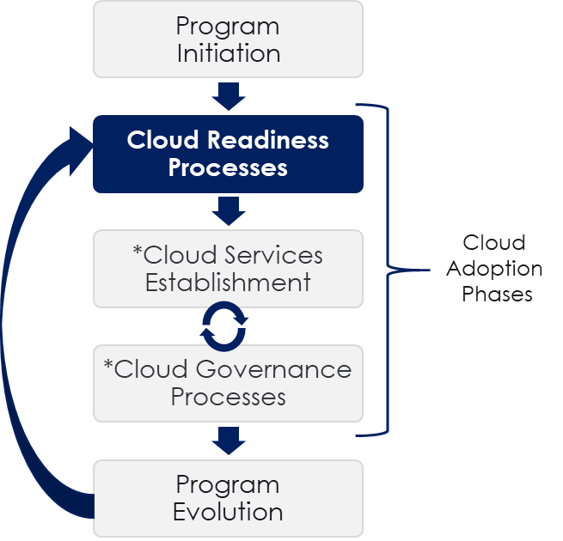
Cloud Adoption Program Overview
Cloud Adoption is a program not a project.
It does not have a defined end.
It continues to evolve indefinitely.
Cloud Readiness Processes is the first phase of Cloud Adoption!
*Iterative for each new application or workload migration

Slide 6
Cloud Readiness Processes
The first key phase of a successful Cloud Adoption is the Cloud Readiness Processes.
The goal of the Cloud Readiness Processes is to establish the following processes;
Cloud Initiation Process
Cloud Governance Establishment
Cloud Direction Creation

Slide 7
Cloud Direction Creation – Overview
The final process of the Cloud Readiness Processes is Cloud Direction Creation.
The Cloud Direction Creation requires definition and alignment on the following;
High Level Cloud Roadmap
High Level Cloud Services Design
Create your High Level Cloud Services Design and End State view.
Create your High Level Cloud Roadmap and associated Adoption Phases.
Organizational Change Management
Create your Organizational Change Management Plan.
Initial Cloud Initiatives
Identify your Initial Cloud Initiatives.

Slide 8
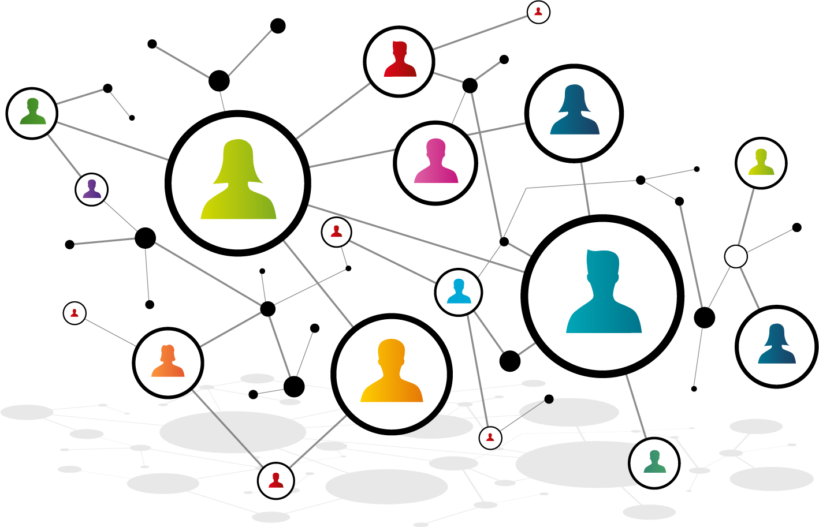
Organizational Change Management – Overview
Context
Purpose
Impact
The Curve
Progress

Slide 9
Organizational Change Management – Overview
Organizational Change Management is one of the six Cloud Adoption Core Principles that are critical for a successful Cloud Adoption.
Cloud Adoption Core Principles
Organizational Change Management
Single Pane of Glass Visibility
Multi-Cloud Support
Self Service /w Extensive Automation
Cloud Speed/ Frictionless Governance
Security/ Privacy Built In
Organizational Change Management is a process that requires:
Top Down Support and Commitment
Executive and Senior Management
Establish Clear Objectives and KPIs
Departmental Business Level
Champion the Transition and Provide Guidance
Cloud Centre of Excellence (CCoE)
Cloud Core Team (CCT)
Establish a Clear Communications Plan
Educate all members of the organization
Establish a Substantial Training Plan
Assist all members of the organization

Slide 10
Organizational Change Management – Purpose
Adopting the Cloud is more than a single event, it is a process, that requires a culture change.
The purpose of the Change Management Strategy for this journey is to:
Define the key stakeholders & impacted audiences (as per the Stakeholder & Impact Assessment template)
Define the extent of impact to stakeholders
Describe gaps in knowledge and skills that need to be addressed to meet objectives
Outline communications and training strategies
Develop and deliver on Action Plans to execute on the Change Management Strategy

Slide 11
Organizational Change Management – Impact
Cloud Adoption impacts audiences from every part of the organization:
Finance and Procurement
Move from CAPEX to OPEX with different Cloud subscription models to manage on a daily basis to optimize utilization
Communications
Everyone in the organization needs to understand ‘why it is good for them’ and have access to information
Human Resources
Requires hiring of new cloud skills and experienced contractors and extensive cloud training programs for employees.
Programs
Needs to understand the value of the cloud to them and fully embrace the iterative nature of the process
Development
The CI/CD pipeline must be fully automated, all test cases must be automated, and all security components must be built-in and security policies adhered to
Operations
All environment builds must be completely automated as infrastructure-as-code and all changes must be scripted and included in the CI/CD pipeline.
QA
All testing (functionality, security, operational, performance) needs to be automated and occur for every change as part of the CI/CD pipeline
Security
Security now must be embedded in the CI/CD process as there is no time for separate security testing

Slide 12
Organizational Change Management – The Curve
Identifying where each audience falls on the curve can indicate where training or communications interventions are required to get audiences where they need to be by the end of the initiative.
Act
Unaware is :
Lack of knowledge of the initiative/change
Exit Criteria:
Realizes that the change will affect the status quo without understanding the full impact
Aware is :
Knowledgeable of initiative/change but unclear of the scope, depth, full impact, or rationale for change
The realization that they are affected but not sure how
Exit Criteria:
Describes the change and the business rationale behind it after active questioning
Understand is :
The comprehension of the nature and intent of the change as well as where they “fit in”
Exit Criteria:
Speaks positively of the change at an individual and organizational level
Participates actively in meetings to discuss the change
Believe
Believe is :
Shows signs of buy-in for the Change
Demonstrates a willingness to embrace the change in some fashion
“Test run” of new org, process, system or concept
Exit Criteria:
Attempts to implement the change
Act is :
Long-term, in-depth testing, trial and application of the change.
The notion that the new processes are the status quo, not a deviation from it.
Where the implementation of the change is past the point of no return
Exit Criteria:
This is the status quo
Understand
Aware
Unaware

Slide 13
Organizational Change Management – Progress
If all factors are not in place, the chances of successful change are significantly reduced.
Use this grid to track your change progress with each audience.
“See It”
“Own It”
“Live It”
“Change Happens”
Case for change
Committed leadership
Clear WIIFM
Concrete plan
Tools in place
Reinfor- cement
SUCCESS!
Case for change
Committed leadership
Clear WIIFM
Concrete plan
Tools in place
Reinfor- cement
It’s not urgent
Case for change
Committed leadership
Clear WIIFM
Concrete plan
Tools in place
Reinfor- cement
It’s not real
Case for change
Committed leadership
Clear WIIFM
Concrete plan
Tools in place
Reinfor- cement
It’s not worth it
Case for change
Committed leadership
Clear WIIFM
Concrete plan
Tools in place
Reinfor- cement
It’s not going anywhere
Case for change
Committed leadership
Clear WIIFM
Concrete plan
Tools in place
Reinfor- cement
It’s not possible
Case for change
Committed leadership
Clear WIIFM
Concrete plan
Tools in place
Reinfor- cement
It’s not for long

Slide 14
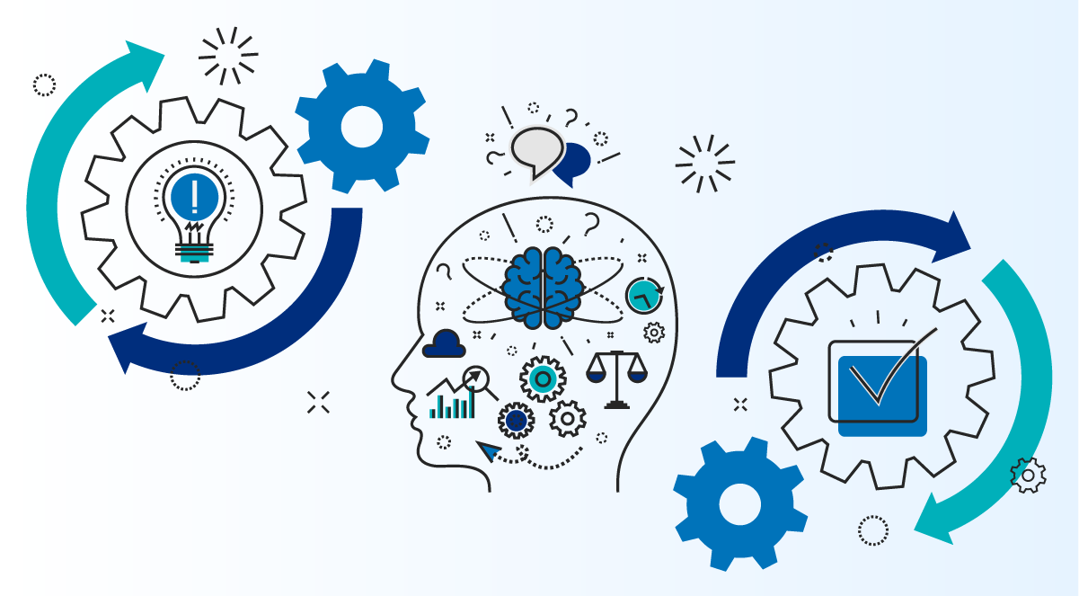
Organizational Change Management – Process
Change Impact Assessment
Change Mgmt Strategy Creation
Action Plans

Slide 15
Organizational Change Management – Process Phases
The Organizational Change Management process is comprised of the following three main phases;
Change Impact Assessment
Change Management Strategy Creation
Action Plans
Understand Cloud Adoption program objectives and scope and identify impact on all stakeholders
Defines the strategic approach to successfully deliver the Cloud Adoption program from a people perspective
Design, Develop, and Deliver the required Action Plans to implement the Change Management Strategy
*See Appendix for Definition and Templates

Slide 16
Change Impact Assessment
The first phase in the Organizational Change Management process is the Change Impact Assessment.
The Change Impact Assessment phase is comprised of the following tasks:
Understand Objectives and Scope
Identify Change Vision
Identify Benefits and Challenges
Ensure alignment on the Departmental Business Objectives and KPIs as well as Program scope in terms of impacted audiences for Cloud Adoption
Identify the expected outcomes of the change on the Department as a whole in terms of how it functions internally as well as how it delivers its services externally
Identify the benefits and challenges of the Cloud Adoption Change for the Department as a whole.
Identify Impacted Audiences
Detailed Audience Analysis
Identify Cloud Adoption Change Sponsors, Stakeholders, and all Audiences (existing and new) impacted by the Change.
For each impacted Audience, meet with them to identify required changes to transition to Cloud and analyze the impact level and impacts of each change.

Slide 17
Change Management Strategy
The next phase in the Organizational Change Management process is the Change Management Strategy Creation.
The Change Management Strategy Creation phase is comprised of the following tasks:
Communications and Engagement
Sponsorship
Training
Identifies the purpose of all required Communications and defines how the program will communicate to its stakeholders and audiences.
Identifies how the Program Sponsor will drive the change to stakeholders and impacted audiences.
Identified the required Training Programs and defines how the Program will train the users that need to acquire new skills
User Support
Acceptance
Identifies the required User Support and defines how end users will receive ongoing support regarding their tasks and roles
Identifies the Program Acceptance Criteria and defines how the program will ensure that the plans are successfully adopted

Slide 18
Change Management Action Plans
The final phase in the Organizational Change Management process is the Action Plans.
The Action Plans phase is comprised of the following tasks:
Design Action Plans
Develop Action Plan
Deliver Action Plans
Evaluate and Improve
Design Actions Plans to implement the Change Management Strategy for all required audiences in Sponsors and Stakeholders (i.e.. Communications Plans, Training Plans, User Support Plans, etc.)
Develop Action Plan Materials to implement the Change Management Strategy for all required audiences.(i.e.. Communications Material, Training Materials, User Support Material, etc.)
Deliver Action Plans to all required audiences to implement and Change Management Strategy. (i.e.. Communications, Training, Support, etc.)
Ongoing evaluation and improvement of the Change Management Strategy and associated Action Plans against the Acceptance Criteria.

Slide 19
Next Steps in your Cloud Journey
Now that you understand Organizational Change Management and the steps to create and execute a Change Management Strategy,
You are ready to take your next steps in your Cloud Journey!
Perform Change Impact Assessment
Collect Departmental Cloud Adoption Business Objectives and KPIs outputs
Engage Communications Team to Lead this process
Have Communications engage the CCoE to initiate the Impact Assessment
Engage Additional Audiences as required to complete Impact Assessment
Create Change Management Strategy
Have Communications lead the creation of the Change Mgmt Strategy
Engage Sponsors, Training, and Support Teams to validate required programs
Present Change Mgmt. Strategy to CCoE and Cloud Exec for Approval
Design, Develop, and initiate Delivery of Change Action Plan
Have Communications lead the execution of the Change Mgmt. Strategy
Validate Action Plans and Action Plan Materials with the CCoE
Schedule Action Plan Delivery in co-ordination with CCoE and CCT Delivery of Cloud Services
Feed Improvement Plans into CCoE for approval

Slide 20
Appendix

Slide 21
Sponsorship Definition
Sponsoring Change Involves:
Being visible, active, vocal, fully involved in project activities, and relentless in communications
Showing personal belief that the future state is worth the “price” of the transition
Executive sponsorship is critical; a leadership coalition is also critical. Having other leaders within the organization advocate and sponsor the change is equally important in driving change
The Sponsorship role fulfills the following responsibilities:
For the Initiative/Project:
Obtain project resources
Promote change to audience and stakeholders
Build and maintain project momentum and leadership support
For Employees:
Maintain employee focus and effort on the change
Continuously promote understanding by clarifying the change goals and benefits
Continuously reinforce the change through recognition and acknowledgement

Slide 22
Stakeholders & Impacted Audiences Assessment Definitions
Stakeholders
Impacted Audiences
Those who have a vested interest in seeing the change successful or who might be affected by the outcome of the change.
Sponsors
Individuals who are in a governance role
Individuals who commit funds
Individuals who may see downstream affects of the change
Individuals who need to understand the change
Those who are directly impacted by the change (e.g., individuals who need to change how they do something – a change in process, a change in responsibility, a change in technology, or a change in how they fit within an organization - a change in role, change in team). Impacts can range from Low to High.
Low Impact
Medium Impact
High Impact
“Indirect” impact
Limited to no job or responsibility changes
Minor process and/or technology change
Limited culture change
Overall job responsibilities will change less than 10%
“Direct” impact
Moderate job or responsibility changes
Moderate process and/or technology change
Moderate culture change
Overall job responsibilities will change by 10-50%
“Direct” impact
Significant job or responsibility changes
Significant process and/or technology change
Significant culture change
Overall job responsibilities will change by 50-100%

Slide 23
Stakeholders Identification Template
Stakeholder | Role description and current situation/responsibilities
[Stakeholder Name] | Role: Situation:
[Stakeholder Name] | Role: Situation:
[Stakeholder Name] | Role: Situation:
[Stakeholder Name] | Role: Situation:
[Stakeholder Name] | Role: Situation:

Slide 24
Cloud Adoption Change Vision Technology
Today | To Be Vision
Current Mode of Operations | Expected Outcomes from Cloud Adoption

Slide 25
Stakeholders & Audience Impact Assessment Template [Audience Name]
Description
Stakeholder/Audience Description.
As Is
Current mode of Operation.
To Be
New mode of Operation with Cloud.
Audience: High Impact
Audience Segments that are highly impacted.
Audience: Medium Impact
Audience Segments that are moderately impacted.
Audience: Low Impact
Audience Segments that are minimally impacted.
Audience Characteristics:
Define # of individual in each group
Describe other characteristics of interest
Assumptions/Risks/Comments:
Notes on your assumptions, etc..

Slide 26
Communication Plan Guidelines
No communication program will be successful if it is only driven by the initiative/project team. Respected and well-positioned communicators will be used to convey the necessary messages and take ownership. Face-to-face events with the impacted stakeholders are the most effective away to gain involvement and provide an opportunity for feedback. These events can also be used to sell the benefits of the program.
Ownership and Involvement
It is vital that senior management is committed to the success of the initiative. What they do is more important than what they say. Communication items and events should be created that provide opportunities for people to observe this commitment. Need to find appropriate balance between creating awareness/ensuring engagement and managing expectations
Commitment
Involve Stakeholders
Mass communications rarely change people’s beliefs or behaviours. Due to the scope of the initiative, a key aspect will be to engage representatives of impacted groups early and often. This will ensure that an increasing number of communications are face-to-face and/or sent by Managers/Supervisors. This has been shown to be one of the most effective communication methods.
Strong Visual Style/Identity
Where feasible, communication materials should have a consistent “look and feel” carried through all materials (exceptions include Intranet content). This provides a sense of consistency and initiative recognition for the audience and will improve the visual impact of all initiative communication. This may include the use of a logo or other branding items that contribute to a strong sense of purpose and pride in the initiative.
Tailored Messages & Broad-band communications
A broad-band approach will be used to get messages out to large audiences. Most messages communicated will be customized to each target audience segment so information is relevant and communicates the desired change in beliefs or behaviours. The messages should answer the key questions: “What does it mean for me?” and “What is my role?” All communication must deliver realistic messages and be consistent and easy to understand.

Slide 27
Communication Plan Guidelines Cont.
Communication items and events help stakeholders form an opinion of the initiative and should be of the highest quality. A quality-based review process and high-quality production will ensure that communication materials and events reflect the high standards of the initiative.
Quality
In order to maintain an accurate picture of whether or not key messages are reaching the target audience, feedback will need to be collected on a timely basis. A series of formal and informal feedback mechanisms are required such as structured questionnaires, face-to-face interviews, and direct links with team briefings. Information should only be gathered where actions will be taken based on the results.
Measurement and Evaluation
Communications must be timed appropriately and be relevant to the target audience. Too much communication too early is counterproductive. Employees become saturated and then disregard more important messages closer to “change”.
Relevance & Timing
Push communications (e-mails, voice mails) will be sent out when new information is posted on the intranet site, when information is time-sensitive, or if the message is urgent or critical, etc. Pull communications will be used for complex or detailed information that the user requires/must know. Push communications can also be used as “teasers” (e.g., go to web site to find out details).
Push vs. Pull Communications
Reward & Recognition
It is important to recognize when impacted audience groups meet readiness and acceptance goals. Also other critical players should be recognized by Managers and initiative executives for meeting targets.

Slide 28
Communications Plan Template
Communication Vehicle | Target Audience | Sender | Timing

Slide 29
Communications Material - Awareness Campaign Template
Internal Impacted Audiences | Key Messages
Messages for senior managers and executives | business reasons for Cloud details about Cloud impact of the Cloud roles and responsibilities of senior managers and executives how the development is happening and progressing
Messages for managers and supervisors | business reason for Cloud details about the Cloud how the initiative is being implemented impact of the new system on managers roles and expectations for managers and supervisors how managers and supervisors will be prepared and supported
Messages for employees | business reason for Cloud necessity to ensure organizational success and sustainability role of the new system in support of business initiatives and strategies risks of not changing to a new system (impacts, consequences) benefits of the Cloud: improvements to processes, operations and design enhancements details about the Cloud how the initiative is happening impact of the Cloud on the employee why employees should want to participate (WIIFM) explain how the new system aligns with employee priorities indicate potential opportunities how the Cloud will increase the quality of their work life demonstrating how it will make their job easier, more efficient, more productive, and less redundant provide testimonials and examples of where the new system was successful elsewhere how employees will be supported through the project what they will need to be prepared resources that are made available to help them with the transition information pertaining to how and when employees will be trained where to go for information

Slide 30
Change Management Activities Roadmap - Template
Q1 | Q2 | Q3 | Q4
Communications & Training
*CIO Roadshow – Nov 18-22
Sponsor Messaging
CIO Blog /
Newsletter
CIO Road Show*
CIO Blog /
Newsletter
CIO Blog /
Newsletter
CIO Blog /
Newsletter
Cloud Series
Intro
Roles
Success
Topic 4
Topic 5
Topic 6
Training Opportunities
Cloud 101
DevSecOps
More Advanced topics..
More Advanced topics..
Client Engagement
Intro
Process
Topic
Topic
Cloud Knowledge Base

Slide 31
Organizational Change Management – Impact & Strategy Checklist
Phase | Tasks | Identify | Document | Validate
Change Impact Assessment | Understand Objectives and Scope | ✓ | ✓ | ✓
 | Identify Change Vision
 | Identify Benefits and Challenges
 | Identify Impacted Audiences
 | Detailed Audience Analysis
Change Management Strategy | Communications and Engagement
 | Sponsorship
 | Training
 | User Support
 | Acceptance

Slide 32
Organizational Change Management – Action Plan Checklist
Action Plan | Plan Design | Content Develop | Plan Delivery | Evaluate and Improve
Communications Plan | ✓
Sponsorship Plan
Training Plan
Support Plan

