Slide 1
Government of Canada Enterprise Architecture Review Board (GC EARB)
Presenter Template
Department – Project Name
(Date)
Presentation for:
EARB Appearance:
Contact Information:
 Endorsement
Information
Exemption
 Initial
Follow-up
Final Architecture
Presenter(s):
Name /Email / Phone #
Name /Email / Phone #
Last Updated June 7, 2019
GC Docs #31758070

Slide 2
Purpose of GC EARB Session
Please identify and describe …
The purpose of this presentation is to seek GC EARB endorsement to …
or
The purpose of this presentation is to provide GC EARB information related to …
or
The purpose of this presentation is to seek an exemption from GC EARB related to …

Slide 3
Request - Background
Short synopsis of the project being discussed.
Describe briefly the problems with the current situation, how current systems fail to achieve departmental requirements. Describe the opportunity that the Department needs to leverage.
Please describe how the Investment/Project/Solution or Effort proposal is within the Departmental Mandate?
Tell us which Business Capability you are enabling with this request.
(Please refer to this link to list of Business Capability and its definitions: https://gcconnex.gc.ca/file/group/21723432/all#33721386)
Note: A “Current Architecture” diagram can be optionally included in the Appendix.

Slide 4
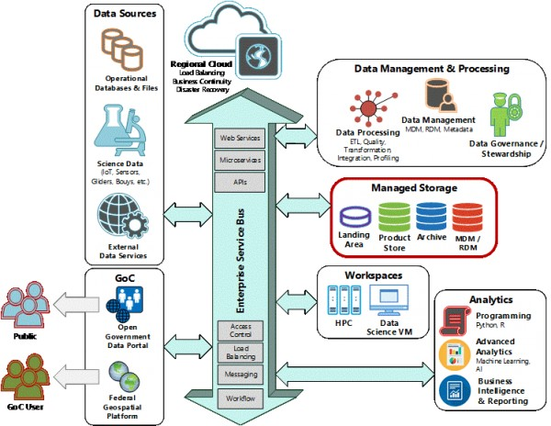
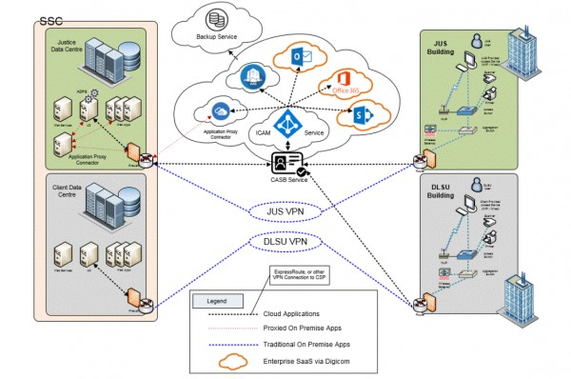
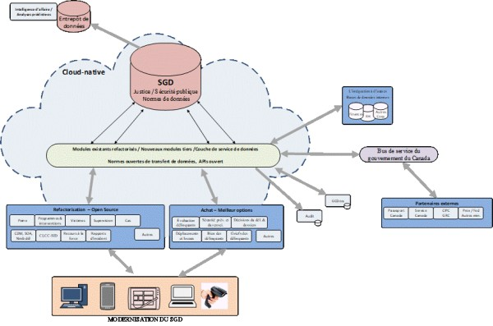
Target State Architecture - DIAGRAM
EXAMPLE 1…
EXAMPLE 2…
EXAMPLE 3…
Identify what aspect of the future state that THIS project is addressing
Here are 3 examples from past GCEARB presentations.

Slide 5
Request - Detailed Information
Anticipated Benefits / Outcomes
(Briefly objectives, outcomes and results sought as part of the benefit realization for this investment )
As the Investment funding gets spent, what changes and how those changes fixes the stated problems? E.g: Process, Software functionality, new software, less paper (describe what forms, how many will disappear, more secure access, easier access, increase self-service etc.
Governance
Departmental Governance Bodies
Identify the most Senior Governance body responsible for the success, and benefit realization, for this Investment/Project/Solution
Business Owner
Technical Owner
Identify the Business sponsor role that is championing Project
Identify the Technical sponsor role that is championing Project

Slide 6
Risks & Mitigations
Project PCRA Score:
Organization OPMCA Level:
Risks |  | Mitigations | Prob. | Impact
1 | Identify the 3 most important Risks to this Investment … |  | H/M/L | H/M/L
2 |  |  | H/M/L | H/M/L
3 |  |  | H/M/L | H/M/L
PCRA: Project Complexity and Risk
OPMCA: Organizational Project Management Capacity

Slide 7
To be completed by GC EA Team
Executive Summary
 Endorsement  Information | PCRA: OPMCA: | One time: $ On going: $ | Overall:
Type of Cloud |  SaaS |  PaaS |  IaaS |  Not Applicable | Data Classification |  Unclassified |  Protected A |  Protected B |  Other
Summary of Proposal
Enterprise Architecture Assessment
 | Business
 | Information
 | Application
 | Technology
 | Security & Privacy
GC EA Recommendation | Conditions
Architectural Alignment:
Fully
Partially
Not

Slide 8
ANNEX
APPENDIX 1
GC Digital Standards
Required for GC EA Assessment
NOT to be part of Presentation
APPENDIX 2
GC Architectural Standards
Required for GC EA Assessment
NOT to be part of Presentation
APPENDIX 3
Additional Project Details
Required for GC EA Assessment
NOT to be part of Presentation
APPENDIX 4
Algorithmic Impact Assessment
Complete as required
NOT to be part of Presentation
APPENDIX 5
Exemption Request Form
Complete as required.

Slide 9
APPENDIX 1: Digital Alignment
 | ◆ | Design with users Research with users to understand their needs and the problems we want to solve. Conduct ongoing testing with users to guide design and development. |  |  |  | Build in accessibility from the start Services should meet or exceed accessibility standards. Users with distinct needs should be engaged from the outset to ensure what is delivered will work for everyone.
 | ❖ | Iterate and improve frequently Develop services using agile, iterative and user-centred methods. Continuously improve in response to user needs. Try new things, start small and scale up. |  |  |  | Empower staff to deliver better services Make sure that staff have access to the tools, training and technologies they need. Empower the team to make decisions throughout the design, build and operation of the service.
 | ⬥ | Work in the open by default Share evidence, research and decision making openly. Make all non-sensitive data, information, and new code developed in delivery of services open to the outside world for sharing and reuse under an open license. |  |  |  | Be good data stewards Collect data from users only once and reuse wherever possible. Ensure that data is collected and held in a secure way so that it can easily be reused by others to provide services.
 |  | Use open standards and solutions Leverage open standards and embrace leading practices, including the use of open source software where appropriate. Design for services and platforms that are seamless for Canadians to use no matter what device or channel they are using. |  |  |  | Design ethical services Make sure that everyone receives fair treatment. Comply with ethical guidelines in the design and use of systems which automate decision making (such as the use of artificial intelligence).
 |  | Address security and privacy risks Take a balanced approach to managing risk by implementing appropriate privacy and security measures. Make security measures frictionless so that they do not place a burden on users. |  |  |  | Collaborate widely Create multidisciplinary teams with the range of skills needed to deliver a common goal. Share and collaborate in the open. Identify and create partnerships which help deliver value to users.
Architectural Alignment:
Fully
Partially
Not

Slide 10
APPENDIX 2:
GC Architectural Standards
BUSINESS Alignment
(Please check  all that apply)
1 - Align to the GC Business Capability model | HOW will this be achieved?
Define program services as business capabilities to establish a common vocabulary between business, development, and operation
Identify capabilities that are common to the GC enterprise and can be shared and reused
Model business processes using Business Process Modelling Notation (BPMN) to identify common enterprise processes
2 - Design for Users First & Deliver with Multidisciplinary Teams | HOW will this be achieved?
Focus on the needs of users, using agile, iterative, and user-centred methods
Conform to both accessibility and official languages requirements
Include all skillsets required for delivery, including for requirements, design, development, and operations
Work across the entire application lifecycle, from development and testing to deployment and operations
Ensure quality is considered throughout the Software Development Lifecycle
Ensure accountability for privacy is clear
Encourage and adopt Test Driven Development (TDD) to improve the trust between Business and IT

Slide 11
BUSINESS Alignment
APPENDIX 2:
GC Architectural Standards
(Please check  all that apply)
3 - Design Systems to be Measurable and Accountable | HOW will this be achieved?
Publish performance expectations for each IT service
Make an audit trail available for all transactions to ensure accountability and non-repudiation
Establish business and IT metrics to enable business outcomes
Apply oversight and lifecycle management to digital investments through governance

Slide 12
INFORMATION Alignment
APPENDIX 2:
GC Architectural Standards
(Please check  all that apply)
4 – Data Collection | HOW will this be achieved?
Ensure data is collected in a manner that maximizes use and availability of data
Ensure data collected aligns to existing enterprise and international standards
Where enterprise or international standards don’t exist, develop Standards in the open with key subject matter experts
Ensure collection of data yields high quality data as per data quality guidelines
Ensure data is collected through ethical practices supporting appropriate citizen and business-centric use
Data should only be purchased once and should align with international standards
Where necessary, ensure collaboration with department/ agency data stewards/ custodians, other levels of government, & Indigenous people
5 – Data Management | HOW will this be achieved?
Demonstrate alignment with enterprise and departmental data governance and strategies
Ensure accountability for data roles and responsibilities
Design to maximize data use and availability

Slide 13
INFORMATION Alignment
APPENDIX 2:
GC Architectural Standards
(Please check  all that apply)
6 – Data Storage | HOW will this be achieved?
Ensure data is stored in a secure manner in accordance with the National Cyber Security Strategy, and the Privacy Act
Follow existing retention and disposition schedules
Ensure data is stored in a way to facilitate easy data discoverability, accessibility and interoperability
7 – Data Sharing | HOW will this be achieved?
Data should be shared openly by default as per the Directive on Open Government
Ensure government-held data can be combined with data from other sources enabling interoperability and interpretability through for internal and external use
Reduce the collection of redundant data
Reuse existing data where possible
Encourage data sharing and collaboration

Slide 14
APPLICATION Alignment
APPENDIX 2:
GC Architectural Standards
(Please check  all that apply)
8- Use open standards and solutions by default | HOW will this be achieved?
Where possible, use open standards and open source software first.
If an open source option is not available or does not meet user needs, favour platform-agnostic COTS over proprietary COTS, avoiding technology dependency, allowing for substitutability and interoperability
If a custom-built application is the appropriate option, by default any source code written by the government must be released in an open format via Government of Canada websites and services designated by the Treasury Board of Canada Secretariat
All source code open must be released under an appropriate open source software license
Expose public data to implement Open Data and Open Information initiatives
9 - Maximize Reuse | HOW will this be achieved?
Leverage and reuse existing solutions, components, and processes
Select enterprise and cluster solutions over department-specific solutions
Achieve simplification by minimizing duplication of components and adhering to relevant standards
Inform the GC EARB about departmental investments and innovations
Share code publicly when appropriate, and when not, share within the Government of Canada

Slide 15
APPLICATION Alignment
APPENDIX 2:
GC Architectural Standards
(Please check  all that apply)
10- Enable Interoperability | HOW will this be achieved?
Expose all functionality as services
Use micro services built around business capabilities. Scope each service to a single purpose
Run each IT service in its own process and have it communicate with other IT services through a well-defined interface, such as an HTTPS-based application programming interface (API) as per Appendix D: Mandatory Procedures for Application Programming Interfaces
Run applications in containers
Leverage the GC Digital Exchange Platform for components such as the API Store, Messaging, and the GC Service Bus

Slide 16
TECHNOLOGY Alignment
APPENDIX 2:
GC Architectural Standards
(Please check  all that apply)
11 - Use Cloud first* | HOW will this be achieved?
Enforce this order of preference: Software as a Service (SaaS) first, then Platform as a Service (PaaS), and lastly Infrastructure as a Service (IaaS)
Enforce this order of preference: Public cloud first, then Hybrid cloud, then Private cloud, and lastly non-cloud (on-premises) solutions
Design for cloud mobility and develop an exit strategy to avoid vendor lock-in
12 - Design for Performance, Availability, and Scalability | HOW will this be achieved?
Design for resiliency
Ensure response times meet user needs for availability
Support zero-downtime deployments for planned and unplanned maintenance
Use distributed architectures, assume failure will happen, handle errors gracefully, and monitor actively
* NOTE: As per CIO of Canada: All OpenText and SAP renewals will now be done through the new Cloud First policy, which states Software As A Service (SaaS).

Slide 17
SECURITY & PRIVACY Alignment
APPENDIX 2:
GC Architectural Standards
(Please check  all that apply)
13 - Design for Security and Privacy | HOW will this be achieved?
Implement security across all architectural layers
Categorize data properly to determine appropriate safeguards
Perform a privacy impact assessment (PIA) and mitigate all privacy risks when personal information is involved
Balance user and business needs with proportionate security measures and adequate privacy protections.

Slide 18
APPENDIX 3: Additional Project Details
Request Summary Information
TBS Project/Activity ID (from IT PLAN)
Concept Case (ENDORSED ?) | YES  DATE: ___________ | NO    REASON:
Timeline | Planned Start Date: MM – YYYY | Planned End Date: MM - YYYY
Cost Summary | One Time project cost: $ | On-going (annual) costs: $
Funding Source | A-Base  B-Base  | Other: Please specify
Current Gate*
On schedule? | YES  NO    | IF not… why not?
(TB Sub)
Departmental Architecture
Do you have a Departmental Architecture Review Board (ARB)? | YES  | NO 
Who is the Chief Architect? | Name Email / Phone #
Has the Departmental EA and Architecture Review Board sanctioned the preferred Solution Architecture option? | YES  | NO 
NOTE: Please provide a copy of your ARB Minutes & Record of Decision
* TBS Gates:
https://www.canada.ca/en/treasury-board-secretariat/services/information-technology-project-management/project-management/guide-project-gating-it-enabled-projects.html

Slide 19
APPENDIX 3:
Shared Services Canada (SSC) Involvement
SSC Scope
What is the scope of work required by Shared Services Canada?
When/How has SSC been involved in this project?
What SSC Services are to be impacted or consumed? | http://service.ssc-spc.gc.ca/en/services Include due dates for SSC deliverables.
What are the dependencies and assumptions? | (ex: authentication, cloud connectivity. If legacy Data Centre, which one and has capacity has been confirmed.)
SSC Internal Governance
Presentation title: Please include Presentation title, committee and date of presentation (or rational for not going through governance) | Governance Committees: Committee DD/MM/YY Committee DD/MM/YY
SSC Contact
SSC BR number (if available) | BR Number
SSC Client Executive contact | Name/Title
SSC project contact | Name/Title
SSC architecture contact | Name/Title (if available)
For help in completing this slide feel free to contact your Client Executive
http://service.ssc-spc.gc.ca/en/contact/partclisupport/client-execs

Slide 20
APPENDIX 4: Algorithmic Digital Solution - Impact Assessment Requirements
Background Information :
https://www.canada.ca/en/government/system/digital-government/modern-emerging-technologies/responsible-use-ai/algorithmic-impact-assessment.html
1
Complete AIA for project
https://canada-ca.github.io/aia-eia-js/
2
SAVE results
“Print” to PDF
3
INCLUDE results with EARB intake
EMAIL: ZZCIOBDP@tbs-sct.gc.ca

Slide 21
APPENDIX 5: Exemption Request
Tell us what this exemption request for ( e.g., target reference architecture, standard, etc.).
Describe which target reference architecture or standard for which an exemption / exception request is being sought, and why exemption is required. Explain why these guidance not applicable to your department.
Please explain how your Project/Solution or Effort proposal used to uniquely support your Departmental Mandate?
Note: You may insert more pages if required. Please remove these guidance words once you complete this page.
Risk to project if exemption is not endorsed?
Describe the risk and why the GC EARB should support the exemption request

