Slide 1
OVERVIEW
GC Enterprise Architecture (EA) and GC Enterprise Architecture Review Board (EARB)
Last updated: APR 26, 2022
Notes:
This is a presentation that EA can use as part of its outreach program to departments and external stakeholders.

Slide 2

GC EA: Overview
The “WHAT”
Enterprise Architecture (EA) is a conceptual blueprint that defines the structure and operation of an organization considering and aligning business, information/data, application, technology, and security domains to support strategic outcomes.
Drivers
Business architecture - advocates a whole‑of‑government approach driven by user and stakeholder needs where IT is aligned to common business capabilities to deliver a cohesive digital user experience
Internal
Policy
Strategies
Mandates
Digital
Tech Debt
External
Technology
Regulatory
Cyber threats
Economic
Competition
Information architecture - includes both structured and unstructured data. It facilitates effective sharing of data and information across government and the adoption of federal and international standards. Personal information must respect the requirements of the Privacy Act
Application architecture - focuses on digitizing business services developed via open source or SaaS re‑useable business capabilities that enable interoperability through API’s.
Technology architecture - is an important enabler of highly available and adaptable infrastructure solutions that are aligned with the chosen application architecture.
Digital service modernization
drives new technology adoption
Security architecture - standardized approach to developing IT security architecture, ensuring that basic security blocks are implemented across the enterprise as the infrastructure is being renewed.
Notes:
EA is positioned as strategic activity.
This a holistic view of Enterprise Architecture.
It is divided into 5 domains, B, I, A, T and S to facilitate architecture design and reviews but each domain is co dependant on the others.
There is a ying and a yang between modernizing digital services and onboarding new technologies, the 2 must work hand in hand.

Slide 3
GC EA: Policy Requirements
The “WHY”
Policy on Service and Digital
Directive on Service and Digital
The Chief Information Officer (CIO) of Canada is responsible for:
Prescribing expectations with regard to enterprise architecture.
Establishing and chairing an enterprise architecture review board that is mandated to define current and target architecture standards for the Government of Canada and review departmental proposals for alignment.
The departmental Chief Information Officer (CIO) is responsible for:
Chairing a departmental architecture review board that is mandated to review and approve the architecture of all departmental digital initiatives and ensure their alignment with enterprise architectures.
Submitting to the Government of Canada enterprise architecture review board proposals concerned with the design, development, installation and implementation of digital initiatives that:
  Exceed certain Investment and OPMC thresholds
  Involve Emerging technologies
  Require an exception
  Have a deployment model other than public cloud
  are directed by the CIO of Canada
_______________________________________________________________
Policy: Policy on Service and Digital- Canada.ca (tbs-sct.gc.ca)
Directive: Directive on Service and Digital- Canada.ca (tbs-sct.gc.ca)
Notes:
EA is embedded in Policy and Directives.
CIOs have requirements concerning EA and EA review boards

Slide 4
GC Enterprise Architecture Framework
Government of Canada Enterprise Architecture Framework - Canada.ca
The “HOW”
The Enterprise Architecture Framework is the criteria used by the Government of Canada enterprise architecture review board and departmental architecture review boards when reviewing digital initiatives to ensure their alignment with enterprise architectures across business, information, application, technology and security domains to support strategic outcomes.
1
Business Architecture
Design services digitally from end‑to‑end to meet Government of Canada users and other stakeholders’ needs
Architect to be outcome‑driven and strategically aligned to the department and to the Government of Canada
Promote horizontal enablement of the enterprise
2
Collect data to address the needs of users and other stakeholders
Manage and reuse data strategically and responsibly
Use and share data openly in an ethical and secure manner
Design with privacy in mind for the collection, use and management of personal Information
Information Architecture
3
Application Architecture
Use open-source solutions hosted in public cloud
Use software as a service (SaaS) hosted in public cloud
Design for Interoperability
4
Technology Architecture
Use cloud first
Design for performance, availability and scalability
Follow DevSecOps principles
5
Security Architecture
Build security into the system life cycle across all architectural layers
Ensure secure access to systems and services
Maintain secure operations
Notes:
Published on Canada.ca
This is the target that initiatives are reviewed against
Key part of the GC EARB presentation template and EA summary slide.
Departments must demonstrated how they are achieving targets across all five layers.
If they are unable to meet then recommendations and conditions are prescribed and noted in the RoD.

Slide 5
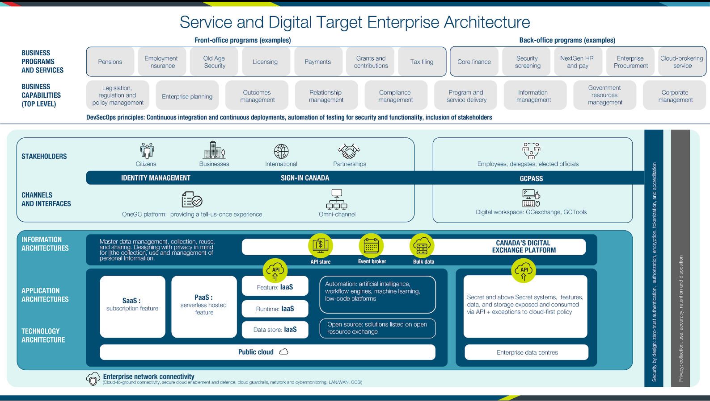
Service and Digital Target State Enterprise Architecture
Service and Digital Target Enterprise Architecture White Paper - Canada.ca
Defines a strategic model for the digital enablement of GC services that:
❶
  Promotes a whole‑of‑government approach and a cohesive user experience
  Aligns IT with business services
  Advocates solutions that are based on reusable components to reduce redundancy
  Adopts modern and innovative technology and reduces technical debt
❷
❸
❹
Notes:
Developed with EA community
Focus is on designing programs and services for users (external and employees) for a cohesive user experience.
Represents an all of government approach
GC programs and services are enabled by business capabilities
Covers all layers of the EA framework BIATS
Will be published on Canada.ca with the EA framework

Slide 6
Role of TBS GC Enterprise Architecture
To fulfill the GC EARB mandate, OCIO Enterprise Architecture collaborates with the extended EA team (SSC, CCCS, and Cyber) and departmental architects to:
Develop Target Architecture Standards
Across the domains:
  Business
  Information
  Application
  Technology
  Security
Guide implementation
of the Enterprise Architecture Framework as the criteria used by GC EARB when reviewing digital initiatives to ensure their alignment with enterprise architectures
Networks of expertise
Leads Enterprise Architecture and Open Source
Consolidates content from Data, Cloud, Digital workspace & Cyber to develop enterprise solutions and share best practices
Early engagement
pre-GC EARB date to co-architect proposals with Departments for alignment to the Enterprise Architecture Framework, Target State Architecture
and Enterprise Solutions
Notes:
The TBS EA team SSC, CCCS and Cyber, co-architect with departmental EA’s and engages with SME’s
The review process start several months before the GC EARB presentation.
Examples,
-assisting departments with secure cloud to ground architecture
-sharing previous departmental architectures to enable reuse

Slide 7

Due Diligence and EA Points of Influence
EA focus is GC EARB but also reviews and inputs across all processes
DIRECTION
BUSINESS PROBLEM/
IDEATION
DESIGN
TB AUTHORITIES
EXECUTION
MEMORANDUM TO CABINET
CONCEPT CASE
Mandatory Procedure
GC EARB
Directive
TB SUBMISSION
Authorities
PROJECT OVERSIGHT
Ongoing Project Monitoring
What decision is being sought from cabinet, i.e., what is the problem to be solved?
What is the recommended option and its context?
Does the proposed solution have implications for OCIO?
Has the problem or
opportunity been well defined?
Is there a clear vision
of the desired
business outcomes
and future state?
Is the opportunity applying the Digital Standards?
Is the initiative aligned to the EA framework?
Is the initiative defining a new target architecture standard?
Is the initiative aligned to enterprise solutions?
Does the initiative and/or project
comply to TB policies?
Is it aligned with GC
Strategies?
Has the project been to GC EARB?
Is the project positioned for success?
Are course corrections needed?
APPLY LESSONS LEARNED
Notes:
Focus is GC EARB but EA also reviews MC’s, CC’s, and TB subs.

Slide 8


Governance Overview
The “WHO”
Tasking from DM CEPP
Policy on Service and Digital ¹ triggers Departments to seek GC EARB endorsement.
Chief Information Officers Council
(CIOC)
ADM Service and Enterprise Priorities
(SEP)
DM Enterprise Priorities and Planning
(CEPP)
Departments Digital Journey:
Dept’l Plan for Service & Digital
Concept Case
GC EARB submission
TB Submission
NOTE:
CIOC and other committees can request (ad hoc) to receive GC EARB presentation’s
Action item returned
Enterprise Architecture Community of Practice
Government of Canada Enterprise Architecture Review Board
(GC EARB)
Action item identified by WG
  Defines new and target architecture standards
  Ensures alignment.
Updates provided by EARB (as required)
The Enterprise Architecture Framework is the criteria used by the Government of Canada enterprise architecture review board and departmental architecture review boards when reviewing digital initiatives to ensure their alignment with enterprise architectures across: Business, Information, Application, Technology and Security domains to support strategic outcomes.
Working Groups on specific topics
___________________________
¹ Section 4.1.2.3 of the Policy on Service and Digital. The Chief Information Officer (CIO) of Canada is responsible for: Prescribing expectations with regard to enterprise architecture.
Section 4.1.2.4 of the Policy on Service and Digital. The Chief Information Officer (CIO) of Canada is responsible for: Establishing and chairing an enterprise architecture review board that is mandated to define current and target architecture standards for the Government of Canada and review departmental proposals for alignment.

Slide 9
GC Enterprise Architecture Review Board (GC EARB)
Document Overview: GC EARB Past Meetings_FULL Summary (tbs-sct.gc.ca)
TBS/SSC Digital Workspace and Supporting Standards
TBS Decision making Framework for Enterprise Solutions
SSC Next Generation HR Pay
First Department initiative presentation @ GC EARB (GAC)
TBS Sign-in Canada concept
GC API standards and store
May 2021
Apr-2018
Apr 2019
Oct 2019
June 2020
Oct 2017
ESDC Benefits Delivery Modernization Update
TBS OneGC Vision & Way Forward
SSC Network Reference Architecture
SSC/TBS Mainframe Strategy
TBS/SSC Cloud connection Patterns
Dec 2017
Jun-2018
Jun 2019
Dec 2019
March 2021
LAUNCHED
Bi-weekly meetings chaired by SSC and OCIO CTOs -- 97 meetings covering 585 agenda items*
March 17, 2017
Jul 2017
Feb 2018
Dec 2018
Oct 2019
Jan 2020
Nov 2020
Aug 2021
GC Business Capability Model
TBS Cloud Reference Architecture
TBS Digital Standards and Mandatory Procedures for EA Assessment
TBS Open Source Policy and Whitepaper
TC Known Traveller Digital Identity Program
TBS EA framework and Service & Digital Target Enterprise Architecture
PSPC GC
eCommerce
Nov 2017
May 2018
Aug 2019
Dec 2019
Oct 2020
April 2021
Strategic Plan formally announces GC EARB
GC Enterprise Data Architecture
PSPC GC Case roadmap to the Cloud
SSC Secure Cloud Enablement and Defense
IRCC, Digital Platform Modernization
PHAC National Vaccine Management IT Platform
*as @ April 21, 2022
Notes:
All major initiatives have been reviewed at GC EARB
EA orchestrates GC EARB in partner ship with OCIO secretariat, extended EA team (SSC, Cyber, CCCS) and departmental EA’s

Slide 10
Why We Do This -- Early Influence
Refine the Business Problem
1
Early conversations are important to ensure alignment on direction before solutions are determined
Early Architectural Insights
2
The digital and architecture standards have been built into our governance and oversight processes
3
Broader Collaboration
Leverage knowledge, experience and existing information to uncover synergies that drive Enterprise level solutions
The injection of standards and governance continues to make a difference for departmental projects.
Notes:
OLD:
$1 million for Small Depts. /Agencies, $5 million for Large LDAs, and $15 million for DND.
IT plan projects
Public facing services
Enterprise or Enterprise cluster solutions (e.g., can be re-used by other government departments)
Seeking to establish or update an Enterprise Target Architecture or Standard
Seeking an Architectural Exemption
Cloud based or Cloud Services
Conducting Research, Experiment, or Innovation proposal
Preparing a contract renewal(s) for long-standing technology (e.g., solutions intended to have a 5-10 year lifecycle) or values that meet the established financial thresholds
Disruptive/transformational and/or new technology

Slide 11
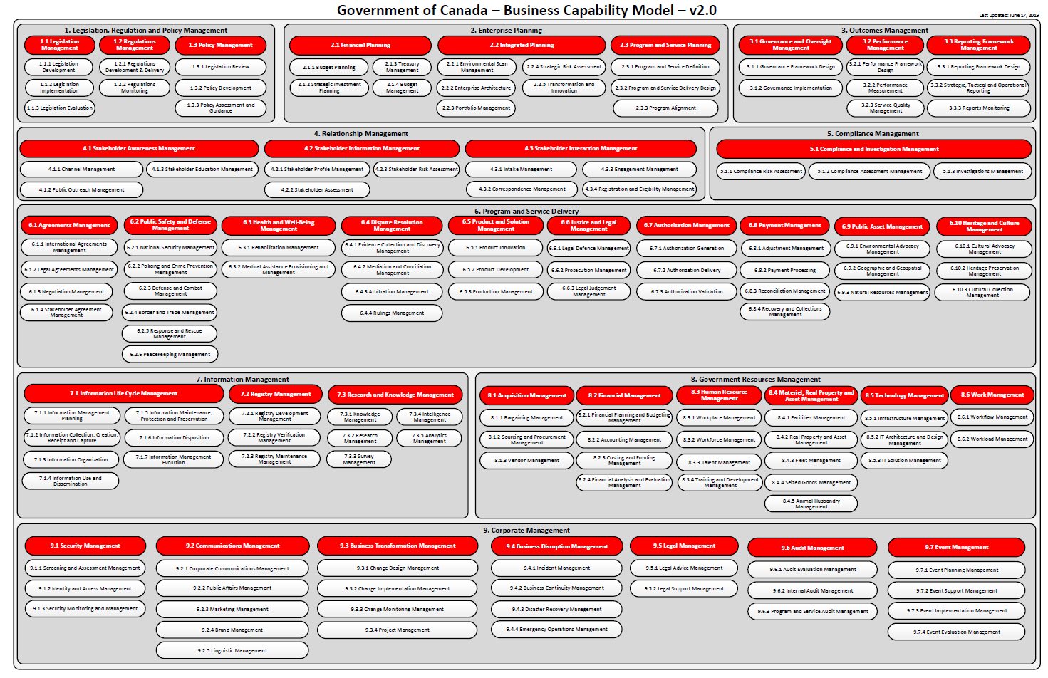
Business Drivers & the GC Business Capability Model …
Where to start
Business Architecture… represents holistic, multidimensional business views of:
capabilities, end-to-end value delivery, information, and organizational structure; and the relationships among these business views and strategies, products, policies, initiatives, and stakeholders.
It gives us a way to look at our organizations differently so that we can see what is common versus what is different or unique. This enables us to work as a cohesive enterprise.
Defined…
The Capability concept is a top- down view of an organization.
It looks at the major components of an organization in a holistic manner that includes: people, processes, information and technology.
It is the “what” and the “why”… not the “how”, “who”, or “where”.
GC Enterprise Architecture/Business Capability Model - wiki (gccollab.ca)
Notes:
The business capability concept is a top-down view of an organization. It is a key element and often the first step in a Business Architecture discipline. It gives us a different way to look at the major components of our organizations using a shared framework that bridges Programs and Services. This technique helps us in identifying where there are commonalities versus where there are very different or unique activities. With this understanding, we can work towards a more cohesive enterprise.

Slide 12

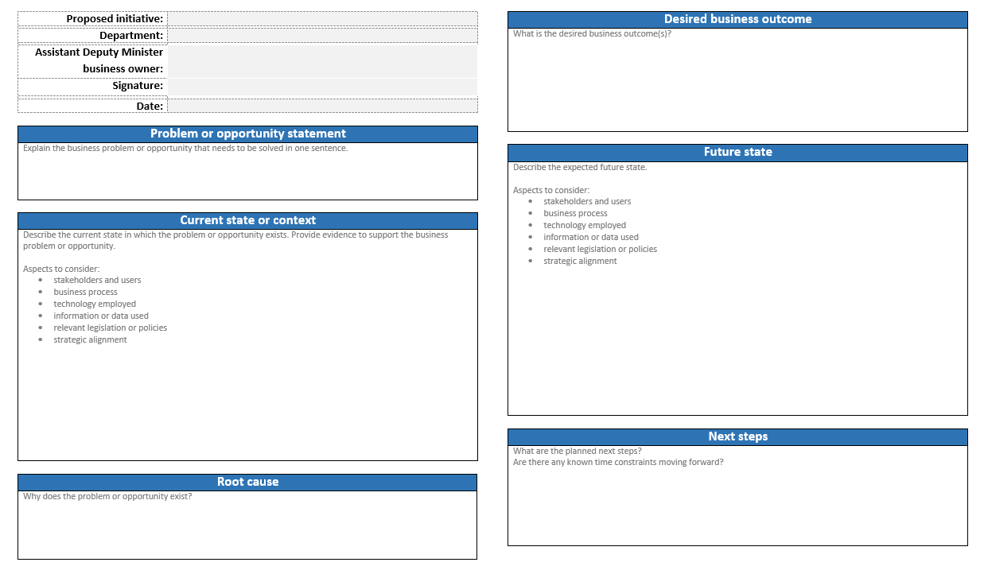

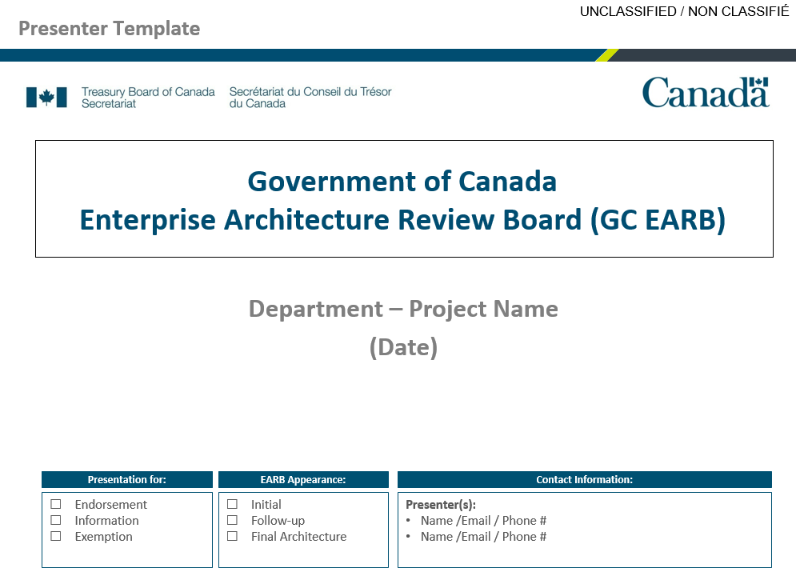
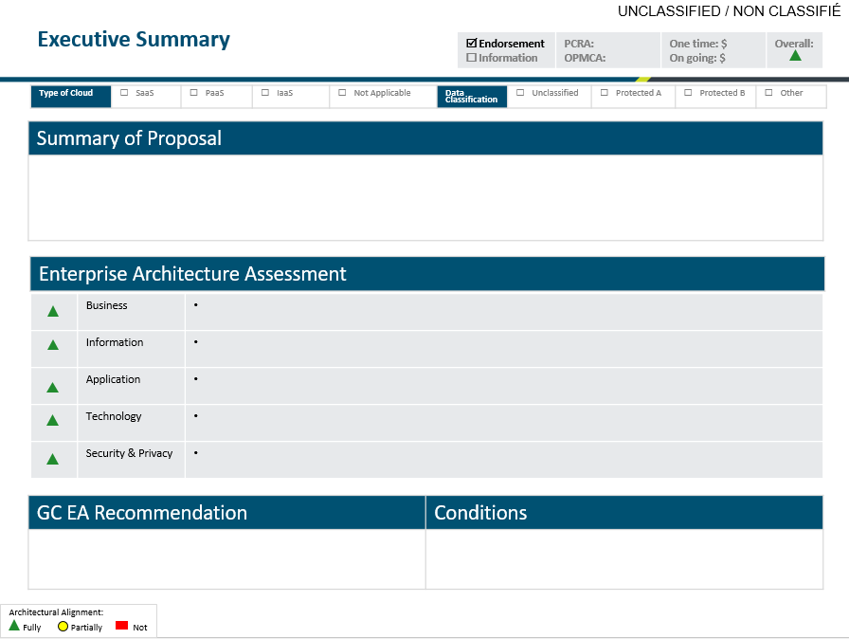
High-level Conceptual Timeline
$$$ ≥ $2.5 M*
A
Concept Case
Identifies and defines strategic needs by the business
Project Gating
Business Concept Development
Project Approach
Business Case Development
Project Charter Development
Project Detailed Planning
Build/Configure, Integrate & Test
Release & Close
❶
❷
❸
❹
❺
❻
❼
GC EARB Engagement
B
A
Appendix B: Mandatory Procedures for Concept Cases for Digitally Enabled Projects
(https://www.tbs-sct.gc.ca/pol/doc-eng.aspx?id=32593&section=procedure&p=B)
B
GC Enterprise Architecture/Board - wiki (gccollab.ca)

Slide 13
When to come to GC EARB?
GC Enterprise Architecture/Board/When to come - wiki (gccollab.ca)
The Process
❶ Please ensure that all proposals submitted for review by the Government of Canada Enterprise Architecture Review Board have first been assessed by the departmental architecture review board where one has been established.
❖ Ensure that proposals are submitted to the Government of Canada Enterprise Architecture Review Board following review of concept cases¹ for digital projects and before the development of a Treasury Board Submission or Departmental Business Case.
❸ Self-assess against the of your initiative against the "Criteria" in the Directive on Service and Digital to determine if the initiative should be presenting to the GC EARB.
“The Criteria”
Proposals concerned with the design, development, installation and implementation of digital services or solutions, information systems and applications (“digital initiatives”) where the department is willing to invest a minimum of the following amounts in order to address the problem or take advantage of the opportunity:
That involve emerging technologies
That require an exception under this directive or other directives under the policy
That are categorized at the protected B level or below‎ using a deployment model other than public cloud for application hosting (including infrastructure), application deployment, or application development
As directed by the Chief Information Officer of Canada.
$2.5 million + OPMCA of 0 or 1 $5 million + OPMCA of 2 | $10 million + OPMCA of 3 $15 million Department of National Defence | $25 million + OPMCA of 4
Appendix B: Mandatory Procedures for Concept Cases for Digitally Enabled Projects (https://www.tbs-sct.gc.ca/pol/doc-eng.aspx?id=32593&section=procedure&p=B)

Slide 14
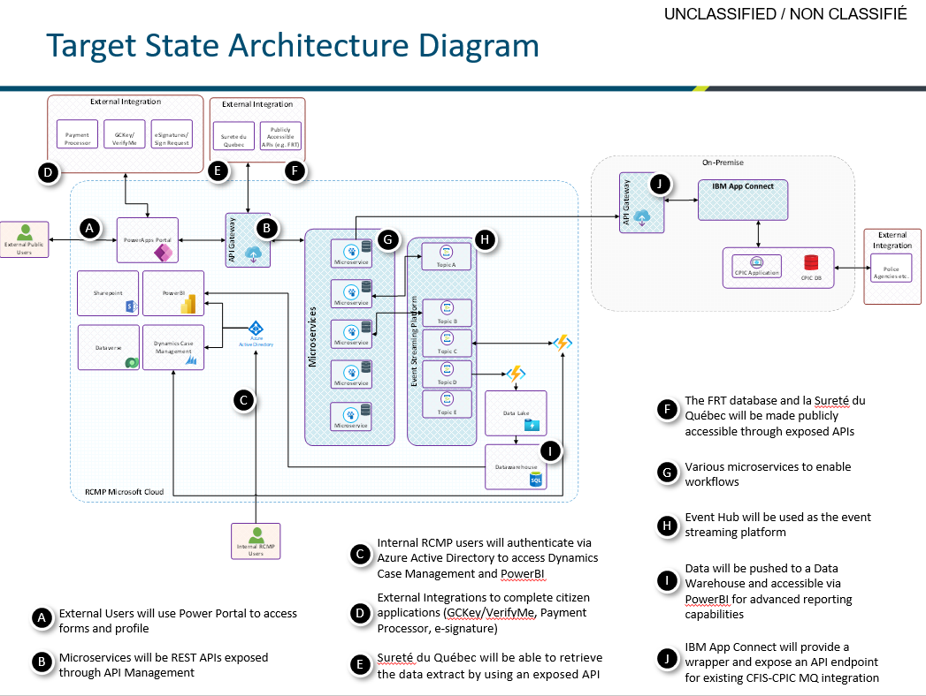
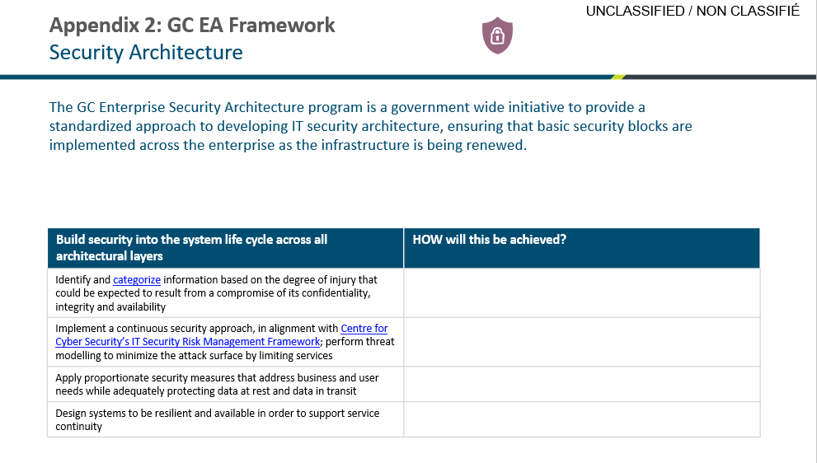
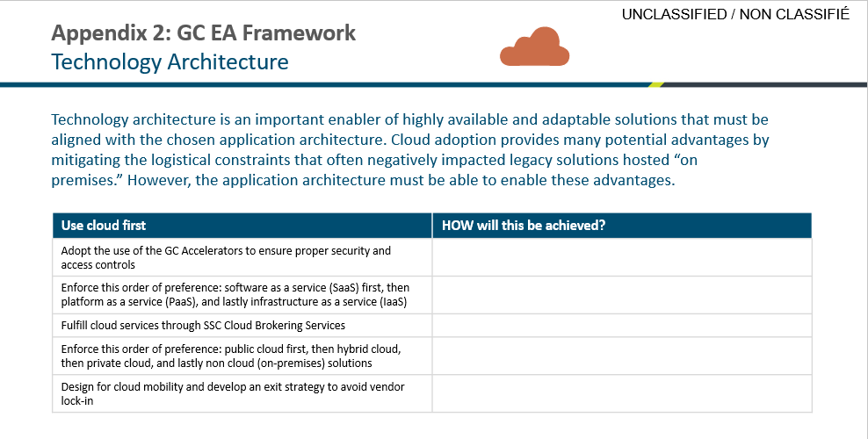
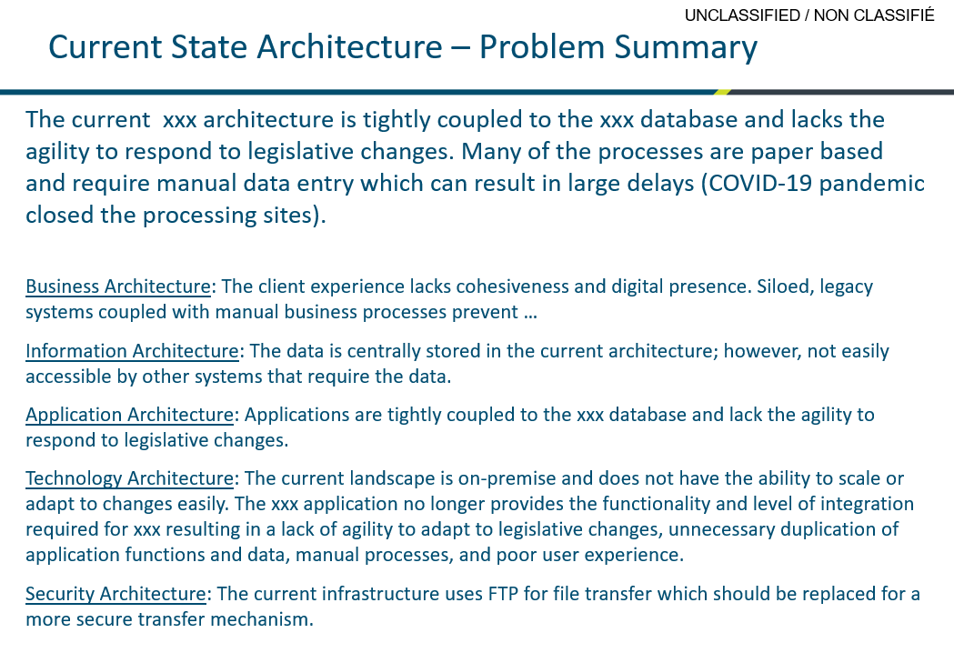
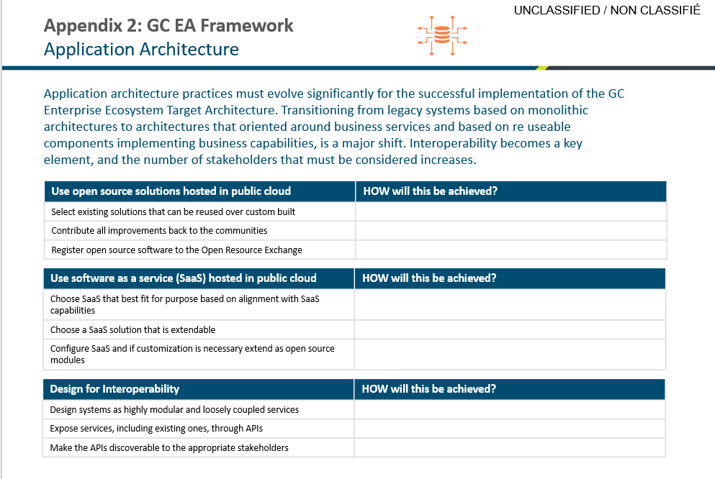
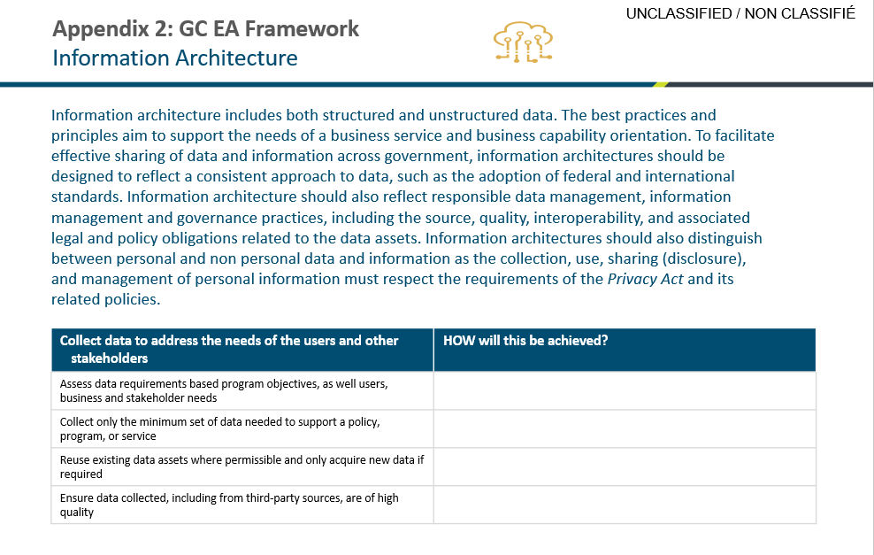
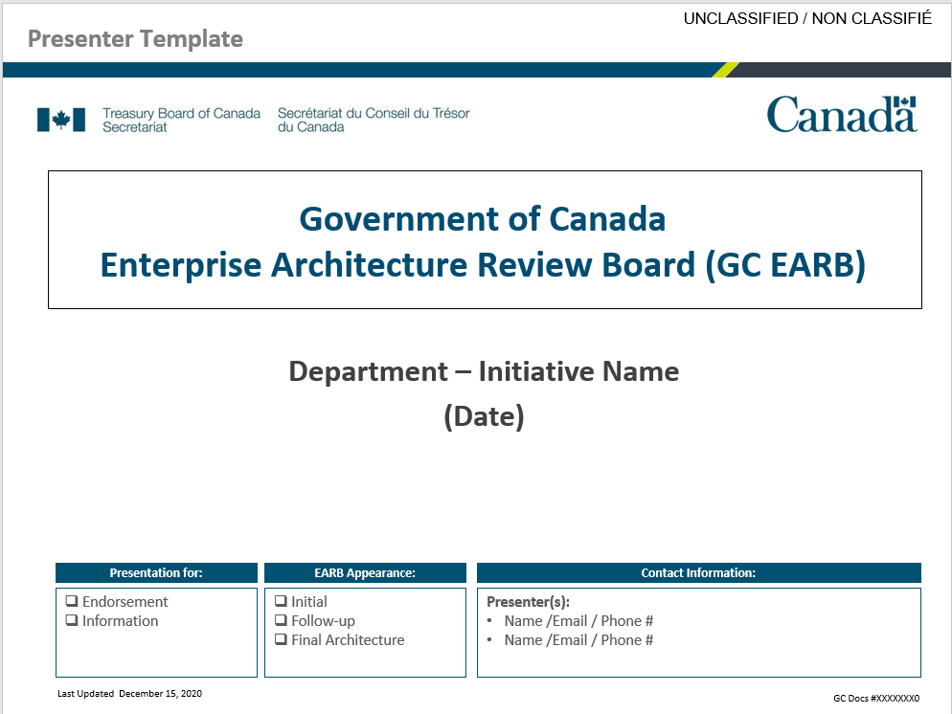
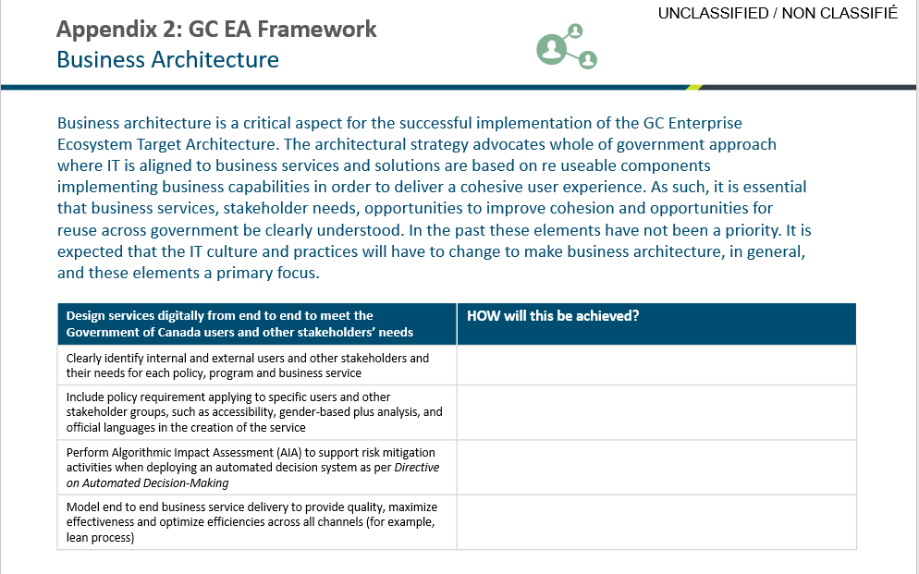
Main Tool = GC EARB Template
https://wiki.gccollab.ca/images/b/bb/2020-12-15-GC_EARB_Presenter_GENERAL.pptx
https://wiki.gccollab.ca/images/c/c5/2021-03-11_GC_EARB_Presenter_GENERAL_FR.pptx
Using the EA Framework

Slide 15
References
GC Enterprise Architecture
GC Enterprise Architecture Review Board, GC EARB
GC Service & Digital Target Enterprise Architecture
Government of Canada Enterprise Architecture Framework - Canada.ca
GC Enterprise Architecture/Business Capability Model - wiki (gccollab.ca)
GC Enterprise Architecture/Enterprise Solutions - wiki (gccollab.ca)
GC Enterprise Architecture/Board/Past Sessions - wiki (gccollab.ca)
GC Enterprise Architecture/Board/Forward Agenda - wiki (gccollab.ca)
Policy on Service and Digital
Directive on Service and Digital
Digital Operations Strategic Plan: 2021–2024 - Canada.ca
Enterprise Architecture Community of Practice : GCcollab
General Information Sources …
TOGAF | The Open Group Website
Business Architecture Guild
Contact Us… Enterprise Architecture / Architecture d’enterprise
EA.AE@tbs-sct.gc.ca

Slide 16
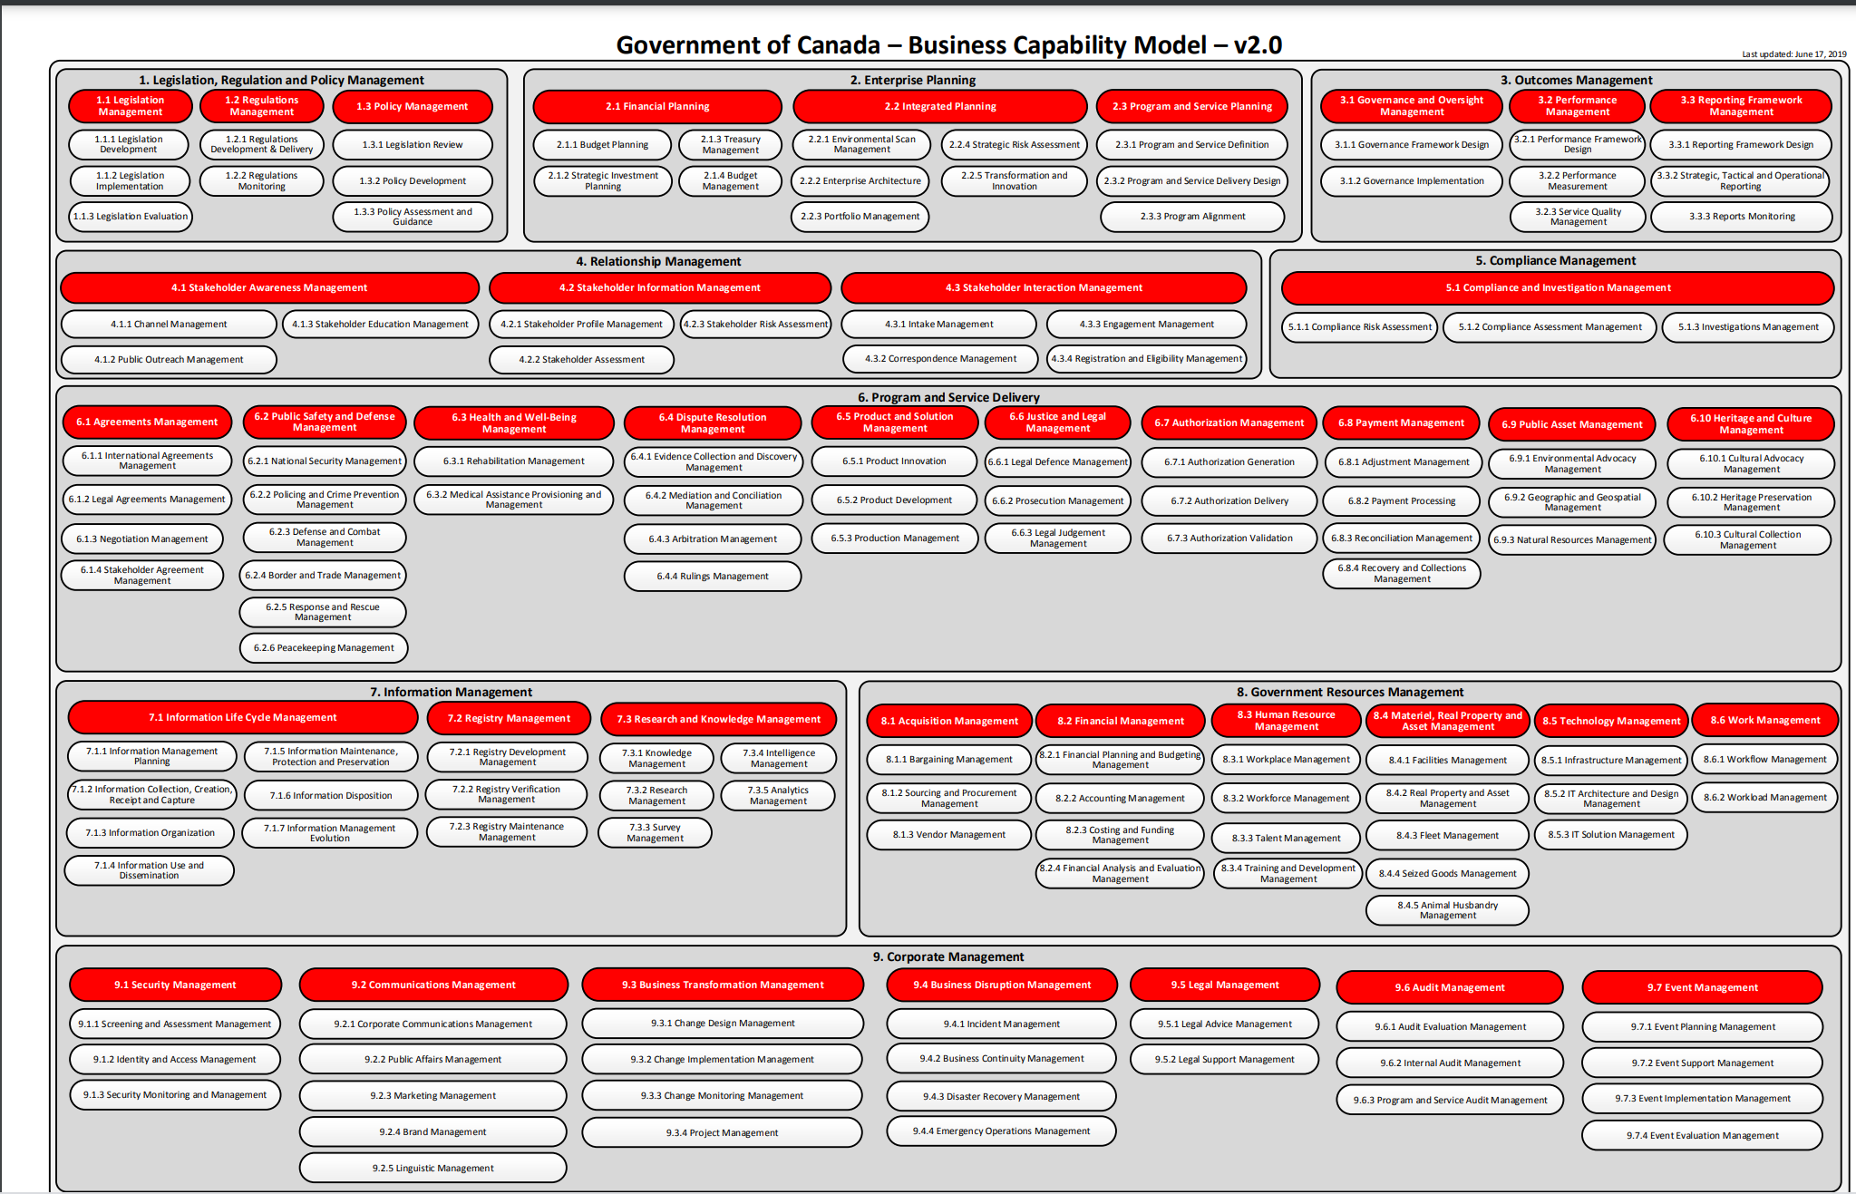
Government of Canada Business Capability Model
GC Enterprise Architecture/Business Capability Model - wiki (gccollab.ca)
16
Notes:
Common language between program and service business folks and IT
GC EARB presentations identify which capabilities they are addressing
A business capability is what an organization needs to deliver its programs and services.
Can identify common capabilities across programs and services.

Slide 17
Project Management Gating Model
Business Concept Development
Project Approach
Business Case Development
Project Charter Development
Project Detailed Planning
Build/Configure, Integrate & Test
Release & Close
❶
❷
❸
❹
❺
❻
❼
Business Concept Document (BCD)
High-level ARB discussion
GATE 1 Presentation deck
Business Requirements Document (BRD)
Options Analysis (OA) & Recom’n
Statement of Sensitivity (SOS)
Security Control Template Matrix (CSTM)
Architecture Review Board (ARB)
Detailed Cost Estimates (± 25%)
Business Case Document (BC)
GATE 3 Presentation deck
Project Charter Document (PCD)
(± 15% estimate)
Project Complexity & Risk Assessment (PCRA)
(IF required ≥ $2.5M)
Project Management Plan (PMP)
Architecture Update (ARB)
Solution Requirements Specification (SRS)
Requirements Traceability Matrix (RTM)
System Design (SDD)
Final Concept of Operations (CONOP)
Security Assessment & Authorization (SA&A)
Vulnerability Assessment Report (VA)
Install/Config Manual
User Acceptance Testing Sign-off (UAT)
Transition to Operations (TOD)
Authority to Operate (ATO)
Project Close-Out Report (PCR)
System Acceptance Sign-off
GATE 7 Presentation deck
To eliminate ideas that do not make sense or will prove to be impossible to execute.
To validate the wisdom and feasibility of the proposed approach to the project.
To confirm a compelling business case; and to identify that any shortcomings risks can be managed
To ensure all necessary ingredients for a successful execution are in place prior to starting the project.
To ensure the project is ready to proceed with minimal risks caused by inattention to essential details.
To ensure the project is ready to deploy and that migration plans and on-going support are in place.
To confirm success of project delivery from a business perspective & review lessons learned.
https://www.canada.ca/en/treasury-board-secretariat/services/information-technology-project-management/project-management/guide-project-gating-it-enabled-projects.html

