Slide 1
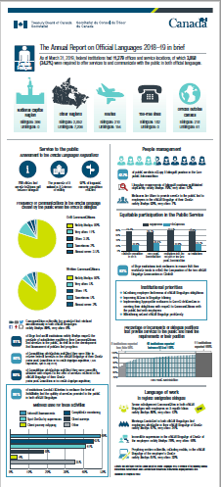
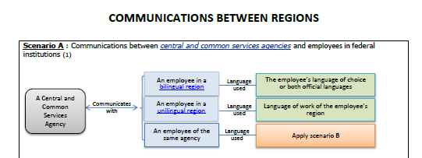
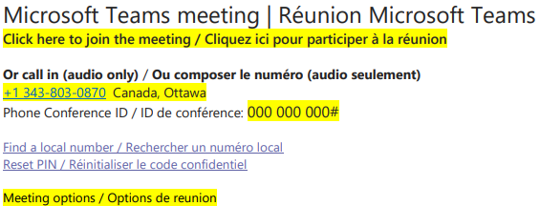
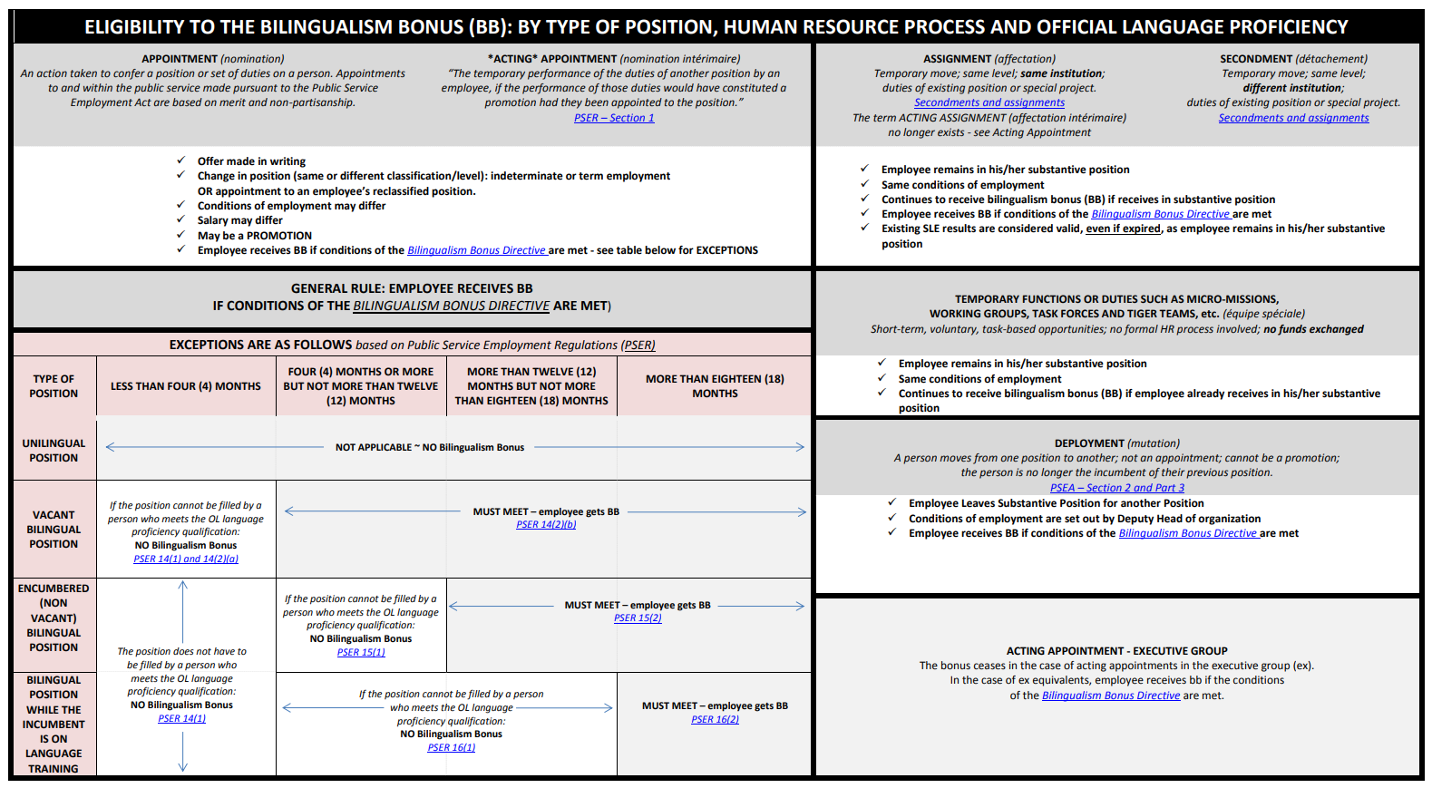
THE OFFICIAL LANGUAGES CENTRE OF EXCELLENCE
ENGLISH
ANNUAL REPORT
CLICK BELOW TO JOIN US FOR A CHAT ON MS TEAMS!
March 1 / 10:30AM – 11:30AM EST
March 1 / 2:00PM – 3:00PM EST
COMMUNICATIONS BETWEEN REGIONS
WORKING REMOTELY: ENSURING LINGUISTIC DUALITY
LINGUISTIC PROFILES
TEMPLATE: BILINGUAL MS TEAMS INVITATION
SUPERVISING IN BOTH OL’S: 6 SCENARIOS
TOOLS &
VISUAL
AIDS
BILINGUALISM BONUS
MS TEAMS BACKGROUNDS
SUBSCRIBE TO OUR NEWSLETTER!
GUIDE: NON-IMPERATIVE STAFFING
THE OL CONNECTION
QUESTIONS?
?
COMMUNITY OF
OFFICIAL LANGUAGES
FOLLOW @TBS

