Slide 1
EA in an Agile/DevOps World
Ross Castillo
Gartner Leadership Partner,
Enterprise Architecture and Innovation

Slide 2
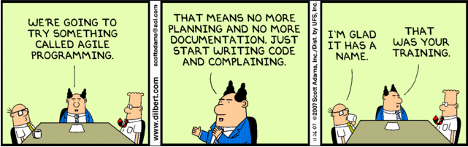

Slide 3








Evolution of Value Delivery
Requirements
Design
Implementation
WATERFALL
Verification
4
444
:
Documents
Documents
Unverified System
System
Incremental
Delivery

Slide 4
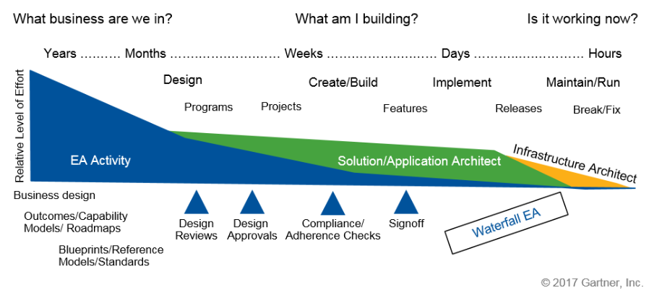
Waterfall EA

Slide 5
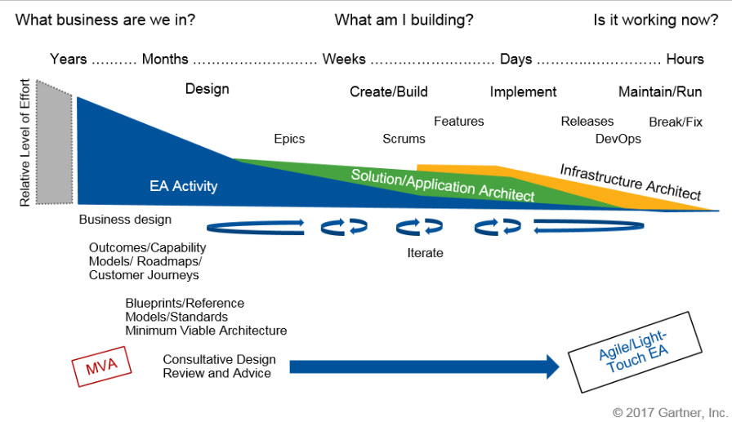
Agile EA aka Light Touch EA

Slide 6


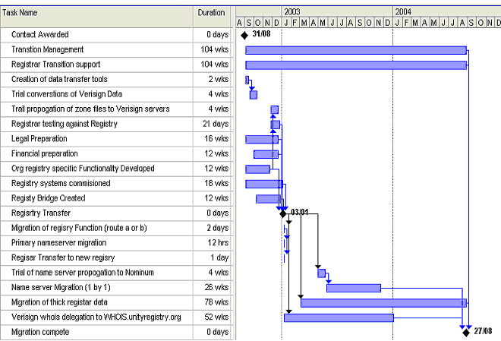
Shift From Projects to Products
Funding the project
Funding for life of the product
Work stops on a fixed date
Work stops when product retires
Change avoidance
Changing acceptance
Focus on plan
Focus on business value

Slide 7
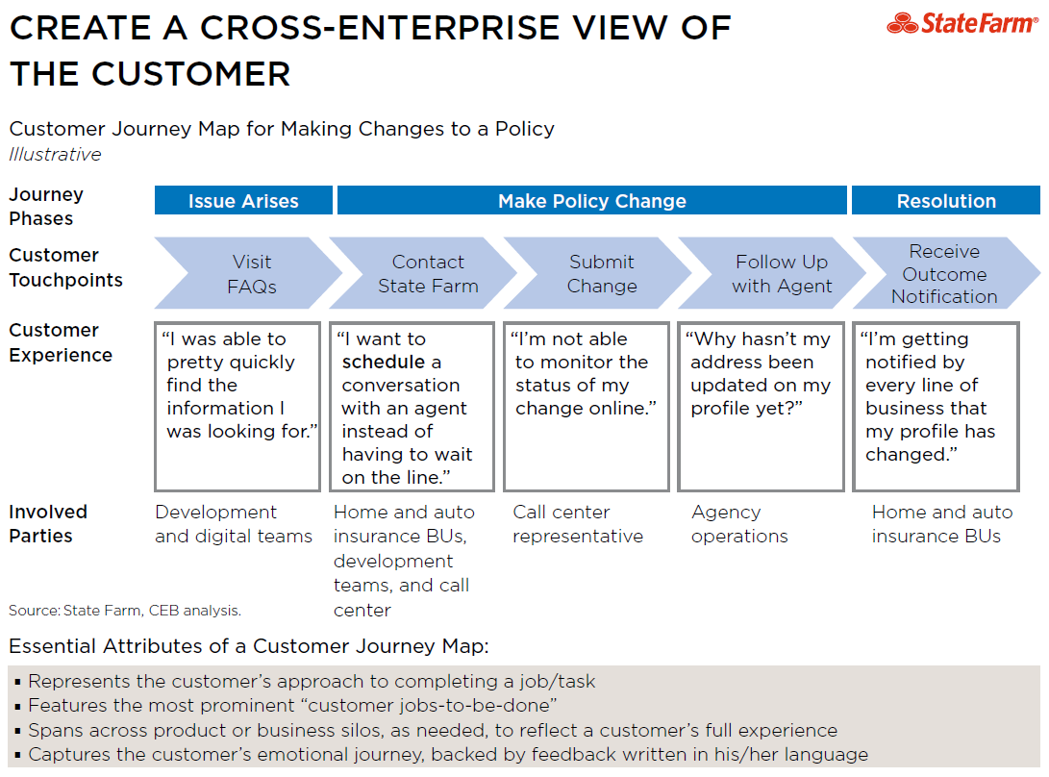

Slide 8
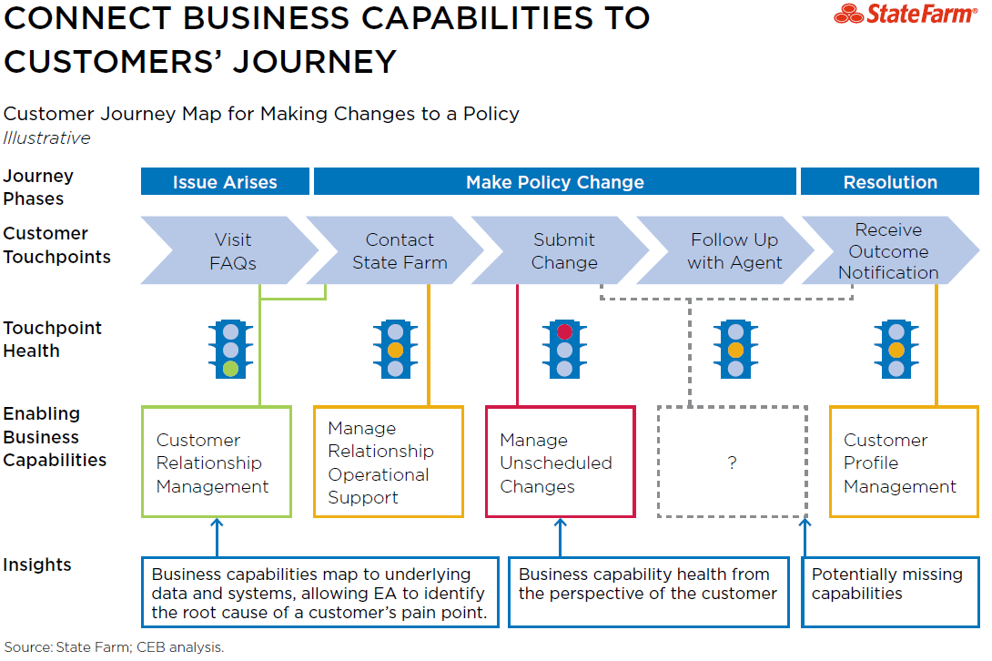

Slide 9
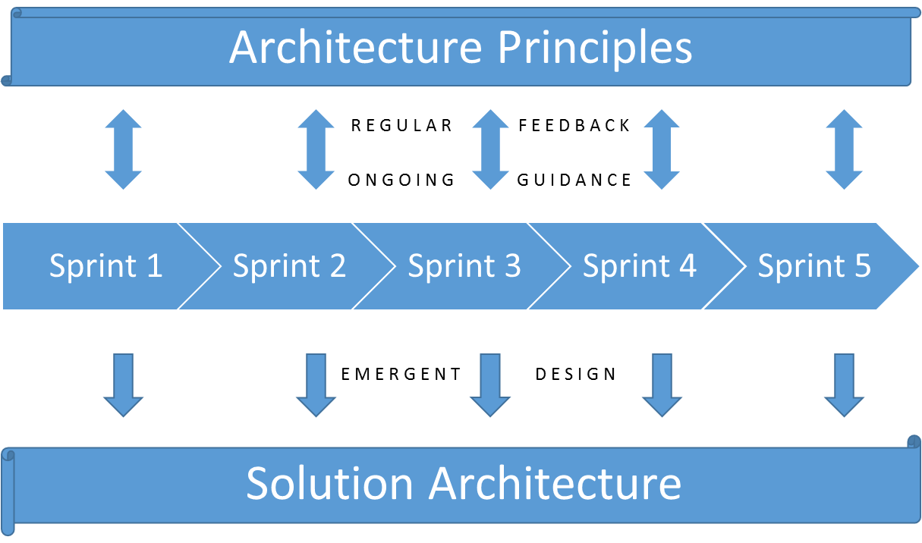
Consultative Design, Review and Advice
Teams won't be able to consume lots of upfront architecture
Provide input a little at a time, at the team's pace
Base guidance on well understood and consistently applied principles
Discuss the "why" and let the "how" emerge
Embrace feedback

Slide 10
ARCHITECTURE REVIEW LIFECYCLE– AGILE DELIVERY – ARB Governance
Architecture Review Lifecycle with an Agile Review Model
Key Features
Initial Architecture Review: Review committee, with support from SME communities, deliberates project design and scope planning.
Reviews as Necessary: Review committee reviews Sprint backlogs as needed, depending on changes to the upfront design.
Organizational Advantages
Comprehensive oversight on projects that are moving quickly through solutions development
Reviewing sprint backlogs allows project teams to receive reviews without stopping production.
Organizational Risks
Mandatory reviews are likely perceived as bottleneck by teams with smaller requirements loads
Depends on the availability of subject matter experts during calendar based meetings
Agile workflows make it difficult to identify when design changes become architecturally significant.
Develop
Test
Integrate
Concept
Design
Scope
Deploy
Sprints
Initial Architecture Review
Reviews
as
Necessary
(If Necessary)
How do you determine if ARB Governance is necessary?
Source: CEB analysis

Slide 11

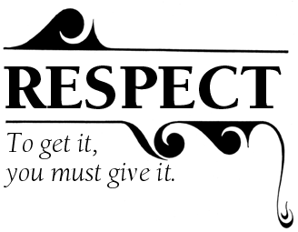

Win Over the Team: It's Not About Process or Tools,
It's About Hearts and Minds
Don't be a roadblock to agile. It's better to help facilitate agile practice adoption than have it bypass architecture.
Stop arguing on why you should work together, and start working on how you're going to work together.
Take the blinders off. Help the team see the big picture; after all, they are the "brush."

Slide 12
Recommendations
Think product (iterative value) no project (big bang deployment).
Work closely with the product owner or manager, use your customer journeys to become the voice of the customer
Adjust your EA practice to be consultative in the context of this
cultural change
Win hearts and minds by providing value to the product
Err on the side of flexibility and delivery versus completeness
and thoroughness
Notes:
Placeholder for text (substitute your own text; delete when not used)

